Slide 1
The Current State of BLIS
Field G. Van Zee
The University of Texas at Austin

Slide 2
Funding
NSF
  Award ACI-1148125/1340293: SI2-SSI: A Linear Algebra Software Infrastructure for Sustained Innovation in Computational Chemistry and other Sciences. (Funded June 1, 2012 - May 31, 2015.)
  Award CCF-1320112: SHF: Small: From Matrix Computations to Tensor Computations. (Funded August 1, 2013 - July 31, 2016.)
Industry (grants and hardware)
  Microsoft
  Intel
  AMD
  Texas Instruments

Slide 3
Science of High Performance Computing (SHPC) research group
Led by Robert A. van de Geijn
Contributes to the science of DLA and instantiates research results as open source software
Long history of support from National Science Foundation
Industrial Affiliates program
  Potential members: Intel, AMD, ARM, Texas Instruments, and others
Website: http://shpc.ices.utexas.edu/

Slide 4
Publications
“BLIS: A Framework for Rapid Instantiation of BLAS Functionality” (TOMS; in print)
“The BLIS Framework: Experiments in Portability” (TOMS; accepted)
“Anatomy of Many-Threaded Matrix Multiplication” (IPDPS; in proceedings)
“Analytical Models for the BLIS Framework” (TOMS; accepted pending modifications)
“Implementing High-Performance Complex Matrix Multiplication” (TOMS; in review)

Slide 5
BLIS Credits
Field G. Van Zee
  Core design, build system, test suite, induced complex implementations, various hardware support (Intel x86_64, AMD)
Tyler M. Smith
  Multithreading support, various hardware support (IBM BG/Q, Intel Phi, AMD)
Francisco D. Igual
  Various hardware support (Texas Instruments DSP, ARM)
Xianyi Zhang
  Configure-time hardware detection, various hardware support (Loongson 3A)
Several others
  Bugfixes and various patches
Robert A. van de Geijn
  Funding, group management, etc.

Slide 6
Review
BLAS: Basic Linear Algebra Subprograms
  Level 1: vector-vector [Lawson et al. 1979]
  Level 2: matrix-vector [Dongarra et al. 1988]
  Level 3: matrix-matrix [Dongarra et al. 1990]
Why are BLAS important?
  BLAS constitute the “bottom of the food chain” for most dense linear algebra applications, as well as other HPC libraries
  LAPACK, libflame, MATLAB, PETSc, etc.

Slide 7
Review
What is BLIS?
  A framework for instantiating BLAS libraries (ie: fully compatible with BLAS)
What else is BLIS?
  Provides alternative BLAS-like (C friendly) API that fixes deficiencies in original BLAS
  Provides an expert object-based API
  Provides a superset of BLAS functionality
  A productivity lever
  A research sandbox

Slide 8
Limitations of BLAS
Interface supports only column-major storage
  We want to support column-major storage, row-major storage, and general stride (tensors).
  Further yet, we want to support operands of mixed storage formats. Example:
    C = C + A B
    where A is column-stored, B is row-stored, and C has general stride.

Slide 9
Limitations of BLAS
Incomplete support for complex operations (no “conjugate without transposition”) Examples:
  y = y + α conj(x) axpy
  y = y + A conj(x) gemv
  C = C + conj(A) B gemv, gemm
  C = C + conj(A) A^{T} her, herk
  B = conj(L) B trmv, trmm
  B = conj(L)⁻¹ B trsv, trsm

Slide 10
Limitations of BLAS
No standard API for lower-level kernels
  We want to be able to break through layers to optimize higher-level operations
BLAS was designed only as a specification for an end-user library
  Instead, we want a framework for building such libraries

Slide 11
Limitations of BLAS
Operation support has not changed since the 1980’s
  We want to support for critical operations omitted from the BLAS

Slide 12
Limitations of BLAS
Let’s look at limitations of specific implementations
  Netlib
  GotoBLAS/OpenBLAS
  ATLAS
  MKL

Slide 13
Limitations of BLAS
Netlib
  Free and open source (public domain)
  Very slow
  Fortran-77
  Just a collection of routines
  Meant as a reference implementation

Slide 14
Limitations of BLAS
GotoBLAS (Kazushige Goto)
  Now maintained by Xianyi Zhang under the name “OpenBLAS”
  Free and open source (BSD)
  Very fast
  Supports many architectures
  Difficult to read or understand
    Not just the assembly code

Slide 15
Limitations of BLAS
ATLAS (Clint Whaley)
  Free and open source (BSD-like)
  Picks from a collection of assembly kernels, and fine-tunes itself, or tunes itself “from scratch” on new/unknown architectures
    Algorithms only allow square blocksizes
    Sometimes does a poor job
  Very large executable footprint
  Difficult (or impossible) cross-compiling
  Difficult to read and understand
    Auto-tuning mechanism is extraordinarily complex

Slide 16
Limitations of BLAS
MKL (Intel)
  Basic functionality is very fast for Intel architectures.
    We’ve discovered suboptimal cases on occasion (mostly in LAPACK)
  Commercial product
    Recently became free!
    Not open source
    Not extensible
  Maybe not so fast on AMD hardware?

Slide 17
Why do we need BLIS?
Current options are…
  Woefully inadequate; slow
    netlib
  Byzantine; difficult to read (effectively a black box)
    OpenBLAS, ATLAS
  Closed source (an actual black box)
    MKL
  Bloated; not suitable for embedded hardware
    ATLAS

Slide 18
Why do we need BLIS?
And even if there were a BLAS library that was clean, free, fast, and small…
  The interface is still inadequate
  It’s still not a framework

Slide 19
What are the goals of BLIS?
BLIS priorities
  Abstraction (layering)
  Extensible
  Readable (clean)
  Easy to maintain (compact; minimal code duplication)
  High performance
  Compatibility (BLAS, CBLAS)

Slide 20
Current status of BLIS
License: 3-clause BSD
Current version: 0.1.8-4
  Reminder: How does versioning work?
Host: http://github.com/flame/blis
Documentation / wikis (in transition)
GNU-like build system
Configure-time hardware detection (x86_64 only)
BLAS / CBLAS compatibility layers

Slide 21
Current status of BLIS
Multiple APIs
  BLAS, CBLAS, BLAS-like, object-based
Generalized hierarchical multithreading
  Quadratic partitioning for load balance
Dynamic memory allocator
  No more configuration needed
Induced complex domain matrix multiplication
Comprehensive, fully parameterized test suite

Slide 22
BLIS build system
Follows GNU conventions (roughly)
./configure ; make ; make install
Static and/or shared library output
No auto-tuning
  Compilation is straightforward and quick (1 ~ 5 minutes)
Relatively compact library footprint:
  BLIS: ~ 3MB
  ATLAS (with f77 API): ~ 7MB

Slide 23
Library footprint comparison
BLIS libraries are relatively small
Driver with dgemm() linked to… | Library size** | Executable size
Nothing* | N/A | 82K
OpenBLAS 0.2.14 | 3.00MB | 107K
BLIS 0.1.8-3 | 3.06MB | 180K
ATLAS 3.9.74 | 7.08MB | 2.38M
* With dgemm() invocation removed.
** On an Intel Haswell system.

Slide 24
Current hardware support
Reference implementation (C99)
ARM v7/v8
Loongson 3A
IBM
  POWER7
  Blue Gene / Q

Slide 25
Current hardware support
Intel
  Penryn/Dunnington
  Sandy Bridge / Ivy Bridge
  Haswell / Broadwell
  Xeon Phi (Knights Corner)
AMD
  Bulldozer / Piledriver / Steamroller / Excavator

Slide 26
BLAS compatibility
BLAS compatibility API
  Supports 32- and 64-bit integers (configure-time option)
  Arbitrary prepending/appending of underscores (configure-time option)
  Lowercase symbols only
CBLAS compatibility API
  Netlib (not CLAPACK)
  Built in terms of BLAS API

Slide 27
BLIS architectural features
Level-3 operations
  Five loops around a common gemm micro-kernel
    Exception: trsm.
      Requires additional specialized micro-kernels
  Consolidation of macro-kernels:
    gemm/hemm/symm
    herk/her2k/syrk/syr2k
    trmm/trmm3
    trsm
  Exposed matrix packing kernels
    Usually not optimized. Why?
      bandwidth saturation; lower-order term

Slide 28
What does the micro-kernel look like?
[gemm] micro-kernel
  C is MR x NR (where MR, NR ≈ 4)
  k dimension is relatively large
But how do we get there?
C
+=
A
B

Slide 29
The gemm algorithm
+=

Slide 30
The gemm algorithm
NC
NC
+=

Slide 31
The gemm algorithm
+=

Slide 32
The gemm algorithm
KC
KC
+=

Slide 33
The gemm algorithm
+=

Slide 34
The gemm algorithm
+=
Pack row panel of B

Slide 35
The gemm algorithm
+=
Pack row panel of B
NR

Slide 36
The gemm algorithm
+=

Slide 37
The gemm algorithm
MC
+=

Slide 38
The gemm algorithm
+=

Slide 39
The gemm algorithm
+=
Pack block of A

Slide 40
The gemm algorithm
+=
Pack block of A
MR

Slide 41
The gemm algorithm
+=

Slide 42
The gemm algorithm
+=

Slide 43
The gemm algorithm
NR
+=
NR

Slide 44
The gemm algorithm
+=

Slide 45
The gemm algorithm
MR
+=
MR

Slide 46
The gemm algorithm
+=

Slide 47
The gemm micro-kernel
+=

Slide 48
The gemm micro-kernel
NR
KC
NR
MR
C
+=
A
B
KC

Slide 49
The gemm micro-kernel
NR
KC
NR
MR
C
+=
A
β₀
β₁
β₂
β₃
B
KC
γ₀₀
γ₀₁
γ₀₂
γ₀₃
α₀
γ₁₀
γ₁₁
γ₁₂
γ₁₃
α₁
+=
γ₂₀
γ₂₁
γ₂₂
γ₂₃
α₂
γ₃₀
γ₃₁
γ₃₂
γ₃₃
α₃

Slide 50
BLIS architectural features
Generalized level-2/-3 infrastructure
  Core set of generic algorithms
  Control trees encode the execution path between them to induce desired “overall” algorithm
    Think of them like hierarchical instructions
  A new algorithm does not necessarily result in new code, just a new control tree

Slide 51
BLIS architectural features
Level-2 operations
  Common level-1v/level-1f kernels
    axpyv, dotxv, axpy2v, dotxf, dotxaxpyf
Performance of… | Is improved by optimizing… | But is improved even more by optimizing…
gemv, trmv, trsv (column-stored) | axpyv | axpyf
gemv, trmv, trsv (row-stored) | dotx | dotxf
hemv/symv (row- and column-stored) | dotx + axpyv, dotaxpyv | dotxaxpyf
her2/syr2 (row- and column-stored) | axpyv | axpy2v
her/syr (row- and column-stored) | axpyv

Slide 52
BLAS compatibility layer
char transa, transb;
int m, n, k;
int lda, ldb, ldc;
double *alpha, *beta, *a, *b, *c;
transa = ‘N’; // no transpose
transb = ‘T’; // transpose
// etc...
dgemm_( &transa,
&transb,
&m, &n, &k,
alpha,
a, &lda,
b, &ldb,
beta,
c, &ldc );

Slide 53
BLIS API (user-level)
trans_t transa, transb; // Enumerated types
dim_t m, n, k; // typdef’ed unsigned long ints
inc_t rs_a, cs_a, rs_b, cs_b, rs_c, cs_c;
double *alpha, *beta, *a, *b, *c;
transa = BLIS_NO_TRANSPOSE;
transb = BLIS_TRANSPOSE;
// etc...
bli_dgemm( transa, // Notice pass-by-value for
transb, // all non-floating point
m, n, k, // arguments.
alpha,
a, rs_a, cs_a, // Notice row and col strides
b, rs_b, cs_b, // for all matrix operands!
beta,
c, rs_c, cs_c );

Slide 54
BLIS API (developer-level)
num_t dt = BLIS_DOUBLE;
obj_t alpha, beta, a, b, c;
dim_t m, n, k;
inc_t rs_a, cs_a, rs_b, cs_b, rs_c, cs_c;
void *buf_a, *buf_b, *buf_c;
// Initialize m, n, k, rs_a, cs_a, etc...
bli_obj_init_attach_buf( dt, m, k, buf_a, rs_a, cs_a, &a );
bli_obj_init_attach_buf( dt, k, n, buf_b, rs_b, cs_b, &b );
bli_obj_init_attach_buf( dt, m, n, buf_c, rs_c, cs_c, &c );
bli_gemm( &alpha,
&a,
&b,
&beta,
&c );

Slide 55
BLIS multithreading
OpenMP or POSIX threads
Loops eligible for parallelism: 5th, 3rd 2nd, 1st
  Parallelize two or more loops simultaneously
  Which loops to target depends on which caches are shared
  4th loop requires accumulation (mutual exclusion)
Implemented with a control tree-like mechanism
Controlled via environment variables
  BLIS_JC_NT (5th loop)
  BLIS_IC_NT (3rd loop)
  BLIS_JR_NT (2nd loop)
  BLIS_IR_NT (1st loop)

Slide 56
BLIS multithreading
Quadratic partitioning

Slide 57
BLIS multithreading
Quadratic partitioning
  Wait, what?

Slide 58
BLIS multithreading

Slide 59
BLIS multithreading
n
m

Slide 60
BLIS multithreading
n
m

Slide 61
BLIS multithreading
n
m
w ≈ n / 4

Slide 62
BLIS multithreading

Slide 63
BLIS multithreading
n
n

Slide 64
BLIS multithreading
n
n

Slide 65
BLIS multithreading
n
n
w ≈ ?

Slide 66
BLIS multithreading

Slide 67
BLIS multithreading
n
m

Slide 68
BLIS multithreading
n
m

Slide 69
BLIS multithreading
n
m
w ≈ ?

Slide 70
BLIS multithreading
Quadratic partitioning
  Affects: herk, her2k, syrk, syr2k, trmm, trmm3
  Arbitrary quasi-trapezoids (trapezoid-oids?)
  Arbitrary diagonal offsets
  Lower- or upper-stored Hermitian/symmetric or triangular matrices
  Partition along m or n dimension, forwards or backwards
    This matters because of edge case placement
  Subpartitions guaranteed to be multiples of “blocking factors” (ie: register blocksizes). except subpartition containing edge case, if it exists

Slide 71
BLIS multithreading
Quadratic partitioning
  How much does it matter? Let’s find out!
  Test hardware
    3.6 GHz Intel Haswell (4 cores)
  Test operation
    Hermitian rank-k update: C += A A^{H}
+=

Slide 72
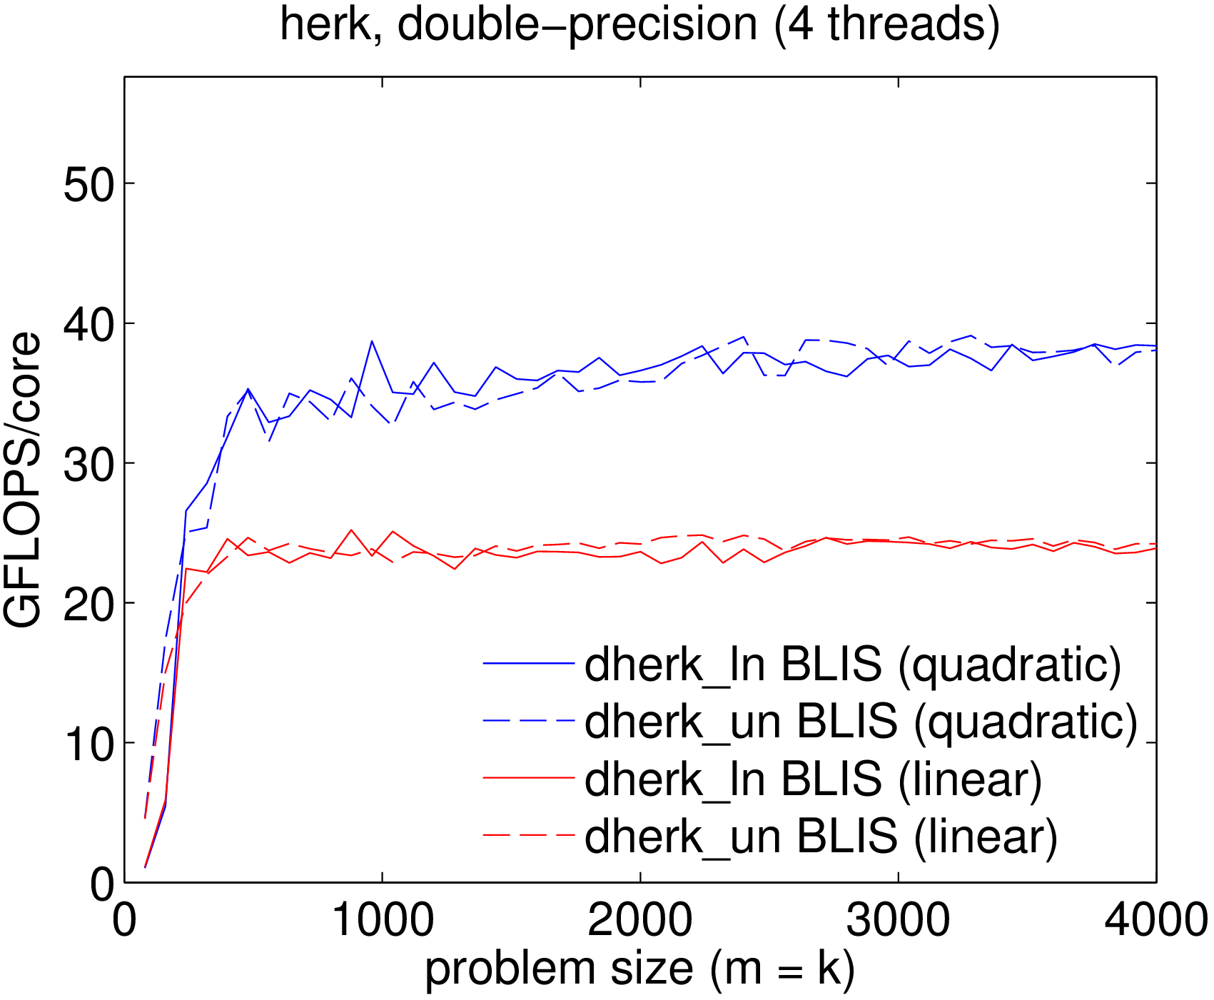
BLIS multithreading

Slide 73
BLIS memory allocator
Manages memory used to pack A and B
Old allocator: built on statically allocated memory regions
  Required careful configuration
  Difficult to extend
New allocator: based on new “pool” ADT
  Scales to arbitrary # of cores/blocks, on-demand, as needed
  No configuration needed

Slide 74
BLIS induced methods for complex domain
Basic idea: implement (“induce”) complex matrix multiplication without complex micro-kernels
3m method
  Potentially faster runtimes, but more memops
  Slightly less numerical accuracy (deal-breaker?)
4m method
  Inherent limitations (redundant/inefficient memops)
  Numerical properties unchanged

Slide 75
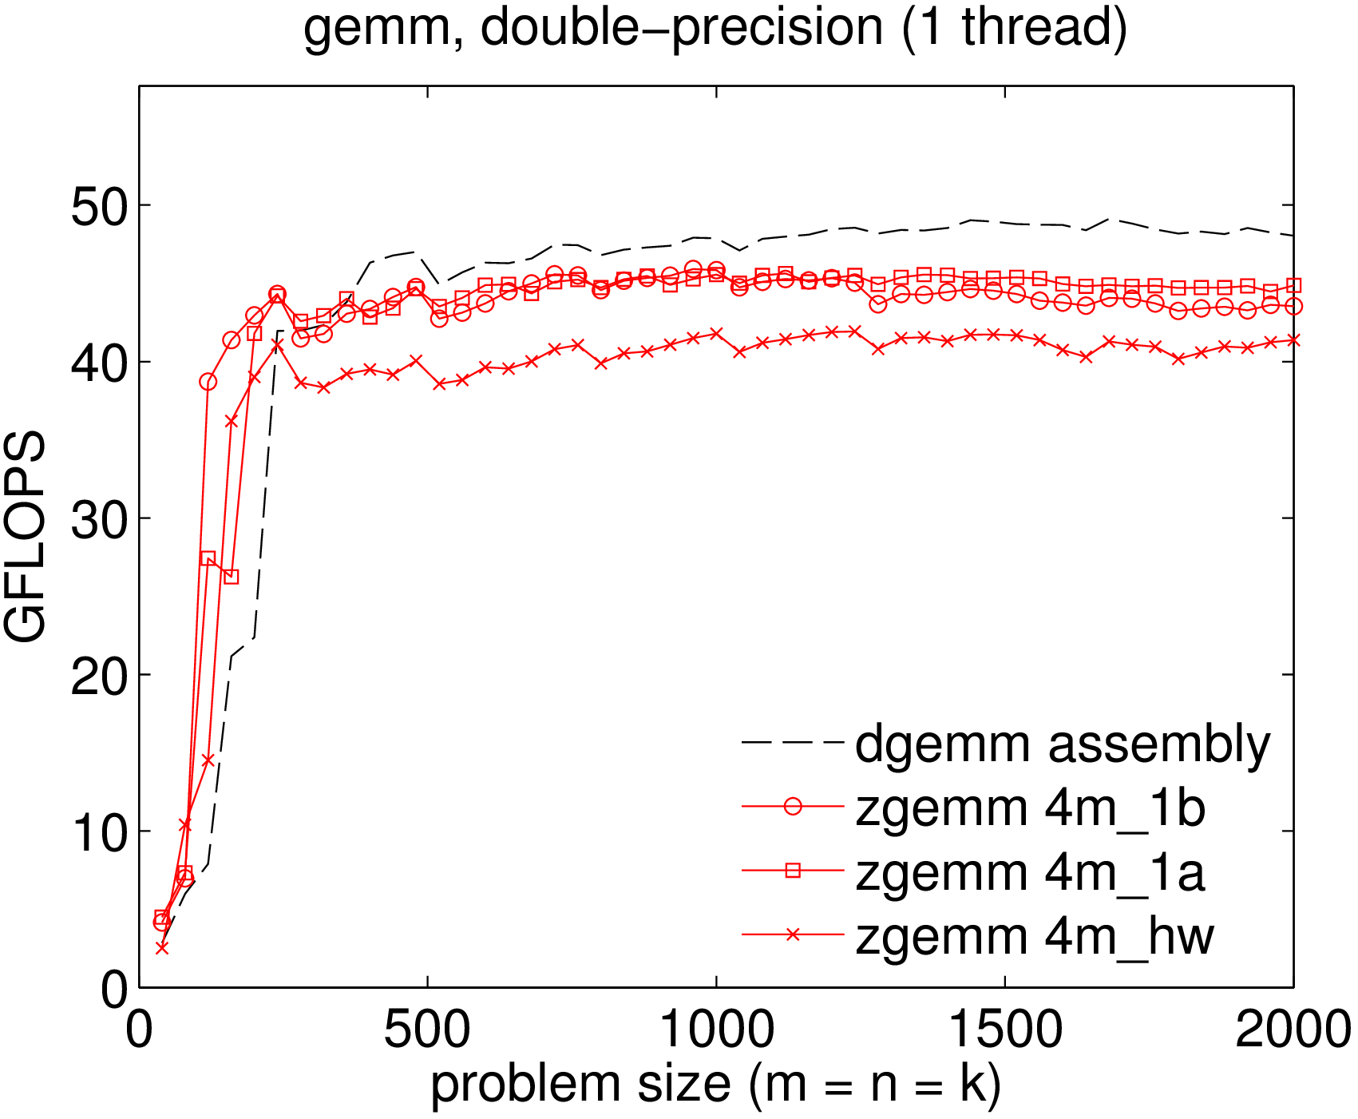
BLIS induced methods for complex domain

Slide 76
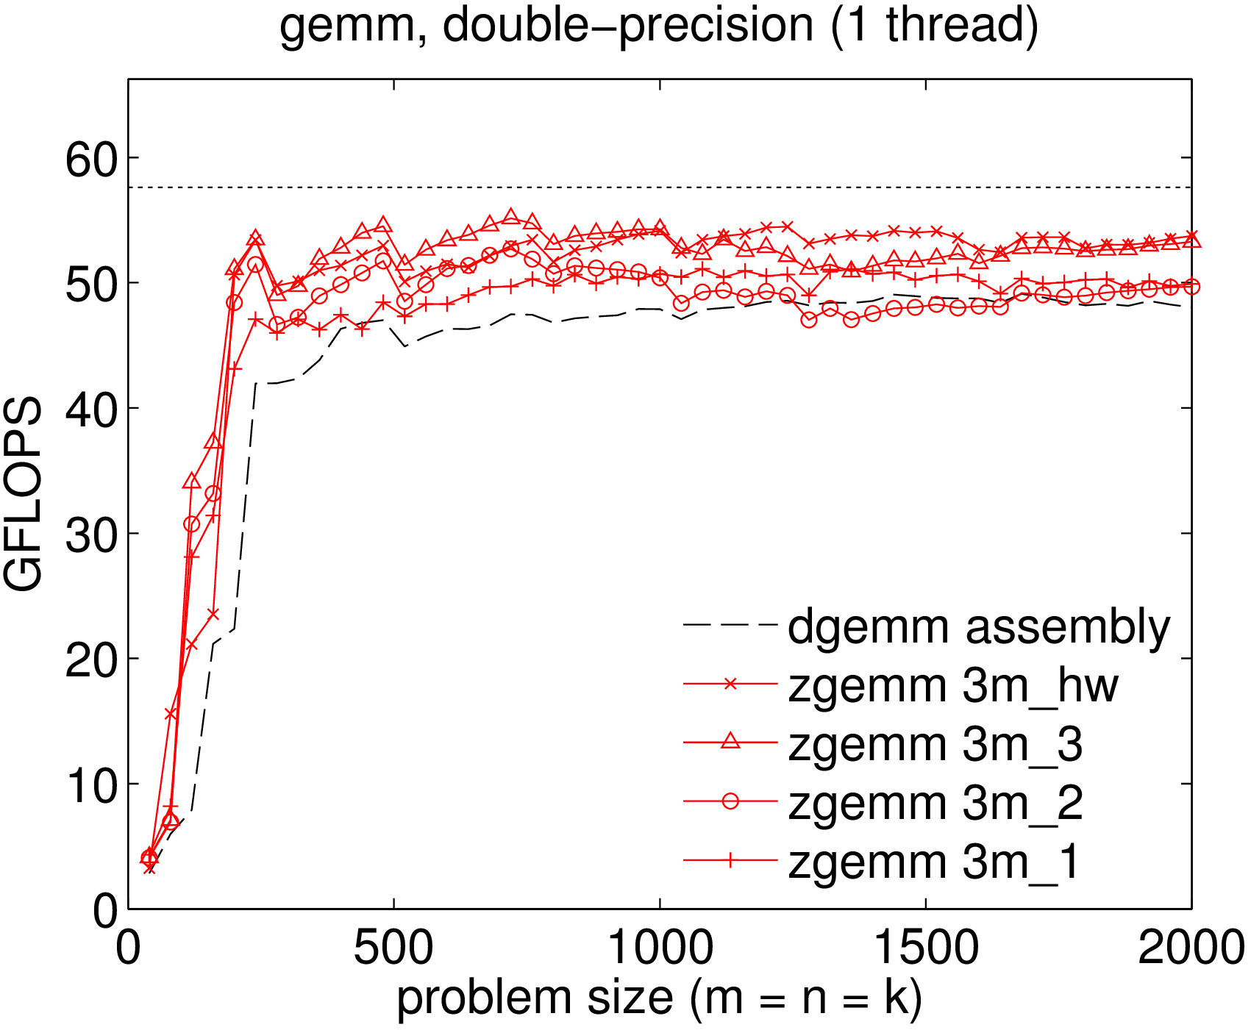
BLIS induced methods for complex domain

Slide 77
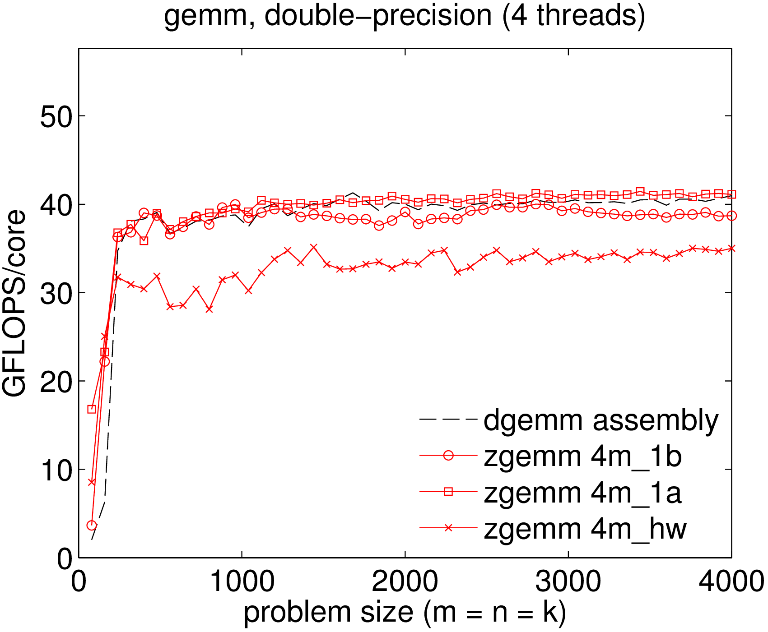
BLIS induced methods for complex domain

Slide 78
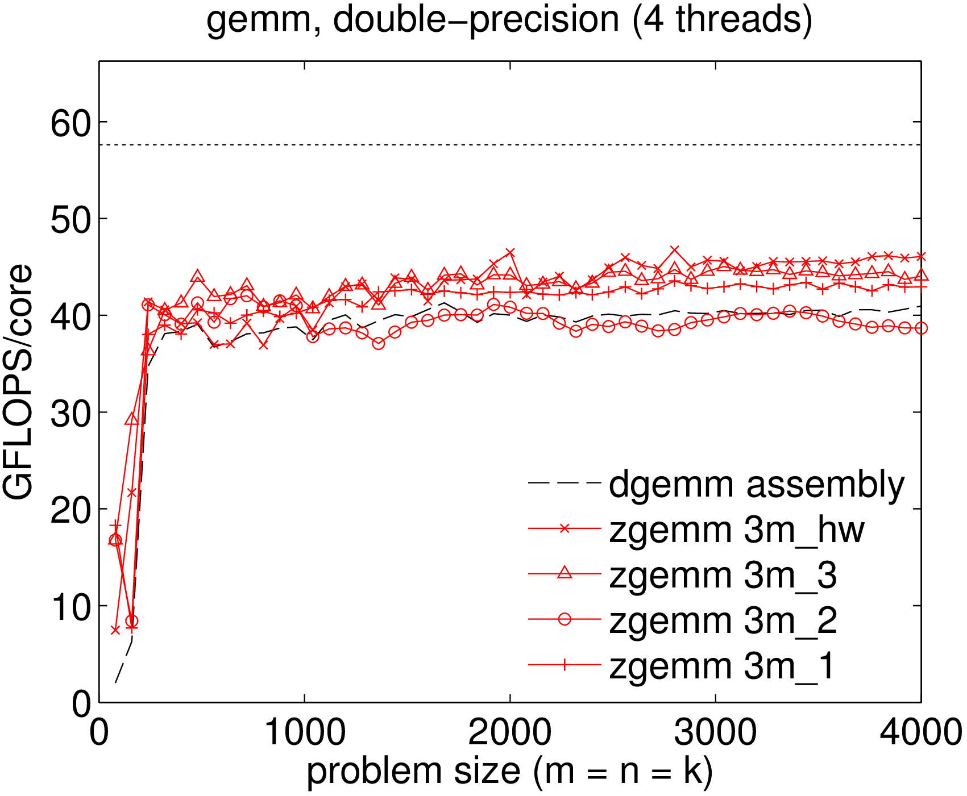
BLIS induced methods for complex domain

Slide 79
BLIS test suite
Allows enabling/disabling:
  Operations, individually or by groups
  Arbitrary combinations of operation parameters
  Arbitrary combinations of storage formats (row, column, general)
  Any combination of datatypes
Problem sizes parametrized by first, max, increment
  Optionally bind matrix dimensions to constants
Outputs to standard output and/or files
  Optional matlab-friendly format

Slide 80
BLIS future plans
Runtime management of kernels
  Allows runtime detection: deployment of one library for multiple microarchitectures in same family
    Examples: amd64, intel64, x86_64
  Allows expert to manually change micro-kernel and associated blocksizes at runtime
Create more user-friendly runtime API for controlling multithreading
Possible new kernels/operations to facilitate optimizations in LAPACK layer
  Integrate into successor to libflame
Other gemm algorithms (ie: partitioning paths)

Slide 81
Further information
Website:
  http://github.com/flame/blis/
Discussion:
  http://groups.google.com/group/blis-devel
Contact:
  field@cs.utexas.edu

Slide 82
BLIS
n_{C}
5th loop around micro-kernel
n_{C}
C_{j}
+=
A
B_{j}
4th loop around micro-kernel
k_{C}
B_{p}
C_{j}
+=
A_{p}
k_{C}
~
3rd loop around micro-kernel
Pack B_{p} → B_{p}
C_{i}
m_{C}
m_{C}
A_{i}
~
+=
B_{p}
~
Pack A_{i} → A_{i}
n_{R}
2nd loop around micro-kernel
~
n_{R}
~
C_{i}
A_{i}
B_{p}
m_{R}
+=
k_{C}
1st loop around micro-kernel
n_{R}
m_{R}
+=
k_{C}
micro-kernel
main memory
1
L3 cache
+=
L2 cache
1
L1 cache
registers

Slide 83
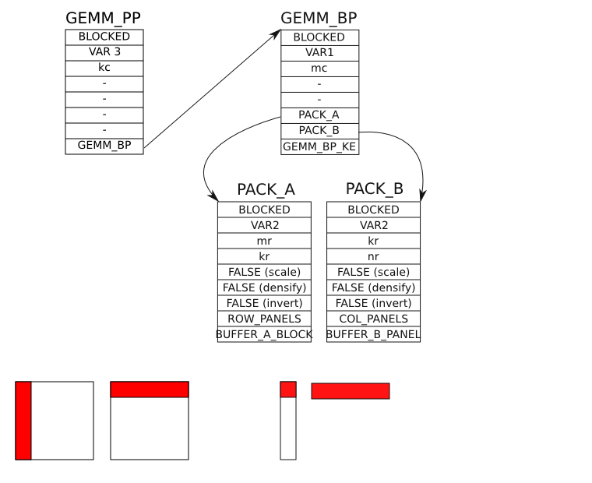
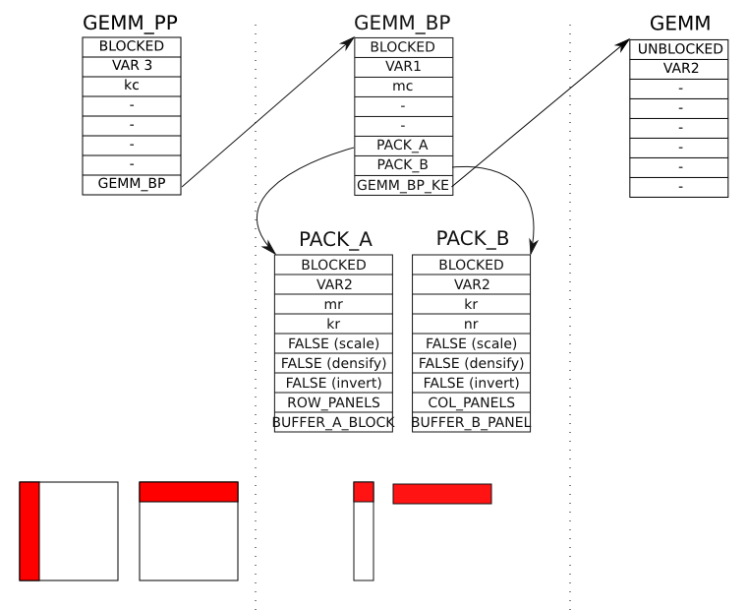
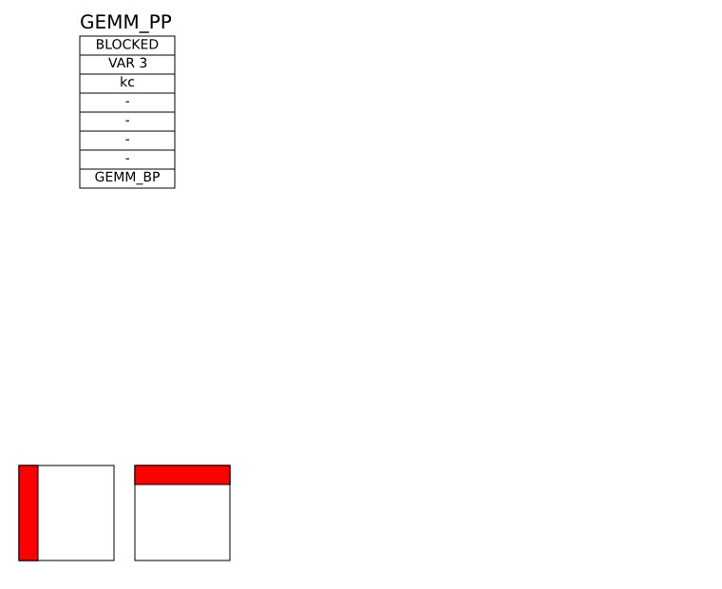
BLIS and DMA. Control trees

Slide 84
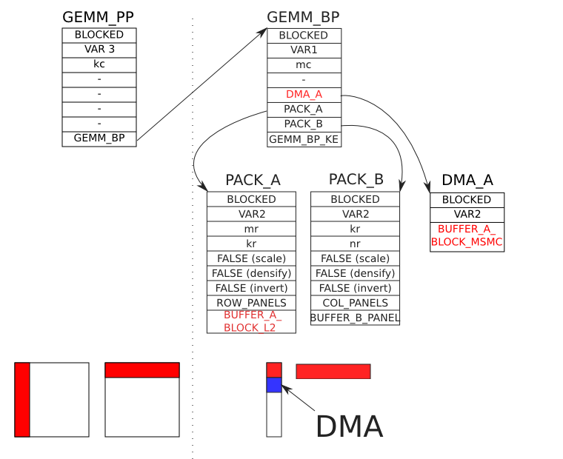
BLIS and DMA. Control trees

