Slide 1


SuperMatrix on Heterogeneous Platforms
Jianyu Huang
SHPC, UT Austin

Slide 2

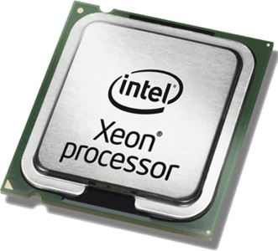
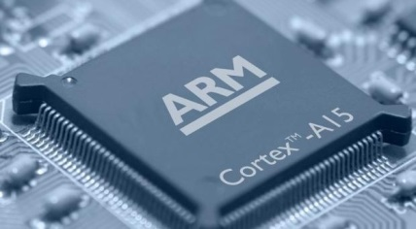
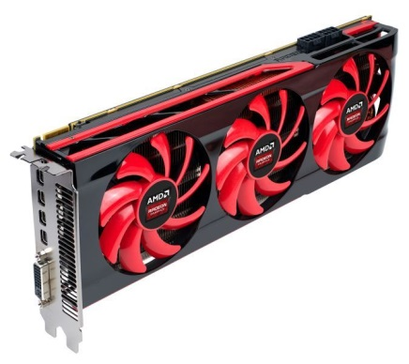
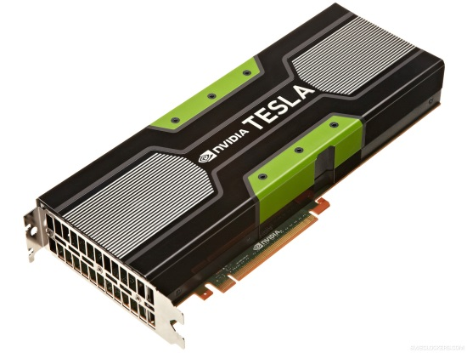
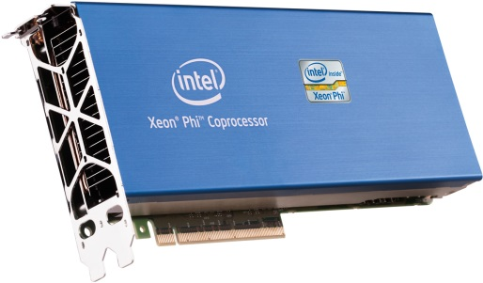
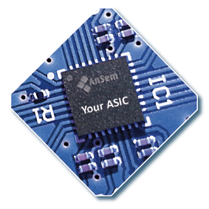
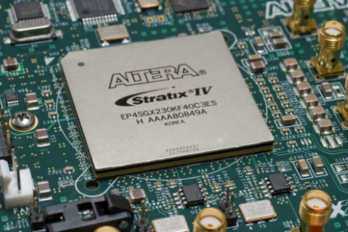
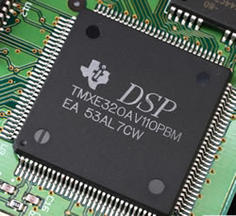
How Heterogeneous?
CPU
MIC
/GPU
Accelerator

Slide 3








How Many Languages?

Slide 4



Question!
one ring to rule them all?

Slide 5
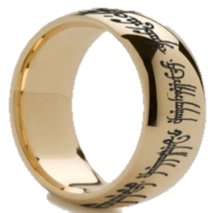
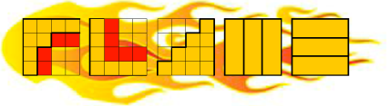
FLAME Answer: SuperMatrix
one ring to rule them all
libflame
SuperMatrix
clBLAS
cuBLAS
GPU
ACML
MKL
BLIS
CPU/MIC
BLIS
Accelerator/Other platforms
OpenCL
CUDA
OpenMP/pthread
OpenMP/pthread
OpenMP/pthread
OpenMP/pthread
C/assembly/Fortran
C/Fortran/Assembly
C/Assembly
C/Assembly
Programmability
  Use tools provide by FLAME
Parallelism
  Directed acyclic graph
  (DAG) scheduling
Ernie Chan. “Application of Dependence Analysis and Runtime Data Flow Graph Scheduling to Matrix Computations.” Ph.D. dissertation, Department of Computer Science, The University of Texas at Austin
Chan, Ernie, et al. "SuperMatrix out-of-order scheduling of matrix operations for SMP and multi-core architectures." Proceedings of the nineteenth annual ACM symposium on Parallel algorithms and architectures. ACM, 2007.

Slide 6
FLAME Answer: SuperMatrix
Chan, E., Quintana-Ortí, E. S., Quintana-Ortí, G., and van de Geijn, R.. SuperMatrix out-of-order scheduling of matrix operations for SMP and multi-core architectures. In SPAA'07: Proceedings of the Nineteenth Annual ACM Symposium on Parallelism in Algorithms and Architectures, pages 116-125, San Diego, CA, USA, June 9-11, 2007.
Chan, E., G. Van Zee, F., Quintana-Ortí, E. S., Quintana-Ortí, G., and van de Geijn, R.. Satisfying your dependencies with SuperMatrix. InCluster'07: Proceedings of the 2007 IEEE International Conference on Cluster Computing, pages 91-99, Austin, TX, USA, September 17-20, 2007.
Chan, E., G. Van Zee, F., Bientinesi, P., Quintana-Ortí, E. S., Quintana-Ortí, G., and van de Geijn, R.. SuperMatrix: A multithreaded runtime scheduling system for algorithms-by-blocks. In PPoPP'08: Proceedings of the Thirteenth ACM SIGPLAN Symposium on Principles and Practice of Parallel Programming, pages 123-132, Salt Lake City, UT, USA, February 20-23, 2008.
Quintana-Orti, G., Igual, F. D., Quintana-Orti, E. S., van de Geijn, R.. Solving dense linear systems on platforms with multiple hardware accelerators. In PPoPP '09 Proceedings of the 14th ACM SIGPLAN symposium on Principles and Practice of Parallel Programming, 2009
Quintana-Ortí, G., Quintana-Ortí, E.S., van de Geijn, R., G. Van Zee, F., and Chan, E.. Programming matrix algorithms-by-blocks for thread-level parallelism. ACM Transactions on Mathematical Software, 36(3):14:1-14:26, July 2009.
Chan, E.. “Application of Dependence Analysis and Runtime Data Flow Graph Scheduling to Matrix Computations.” Ph.D. dissertation, Department of Computer Science, The University of Texas at Austin
Quintana-Ortí, G., Igual, F. D., Marqués, M., Quintana-Ortí, E. S., and van de Geijn, R.. "A Runtime System for Programming Out-of-Core Matrix Algorithms-by-Tiles on Multithreaded Architectures." ACM Transactions on Mathematical Software (TOMS) 38, no. 4 (2012): 25.

Slide 7
Parallel?
S0: D ← A*B
S1: A → L * L^{T}
S2: B ← B * L^{-T}
S3: C ← C – B * B^{T}
S4: X ← L⁻¹ * X
Write After Read: (S0, S1)
Read After Write: (S0, S1)
Read After Write: (S1, S2)
Read After Write: (S2, S3)
Read After Write: (S1, S4)
Can the code be parallelized?
Are you sure S1 and S2 cannot be parallelized?

Slide 8
Parallel?
S0: D ← A*B
S1: A → L * L^{T}
S2: B ← B * L^{-T}
S3: C ← C – B * B^{T}
S4: X ← L⁻¹ * X
D
A
B
A
L
B
B
L
C
C
B^{T}
B
X
L
B
How to parallelize?

Slide 9
Traditional Library Approach
S0: D ← A*B
S1: A → L * L^{T}
S2: B ← B * L^{-T}
S3: C ← C – B * B^{T}
S4: X ← L⁻¹ * X
S0: ParGemm (A,B,D)
S1: L = ParPortf(A)
S2: ParTrsm(L,B)
S3: ParSyrk(B,C)
S4: ParTrsm(L,X)
How to parallelize?

Slide 10
Traditional Library Approach
Implemented with libflame and BLIS
S0: D ← A*B
S1: A → L * L^{T}
S2: B ← B * L^{-T}
S3: C ← C – B * B^{T}
S4: X ← L⁻¹ * X
  /*-----------------------------------------------*/
  FLA_Gemm( FLA_NO_TRANSPOSE,FLA_NO_TRANSPOSE,
  FLA_ONE, A, B, FLA_ZERO, D );
  FLA_Chol( FLA_LOWER_TRIANGULAR, A );
  FLA_Trsm( FLA_RIGHT, FLA_LOWER_TRIANGULAR,
  FLA_TRANSPOSE, FLA_NONUNIT_DIAG,
  FLA_ONE, A, B );
  FLA_Syrk( FLA_LOWER_TRIANGULAR, FLA_NO_TRANSPOSE,
  FLA_MINUS_ONE, B, FLA_ONE, C );
  FLA_Trsm( FLA_LEFT, FLA_LOWER_TRIANGULAR,
  FLA_NO_TRANSPOSE, FLA_NONUNIT_DIAG,
  FLA_ONE, L, X );
  /*-----------------------------------------------*/
Supported by parallel BLAS, LAPACK (multi-thread BLIS)

Slide 11
Problem for Fine-grained Parallelism
Synchronization point overhead
Not fit for multiple devices scenarios.
Coarse-grained parallelism
libflame
libflame
Fine-grained parallelism
BLIS
pthreads
OpenMP
pthreads
OpenMP
BLIS
BLIS
Introduce parallelism across instructions
Fit for the platform with multiple computation units.

Slide 12
Coarse-grained Parallelism
Coarse-grained parallelism
libflame
libflame
Fine-grained parallelism
SuperMatrix
BLIS
pthreads
OpenMP
BLIS
BLIS
Introduce parallelism across instructions
Fit for the platform with multiple computation units.

Slide 13
SuperMatrix Approach
S0: D ← A*B
S1: A → L * L^{T}
S2: B ← B * L^{-T}
S3: C ← C – B * B^{T}
S4: X ← L⁻¹ * X
D
A
B
A
L
B
B
L
C
C
B^{T}
B
X
L
B
How to parallelize?

Slide 14
SuperMatrix Approach
S0: D ← A*B
S1: A → L * L^{T}
S2: B ← B * L^{-T}
S3: C ← C – B * B^{T}
S4: X ← L⁻¹ * X
How to parallelize?

Slide 15
SuperMatrix Approach
S0: D ← A*B
S1: A → L * L^{T}
S2: B ← B * L^{-T}
S3: C ← C – B * B^{T}
S4: X ← L⁻¹ * X
Partitioning/Algorithm-by-blocks!
How to parallelize?

Slide 16
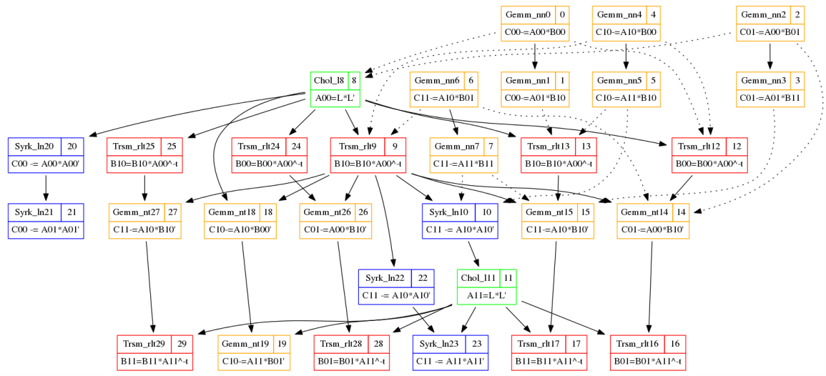
SuperMatrix Approach
S0: D ← A*B
S1: A → L * L^{T}
S2: B ← B * L^{-T}
S3: C ← C – B * B^{T}
S4: X ← L⁻¹ * X
How to parallelize?

Slide 17
SuperMatrix Approach
Construct the DAG across the instructions automatically
No need to annotate the task dependencies manually!

Slide 18
Traditional Library Approach
Implemented with libflame and BLIS
S0: D ← A*B
S1: A → L * L^{T}
S2: B ← B * L^{-T}
S3: C ← C – B * B^{T}
S4: X ← L⁻¹ * X
  /*-----------------------------------------------*/
  FLA_Gemm( FLA_NO_TRANSPOSE,FLA_NO_TRANSPOSE,
  FLA_ONE, A, B, FLA_ZERO, D );
  FLA_Chol( FLA_LOWER_TRIANGULAR, A );
  FLA_Trsm( FLA_RIGHT, FLA_LOWER_TRIANGULAR,
  FLA_TRANSPOSE, FLA_NONUNIT_DIAG,
  FLA_ONE, A, B );
  FLA_Syrk( FLA_LOWER_TRIANGULAR, FLA_NO_TRANSPOSE,
  FLA_MINUS_ONE, B, FLA_ONE, C );
  FLA_Trsm( FLA_LEFT, FLA_LOWER_TRIANGULAR,
  FLA_NO_TRANSPOSE, FLA_NONUNIT_DIAG,
  FLA_ONE, L, X );
  /*-----------------------------------------------*/
Supported by parallel BLAS, LAPACK (multi-thread BLIS)

Slide 19
SuperMatrix Approach
Implemented with libflame and BLIS
S0: D ← A*B
S1: A → L * L^{T}
S2: B ← B * L^{-T}
S3: C ← C – B * B^{T}
S4: X ← L⁻¹ * X
  /*-----------------------------------------------*/
  FLASH_Gemm( FLA_NO_TRANSPOSE,FLA_NO_TRANSPOSE,
  FLA_ONE, A, B, FLA_ZERO, D );
  FLASH_Chol( FLA_LOWER_TRIANGULAR, A );
  FLASH_Trsm( FLA_RIGHT, FLA_LOWER_TRIANGULAR,
  FLA_TRANSPOSE, FLA_NONUNIT_DIAG,
  FLA_ONE, A, B );
  FLASH_Syrk( FLA_LOWER_TRIANGULAR, FLA_NO_TRANSPOSE,
  FLA_MINUS_ONE, B, FLA_ONE, C );
  FLASH_Trsm( FLA_LEFT, FLA_LOWER_TRIANGULAR,
  FLA_NO_TRANSPOSE, FLA_NONUNIT_DIAG,
  FLA_ONE, L, X );
  /*-----------------------------------------------*/
Tiny Code Change!

Slide 20
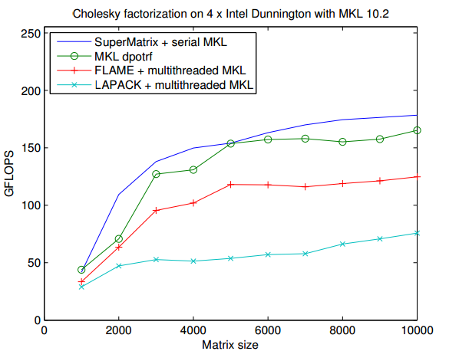
Free Lunch for Both Programmability and Performance!
From libflame manual, 2011

Slide 21

Original SuperMatrix primarily targets at multi-core shared memory system…

Slide 22





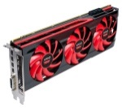
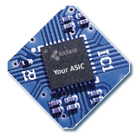
HPC
Heterogeneous Platforms
Matrix
PCIE

Slide 23
Challenges in Heterogeneous Platforms!
S0: D ← A*A^{T}
S1: A → L * L^{T}
S2: B ← B * L^{-T}
S3: C ← C – B * B^{T}
S4: X ← L⁻¹ * X
S0: ParGemm (A,A^{T},D)
S1: L = ParPortf(A)
S2: ParTrsm(L,B)
S3: ParSyrk(B,C)
S4: ParTrsm(L,X)
What if there is one accelerator in your system?

Slide 24
Challenges in Heterogeneous Platforms!
S0: ParGemm (A,A^{T},D)
S1: L = ParPortf(A)
S2: ParTrsm(L,B)
S3: ParSyrk(B,C)
S4: ParTrsm(L,X)
  /*-----------------------------*/
  Memcpy(A, hA);
  Memcpy(D, hD);
  Memcpy(B, hB);
  Memcpy(C, hC);
  Memcpy(X, hX);
  /*-----------------------------*/
  /*-----------------------------*/
  Memcpy(hX, X);
  /*-----------------------------*/
What if there are 4 GPUs and 8 CPU cores in your system?
What if there is one accelerator in your system?

Slide 25
Adapting Original SuperMatrix to Heterogeneous Platforms
Software Cache
Heterogeneous Scheduler
Asynchronous Memory Copy
Worker Task Performance Model

Slide 26

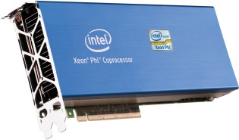
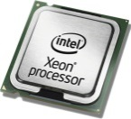

Naïve Approach
Transfer data from host to device before execution
C
A
B
PCIE
Execute the task on the device
Transfer data from device to host upon execution
No Data Reuse on the devices !

Slide 27

Software Cache
No need to transfer data from host to device before execution if the data is already on the device
C
A
B
PCIE
No need to transfer data from device to host upon execution if the data is not required by the host immediately
Quintana-Ortí, G., et al. "Solving dense linear systems on platforms with multiple hardware accelerators." In PPoPP '09 Proceedings of the 14th ACM SIGPLAN symposium on Principles and Practice of Parallel Programming, 2009

Slide 28
HEFT(Heterogeneous Earliest Finish Time)
Timeline
0 | 1 | 2 | 3 | 4 | 5 | 6 | 7 | 8 | 9 | 10 | 11 | 12 | 13 | 14 | 15 | …
8
Available Time
Task 1
Where should we place Task 6?
Task 6
Task 6
Task 2
Task 3
Task 4
Task 5
EST(Earliest Start Time)
EFT(Earliest Finish Time)
Topcuoglu, H., Hariri, S., and Wu, M.. "Performance-effective and low-complexity task scheduling for heterogeneous computing." IEEE Transactions on Parallel and Distributed Systems, 13.3 (2002): 260-274.

Slide 29
3x3 Blocked Cholesky Decomposition
CHOL₀
A_{0,0} ← Chol( A_{0,0} )
TRSM₁
A_{1,0} ←A_{1,0} A_{0,0}^{-T}
TRSM₂
A_{2,0} ← A_{2,0} A_{0,0}^{-T}
SYRK₃
A_{1,1} ← A_{1,1} – A_{1,0} A_{1,0}^{T}
GEMM₄
A_{2,1} ← A_{2,1} – A_{2,0} A_{1,0}^{T}
SYRK₅
A_{2,2} ← A_{2,2} – A_{2,0} A_{2,0}^{T}
CHOL₆
A_{1,1} ← Chol( A_{1,1} )
TRSM₇
A_{2,1} ← A_{2,1} A_{1,1}^{-T}
SYRK₈
A_{2,2} ← A_{2,2} – A_{2,1} A_{2,1}^{T}
CHOL₉
A_{2,2} ← Chol( A_{2,2} )
29

Slide 30
Data Distribution
CHOL₀
A_{0,0} ← Chol( A_{0,0} )
 | CPU | GPU0 | GPU1
A00 | 1 | 0 | 0
A10 | 1 | 0 | 0
A11 | 1 | 0 | 0
A20 | 1 | 0 | 0
A21 | 1 | 0 | 0
A22 | 1 | 0 | 0
TRSM₁
A_{1,0} ←A_{1,0} A_{0,0}^{-T}
TRSM₂
A_{2,0} ← A_{2,0} A_{0,0}^{-T}
SYRK₃
A_{1,1} ← A_{1,1} – A_{1,0} A_{1,0}^{T}
GEMM₄
A_{2,1} ← A_{2,1} – A_{2,0} A_{1,0}^{T}
SYRK₅
A_{2,2} ← A_{2,2} – A_{2,0} A_{2,0}^{T}
Scheduler
CHOL₆
A_{1,1} ← Chol( A_{1,1} )
 | CPU | GPU0 | GPU1
CHOL0
TRSM1
TRSM2
SYRK3
GEMM4
SYRK5
CHOL6
TRSM7
SYRK8
CHOL9
TRSM₇
A_{2,1} ← A_{2,1} A_{1,1}^{-T}
SYRK₈
A_{2,2} ← A_{2,2} – A_{2,1} A_{2,1}^{T}
HEFT assignment table
 | CPU | GPU0 | GPU1
Avail | 0 | 0 | 0
EST
EFT
Priority
CHOL₉
A_{2,2} ← Chol( A_{2,2} )

Slide 31
Data Distribution
CHOL₀
A_{0,0} ← Chol( A_{0,0} )
 | CPU | GPU0 | GPU1
A00 | 1 | 0 | 0
A10 | 1 | 0 | 0
A11 | 1 | 0 | 0
A20 | 1 | 0 | 0
A21 | 1 | 0 | 0
A22 | 1 | 0 | 0
TRSM₁
A_{1,0} ←A_{1,0} A_{0,0}^{-T}
TRSM₂
A_{2,0} ← A_{2,0} A_{0,0}^{-T}
SYRK₃
A_{1,1} ← A_{1,1} – A_{1,0} A_{1,0}^{T}
GEMM₄
A_{2,1} ← A_{2,1} – A_{2,0} A_{1,0}^{T}
SYRK₅
A_{2,2} ← A_{2,2} – A_{2,0} A_{2,0}^{T}
Scheduler
CHOL₆
A_{1,1} ← Chol( A_{1,1} )
 | CPU | GPU0 | GPU1
CHOL0 | X
TRSM1
TRSM2
SYRK3
GEMM4
SYRK5
CHOL6
TRSM7
SYRK8
CHOL9
TRSM₇
A_{2,1} ← A_{2,1} A_{1,1}^{-T}
SYRK₈
A_{2,2} ← A_{2,2} – A_{2,1} A_{2,1}^{T}
HEFT assignment table
 | CPU | GPU0 | GPU1
Avail | 0 | 0 | 0
EST | 0 | 1 | 1
EFT | 1.5 | 2 | 2
Priority | 1 | 2 | 3
CHOL₉
A_{2,2} ← Chol( A_{2,2} )

Slide 32
Data Distribution
CHOL₀
A_{0,0} ← Chol( A_{0,0} )
 | CPU | GPU0 | GPU1
A00 | 1 | 1 | 0
A10 | 0 | 1 | 0
A11 | 1 | 0 | 0
A20 | 1 | 0 | 0
A21 | 1 | 0 | 0
A22 | 1 | 0 | 0
TRSM₁
A_{1,0} ←A_{1,0} A_{0,0}^{-T}
TRSM₂
A_{2,0} ← A_{2,0} A_{0,0}^{-T}
SYRK₃
A_{1,1} ← A_{1,1} – A_{1,0} A_{1,0}^{T}
GEMM₄
A_{2,1} ← A_{2,1} – A_{2,0} A_{1,0}^{T}
SYRK₅
A_{2,2} ← A_{2,2} – A_{2,0} A_{2,0}^{T}
Scheduler
CHOL₆
A_{1,1} ← Chol( A_{1,1} )
 | CPU | GPU0 | GPU1
CHOL0 | X
TRSM1 |  | X
TRSM2
SYRK3
GEMM4
SYRK5
CHOL6
TRSM7
SYRK8
CHOL9
TRSM₇
A_{2,1} ← A_{2,1} A_{1,1}^{-T}
SYRK₈
A_{2,2} ← A_{2,2} – A_{2,1} A_{2,1}^{T}
HEFT assignment table
 | CPU | GPU0 | GPU1
Avail | 1.5 | 0 | 0
EST | 1.5 | 3.5 | 3.5
EFT | 5.5 | 5 | 5
Priority | 3 | 1 | 2
CHOL₉
A_{2,2} ← Chol( A_{2,2} )

Slide 33
Data Distribution
CHOL₀
A_{0,0} ← Chol( A_{0,0} )
 | CPU | GPU0 | GPU1
A00 | 1 | 1 | 1
A10 | 0 | 1 | 0
A11 | 1 | 0 | 0
A20 | 0 | 0 | 1
A21 | 1 | 0 | 0
A22 | 1 | 0 | 0
TRSM₁
A_{1,0} ←A_{1,0} A_{0,0}^{-T}
TRSM₂
A_{2,0} ← A_{2,0} A_{0,0}^{-T}
SYRK₃
A_{1,1} ← A_{1,1} – A_{1,0} A_{1,0}^{T}
GEMM₄
A_{2,1} ← A_{2,1} – A_{2,0} A_{1,0}^{T}
SYRK₅
A_{2,2} ← A_{2,2} – A_{2,0} A_{2,0}^{T}
Scheduler
CHOL₆
A_{1,1} ← Chol( A_{1,1} )
 | CPU | GPU0 | GPU1
CHOL0 | X
TRSM1 |  | X
TRSM2 |  |  | X
SYRK3
GEMM4
SYRK5
CHOL6
TRSM7
SYRK8
CHOL9
TRSM₇
A_{2,1} ← A_{2,1} A_{1,1}^{-T}
SYRK₈
A_{2,2} ← A_{2,2} – A_{2,1} A_{2,1}^{T}
HEFT assignment table
 | CPU | GPU0 | GPU1
Avail | 1.5 | 5 | 0
EST | 1.5 | 5 | 3.5
EFT | 5.5 | 6.5 | 5
Priority | 2 | 3 | 1
CHOL₉
A_{2,2} ← Chol( A_{2,2} )

Slide 34
Data Distribution
CHOL₀
A_{0,0} ← Chol( A_{0,0} )
 | CPU | GPU0 | GPU1
A00 | 1 | 1 | 1
A10 | 0 | 1 | 0
A11 | 0 | 1 | 0
A20 | 0 | 0 | 1
A21 | 1 | 0 | 0
A22 | 1 | 0 | 0
TRSM₁
A_{1,0} ←A_{1,0} A_{0,0}^{-T}
TRSM₂
A_{2,0} ← A_{2,0} A_{0,0}^{-T}
SYRK₃
A_{1,1} ← A_{1,1} – A_{1,0} A_{1,0}^{T}
GEMM₄
A_{2,1} ← A_{2,1} – A_{2,0} A_{1,0}^{T}
SYRK₅
A_{2,2} ← A_{2,2} – A_{2,0} A_{2,0}^{T}
Scheduler
CHOL₆
A_{1,1} ← Chol( A_{1,1} )
 | CPU | GPU0 | GPU1
CHOL0 | X
TRSM1 |  | X
TRSM2 |  |  | X
SYRK3 |  | X
GEMM4
SYRK5
CHOL6
TRSM7
SYRK8
CHOL9
TRSM₇
A_{2,1} ← A_{2,1} A_{1,1}^{-T}
SYRK₈
A_{2,2} ← A_{2,2} – A_{2,1} A_{2,1}^{T}
HEFT assignment table
 | CPU | GPU0 | GPU1
Avail | 1.5 | 5 | 5
EST | 6 | 5 | 7
EFT | 10 | 6.5 | 8.5
Priority | 3 | 1 | 2
CHOL₉
A_{2,2} ← Chol( A_{2,2} )

Slide 35
Data Distribution
CHOL₀
A_{0,0} ← Chol( A_{0,0} )
 | CPU | GPU0 | GPU1
A00 | 1 | 1 | 1
A10 | 0 | 1 | 0
A11 | 0 | 1 | 0
A20 | 1 | 1 | 1
A21 | 0 | 1 | 0
A22 | 1 | 0 | 0
TRSM₁
A_{1,0} ←A_{1,0} A_{0,0}^{-T}
TRSM₂
A_{2,0} ← A_{2,0} A_{0,0}^{-T}
SYRK₃
A_{1,1} ← A_{1,1} – A_{1,0} A_{1,0}^{T}
GEMM₄
A_{2,1} ← A_{2,1} – A_{2,0} A_{1,0}^{T}
SYRK₅
A_{2,2} ← A_{2,2} – A_{2,0} A_{2,0}^{T}
Scheduler
CHOL₆
A_{1,1} ← Chol( A_{1,1} )
 | CPU | GPU0 | GPU1
CHOL0 | X
TRSM1 |  | X
TRSM2 |  |  | X
SYRK3 |  | X
GEMM4 |  | X
SYRK5
CHOL6
TRSM7
SYRK8
CHOL9
TRSM₇
A_{2,1} ← A_{2,1} A_{1,1}^{-T}
SYRK₈
A_{2,2} ← A_{2,2} – A_{2,1} A_{2,1}^{T}
HEFT assignment table
 | CPU | GPU0 | GPU1
Avail | 1.5 | 6.5 | 5
EST | 6 | 7 | 7
EFT | 14 | 10 | 10
Priority | 3 | 1 | 2
CHOL₉
A_{2,2} ← Chol( A_{2,2} )

Slide 36
Data Distribution
CHOL₀
A_{0,0} ← Chol( A_{0,0} )
 | CPU | GPU0 | GPU1
A00 | 1 | 1 | 1
A10 | 0 | 1 | 0
A11 | 0 | 1 | 0
A20 | 1 | 1 | 1
A21 | 0 | 1 | 0
A22 | 0 | 0 | 1
TRSM₁
A_{1,0} ←A_{1,0} A_{0,0}^{-T}
TRSM₂
A_{2,0} ← A_{2,0} A_{0,0}^{-T}
SYRK₃
A_{1,1} ← A_{1,1} – A_{1,0} A_{1,0}^{T}
GEMM₄
A_{2,1} ← A_{2,1} – A_{2,0} A_{1,0}^{T}
SYRK₅
A_{2,2} ← A_{2,2} – A_{2,0} A_{2,0}^{T}
Scheduler
CHOL₆
A_{1,1} ← Chol( A_{1,1} )
 | CPU | GPU0 | GPU1
CHOL0 | X
TRSM1 |  | X
TRSM2 |  |  | X
SYRK3 |  | X
GEMM4 |  | X
SYRK5 |  |  | X
CHOL6
TRSM7
SYRK8
CHOL9
TRSM₇
A_{2,1} ← A_{2,1} A_{1,1}^{-T}
SYRK₈
A_{2,2} ← A_{2,2} – A_{2,1} A_{2,1}^{T}
HEFT assignment table
 | CPU | GPU0 | GPU1
Avail | 1.5 | 10 | 5
EST | 6 | 10 | 5
EFT | 10 | 11.5 | 6.5
Priority | 2 | 3 | 1
CHOL₉
A_{2,2} ← Chol( A_{2,2} )

Slide 37
Data Distribution
CHOL₀
A_{0,0} ← Chol( A_{0,0} )
 | CPU | GPU0 | GPU1
A00 | 1 | 1 | 1
A10 | 0 | 1 | 0
A11 | 1 | 0 | 0
A20 | 1 | 1 | 1
A21 | 0 | 1 | 0
A22 | 0 | 0 | 1
TRSM₁
A_{1,0} ←A_{1,0} A_{0,0}^{-T}
TRSM₂
A_{2,0} ← A_{2,0} A_{0,0}^{-T}
SYRK₃
A_{1,1} ← A_{1,1} – A_{1,0} A_{1,0}^{T}
GEMM₄
A_{2,1} ← A_{2,1} – A_{2,0} A_{1,0}^{T}
SYRK₅
A_{2,2} ← A_{2,2} – A_{2,0} A_{2,0}^{T}
Scheduler
CHOL₆
A_{1,1} ← Chol( A_{1,1} )
 | CPU | GPU0 | GPU1
CHOL0 | X
TRSM1 |  | X
TRSM2 |  |  | X
SYRK3 |  | X
GEMM4 |  | X
SYRK5 |  |  | X
CHOL6 | X
TRSM7
SYRK8
CHOL9
TRSM₇
A_{2,1} ← A_{2,1} A_{1,1}^{-T}
SYRK₈
A_{2,2} ← A_{2,2} – A_{2,1} A_{2,1}^{T}
HEFT assignment table
 | CPU | GPU0 | GPU1
Avail | 1.5 | 10 | 6.5
EST | 7.5 | 10 | 8.5
EFT | 9 | 11 | 9.5
Priority | 1 | 3 | 2
CHOL₉
A_{2,2} ← Chol( A_{2,2} )

Slide 38
Data Distribution
CHOL₀
A_{0,0} ← Chol( A_{0,0} )
 | CPU | GPU0 | GPU1
A00 | 1 | 1 | 1
A10 | 0 | 1 | 0
A11 | 1 | 1 | 0
A20 | 1 | 1 | 1
A21 | 0 | 1 | 0
A22 | 0 | 0 | 1
TRSM₁
A_{1,0} ←A_{1,0} A_{0,0}^{-T}
TRSM₂
A_{2,0} ← A_{2,0} A_{0,0}^{-T}
SYRK₃
A_{1,1} ← A_{1,1} – A_{1,0} A_{1,0}^{T}
GEMM₄
A_{2,1} ← A_{2,1} – A_{2,0} A_{1,0}^{T}
SYRK₅
A_{2,2} ← A_{2,2} – A_{2,0} A_{2,0}^{T}
Scheduler
CHOL₆
A_{1,1} ← Chol( A_{1,1} )
 | CPU | GPU0 | GPU1
CHOL0 | X
TRSM1 |  | X
TRSM2 |  |  | X
SYRK3 |  | X
GEMM4 |  | X
SYRK5 |  |  | X
CHOL6 | X
TRSM7 |  | X
SYRK8
CHOL9
TRSM₇
A_{2,1} ← A_{2,1} A_{1,1}^{-T}
SYRK₈
A_{2,2} ← A_{2,2} – A_{2,1} A_{2,1}^{T}
HEFT assignment table
 | CPU | GPU0 | GPU1
Avail | 9 | 10 | 6.5
EST | 11 | 10 | 12
EFT | 15 | 11.5 | 13.5
Priority | 3 | 1 | 2
CHOL₉
A_{2,2} ← Chol( A_{2,2} )

Slide 39
Data Distribution
CHOL₀
A_{0,0} ← Chol( A_{0,0} )
 | CPU | GPU0 | GPU1
A00 | 1 | 1 | 1
A10 | 0 | 1 | 0
A11 | 1 | 1 | 0
A20 | 1 | 1 | 1
A21 | 0 | 1 | 0
A22 | 0 | 1 | 0
TRSM₁
A_{1,0} ←A_{1,0} A_{0,0}^{-T}
TRSM₂
A_{2,0} ← A_{2,0} A_{0,0}^{-T}
SYRK₃
A_{1,1} ← A_{1,1} – A_{1,0} A_{1,0}^{T}
GEMM₄
A_{2,1} ← A_{2,1} – A_{2,0} A_{1,0}^{T}
SYRK₅
A_{2,2} ← A_{2,2} – A_{2,0} A_{2,0}^{T}
Scheduler
CHOL₆
A_{1,1} ← Chol( A_{1,1} )
 | CPU | GPU0 | GPU1
CHOL0 | X
TRSM1 |  | X
TRSM2 |  |  | X
SYRK3 |  | X
GEMM4 |  | X
SYRK5 |  |  | X
CHOL6 | X
TRSM7 |  | X
SYRK8 |  | X
CHOL9
TRSM₇
A_{2,1} ← A_{2,1} A_{1,1}^{-T}
SYRK₈
A_{2,2} ← A_{2,2} – A_{2,1} A_{2,1}^{T}
HEFT assignment table
 | CPU | GPU0 | GPU1
Avail | 9 | 11.5 | 6.5
EST | 12.5 | 11.5 | 13.5
EFT | 16.5 | 13 | 15
Priority | 3 | 1 | 2
CHOL₉
A_{2,2} ← Chol( A_{2,2} )

Slide 40
Data Distribution
CHOL₀
A_{0,0} ← Chol( A_{0,0} )
 | CPU | GPU0 | GPU1
A00 | 1 | 1 | 1
A10 | 0 | 1 | 0
A11 | 1 | 1 | 0
A20 | 1 | 1 | 1
A21 | 0 | 1 | 0
A22 | 0 | 1 | 0
TRSM₁
A_{1,0} ←A_{1,0} A_{0,0}^{-T}
TRSM₂
A_{2,0} ← A_{2,0} A_{0,0}^{-T}
SYRK₃
A_{1,1} ← A_{1,1} – A_{1,0} A_{1,0}^{T}
GEMM₄
A_{2,1} ← A_{2,1} – A_{2,0} A_{1,0}^{T}
SYRK₅
A_{2,2} ← A_{2,2} – A_{2,0} A_{2,0}^{T}
Scheduler
CHOL₆
A_{1,1} ← Chol( A_{1,1} )
 | CPU | GPU0 | GPU1
CHOL0 | X
TRSM1 |  | X
TRSM2 |  |  | X
SYRK3 |  | X
GEMM4 |  | X
SYRK5 |  |  | X
CHOL6 | X
TRSM7 |  | X
SYRK8 |  | X
CHOL9 |  | X
TRSM₇
A_{2,1} ← A_{2,1} A_{1,1}^{-T}
SYRK₈
A_{2,2} ← A_{2,2} – A_{2,1} A_{2,1}^{T}
HEFT assignment table
 | CPU | GPU0 | GPU1
Avail | 9 | 13 | 6.5
EST | 14 | 13 | 15
EFT | 15.5 | 14 | 16
Priority | 2 | 1 | 3
CHOL₉
A_{2,2} ← Chol( A_{2,2} )

Slide 41
SuperMatrix Approach on Heterogeneous Platforms
S0: D ← A*B
S1: A → L * L^{T}
S2: B ← B * L^{-T}
S3: C ← C – B * B^{T}
S4: X ← L⁻¹ * X
  /*-----------------------------------------------*/
  FLASH_Gemm( FLA_NO_TRANSPOSE,FLA_NO_TRANSPOSE,
  FLA_ONE, A, B, FLA_ZERO, D );
  FLASH_Chol( FLA_LOWER_TRIANGULAR, A );
  FLASH_Trsm( FLA_RIGHT, FLA_LOWER_TRIANGULAR,
  FLA_TRANSPOSE, FLA_NONUNIT_DIAG,
  FLA_ONE, A, B );
  FLASH_Syrk( FLA_LOWER_TRIANGULAR, FLA_NO_TRANSPOSE,
  FLA_MINUS_ONE, B, FLA_ONE, C );
  FLASH_Trsm( FLA_LEFT, FLA_LOWER_TRIANGULAR,
  FLA_NO_TRANSPOSE, FLA_NONUNIT_DIAG,
  FLA_ONE, L, X );
  /*-----------------------------------------------*/
No Code Change!

Slide 42
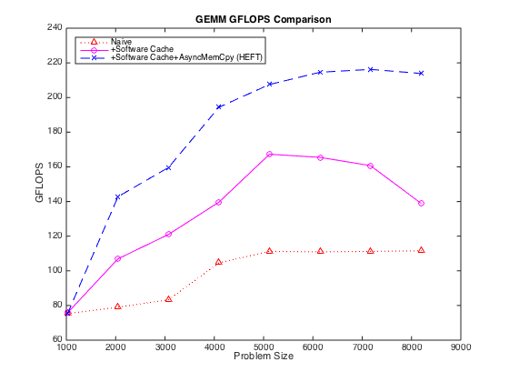
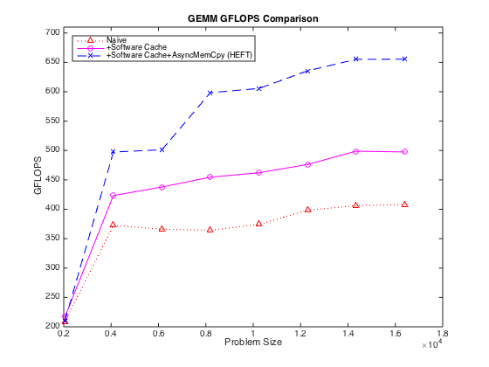
Performance
6-core single-socket Xeon E5649 CPU + 1 GTX 480 GPU card
BLOCK SIZE: 1024
6-core single-socket Xeon E5649 CPU + 2 Tesla C2070 GPU card
BLOCK SIZE: 2048

Slide 43
Conclusion
one ring to rule them all
libflame
SuperMatrix
clBLAS
cuBLAS
GPU
ACML
MKL
BLIS
CPU/MIC
BLIS
Accelerator/Other platforms
OpenCL
CUDA
OpenMP/pthread
OpenMP/pthread
OpenMP/pthread
OpenMP/pthread
C/assembly/Fortran
C/Fortran/Assembly
C/Assembly
C/Assembly

Slide 44
SuperMatrix Approach on Heterogeneous Platforms
S0: D ← A*B
S1: A → L * L^{T}
S2: B ← B * L^{-T}
S3: C ← C – B * B^{T}
S4: X ← L⁻¹ * X
  /*-----------------------------------------------*/
  FLASH_Gemm( FLA_NO_TRANSPOSE,FLA_NO_TRANSPOSE,
  FLA_ONE, A, B, FLA_ZERO, D );
  FLASH_Chol( FLA_LOWER_TRIANGULAR, A );
  FLASH_Trsm( FLA_RIGHT, FLA_LOWER_TRIANGULAR,
  FLA_TRANSPOSE, FLA_NONUNIT_DIAG,
  FLA_ONE, A, B );
  FLASH_Syrk( FLA_LOWER_TRIANGULAR, FLA_NO_TRANSPOSE,
  FLA_MINUS_ONE, B, FLA_ONE, C );
  FLASH_Trsm( FLA_LEFT, FLA_LOWER_TRIANGULAR,
  FLA_NO_TRANSPOSE, FLA_NONUNIT_DIAG,
  FLA_ONE, L, X );
  /*-----------------------------------------------*/
No Code Change!

Slide 45
Related Work
 | Target Platform | Lapack Project | FLAME Project
 | Sequential | LAPACK | libflame
 | Sequential+multithreaded BLAS | LAPACK | libflame
 | Multicore/multithreaded | PLASMA | libflame+SuperMatrix
 | Multicore+out-of-order scheduling | PLASMA+Quark | libflame+SuperMatrix
 | CPU + single GPU | MAGMA | libflame+SuperMatrix
 | Multicore + multi-GPU | DAGuE/StarPU/ XKaapi | libflame+SuperMatrix

Slide 46

Questions?

