Slide 1
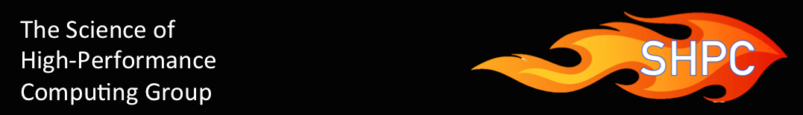
BLIS and libflame: past, present, and future
Robert van de Geijn

Slide 2
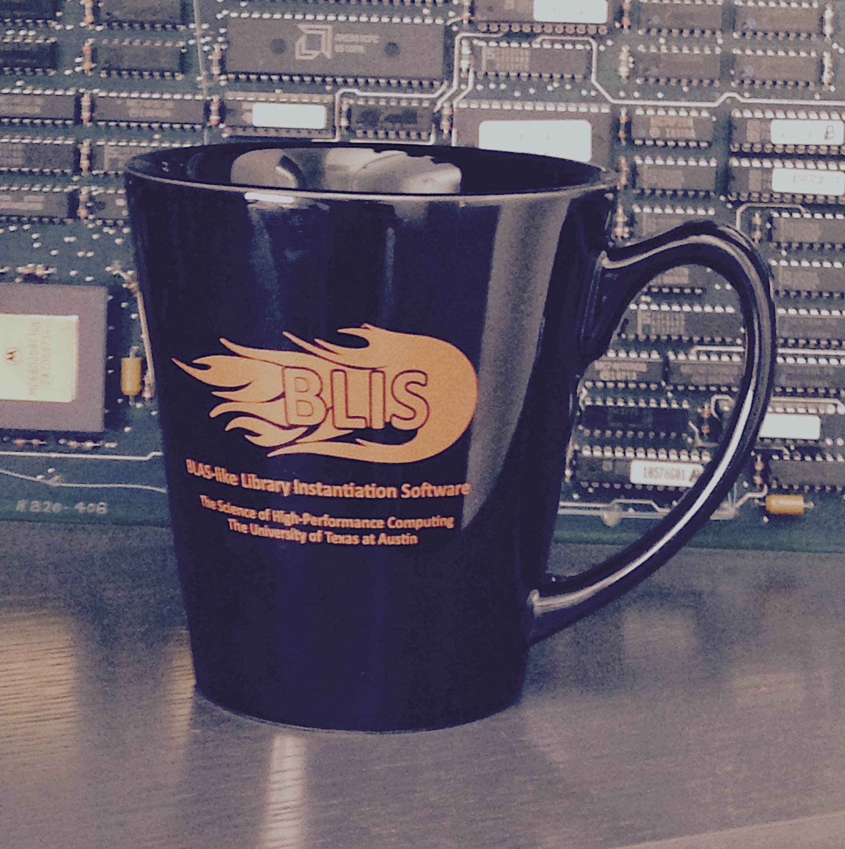
Welcome!

Slide 3
Participants from UT
Computer Sciences
Statistics and Data Sciences
Chemistry
Electrical and Computer Engineering
Institute for Computational Engineering and Sciences (ICES)
Computational Science, Engineering, and Mathematics (CSEM) Ph.D. Program
Texas Advanced Computing Center (TACC)

Slide 4









Slide 5






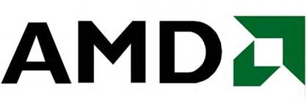



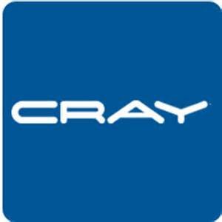



Slide 6
The BLIS Retreat
2013: 11 Universities, 2 Labs, 8 Companies
2014: 9 Universities, 2 Labs, 6 Companies
2015: 9 Universities, 2 Labs, 11 Companies

Slide 7

Speak the Language
FLAME
  Notation
  Methodology
  APIs
    FLAMEC
    FLAME@lab
    FLAMEPy
    FLaTeX
libflame
SuperMatrix
FLAPACK
Elemental
BLIS
LAC/LAP
DxT
LAFF

Slide 8
Speak the Language
FLAME
  Notation
  Methodology
  APIs
    FLAMEC
    FLAME@lab
    FLAMEPy
    FLaTeX
libflame
SuperMatrix
FLAPACK
Elemental
BLIS
LAC/LAP
DxT
LAFF

Slide 31
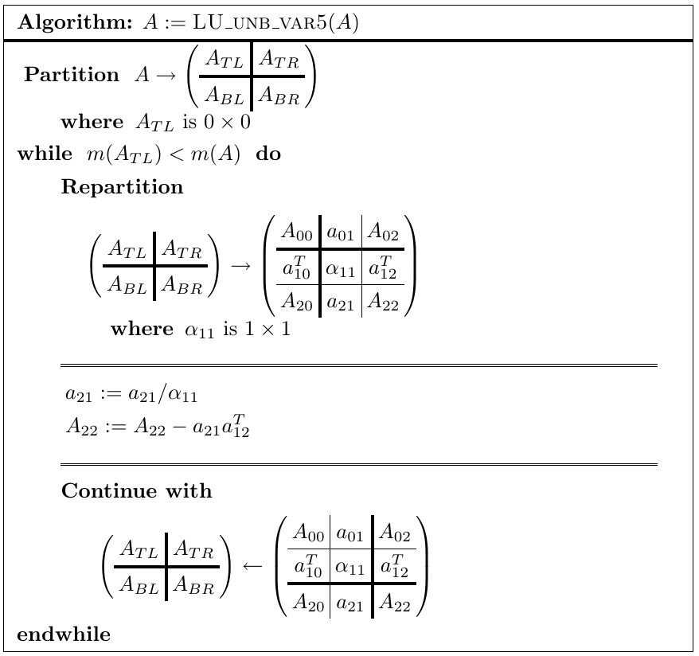

Slide 32
Related Publications
A Note on Parallel Matrix Inversion. Xiaobai Sun, Enrique S. Quintana, Gregorio Quintana, and Robert van de Geijn. SIAM Journal on Scientific Computing , Vol. 22, No. 5, pp. 1762--1771. (2001)

Slide 33
Speak the Language
FLAME
  Notation
  Methodology
  APIs
    FLAMEC
    FLAME@lab
    FLAMEPy
    FLaTeX
libflame
SuperMatrix
FLAPACK
Elemental
BLIS
LAC.LAP
DxT
LAFF

Slide 34
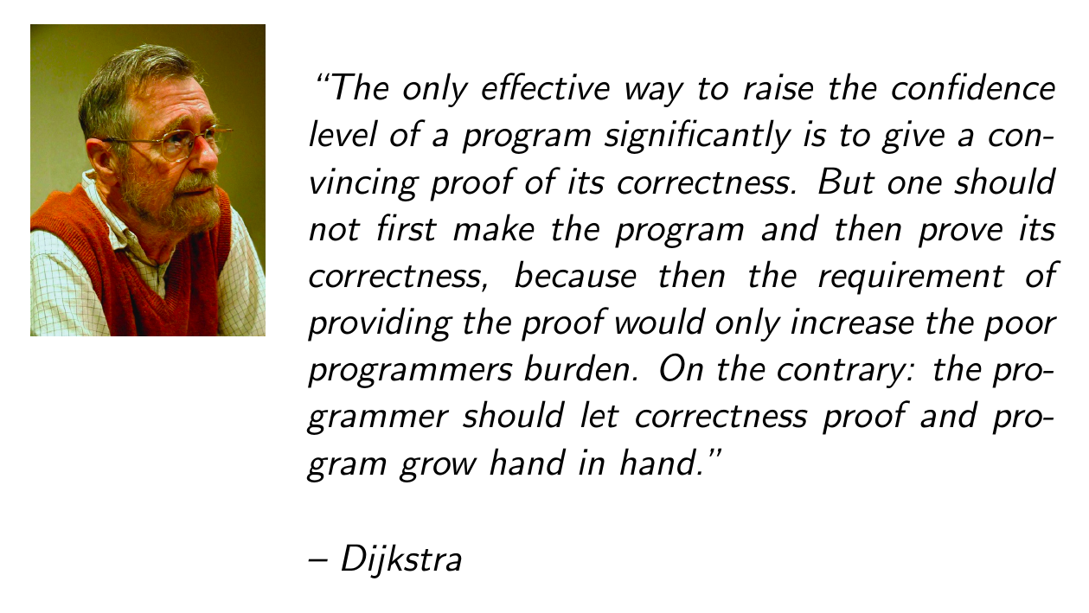

Slide 35
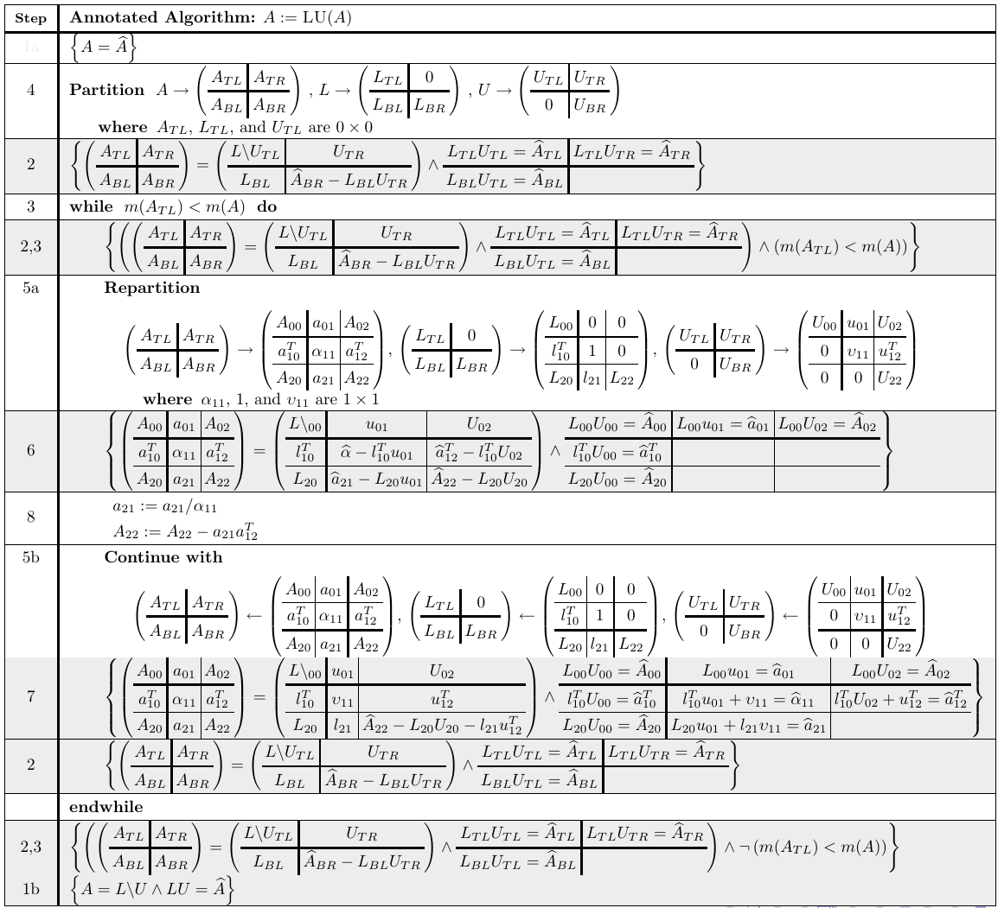

Slide 36
Related Publications
John A. Gunnels. A Systematic Approach to the Design and Analysis of Linear Algebra Algorithms. Ph.D. Dissertation. Nov. 2001
John Gunnels, Fred G. Gustavson, Greg M. Henry, Robert A. van de Geijn. FLAME: Formal Linear Algebra Methods Environment, ACM Transactions on Mathematical Software (TOMS), 2001
Paolo Bientinesi, John A. Gunnels, Margaret E. Myers, Enrique S. Quintana-Orti, Robert A. van de Geijn. The science of deriving dense linear algebra algorithms. ACM Transactions on Mathematical Software (TOMS), 2005
Paolo Bientinesi. Mechanical Derivation and Systematic Analysis of Correct Linear Algebra Algorithms. Ph.D. Dissertation. Aug. 2006
Robert A. van de Geijn and Enrique S. Quintana-Orti. The Science of Programming Matrix Computations. www.lulu.com , 2008
Paolo Bientinesi, John Gunnels, Maggie Myers, Enrique Quintana-Orti, Tyler Rhodes, Robert van de Geijn, and Field Van Zee. Deriving Linear Algebra Libraries. Formal Aspects of Computing. 2012
Tze Meng Low. A Calculus of Loop Invariants for Dense Linear Algebra Optimization. Computer Science. December 2013.

Slide 37
Speak the Language
FLAME
  Notation
  Methodology
  APIs
    FLAMEC
    FLAME@lab
    FLAMEPy
    FLaTeX
libflame
SuperMatrix
FLAPACK
Elemental
BLIS
LAC/LAP
DxT
LAFF

Slide 38
Related Publications
John Gunnels, Fred G. Gustavson, Greg M. Henry, Robert A. van de Geijn. FLAME: Formal Linear Algebra Methods Environment, ACM Transactions on Mathematical Software (TOMS), 2001
Paolo Bientinesi, Enrique S. Quintana-Orti, Robert A. van de Geijn. Representing linear algebra algorithms in code: the FLAME application program interfaces. ACM Transactions on Mathematical Software (TOMS), 2005
Margaret Myers, Pierce van de Geijn, Robert van de Geijn. Linear Algebra: Foundations to Frontiers - Notes to LAFF. (MOOC) offered by edX
Field G. Van Zee. libflame: The Complete Reference. www.lulu.com, 2009

Slide 39
Speak the Language
FLAME
  Notation
  Methodology
  APIs
    FLAMEC
    FLAME@lab
    FLAMEPy
    FLaTeX
libflame
SuperMatrix
FLAPACK
Elemental
BLIS
LAC/LAP
DxT
LAFF

Slide 40
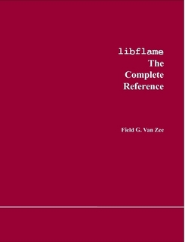
libflame
Reimplementation of important parts of LAPACK
Families of algorithms for key operations
Improvements to important algorithms
  Reduction to condensed form
  Symmetric QR algorithm for computing the Spectral Decomposition and SVD
Alternative (object based) interface
Comprehensive users’ guide

Slide 41
Related Publications
Field G. Van Zee. libflame: The Complete Reference. www.lulu.com, 2009
Field G. Van Zee, Ernie Chan, Robert A. van de Geijn, Enrique S. Quintana-Orti, Gregorio Quintana-Orti. The libflame Library for Dense Matrix Computations. IEEE CiSE, Vol. 11, No 6, 2009
Field G. Van Zee, Robert A. van de Geijn, Gregorio Quintana-Ortí, G. Joseph Elizondo. Families of Algorithms for Reducing a Matrix to Condensed Form. ACM Transactions on Mathematical Software (TOMS), 2012
Field G. Van Zee, Robert A. van de Geijn, Gregorio Quintana-Ortí. Restructuring the Tridiagonal and Bidiagonal QR Algorithms for Performance. ACM Transactions on Mathematical Software (TOMS), 2014

Slide 42
Speak the Language
FLAME
  Notation
  Methodology
  APIs
    FLAMEC
    FLAME@lab
    FLAMEPy
    FLaTeX
libflame
SuperMatrix
FLAPACK
Elemental
BLIS
LAC/LAP
DxT
LAFF

Slide 43
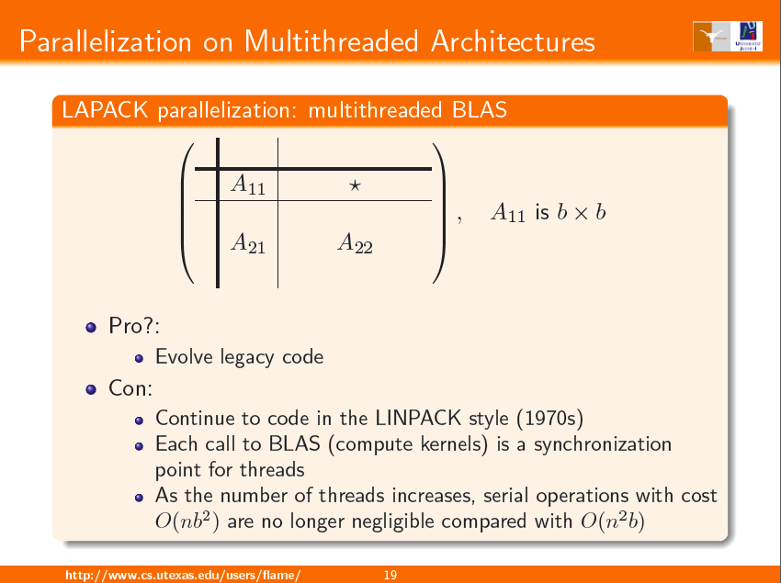

Slide 44
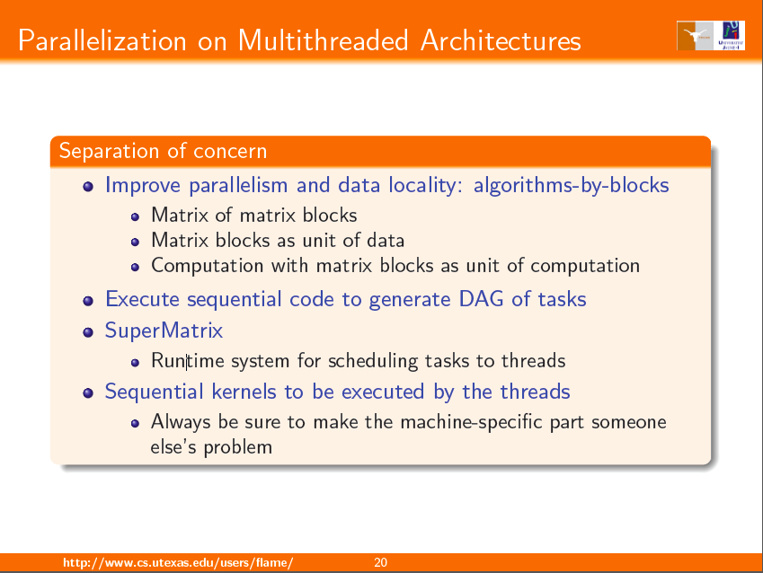

Slide 45
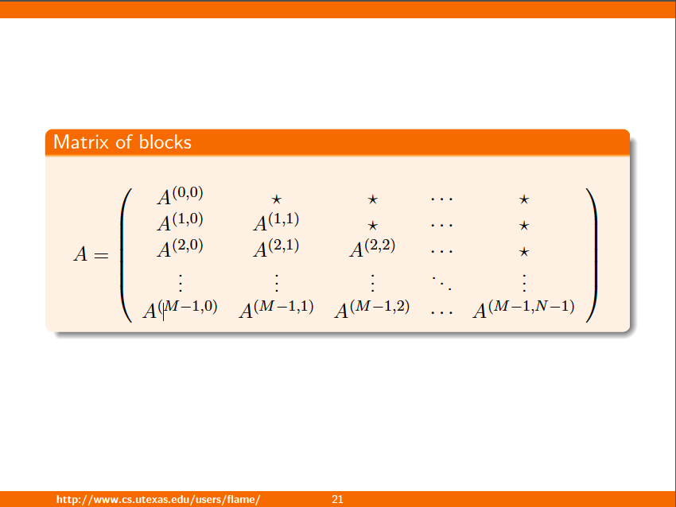

Slide 46
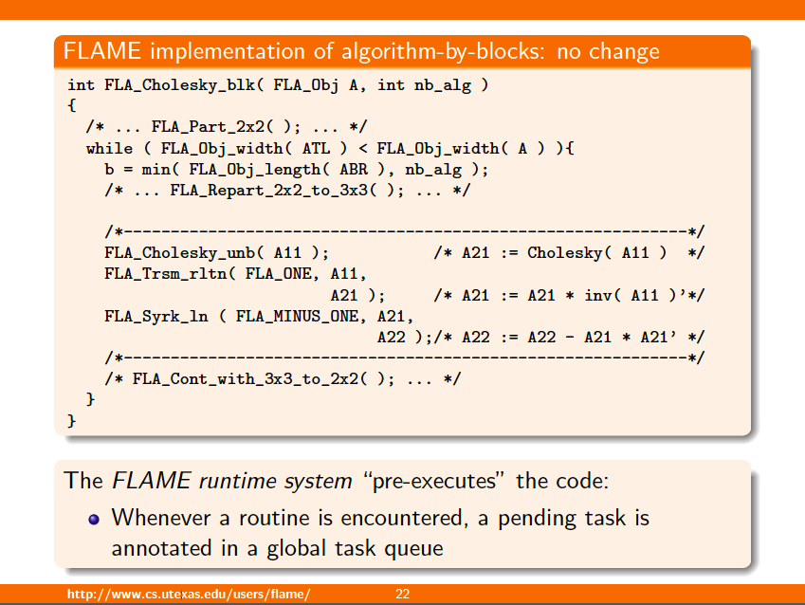

Slide 47
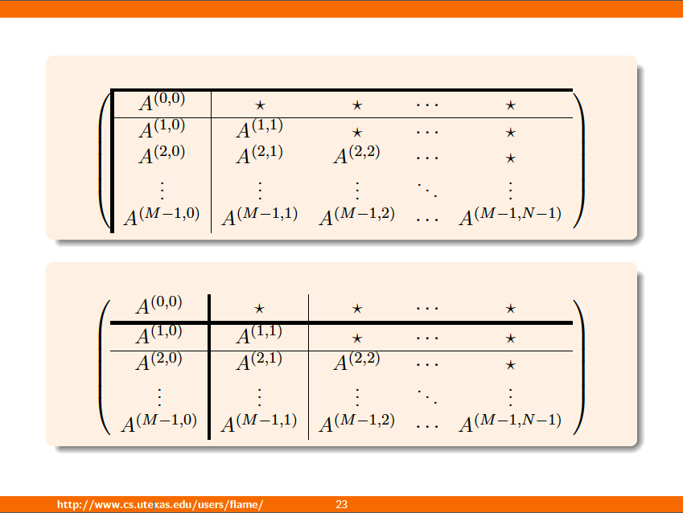

Slide 48
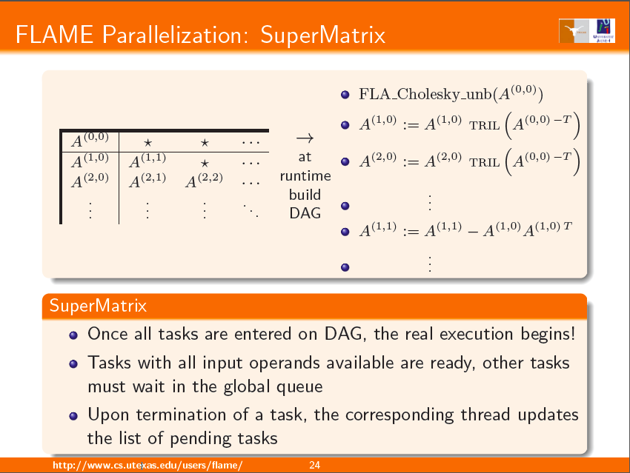

Slide 49
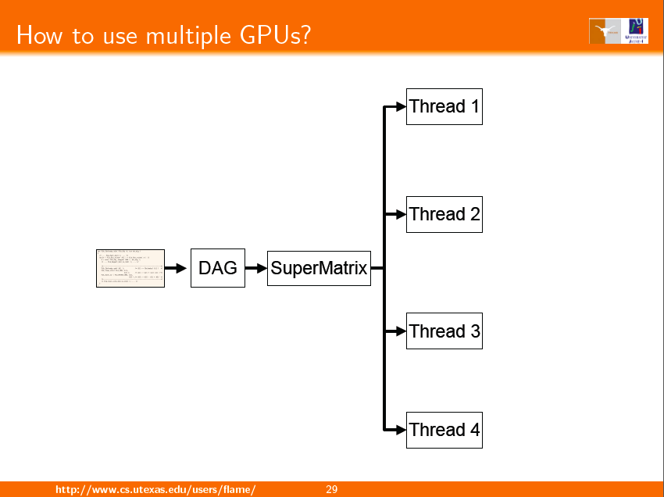

Slide 50
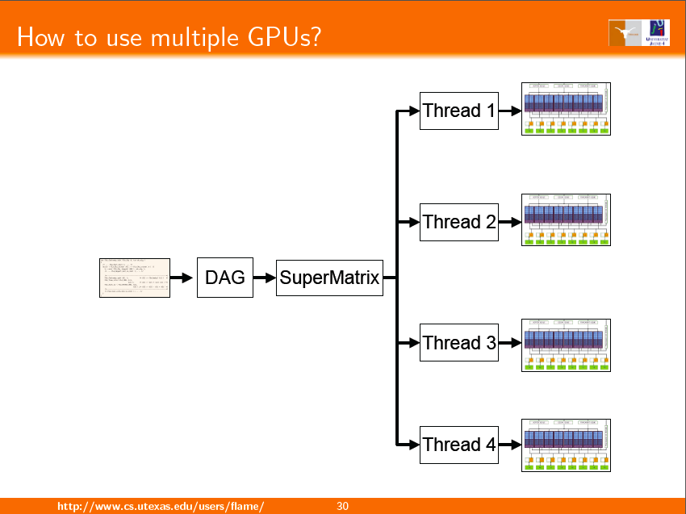

Slide 51
Related Publications
Tze Meng Low and Robert van de Geijn. An API for Manipulating Matrices Stored by Blocks. FLAME Working Note #12. 2004
F. D. Igual, E. Chan, E. S. Quintana-Ortí, G. Quintana-Ortí, R. A. van de Geijn, and F. G. Van Zee. The FLAME approach: From dense linear algebra algorithms to high-performance multi-accelerator implementations. JPDC. 2012.
F. G. Van Zee, E. Chan, E. S. Quintana-Ortí, G. Quintana-Ortí, and R. A. van de Geijn. Introducing: The libflame library for dense matrix computations. IEEE CiSE, 2009.
E. S. Quintana-Ortí, G. Quintana-Ortí, R. A. van de Geijn, F. G. Van Zee, and E. Chan. Programming matrix algorithms-by-blocks for thread-level parallelism. ACM Transactions on Mathematical Software, 36(3):14:1-14:26, July 2009.
E. Chan, A. Chapman, and R. van de Geijn. Managing the complexity of lookahead for LU factorization with pivoting. SPAA'10. 2010.Greece, June 13-15, 2010.
E. S. Quintana-Ortí, G. Quintana-Ortí, E. Chan, R. van de Geijn, and F. G. Van Zee. Design of scalable dense linear algebra libraries for multithreaded architectures: the LU factorization. In MTAAP'08. 2008.
E. Chan, F. G. Van Zee, P. Bientinesi, E. S. Quintana-Ortí, G. Quintana-Ortí, and R. van de Geijn. SuperMatrix: A multithreaded runtime scheduling system for algorithms-by-blocks. PPoPP'08. 2008.
E. S. Quintana-Ortí, G. Quintana-Ortí, E. Chan, R. A. van de Geijn, and F. G. Van Zee. Scheduling of QR factorization algorithms on SMP and multi-core architectures. PDP'08. 2008.
E. Chan, F. G. Van Zee, E. S. Quintana-Ortí, G. Quintana-Ortí, and R. van de Geijn. Satisfying your dependencies with SuperMatrix. Cluster'07. 2007.
E. Chan, E. S. Quintana-Ortí, G. Quintana-Ortí, and R. van de Geijn. SuperMatrix out-of-order scheduling of matrix operations for SMP and multi-core architectures. SPAA'07. 2007.
Gregorio Quintana-Orti, Francisco D. Igual, Enrique S. Quintana-Orti, Robert A. van de Geijn. Solving dense linear systems on platforms with multiple hardware accelerators. PPoPP ’00, 2009.

Slide 52
Speak the Language
FLAME
  Notation
  Methodology
  APIs
    FLAMEC
    FLAME@lab
    FLAMEPy
    FLaTeX
libflame
SuperMatrix
FLAPACK
Elemental
BLIS
LAC/LAP
DxT
LAFF

Slide 53
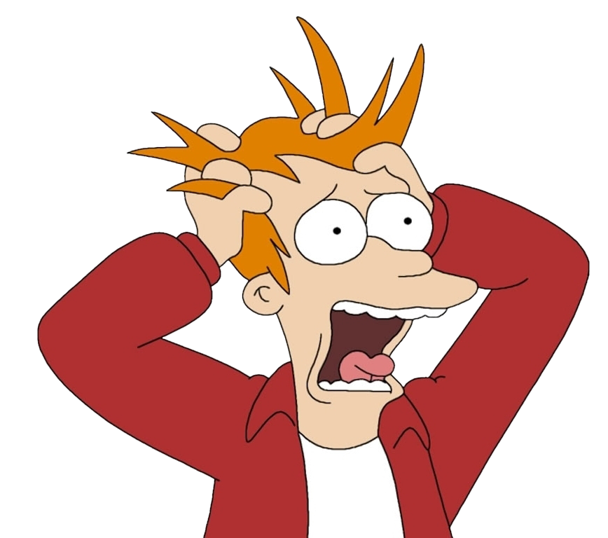
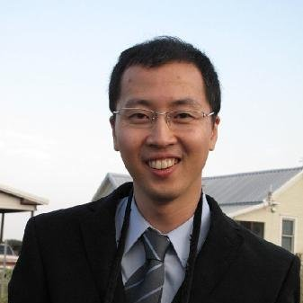
Full LAPACK
Functionality/Compatibility
libflame provides
  Subset of LAPACK functionality
  Alternative (object-based) interface
Desirable:
  Full LAPACK functionality
  Backward compatibility
LAPACK has millions of lines of code…
Dr. Kyungjoo Kim
to the rescue

Slide 54
Full LAPACK
Functionality/Compatibility
LAPACK -> f2c -> fix a bit -> FORTRAN FREE LIBRARY
For each LAPACK routine
  If libflame has functionality
    Use LAPACK routine as interface
    Rip out guts
    Call libflame routine
Result: “FLAPACK” (our internal name for this part of libflame)
  No Fortran
  Full LAPACK functionality
  Passes LAPACK test suite
  Part of standard libflame release
Gives a path for incrementally replacing all of LAPACK

Slide 55
Speak the Language
FLAME
  Notation
  Methodology
  APIs
    FLAMEC
    FLAME@lab
    FLAMEPy
    FLaTeX
libflame
SuperMatrix
FLAPACK
Elemental
BLIS
LAC/LAP
DxT
LAFF

Slide 56
Elemental
Developed by Jack Poulson
Distributed memory DLA library (but now so much more…)
Has gained wide use at the national labs
Coding style and theoretical underpinnings inspired by PLAPACK and FLAME

Slide 57
Related Publications
Martin D. Schatz, Robert A. van de Geijn, Jack Poulson. Parallel Matrix Multiplication: A Systematic Journey. SIAM Journal on Scientific Computing. To appear (pending minor modifications)
Jack Poulson, Bryan Marker, Robert A. van de Geijn, Jeff R. Hammond, Nichols A. Romero. Elemental: A New Framework for Distributed Memory Dense Matrix Computations. ACM Transactions on Mathematical Software (TOMS), 2013

Slide 58
Speak the Language
FLAME
  Notation
  Methodology
  APIs
    FLAMEC
    FLAME@lab
    FLAMEPy
    FLaTeX
libflame
SuperMatrix
FLAPACK
Elemental
BLIS
LAC/LAP
DxT
LAFF

Slide 59
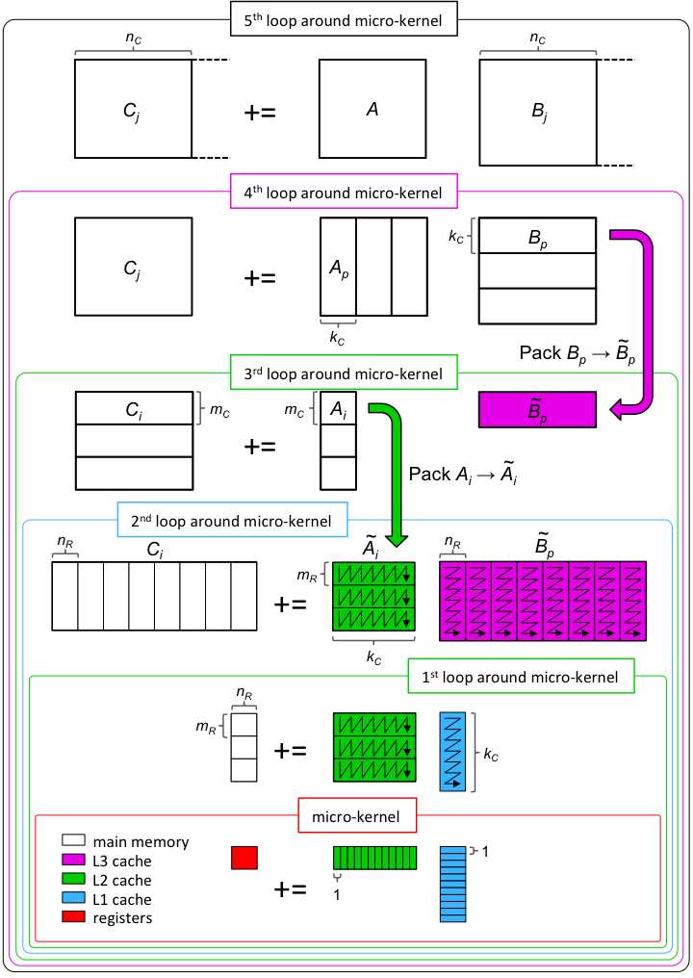

Slide 60
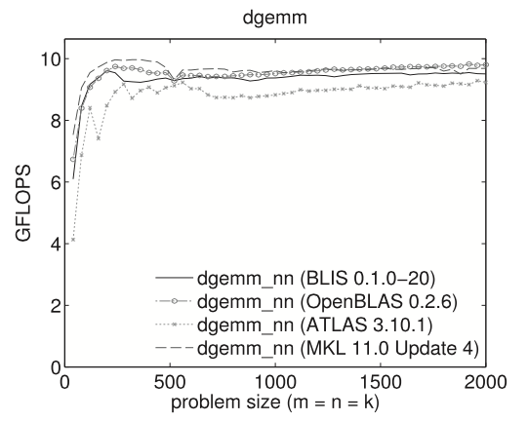
Intel Xeon “Dunnington”
(one core)

Slide 61
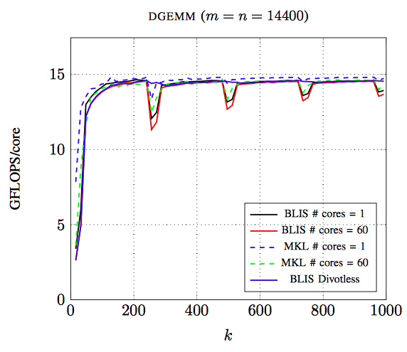
Intel Xeon Phi

Slide 62
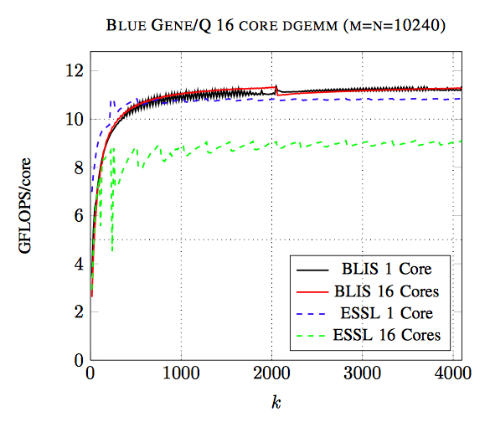
Intel Xeon Phi

Slide 63
Related Publications
John A. Gunnels, Greg M. Henry, and Robert A. van de Geijn. A Family of High-Performance Matrix Algorithms. In Computational Science - 2001.
Kazushige Goto, Robert A. van de Geijn. Anatomy of high-performance matrix multiplication. ACM Transactions on Mathematical Software (TOMS), 2008.
Kazushige Goto, Robert van de Geijn. High-performance implementation of the level-3 BLAS. ACM Transactions on Mathematical Software (TOMS), 2008
Field G. Van Zee, Robert A. van de Geijn. BLIS: A Framework for Rapidly Instantiating BLAS Functionality. ACM Transactions on Mathematical Software (TOMS), 2015
Tyler M. Smith, Robert van de Geijn, Mikhail Smelyanskiy, Jeff R. Hammond, and Field G. Van Zee. Anatomy of High-Performance Many-Threaded Matrix Multiplication. IPDPS 2014.
Field G. Van Zee, Tyler Smith, Bryan Marker, Tze Meng Low, Robert A. van de Geijn, Francisco D. Igual, Mikhail Smelyanskiy, Xianyi Zhang, Michael Kistler, Vernon Austel, John Gunnels, Lee Killough. The BLIS Framework: Experiments in Portability. ACM Transactions on Mathematical Software. To appear.

Slide 64
Speak the Language
FLAME
  Notation
  Methodology
  APIs
    FLAMEC
    FLAME@lab
    FLAMEPy
    FLaTeX
libflame
SuperMatrix
FLAPACK
Elemental
BLIS
LAC/LAP
DxT
LAFF

Slide 65
Design of Linear Algebra Core (LAC)
Distributed memory architecture
Broadcast Buses
Notes:
Why does it look like this?
Cutomized for rank-1
Broadcast buses
Unique:
Distributed memory architecture
Broadcast operation.
Where we are different than systolic

Slide 66
GEMM Performance and Efficiency on Various Cores
 | W/mm² | GFLOPS/mm² | GFLOPS/W | Utilization
Cell SPE (SP) | 0.4 | 6.4 | 16 | 88%
NVidia GTX480 SM (SP) | 0.5 | 3.8 | 7 | 58%
NVidia GTX480 SM (DP) | 0.5 | 1.7 | 3.4 | 58%
Rigel cluster (SP) | 0.3 | 4.5 | 15 | 40%
Intel Core (DP) | 0.5 | 0.4 | 0.85 | 95%
Altera Stratix IV (DP) | 0.02 | 0.05 | 3.5 | 90+%
ClearSpeed CSX700(DP) | 0.02 | 0.28 | 12.5 | 78%
LAC (SP) | 0.2 | 19.5 | 104 | 95+%
LAC (DP) 32 GFLOPS | 0.3 | 15.6 | 47 | 95+%
Notes:
Why we should care?
Touch two or three of the columns and rows
32 GLOPS DP

Slide 67
Related Publications
Ardavan Pedram, Andreas Gerstlauer, and Robert van de Geijn. Algorithm, Architecture, and Floating-Point Unit Codesign of a Matrix Factorization Accelerator. IEEE Trans. on Computers. 2014
Ardavan Pedram, Andreas Gerstlauer, and Robert van de Geijn. Floating Point Architecture Extensions for Optimized Matrix Factorization. ARITH21.
Ardavan Pedram, Robert van de Geijn, and Andreas Gerstlauer. Codesign Tradeoffs for High-Performance, Low-Power Linear Algebra Architectures. IEEE Trans.on Computers. Volume 61, Issue 12, 2012.
Ardavan Pedram, Andreas Gerstlauer, and Robert van de Geijn. On the Efficiency of Register File versus Broadcast Interconnect for Collective Communications in Data-Parallel Hardware Accelerators. SBAC-PAD 2012.
Ardavan Pedram, Syed Gilani, Nam Sung Kim, Robert van de Geijn, Mike Schulte, and Andreas Gerstlauer. A Linear Algebra Core Design For Efﬁcient Level-3 BLAS. ASAP2012.
Ardavan Pedram, Andreas Gerstlauer, and Robert van de Geijn. A High-performance, Low-power Linear Algebra Core. ASAP2011.

Slide 68
Speak the Language
FLAME
  Notation
  Methodology
  APIs
    FLAMEC
    FLAME@lab
    FLAMEPy
    FLaTeX
libflame
SuperMatrix
FLAPACK
Elemental
BLIS
LAC/LAP
DxT
LAFF

Slide 69
Design-by-Transformation (DxT)
Currently: Libraries exist as code
Future:
  Notation/Domain Specific Language
  Encode knowledge about algorithms and architectures
  Tools search algorithmic design space and produce an optimal implementation
Examples
  DxTer
  Tensor Contraction Engine
  Spiral

Slide 70
Related Publications
Bryan Marker, Martin Schatz, Devin Matthews, Isil Dillig, Robert van de Geijn, and Don Batory. DxTer: An Extensible Tool for Optimal Dataflow Program Generation. Tech Report.
Bryan Marker, Don Batory, and Robert van de Geijn. “Understanding Performance Stairs: Elucidating Heuristics.” International Conference on Automated Software Engineering 2014.
Bryan Marker, Don Batory, and Robert van de Geijn. “Code Generation and Optimization of Distributed-Memory Dense Linear Algebra Kernels.” iWAPT 2013.
Bryan Marker, Jack Poulson, Don Batory, and Robert van de Geijn. “Designed Linear Algebra Algorithms by Transformation: Mechanizing the Expert Developer.” iWAPT 2012.

Slide 71
Speak the Language
FLAME
  Notation
  Methodology
  APIs
    FLAMEC
    FLAME@lab
    FLAMEPy
    FLaTeX
libflame
SuperMatrix
FLAPACK
Elemental
BLIS
LAC/LAP
DxT
LAFF

Slide 72
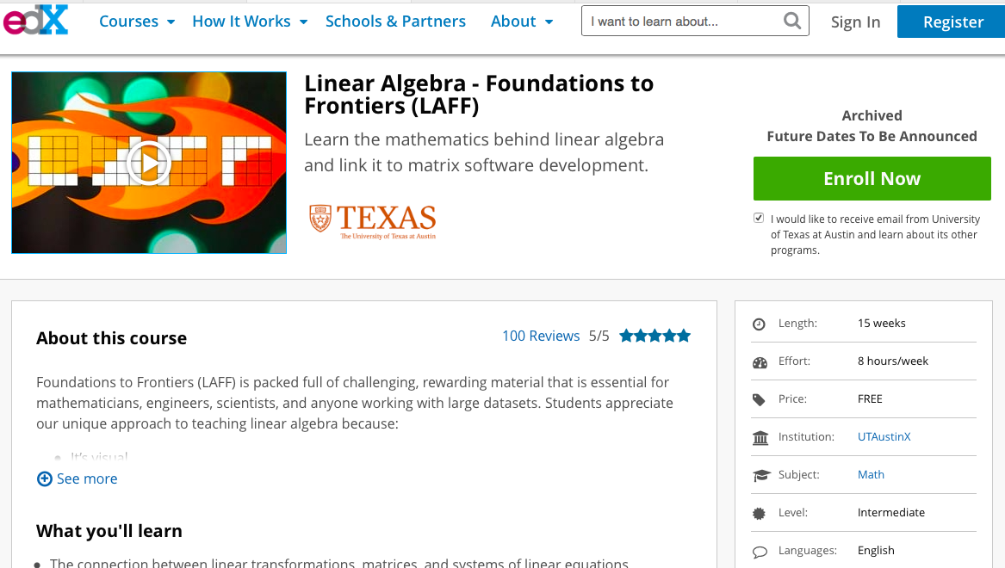

Slide 73
Linear Algebra: Foundations to Frontiers (LAFF)
Developed by Maggie Myers and Robert van de Geijn (with help from the LAFF team)
Offered on the edX platform
  Spring 2014, Spring 2015, Summer 2015
  75,000+ participants from 160+ countries
Notes (900 pages), videos (270+), programming assignments (Python and Matlab), other activities

Slide 74
Related Publications
Maggie Myers, Pierce van de Geijn, Robert van de Geijn. Linear Algebra: Foundations to Frontiers – Notes to LAFF With (Python). Self-published. www.ulaff.net. 2014.
Maggie Myers, Pierce van de Geijn, Robert van de Geijn. Linear Algebra: Foundations to Frontiers – Notes to LAFF With (Matlab). Self-published. www.ulaff.net. 2015.
Robert van de Geijn. Linear Algebra: Foundations to Frontiers – Notes on Numerical Linear Algebra. Self-published. www.ulaff.net. 2015.

Slide 75
History of Funding
New SSI
Grant?
SSI Grant
National Science Foundation
2003
2004
2005
2006
2007
2008
2009
2010
2011
2012
2013
2014
2015
2016
2017
Microsoft
AMD
Corporate Sponsorship
Intel
Texas Intruments

Slide 76
History of Funding
National Science Foundation
Foundational research
2003
2004
2005
2006
2007
2008
2009
2010
2011
2012
2013
2014
2015
2016
2017

Slide 77
NSF’s SI2 Program
Software Infrastructure for Sustained Innovation
  Software infrastructure as a vital resource for scientific exploration
  Much like the NSF Supercomputing Centers provide hardware infrastructure
SSI: medium size grants under the program
First SSI grant:
  Collaboration with UChicago (Jeff Hammond) and Stanford (Jack Poulson)
  (Co)PIs at UT: RvdG (CS/ICES), Don Batory (CS), Victor Eijkhout (TACC), Maggie Myers (SDS), John Stanton (Chem/ICES)
  Transform our foundational research into a new, vertically integrated DLA software stack
  Produced BLIS, FLAPACK, improvements to Elemental, and improvements to Aquarius

Slide 78


History of Funding
New SSI
Grant?
SSI Grant
National Science Foundation
2003
2004
2005
2006
2007
2008
2009
2010
2011
2012
2013
2014
2015
2016
2017
Field
Microsoft
AMD
Corporate Sponsorship
Intel
Texas Intruments

Slide 79
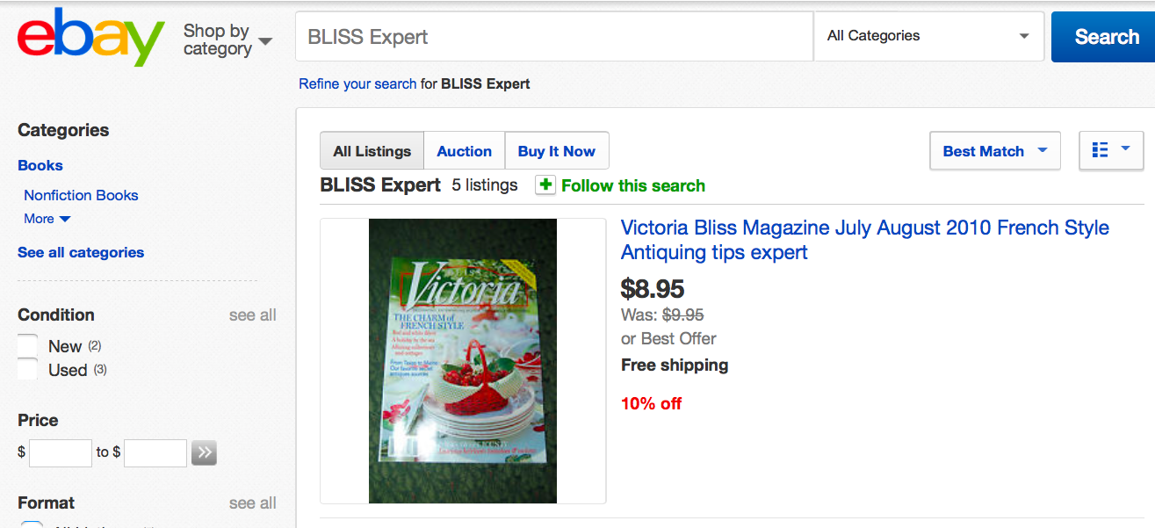
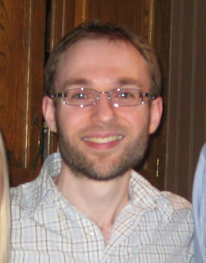
Field Van Zee, BLIS Expert
$500,000

Slide 80
Pending SSI Grant
Collaboration with CMU
(Tze Meng Low)
PIs at UT: RvdG (CS/ICES), Don Batory (CS), Victor Eijkhout (TACC), Maggie Myers (SDS), John Stanton (Chem/ICES)
Continue development of the DLA software stack.

Slide 81
Pending SSI Grant
  Add more algorithms for level-3 BLAS to BLIS
  Extend BLIS functionality
  Runtime detection of hardware
  Autogenerating BLIS kernels
  Acceleration with Strassen’s algorithm
  Multithreading for the above
  C++ BLIS API
  Exploit the building blocks exposed by BLIS to optimize LAPACK functionality
  Improvements to SuperMatrix scheduling
  Exploit DxT for optimization across layers
  Generate kernels (e.g., for packing) with Spiral
  Various efforts to bring BLIS insights into tensor computation libraries.
  Various pedagogical activities

Slide 82
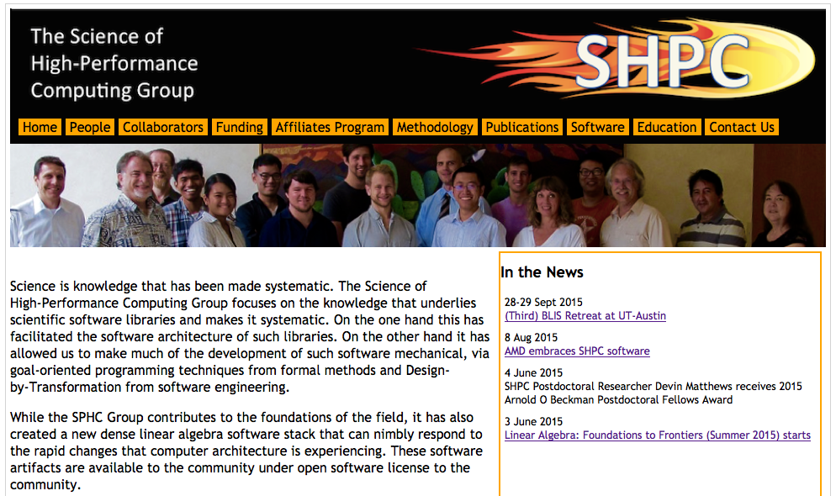
The Science of High-Performance Computing Group

