Slide 1
Adding Algorithm Based Fault-Tolerance to BLIS
Tyler Smith, Robert van de Geijn, Mikhail Smelyanskiy, Enrique Quintana-Ortí

Slide 2
Introduction
Soft errors:
Transient hardware failures
Caused by high-energy particle incidence.
Cause crashes, and numerical errors
Present-day supercomputers:
Mean time between failures (MTBF) is already quite high
Notes:
The problem that we are trying to address is…
Tera- scalesystems:
ASCI Q at LANL: 26.1 CPU failures per week [15].
Peta-scale systems:
Titan at ORNL, MTBF for double-bit errors in registers and memory is seven days
Sequoa at LLNL MTBF for correctable errors is predicted to be 1.5 days
when accounting for instruction cache, data cache, and GPR and FPR register files, the mean time between correctable errors is predicted to be 1.5 days [6].

Slide 3
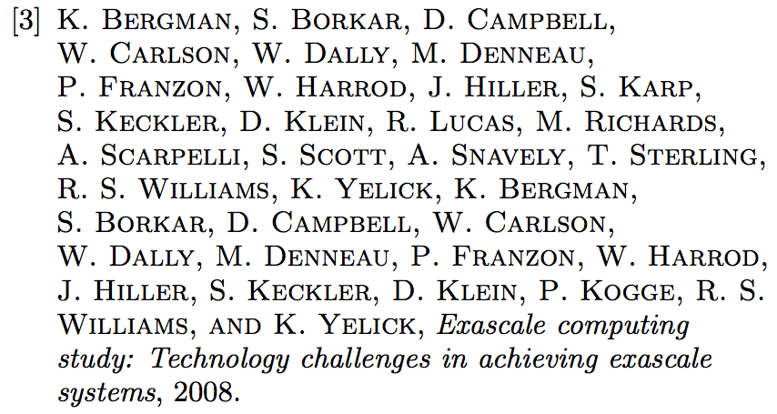
Motivation
Future supercomputers:
3 orders of magnitude more components in exascale systems
MTBF will deteriorate
Resiliance will be a fundamental problem [3]

Slide 4
Some solutions
Checkpoint and restart of entire application
Recovery from hard but not soft error
Redundancy
Double redundancy to detect
Triple redundancy to correct
These solutions may cost too much in terms of power budget
Notes:
Overhead of checkpointing to permanent storage won’t scale to the size of exascale systems
Checkpointing to nonvolatile memory (burst buffers) incurs higher system cost

Slide 5
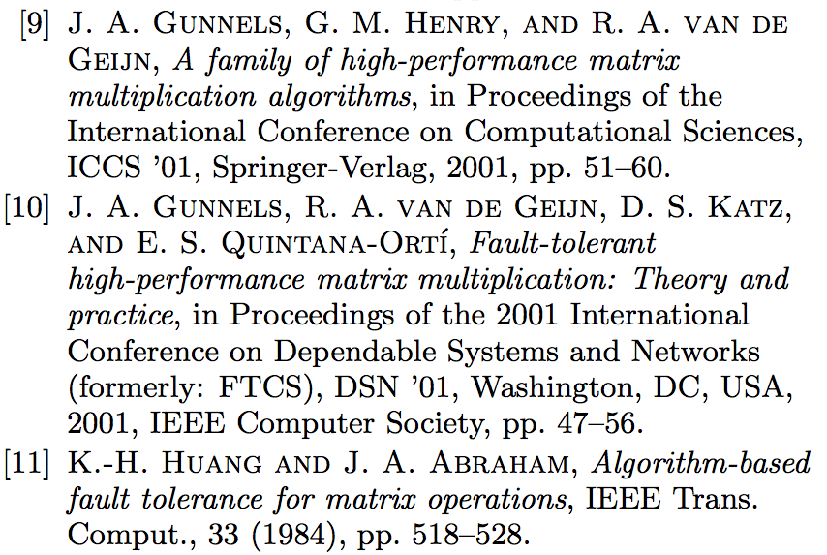
Application Based Fault-tolerance (ABFT)
ABFT [11]
Low overhead
Needs to be integrated into application
FLARE [10]
Fault tolerant ITXGEMM [9]
Our work
Fault Tolerant BLIS
Notes:
FLARE = formal linear algebra recovery environment
The insight is that both memory movements and the cost of validating correctness are O(n^2) cost that is amortized over O(n^3) computations
So it makes sense that you would be able to integrate both of these things within the same framework
Our work: fault tolerance in a modern implementation of GEMM on modern hardware.

Slide 6
Outline
Detecting and Correcting Errors
Integrating ABFT into BLIS
Performance Results

Slide 7
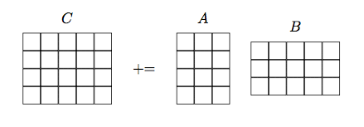
Detecting Errors
Our GEMM operation:
Notes:
For simplicity we’re going to pretend that it’s a ‘=‘ instead of a +=
But the fact that it’s a += comes up in the end

Slide 8
Detecting Errors
Right Checksum:

Slide 9
Detecting Errors
Right Checksum:

Slide 10
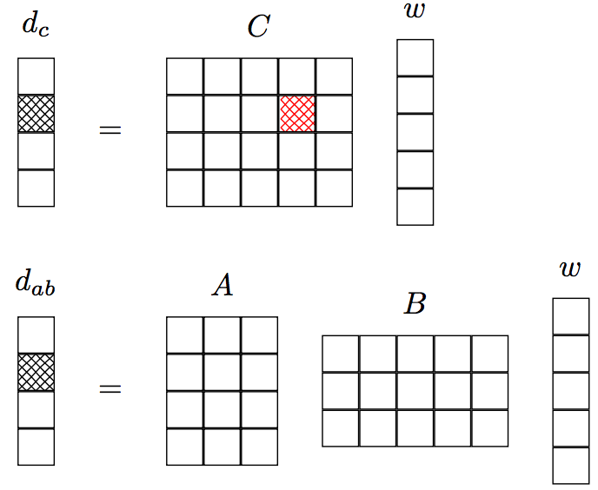
Detecting Errors
Right Checksum:

Slide 11
Detecting Errors
Left Checksum:

Slide 12
Detecting Errors
Left Checksum:

Slide 13
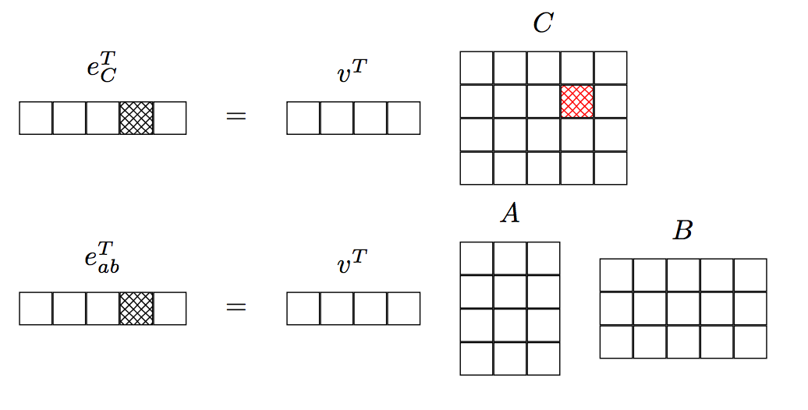
Detecting Errors
Left Checksum:
Notes:
Change this one to show both sides!

Slide 14
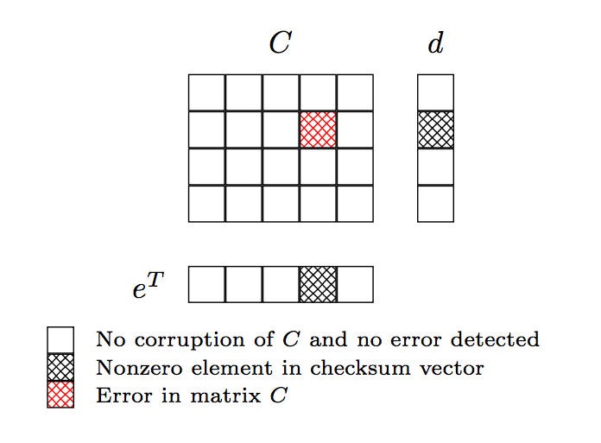
Detecting Errors
Error Location:
Notes:
d is actually difference between d_c and d_ab
E is actually difference between e_c and e_ab

Slide 15
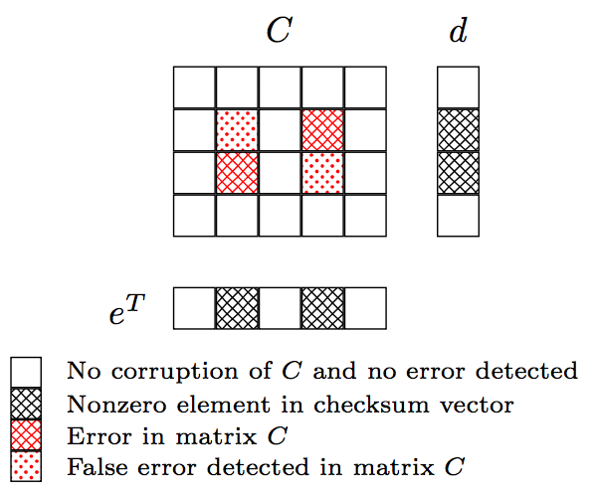
Detecting Errors
Multiple Errors:
Notes:
Don’t mention false negatives unless somebody asks

Slide 16
Errors in A and B
Single Errors in A or B can corrupt multiple elements of C
One corrupted element in A can corrupt a whole row of C
One corrupted element in B can corrupt a whole column of C
Our approach handles this

Slide 17
Correcting Errors
Traditional ABFT approach:
Calculate what the error is, subtract it away
Questions about numerical stability
We do checkpoint-and-rollback
Checkpoint C to main memory
If error is detected, rollback and recompute
We rollback and recompute only corrupted elements

Slide 18
Outline
Detecting and Correcting Errors
Integrating ABFT into BLIS
Performance Results

Slide 19
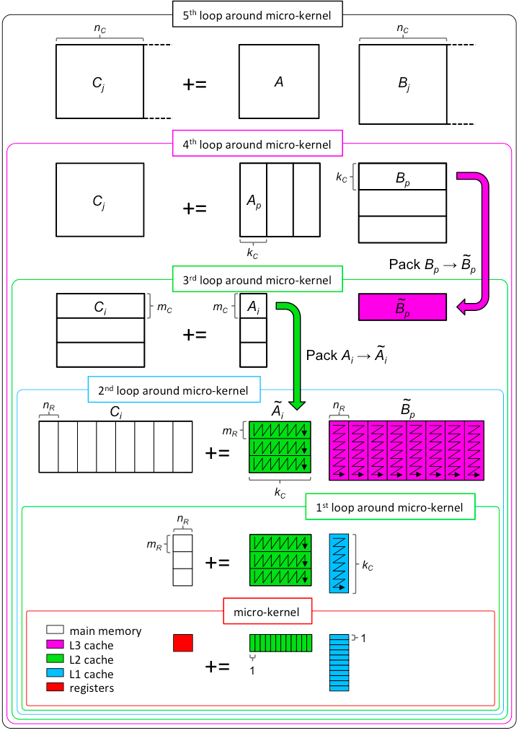
Integrating ABFT into BLIS
Each loop here represents a different layer within BLIS
Can implement ABFT at your choice of layer
Tradeoff:
Higher levels:
Cheaper ABFT
But errors are detected less soon
Lower levels:
Expensive ABFT
Errors are caught quickly
We implement ABFT at the macro-kernel level
Notes:
First say: Here are the multiple layers in BLIS,
Talk about tradeoff: it’s an O(n^3) vs O(n^2) cost thing so higher levels, bigger matrices, the more that n^2 cost goes away

Slide 20
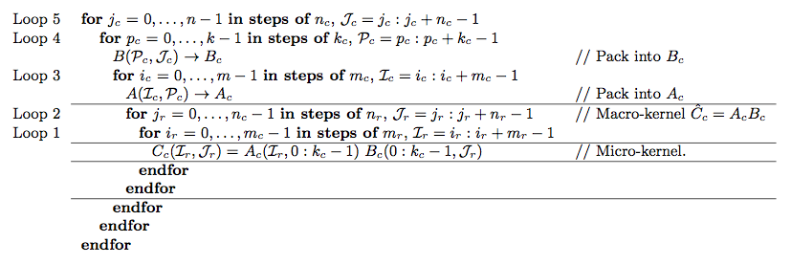
Integrating ABFT into BLIS
Notes:
This is the set of loops that implements the BLIS Gemm algorithm illustrated in the previous slide
What I’m going to do is use the image on that slide to illustrate where the fault tolerant mechanisms will be added,
And the changes to the code will be shown in this set of loops

Slide 21
Fault Tolerance at the Macro-kernel Level
Things to add to BLIS
Right Checksum
Left Checksum
Checkpointing C
Rollback and Recovery

Slide 22
Right Checksum
Must compute:
B(w)
A(Bw)
Cw
Goal: Reduce extra memory movements
Notes:
Walk through the blocks used in these computations
One option would be to simply take your panel of B, and your checksum vector, and do a matrix vector multiply,
You could even just call GEMV,

Slide 23
Right Checksum
B(w)
A(Bw)
Cw

Slide 24
Right Checksum
B(w)
A(Bw)
Cw

Slide 25
Right Checksum
B(w)
A(Bw)
Cw

Slide 26
Right Checksum
B(w)
A(Bw)
Cw

Slide 27
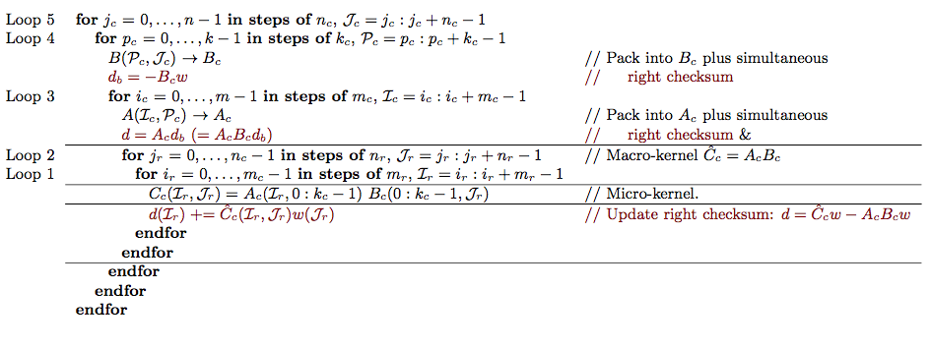
Right Checksum

Slide 28
Left Checksum
Must Compute
v^{T}A
(v^{T}A)B
v^{T}C

Slide 29
Left Checksum
v^{T}A
(v^{T}A)B
v^{T}C

Slide 30
Left Checksum
v^{T}A
(v^{T}A)B
v^{T}C

Slide 31
Left Checksum
v^{T}A
(v^{T}A)B
v^{T}C

Slide 32
Left Checksum
v^{T}A
(v^{T}A)B
v^{T}C

Slide 33
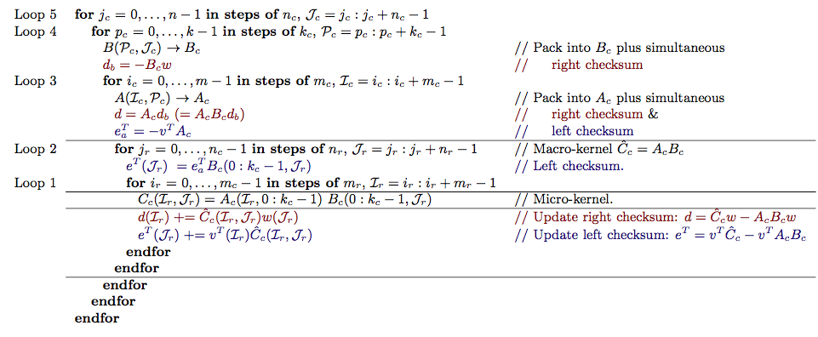
Left Checksum

Slide 34
Left Checksum
Can perform v^{T}A while packing
Problem: (v^{T}A) B must be performed once per macro-kernel
Left checksum has a higher overhead than right
Solution:
Perform left checksum lazily
Only perform left checksum if right checksum detects error

Slide 35
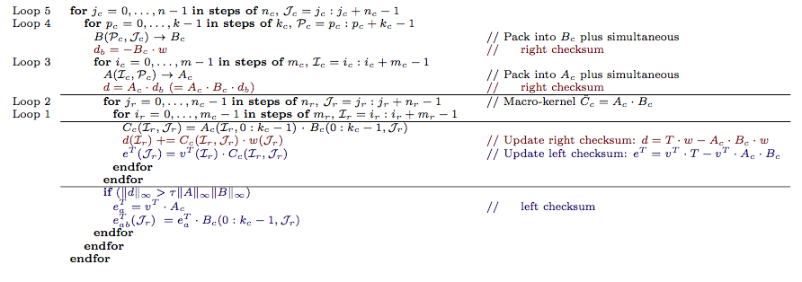
Lazy Left Checksum
Notes:
Mistake on this slide.
C should be T
Should be a C += T at the end

Slide 36
Checkpointing
Notes:
Just use the picture to talk about where you checkpoint
Just like: point out the size of C,
Talk about the whol mc by nc block of C needs to be checkpointed
Can bump B out of the L3 cache
Point out how you can checkpoint within the micro-kernel, save memory movements by doing it while C is in registers

Slide 37
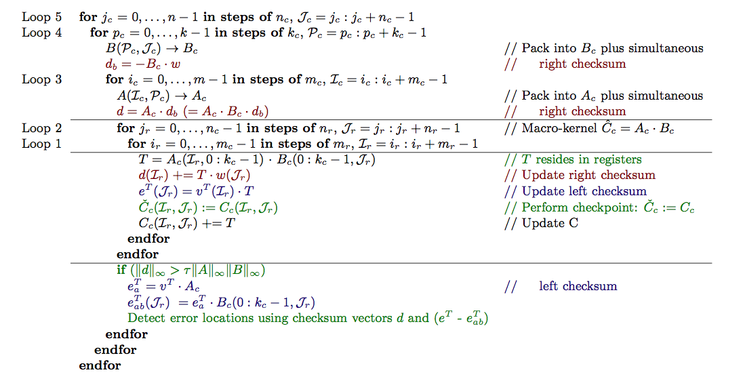
Checkpointing

Slide 38
Multithreading Issues
Fewer loops have independent iterations
Checksum vector computation
Solved by giving each thread their own checksum vectors, doing a reduction
Load imbalance
When 1 thread is busy doing recovery, other threads wait
Notes:
For example 2nd loop around the microkernel, each iteration updates all of checksum vector d.

Slide 39
Load Imbalance
Solutions:
Dynamic parallelism
Waiting threads can steal work from slow threads
Lazy recomputation
Mark corrupted elements of C
All threads cooperatively perform recovery
Easy to implement in BLIS
Data is cold in cache

Slide 40
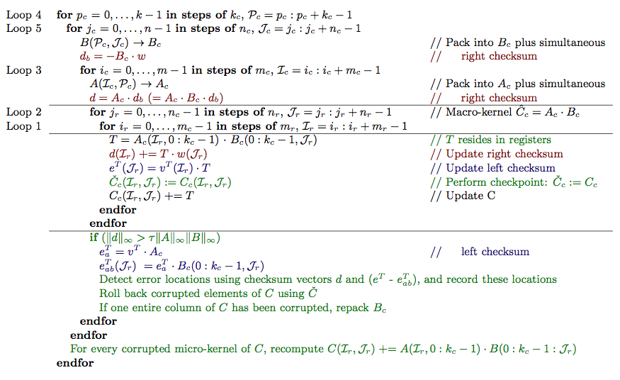
Final Implementation
Notes:
Change color of recovery stuff

Slide 41
Outline
Detecting and Correcting Errors
Integrating ABFT into BLIS
Performance Results
Notes:
Intel Xeon E5-2680 ivy bridge
Single node of stampede

Slide 42
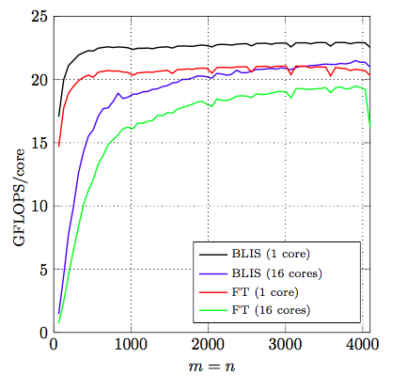
Performance Results
Cost of detecting errors
No errors introduced
Both 1 and 16 core
K is set to 256

Slide 43
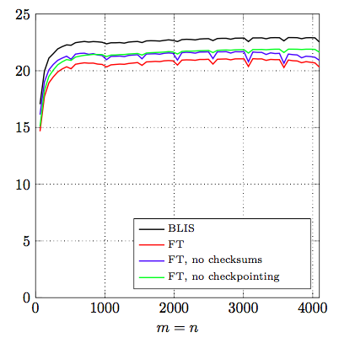
Performance Results
Breakdown of costs of detecting errors
No errors introduced
Single Core
K is set to 256
Both Checksums and checkpointing exhibit similar costs

Slide 44
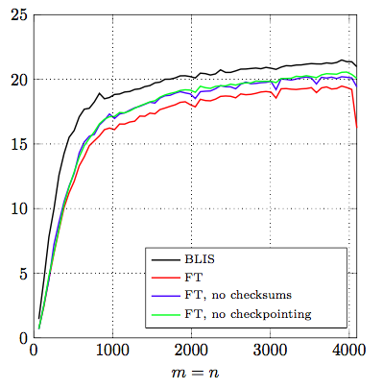
Performance Results
Breakdown of costs of detecting errors
No errors introduced
16 Cores
K is set to 256
Both Checksums and checkpointing exhibit similar costs

Slide 45
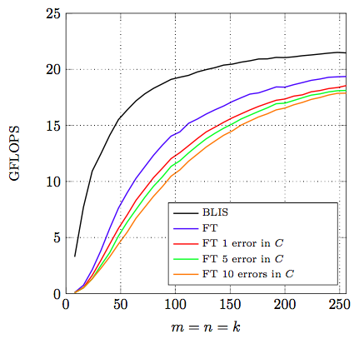
Performance Results
Detecting and correcting errors in C
Single Core
Square matrices
Quantifying cost of corrrecting for small matrices
Notes:
Note that difference between FT and FT 1 error is largely because of the added cost of doing the lazy left checksum

Slide 46
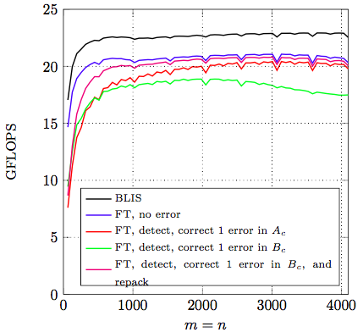
Performance Results
Detecting and correcting errors in A and B
Single Core
K = 256
1 error in A corrupts Nc elements of C
1 error in B corrupts M elements of C
Notes:
Note that difference between FT and FT 1 error is largely because of the added cost of doing the lazy left checksum

Slide 47
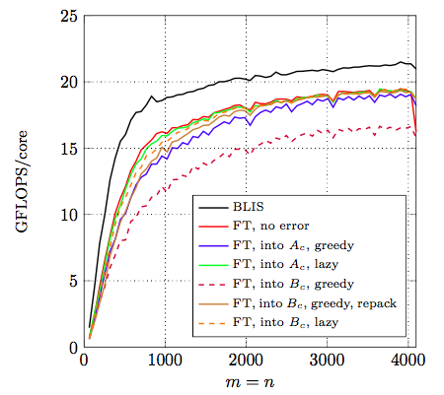
Performance Results
Detecting and correcting errors in A and B
Multi Core
K = 256
1 error in A corrupts Nc elements of C
1 error in B corrupts M elements of C
Notes:
Note that difference between FT and FT 1 error is largely because of the added cost of doing the lazy left checksum

Slide 48
Thank You!
Questions?
tms@cs.utexas.edu

