Slide 1
Generation of SIMD
Dense Linear Algebra Kernels
with Analytical Models
Richard M. Veras, Tze Meng Low & Franz Franchetti
Carnegie Mellon University
Tyler Smith & Robert van de Geijn
University of Texas at Austin
Notes:
TODO: Add references and a bib

Slide 2
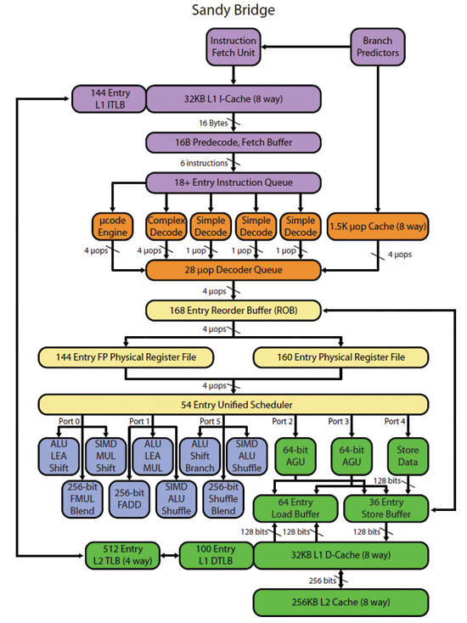
Introduction: What is the problem?
What is our solution
Kernel within a kernel
Enumerating a space of potential implementations for kernel-in-kernel and estimating their theoretical bounds.
Mechanical conversion of that candidate kernel-in-kernel into a high performance implementation (try to get as close to the bounds as we can)
4th loop around micro-kernel
k_{C}
B_{p}
C_{j}
+=
A_{p}
k_{C}
~
Pack B_{p} → B_{p}
3rd loop around micro-kernel
C_{i}
m_{C}
m_{C}
A_{i}
~
B_{p}
+=
~
Pack A_{i} → A_{i}
n_{R}
2nd loop around micro-kernel
~
n_{R}
~
C_{i}
A_{i}
B_{p}
m_{R}
+=
k_{C}
1st loop around micro-kernel
n_{R}
m_{R}
+=
k_{C}
micro-kernel
main memory
1
L3 cache
+=
L2 cache
1
L1 cache
registers
Notes:
## How do we take the micro kernel on the left and implement it to run efficiently on the thing on the right?
What is the problem and why is it hard
Implementing the last mile for a high performance dgemm. BLIS reduced it to a small kernel, low et al showed how those remaining parameters can be determined, this work shows how to actually implement it.

Slide 3
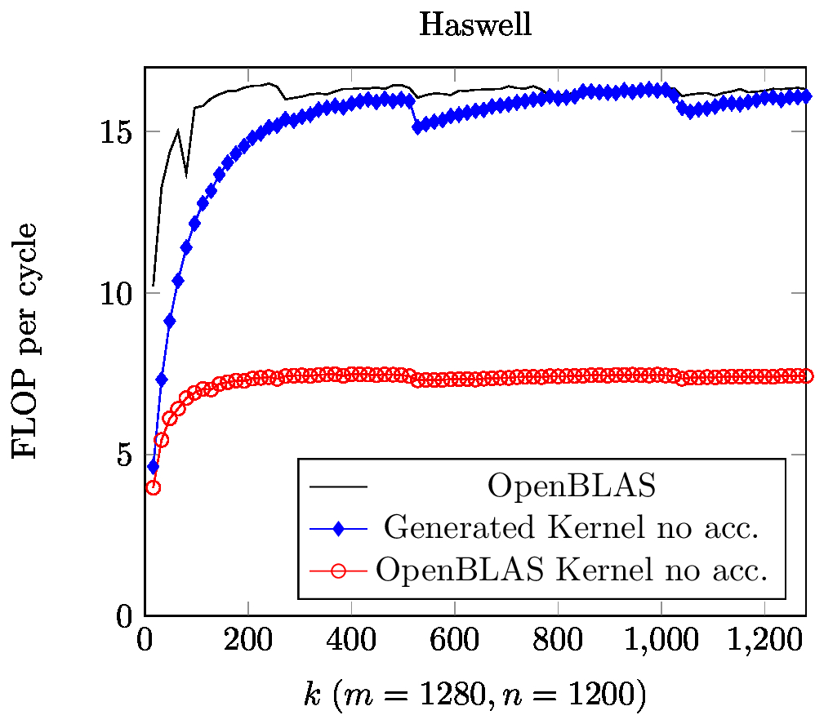
Introduction: What is our Solution
Kernel within a kernel
An approach for finding high performance candidate implementations.
A mechanical method for transforming that candidate into a high performance implementation.
Notes:
What is our solution
Kernel within a kernel
Enumerating a space of potential implementations for kernel-in-kernel and estimating their theoretical bounds.
Mechanical conversion of that candidate kernel-in-kernel into a high performance implementation (try to get as close to the bounds as we can)

Slide 4
Overview
Introduction
Background
Kernel within a kernel
Candidate Components that cover the kernel
Implementation: Reaching theoretical performance
Keeping the non-obvious bottlenecks away
Statically scheduling to deal with the remaining bottlenecks
Results and Analysis
Summary

Slide 5
Background: A kernel for the BLIS kernel
B0
B1
B0
B1
mc
A0
C00
C01
A0
LDA
LDB
MUL
ADD
---
PERM
MUL
ADD
Outer Product
+=
A1
C10
C11
A1
Notes:
We treat SIMD registers as another level of cache.
We know we have an outer product that we want to implement with SIMD instructions. What are these instructions. Will have lda ldb perm fma
Want high perf so all we need is outer-product, how do we do it?
TODO: MR NR
TODO: Easy Outer-Product to vector instructions.
The more we reduce the problem the less we have to focus and the easier it is to concentrate our efforts (to discover what needed to be done) to implement the kernel.
The Outer product is the kernel and this Is where we have to spend out effort.
PIC: Micro kernel to outer product

Slide 6
Background: Outer Product to Component
LDB
LDB
B0
B1
B2
B3
B0
PERM
LDA
LDA
A0
B0
A0
B0
B1
B3
B2
A1
B0
A1
B1
B0
B2
B3
PERM
A2
B0
A2
B2
B3
B1
B0
A3
B3
FMA
A3
B0
B2
B0
B1
00
00
01
03
02
10
11
10
12
13
FMA
20
22
23
21
20
30
33
32
30
31
Notes:
Each one of these instruction blocks encodes some sort of action
We identified what we need, how do we get closer to implementing it?
We want to pick something that will give us a high theoretical peak and then we will spend the rest of our effort trying to get that peak
We know we will need to use vector instructions
We enumerate a myriad of outer product like operations using a handful of vector instructions (load A, load/perm B, Multiply, Add)
We determine how will tile our original outer product with these by estimating the best.
PIC: Options for components and how we cover the outer product.

Slide 7
Implementing in context of the kernel
B0
B1
B2
B3
A0
A1
LDA
LDB
MUL
ADD
-->
PERM
MUL
ADD
-->
PERM
MUL
ADD
-->
PERM
MUL
ADD
A2
A3
A4
LDA
vvv
MUL
ADD
-->
vvv
MUL
ADD
-->
vvv
MUL
ADD
-->
vvv
MUL
ADD
A5
A6
A7
Notes:
We want to cover our outer product with components that would give us a high theoretical peak
We know we have a class of components to choose from, how do we pick the best?

Slide 8
Implementing a High Performance Kernel
Remove any obstacles that will place the bottleneck anywhere but the multiply-add units..
Statically schedule what we have to insure that multiply-add instructions retire at the predicted peak rate.
Notes:
We want a high performance implementation of an outer-product and now we have the starting point (components) with a bounds on the potential performance, now how do we get there? How do we insure that we achieve the performance set by those bounds?
We have two steps here, we need to pick the remaining instructions and how we use them, and we need to schedule our instructions selection.
OOO picture: Our model hinges on the Execute Engine being the bottleneck, so we cannot break that assumption. The model only sets a bound, so we need do the best that we can to keep the Multiply-Add units filled.
We want a high performance implementation of an outer-product and now we have the starting point (components) with a bounds on the potential performance, now how do we get there? How do we insure that we achieve the performance set by those bounds?
We have two steps here, we need to pick the remaining instructions and how we use them, and we need to schedule our instructions selection.
OOO picture: Our model hinges on the Execute Engine being the bottleneck, so we cannot break that assumption. The model only sets a bound, so we need do the best that we can to keep the Multiply-Add units filled.

Slide 9
Implementation: Avoiding Bottlenecks
Picking Instructions with shorter encodings:
vmovapd 66 41 0f 28 c0
vmovaps 0f 28 47 c0
Keeping Offsets between -128 and 127:
add 0x40, rdi 48 83 c7 40
add 0x100,rdi 48 83 c7 00 01 00 00
Using Low Number Registers:
addpd xmm0,xmm8 66 44 0f 58 c0
addpd xmm0,xmm1 66 44 59 c8
Notes:
Our approach requires that only the FMA is the bottleneck, so we must take care of some implementation details that prevent the Fetch-Decode stage from being the bottleneck. So we operate within the bounds of the path <← Key Idea
PIC: OOO Highlight Fetch
Code: Picking VMULPS over VMULPD
Code: Computing Address within bounds
Code: using low numbered registers.

Slide 10
Statically Scheduling Instructions
// Prolog:
READ(0)
READ(1) ADD(0)
---- ADD(1) READ(2)
// Steady State:
for(p = 3; p < K; p++ )
WRITE(p-3) ---- ADD(p-1) READ(p)
// Epilog:
---- WRITE(K-2) ---- ADD(K-1)
---- ---- ---- ----
---- ---- ---- WRITE(K-1)
We have the vector instructions that will get us the bounds we would like, we have tweaked those instructions so that we are still bounded by the multiply-add, now we have to do the last mile of insuring that instruction stalls do not prevent us from executed at the peak rate of our floating point unit.
Static scheduling is necessary to prevent stalls, even on OOO, because it helps us hide bubbles that occur as the processor is computing near peak.
TO do this is we need to manage our usage of registers
We need to break components down into pieces that can be scheduled. Then we need to schedule the component as a whole.
for(p = 0; p < K; p++ )
r1 = a[p] // 1 cycle
r2 = r1+1 // 2 cycles
a[p] = r2 // 1 cycle
RD
s
Clock Cycle
1
2
3
4
ADD
s
s
WR
LD ALU WR
5
LD ALU WR
6
LD ALU WR
7
[Lam, 1988]
LD ALU WR

Slide 11
Managing our Usage of Registers
LDA
LDB PERM
MUL MUL
ADD ADD
PERM PERM
MUL MUL
ADD ADD
LDA
LDB
MUL
ADD
-->
PERM
MUL
ADD
-->
PERM
MUL
ADD
-->
PERM
MUL
ADD
LDA
vvv
MUL
ADD
-->
vvv
MUL
ADD
-->
vvv
MUL
ADD
-->
vvv
MUL
ADD
LDA
MUL MUL
ADD ADD
MUL MUL
ADD ADD
Notes:
Static scheduling requires extra registers that are already at a premium. We have to figure out how to partially update our outer-product while still being able to schedule the instructions to hide their latency.
We need to figure out how many pieces of the component that we can compute simultaneously with the registers that we have
PIC: Breaking up a component into Partial Components
FORM: Equation for how many component

Slide 12
Scheduling the Partial Components
LDA
LDB
PERM
MUL
MUL
ADD
ADD
// Code
ADD
MUL
PERM
LDA
MUL
MUL
ADD
ADD
PERM
PERM
MUL
MUL
ADD
ADD
MUL
MUL
ADD
ADD
LDA
LDB
PERM
MUL
MUL
ADD
ADD
LDA
MUL
MUL
ADD
ADD
PERM
PERM
MUL
MUL
ADD
ADD
MUL
MUL
ADD
ADD
Notes:
We know how much work we can do simultaneously, so we use what few registers we have to interleave their operations and hide their latency.
Pic: Break component into Sub Components
Pic: stack them in SWP fashion

Slide 13
Overview
Introduction
Background
Kernel within a kernel
Candidate Components that cover the kernel
Implementation: Reaching theoretical performance
Keeping the non-obvious bottlenecks away
Statically scheduling to deal with the remaining bottlenecks
Results and Analysis
Summary

Slide 14
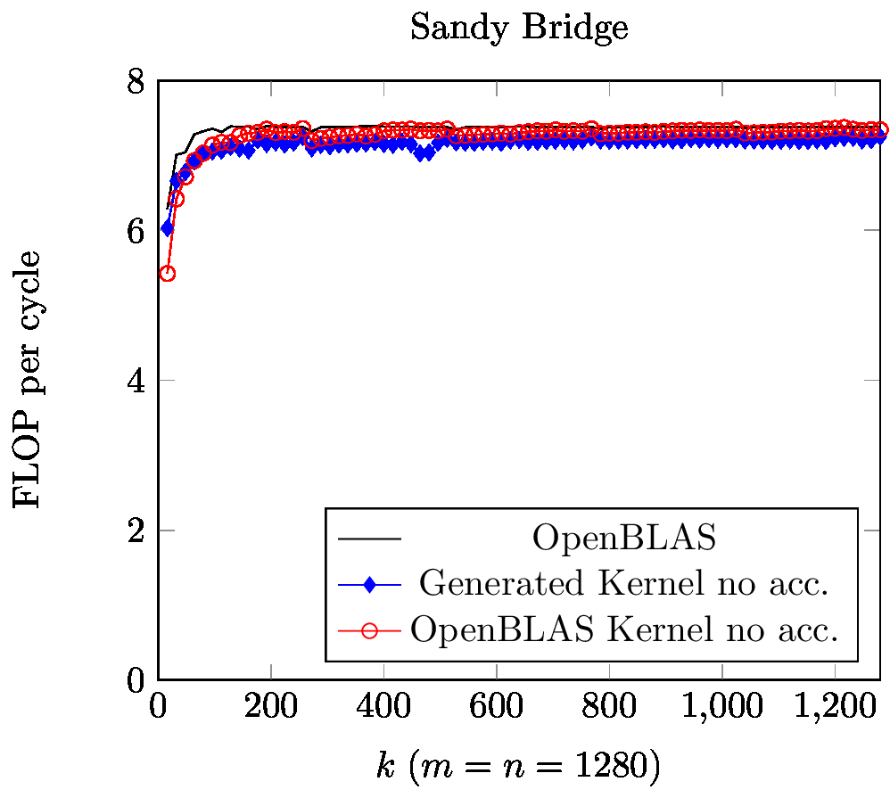
Sequential Results: HSW and SNB

Slide 15
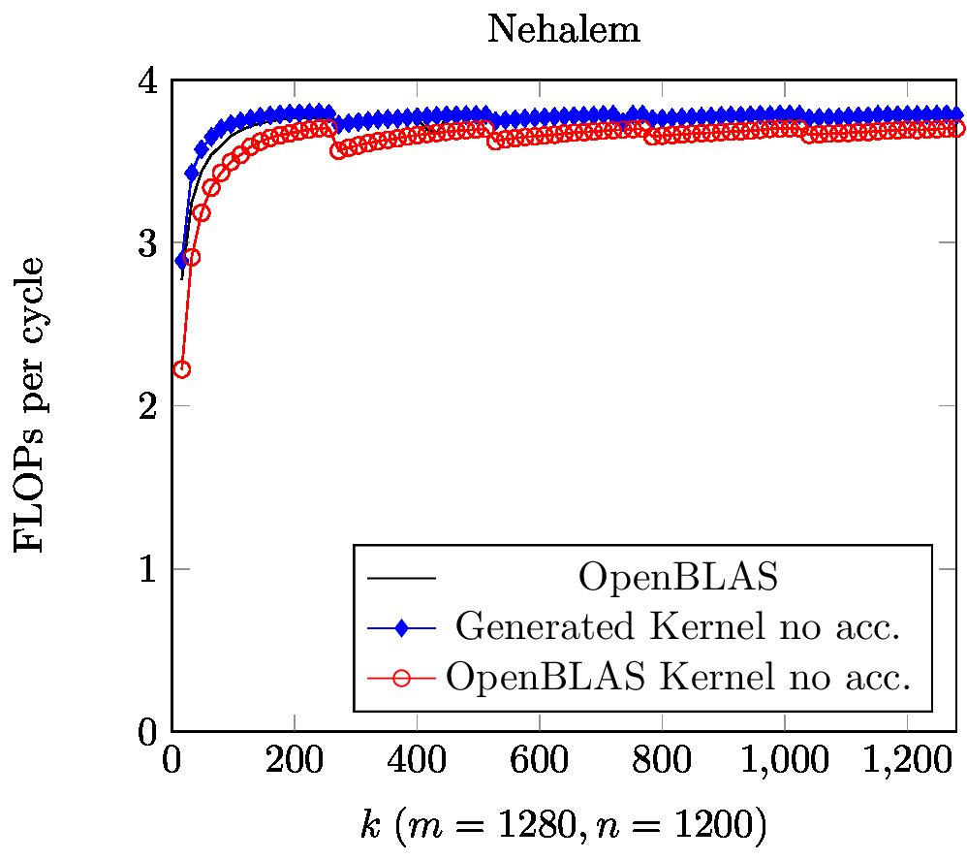
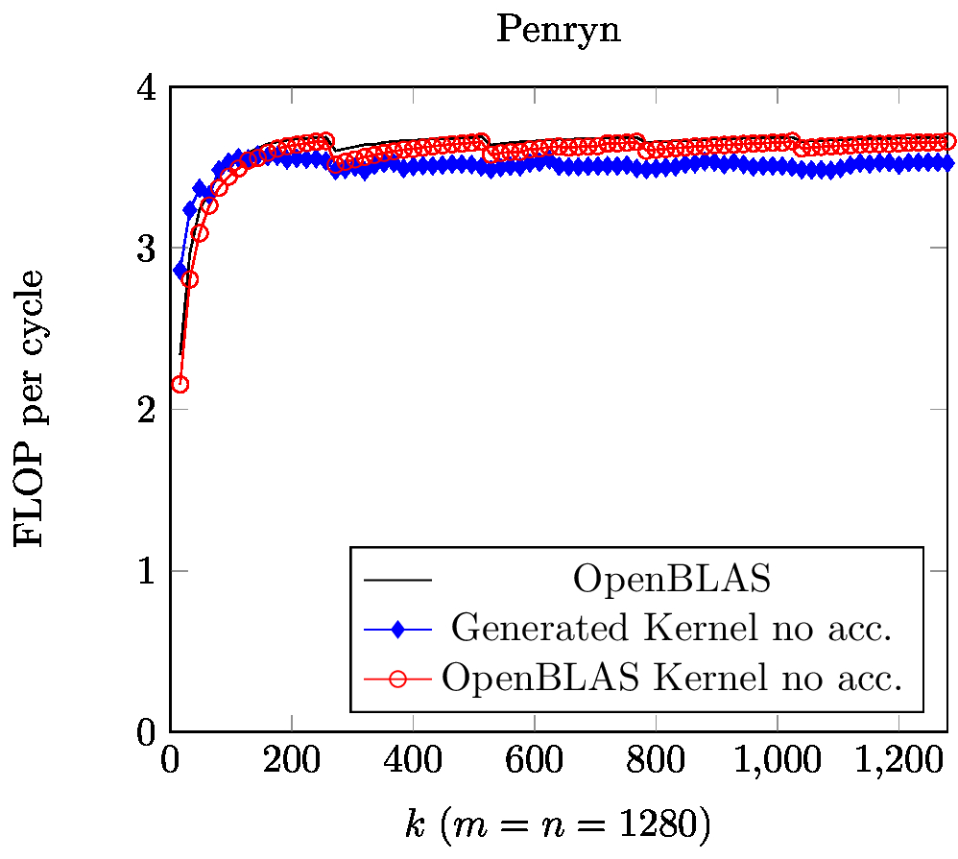
Sequential Results: NEH and PEN

Slide 16
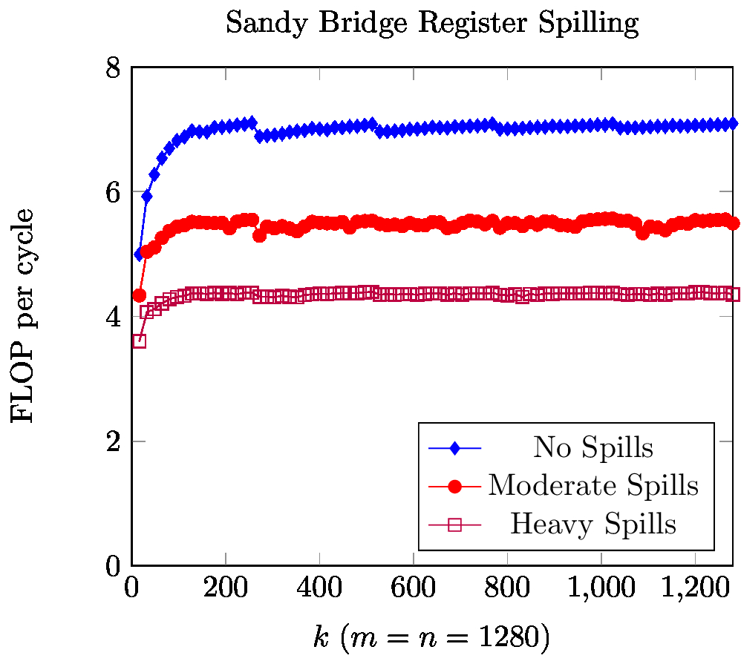
Spilling Results
Notes:
Spilling really has to be avoided because the performance hit extends beyond the kernel.

Slide 17
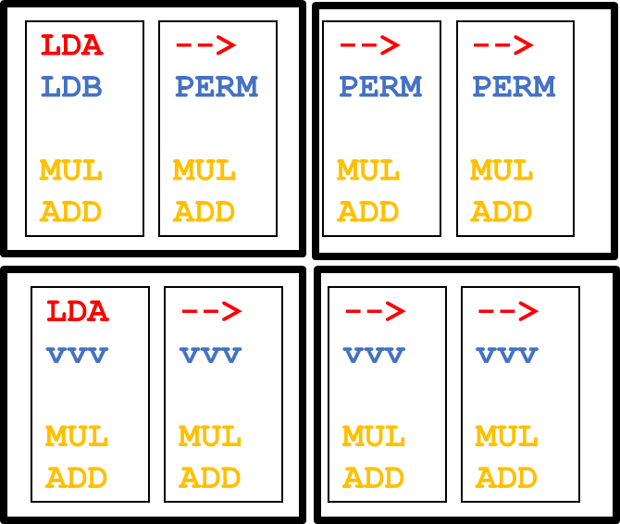
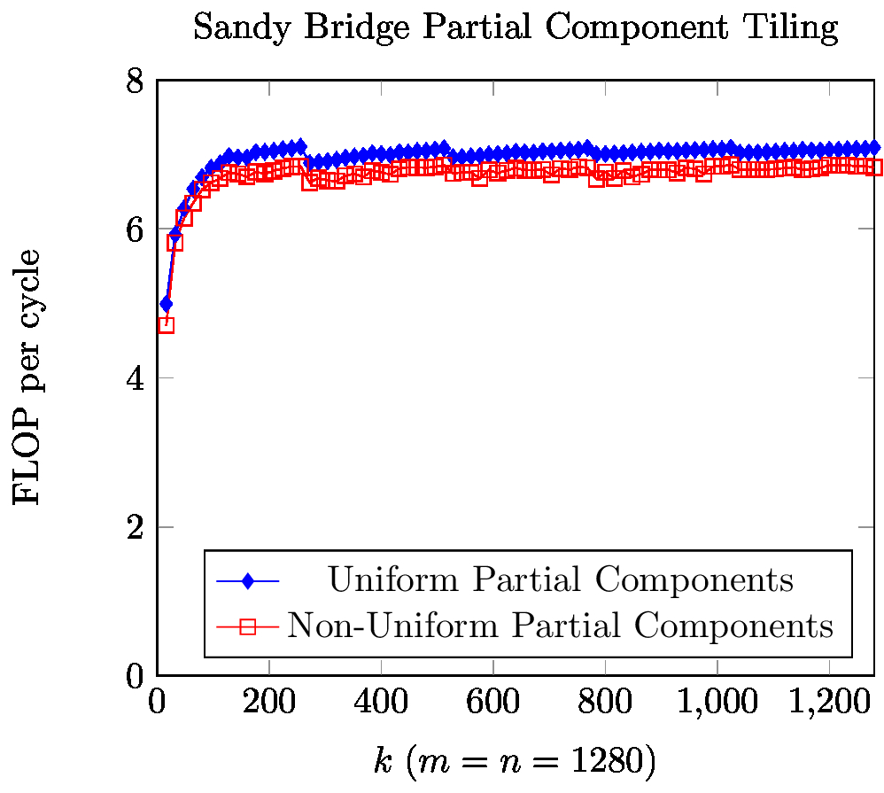
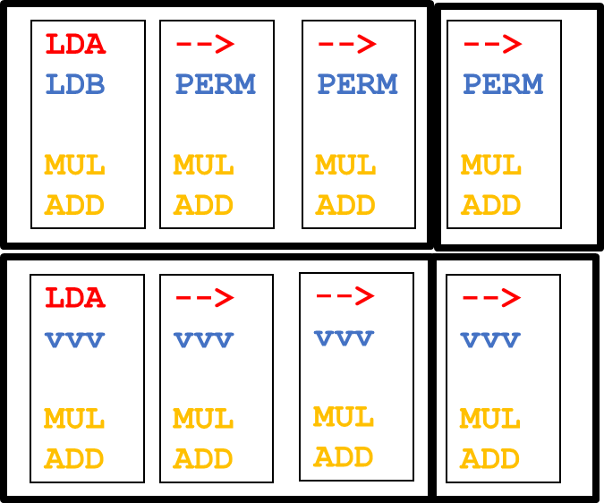
Partial Component Shape
LDA
LDB
MUL
ADD
-->
PERM
MUL
ADD
-->
PERM
MUL
ADD
-->
PERM
MUL
ADD
LDA
vvv
MUL
ADD
-->
vvv
MUL
ADD
-->
vvv
MUL
ADD
-->
vvv
MUL
ADD
Versus
LDA
LDB
MUL
ADD
-->
PERM
MUL
ADD
-->
PERM
MUL
ADD
-->
PERM
MUL
ADD
LDA
vvv
MUL
ADD
-->
vvv
MUL
ADD
-->
vvv
MUL
ADD
-->
vvv
MUL
ADD
Notes:
TODO: Show the shape
All other things constant turns out even shapes are good for the decoder

Slide 18
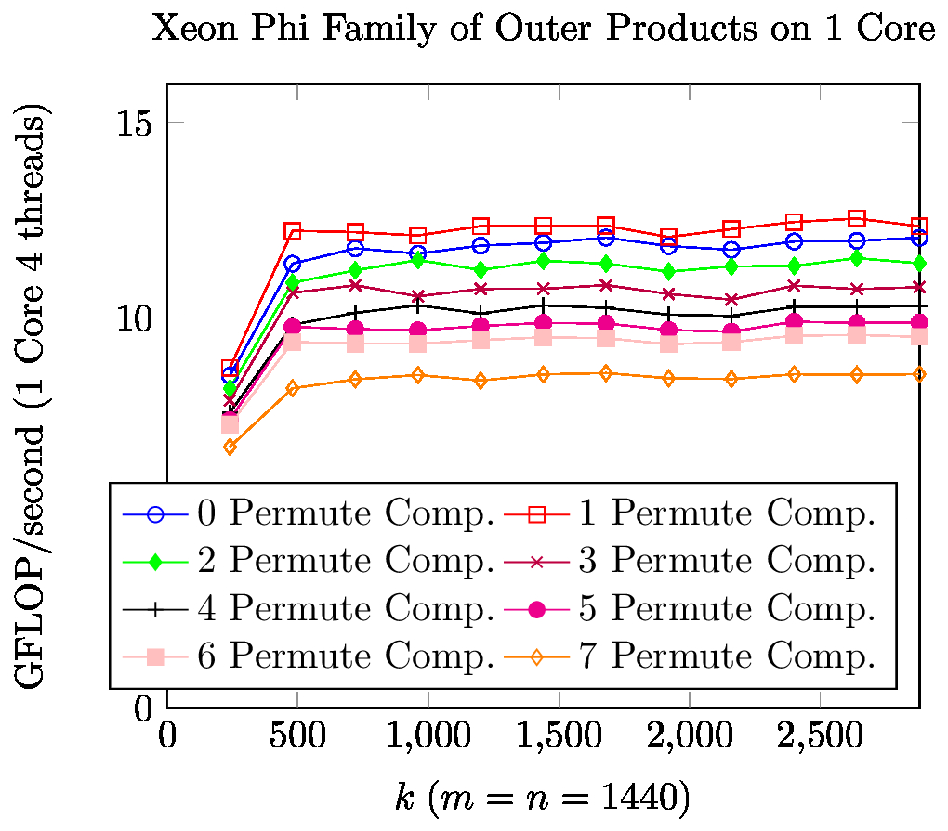
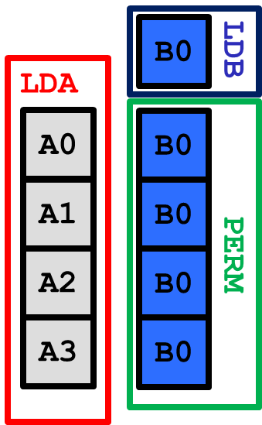
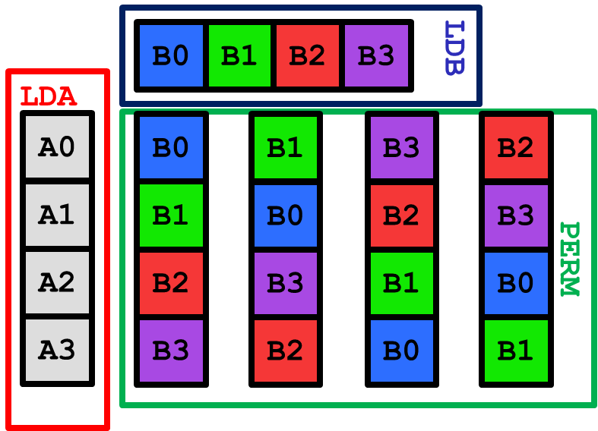
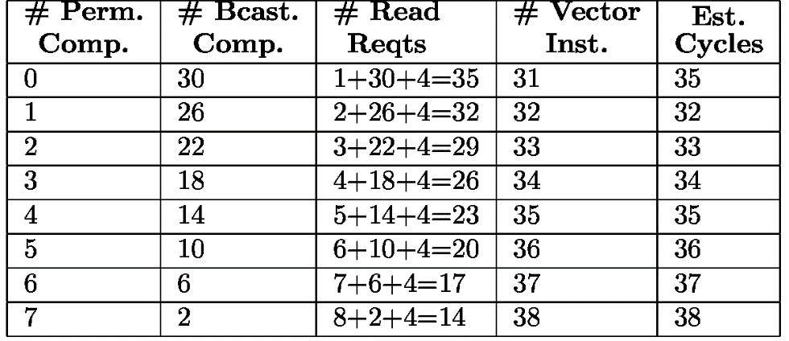
Instruction Selection Model
Notes:
TODO: Draw BCAST and PERM component
Heterogeneously tiled outer-products are necessary for weird accelerators, and out model does a fairly accurate job at getting the relative performance correct.
Model Sets the upper bounds

Slide 19
Moving Forward
We wanted to take the mystery out of implementing high performance Blis kernel using the double precision outer-product kernel within the micro-kernel
Look at other options and data types
Capture all other architectures because of recurring motifs.

Slide 20
Summary
Distill to kernel in a kernel
Determined how we estimate the best theoretical options
Show how we can mechanically turn that selection into an implementation
Presented options for the future

Slide 21
Background: BLIS
4th loop around micro-kernel
Outer Product
k_{C}
B_{p}
C_{j}
+=
A_{p}
+=
k_{C}
~
Pack B_{p} → B_{p}
3rd loop around micro-kernel
C_{i}
m_{C}
m_{C}
A_{i}
~
B_{p}
+=
~
Pack A_{i} → A_{i}
n_{R}
2nd loop around micro-kernel
~
n_{R}
~
C_{i}
A_{i}
B_{p}
m_{R}
+=
k_{C}
1st loop around micro-kernel
n_{R}
m_{R}
+=
k_{C}
micro-kernel
main memory
1
L3 cache
+=
L2 cache
1
L1 cache
registers
Notes:
How do we fit in this bigger picture?
-

Slide 22
The Tools we Have to Work With
LDB
LDB
B0
B1
B0
B1
LDA
PERM
LDA
PERM
A0
A0
B0
B1
A1
A1
B1
B0
FMA
FMA
00
00
00
01
10
10
11
10
Notes:
There are a lot of these weird vector instruction mixes and we need to enumerate them

Slide 23
Finding Prime Components
LDB
LDB
B0
B1
B2
B3
B0
PERM
LDA
LDA
A0
B0
A0
B0
B1
B3
B2
A1
B0
A1
B1
B0
B2
B3
PERM
A2
B0
A2
B2
B3
B1
B0
A3
B3
FMA
A3
B0
B2
B0
B1
00
00
01
03
02
10
11
10
12
13
FMA
20
22
23
21
20
30
33
32
30
31
Notes:
What is our Problem?
We want an outer product, but we need to build up from what our isa provides. If we have the atomic outer products, we can reduce our big outer product into smaller ones
What is our Goal?
We want to find the set of all possible prime tiles that can be produced by the ISA that we can later tile into big one
Enumerating Prime Tiles
Basic Case
Butterfly
Everything in between

Slide 24
Enumerating the Possible Tilings
B0
B1
B2
B3
B0
B1
B2
B3
Have this
A0
B0
B1
B2
B3
A0
B0
B1
B3
B2
A1
B0
B1
B2
B3
A1
B1
B0
B2
B3
A2
B0
B1
B2
B3
A2
B2
B3
B1
B0
A3
B0
B1
B2
B3
A3
B3
B2
B0
B1
Notes:
What is our problem?
We want to impl
ment this outer product, We have all of these prime components, but they are smaller than the mrxnr tile that we need!
What is our goal?
We have to find the set of possible tilings of these prime components that give us an outer product.
How do we do it?
We enumerate the possibilities that work. Plain and simple
Show an Example
Prime components that do not fill
Prime components that do fill

