Slide 1
Exploiting BLIS to Optimize LU with Pivoting
Xianyi Zhang
traits.zhang@gmail.com

Slide 2
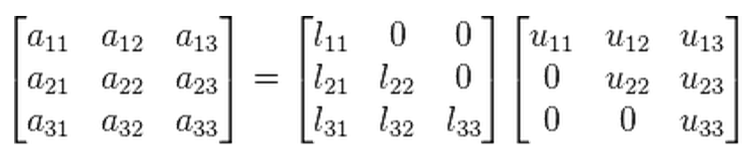
LU factorization
A=LU
Partial Pivoting
  PA=LU, reorder the rows of A
  Numerically stable in practice

Slide 3
Why is LU important?
Solving linear equations
  Ax=b
  PA=LU
  LUx=Pb
  Solve Ly=Pb for y
  Solve Ux=y for x
How does LAPACK implement?

Slide 4
LAPACK implementation
getrf
  Blocked algorithm
  BLAS3
    gemm, trsm
getf2
  Unblocked
  BLAS2 and BLAS1

Slide 5
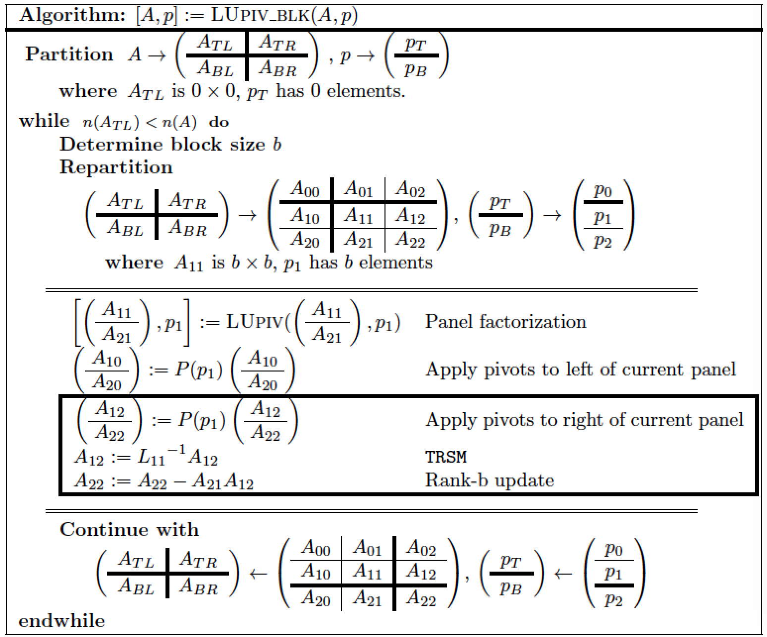
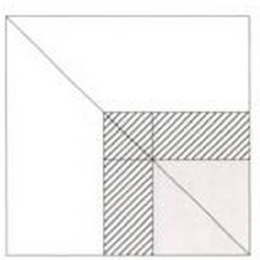
LAPACK implementation
Right looking blocked algorithm (getrf)

Slide 6
Naive implementation
Compile BLIS with BLAS compatibility layer
Compile LAPACK
Link LAPACK with BLIS
Done! ☺

Slide 7
Thank you for your attention

Slide 8
Thank you for your attention
How about performance?

Slide 9
Naïve implementation Performance
dgetrf, double real, single thread
Testbed
  Intel Xeon E5-2680 (2.7 GHz, Turbo 3.5 GHz)
  Ubuntu 14.04
  gcc and gfortran 4.8.2
Input Matrix
  Square matrices
  100-5000, step 100
Tune NB block size
  NB 128

Slide 10
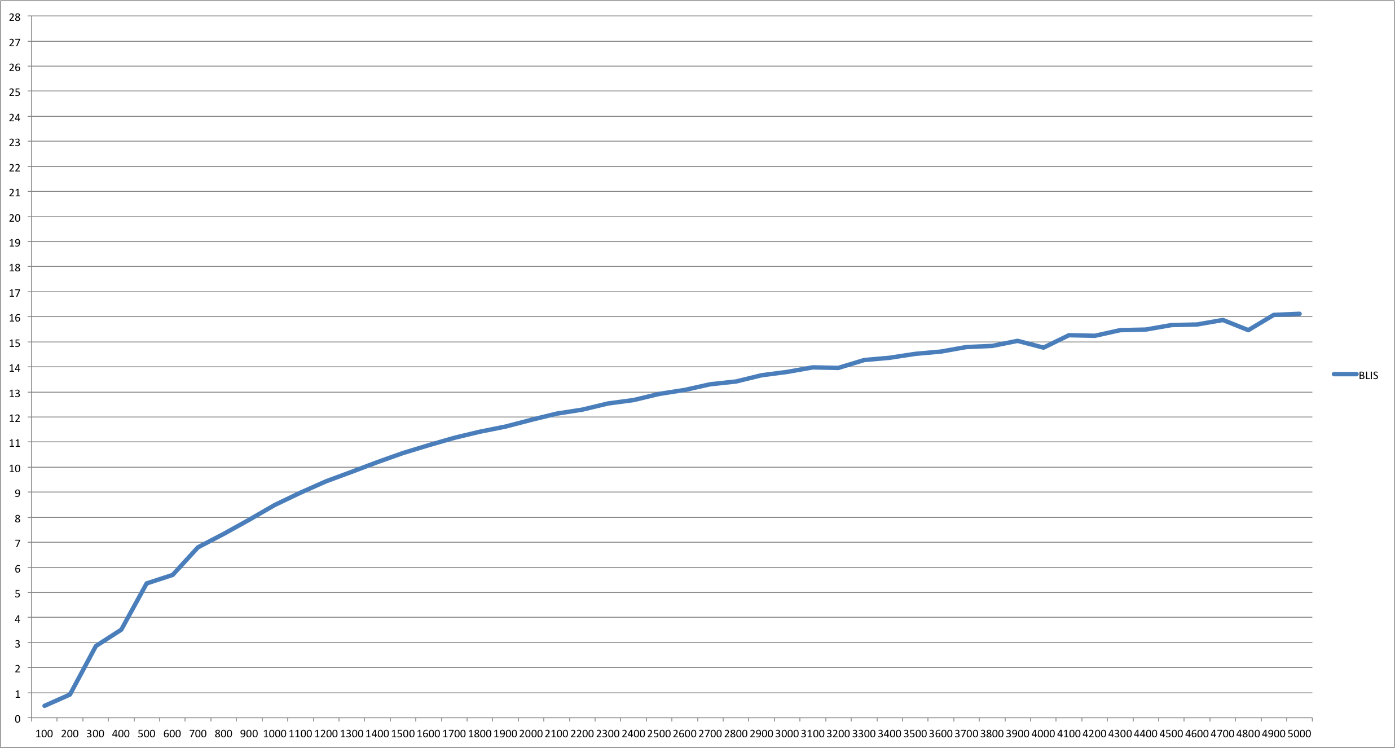
Naïve implementation Performance
Notes:
Achieve 57.5% of peak performance.

Slide 11
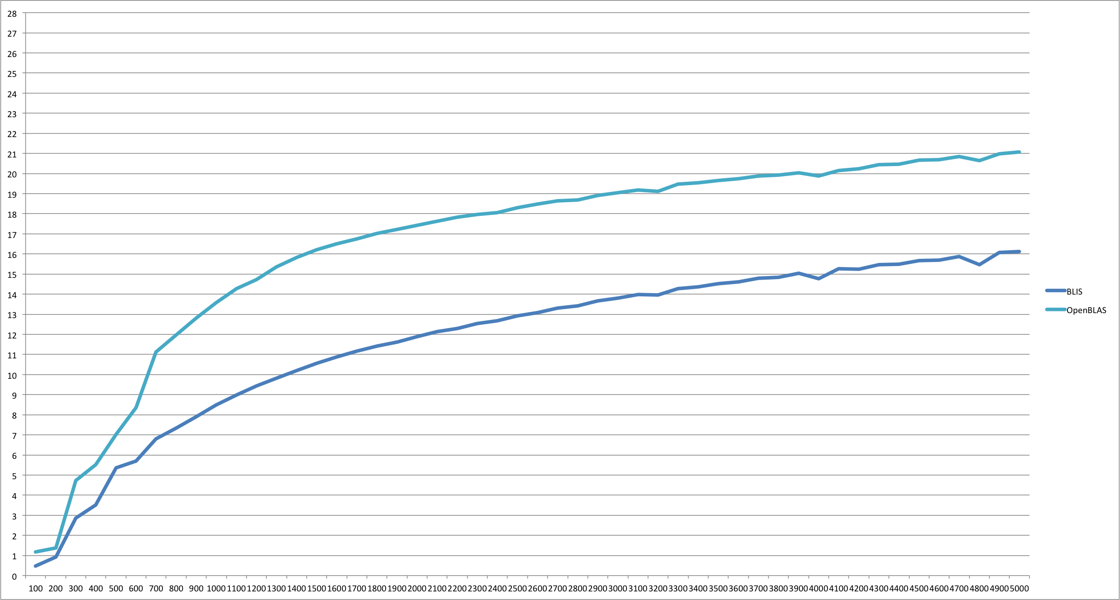
Naïve implementation Performance
Compare with LAPACK+OpenBLAS

Slide 12
Why?
Profiling
  One step in LU
 | BLIS (second) | OpenBLAS (second)
DTRSM | 0.010 | 0.009
DGEMM | 0.209 | 0.192
DGETF2 | 0.086 | 0.032

Slide 13

GETF2 panel factorization
Right looking unblocked
  trsm->scal
  Rank-b update -> Rank-1
    ger

Slide 14
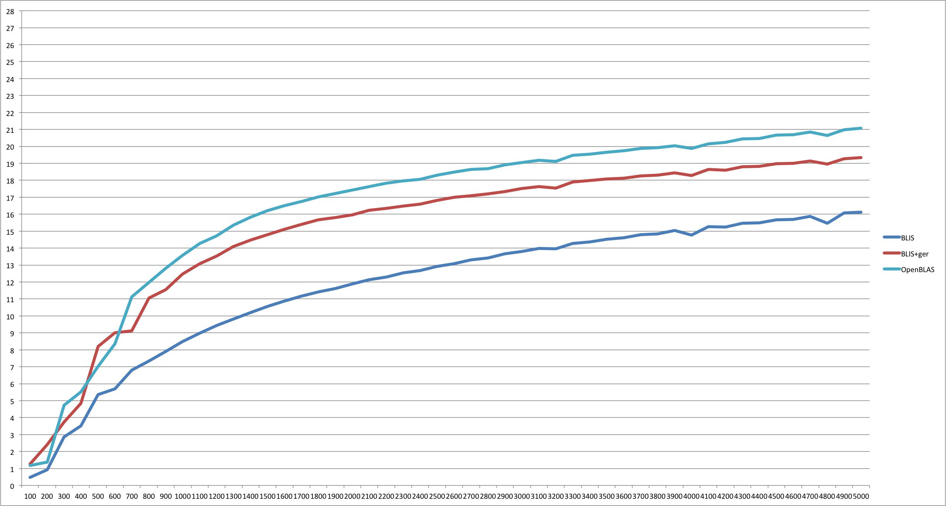
Performance
BLIS+Optimized GER (NB 188)
Notes:
Improve about 20%.

Slide 15
What’s the best NB?
Input NxN matrix
BLAS3
 | m | n | k
TRSM | NB | N-NB | NB
GEMM | N-NB | N-NB | NB

Slide 16
The gemm algorithm
+=

Slide 17
The gemm algorithm
NC (e.g. 4096 on Sandy Bridge)
NC
NC
+=

Slide 18
The gemm algorithm
+=

Slide 19
The gemm algorithm
KC (e.g. 256 on Sandy Bridge)
KC
KC
+=

Slide 20
The gemm algorithm
+=
 | m | n | k
GEPP | N-NB | NC (4096) | KC (256)
GEMM in LU | N-NB | N-NB | NB (188)
NB=n*KC (n=1,2…) for better performance

Slide 21
Limits of Panel factorization
Getf2 (N, NB…)
  BLAS 2/1
  Very slow compared to blocked implemenation
  NB as small as possible

Slide 22
Recursive Panel factorization
Factor NxNB panel by blocked

Slide 23
Recursive Panel factorization
Factor NxNB panel by blocked
  Block size: NB/2

Slide 24
Recursive Panel factorization
Recursive factor Nx(NB/2) panel

Slide 25
Recursive Panel factorization
Recursive factor Nx(NB/2) panel
  Block size: NB/2/2

Slide 26
Recursive Panel factorization
Recursive …
  Stop when nb is small
  Call unblocked algorithm (getf2)

Slide 27
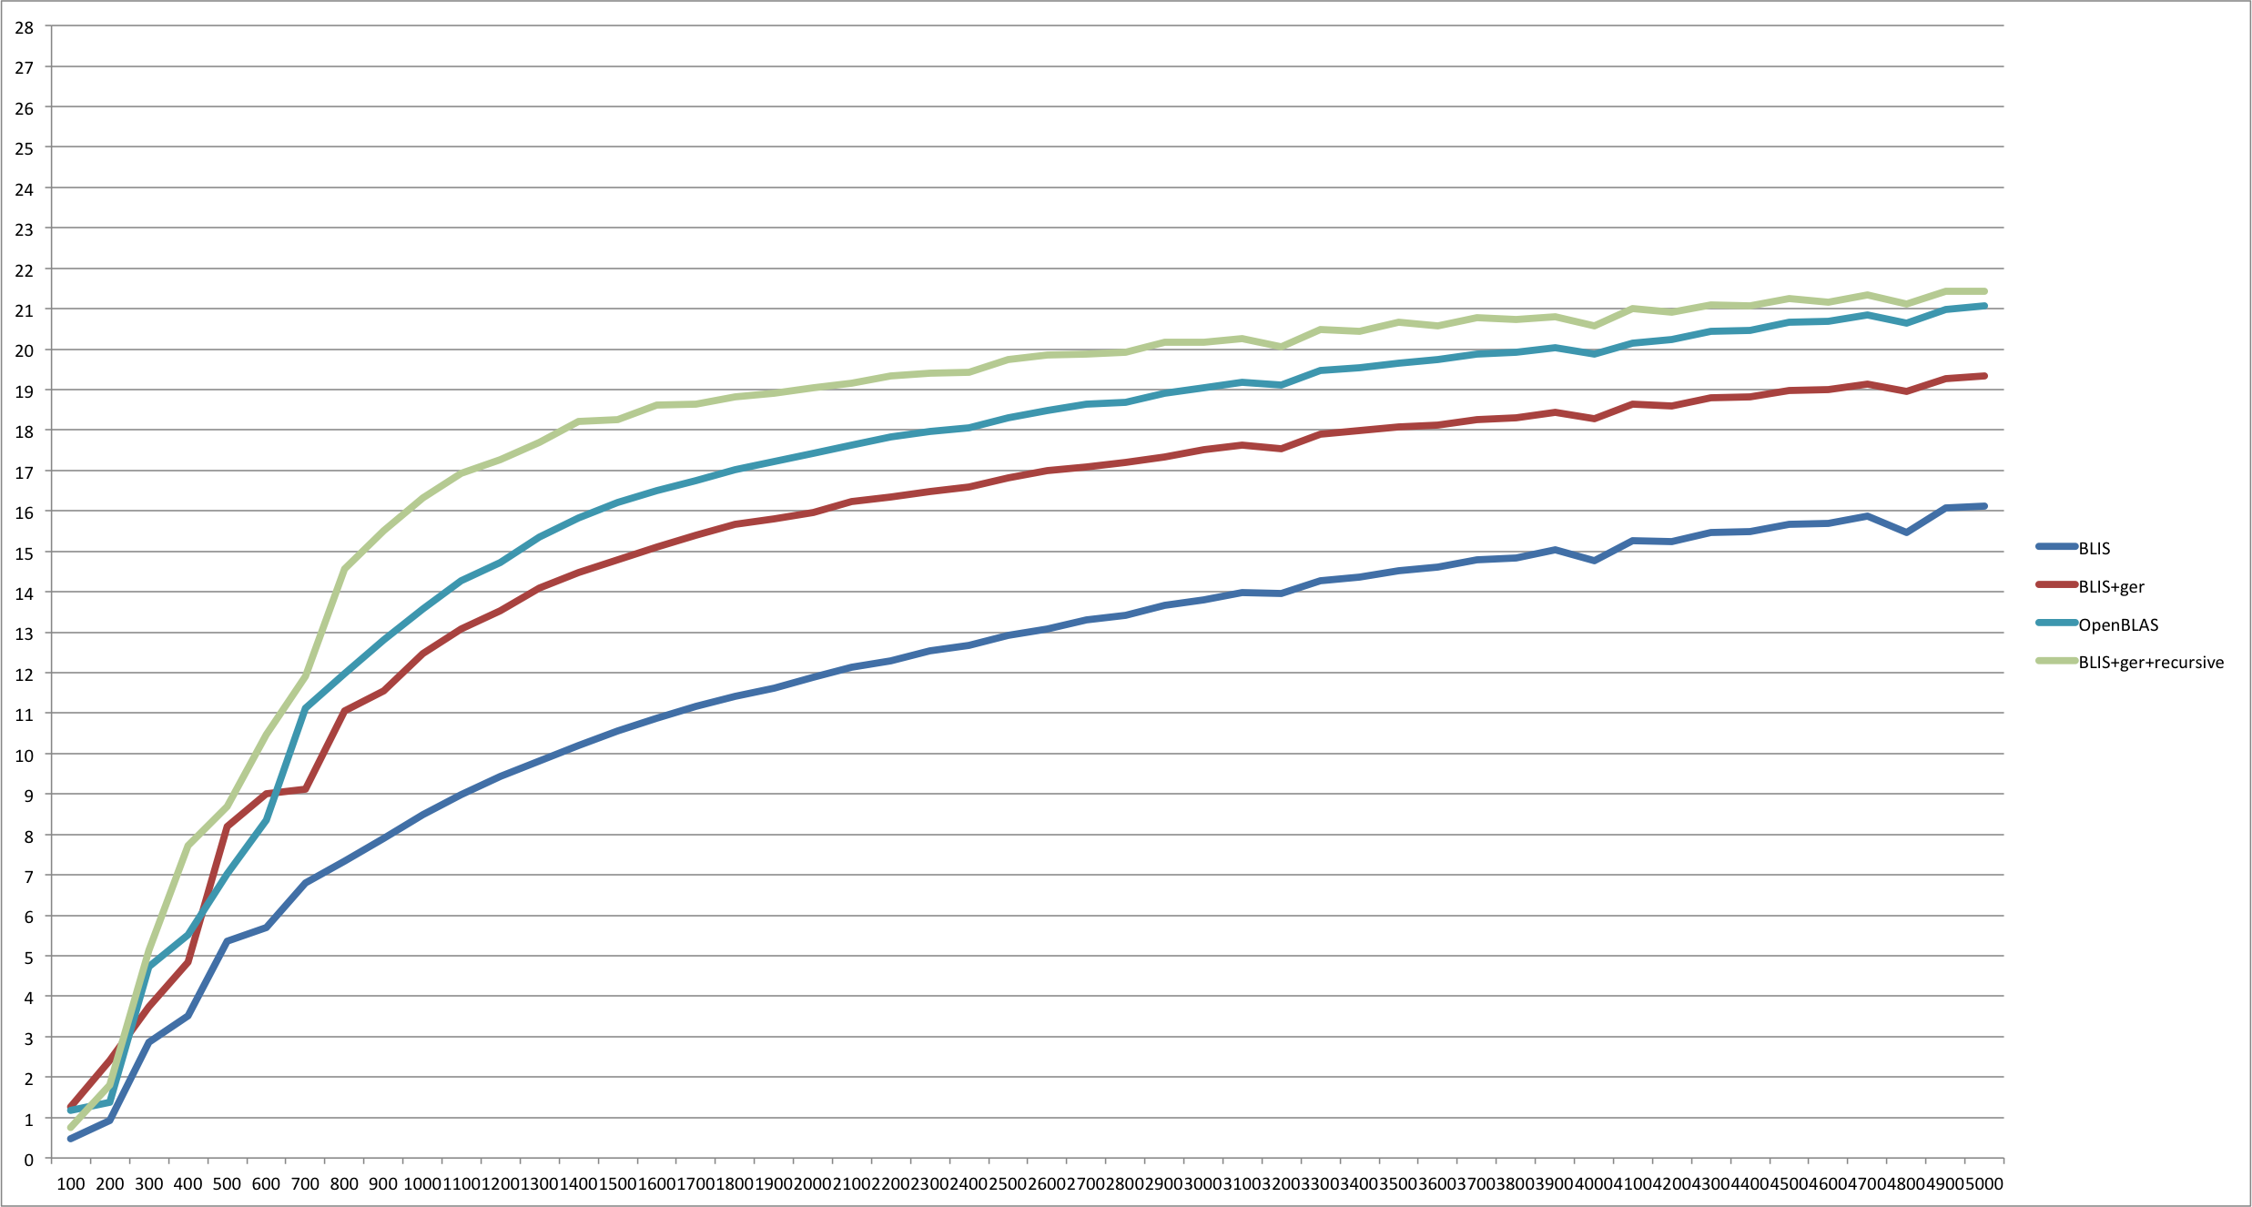
Performance
BLIS+Optimized GER+Recursive Panel
Notes:
Improve 10%.

Slide 28
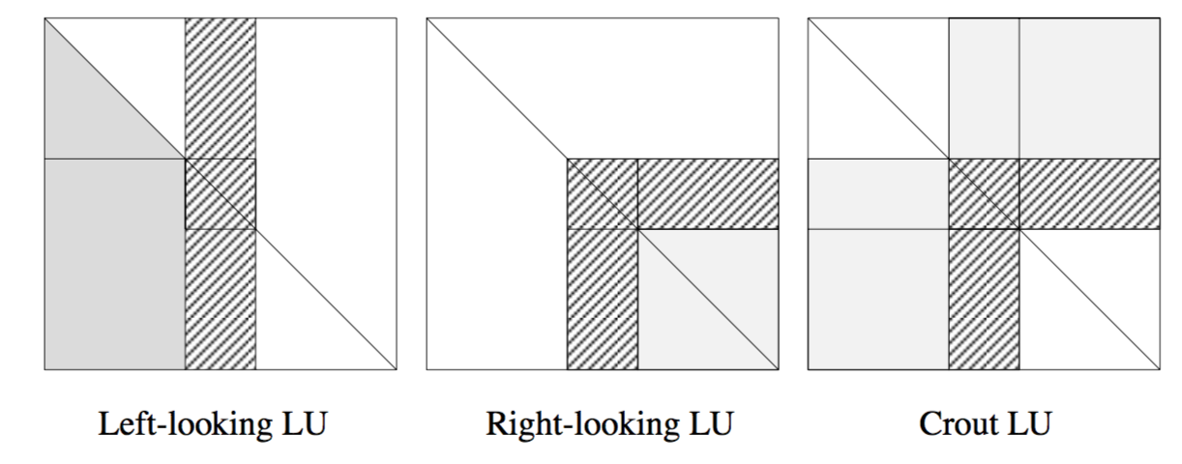
Revisit getf2 implementation
Left-looking, fewer memory accesses

Slide 29
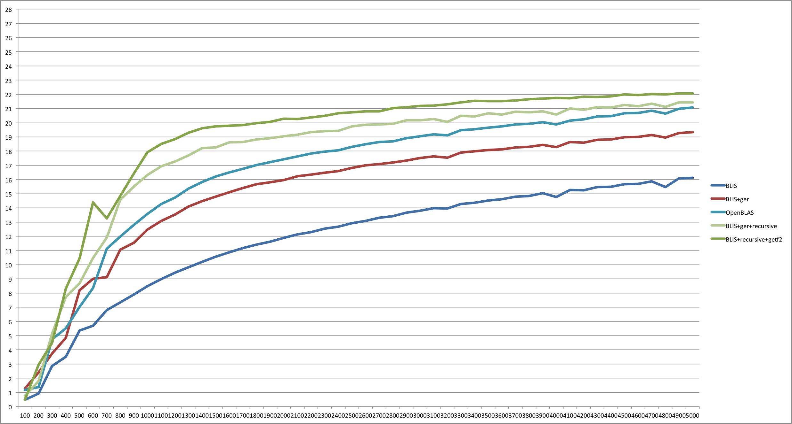
Performance
BLIS+Recursive+Left looking Getf2
Notes:
For small matrix, it can improve about 10%. For large matrix, it can improve 3%

Slide 30
Pivoting and trsm

Slide 31
The gemm algorithm
+=

Slide 32
The gemm algorithm
+=
Pack row panel of B

Slide 33
The gemm algorithm
+=
Pack row panel of B
NR

Slide 34
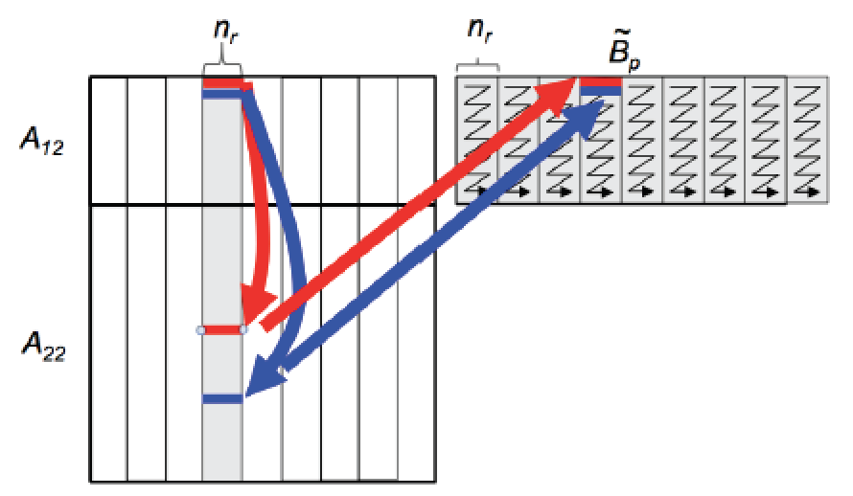
Merge swap and trsm packing

Slide 35
Merge trsm and gemm
Reuse packed B
Packed B

Slide 36
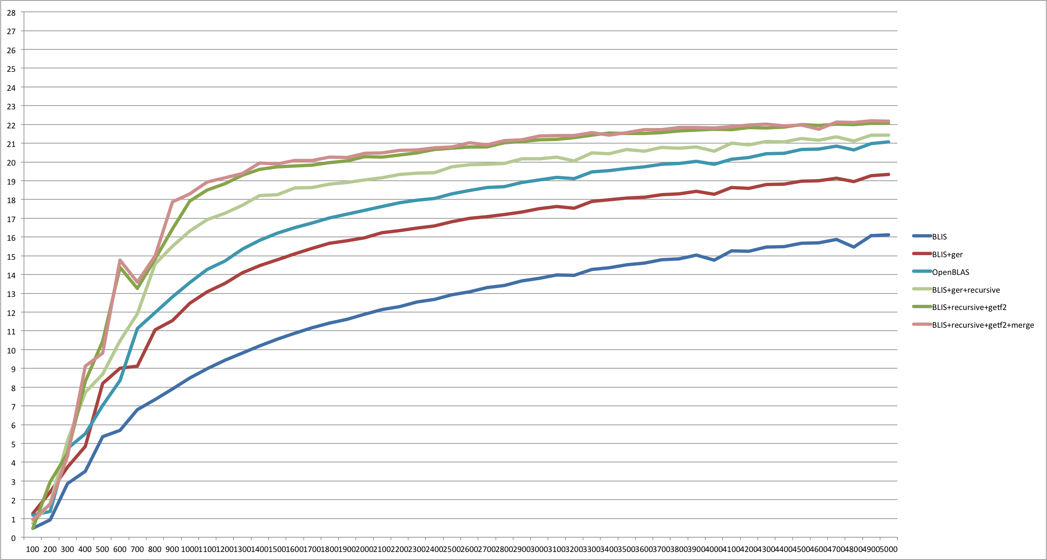
Performance
BLIS+Recursive+Getf2+Merge
Notes:
Improve the performance up to 2.7% on small matrices. For large matrix, the improvement is less than 1%.

Slide 37
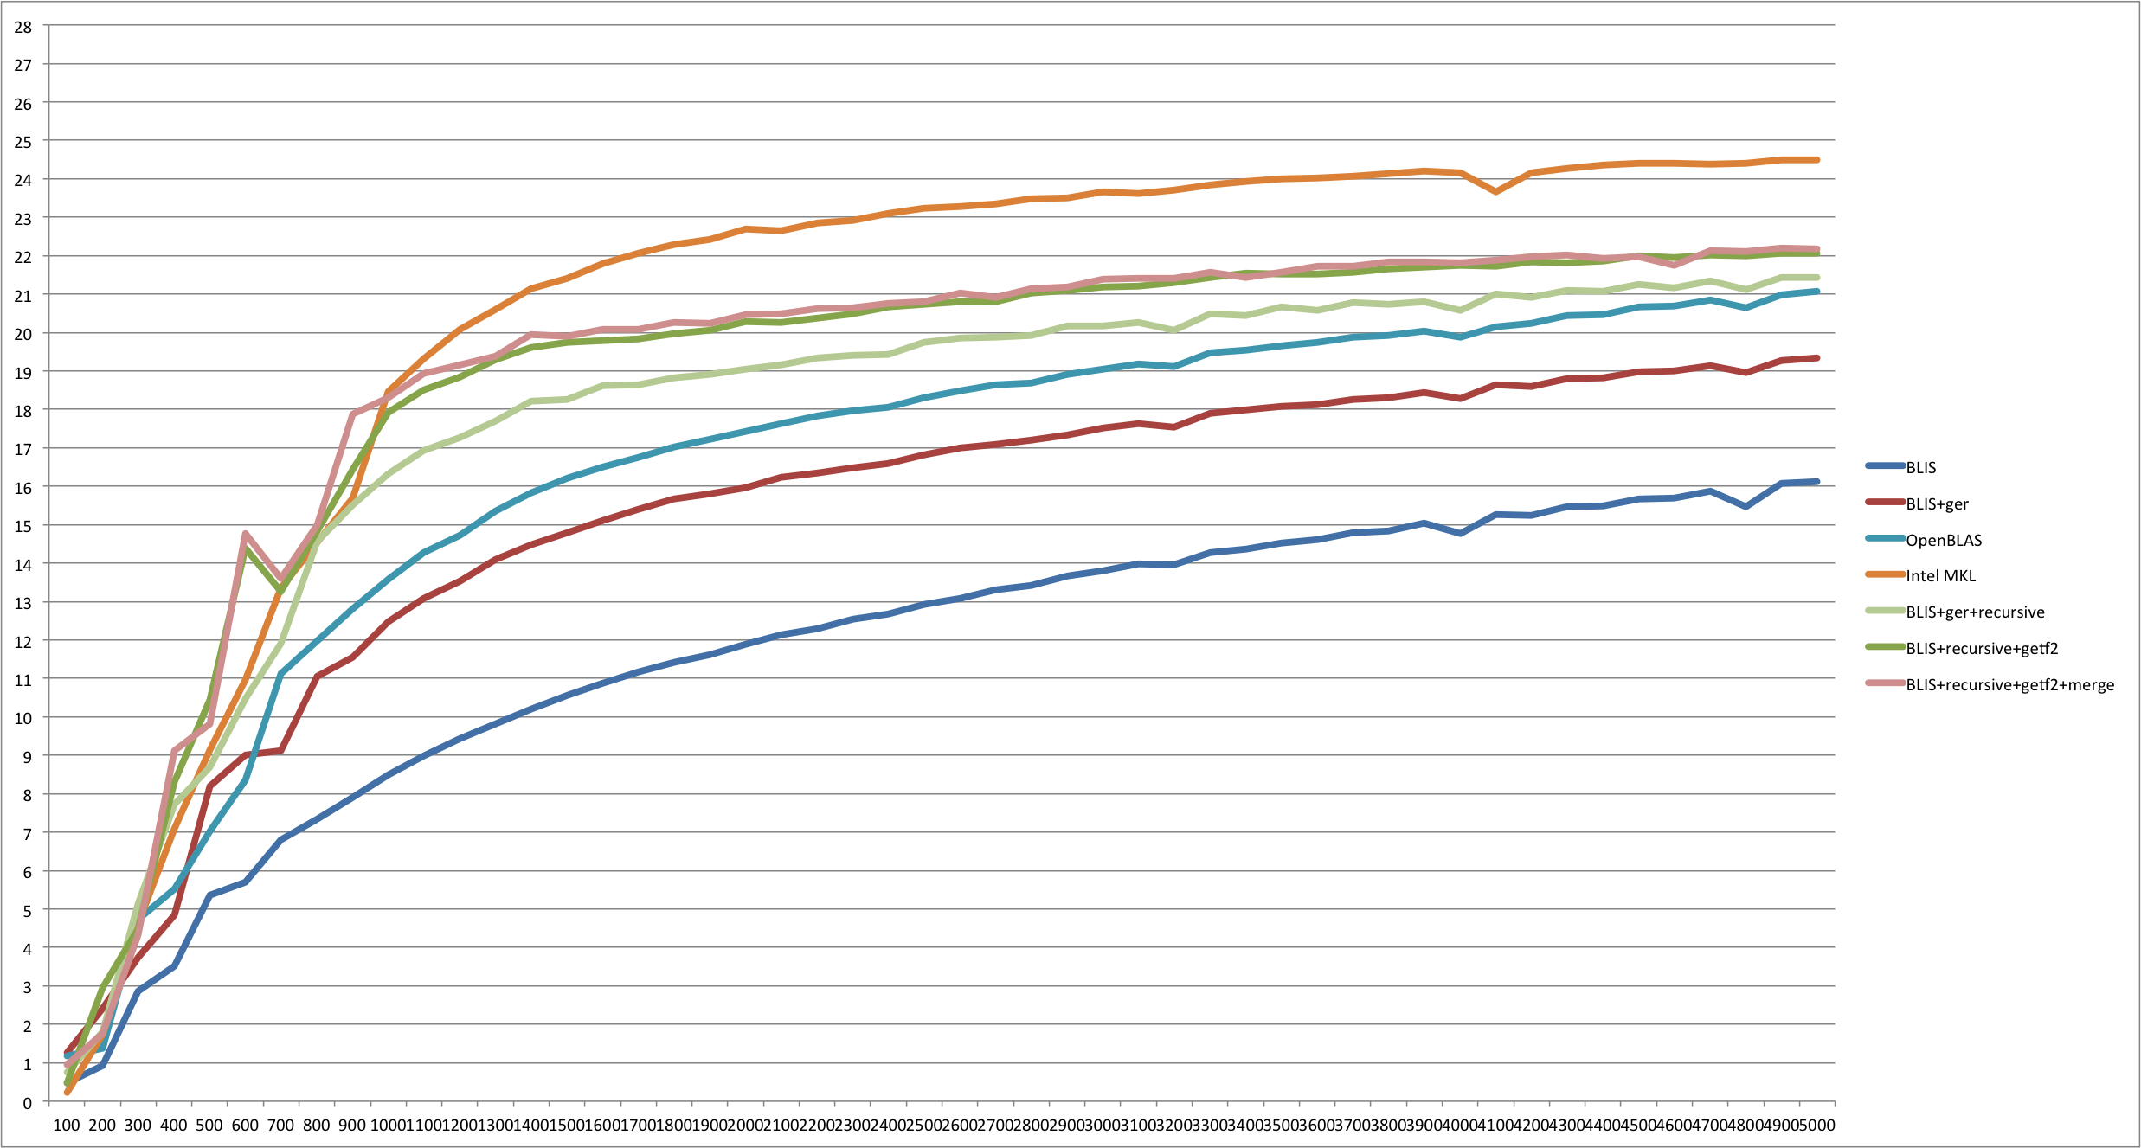
Performance
Intel MKL 11.2

Slide 38
Performance Gap
Large matrix
  ~10%
  BLAS3
    Trsm
    Gemm

Slide 39
Performance Gap
Large matrix
  ~10%
  BLAS3
    Trsm
    Gemm
How about using OpenBLAS trsm and gemm

Slide 40
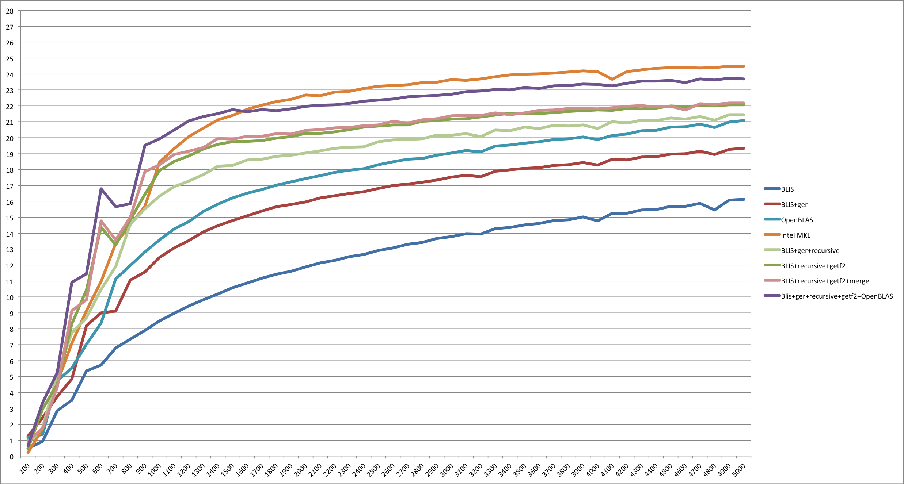
Performance Gap

Slide 41
Summary
Optimization
  Ger
  Recursive panel factorization
  Left looking panel factorization
  Merge pivoting, trsm, and gemm
Performance
  Naïve implementation, 1.37-2.26x
  Intel MKL
    Small matrix, 1.09x
    Large matrix, performance gap ~10%

Slide 42
Further works
Investigate trsm and gemm
Recursive panel
Parallelize
  Paralyze

Slide 43
Thank you for your attention
again

