Slide 1
BLIS: Year In Review, 2015-2016
Field G. Van Zee
Science of High Performance Computing
The University of Texas at Austin

Slide 2
Science of High Performance Computing (SHPC) research group
Led by Robert A. van de Geijn
Contributes to the science of DLA and instantiates research results as open source software
Long history of support from National Science Foundation
Website: http://shpc.ices.utexas.edu/

Slide 3
SHPC Funding (BLIS)
NSF
  Award ACI-1148125/1340293: SI2-SSI: A Linear Algebra Software Infrastructure for Sustained Innovation in Computational Chemistry and other Sciences. (Funded June 1, 2012 - May 31, 2015.)
  Award CCF-1320112: SHF: Small: From Matrix Computations to Tensor Computations. (Funded August 1, 2013 - July 31, 2016.)
  Award ACI-1550493: SI2-SSI: Sustaining Innovation in the Linear Algebra Software Stack for Computational Chemistry and other Sciences. (Funded July 15, 2016 – June 30, 2018.)

Slide 4
SHPC Funding (BLIS)
Industry (grants and hardware)
  Microsoft
  Texas Instruments
  Intel
  AMD
  HP Enterprise

Slide 5
Publications
“BLIS: A Framework for Rapid Instantiation of BLAS Functionality” (TOMS; in print)
“The BLIS Framework: Experiments in Portability” (TOMS; in print)
“Anatomy of Many-Threaded Matrix Multiplication” (IPDPS; in proceedings)
“Analytical Models for the BLIS Framework” (TOMS; in print)
“Implementing High-Performance Complex Matrix Multiplication” (TOMS; in revision)

Slide 6
BLIS Credits
Field G. Van Zee
  Core design, build system, test suite, induced complex implementations, various hardware support (Intel x86_64, AMD)
Tyler M. Smith
  Multithreading, various hardware support (IBM BG/Q, Intel Phi, AMD)
Devin Matthews
  Build system, kernel improvements, BLAS/CBLAS layer enhancements, and more
Francisco D. Igual
  Various hardware support (Texas Instruments DSP, ARM)
Xianyi Zhang
  Configure-time hardware detection, various hardware support (Loongson 3A)
Several others
  Bugfixes and various patches
Robert A. van de Geijn
  Funding, group management, etc.

Slide 7
Review
BLAS: Basic Linear Algebra Subprograms
  Level 1: vector-vector [Lawson et al. 1979]
  Level 2: matrix-vector [Dongarra et al. 1988]
  Level 3: matrix-matrix [Dongarra et al. 1990]
Why are BLAS important?
  BLAS constitute the “bottom of the food chain” for most dense linear algebra applications, as well as other HPC libraries
  LAPACK, libflame, MATLAB, PETSc, etc.

Slide 8
Review
What is BLIS?
  A framework for instantiating BLAS libraries (ie: fully compatible with BLAS)
What else is BLIS?
  Provides alternative BLAS-like (C friendly) API that fixes deficiencies in original BLAS
  Provides an expert object-based API
  Provides a superset of BLAS functionality
  A productivity lever
  A research sandbox

Slide 9
Current status of BLIS
License: 3-clause BSD
Current version: 0.2.0-60
  Reminder: How does versioning work?
Host: http://github.com/flame/blis
  Documentation / wikis
GNU-like build system
Configure-time hardware detection (some x86_64)
BLAS / CBLAS compatibility layers

Slide 10
Current status of BLIS
Multiple APIs
  BLAS-like, object-based (+ BLAS, CBLAS)
Generalized hierarchical multithreading
  Extract parallelism from multiple dimensions
Comprehensive, fully parameterized test suite

Slide 11
What’s New: Performance
Quadratic partitioning for multithreading
Miscellaneous kernel improvements

Slide 12
BLIS multithreading
OpenMP or POSIX threads
Loops eligible for parallelism: 5th, 3rd 2nd, 1st
  Parallelize two or more loops simultaneously
  Which loops to target depends on which caches are shared
  4th loop requires accumulation (mutual exclusion)
Implemented with a control tree-like mechanism
Controlled via environment variables
  BLIS_JC_NT (5th loop)
  BLIS_IC_NT (3rd loop)
  BLIS_JR_NT (2nd loop)
  BLIS_IR_NT (1st loop)

Slide 13
BLIS multithreading
Quadratic partitioning

Slide 14
BLIS multithreading

Slide 15
BLIS multithreading
n
m

Slide 16
BLIS multithreading
n
m

Slide 17
BLIS multithreading
n
m
w ≈ n / 4

Slide 18
BLIS multithreading

Slide 19
BLIS multithreading
n
n

Slide 20
BLIS multithreading
n
n

Slide 21
BLIS multithreading
n
n
w ≈ ?

Slide 22
BLIS multithreading

Slide 23
BLIS multithreading
n
m

Slide 24
BLIS multithreading
n
m

Slide 25
BLIS multithreading
n
m
w ≈ ?

Slide 26
BLIS multithreading
Quadratic partitioning
  Affects: herk, her2k, syrk, syr2k, trmm, trmm3
  Arbitrary quasi-trapezoids (trapezoid-oids?)
  Arbitrary diagonal offsets
  Lower- or upper-stored Hermitian/symmetric or triangular matrices
  Partition along m or n dimension, forwards or backwards
    This matters because of edge case placement
  Subpartitions guaranteed to be multiples of “blocking factors” (ie: register blocksizes), except subpartition containing edge case, if it exists

Slide 27
BLIS multithreading
Quadratic partitioning
  How much does it matter? Let’s find out!
  Test hardware
    3.6 GHz Intel Haswell (4 cores)
  Test operation
    Hermitian rank-k update: C += A A^{H}
+=

Slide 28
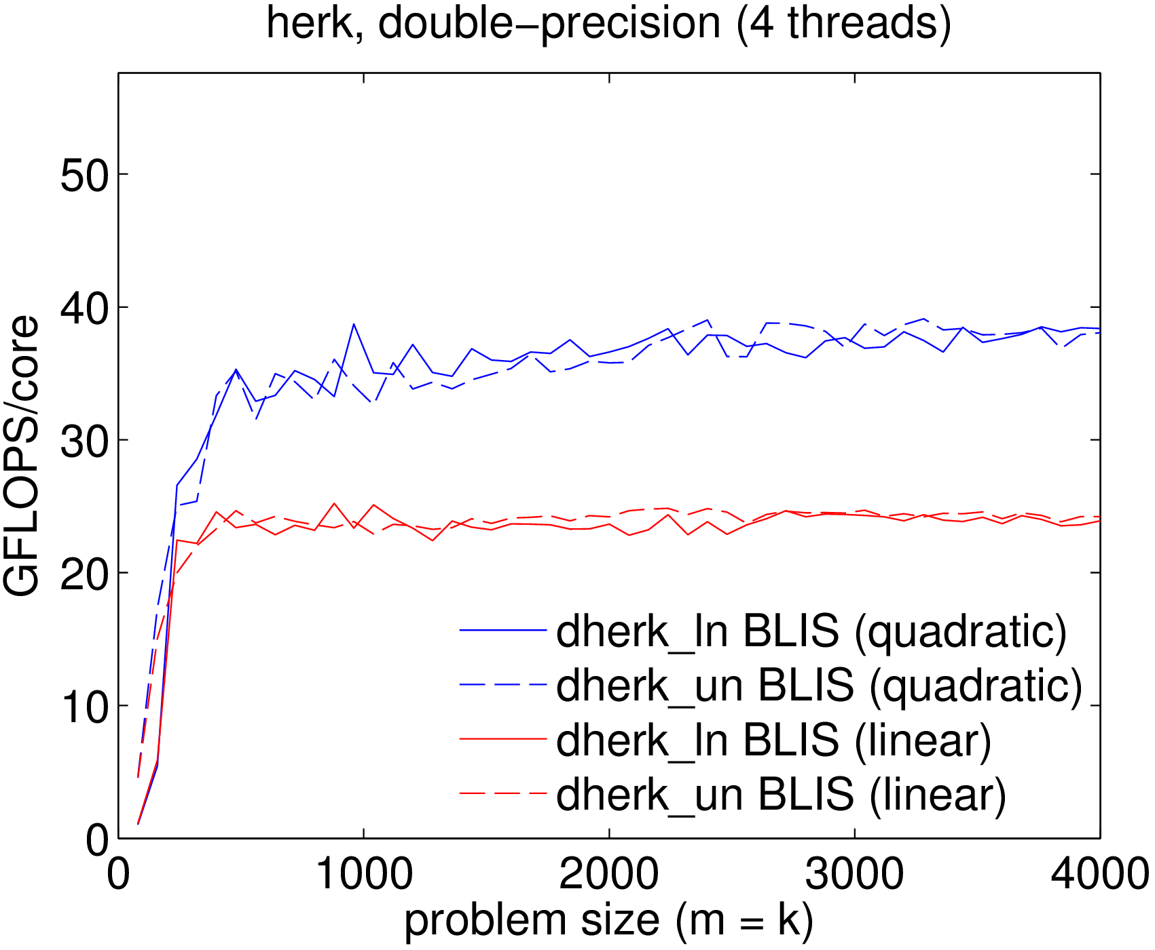
BLIS multithreading

Slide 29
Miscellaneous Kernel Improvements
Various kernel updates
  AMD Bulldozer/Piledriver/Steamroller (Etienne Sauvage)
  ARM (Francisco Igual)
  Sandybridge, Haswell (Field Van Zee, Devin Matthews)
    Added native complex domain kernels for gemm
    Relaxed alignment requirements

Slide 30
What’s New: User Experience
configure script
Build time
BLAS/CBLAS
Test suite
POSIX threads
New operations

Slide 31
configure script
Added new configure (plus long-style) options (Devin Matthews)
  enable/disable debugging symbols
  specify multithreading model (OpenMP/pthreads)
  enable/disable BLAS/CBLAS compatibility layers
  enable/disable static/shared library builds
  specifying internal and BLAS integer sizes
  enable/disable verbose output
  specify C compiler (support for gcc, icc, clang)
    determines actual flags for things like multitheading

Slide 32
Build time
BLAS/CBLAS compilation
  Previously, all files were compiled
  C preprocessor guards determined whether symbols were included in object files
  Now, build system is aware of BLAS/CBLAS enabled-ness
  Compilation time cut by about 20%
Many files containing object-level API code were retired/consolidated
  level-2 and level-3
  Compilation time cut by about 15%

Slide 33
BLAS/CBLAS compatibility
Recall: BLAS compatibility layer
  Supports 32- and 64-bit integers
    independent of integer size used internally within BLIS
CBLAS compatibility layer
  Original netlib/ATLAS code expressed in terms of int
  Now expressed in terms of BLAS compatibility layer integer: f77_int
  Better integration when using 64-bit integers

Slide 34
Test suite
New alignment switch
  Perform tests using matrices with or without forced alignment (starting address and leading dimension)
Specialized randnv, randnm operations
  Randomizes with powers of two in a narrow range
  Provides a useful “second opinion” in certain marginal cases (numerically-speaking)
  Added at AMD’s request
bli_clock() reimplemented (Devin Matthews)
  Migrated away from deprecated gettimeofday()
  Now use clock_gettime()

Slide 35
POSIX threads
Use gcc increment-and-fetch instead of pthread_mutex (Jeff Hammond)
Define a barrier for environments where _POSIX_BARRIER is not defined (Tyler Smith)
  OS X
Use spin locks instead of pthread barriers (Tyler Smith)

Slide 36
New operations
axpy-like operations (Devin Matthews)
  axpby
    y := alpha x + beta y
  xpby
    y := x + beta y

Slide 37
What’s New: Developer Experience
Kernel maintenance
Memory allocator
Runtime contexts
Redesigned control trees
Reorganized APIs for multithreading

Slide 38
Kernel Maintenance
Kernels directory reorganized
  Named using microarchitectures (e.g. haswell) instead of vector instruction set (e.g. avx)
Use restrict keyword in all kernel APIs (Devin Matthews)
  Allows the compiler to assume no aliasing between restrict pointers
  Facilitates some compiler-level optimizations

Slide 39
Memory Allocator
Implemented developer-configurable malloc() and free() for three categories of allocation
  pool: used to allocate blocks for the pools of packing buffers
  user: used to allocate when the user implicitly allocates memory, e.g. bli_obj_create()
  internal: used internally within BLIS to allocate data structures such as control tree nodes

Slide 40
Memory Allocator
Allow runtime resizing of memory pools
  If blocksizes change at runtime, memory pools will be re-initialized automatically
Integrated a new “memory broker” abstraction (Ricardo Magana)
  facilitates multiple pools, one per memory space
  lays the foundation for using BLIS on NUMA systems

Slide 41
Runtime Contexts
Introduced in the “big commit” (537a1f4)
Originally Lee Killough’s idea, during early design discussions
Basic idea: architecture-sensitive parameters such as cache and register blocksizes are stored, and passed down the function stack, in a special structure called a “context” (cntx_t)
Lays the groundwork for
  hardware auto-detection
  runtime management of kernels
Other possible applications
  Provide different contexts to different threads?

Slide 42
Redesigned Control Trees
Previously, variant subproblems were encoded “child” nodes/branches
  This resulted in more complicated code with many function calls with quick returns (NULL branches)
New design “linearizes” the trees (chains?)
  Suggested by Tyler Smith, independently implemented in TBLIS by Devin Matthews
  Now two types of nodes: partitioning (e.g. blocked variants) and non-partitioning (e.g. packing)

Slide 43
Redesigned Control Trees
Benefits
  Simplified level-3 blocked variant code (a lot)
  Consolidation of gemm_t, packm_t, and trsm_t control tree node types into a single type, cntl_t
  Fewer barriers and broadcasts (when multithreading)
  Now allows experts to build custom trees that specify alternative implementations without needing to first integrate those codes into BLIS
  No longer stateless: “cache” packing buffers (memory pool blocks)

Slide 44
Reorganized Multithreading APIs
Streamlined namespaces/types
  bli_thrcomm_*()
    Thread communicator API
  bli_thrinfo_*()
    Thread info (aka “thread control tree”) API
  bli_thread_*()
    Other thread-related APIs
  Types: thrcomm_t, thrinfo_t
Consolidated thrinfo_t structures across level-3 operations
  Only two kinds now: gemm and trsm
  thrinfo_t now mirrors cntl_t

Slide 45
Future Plans
Carouseling (Tyler Smith)
  Parallelize 4th loop
  Multithreaded “pack-and-compute” optimization
Runtime management of kernels
  Allows runtime hardware detection
  Allows expert to manually change micro-kernel and associated blocksizes at runtime
Create more user-friendly runtime API for controlling multithreading
Possible new kernels/operations to facilitate optimizations in LAPACK layer
  Integrate into successor to libflame
Other gemm algorithms / partitioning paths (Tyler Smith)

Slide 46
Further Information
Website:
  http://github.com/flame/blis/
Discussion:
  http://groups.google.com/group/blis-devel
  http://groups.google.com/group/blis-discuss
Contact:
  field@cs.utexas.edu

Slide 47
It’s over!

