Slide 1
BLIS optimized for EPYCTM Processors
© 2017 Advanced Micro Devices, Inc. All rights reserved.

Slide 2
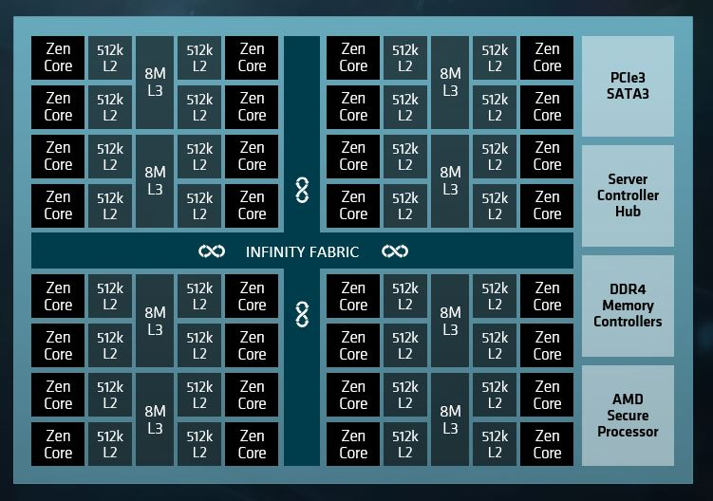
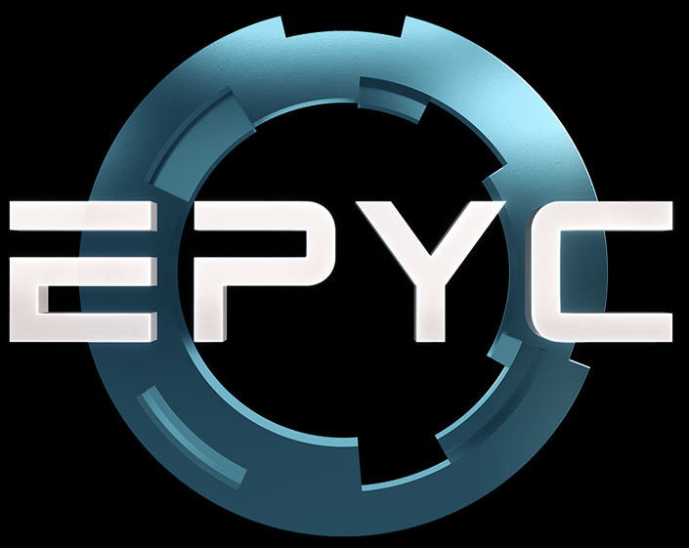
AMD EPYCTM Processors
The AMD EPYCTM SOC contains AMD X86 core codenamed “Zen”.
Single EPYCTM package can have up to 32 Zen cores.

Slide 3
CONTENTS
Small matrix GEMM optimizations and its impact on Caffe benchmark.
Efficiency of GEMM in AMD EPYCTM Processor.
Optimizations of TRSM, AMAX, GEMV, DOT…..
Impact of optimizations on QR, LU AND Cholesky factorizations.

Slide 4
AMD EPYCTM Processor – Hardware configuration
OS: Ubuntu
Hard disk : 1 TB
CPU name: AMD EPYC 7601 32-Core Processor
CPU type: AMD K17 (Zen) architecture
Sockets: 2
Cores per socket: 32
Threads per core: 2
L3 cache : 8 MB
L2 Cache : 512 KB
L1 Cache : 32 KB
CPU frequency: 3.2 GHz
RAM : 256 GB DDR4 @ 1.2 GHz
*PC manufacturers may vary configurations yielding different results.

Slide 5
Small matrix optimizations AND ITs APPLICATIONS in MACHINE LEARNING

Slide 6
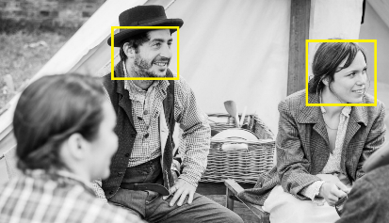
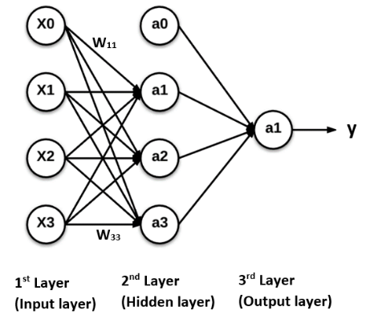
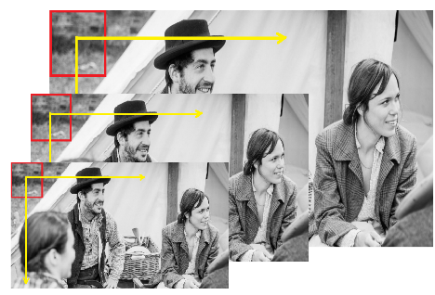
SMALL MATRIX PERFORMANCE AND MACHINE LEARNING
Machine Learning frameworks such as Caffe spend significant* amount
of time in 3D convolution (expressed as GEMM) and
forward connected (expressed as GEMV) layers.
Typically GEMM is called for small matrices.
Problem size is small
(x₁, x₂ ,…, x_{n})
Search for faces at
different resolutions and locations
* https://petewarden.com/2015/04/20/why-gemm-is-at-the-heart-of-deep-learning/

Slide 7
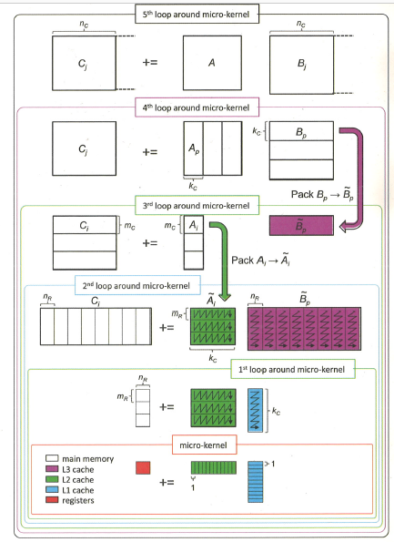
PERFORMANCE ANAYSIS FOR SMALL MATRIX
Impact of Data Packing
Data Packing in BLIS
Enables efficient cache utilization during GEMM operation
Packing benefits large matrices but introduces overhead for small matrices
Low re-access does not cover packing expense
Packing of data to avoid TLB misses is not necessary for small matrices that easily fit in L2 cache
Chart source : https://github.com/flame/blis/wiki/Multithreading

Slide 8
PROPOSED approach / solution
Utilize cache through re-use without explicit packing.
Applicable to matrix sizes that are small enough to fit in caches.
Matrix C Matrix A Matrix B
= x

Slide 9
SMALL MATRIX GEMM OPTIMIZATIONS

Slide 10
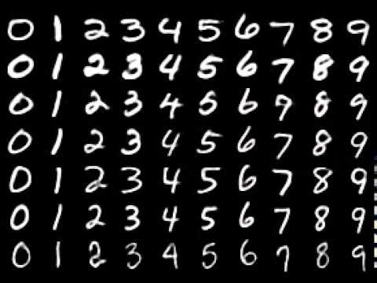
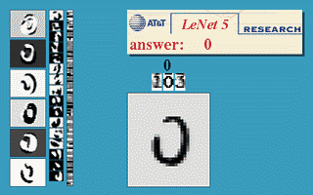
CAFFE MNIST HAND WRITTEN DIGIT RECOGNITION
Up to 18% improvement
Source: http://yann.lecun.com/exdb/lenet/

Slide 11
Efficiency of gemm in amd epyc^{tm} Processor

Slide 12
GEMM TUNED FOR AMD EPYCTM Processor
DGEMM efficiency hits 97% in AMD EPYCTM Processor.
The GEMM loop parameters are tuned for higher efficiency.

Slide 13
TRSM and other blis api optimizations

Slide 14
GEMMTRSM fused kernel implementation
Up to 20% improvement

Slide 15
GEMV and level 1F kernel optimizations
Up to 80% improvement

Slide 16
Level 1 BLIS API OPTIMIZATIONS
Up to 4x times improvement

Slide 17
Matrix factorizations performance improvement in libflame

Slide 18
Performance improvement in QR
Up to 70% improvement

Slide 19
Performance improvement in cholesky
Up to 12% improvement

Slide 20
Performance improvement in LU
Up to 16% improvement

Slide 21
References & Source Code
http://developer.amd.com/amd-cpu-foundation-libraries-epyctm-processors/
http://developer.amd.com/amd-secure-random-number-generator-library/
http://developer.amd.com/amd-cpu-libraries/
https://github.com/amd/blis
https://github.com/amd/libflame
http://developer.amd.com/accelerating-machine-learning-frameworks-using-blis/

Slide 22
Questions?

Slide 23
DISCLAIMER
The information contained herein is for informational purposes only, and is subject to change without notice. While every precaution has been taken in the preparation of this document, it may contain technical inaccuracies, omissions and typographical errors, and AMD is under no obligation to update or otherwise correct this information. Advanced Micro Devices, Inc. makes no representations or warranties with respect to the accuracy or completeness of the contents of this document, and assumes no liability of any kind, including the implied warranties of non infringement, merchantability or fitness for particular purposes, with respect to the operation or use of AMD hardware, software or other products described herein. No license, including implied or arising by estoppel, to any intellectual property rights is granted by this document. Terms and limitations applicable to the purchase or use of AMD’s products are as set forth in a signed agreement between the parties or in AMD’s Standard Terms and Conditions of Sale.
AMD, the AMD Arrow logo, EPYC and combinations thereof are trademarks of Advanced Micro Devices, Inc. Other product names used in this publication are for identification purposes only and may be trademarks of their respective companies.
© 2017 Advanced Micro Devices, Inc. All rights reserved.

Slide 24
EndNotes
SLIDE 9
Testing was conducted as of 11th August 2017 on the test system comprising AMD EPYCTM 7601, 64 cores clocked at 3.2 GHz. The machine had DDR4 RAM of 256 GB, clocked at 1.2 GHz and 1 TB of Hard disk. The test system had Ubuntu operating system installed. PC manufacturers may vary configurations yielding different results. TE-08
SLIDE 10
Testing was conducted as of 11th August 2017 on the test system comprising AMD EPYCTM 7601, 64 cores clocked at 3.2 GHz. The machine had DDR4 RAM of 256 GB, clocked at 1.2 GHz and 1 TB of Hard disk. The test system had Ubuntu operating system installed. PC manufacturers may vary configurations yielding different results. TE-09
SLIDE 12
Testing was conducted as of 11th August 2017 on the test system comprising AMD EPYCTM7601, 64 cores clocked at 3.2 GHz. The machine had DDR4 RAM of 256 GB, clocked at 1.2 GHz and 1 TB of Hard disk. The test system had Ubuntu operating system installed. PC manufacturers may vary configurations yielding different results. TE-10
SLIDE 14
Testing was conducted as of 11th August 2017 on the test system comprising AMD EPYCTM7601, 64 cores clocked at 3.2 GHz. The machine had DDR4 RAM of 256 GB, clocked at 1.2 GHz and 1 TB of Hard disk. The test system had Ubuntu operating system installed. PC manufacturers may vary configurations yielding different results. TE-11
SLIDE 15
Testing was conducted as of 11th August 2017 on the test system comprising AMD EPYCTM7601, 64 cores clocked at 3.2 GHz. The machine had DDR4 RAM of 256 GB, clocked at 1.2 GHz and 1 TB of Hard disk. The test system had Ubuntu operating system installed. PC manufacturers may vary configurations yielding different results. TE-12
SLIDE 16
Testing was conducted as of 11th August 2017 on the test system comprising AMD EPYCTM7601, 64 cores clocked at 3.2 GHz. The machine had DDR4 RAM of 256 GB, clocked at 1.2 GHz and 1 TB of Hard disk. The test system had Ubuntu operating system installed. PC manufacturers may vary configurations yielding different results.TE-13
SLIDE 18
Testing was conducted as of 11th August 2017 on the test system comprising AMD EPYCTM7601, 64 cores clocked at 3.2 GHz. The machine had DDR4 RAM of 256 GB, clocked at 1.2 GHz and 1 TB of Hard disk. The test system had Ubuntu operating system installed. PC manufacturers may vary configurations yielding different results. TE-14

Slide 25
EndNotes
Slide 19
Testing was conducted as of 11th August 2017 on the test system comprising AMD EPYCTM7601 64 cores clocked at 3.2 GHz. The machine had DDR4 RAM of 256 GB, clocked at 1.2 GHz and 1 TB of Hard disk. The test system had Ubuntu operating system installed. PC manufacturers may vary configurations yielding different results. TE-15
Slide 20
Testing was conducted as of 11th August 2017 on the test system comprising AMD EPYCTM7601, 64 cores clocked at 3.2 GHz. The machine had DDR4 RAM of 256 GB, clocked at 1.2 GHz and 1 TB of Hard disk. The test system had Ubuntu operating system installed. PC manufacturers may vary configurations yielding different results. TE-16

