Slide 1
Fat by Thin Matrix Multiplication
Thomas Hines
Tennessee Tech University

Slide 2
Fat and Thin Matrices
Fat – Few rows and many columns
Thin – Many rows and few columns
Fat by Thin – k >> m , n
C is very small compared to A and B
*
=

Slide 3
Experimental Setup
Ivybride node and Broadwell node
Ivybridge E5-2680v2 x 2 with 20 total cores
Broadwell E5-2680v4 x 2 with 28 total cores
Library versions
Intel MKL 2019.0.3
BLIS 0.5.1
OpenBLAS 0.3.6
Call DGEMM
Best of 10 runs

Slide 4
Experimental Setup
Sweep from fat by thin to square
Start: (m, k, n) = (64, 16 777 216, 64)
End: (m, k, n) = (4096, 4096, 4096)
Kept the total number of multiplications constant
$m∗k∗n={4096}^{3}$
Rough performance predictor
Time to load A and B from RAM + time to multiply

Slide 5
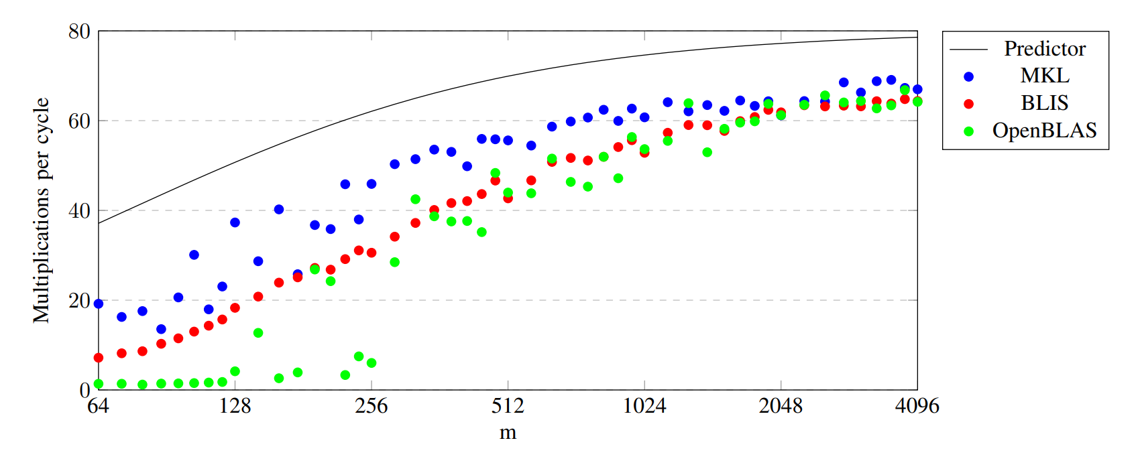
Ivybridge 20 threads sweep
Graph of ivy_bridge sweep

Slide 6
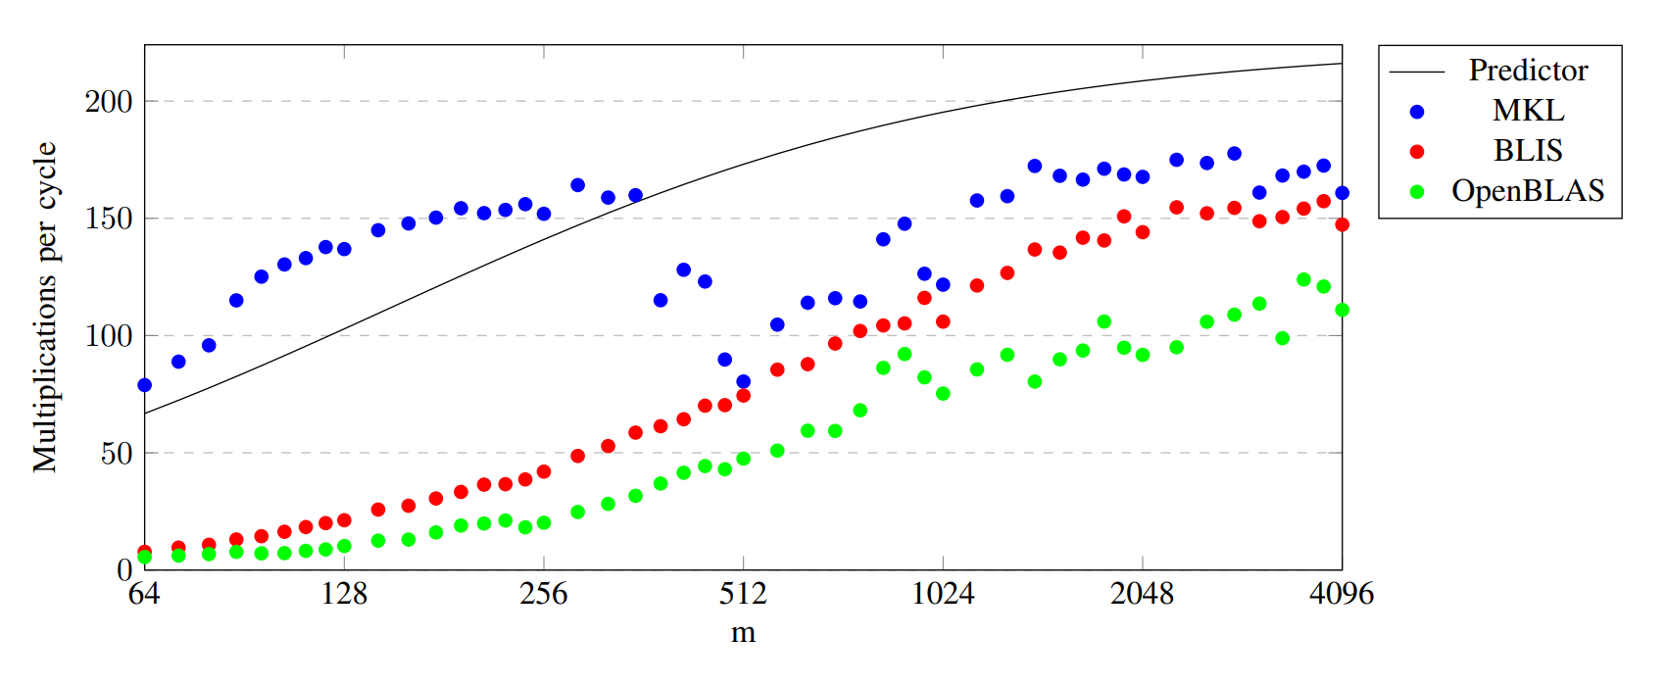
Broadwell 28 threads sweep
Graph of Broadwell sweep

Slide 7
Multi-threaded vs Single threaded
The next step is to look at single threaded performance
But what if a global resource is the bottleneck?
RAM bandwidth
Run a single threaded DGEMM on each core at the same time

Slide 8
Ivybridge 20 independent threads

Slide 9
Broadwell 28 independent threads

Slide 10
Rough “Fix”
Single threaded performance is high in the fat by thin region
Turn the multiplication into independent smaller multiplications
Split A and B in the k dimension
Adds extra work
Extra memory for temporary C’s
Sum reduction of the temporary C’s
However, C is small

Slide 11
Ivybridge default vs duplicate C

Slide 12
Broadwell default vs duplicate C

Slide 13
BLIS Loop Multi-threading
Ivybridge with 20 threads parallelizes the loops as:
1, 1, 10, 2, 1
The third loop partitions in the m dimension
If m=64, then the effective $m_{c}$ is 6.4 (rounds to 8)
Ã=sliver of Ã
The preferred $m_{c}$ size is 96
$m_{c}$ will be smaller than the preferred size when m<960

Slide 14
Duplicate-C BLIS Loop Multi-threading
The loop threading is effectively 1, 20, 1, 1, 1
Not identical – no synchronization
The third loop is not parallelized
Effective $m_{c}$ is roughly 10x larger for small m

Slide 15
Potential Modifications
Simple
Switch point to swap to alternative loop threading.
Complicated
Determine loop threading based on m, k, and n.
In both cases the 2nd loop needs to be parallelizable

