Slide 1
CVPR 2019 Tutorial on Map Synchronization
Introduction
Qixing Huang
Xiaowei Zhou
Junyan Zhu
Tinghui Zhou

Slide 2
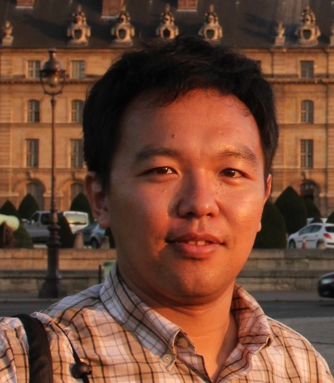
Speakers

Slide 3
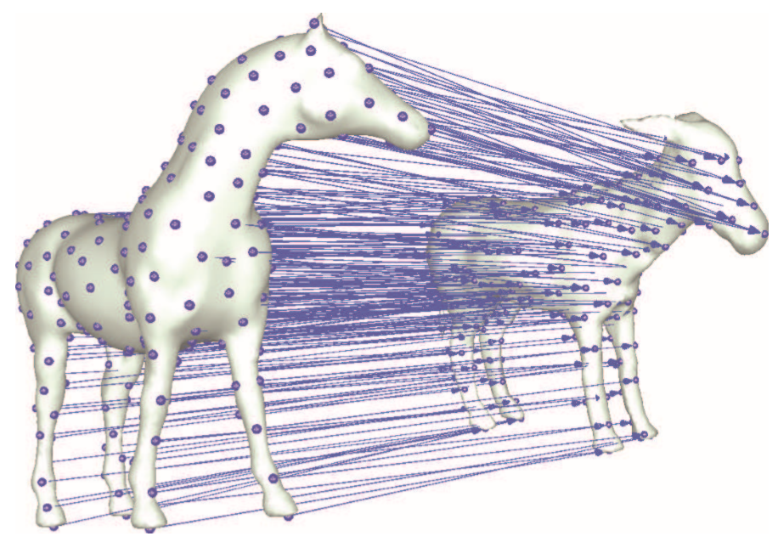
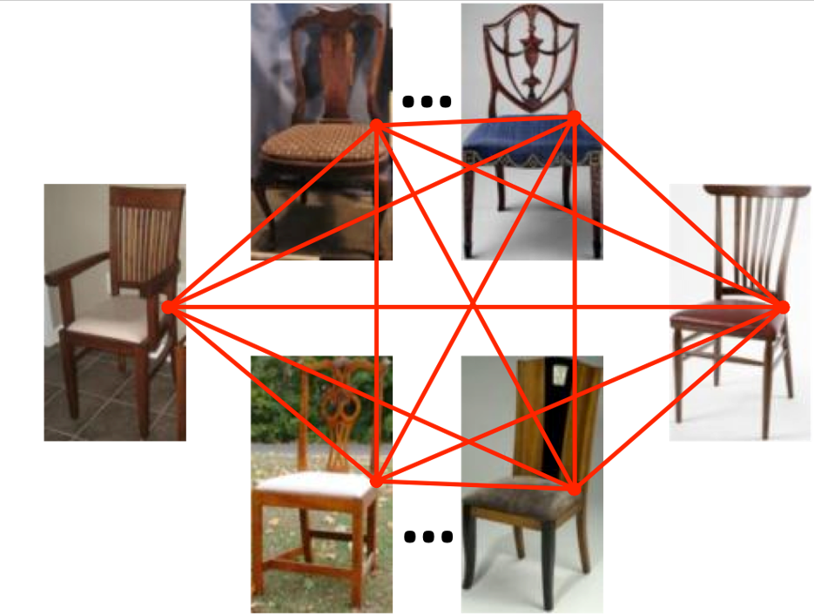
Map Synchronization?
Map
Synchronization

Slide 4
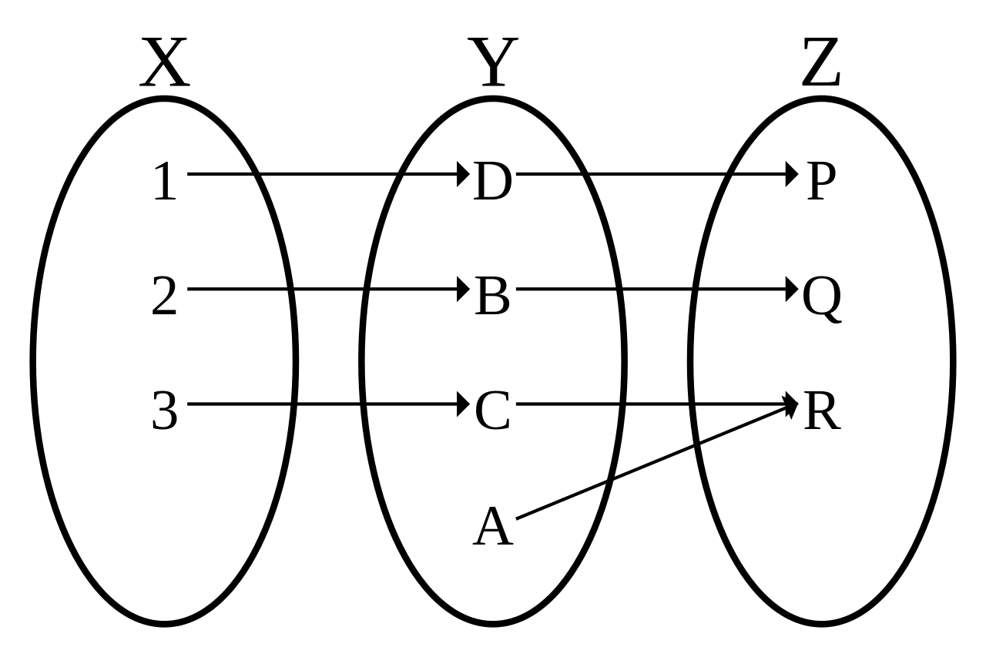
Maps between sets
Source: https://en.wikipedia.org/wiki/Bijection

Slide 5
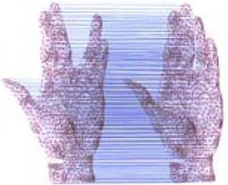
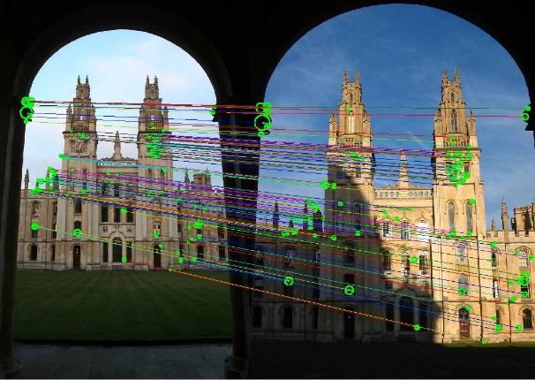
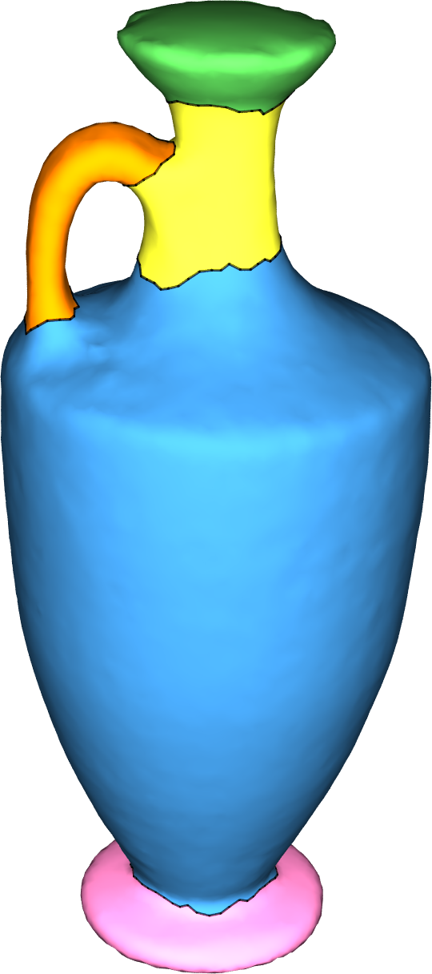
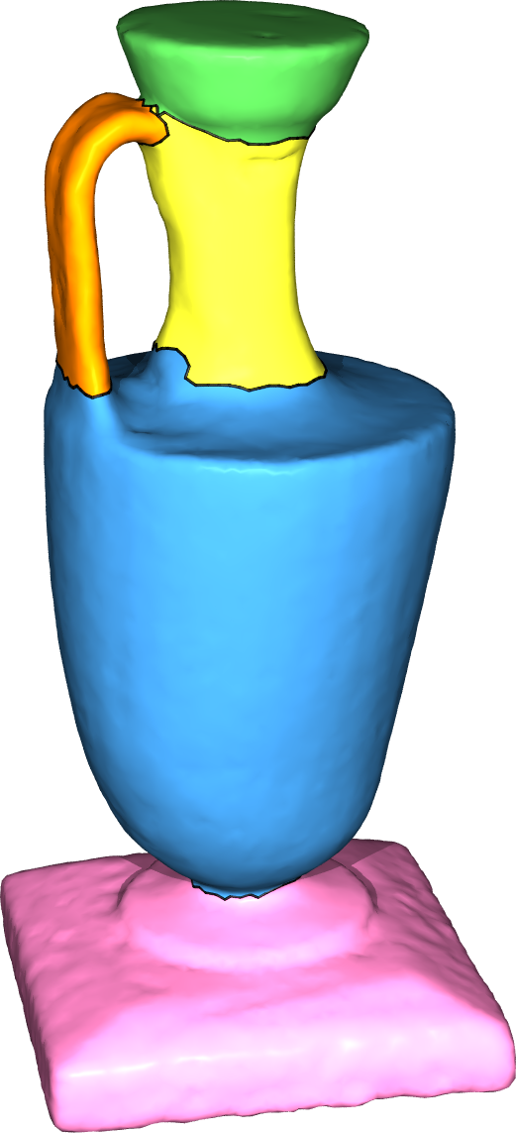
Maps can take many forms
Dense correspondences
Feature correspondences
Segment correspondences
Source: http://www.robots.ox.ac.uk/~vgg/practicals/instance-recognition/index.html

Slide 6
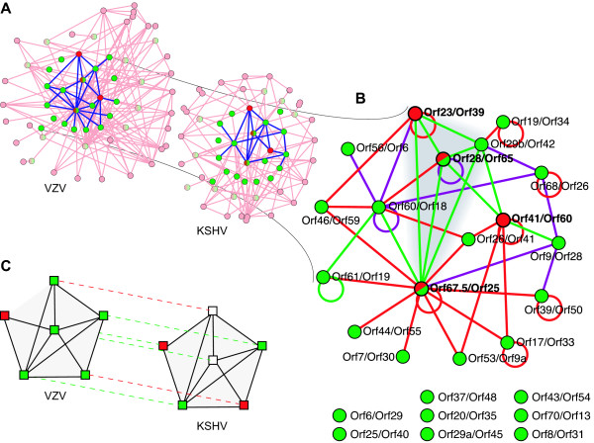
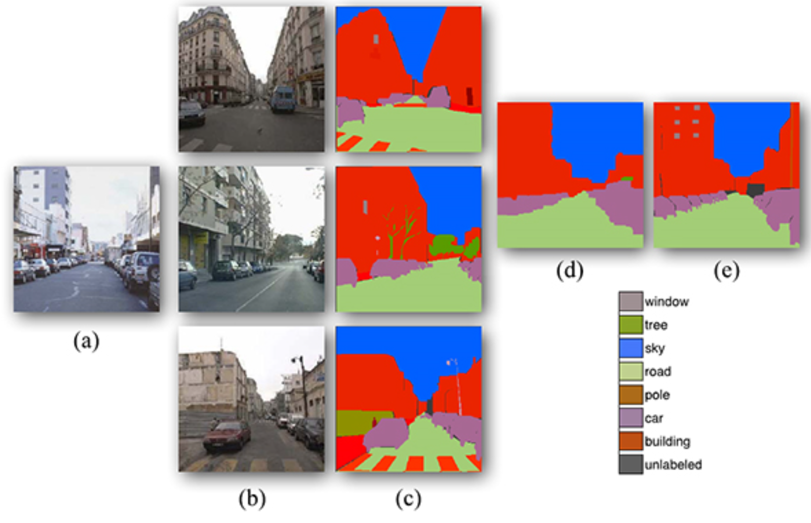
Application in information propagation
Protein-protein interaction network alignment
[Kolar et al. 08]
Nonparametric Scene Parsing
[Liu et al. 11]

Slide 7
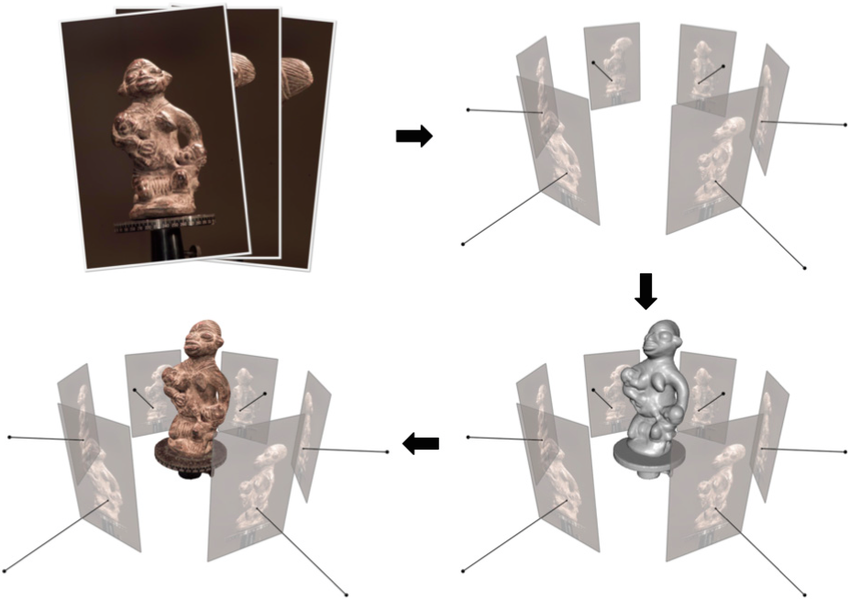
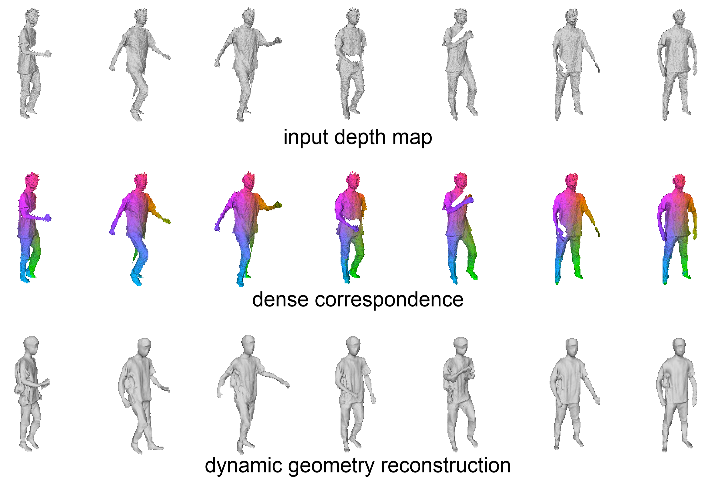
Application in 3D Reconstruction
Multiview Stereo
[Furukawa and Hernandez 15]
Dynamic geometry reconstruction
[Li et al. 15]

Slide 8
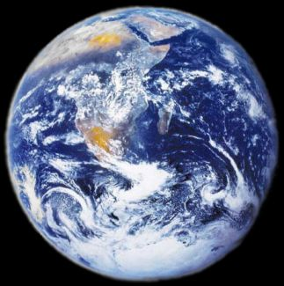
Neural networks are maps
Approximate any function given sufficient data

Slide 9
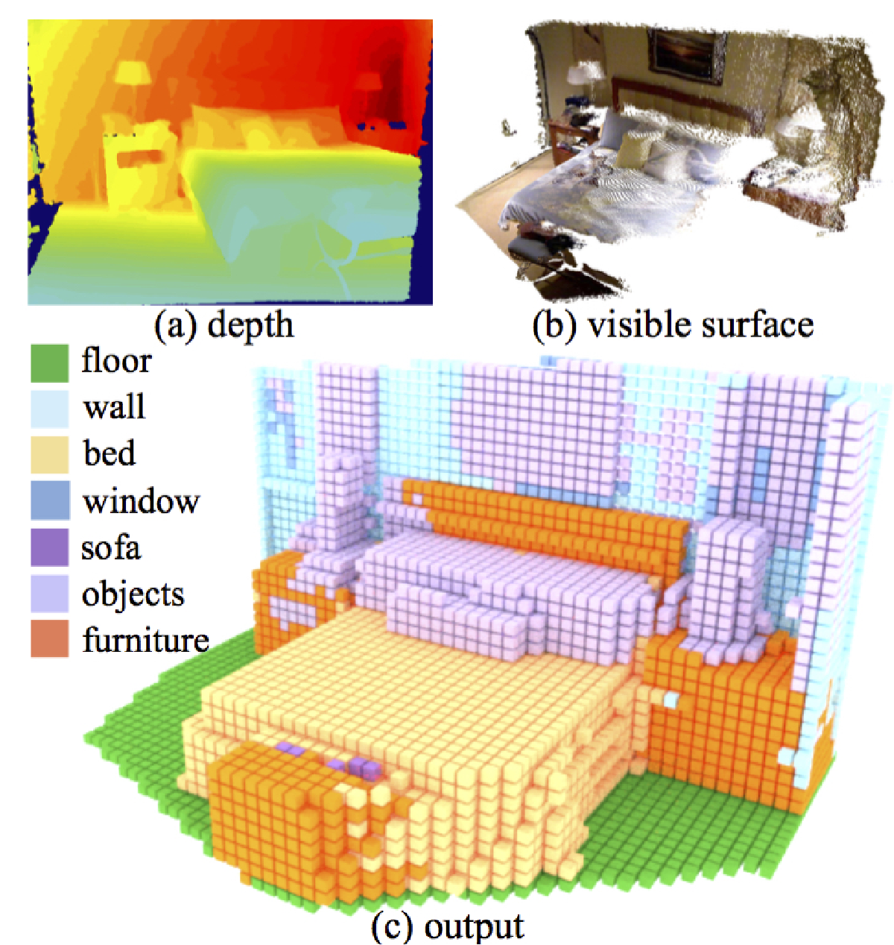
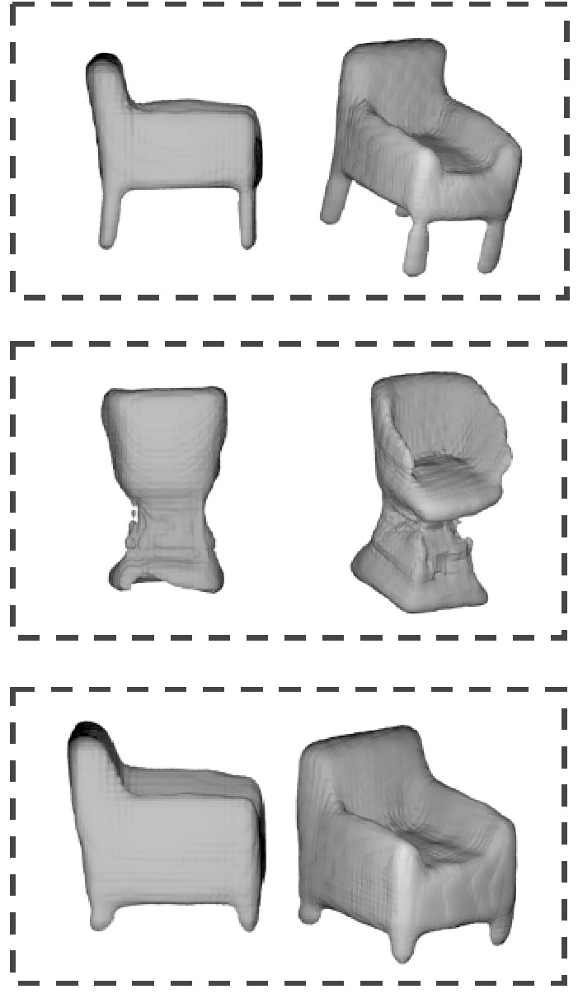
Monocular reconstruction
Semantic scene completion [Song et al. 17]
MarrNet [Wu et al. 17]
Space of images
Space of 3D models

Slide 10
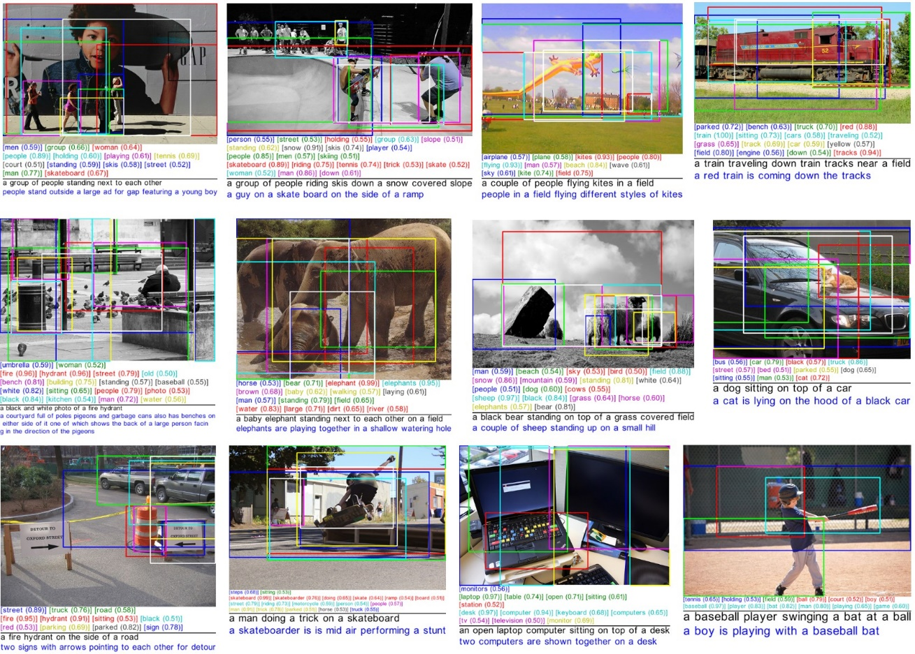
Image Captioning
Space of images
Space of natural language descriptions

Slide 11
The promise of joint map computation

Slide 12
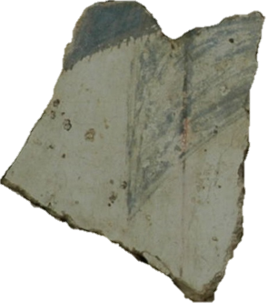
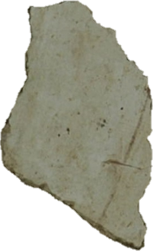
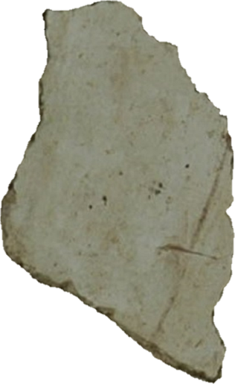
Ambiguities in assembling pieces
Notes:
Let me give a concrete example in terms of assembling fractured pieces, which I believe many of you have done such tasks before. However, this is usually a hard task, and in this example, we have ambiguities when assembling these two pieces. The major reason is that these two pieces do not provide sufficient information for establishing the map.

Slide 13
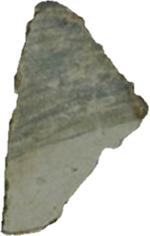
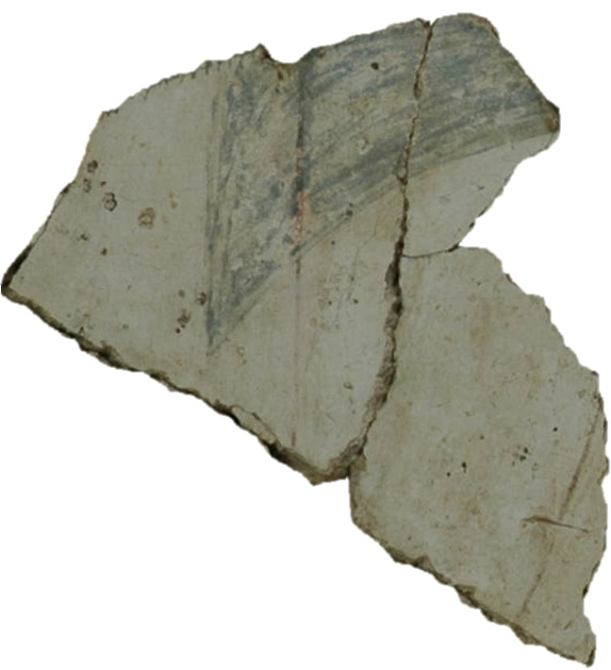
Resolving ambiguities by looking at additional pieces
Notes:
To resolve these ambiguities, we typically look at additional pieces. In this case, there is a strong match between the additional piece show on the top and the piece on the left. This leads to a strong match among these three pieces. In other words, this additional piece tells us how to match the first two pieces. So it is important to jointly establish the maps.

Slide 14
Resolving ambiguities by looking at additional pieces
Notes:
Btw, these three pieces come from a Theran Wall Painting in Greece, which consists of 4000 pieces. To solve the problem at this level, we need many more such reasonings.

Slide 15
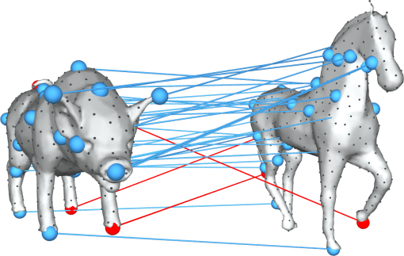
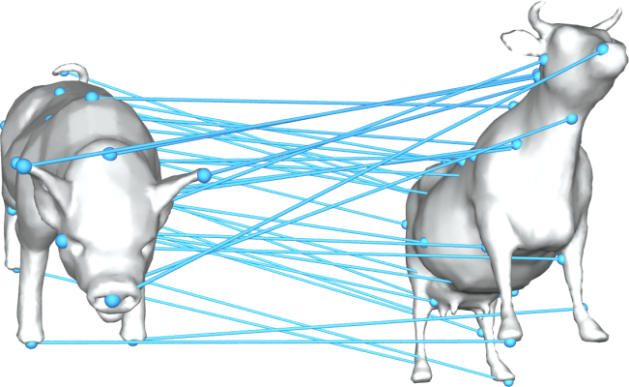
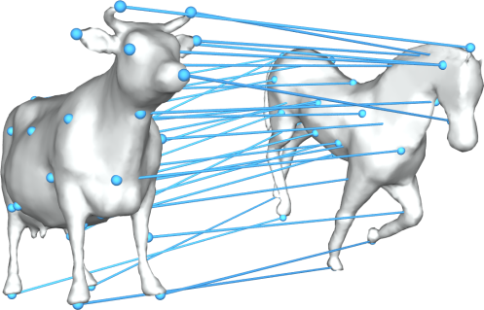
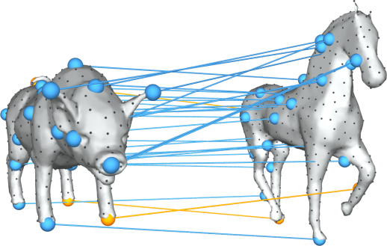
Matching through intermediate objects --- map propagation
Blended intrinsic maps
[Kim et al. 11]
Intermediate
object
Composite
Notes:
Let me explain the idea from a slightly different perspective. Here we build the map from a pig object to a horse object, and the state-of-the-art pairwise matching method returns some bad correspondences. Instead of improving the matching method, we can leverage data to improve the correspondences. Specifically, when inserting a cow model, whose shape lie in between the pig and the horse. In this case, the pair-wise shape matcher generates two better maps. We can compose them to derive a much better map between the cow model and the horse model.

Slide 16
Multi-lingual translation
[Johnson et al. 16]
Korean
Sparse
paired data
Portuguese
Rich
paired data
Rich
paired data
English

Slide 17
Agenda
09:00 am – 09:15 am: Introduction (Qixing Huang)
09:15 am – 10:15 am: Correspondences and transformations (Xiaowei Zhou)
10:15 am – 10:45 am: Unsupervised object/part discovery (Qixing Huang)
10:45 am – 11:00 am: Break
11:00 am – 11:50 am: Cross-domain mapping (Junyan Zhu)
11:50 am – 12:25 pm: Theoretical aspects (Qixing Huang)
12:25 pm – 12:30 pm: Concluding remarks (All Together)

