Slide 1
Agenda
09:00 am – 09:15 am: Introduction (Qixing Huang)
09:15 am – 10:15 am: Correspondences and transformations (Xiaowei Zhou)
10:15 am – 10:45 am: Unsupervised object/part discovery (Qixing Huang)
10:45 am – 11:00 am: Break
11:00 am – 11:50 am: Cross-domain matching (Junyan Zhu)
11:50 am – 12:25 pm: Theoretical aspects (Qixing Huang)
12:25 pm – 12:30 pm: Concluding remarks (All Together)

Slide 2
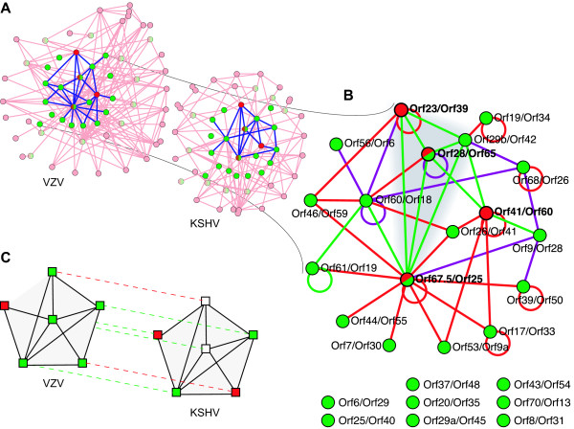
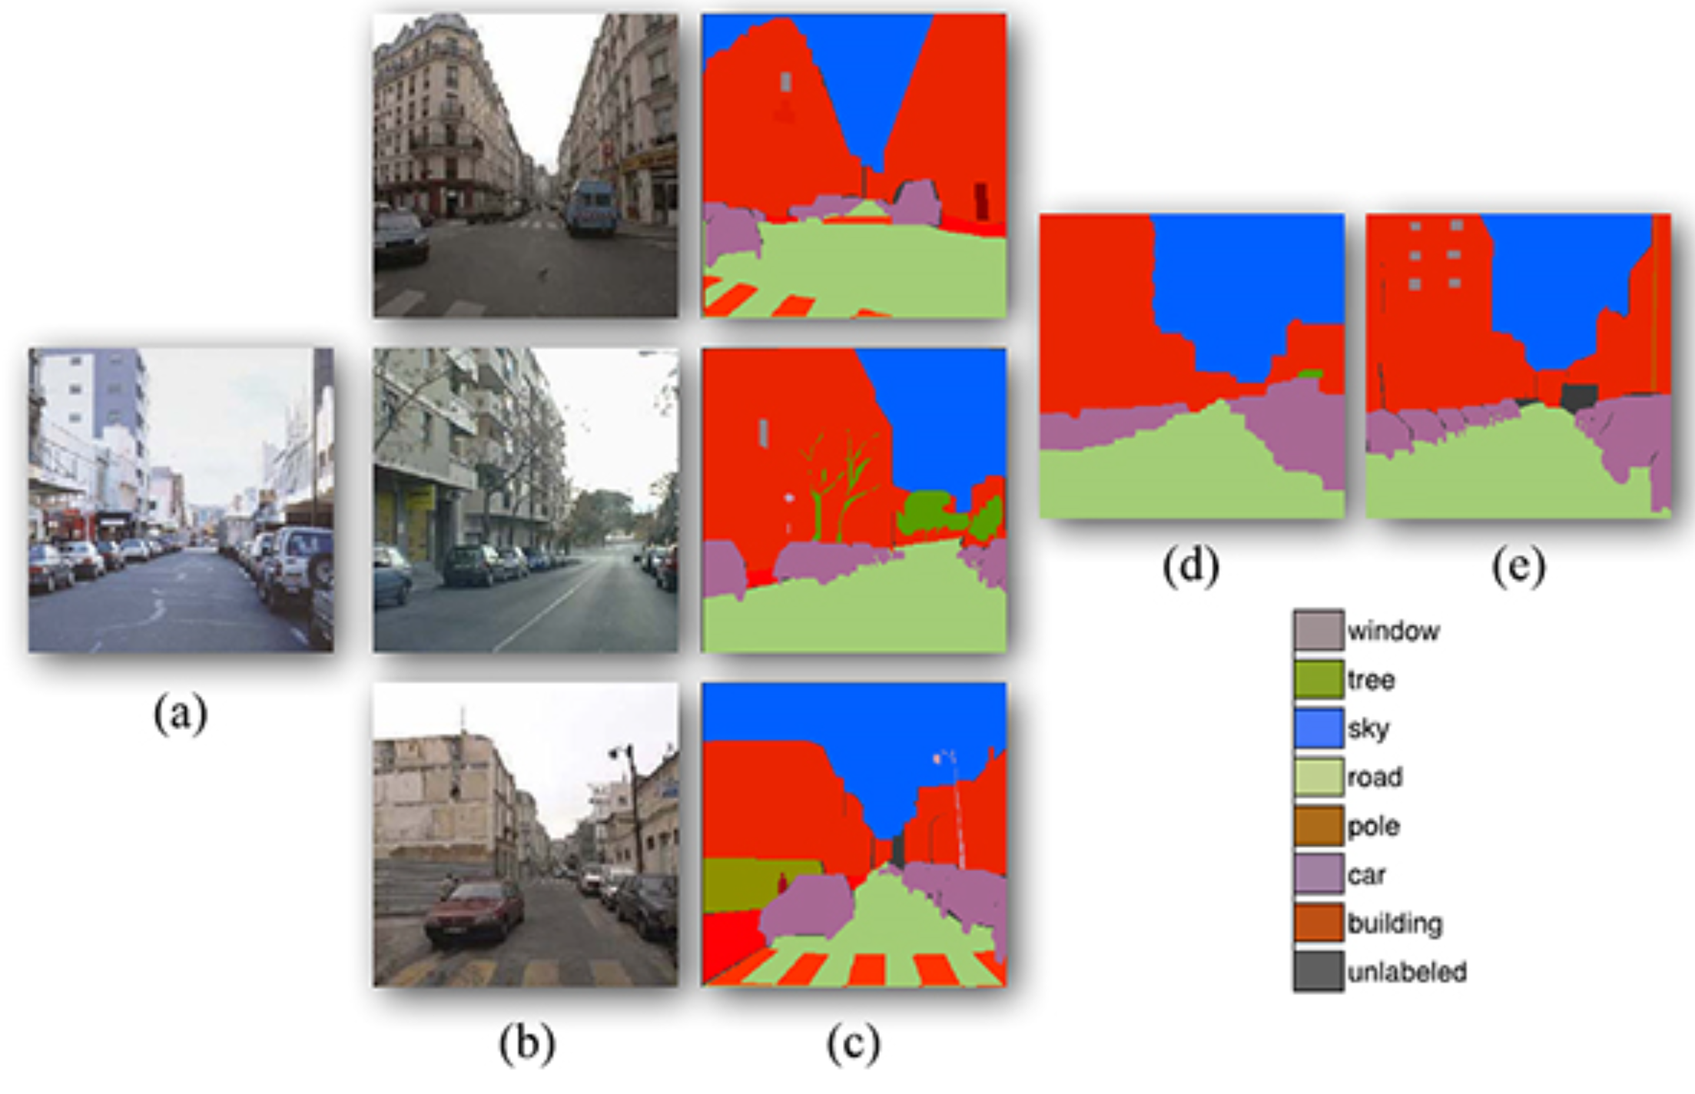
Map as an information transporter
Protein-protein interaction network alignment
[Kolar et al. 08]
Nonparametric Scene Parsing
[Liu et al. 11]

Slide 3
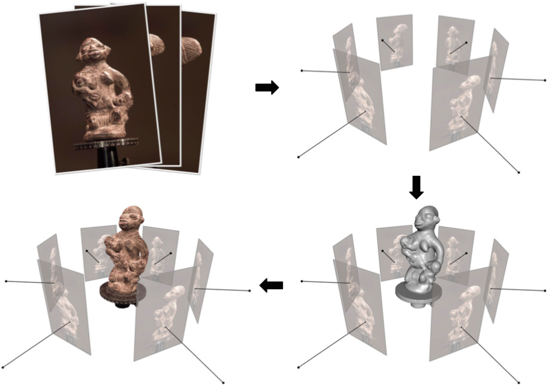
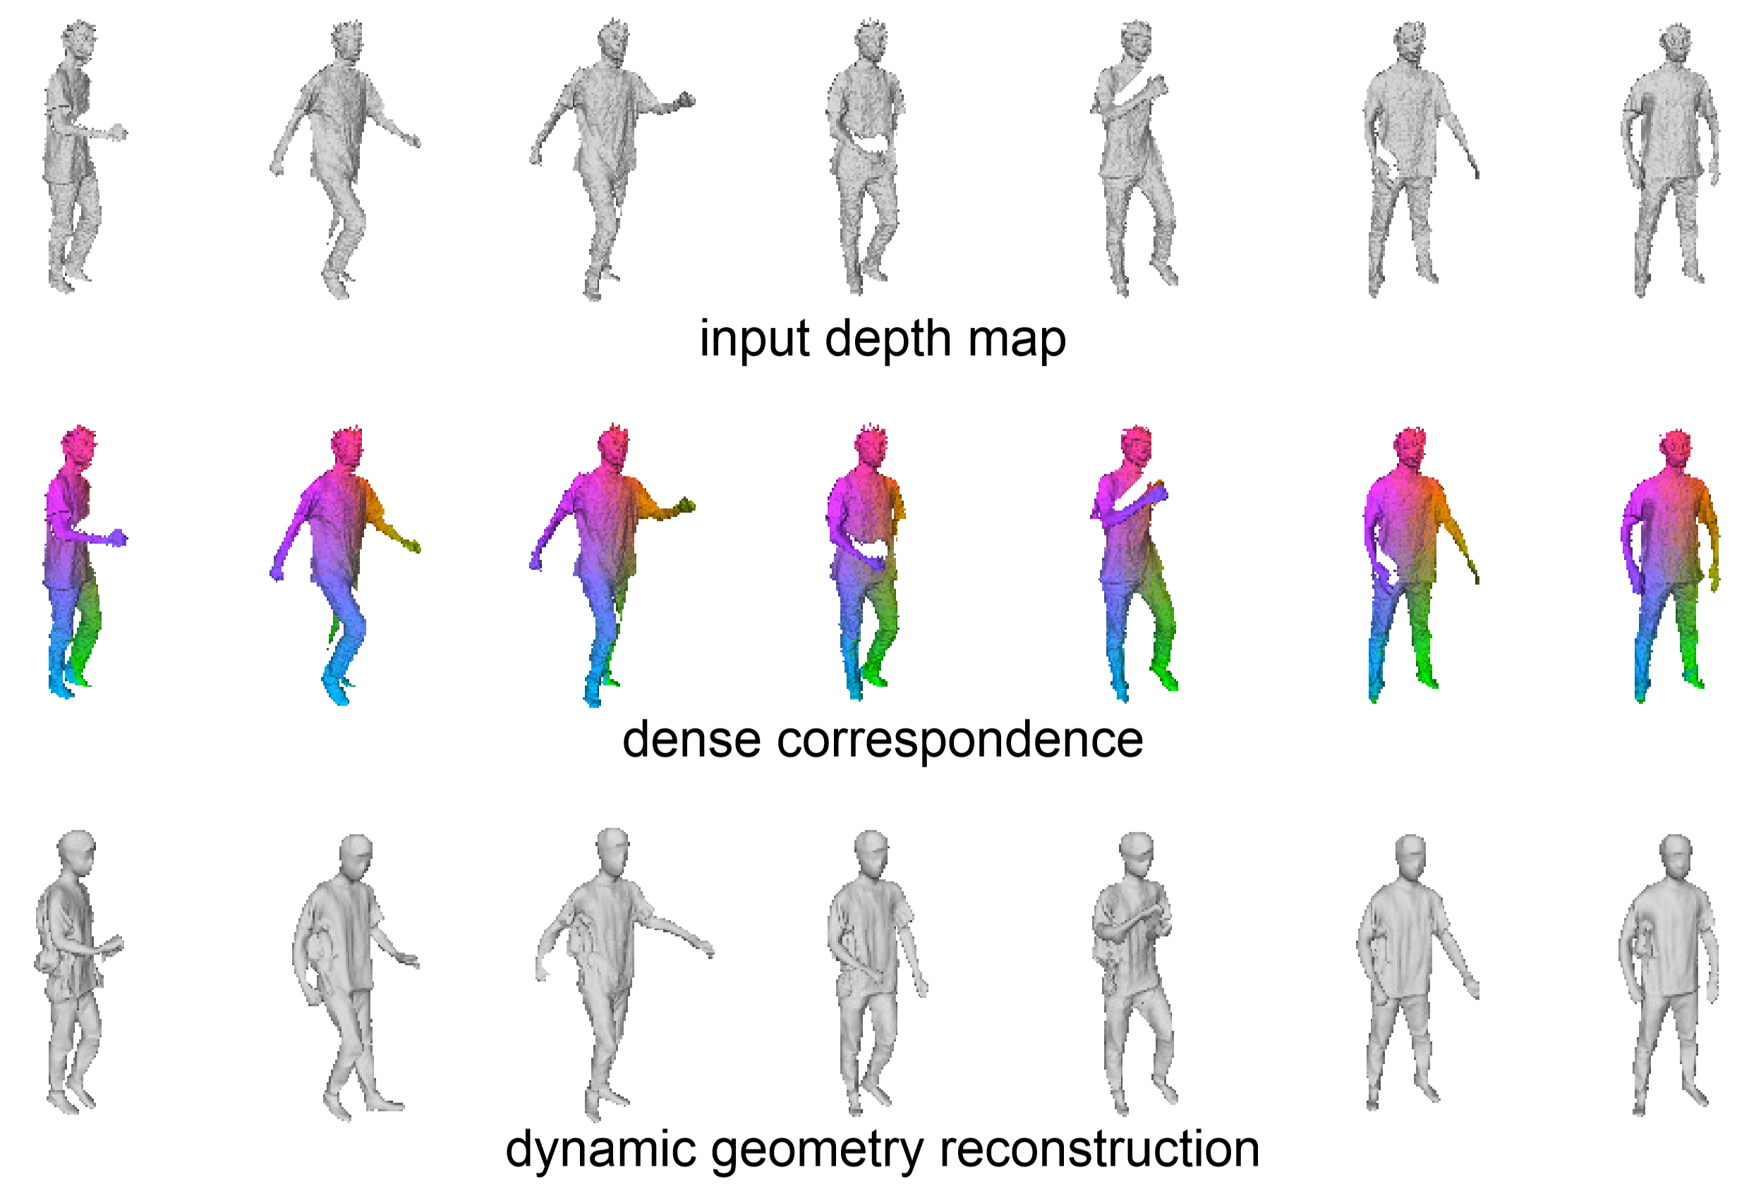
Map as an information aggregator
Multiview Stereo
[Furukawa and Hernandez 15]
Dynamic geometry reconstruction
[Li et al. 15]

Slide 4
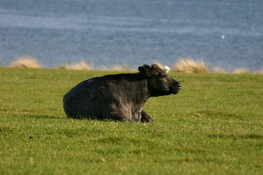
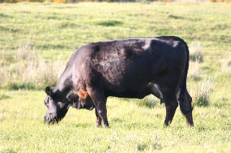
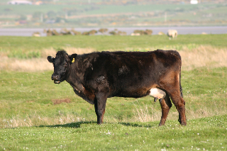
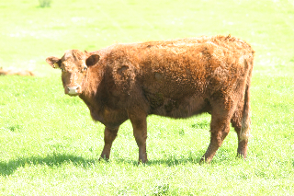
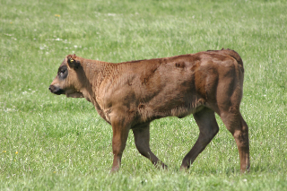
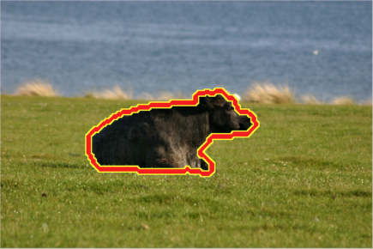
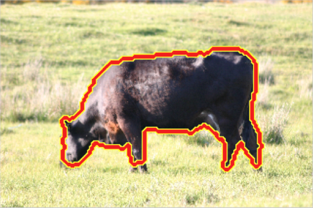
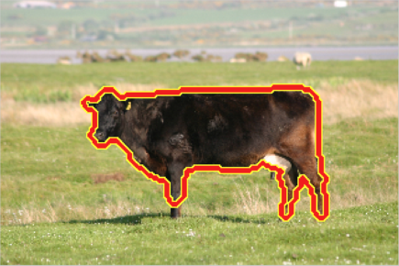
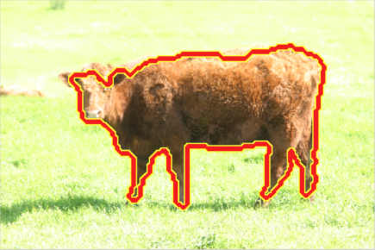
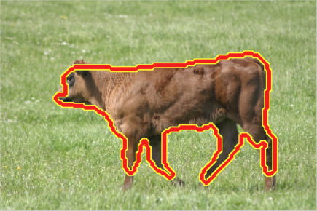
Unsupervised object/part discovery

Slide 5
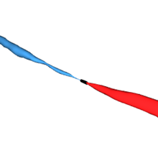
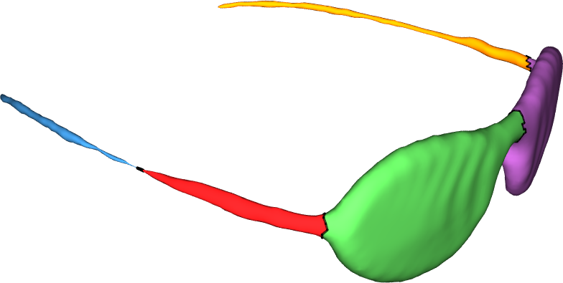
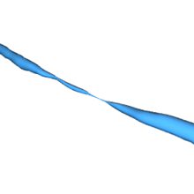
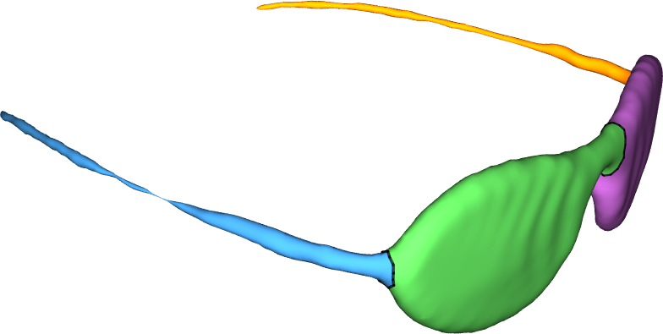
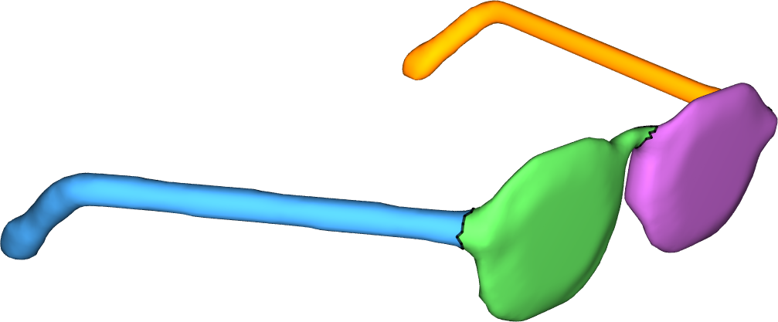

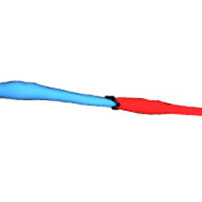
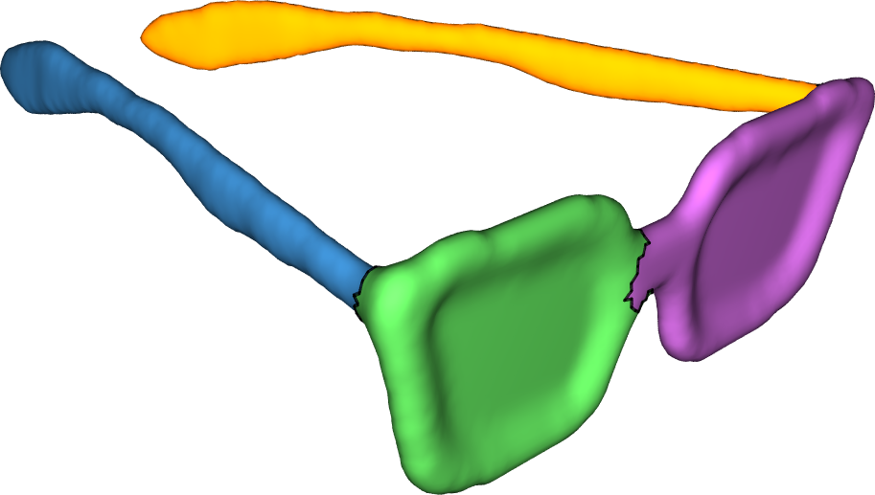
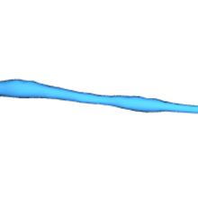
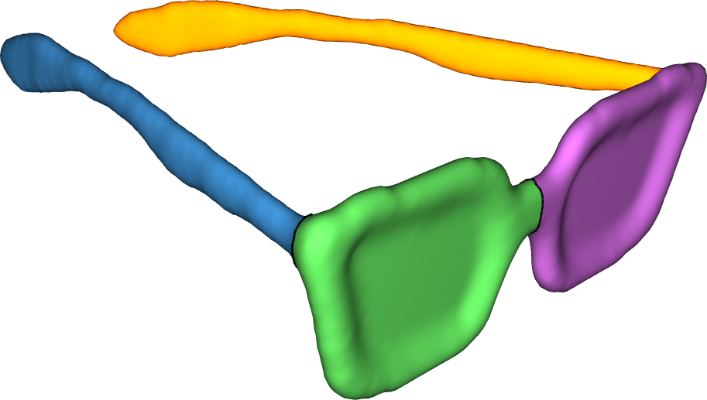
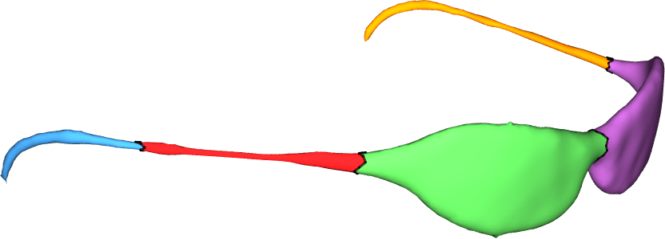
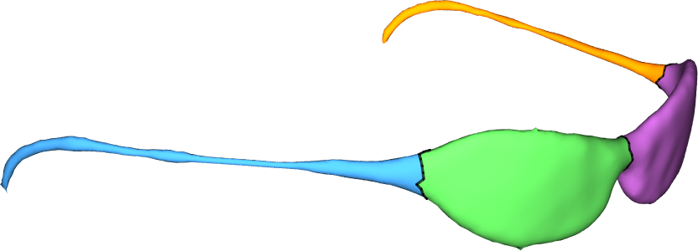
Type I: Consistent segmentation
Extraneous geometric clues
Single shape segmentation
[Chen et al. 09]
Joint shape segmentation
[Huang et al. 11]

Slide 6
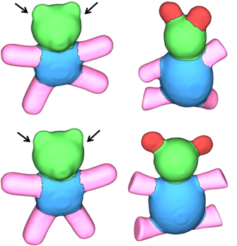
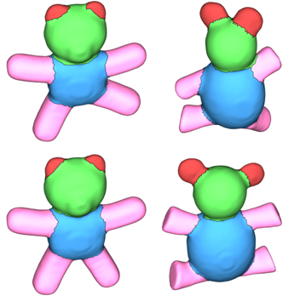
Type I: Consistent segmentation
Low saliency
Single shape segmentation
[Chen et al. 09]
Joint shape segmentation
[Huang et al. 11]

Slide 7
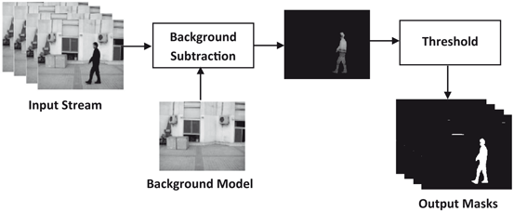
Type II: Variability-driven techniques
[Shaikh et al. 14]
Object maps are identity maps

Slide 8
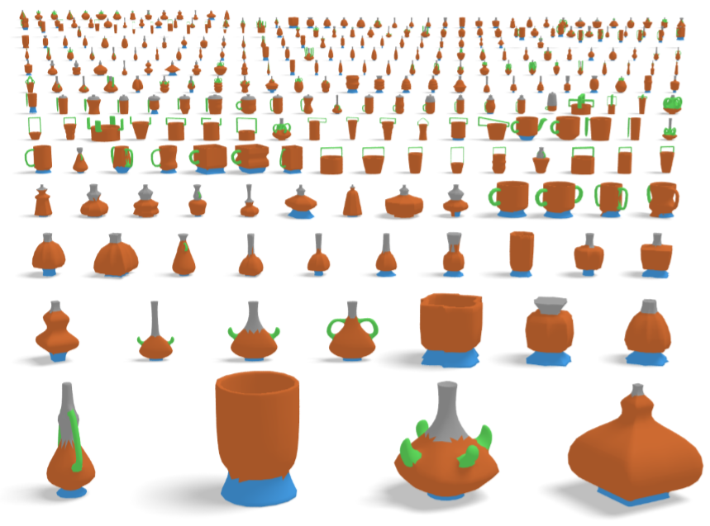
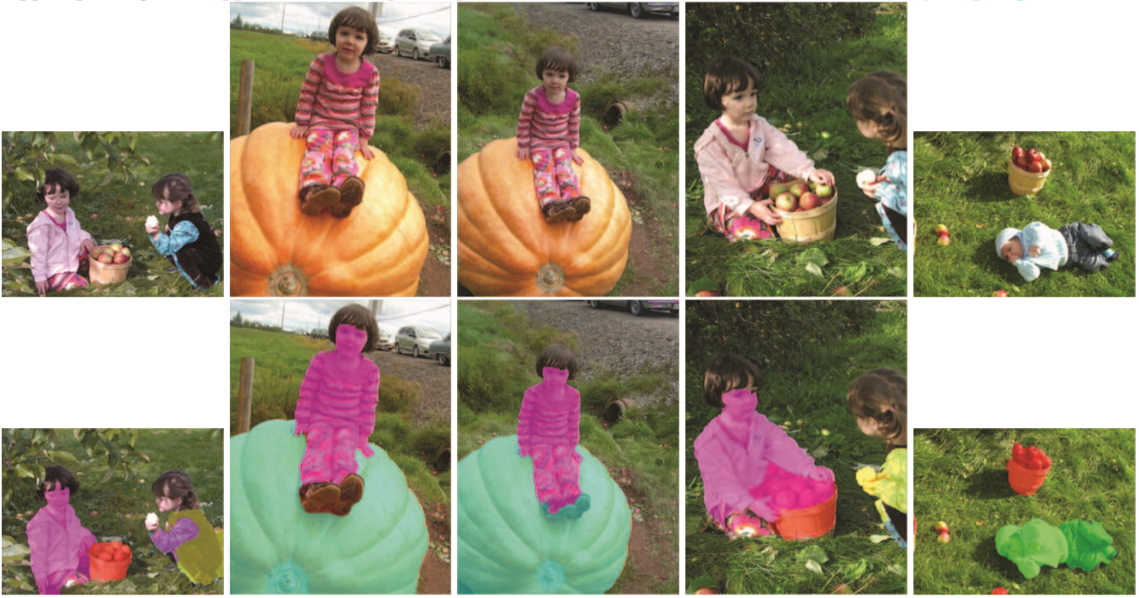
Need to establish high-quality maps on heterogeneous datasets

Slide 9
Three axes
Map representation
Variability-driven
Consistency-driven

Slide 10
Consistent Segmentation

Slide 11
Consistent segmentation approach I

Slide 12
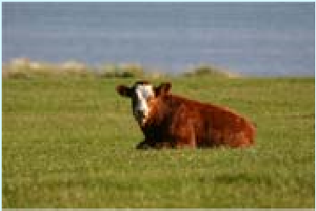
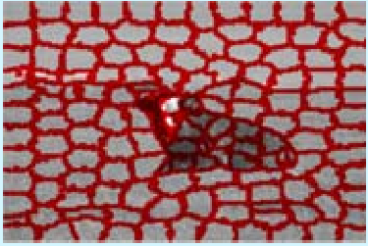
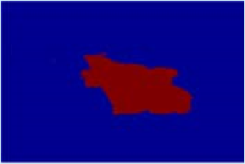

Single-object segmentation
[Shi and Malik, 2000]
Normalized
Laplacian
Data Matrix
=

Slide 13
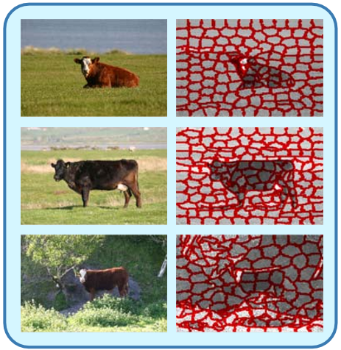
Connection Laplacian
L₁
L₂
=
L₃
Diagonal blocks are individual Laplacian matrices

Slide 14
Connection Laplacian
[Wang et al. 13]
L₁
L₂
=
L₃
Off-diagonal blocks are zero -> segmenting images independently

Slide 15
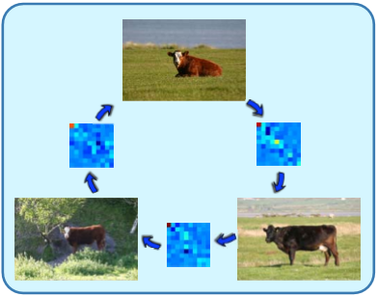
Connection Laplacian
[Wang et al. 13]
L₁
X₁₂
X₁₃
X₂₁
L₂
X₂₃
=
X₃₁
X₃₂
L₃
Off-diagonal blocks are maps -> consistent segmentation

Slide 16
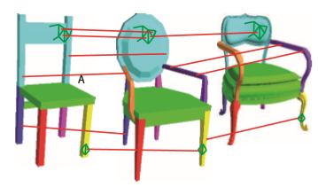
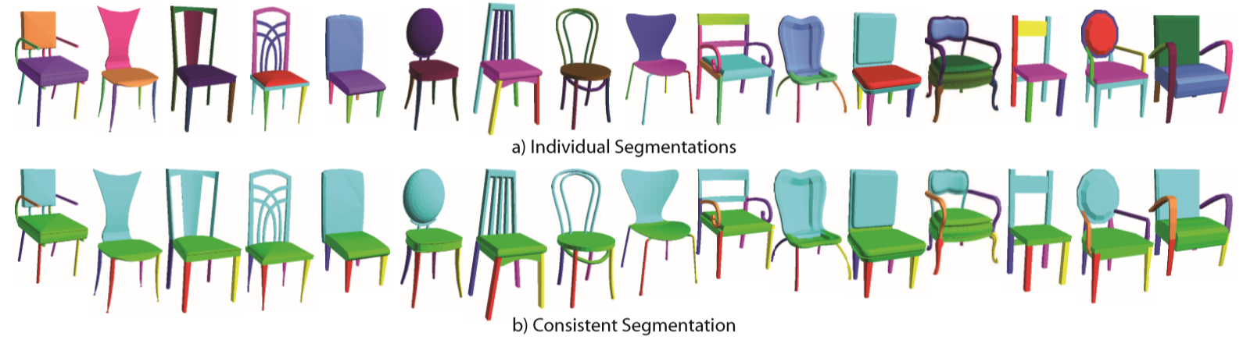
Consistent segmentation of 3D models
[Golovinskiy and Funkhouser 09]
Point correspondences

Slide 17
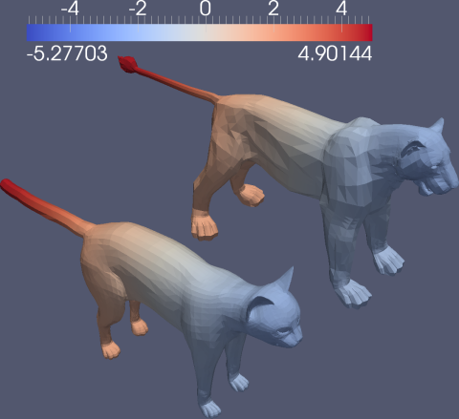
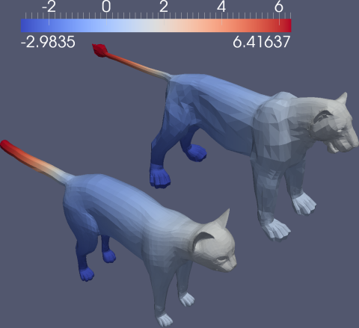
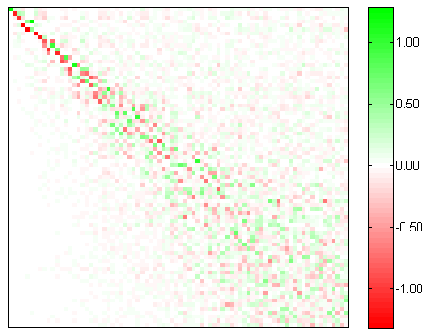
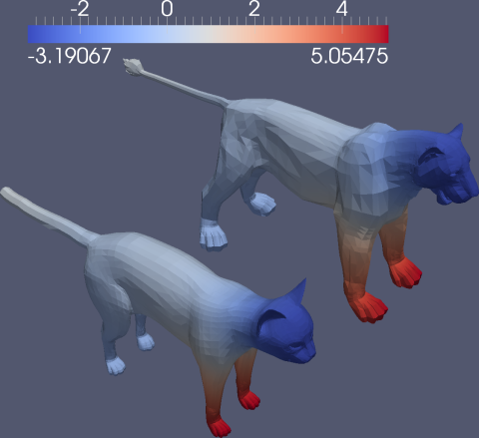
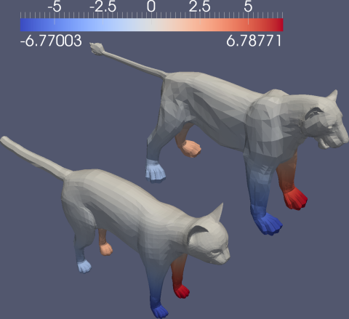

Functional maps
[Ovsjanikov et al. 12]
Addressing the curse of dimensionality
from cat to lion
F is a linear operator (matrix)
Functions on cat are transferred to lion using F

Slide 18
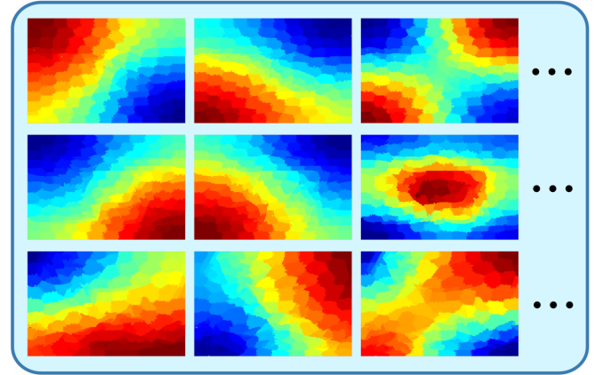
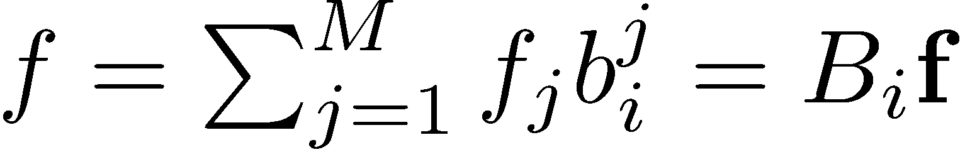
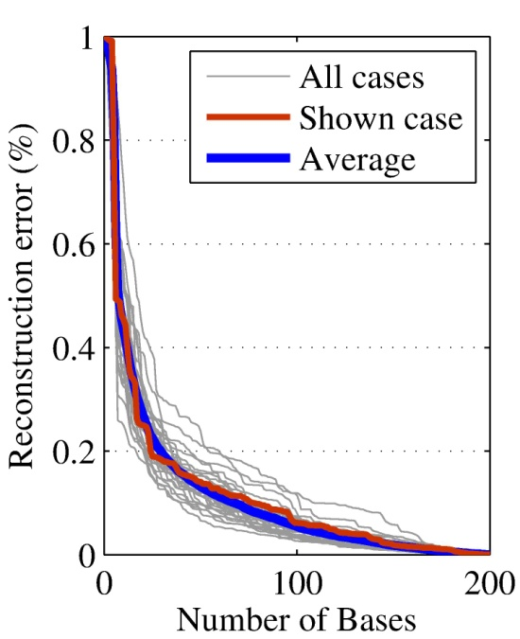
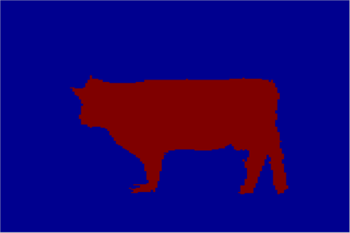
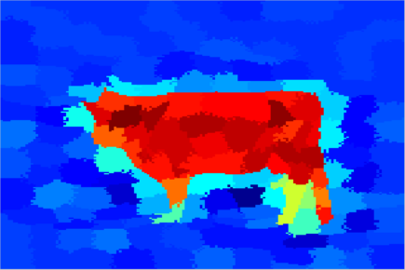
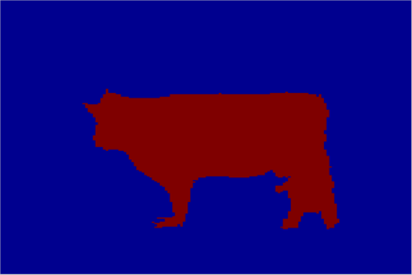
Functional maps between images
[Wang et al. 13]
Basis of functional space
First M Laplacian eigenfunctions of the graph
Reconstruct any function with small error (M=30)
Binary indicator function
Reconstructed function
Thresholded
reconstructed function
Reconstruction error

Slide 19
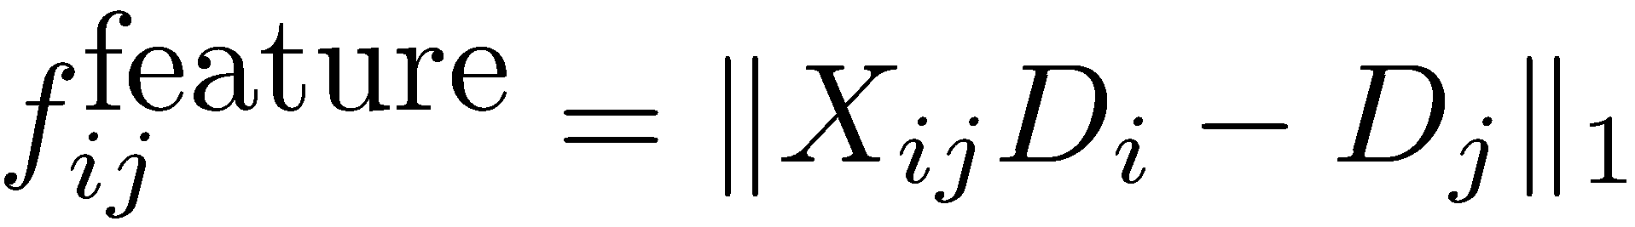
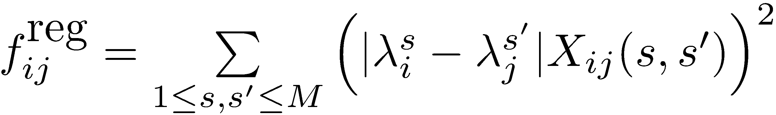


Computing functional maps
Descriptor alignment
Frequency alignment
Map consistency
Image global similarity weight via GIST

Slide 20




Functional map synchronization
Overall optimization
Alternating optimization:
  Fix Y, solve X Independent QP problems
  Fix X, solve Y Eigenvalue problem

Slide 21

The importance of consistent functional maps
Class | N | L | Kuettel ’12 | Fmaps -s | Fmaps -uns
Plane | 178 | 88 | 90.7 | 92.1 | 89.4
Bus | 152 | 78 | 81.6 | 87.1 | 80.7
Car | 255 | 128 | 76.1 | 90.9 | 82.3
Cat | 250 | 131 | 77.7 | 85.5 | 82.5
Cow | 135 | 64 | 82.5 | 87.7 | 85.5
Dog | 249 | 121 | 81.9 | 88.5 | 84.2
Horse | 147 | 68 | 83.1 | 88.9 | 87.0
Sheep | 120 | 63 | 83.9 | 89.6 | 86.5

Slide 22
Consistent segmentation approach II

Slide 23


Joint optimization of segmentation and maps
[Huang et al. 11]
Objective:

Slide 24



Constrained optimization
[Huang et al. 11]

Slide 25
Variability-driven segmentation

Slide 26

Why Chair’s Back is a Part?

Slide 27


Shape algebra for partial similarity
[Huang et al. 19]
X is not full-rank
Ker(X) corresponds
to the indicator space
of the missing part
A cut on the original shape
based on the indicator of each point
to the kernel space
Functional map X

Slide 28

One shape is insufficient
[Huang et al. 19]

Slide 29


Experimental valuation
[Huang et al. 19]
More shapes
Better segmentations
Large variation
Better segmentations

Slide 30


Magic behind this
[Huang et al. 19]
Cycle voting + tensor matrix recovery

Slide 31
Joint Symmetry and Map Synchronization

Slide 32



Symmetric objects are ubiquitous
[Sun et al. 2018]
[Ranson and Stockley 10]
[André et al. 07]
Daily objects
Biological/chemical objects

Slide 33



Multiple plausible
self-maps and pair-wise maps

Slide 34


Symmetry detection first?
Symmetry detection is difficult, particularly in the presence of partial observations
Dome of the Rock

Slide 35



Two correlated problems
Symmetry detection
improves matching
Better symmetry detection
through information aggregation
[Ovsjanikov et al. 13]
[Tevs and Huang et al. 14]

Slide 36

Using the product operator - lifting
Linear programming or semidefinite programming relaxations for MAP inference
[Wainwright and Jordan 08, Kumar et al. 09, Huang et el. 14,….]

Slide 37



Properties of lifting
Proposition: If the orbit size is equal to the group size, then we can recover G from Q

Slide 38


Low-rank factorization
Q₀₀
Q:
=

Slide 39
Low-rank matrix recovery
Block-wise L1-norm for robust recovery
Low-rank constraint
Spectral initialization
Alternating minimization
Greedy rounding

Slide 40


Stool dataset

Slide 41


Slide 42


Slide 43


Quantitative Evaluations
Joint map and symmetry synchronization improves symmetry detection

Slide 44


Quantitative Evaluations
Joint map and symmetry synchronization improves mapping
  With respect to the closest map (not correspondence)

Slide 45
Free Labels for Training Neural Networks?

Slide 46
Agenda
09:00 am – 09:15 am: Introduction (Qixing Huang)
09:15 am – 10:15 am: Correspondences and transformations (Xiaowei Zhou)
10:15 am – 10:45 am: Unsupervised object/part discovery (Qixing Huang)
10:45 am – 11:00 am: Break
11:00 am – 11:50 am: Cross-domain mapping (Junyan Zhu)
11:50 am – 12:25 pm: Theoretical aspects (Qixing Huang)
12:25 pm – 12:30 pm: Concluding remarks (All Together)

