Slide 1
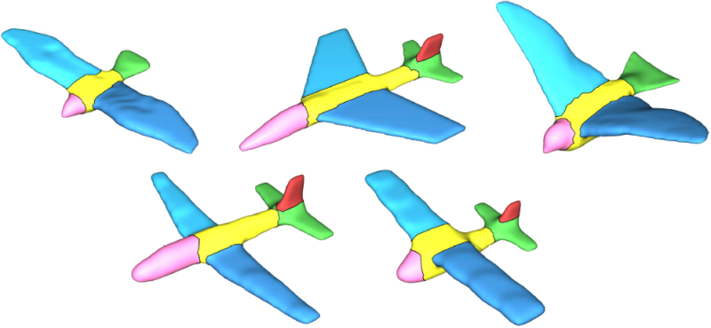

Joint Shape Segmentation with Linear Programing
Qixing Huang
Vladlen Koltun
Leonidas J. Guibas

Slide 2
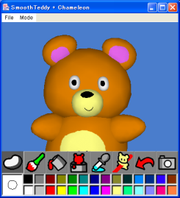
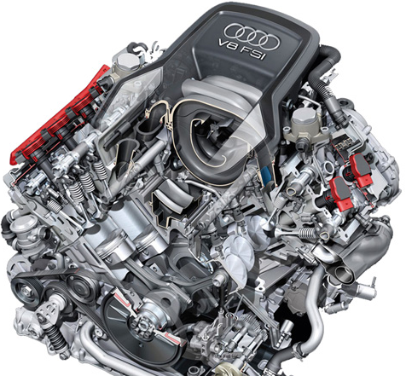
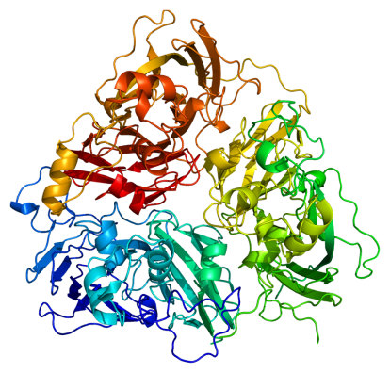
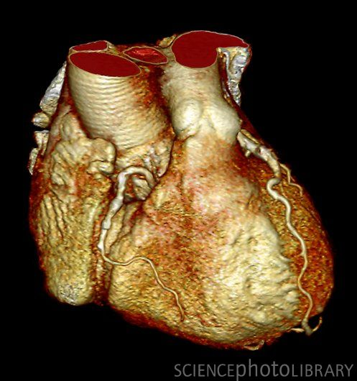


3D Shapes
Large repositories of 3D data are becoming available
Shape Modeling
Mechanical CAD
Molecular Biology
Medicine
Cultural Heritage
Buildings
Notes:
With the help of advances in shape modeling, now it is easy to obtain 3d shapes that describe physical objects in the world.

Slide 3
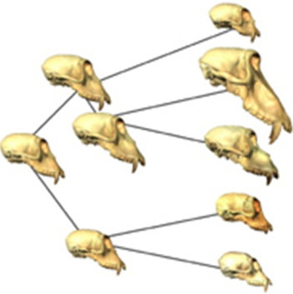

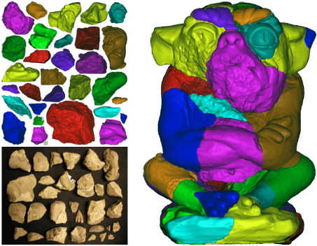
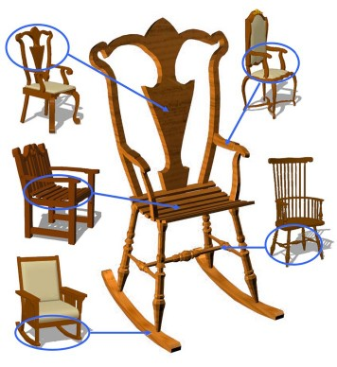

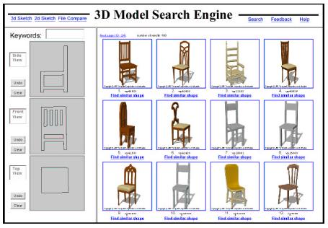
Applications
[Wiley et al.05]
[Cooper et al.10]
[Huang et al.06]
Paleontology
Protein folding
Solving puzzles
[Funkhouser et al.04]
[Gal et al.09]
[Funkhouser et al.05]
Modeling & Editing
Product search
Notes:
Given the boost in 3d shapes, there is on-going interest in applying and utilizing 3d shapes to solve problems in both scientific domains and industry. These applications include understanding of the evolution of human beings, simulating how proteins fold, solving 3d puzzles, shape modeling and editing and shape-driven product search. The success of these applications relies on how well computers can understand shape semantics.

Slide 4
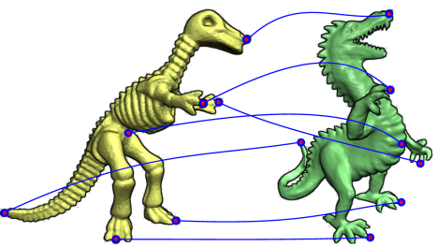
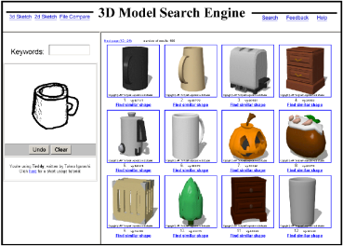
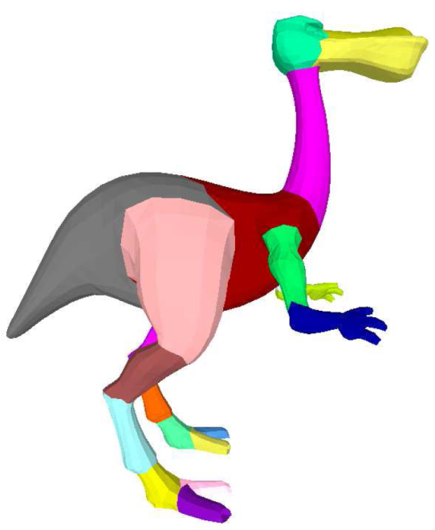
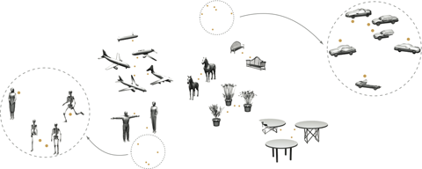
Shape Analysis Tasks
Design algorithms to extract semantic information from one or a collection of shapes
[van Kaick et al. 11]
[Funkhouser et al. 05]
Matching
Retrieval
[Karz and Tal 03]
[Mitra et al. 06]
Segmentation
Classification & Clustering
Notes:
This leads to a research field in computer graphics called shape analysis, which is also appears in the title of this section.The basic goal of shape analysis is to design algorithms to extract semantic information from on or a collection of shapes. There are many primitive tasks in shape analysis. In this presentation, I will focus on shape segmentation because of its fundamental importance.

Slide 5
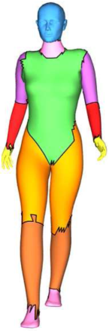

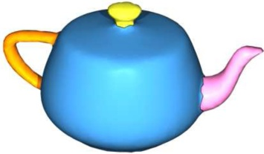
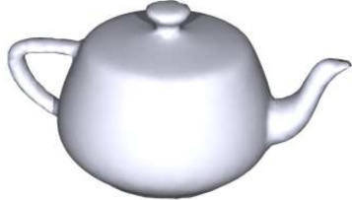
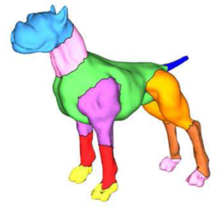
Importance of Shape Segmentation
"How can we decompose a 3D model into parts?"
Psychological research indicates that recognition and shape understanding are based on structural decomposition of the shape into smaller parts [Hoffmann et al. 84,97]
Applications in other shape analysis tasks such as shape matching and shape recognition
Notes:
There are many evidences stating that shape segmentation is important. For example, psychological research indicates that recognition and shape understanding are based on structural decomposition of the shape into smaller parts. On the other hand, meaningful segmentations provide a shape representation that are helpful for other shape analysis tasks such as shape matching and shape recognition.

Slide 6
Related Works
Notes:
Shape segmentation is important but new, there is an extremely rich literature in it. Most of shape segmentations are based on single shape based.

Slide 7
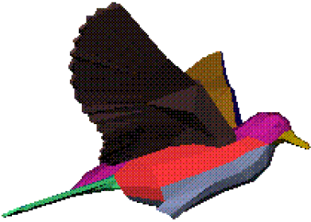
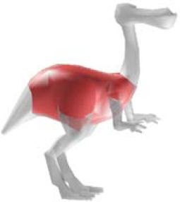
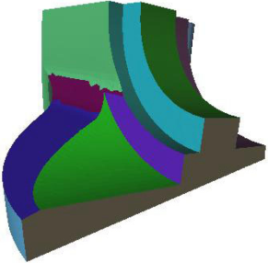
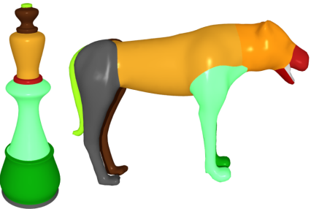
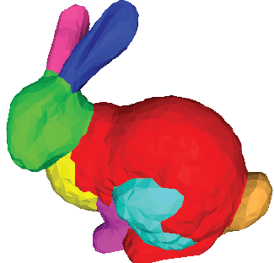
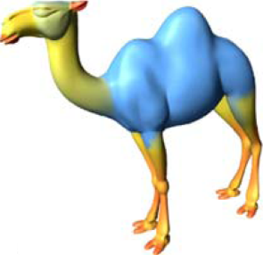
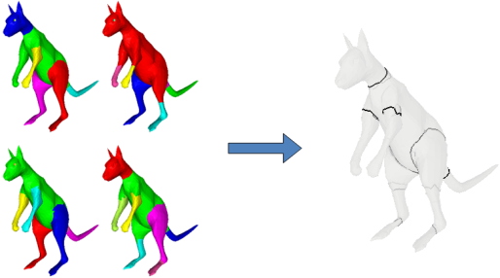
Single-Shape Segmentation
[Shalfman et al. 2002]
[Katz et al. 05]
[Attene et. al 2006]
[Lai et al. 08]
K-Means
Core Extraction
Fitting Primitives
Random Walks
[Golovinskiy and Funkhouser 08]
[Shapira et al. 08]
[Golovinskiy and Funkhouser 08]
Normalized Cuts
Shape Diameter Function
Randomized Cuts
Notes:
Most shape segmentation methods are single-shape based. The basic idea is to segment a shape such as certain objective function is satisfied or certain criteria is met. In the literature, various objectives have been proposed, this slide shows representative ones.

Slide 8
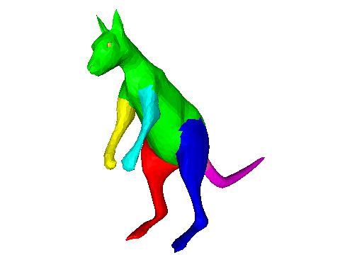
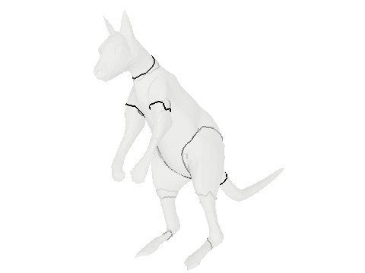
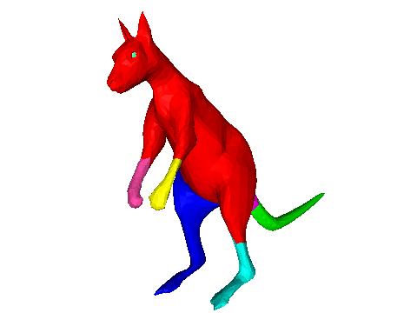
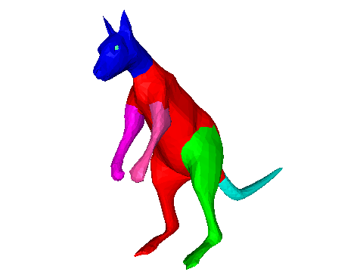
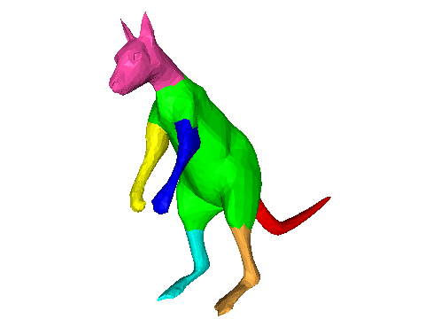
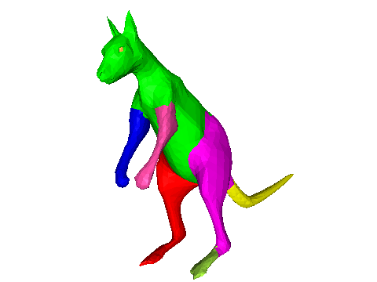
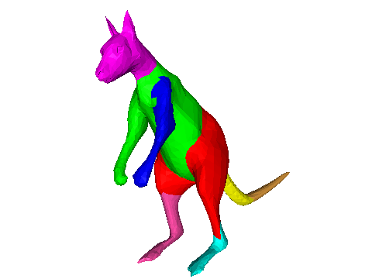
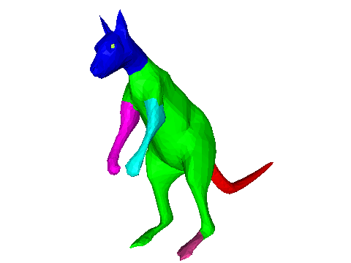
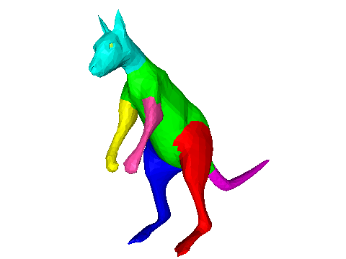
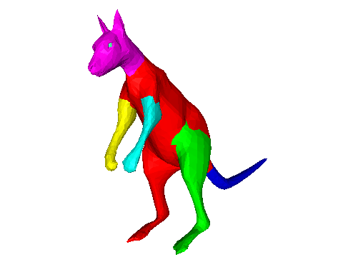
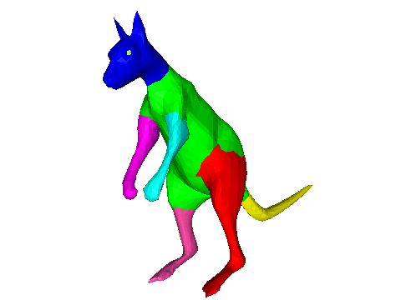
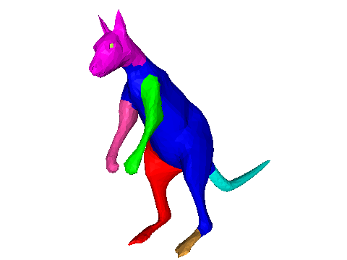
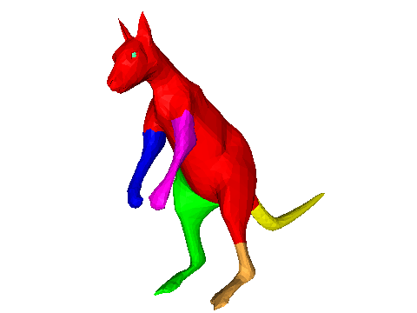
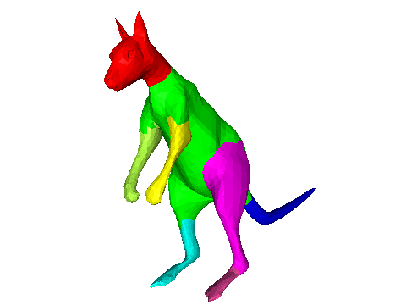
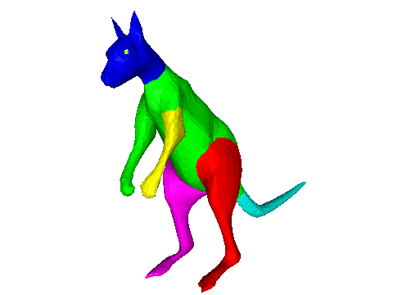
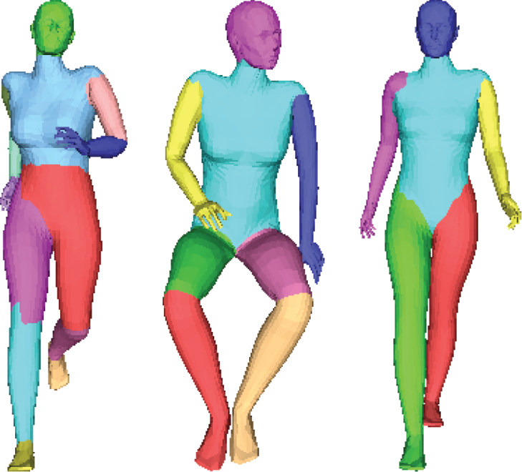
Randomized Cuts [Golovinskiy and Funkhouser 08]
[Slide from Golovinskiy and Funkhouser 08]
Partition Function
Inconsistent across
different poses
Notes:
As it is impossible to enumerate all

Slide 9
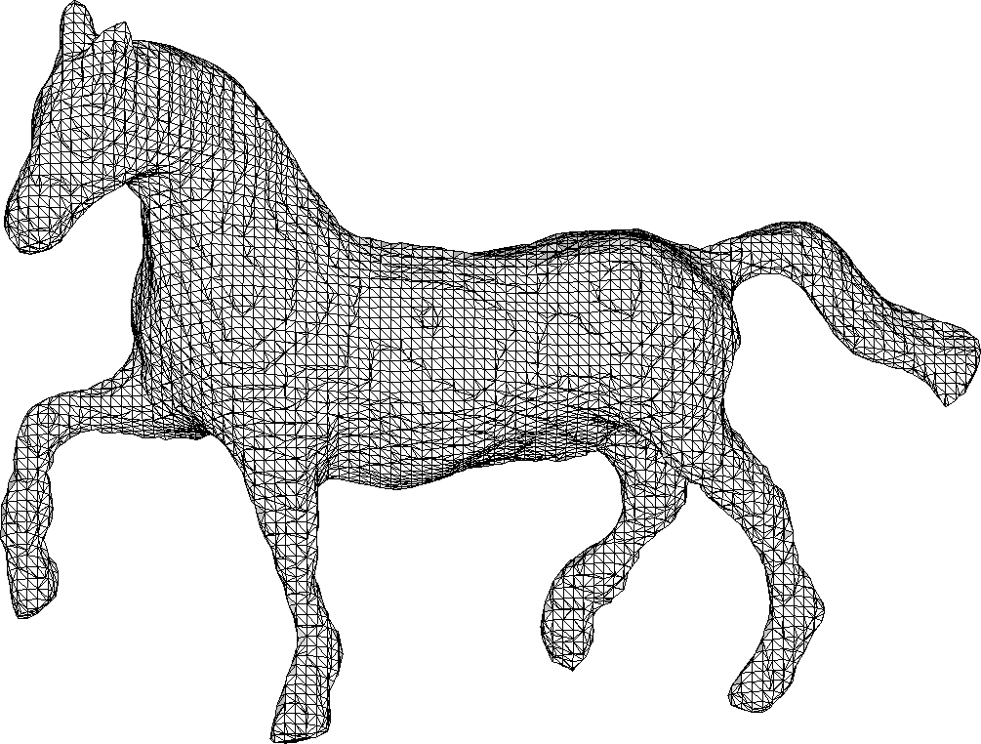
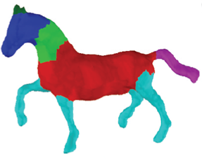
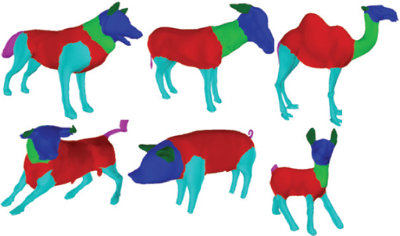

Supervised Methods [Kalogerakis et al.10, van Kaick et al. 11]
[Slide from Kalogerakis et al.10]
Input Mesh
Labeled Mesh
Head
Neck
Torso
Leg
Tail
Training Meshes
Ear
Limitations
  Prior knowledge of the category
  Shape variation within each category shall be small

Slide 10
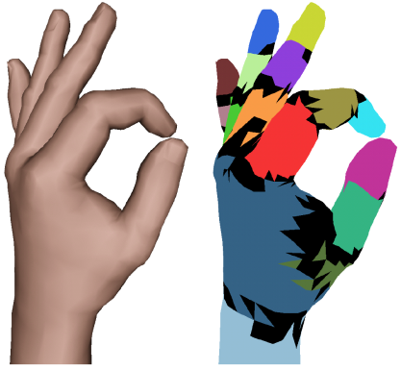
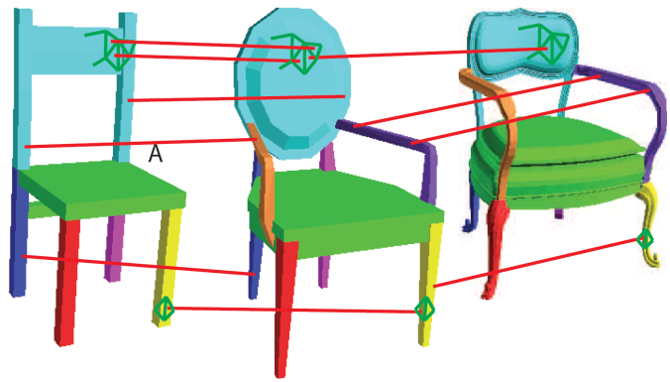
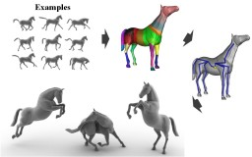
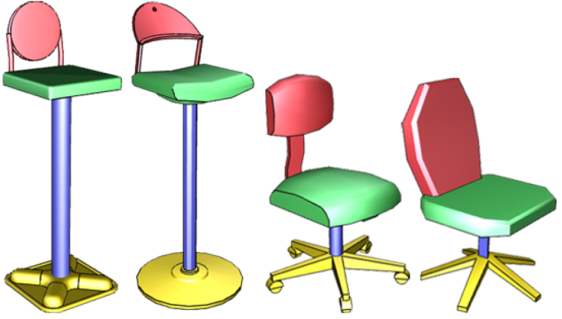
Consistent Segmentations
pre-computed corres.
rigid corres.
[James and Twigg 05]
[Golovinskiy and Funkhouser 09]
Skinning Mesh Animations
Consistent segmentations
[Schaefer and Yuksel 07]
[Xu el al. 10]
Example-based skeleton extraction
Co-segmentation
Notes:
Another flavor of unsupervised data-driven segmentations are based on computing correspondences across shapes. However, existing methods are limited in either pre-computed correspondences or rigid correspondences. Our method also fall in this category, but we can incorporate correspondences between arbitrary shapes.

Slide 11
Joint Shape Segmentation
Notes:
Now I will begin the introduction of joint shape segmentation.

Slide 12
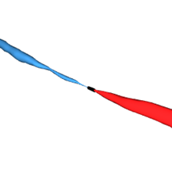
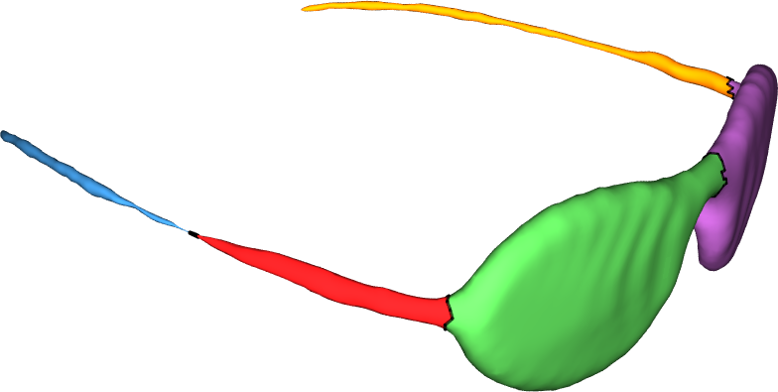
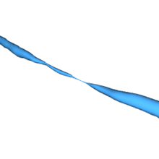









Motivations
Structural similarity of segmentations
Extraneous geometric clues
Single shape segmentation
[Chen et al. 09]
Joint shape segmentation
[Huang et al. 11]
Notes:
In joint-shape segmentation, we want to take two advantages that are bought by having a collection of similar shapes. First, the first advantage is to enforce the structural similarity of segmentations. By structural similarity I mean the similarly between graphs of segment. Enforcing structural similarity is particularly useful when shapes are presented with extraneous geometric clues or local salient cuts.

Slide 13


Motivations
Structural similarity of segmentations
Low saliency
Single shape segmentation
[Chen et al. 09]
Joint shape segmentation
[Huang et al. 11]

Slide 14












Motivations
(Rigid) invariance of segments
Articulated structures
Single shape segmentation
[Chen et al. 09]
Joint shape segmentation
[Huang et al. 11]
Notes:
Another advantage is to enforce the invariance of parts, this is particularly useful for shapes that have articulated structures.

Slide 15


Pair-wise Joint Segmentation
Objective:
Outline:
Segmentation parameterization
Segmentation score
Consistency score
0-1 linear programming formulation
Notes:
Let us start with a easy problem: the joint segmentation of a pair of shapes. We formulate pair-wise joint segmentation as an optimization problem: the objective function combines the score of each individual segmentation and the consistency score between them. Here the structural similarly and invariance of segments are incoporated in the consistency term. Here is a outline for the new few slides, I will first talk about how to parameterize possible segmentations of a shapes such that we are able to optimize in this space. Then I will talk about how to formulate the consistency score. Finally I will present a 0-1 linear programming formulation to this problem.

Slide 16


















Segmentation Parameterization
Randomized Cuts
Shape Diameter
[Shapira et al. 08]
Random Walks
[Lai et al. 08]
Normalized Cuts
[Golovinskiy and
Funkhouser 08]
Initial Segments
Notes:
A segmentation is given by a set of segments. How to find these segments. If you look at what single-shape segmentation methods do. Although globally the results are poor, but each method does introduce some meaningful segments. This motivates the idea used in this paper, we apply randomied cuts for each shape and collect all distinct segments into an initial segment set.

Slide 17





Segmentation Parameterization
Segmentations: subsets of initial segments obtained from randomized segmentations
Randomized Cuts
Initial Segments
Notes:
Now given those initial segments, each segmentation is given by a subset of initial segments. For example, this subset of segments forms a segmentation. If you take another subset, it gives you another segmentation.

Slide 18
Segmentation Parameterization
Segmentations: subsets of initial segments obtained from randomized segmentations
Segmentation constraints: each point is in exactly one segment
Randomized Cuts
The set of initial segments
that cover point p
Initial Segments
Notes:
However, not all subsets form a valid segmentation. In other words, a subset of segments form a valid segmentation if each point is in exactly one segment.

Slide 19

Segmentation Parameterization
Segmentations: subsets of initial segments obtained from randomized segmentations
Segmentation constraints: each point is in exactly one segment
Segmentation score
Randomized Cuts
Prevent tiny segments
Repetitions
Initial Segments
Notes:
For the segmentation score, we define it as the weighted sum of segment repetitions in randomized segmentations.

Slide 20


Segmentation Parameterization
Randomized Cuts
Patches
[Golovinskiy and
Funkhouser 08]
Super-pixels
[Ren and Malik 03]
Initial Segments
Notes:
. In implementation, we first segment each shape into patches using normalized cuts and perform randomized cuts based on this patch representation. Each segment s a subset of patches. This strategy improves efficiency and stability when counting distinct segments.

Slide 21



Consistency Term
Defined in terms of mappings
  Oriented
  Partial
Many-to-one correspondences
Partial similarity
Notes:
We define the consistency score between two segmentations based on the score of the best mappings between them. This is intutive because two segmentations are consistent if you can find a good mapping that map segments to segments. However, we need to careful aout the type of mappings we are using. First it has to be oriented what allows many-to-one correspondences. Second, it could be partial to account for partial similarity. In summary, a valid is a set of correspondences where each segment from the source shape belongs to at most one correspondence.

Slide 22





Consistency Term
Defined in terms of mappings
  Oriented
  Partial
Mapping score [Anguelov et al.05]
Correspondence weight [Osoda et al. 02]
Adjacent correspondence pair weight
Notes:
The mapping score combines the two terms. The first term is the sum of correspondence weights. The invariance a segment is enforced here. The second term states a good mapping should map adjacent correspondences to adjacent correspondence. This enforces the structural similarity.

Slide 23
Consistency Term
Defined in terms of mappings
  Oriented
  Partial
Mapping score [Anguelov et al.05]
Consistency score
Notes:
Given the mapping score, the consistency score is defined as the sum of the best mapping scores in both directions.

Slide 24



Constrained Optimization
Notes:
In summary, pair-wise joint-segmentation is formulated as the following optimization problem. In the next few slides, I will show how to convert it as solving a 0-1 linear program, where both the objective function and the constraints are linear and variables are binary integers.

Slide 25




0-1 Linear Programming Formulation
Introduce binary indicators
Segments
0
1
1
Notes:
The basic idea is to introduce binary indicators. We have indicators associated with initial segments. 1 means this segment is selected, 0 means not.

Slide 26



0-1 Linear Programming Formulation
Introduce binary indicators
Segments
Correspondences
1
0
Notes:
We do this for correspondences and pairs of adjacent correspondences induced from the initial segments.

Slide 27


0-1 Linear Programming Formulation
Introduce binary indicators
Segments
Correspondences
Correspondence pairs
1
0

Slide 28
0-1 Linear Programming Formulation
Introduce binary indicators
Segments
Correspondences
Correspondence pairs
Objective function:
Notes:
Given this, it is easy to write down the objective as a linear function.

Slide 29


0-1 Linear Programming Formulation
Introduce binary indicators
Segments
Correspondences
Correspondence pairs
Segmentation constraints:
Matrix representation:
Notes:
Using segment indicators, the segmentation constraints are given by linear equalities: The sum of the indicators of segments that cover each point should be 1.

Slide 30




0-1 Linear Programming Formulation
Introduce binary indicators
Segments
Correspondences
Correspondence pairs
Mapping constraints:
Notes:
We also have mapping constraints which guarantee the selected correspondings form a valid mapping between the segmentations, which are specified by selected segments.

Slide 31




0-1 Linear Programming Formulation
Introduce binary indicators
Segments
Correspondences
Correspondence pairs
Compatibility constraints:
Notes:
Moreover, the selected correspondence pairs should be consistent with selected correspondences. These constraints are formulated in the same spirit as the segmentation constraints. And please refer to the paper for details

Slide 32










0-1 Linear Programming Formulation
Linear programming relaxation
Notes:
Combing objective function and constraints, we arrive at the following 0-1 linear programming formulation. We solve this problem by solving its linear programming relaxation where variables are allowed to take real-values between 0 and 1. After that, we round the possible real-value solutions into integer solutions. Again please refer to the paper for details.

Slide 33


Similar Shapes
As a by-product, pair-wise joint segmentation determines pairs of similar shapes
Similar
Less similar

Slide 34

Multi-way joint segmentation
Input shapes
  Different objects
  Different categories
Notes:
The extension from pair-wise joint segmentation to multi-way joint segmentation is straight-forward. We first perform all pair-wise joint segmentation to determine the set of similar shapes. Because pair-wise joint segmentation determines whether you can find a structural mapping map between them. For multi-way joint segmentation, we just optimize the segmentation score of each segmentation and the consisency score between pairs of segmentations.

Slide 35

Multi-way joint segmentation
Perform all pair-wise joint segmentation to determine pairs of similar shapes
Notes:
The extension from pair-wise joint segmentation to multi-way joint segmentation is straight-forward. We first perform all pair-wise joint segmentation to determine the set of similar shapes. Because pair-wise joint segmentation determines whether you can find a structural mapping map between them. For multi-way joint segmentation, we just optimize the segmentation score of each segmentation and the consisency score between pairs of segmentations.

Slide 36


Multi-way joint segmentation
Objective function
Notes:
The extension from pair-wise joint segmentation to multi-way joint segmentation is straight-forward. We first perform all pair-wise joint segmentation to determine the set of similar shapes. Because pair-wise joint segmentation determines whether you can find a structural mapping map between them. For multi-way joint segmentation, we just optimize the segmentation score of each segmentation and the consisency score between pairs of segmentations.

Slide 37


Multi-way Joint Segmentation
Formulation
Notes:
Here is the linear programming formulation with relaxed variables.

Slide 38


Multi-way Joint Segmentation
Revised Formulation
Two independent constraint sets
Notes:
We use an alternating optimization strategy to solve this big system efficiently. The idea is to replace x_{i} by x_{ij} here x_{ij} are latent variables.

Slide 39


Alternating Optimization
Shape-wise optimizations:
Pair-wise optimizations:
Notes:
This revised optimization problem can be solved by alternating between shape-wise optimizations and pair-wise optimizations, please refer to the paper for details.

Slide 40

Princeton Segmentation Benchmark [Chen et al. 09]
380 shapes in 19 categories
Manual segmentations for each shape (4300 in total)
Notes:
Let me show you some results now. We have evaluated joint shape segmentation on the Princeton Segmentation Benchmark, which includes 380 shapes in 19 categories. Segmentations are evaluated against manual segmentations.

Slide 41
Princeton Segmentation Benchmark [Chen et al. 09]
Joint : Joint shape segmentation per each category
JointAll : Joint shape segmentation over the entire database
Rand index metric [Rand 1971] - the smaller, the better
Significantly better than single shape segmentations
Competitive against supervised segmentation
JointAll is slightly better than Joint
Notes:
We have performed joint-shape segmentation in two setting. In Joint setting, we perform joint shape segmentation per each category. In JointAll setting, we perform joint shape segmentation over the entire database. For evaluation, we basically show the rand index value here. Results of other evaluation metrices are similar and can be found in the paper. In terms of the rand index metric which is the likely hood of two points are in different segments of one segmentation but are in the same segment of the other segmentation. We can found that joint shape segmentation is significantly better than single shape segmentations here SD and RC represent shape diameter and randomized cuts which are two leading single shape segmentations methods. Second, joint-shape segmentation is competitive against supervised segmentation. Third, JointAll is slightly better than Joint

Slide 42

Rand Index Scores on PSB [Chen et.al 09]
When shape variation of the input is big
Top: Joint
Bottom: JointAll
Notes:
Joint-shape segmentation works best if per category shape variation is big.

Slide 43

Rand Index Scores on PSB [Chen et.al 09]
When shape variation of the input is small
Top: Joint
Bottom: JointAll
Notes:
When shape variation is small, the performance of joint-shape segmentation is close to randomzied cuts (RC). Supervised method outperforms our method in this case. JointAll is better thanJoint in this case, because it increases the shape variation of the input.

Slide 44


Versus Supervised Method [Kalogerakis et al.10]
Supervised segmentation
Joint shape segmentation
Notes:
Here is a visual comparison between joint-shape segmentation and supervised segmentation when the shape variation of the input is big. The problem with supervised segmentation is that it is hard to find descriptive goal features in this case. While our method, we allows partial matching, works well in this case.

Slide 45



Joint versus JointAll
Notes:
This is my favorable example where the neck of human models, which are weak segments, are identified by enforcing the structural similarity with fourleges models whose necks are prominent.

Slide 46


Rand Index Scores on PSB [Chen et.al 09]
Failure case
Notes:
This slides shows a failure case where the tentacles of octopus models are over-segmented by enforcing its similarity to ant models.

Slide 47
Conclusion
Joint-shape segmentation
  Takes a set of unorganized shapes as input
  Enforce structural similarity and segment invariance between segmentations of pairs of similar shapes
  Significant better than single-shape segmentations
  Competitive against supervised segmentations
Formulating it as solving a 0-1 linear program
Optimization Strategy
  Linear programming relaxation
  Alternating optimization

Slide 48
Acknowledgement
Anonymous reviewers
Stanford-KAUST AEA grant
NSF gants 0808515 and 1011228
Stanford Graduate Fellowship

Slide 49
Thank You!

Slide 51
Timing
#Initial segments: 200
Joint setting: 23 mins in average
Joint all: 31 hours

Slide 52

Different Levels of Similar Shapes
very similar shapes
less similar shapes
Notes:
Ok, in joint shape segmentation, there is a important threshold which determines the set of similar shapes. This plot shows the effect of this threshold. When the threshold is high where we only incorporate very similar shapes, we can see the rand index increases drastically. On the other hand, if we incoporate less similar shapes, the rand index value all increases, but the slope is much smaller. I think this is because the contributions of these pairs of shapes to the objective function is small.

Slide 53





Segment Weights
Frequency in randomized
segmentations
Most similar segment
on each other shape
Geometry based similarity score
Notes:
One can certainly weight initial segments based on their repetitions in the randomized segmentations. However, because of low saliency, correct segments might be rated very low. In this case, one has to retain a lot of initial segments. Instead, we use a strategy which determines segment weights jointly. More precisely, the weight is given by the weighted sum of frequencies of most similar segment on each other shape, where the weight is determined by the score of similarity. Under this strategy, a segment which might have low frequency on one shape, could have big weight if its counterpart on other shapes have big weights.

Slide 54



Unsupervised Co-segmentation [Sidi et al. 11]
Initial segmentations
Segment clusters
Result

