Slide 1
Word-level Sequential Memory Abstraction for Model Checking
Per Bjesse
November 19, 2008
TexPoint fonts used in EMF.
Read the TexPoint manual before you delete this box.: A

Slide 2
An interesting observation
Even though certain complex systems contains very large memories, we can prove their correctness by reasoning about a much smaller number of memory entries at a time.

Slide 3
Our idea
We abstract a word-level design by only representing a small number of memory entries
  Writes to unrepresented slots are dropped
  Reads from unrepresented slots return nondeterministic values
We use an abstraction refinement loop to figure out what slots needs to be represented.

Slide 4
Assumptions
Problem has been cast as a word-level netlist with a single dedicated output safe signalling that the properties at hand currently hold
  We are hence checking that no trace exists to a state where safe is false
Constraints have been modelled as part of the netlist.
  All inputs are unconstrained.

Slide 5
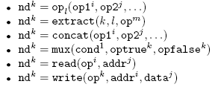
Word-level netlist format
DAG over input variables, state variables, and constant vectors.
Internal nodes (superscripts indicate number of bits in signal):
The op_{l} nodes are particular combinational functions of their inputs such as and or +

Slide 6

Memory manipulation nodes
Two internal nodes are used to model memories:
The read node projects out the interval [addr*k,…,(addr+1)*k-1] from op.
The write node returns the result of substituting data into the the interval [addr*j,…,(addr+1)*j-1] of op.

Slide 7
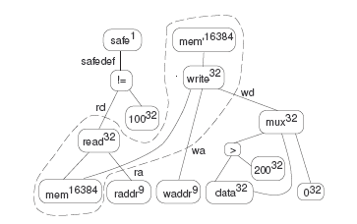
A motivating example
Memory
subsystem
  The state variable mem is initialized to contain the value zero in every slot.
  We check that we never read out the value 100.

Slide 8
The “memory interface”
write addr
read addr
wa
Memory
subsystem
ra
write data
read data
wd
rw
A read and a write happens every cycle
Reads happen before writes

Slide 9
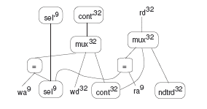
Reimplementing the memory subsystem
The new memory has a single slot represented by a variable cont initialized to zero.
The adress that is represented is stored in the variable sel. This variable is uninitialized, and never changes.
A fresh input is used to return a nondeterministic value for missed reads.

Slide 10
Checking the modified design.
The modified design clearly overapproximates the original design, so the abstraction is sound!
What happens when we try to check it?

Slide 11
Checking the modified design.
The modified design clearly overapproximates the original design, so the abstraction is sound!
What happens when we try to check it?
  FAILURE.
  The counterexample shows a run where the represented slot is different from the slot read in the last time instance, and where ndtread is equal to 100.
  Fix: We have to make sure that the selected slot always is the correct slot!

Slide 12
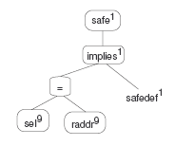
Modifying the safe output
We rewrite the safety output as follows:
The old network driving the safe output
Model checking now shows that the system is safe

Slide 13
Why is the transformations sound?
Can be seen as two steps:
  Adding the selector register sel, and rewriting the output safe to sel=raddr -> read(mem,raddr) != 100
    This preserves all counterexamples (if there are any), so it is sound---we can always pick the initial value of sel to have the value of raddr so the new safe output fails too.
  Rewriting the memory subsystem so that it only represents the slot selected by sel
    This is also sound; the newly generated memory simulates the old memory.

Slide 14
Generalizing the supported memory subsystems
Example memory subsystem:
  Single read port, single write port
  Read before write
In paper:
  Arbitrary number of read and write ports
  Any policy on read/update priorities
  We sweep the netlist and isolate memory subsystem regions that can be abstracted.

Slide 15
Generalizing the abstraction
In our example, we abstracted over the value of raddr at the current time instance.
In general we may need to do several reads correctly over time
  Forwarding multi-part messages…
We generalize this to allow abstraction over a set of pairs (node_{i}, time_{i}), where node_{i} is some netlist node and time_{i} is some integer delay.

Slide 16
Abstracting memories (ctd.)
Every abstraction pair (node_{i}, time_{i}), induces two new registers cont_{i} and sel_{i}
We generate logic that simulates the old subsystem and performs updates to the selected slots correctly (see paper).

Slide 17
Rewriting the output condition
We abstract over a set of pairs (nd_{i}, t_{i}), where nd_{i} is some netlist node and t_{i} is some integer delay.
Assume safedef is the fanin node of the safe node, and that prev(d, Á) is a temporal operator that holds precisely if t > d and Á held d timesteps ago.
We then construct safe to be the implementation of the checker
prev(t₀, sel₀ = nd₀) Æ … Æ prev(t_{N}, sel_{N} = nd_{N})
!
safedef

Slide 18
Correctness
Theorem: If the design has been abstracted using a set of abstraction pairs with maximum t_{i} equal to d, the original design is provable if:
  The transformed design is provable.
  The original design has no counterexamples of length d or shorter.
The correctness follows from a generalization of the informal argument for the motivating example.

Slide 19
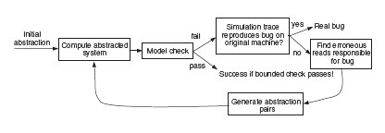
Extracting the abstraction pairs (nd_{i}, t_{i}),
The main crux is now to find a sufficient set of abstraction pairs.
We use an abstraction-refinement loop
Initial abstraction contains no abstraction pairs
We need to add pairs when we find a failure.

Slide 20
Finding new pairs
A spurious failure trace on the abstracted design must have generate the wrong output on some number of read nodes over time.
We compare the simulation trace on the original and abstract design and find a minimum set of read node outputs that needs to be fixed.
Each mismatching read node gives rise to an abstraction pair, where
  the delay is the time distance to the failure cycle
  the node is either (1) the address field of the read node, or (2) some other network node containing the current address of the read node.

Slide 21
Experimental work
We investigate the results of applying the reduction to three designs
  Industrial FIFO
  Industrial Content Addressable Memory (CAM)
  Academic high performance router
These are fundamental building blocks in more complex systems
Intractable for standard model checking due to large datapaths, intermingled with nontrivial control
We couple the memory abstraction with word-level bitwidth reduction (CAV’08).

Slide 22
Industrial FIFO
We prove that if slot is written and has not been overwritten, then it is read out correctly
Can not be solved by bit-level methods.
75 slots, 32 bits per slot
    Originally about 2500 registers.
    276 registers after abstraction (10 seconds)
    56 registers after bitwidth reduction (<1 seconds)
    Provable after 20 min BDD computations
      19000 image computations necessary.

Slide 23
Industrial CAM
Three ports, 48 slots, each 20 bits wide.
We prove that if a piece of data has been written to a slot and not overwritten, it is reported as existing in the CAM if queried
Not solvable by bit-level methods (depth 8 bounded check ¼ 17 hours).
Originally 1111 registers, all necessary.
  156 registers after abstraction (5 seconds)
  26 registers after bitwidth reduction (1 second)
  Proven correct by BDD-based checking immediately.

Slide 24
Router
High performance pipelined router with six ports
Forwards packets broken up into flits (subpackets)
  Each flit is 32 bits, and contains both payload and control data
We prove that a packet injected when the router is in a neutral state, appears at the correct port within a predetermined time.

Slide 25
Router
7516 registers before reduction
Full model provable using bit-level induction (6900 seconds)
We detect 20 simple memories, and abstract it in 200 seconds using two abstraction pairs
Post reduction we have 2196 registers.
Reduced model takes 133 seconds to prove

Slide 26
Related work
Word level formula decision procedures with efficient memory modelling
  BAT, work from NEC, …
  Makes specific choice for back-end decision procedures
  Models memories in a way that only is sound for a bounded executions.
STE with symbolic indexing
  Not a netlist-to-netlist transformation, requires user to express properties in STE logic
Program abstraction [Armando’07].
  Requires necessary memory slots to have fixed address

Slide 27
Conclusions
We have presented an approach for abstracting word-level memories for safety property checking.
  Fully automatic
  Can use any model checking technology
  Allows proofs of certain systems that are out of reach for bit level model checking.
As it is a netlist-to-netlist transformation, it combines nicely with other transformations.
Big speedups, with relatively unsophisticated analysis.

Slide 28
Thank you!

Slide 29
Features
Completely automatic, does not require user guidance
We do not commit to a specific back-end model checking procedure
    This makes our approach orthogonal to the use of other word-level methods
The method fits into a transformational verification framework
    netlist-to-netlist transformation

