Slide 1
Symbolic Program Analysis using Term Rewriting and Generalization
Nishant Sinha
NEC Labs, Princeton, NJ

Slide 2
Symbolic Execution
Symbolic Execution
Assign symbolic values to input variables
Propagate symbolic values through all program paths using a decision procedure for checking path feasibility
Issues
Path Explosion
Sequence of If-Then-Else: O(2^ ^{length of sequence})
Sequence of Loops: O(product of loop paths)
Complex Path Conditions
Due to repeated substitutions
Handled by Incremental SMT solvers effectively
Path enumeration based symbolic execution does not scale
Need a method to merge symbolic values at join points
x<= 1
x > 1
p :=
&b;
p := &a;
x<= 1
x > 1
y := *p + 1;
y := *p + 3;

Slide 3
Data-flow analysis
Provides an uniform way of merging data facts at join points
Join operators for Abstract Domains
Work list based algorithms
However, most join operators sacrifice precision (path-sensitivity) to achieve scalability
Can we devise an efficient symbolic analysis algorithm that preserves path-sensitivity, while avoiding path-enumeration?

Slide 4
Symbolic Program Analysis (SPA)
Our Solution
Data-flow analysis on program expressions (terms)
State is a condition-value tuple <C, σ >
C is the path condition, σ is a map (Var -> Term)
Merge states at join nodes
Using a choose operator
Use a decision procedure (an SMT solver) to check for satisfiability of Error path Conditions (ECs)
Use Term Rewriting and Generalization to simplify choose terms

Slide 5
Background (F-Soft)
Integer programs (+bitvector arithmetic)
Each variable assigned an integer address
Pointers have integer address values
*p = 3; translates to “v = ite(p == &v, 3, v)” for each v in the points-to set of p.
Control Flow Graph (CFG) Representation
CFG nodes have statements; edges have constraints
Call/Return edges between functions in CFG
Approximations
Bounded arrays, heap, recursion
Property Checks
Pointer validity, Array bounds violation, String checker, …
CFG instrumented with Error Blocks, check Reachability

Slide 6
SPA Example
x<= 1
x > 1
p := &b;
p := &a;
[x >1, p :-> &a ]
[x <=1, p :-> &b ]
[true, p :-> choose( (x >1, &a) , (x<=1, &b) )]
x<= 1
x > 1
y := *p + 1;
y := *p + 3;
[true, y :-> choose (
(x>1, *choose( (x >1, &a) , (x<=1, &b)) + 3),
(x <= 1, *choose ((x >1, &a) , (x<=1, &b)) + 1)
) ]
assume (x == 5)
[x==5, y :-> choose (
(x>1, *choose( (x >1, &a) , (x<=1, &b)) + 3),
(x <= 1, *choose ((x >1, &a) , (x<=1, &b)) + 1)
) ]

Slide 7
SPA Algorithm Pseudo-code
SPA () {
//Q is a reverse postorder work list of CFG nodes
while Q is not empty
n := Q.pop()
//Handle error if n is an error node
(C_{n}, σ_{n}) := process_data (n)
for each successor n’ of n
// edge (n,n’) has constraint C
C’_{n} := C σ_{n} /\ C_{n}
if C’_{n} is satisfiable
Data_{n’} := Data_{n’} U (C’_{n}, σ_{n})
Q.insert (n’)
}
process_data (n) {
D := join_data (Data_{n})
clear (Data_{n})
//St_{n} is the list of statements at node n
D’ := compute_post (D, St_{n})
return D’
}
join_data ( <(C_{i}, σ_{i})> ) {
C := C₁ V … V C_{n}
σ := {x :-> choose ( <(C_{i}, σ_{i}(x))> ) }
return (C, σ)
}

Slide 8
Queue Priority Ordering
Priority order is essential for avoiding path explosion
Reverse post order
All predecessors processed before the current node
Problem with loops
Weak total order (Bourdoncle)
SCC-based priority ordering
All nodes following a loop have lower priority than loop nodes

Slide 9
Example (contd.)
choose -> ite
x<= 1
x > 1
p := &b;
p := &a;
[(x >1, p :-> &a) ]
[(x <=1, p :-> &b) ]
[p :-> ite (x >1, &a, &b)]
[p :-> choose( (x >1, &a) , (x<=1, &b) )]
x<= 1
x > 1
y := *p + 1;
y := *p + 3;
[y :-> choose (
(x>1, *choose( (x >1, &a) , (x<=1, &b)) + 3),
(x <= 1, *choose ((x >1, &a) , (x<=1, &b)) + 1)
) ]
[y :-> ite ( x>1, *ite (x >1, &a, &b)) + 3,
*ite((x >1, &a, &b)) + 1
) ]
assume (x == 5)
[(x==5, y :-> choose (
(x>1, *choose( (x >1, &a) , (x<=1, &b)) + 3),
(x <= 1, *choose ((x >1, &a) , (x<=1, &b)) + 1)
) ]
[(x ==5, y :-> ite ( x>1, *ite (x >1, &a, &b)) + 3,
*ite((x >1, &a, &b)) + 1
) ]

Slide 10
Join leads to Complex Terms
choose/ite terms blowup after several joins
Nested ite terms are problematic for SMT solvers
Exponential search space in worst case
However, in many cases, one can exploit the ite term structure to simplify it

Slide 11
Example (contd.)
Rewrite
x<= 1
x > 1
p := &a;
p := &b;
[p :-> ite (x >1, &a, &b)]
x<= 1
x > 1
simplify(ite (C, E, E) ) = simplify(E)
simplify (ite (C, E1, E2), P)) = E1 if P => C
simplify (ite (C, E1, E2), P)) = E2 if P => !C
y := *p + 1;
y := *p + 3;
[y :-> ite ( x>1, *ite (x >1, &a, &b)) + 3,
*ite((x >1, &a, &b)) + 1
) ]
[y :-> ite (x >1, a+3, b+1)]
assume (x == 5)
[(x ==5, y :-> ite ( x>1, *ite (x >1, &a, &b)) + 3,
*ite((x >1, &a, &b)) + 1
) ]
[y :-> b +1]

Slide 12
Example with Arrays (due to M. Musuvathi)
a[0] =0;
if (p_{i}) a[i] = 0 else a[i] = 1; [ i = 1, 2, 3, 4 … ]
assert(a[0] == 0);
a_{i} :-> ite(p_{i}, store(a_{i-1},i,1), store(a_{i-1},i, 0))
To prove a[0] = 0 (select(a_{n},0) = 0), the SMT solver must consider the exponential search space for all p_{i}
Now, consider a rewrite rule provided by user
ite(p, store(a, j, x), store(a, j, y)) = store(a, j, ite(p, x, y))
Notes:
Smt solvers choke?

Slide 13
Efficient Simplification
How do we simplify effectively?
Large set of rules for simplification (ite + theory rules)
May need to add/remove rules particular to a problem
Rules may interact in unexpected ways
The theory of Term Rewriting offers a systematic way to simplify

Slide 14
Term Rewriting
Terms T(S, X) over signature S and set of variables X
Rewrite system is a set of
equations : r = s
conditional equations: (u₁ = v₁ /\ .. /\ u_{n} = v_{n}) => r = s
rewrite rules : l -> r
conditional rewrite rules
Rewriting a term “t” with a Rewrite system
Orient all equations into l -> r
Match : find subterm t’ of t, so that t = lσ
Substitute: t [ t’/rσ]
Goal: Obtain a normal form for t, where can’t apply any rewrite rule
Desirable properties: Termination, Confluence
Given an Equational theory, a Decision Procedure can be obtained by constructing a terminating and confluent rewrite system
Notes:
a set of terms, relations to transform these terms

Slide 15
Rewriting Logic
Logic for Rewrite systems
List of operators (uninterpreted symbols), sorts (types) with ordering
(Conditional) Equations and Rewrite rules on the symbols
Generic specification language for Rewrite systems
Examples
select (store (a, j, x), i) = if i = j then x else select (a, i)
ite (P, E, E) = E
Rewrite engines compile the set of rules into automata for efficient matching
Maude, ELAN, CafeOBJ, ASF+SDF engine, Stratego/XT, Tom
Flexibility to add/remove rules
Maude tool allows modular specification of Rewrite systems in Rewriting Logic

Slide 16
SPA with Rewriting
Rewrite at join points (join_data)
Invoke Maude engine on-the-fly; rules specified in text
Rewrite rules
For choose, ite, Presburger arithmetic
Rewriting logic allows seamless combination of rules for multiple theories
We show that the Rewrite system is terminating
Rewrite rules for ite
Equational axiomatization: McCarthy, Bloom-Tindell, Nelson-Oppen
Semantic: Sethi (implied, useless tests), Burch-Dill
ite+EUF: Bryant et al., Pnueli et al. , Groote-Pol

Slide 17
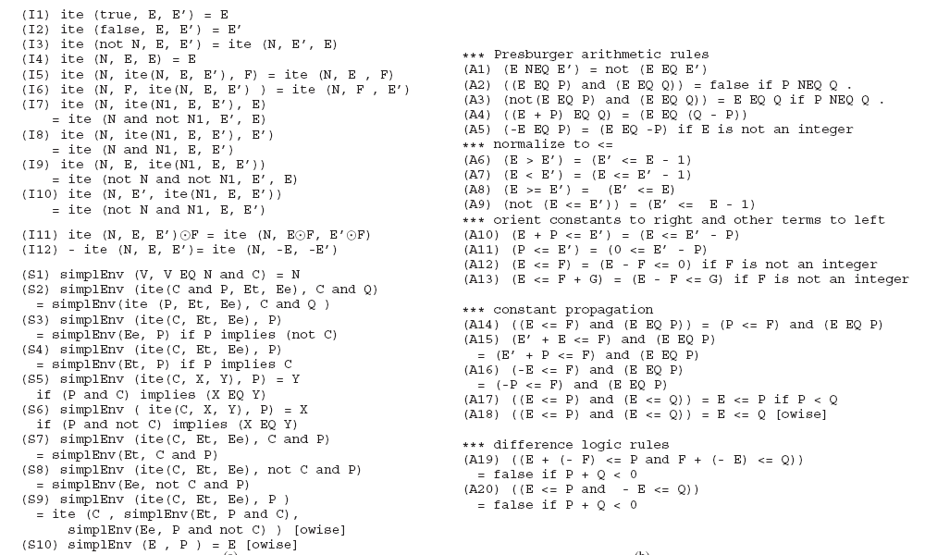
A Sample of Rewrite Rules

Slide 18
Simplification for Loops
Loop heads/exits allow another opportunity for simplification
Can capture/exploit loop structure in more compact way than nested ite terms
Loops give rise to similar parametric term values
for(i=0; i<n; i++)
i :-> choose ( (true,0), (0<n,1), (0<n /\ 1<n, 2), ..)
Generalize as: choose ( (0<= k-1 < n, k-1) ), k = 1, 2, …
Term Generalization via Anti-unification

Slide 19
(Parametric) Anti-Unification of Terms
Anti-unifier (AU) of t₁ and t₂ preserves common structure and introduces new variables for the difference
AU ( f(a, g(b, c)) , f (b, g(x,c)) ) = f (z, g(x, c)) with σ₁ = {z->a, x->b} and σ₂ = {z->b}
Parametric Anti-unification (P-AU)
Given <t₁,…, t_{n}>, find t(k), so that, t_{i} = t(k) [k->i], 1 <= i <= n
e.g., P-AU(<0, 1, 2, .., 10>) = (0<= j <= 10, j)
Intuitively, summarizing N iterations of the loop by a closed form solution
Method: Generalize from individual solutions

Slide 20
A Simple example
Bounded-Parametric term (bp-term): ∫_{i=lo}^{hi} (t(i))
∫ is an associative operator, lo and hi are bounds on i
A list is represented as <l₁, l₂, l₃ , …>
Parametric-AU ( <(a != 1), (a != 1 /\ a != 2), (a != 1 /\ a != 2 /\ a != 3)> )
MATCH : /\* (v), where
σ₁(v) = <a != 1> σ₂(v) = <a != 1, a !=2 > σ₃(v) = <a != 1, a != 2, a !=3>
PARAMETERIZE (<σ₁, σ₂, σ₃>) :
σ₁(v) = ∫_{i=1}¹ (a != i) σ₂(v) = ∫_{i=1}² (a != i) σ₃(v) = ∫_{i=1}³ (a != i)
[e.g., P-AU (1, 2, 3) -> ∫_{i=1}³ (i) ]
P-AU (<σ₁(v), σ₂(v), σ₃(v) >) : σ = ∫_{i=1}^{k} (a != i)
SUBSTITUTE : [ /\*(v) ] σ = (/\_{i=1}^{k} (a != i))
RETURN ∫_{k=1}³ (/\_{i=1}^{k} (a != i)) ---> (1<=k<=3 /\ 1<= i <= k /\ a != i)
Notes:
generalizing from individual solutions, may not get an anti-unifier

Slide 21
Loop/Array P-AU example
i := 0
[i :-> choose [ (true,0), (c₁,1), (c₂, 2), (c₃, 3) … ] ]
i >= n
where c_{k} = (a[0] != 0 /\ … /\ a[k-1] != 0)
/\ (0 <n /\ … /\ k-1 < n)
= /\^{k-1} _{j=0} ( a [j] != 0 ) /\ j < n)
a[i] != 0
so, on generalization:
[ i :-> choose ( (c_{k} /\ n_{k}, k) ) ]
where n_{k} = (k >= 0 /\ k <= loop unrolls)
i := i+1

Slide 22
Approximation for loops
SPA may not terminate, e.g., for reactive loops
Must introduce approximation to guarantee termination
Under-approximation
Iterate each loop until cannot enter or k-loop exiting values found
Not unrolling the loops before-hand
Only Errors detected soundly
Over-approximation
Iterate once; Set all variables written in loop to NON_DET
Better: combine with invariants from other domains, e.g., octagons
Only Proofs (unreachability of error locations) are sound

Slide 23
Alternative Methods
Bounded Model Checking using Program Transition Relation
Formula size blows up with depth, Loops unrolled up to fixed depth
Difficult to exploit program structure
Verification Condition (VC) Generation
Needs program annotations, e.g., loop invariants
SPA may be viewed as an operational style of VC Generation
Abstract Interpretation based Analysis
Join in common abstract domains leads to loss of precision
Eager abstraction for scalability, termination

Slide 24
Related Work
Merge-based symbolic analysis algorithms for Hardware
Symbolic Execution for Hardware: Koebl, Pixley’05
Lightweight simplification of terms; Adhoc treatment of loops
SAT query caching (Arons et al’08): complementary optimization
SSA based WP computation (Flanagan, Saxe’01, Leino’05)
Eager flattening to clauses does not allow simplification of terms
Becomes a burden on the decision procedure
Similar to Calysto (Babic, Hu’07, ‘08)
Data-flow algorithm, Term Rewriting, Generalization are our contributions
Need to incorporate function summaries

Slide 25
Implementation
Implemented in F-Soft framework for C programs
Yices SMT Solver
Maude Rewrite Engine (rules in text ~300 lines)
Compared with DFS-based symbolic execution
Optimized based on Incremental SMT solving (+IncSMT)
Fixed Depth and Loop bounds (minimum to find errors)
Compared with and without Rewriting (+/- Rew)

Slide 26
Experimental Results
Benchmark | DFS-based Symbolic Execution |  |  |  |  |  | SPA
 | -Rew, -IncSMT T(s) DP T(s) |  | +Rew, -IncSMT T(s) DP/Rew T(s) |  | +IncSMT, -Rew T(s) DP T(s) |  | -Rew T(s) DP T(s) |  | +Rew T(s) DP/Rew T(s)
tcas(p1) | TO | >1782 | 200 | 131/40 | 3 | 2 | TO | > 1720 | 88 | 20/67
tcas(p2) | TO | >1782 | 200 | 131/40 | 3 | 2 | TO | >1720 | 88 | 20/67
tcas(p3) | 104 | 103 | 3 | 2.4/0.5 | 0 | 0 | TO | >1720 | 27 | 7/19
tcas(p4) | 112 | 112 | 3 | 2.4/0.5 | 0 | 0 | TO | >1720 | 34 | 10/24
tcas(p5) | TO | >1782 | 200 | 131/40 | 3 | 2 | TO | >1720 | 88 | 20/67
M(p1-30) | 1433 | 1389 | 313 | 214/65 | 9 | 5 | TO | >1761 | 15 | 8/6
TO = 1800s, MO = 2GB

Slide 27
New Experiments (work with G. Li)
Native interface to Maude
Improved specification of conditional rewrite rules
Improved Term Library
Benchmark |  | loc | DFS-based Symbolic Execution |  | SPA
 |  |  | +IncSMT T(s) DP T(s)/Depth |  | +Rew T(s) DP/Rew T(s)
tcas(p5) |  | 550 | 3 | 2/110 | 6.39 | 0.14/6.08
M(p1-30) |  | 3500 | 9 | 5/30 | 0.93 | 0.14/0.32
H (p1-17) |  | 6775 | 55 | 20/90 | 5 | 0.16/3.59

Slide 28
Observations
Average time for each call to Rewrite engine is similar to that for SMT solver
While Incremental SMT is a powerful technology, it alone cannot deal with path explosion
Conditional Rewrite rules are most expensive
ite terms of predicate sort are difficult to simplify with rewriting

Slide 29
Rewriting for Program Analysis
Generic front-end for simplification of terms systematically before clausifying in SMT solvers
Decouple term-based simplification from clause-based simplifications
Avoids re-doing simplification for each call to SMT solver
Tight integration of Rewriting engines with Program analyses is feasible and improves performance

Slide 30
Program Analysis Frameworks
SPA
Task of proving VC shared by Rewriting engine and SMT solver; rewriting exploits structure before clausification
Most Program Analyses : Generate VC -> SMT solver
Whole burden of proving clausified VC on SMT solver: loss of structural information
Rewrite Engine
Terms
Program
Analysis
SMT solver
VCs
Program
Analysis
VCs
SMT solver

Slide 31
Summary
SPA exploits program structure to give rise to structured terms while generating error conditions (ECs)
Avoids path explosion by doing data-flow analysis on terms
Join operator over terms
Term rewriting and generalization exploits term structure to obtain simplified ECs
Simpler ECs are discharged by a Decision Procedure (DP); flattening to clauses is done lazily
Term rewriting as a generic front-end to a DP
However, rewriting can be invoked independently also.

Slide 32
Extensions/Future Work
SPA described in context of integer programs
Rewriting will be widely useful for simplification in theories of bitvectors, arrays and heaps
Efficient SMT query caching for Terms
Incorporate Function Summaries to scale up
Saturation-based rewriting instead of Redundancy Removal
Anti-unification for computing loop invariants
Lazy strategies to apply rewrite rules
Avoid eager/wasteful simplification attempts

Slide 33
Questions?

