Slide 1
Bit-Precise Constraints:
Applications and
Decision Procedures
FMCAD 2009 Tutorial
Nikolaj Bjørner
Microsoft Research

Slide 2
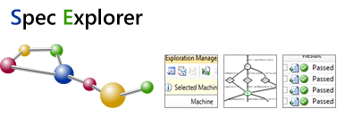



Tutorial Contents
Some Bit-precise Microsoft Engines:
PREfix: The Static Analysis Engine for C/C++.
Pex: Program EXploration for .NET.
SAGE: Scalable Automated Guided Execution
VCC: Verifying C Compiler for the Viridian Hyper-Visor
SpecExplorer: Model-based testing of protocol specs
VS3: Abstract interpretation and Synthesis
Hyper-V
Bit-vector decision procedures by categories
Bit-wise operations
Vector Segments
Bit-vector Arithmetic
Fixed size
Parametric, non-fixed size

Slide 3
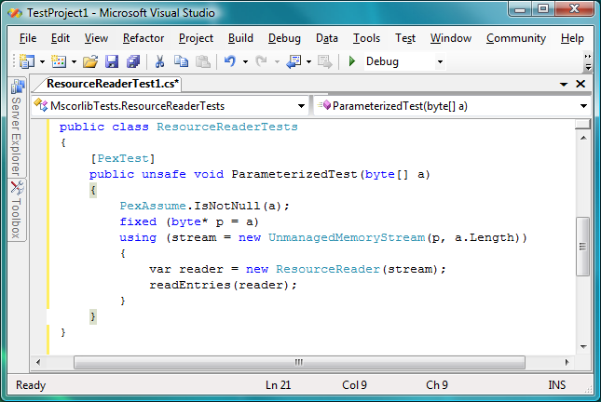
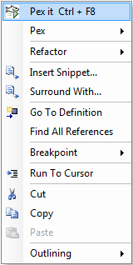
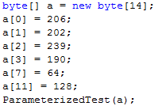
Pex – Bit-precise test Input Generation
Test input, generated by Pex
3

Slide 4
QF_BV benchmarks in SMT-LIB
Number of
benchmarks
Trivial
From trivial to hard
MB
SAGE
From 40MB to 18GB

Slide 5
SAGE Experiments
Most much (100x) bigger than ever tried before!
App Tested | #Tests | Mean Depth | Mean #Instr. | Mean Input Size
ANI | 11468 | 178 | 2,066,087 | 5,400
Media1 | 6890 | 73 | 3,409,376 | 65,536
Media2 | 1045 | 1100 | 271,432,489 | 27,335
Media3 | 2266 | 608 | 54,644,652 | 30,833
Media4 | 909 | 883 | 133,685,240 | 22,209
Compressed File Format | 1527 | 65 | 480,435 | 634
OfficeApp | 3008 | 6502 | 923,731,248 | 45,064
Seven applications – 10 hours search each
Notes:
Clarify depth is in path constraint size. Clarify instructions are post-file-read. Size is variable because of different input-dependent paths.
5

Slide 6
SAGE Architecture
Input0
Coverage
Data
Constraints
Check for
Crashes
(AppVerifier)
Code
Coverage
(Nirvana)
Generate
Constraints
(TruScan)
Solve
Constraints
(Z3)
Input1
Input2
…
InputN
SAGE is mostly developed by
in the Windows division
Michael Levin et.al.
Microsoft Research
algorithms/tools

Slide 7
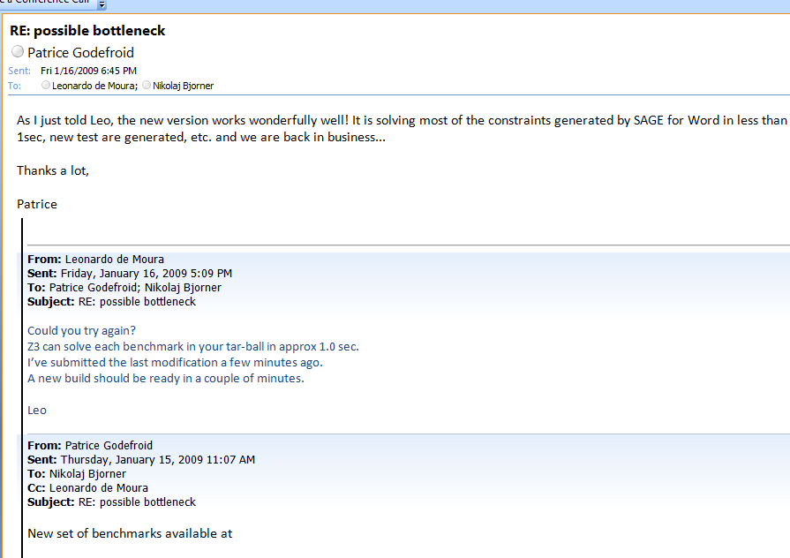
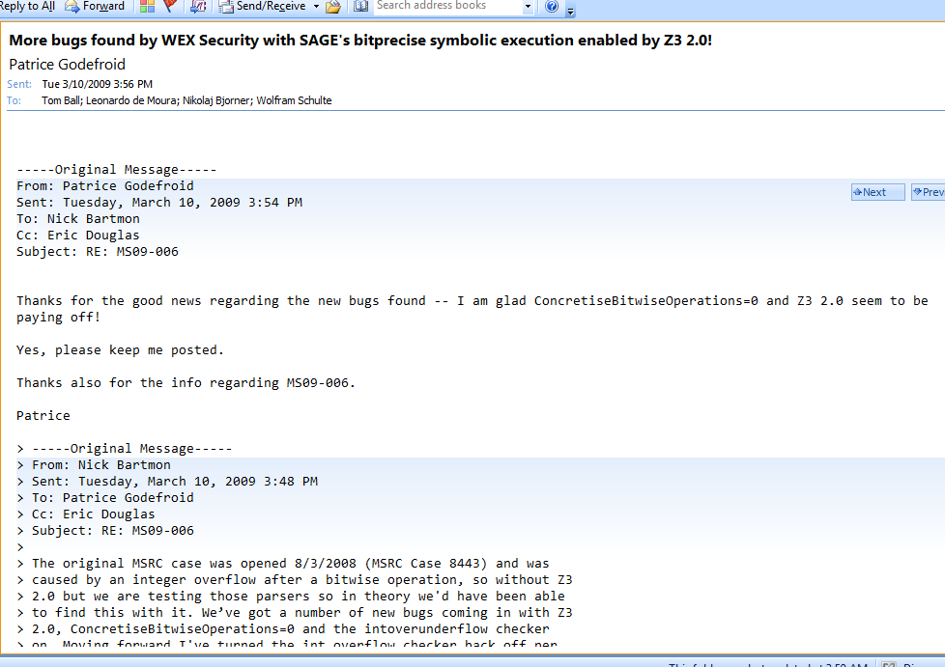

SAGE: nuts and bolts
xor
+
xor
The bottleneck in this case
Was to handle shared structures
With alternated xor and addition.
+
xor
xor
+
xor
xor

Slide 8
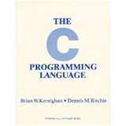
PREfix: What is wrong here?
-INT_MIN= INT_MIN
3(INT_MAX+1)/4 +
(INT_MAX+1)/4
= INT_MIN
int binary_search(int[] arr, int low,
int high, int key)
while (low <= high)
{
// Find middle value
int mid = (low + high) / 2;
int val = arr[mid];
if (val == key) return mid;
if (val < key) low = mid+1;
else high = mid-1;
}
return -1;
}
void itoa(int n, char* s) {
if (n < 0) {
*s++ = ‘-’;
n = -n;
}
// Add digits to s
….
Package: java.util.Arrays
Function: binary_search
Book: Kernighan and Ritchie
Function: itoa (integer to ascii)

Slide 9
The PREfix Static Analysis Engine
int init_name(char **outname, uint n)
{
if (n == 0) return 0;
else if (n > UINT16_MAX) exit(1);
else if ((*outname = malloc(n)) == NULL) {
return 0xC0000095; // NT_STATUS_NO_MEM;
}
return 0;
}
int get_name(char* dst, uint size)
{
char* name;
int status = 0;
status = init_name(&name, size);
if (status != 0) {
goto error;
}
strcpy(dst, name);
error:
return status;
}
model for function init_name
outcome init_name_0:
guards: n == 0
results: result == 0
outcome init_name_1:
guards: n > 0; n <= 65535
results: result == 0xC0000095
outcome init_name_2:
guards: n > 0|; n <= 65535
constraints: valid(outname)
results: result == 0; init(*outname)
models
Can
Pre-condition be violated?
path for function get_name
guards: size == 0
constraints:
facts: init(dst); init(size); status == 0
paths
Yes: name is not initialized
pre-condition for function strcpy
init(dst) and valid(name)
C/C++ functions
warnings

Slide 10
Overflow on unsigned addition
m_nSize == m_nMaxSize == UINT_MAX
iElement = m_nSize;
if( iElement >= m_nMaxSize )
{
bool bSuccess = GrowBuffer( iElement+1 );
…
}
::new( m_pData+iElement ) E( element );
m_nSize++;
iElement + 1 == 0
Code was written for address space < 4GB
Write in unallocated memory

Slide 11
Using an overflown value as allocation size
Overflow check
ULONG AllocationSize;
while (CurrentBuffer != NULL) {
if (NumberOfBuffers > MAX_ULONG / sizeof(MYBUFFER)) {
return NULL;
}
NumberOfBuffers++;
CurrentBuffer = CurrentBuffer->NextBuffer;
}
AllocationSize = sizeof(MYBUFFER)*NumberOfBuffers;
UserBuffersHead = malloc(AllocationSize);
Increment and exit from loop
Possible overflow

Slide 12
Overflow on unsigned subtraction
Possible overflow
LONG l_sub(LONG l_var1, LONG l_var2)
{
LONG l_diff = l_var1 - l_var2; // perform subtraction
// check for overflow
if ( (l_var1>0) && (l_var2<0) && (l_diff<0) ) l_diff=0x7FFFFFFF
…
Forget corner case INT_MIN

Slide 13
Overflow on unsigned addition
Possible overflow
for (uint16 uID = 0; uID < uDevCount && SUCCEEDED(hr); uID++) {
…
if (SUCCEEDED(hr)) {
uID = uDevCount; // Terminates the loop
Loop does not terminate
uID == UINT_MAX

Slide 14
Using an overflown value as allocation size
Can overflow
DWORD dwAlloc;
dwAlloc = MyList->nElements * sizeof(MY_INFO);
if(dwAlloc < MyList->nElements)
… // return
MyList->pInfo = malloc(dwAlloc);
Not a proper test
Allocate less than needed

Slide 15

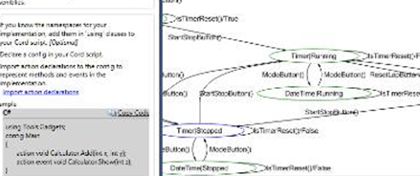
More tools
Short demo
SpecExplorer
2009
Synthesis
[Gulwani, Jha, Tiwari, Venkatesan 09]
[Gulwani, Jha, Tiwari, Seisha 09]
Clear trailing 1 bits from vector

Slide 16
Synthesis – main idea
Spec(x,y),
  Use spec to generate x,y pairs
Operations:
x_{i} = x_{j} + x_{k}, x_{i} = x_{j} - x_{k} x_{i} = x_{j} << l, x_{i} = z,
(j, k < i, l < 32, z is fixed input).
Treat operations as non-deterministic system.
Perform bounded model-checking on operations, using SMT
Find instruction sequence Impl(x,y) satisfying pairs of x,y
Check Spec(x,y) => Impl(x,y) using SMT

Slide 17
Bit-vectors by example
1
0
1
0
1
1
1
0
1
0
1
1
⊗
0
1
1
0
0
1
=
∧
0
1
1
0
0
1
1
0
1
0
1
1
0
1
1
0
0
1
=
0
0
1
0
0
1
Vector Segments
Concatenation
Bit-wise operations
Bit-wise and
1
0
1
0
1
1
+
1
0
1
0
1
1
[4:2] =
0
1
0
0
1
1
0
0
1
=
0
0
0
1
0
0
Vector Segments
Extraction
Modular arithmetic
Addition

Slide 18
Bit-vector theories
[PVS: Butler et.al NASA-TR-96]
bv [N: nat]: THEORY
BEGIN
bit : TYPE = {n: nat | n <= 1}
bvec : TYPE = [below(N) -> bit]
END bv
A bit-vector is a function
from {0..N-1} to {0,1}
NOT(bv: bvec[N]) : bvec =
(LAMBDA i: NOT bv(i)) ;
Bit-wise negation
Well-suited for
Bit-wise operations

Slide 19
Bit-vector theories
[ACL2: Russinoff 05]
(defund bvecp (x k)
(declare (xargs :guard (integerp k)))
(and (integerp x)
(<= 0 x)
(< x (expt 2 k))))
The number x is a k bit-vector if
0 ≤ x < 2^{k}
(defund lnot (x n)
(declare (xargs :guard
(and (natp x) (integerp n) (< 0 n))))
(if (natp n)
(+ -1 (expt 2 n) (- (bits x (1- n) 0)))
0))
Bit-wise negation
Well-suited for
(Modular) arithmetic

Slide 20
Bit-vector theories
subsection {* Bits *}
datatype bit = Zero ("\<zero>")
| One ("\<one>")
primrec bitval :: "bit => nat"
where "bitval \<zero> = 0"
| "bitval \<one> = 1“
[HOL: Wong 93]
[Isabelle: 09]
A bit is the data-type
Zero or One.
A bit-vector is a list of bits.
primrec
bitnot_zero: "(bitnot \<zero>) = \<one>“
bitnot_one : "(bitnot \<one>) = \<zero>"
subsection {* Bit Vectors *}
definition bv_not :: "bit list => bit list“
where "bv_not w = map bitnot w"
Bit-wise negation
Well-suited for
Vector Segments

Slide 21
Decision procedure scopes
Size assumptions
Fixed size
Non-fixed
size
Optimized for
Bit-wise operations
Vector Segments
Modular arithmetic

Slide 22
Bit-vectors not by example
Vars of length n
Arithmetic
Shift
Concat, extract
Bit-wise logical
Formulas

Slide 23
Vector Segments
Fixed size
x_{[8]} = z_{[4]} ⊗ x_{[8]} [3:2] ⊗ a_{[2]}
z_{[4]} = x_{[8]} [7:4] & y_{[8]} [7:4]
Cut, dice & slice
[Bjørner, Pichora TACAS 98]
x_{[8]} [7:4] ⊗ x_{[8]} [3:2] ⊗ x_{[8]} [1:0] = z_{[4]} ⊗ x_{[8]} [3:2] ⊗ a_{[2]}
z_{[4]} = x_{[8]} [7:4] & y_{[8]} [7:4]
Bit-vectors cut into
Disjoint segments
x_{[8]} [7:4] = z_{[4]} x_{[8]} [3:2] = x_{[8]} [3:2]
x_{[8]} [1:0] = a_{[2]} z_{[4]} = x_{[8]} [7:4] & y_{[8]} [7:4]
[Cyrluk, Möller,
Rueß CAV 97]
Bit-vector
equation solver
[Bruttomesso,
Sharygina ICCAD 09]
Backtracking Integration
with modern SMT solver
[Johannsen,
Dreschler VLSI 01]
Reduce bit-width using
equi-SAT analysis

Slide 24
Vector Segments
Non-fixed size
Unification algorithms for
non-fixed size bit-vectors
[Bjørner, Pichora TACAS 98]
[Möller, Rueß FMCAD 98]
Concatenate t with itself until reaching length n

Slide 25
Modular arithmetic
Fixed size
Early focus:
Normal forms and solving linear modular equalities
[Barrett, Dill, Levitt, DAC 98]
Dedicated modular linear arithmetic
[Huang, Chen, IEEE 01]
Reduction of modular linear arithmetic to Integer linear programmig
[Brinkmann, Drechsler, 02]

Slide 26
Solving linear-modular equalities
odd
k, l > m | Un-satisfiable
k = 0
l, m ≥ k k > 0
eg.,
where,
by reduction, solve for:
Modular arithmetic
Fixed size

Slide 27
Triangulate linear-modular equalities
[Müller-Olm & Seidl, ESOP 05]
Main point: algorithm does not
require computing gcd to find
inverse.
r₁ := 2r₁– r₃
r₁ := r₁– r₂
Modular arithmetic
Fixed size

Slide 28
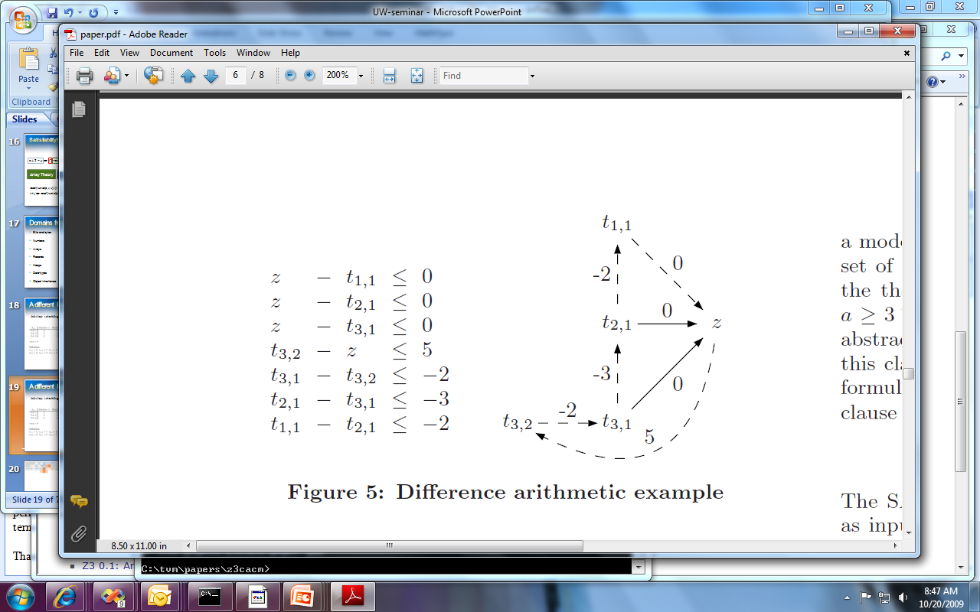
Solving linear modular inequalities
Difference arithmetic reduces to a
basic path search problem
Modular arithmetic
Fixed size

Slide 29
Solving linear modular inequalities
A unique node out of 3 must have value N-1
Modular arithmetic
Fixed size

Slide 30
Solving linear modular inequalities
Neighboring vertices have different
values/colors
Modular arithmetic
Fixed size

Slide 31
Solving linear modular inequalities
conjunctions of
is NP-hard
Neighboring vertices have different
values/colors
Modular arithmetic
Fixed size
[Bjørner, Blass, Gurevich, Muthuvathi, MSR-TR-2008-140]

Slide 32
Non-linear-modular constraints
Circuit equivalence using Gröbner bases:
Factorization using Smarandache:
Taylor-Expansion, Hensel lifting and Newton
Formulate equivalence as
set of polynomial equalities.
Compute Gröbner basis.
[Wienand et.al, CAV 08]
Spec:
r₁=a*b mod 2^{m}
a, b
eq?
Impl:
r₂
whenever
[Chen 96]
[Shekharet.al, DATE 06]
To solve first use SAT solver for then lift and check solution.
Modular arithmetic
Fixed size
[Babić, Musuvathu, TR 05]

Slide 33
Modular arithmetic
Non-fixed size
Bit-vector addition is expressible
using bit-wise operations and
bit-vector equalities.
1
0
1
0
1
1
out = xor(x, y, c)
c’ = (x∧y)∨(x∧c) ∨ (y∧c)
c[0] = 0
c’[N-2:0] = c[N-1:1]
+
0
1
1
0
0
1
Encoding does not accommodate
bit-vector multiplication.
What is possible for multiplication?
Eg, working with p-adics?
FA
FA
FA
FA
FA
FA
Note:
x y c
c’ out
out ↔ xor(x, y, c)
c’ ↔ (x∧y) ∨ (x∧c) ∨ (y∧c)
0
0
0
1
0
0
FA

Slide 34
Bit-wise operations
Fixed size
Two approaches
SAT reduction (Boolector, Z3,…)
  Circuit encoding of bit-wise predicates.
  Bit-wise operations as circuits
  Circuit encoding of adders, multipliers.
Custom modules
  SWORD [Wille, Fey, Groe, Eggersgl, Drechsler, 07]
  Pre-Chaff specialized engine [Huang, Chen, 01]

Slide 35
Encoding circuits to SAT - addition
1
0
1
0
1
1
out = xor(x, y, c)
c’ = (x∧y) ∨ (x∧c) ∨ (y∧c)
c[0] = 0
c’[N-2:0] = c[N-1:1]
+
0
1
1
0
0
1
out_{i} ↔ xor(x_{i}, y_{i}, c_{i} )
c_{i+1} ↔ (x_{i}∧y_{i}) ∨ (x_{i}∧c_{i}) ∨ (y_{i}∧c_{i})
c₀ ↔ 0
FA
FA
FA
FA
FA
FA
0
0
0
1
0
0
(x_{i}∧y_{i} ∧c_{i} → out_{i}) ∧ (out_{i}→ x_{i}∨ y_{i} ∨ c_{i}) ∧
(x_{i}∧ c_{i} → out_{i} ∨ y_{i} ) ∧ (out_{i} ∧ y_{i} ∧ c_{i} → x_{i}) ∧
(c_{i} → out_{i} ∨ x_{i} ∨ y_{i} ) ∧ (out_{i} ∧ x_{i} ∧ c_{i} → y_{i}) ∧
(y_{i} → out_{i} ∨ x_{i} ∨ c_{i} ) ∧ (out_{i} ∧ x_{i} ∧ y_{i} → c_{i}) ∧
(x_{i}∧y_{i} → c_{i+1}) ∧ (c_{i+1} → x_{i}∨ y_{i} ) ∧
(x_{i}∧c_{i} → c_{i+1}) ∧ (c_{i+1} → x_{i}∨ c_{i} ) ∧
(y_{i}∧c_{i} → c_{i+1}) ∧ (c_{i+1} → y_{i}∨ c_{i} ) ∧
¬c₀
Bit-wise operations
Fixed size

Slide 36
Encoding circuits to SAT - multiplication
a₀∧b₃
a₀∧b₂
a₀∧b₁
a₀∧b₀
O(n²) clauses
SAT solving time increases exponentially. Similar for BDDs.
[Bryant, MC25, 08]
Brute-force enumeration + evaluation faster
for 20 bits.
[Matthews, BPR 08]
HA
a₁∧b₂
HA
a₁∧b₁
HA
a₁∧b₀
FA
a₂∧b₁
FA
a₂∧b₀
FA
a₃∧b₀
out₃
out₂
out₁
out₀
Bit-wise operations
Fixed size

Slide 37
Equality propagation and bit-vectors in Z3
Dual interpretation of bit-vector equalities:
  The atom (v = w) is assigned by SAT solver to T or F.
    Propagate between v_{i} and w_{i}
  A bit v_{i} is assigned by SAT solver to T or F.
    Propagate v_{i} to w_{i} whenever (v = w) is assigned to T,
Bit-wise operations
Fixed size

Slide 38
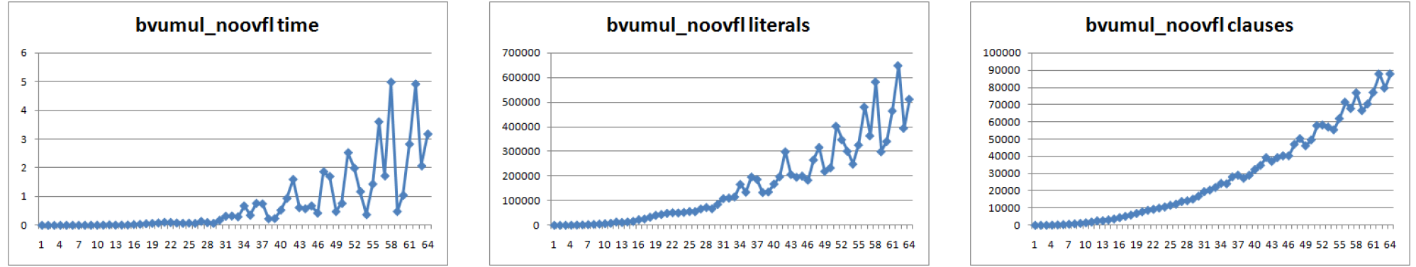
Overflow check
Unsigned multiplication
5s
650K
90K
Bit-wise operations
Fixed size

Slide 39
A more economical overflow check
Always overflows
[Gök 06]
Never overflows
Only overflows into n+1 bits
Bit-wise operations
Fixed size

Slide 40
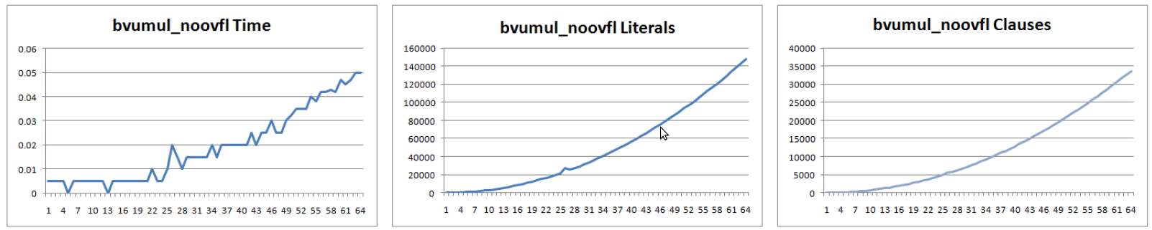
A more economical overflow check
Always overflows
Never overflows
Only overflows into n+1 bits
50ms
150K
35K
1 bit 64 bits
1 bit 64 bits
1 bit 64 bits
Bit-wise operations
Fixed size

Slide 41
Limiting the entropy
[Bryant et.al. 07]
[Brummayer, Biere 09]
Main idea:
Search for model while fixing (most significant) bits.
Method similar to small model search:
Yes: SAT
CORE depends on selected bits?
No: UNSAT
Select set of bits from ϕ. Assume the bits to be 0
(or 1 or same as ref bit)
ϕ is SAT
No
Bit-wise operations
Fixed size
Unfix bits
Yes

Slide 42
Bit-wise operations
Non-fixed size
Repeat bit t
n times.
Bit-wise
and
Negate
bits of t
Fold and on
bits from t
Allow length to be parameterized
by more than one variable
[Pichora 03]
Provides Tableau search procedure for Satisfiability.
Shows that the problem is PSPACE complete.

Slide 43
A few remarks
We presented different views on the theory of bit-vectors. Arithmetic, Concatenation, Bit-wise.
Most software analysis applications require bit-precise analysis.
Software applications objective:
  use bit-vector operations.
  Not as much verify circuits.
Still, existing challenges and solutions are shared.

Slide 44
References
Wong: Modeling Bit Vectors in HOL: the word library [TPHOL 93]
Butler, Miner, Srivas, Greve, Miller: A Bitvectors library for PVS. [NASA 96]
Cyrluk, Möller, Rueß: An Efficient Decision Procedure for the Theory of Fixed-Sized Bit-Vectors. [CAV 97]
Barrett, Dill, Levitt: A decision procedure for bit-vector arithmetic [DAC98]
Bjørner, Pichora Deciding Fixed and Non-fixed Size Bit-vectors [TACAS 98]
Möller, Rueß: Solving Bit-Vector Equations. [FMCAD 98]
Möller [Diploma thesis 98]
Huang, Cheng: Assertion checking by combined word-level ATPG and modular arithmetic constraint-solving techniques [DAC 00]
Huang, Cheng:: Using word-level ATPG and modular arithmetic constraint-solving techniques for assertion property checking [IEEE 01]
Johannsen, Dreschler: Formal Verification on the RT Level Computing One-To-One Design Abstractions by Signal Width Reduction [VLSI'01]
Brinkmann, Drechsler RTL-Datapath Verification using Integer Linear Programming (02)
Ciesielski, Kalla, Zeng, Rouzyere. Taylor Expansion Diagrams: A Compact Canonical Representation with Applications to Symbolic Verification. [DATE 02].
Pichora Twig [PhD. Thesis 03]
Babic, Madan Musuvathi Modular arithmetic Decision Procedure, [MSR-TR-2005-114]
Shekhar, Kalla, Enescu: Equivalence verification of arithmetic datapaths with multiple word-length operands [EDAA 05]
Russinoff: A Formal Theory of Register-Transfer Logic and Computer Arithmetic [web pages 2005]
Muller-Olm, Seidl: Analysis of modular arithmetic [ESOP 05]
Bryant, Kroening, Ouaknine, Seshia, Strichman, Brady An Abstraction-Based Decision Procedure for Bit-Vector Arithmetic [TACAS 2007]
Wille, Fey, Groe, Eggersgl, Drechsler: SWORD: A SAT like prover using word level information. [VLSISoC 2007]
Ganesh ,Dill: Decision Procedure for Bit-Vectors and Arrays [CAV07]
Bit-vectors in MathSAT4: [CAV07]
Ganai, Gupta.SAT-based Scalable Formal Verification Solutions. [Book 2007[.
Olm, Seidl: Analysis of Modular Arithmetic [TOPLAS 07]
Krautz, Wedler, Kunz, Weber, Jacobi, Pflanz: Verifying full-custom multipliers by Boolean equivalence checking and an arithmetic bit level proof [ASPDAC 08]
Wienand, Wedler, Stoffel, Kunz, Greuel: An Algebraic Approach for Proving Data Correctness in Arithmetic Data Paths [CAV 08]
Workshop on bit-precise reasoning at CAV 08.
Bruttomesso, Sharygina: A Scalable Decision Procedure for Fixed-Width Bit-Vectors [ICCAD 09]
Brummayer, Biere, Lemmas on Demand for the Extensional Theory of Arrays. [SMT 08]
Brummayer, Biere, Consistency Checking of All Different Constraints over Bit-Vectors within a SAT-Solver [FMCAD 08]
Brummayer, Biere Effective Bit-Width and Under-Approximation. [EUROCAST 09]
He, Hsiao: An efficient path-oriented bitvector encoding width computation algorithm for bit-precise verification [DATE 09]
Moy, Bjorner, Sielaff: Modular Bug-finding for Integer Overflows in the Large: Sound, Efficient, Bit-precise Static Analysis [MSR-TR-2009]

Slide 45
Available SM(BV) Tools
BAT | http://www.ccs.neu.edu/home/pete/bat/index.html
Beaver | http://uclid.eecs.berkeley.edu
Boolector | http://fmv.jku.at/boolector
CVC3 | http://www.cs.nyu.edu/acsys/cvc3
MathSAT4 | http://mathsat4.disi.unitn.it
OpenSMT | http://verify.inf.unisi.ch/opensmt
Spear | http://domagoj-babic.com/index.php/ResearchProjects/Spear
STP#101 | http://people.csail.mit.edu/vganesh/STP_files/stp.html
SWORD | http://www.smtexec.org/exec/competitors2009.php
Yices2 | http://yices.csl.sri.com/
Z3 | http://research.microsoft.com/projects/z3
Twig | http://www.cs.utoronto.ca/~mpichora/twig/download.html

Slide 47
Abstract Interpretation
and modular arithmetic
See Blog by Ruzica Piskac,
http://icwww.epfl.ch/~piskac/fsharp/
Material based on:
King & Søndergård, CAV 08
Muller-Olm & Seidl, ESOP 2005

Slide 48
Programs as transition systems
Transition system:
⟨
L locations,
V variables,
S = [V → Val] states,
R ⊆ L × S × S × L transitions,
Θ ⊆ S initial states
ℓ_{init} ∈ L initial location
⟩

Slide 49
Abstract abstraction
Concrete reachable states: CR: L → ℘(S)
Abstract reachable states: AR: L → A
Connections:
⊔ : A × A → A
γ : A → ℘(S)
α : S → A
α : ℘(S) → A where α(S) = ⊔ {α(s) | s ∈ S }

Slide 50
Abstract abstraction
Concrete reachable states:
CR ℓ x ← Θ x ∧ ℓ = ℓ_{init}
CR ℓ x ← CR ℓ₀ x₀ ∧ R ℓ₀ x₀ x ℓ
Abstract reachable states:
AR ℓ x ← α(Θ(x)) ∧ ℓ = ℓ_{init}
AR ℓ x ← α(γ(AR ℓ₀ x₀) ∧ R ℓ₀ x₀ x ℓ)
Why? fewer (finite) abstract states

Slide 51
Abstraction using SMT
Abstract reachable states:
AR ℓ_{init} ← α(Θ)
Find interpretation M:
M ⊨ γ(AR ℓ₀ x₀) ∧ R ℓ₀ x₀ x ℓ ∧ ¬γ(AR ℓ x)
Then:
AR ℓ ← AR ℓ ⊔ α(x^{M})

Slide 52
Abstraction: Linear congruences
States are linear congruences:
A V = b mod 2^{m}
    V is set of program variables.
    A matrix, b vector of coefficients [0.. 2^{m}-1]

Slide 53
Example
When at ℓ₂ :
  y is 0.
  c contains number of bits in x.
ℓ₀: y ←x; c ←0;
ℓ₁: while y != 0 do [ y ←y&(y-1); c ← c+1 ]
ℓ₂:

Slide 54
Abstraction: Linear congruences
States are linear congruences:
As Bit-vector constraints (SMTish syntax):
(and
(= (bvadd (bvmul 010 x₀) (bvmul 011 x₁)) 001)
(= (bvadd x₀ x₁) 011)
)

Slide 55
Abstraction: Linear congruences
(A V = b mod 2^{m} ) ⊔ (A’ V = b’ mod 2^{m})
  Combine:
  Triangulate (Muller-Olm & Seidl)
  Project on x

