Slide 1
Verification of Cache Coherence Protocols wrt. Trace Filters
Parosh Aziz Abdulla¹, Mohamed Faouzi Atig¹,
Zeinab Ganjei², Ahmed Rezine² and Yunyun Zhu¹
1. Uppsala University, Sweden
2. Linköping University, Sweden
FMCAD 2015

Slide 2
Outline
Transactional memories
Formal model
Small model theorem
Limit the analysis to a finite number of variables
Verification algorithm for cache coherence
Backward reachability analysis with monotonic abstraction
Prototype
Two cache protocols verified

Slide 3
Transactional Memory

Slide 4
Transactional Memory (TM)
To simplify concurrent programming
Init: x = 0
void add() {
atomic {
int t = x;
t = t + 5;
x = t;
}
}
void add() {
atomic {
int t = x;
t = t + 10;
x = t;
}
}
Thread 1
transaction
Thread 2
Notes:
Conflict: T1 reading the old value of x and writing x based on the old read value, despite that x has been updated by T2. So T1 cannot commit.
Atomicity: All speculative memory updates of a transaction are either committed or discarded as a unit.
Consistency: The memory operations of a transaction take place in order. Transactions are committed one transaction at a time (in some agreed order).
Isolation: Memory updates are not visible outside of a transaction until the transaction commits data.
Tentative changes

Slide 5
Thread₁
Thread₂
Transactional Memory (TM)
read x: 0
int t = x
int t = x
read x: 0
t = t + 5
Conflict!
t = t + 10
x = t
write x: 10
write x: 5
x = t
write x: 5
commit
abort
commit
Init: x = 0
Properties of TMs:
Atomicity
Isolation
void add() {
atomic {
int t = x;
t = t + 5;
x = t;
}
}
void add() {
atomic {
int t = x;
t = t + 10;
x = t;
}
}
int t = x;
int t = x;
t = t + 5;
t = t + 10;
x = t;
x = t;
Thread 1
Thread 2
Notes:
No animation until the red commit-commit
Two threads writing on the same variable, so one must abort
Atomicity: All speculative memory updates of a transaction are either committed or discarded as a unit.
Consistency: The memory operations of a transaction take place in order. Transactions are committed one transaction at a time (in some agreed order).
Isolation: Memory updates are not visible outside of a transaction until the transaction commits data.
Tentative changes

Slide 6
Thread₁
Thread₂
Transactional Memory (TM)
read x: 0
int t = x
int t = x
read x: 0
t = t + 5
t = t + 10
x = t
write x: 10
write x: 5
x = t
write x: 5
commit
abort
commit
Init: x = 0
void add() {
atomic {
int t = x;
t = t + 5;
x = t;
}
}
void add() {
atomic {
int t = x;
t = t + 10;
x = t;
}
}
Hardware TM
Thread 1
Thread 2
Notes:
Hardware transactional memory systems may comprise modifications in processors, cache and bus protocol to support transactions

Slide 7
Hardware Transactional Memory (HTM)
Thread₁
Thread₂
int t = x
t = t + 5
int t = x
t = t + 10
x = t
x = t
Conflict manager
Decide if an instruction
can be executed
Cache protocol
Adapted with TM context
commit
abort
commit
instruction
response
Conflict manager
Cache C₁
line
state
data
Cache C₂
line
state
data
x
I
0
x
I
0
y
I
0
y
I
0
z
I
0
z
I
0
Memory
line
state
data
x
I
0
y
I
0
z
I
0
Notes:
Conflict manager: communicates with the program and decides if an instruction can be executed
Cache protocol: after each instruction execution, the state of some cache line is changed according to the transition rules of the protocol

Slide 8
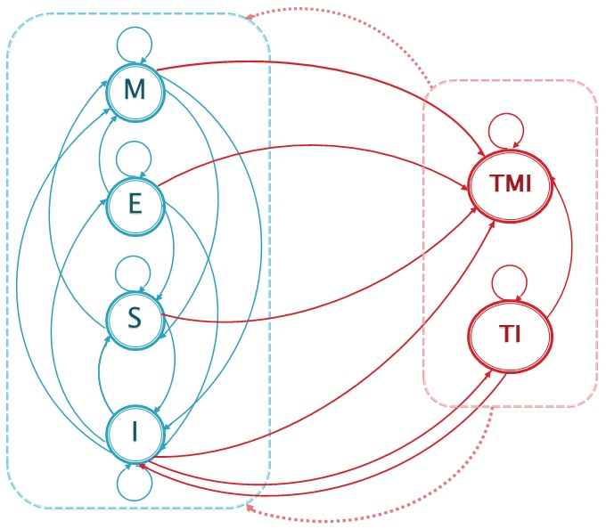
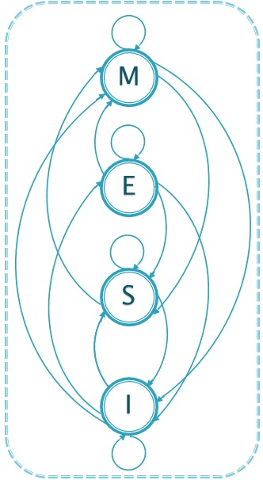
MESI Protocol
Thread₁
Thread₂
Thread₁
Thread₂
TMESI Protocol (of FlexTM)
Motivating Example
write x
write x
Trace not allowed!
Trace allowed
read x
Write within a transaction
write x
Modified
write x
commit
commit
commit
commit
Commit
abort
Exclusive
Filter
instruction
response
Conflict manager
Shared
Cache C₁
line
state
data
Cache C₂
line
state
data
I
M
M
TMI
M
M
TMI
I
0
M
0
Abort
x
x
I
Incoherent states!
y
I
0
y
I
0
Invalid
z
I
0
z
I
0
Read while another writes within a transaction
Memory
line
state
data
x
I
0
y
I
0
z
I
0
Notes:
Mention what a trace is!
Emphasize that the example illustrates the conflict manager is needed
Conflict manager add (filter) in last animation!
Protocol: shows the transitions of the cache line states. Suppose there is only one variable in each cache line here
Tentative write in a transaction -> Tmi state needed -> reflex itomicity
Motivating example: suppose there is no conflict manager -> all the instructions can be executed -> incoherent states reached –> conflict manager needed -> commit in t1 not allowed -> trace allowed
Red (M, M): two threads modifying the same variable at the same time
Conflict manager behaves like a filter

Slide 9
Goal
Thread₁
.
.
Thread₂
.
.
Thread₂
.
.
Thread_{n}
.
.
Thread₁
Thread₂
Thread₁
.
.
write x
write x
write x
write y
write y
read z
read y
read y
read x
write x
write z
...
commit
read x
commit
commit
abort
abort
abort
Verification of coherence
in presence of filters
Challenges:
Unbounded number of transactions
Unbounded number of threads
Unbounded number of variables
write y
write y
commit
commit
commit
abort
write x
write y
write z
instruction
instruction
response
response
Conflict manager
Filter
Cache C₁
state
Cache C₂
Cache C_{n}
line
state
data
line
data
line
state
data
line
state
data
line
state
data
Cache C₁
line
state
data
Cache C₁
Cache C_{n}
Cache C₁
Cache C₂
I
Cache C₂
M
0
0
I
0
0
I
0
I
0
x
I
x
I
x
x
TMI
x
...
x
...
...
...
...
TMI
I
I
0
I
TMI
0
I
0
y
y
0
y
0
y
0
y
y
z
z
z
0
z
0
z
0
z
0
I
0
0
I
I
I
I
TMI
line
state
data
line
state
data
Memory
line
state
data
Memory
Memory
Memory
I
0
0
I
0
I
x
...
x
x
I
I
y
I
0
0
y
0
y
z
0
z
z
0
I
0
I
I
Notes:
What we verify: all the traces pass the filter do not reach any incoherent state according to the cache protocol

Slide 10
Contributions

Slide 11
Contributions
Formal model for protocols with filters
Small model theorem
Reduces the problem to finite number of variables
Backward reachability analysis
Prototype

Slide 12
Formal Model

Slide 13

Formal Model: Cache
Configuration
Maps each cache line to a state
Transitions:
Concerns the same cache line of different threads
$$\left(I\underset{→}{required\left\{E, TI, I\right\}, forbidden \left\{TMI\right\}, broadcast\{E→S\}}S\right)$$
None remote cache line of x is TMI
All the remote cache lines of x in M transits to S
At least one remote cache line of x is E, TI or I
state
Cache C₁
Cache C₂
Cache C₃
line
state
line
state
line
state
I
S
S
E
I
x
I
x
E
x
I
y
TI
y
I
y
I
z
TMI
z
I
z
I
local
remote
remote
Notes:
Mention that transitions are between configurations
Describe the configuration example and avoid defining it
The cache protocol rules consist of the set of the transitions
Horizontal transition: perform the transition on cache c1, which is called the local cache while the other two are called remote caches.
Required: look at the remote cache, if they satisfy the condition; forbidden: no remote cache line is TMI. Then perform the state, and the broadcast should also apply

Slide 14
Formal Model: Filter
Thread₁
Thread₂
write x
write x
Finite set of forbidden
patterns
Forbidden pattern
commit
commit
write, x, t₁
write, x, t₂
commit, t₁
commit, t₂
instruction
response
Filter
write, x, t₁
Trace not allowed!
commit, t₂
write, y, t₂
write, x, t₂
read, z, t₁
commit, t₂
write, x, t₁
write, x, t₂
commit, t₂
commit, t₂
trace
Cache C₁
Cache C₂
Cache C₃
line
state
line
state
line
state
x
I
x
I
x
I
y
I
y
I
y
I
z
I
z
I
z
I
Notes:
E.g., a simple trace, that we call a pattern, does not pass the filter. There is a trace in which the pattern exists, so the trace cannot pass the filter either.
A filter does not pass forbidden patterns and the traces in which any forbidden pattern exists

Slide 15
Small Model Theorem

Slide 16
Small Model Theorem
Thread₁
Thread₂
Thread₁
Thread₂
write x
write x
read y
Reduces the analysis to a finite number
of variables
write z
write x
write x
commit
commit
commit
commit
write, x, t₁
read, y, t₂
write, x, t₂
commit, t₂
commit, t₁
write, x, t₁
write, z, t₁
write, x, t₂
commit, t₂
commit, t₁
response
instruction
Incorrect
write, x, t₁
write, x, t₂
commit, t₁
commit, t₂
Filter
Reaches incoherent state, and passes the filter
Cache C₁
Cache C₂
line
state
line
state
M
M
M
M
Only x involved
x
I
x
I
E
y
I
y
I
M
z
I
z
I
Notes:
Suppose the filter does not work correctly, there is a trace which reaches incoherent states. We find that only x is involved in the bad states, so we project the trace to x and get a shorter trace with only one variable x. This trace can also pass the filter but reaches the bad state.

Slide 17
Backward Reachability Analysis

Slide 18
Well-Structured Transition System
Define a well-quasi-order on configurations
Prove transition relation is monotonic
Provide an algorithm to compute the set of predecessors of an upward closed set
Achievable with techniques
Notes:
Pre: compute the set of configurations from which will get the current set of configurations after the transition the is performed

Slide 19
Well-Structured Transition System
Define a well-quasi-order on configurations
Conf₁
Conf₂
Cache C₁
Cache C₂
Cache C₁
Cache C₂
Cache C₃
line
state
line
state
line
state
line
state
line
state
⊑
x
S
x
S
x
S
x
S
x
S
z
E
z
I
y
E
y
I
y
I
z
TMI
z
I
z
I
Notes:
Define an ordering -> upward closed sets -> must also be upward closed sets in monotonicity -> ordering not monotonic in our case -> make the set after pre upward closed if it is not, which is called monotonic abstraction
The system is well-structured -> backward reachability can be applied
The algorithm terminates because the order is a well-quasi-order

Slide 20
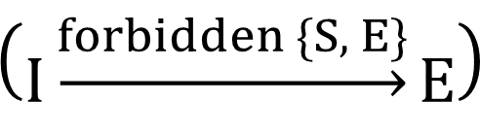
Well-Structured Transition System
Prove transition relation is monotonic
Conf₂
Conf₄
C₁
C₂
C₃
I
I
S
x
x
x
S
Due to forbidden sets in transitions
⊑
⊑
⊑
Conf₁
Conf₃
C₁
C₂
$$\left(I\underset{→}{forbidden \{S, E\}}E\right)$$
C₁
C₂
x
I
x
I
x
E
x
I
Notes:
larger configurations “simulate” smaller configurations
c1 <= c2, and c2->c3, but if there is forbidden{E} in the transition, and c2 contains E, then there is no c4 such that c2->c4 for the same transition

Slide 21
Well-Structured Transition System
Define a well-quasi-order on configurations
Prove transition relation is monotonic
Monotonic abstraction needed

Slide 22
Upward Closed Set
Incoherent states representable
by finite caches
With more caches still incoherent
Upward closed sets: symbolic representations
for incoherent states
M
M
I
I
S
M
M
I
M
M
Minimal element
Notes:
Set of configurations of incoherent states (bad set): upward closed
Upward-closed sets are preserved in monotonicity

Slide 23
Backward Reachability Analysis
Monotonic abstraction
Start from bad set
Compute the set of predecessors,
and make it upward-closed if needed
Stop if no more new configuration
discovered.
A searching branch closed if
The minimal element is subsumed
By an older minimal element
The trace fails the filter
∩ Init = ∅ ?
t₂
t₁
t₂
t₃
⊒
t₁
t₃
Trace (t₃, t₂) fails the filter
Notes:
The transitions are different since the sets are different and sometimes only some specific transitions can be performed on the specific set
Compute predecessors (with information of minimal elements)

Slide 24
Prototype

Slide 25
Prototype
Extension of Zaama, which implements constrained monotonic abstraction
Applied to
Two cache protocols
With six filters
Results obtained a 2.9 Ghz Intel Core i7 with 8GB of RAM

Slide 26
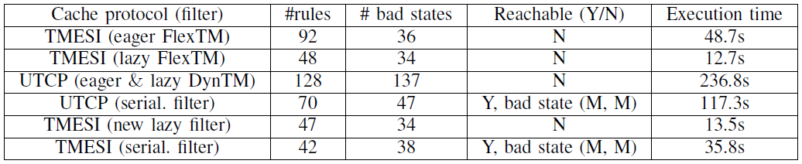
Experimental Results
Cache protocol (filter) #rules #bad states Reachable(Y/N) Execution time
UTCP (serial. filter) 70 47 Yes, bad state (M, M) 117.3s
TMESI (serial. filter) 42 38 Yes, bad state (M, M) 35.8s

Slide 27
Conclusion
Formal model for protocols with filters
Small model theorem
Reduces the problem to finite number of variables
Backward reachability analysis
Prototype

Slide 28
Thank You

Slide 30
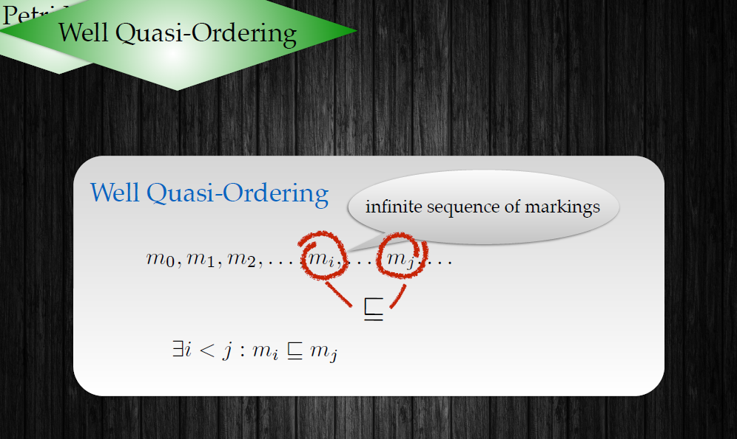

Slide 31
