Slide 1
Universal Boolean Functional Vectors
Jesse Bingham
FMCAD 2015
Austin, Texas, USA

Slide 2
“… I see the theoretical contribution in this paper as a very personal view of something very intuitive (and standard)” -Anonymous Reviewer, 2015
“Somebody needs to be killed for the title of your paper.” -Non-anonymous Colleague, 2015
“… this difficulty also arises in circuits containing shifters where the shift amount depends on the data, such as in a floating point alignment unit. Multiplication is a particularly difficult function, ...” -Randy Bryant, 1998
?

Slide 3
This Talk Has Three Parts
Summary of Approach – meant to be accessible by all
Case Study: Floating Point Addition
Main Theoretical Result
Please see paper for related work, mathematical rigor, further experiments, and whatever else is in there
Assumption: you have some clue what a BDD is.

Slide 4
Summary of Approach

Slide 5













In a Nutshell…
Might be
exponentially big
secondary
variables
primary
variables
All of tractable size

Slide 6


What about Soundness?
Clearly,
But we only have
when is universal
=?
=?

Slide 7

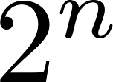





Universality
1
0
1
There exists an
input pattern
such that
1
For all
output patterns
…
…
0
0
Said another way: universality means that, when viewed as
a function from -assignments to -assignments, is surjective
If is universal, we call it a UBFV, and we
call a UBFV representation of

Slide 8
Results
Theory
Any function that can be tractably represented using a partitioned BDD has a tractable UBFV representation
Corollary: represent the hidden-weighted bit function tractably
Cute: any (non-constant) single-output function has a UBFV representation that is just a variable
Might involve exponentially large UBFV BDDs
Practice
Huge impact on proofs of Floating-Point Addition Hardware
E.g. double precision: reduced proof run-time from 50 hours to ½ hour
Allows for packed FADD operations to be verified end-to-end
Ditto for Fused-Multiply Add (FMA) designs
Also: normalizing floating point hardware, string instructions
Several approaches to verifying universality

Slide 9
Case Study: Floating Point Addition

Slide 10



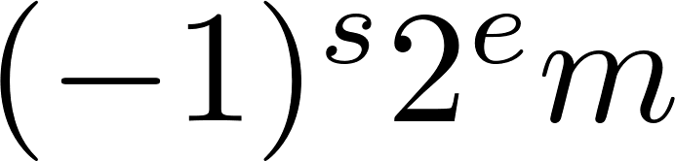


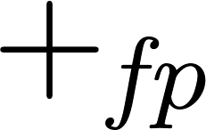


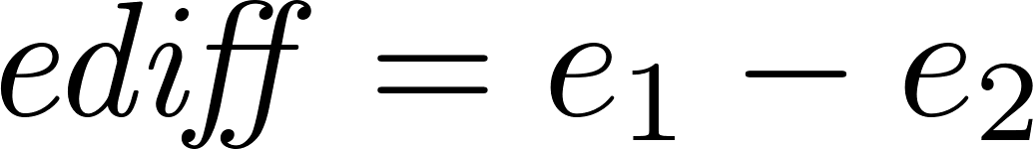


Floating Point Addition (FADD)
sign
exponent
mantissa
Value represented is

Slide 11
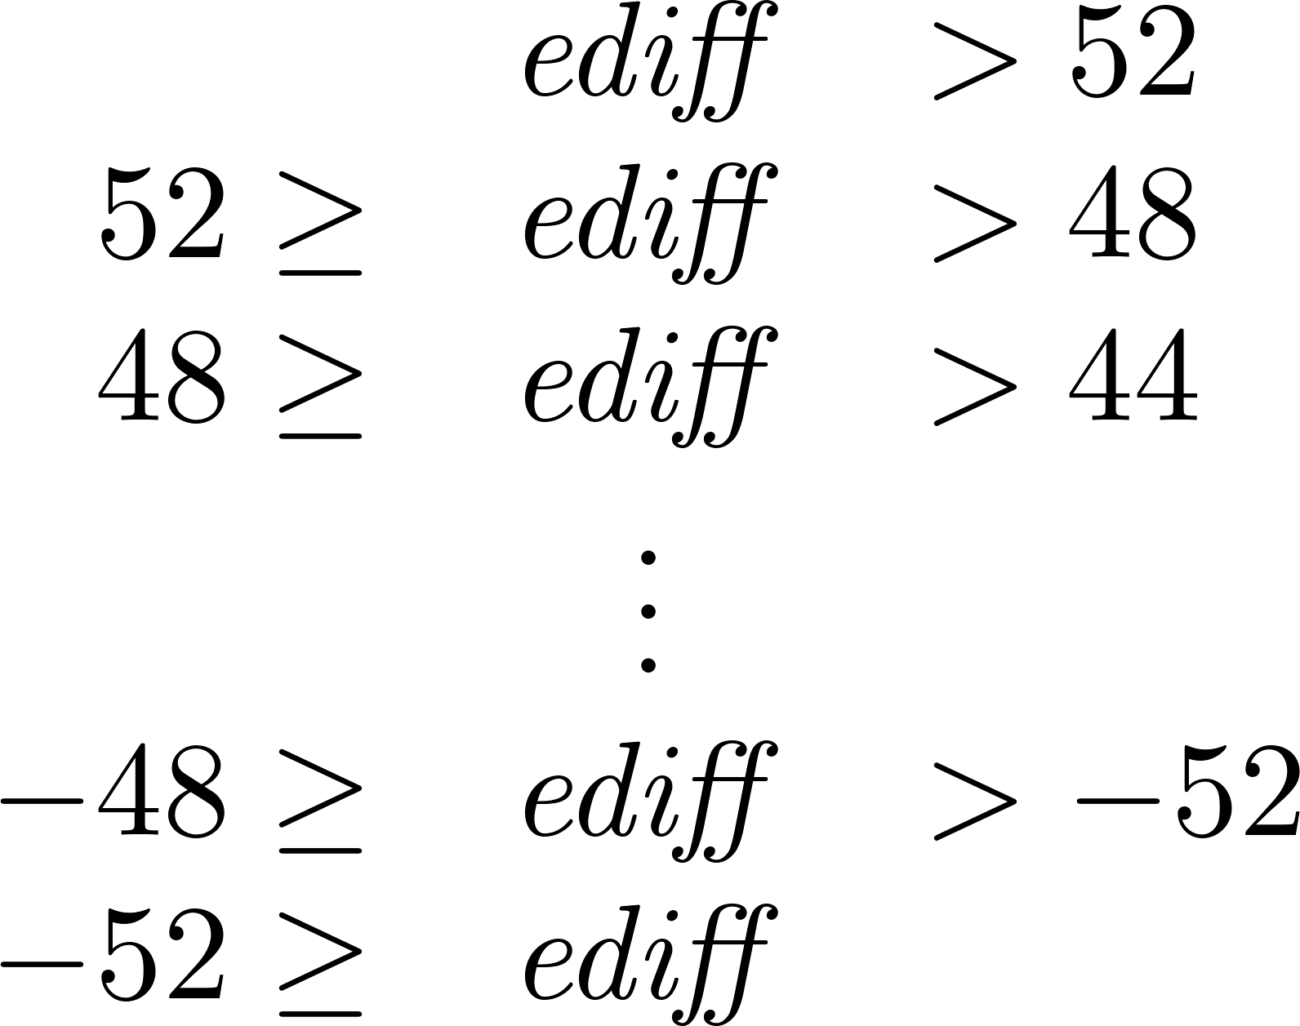
FADD with BDDs
Integer addition: if variable order interleaves the bits from both inputs, you get linear sized BDDs
FADD: because of the data-dependent (ediff) alignment, there is no good variable order
BDDs for FADD are exponential for any order
Standard solution: case split based on ediff
28 cases

Slide 12

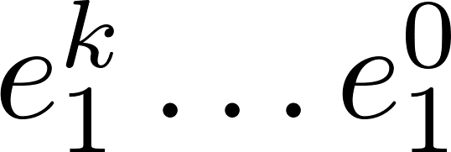
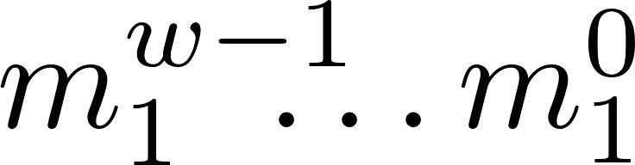
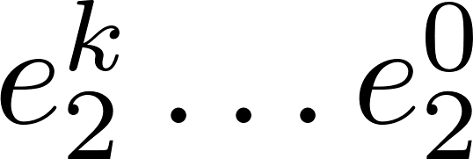
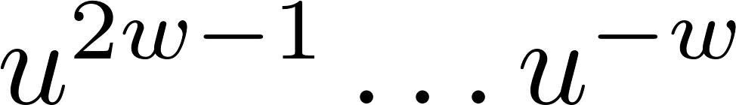
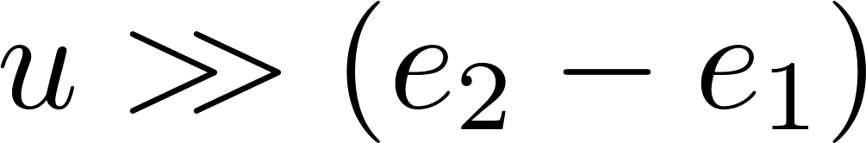


A UBFV for FADD
variables
Shift right by ediff
(negative
ediff shifts left)
A
Importantly,
this is
universal
Extract middle
bits from shifter
BDDs over the variables

Slide 13



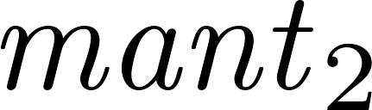
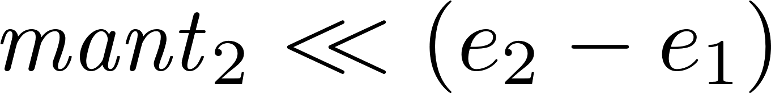

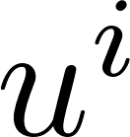
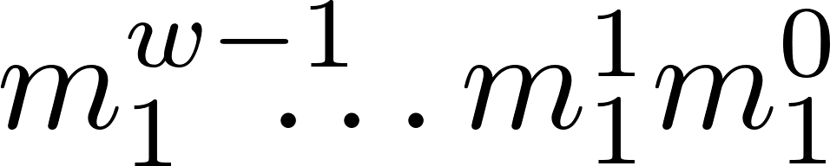
Trivial BDDs
Moderate BDDs
FADD
circuit
bit only depends on
and variables
Moderate BDDs
Normalizer & Rounder

Slide 14
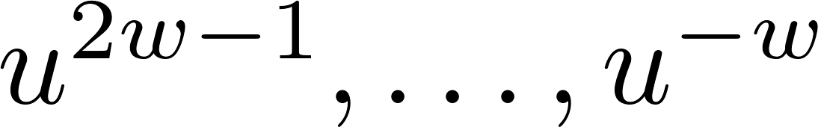

In Summary
The FADD UBFV just presented involves variables
Intuition: is the bit of the second input’s mantissa that aligns with bit of the first after alignment
The variable order that interleaves the variables with the variables results with BDDs behavior similar to integer addition
Normalization and Rounding do not introduce significant additional complexity
Hence we can verify FADD instructions without case splitting, by symbolically simulating with this UBFV

Slide 15
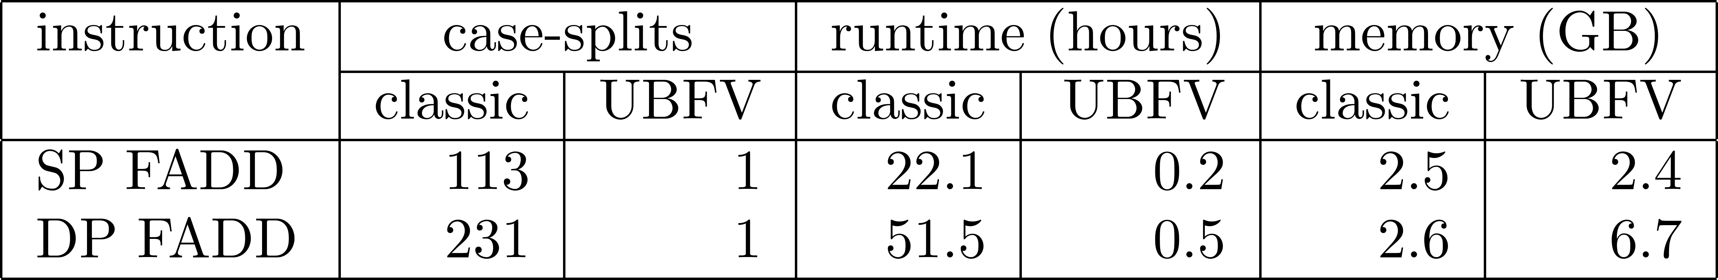
Results
Comparison of UBFV-approach vs classical case-splitting approach, for SSE Scalar FADD instructions (recent Intel design)
For single instruction multiple-data (SIMD) instructions it is also effective
Allows for elimination of decomposition cut-point
See paper for results on other instructions, such as Fused-Multiply Add

Slide 16
Theory: Partitioned BDDs and UBFV Representations

Slide 17
Summary of Theorem
Partitioned BDDs represent a function by a set of BDDs, each can employ a different variable order
Basically a formalization of BDD case-splitting
There exist functions that have tractable partitioned BDDs that don’t have tractable BDDs
Floating point addition, hidden weighted bit, etc
Theorem: any partitioned BDD has a UBFV representation (a single BDD) with at most a polynomial increase in size
Furthermore, the UBFV only has logarithmically more secondary variables
Promotes BDD node “sharing” across partitions

Slide 18









Partitioned BDDs
$$f$$
$$w_{i}$$
: ith case split
∨
$$f_{i}$$
: represents f within w_{i}
∧
∧
∧
…
BDDs over n variables
$$f_{1}$$
$$w_{1}$$
$$f_{2}$$
$$w_{2}$$
$$f_{k}$$
$$w_{k}$$
different
variable
orders

Slide 19



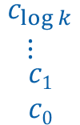






UBFV Representation Construction
Three-fold Trickery:
log₂(k) secondary variables select one of the k partitions
Secondary variables y₁,…,y_{n} are such that in each partition, y_{i} corresponds to the ith primary variable in the partition’s order
jth partition becomes BDD for generalized co-factor of f_{j} with respect to w_{j}, which has size at most |f_{j}||w_{j}|.
$$\begin{matrix}\begin{matrix}c_{\log{k}} \\ ⋮ \end{matrix} \\ c1 \\ c0\end{matrix}$$
$$c[1]$$
$$c[2]$$
$$…$$
$$c[k]$$
$$\begin{matrix}\begin{matrix}y_{1} \\ y_{2}\end{matrix} \\ \begin{matrix}y_{3} \\ ⋮ \\ y_{n}\end{matrix}\end{matrix}$$
$${f′}_{1}$$
$${f′}_{2}$$
$${f′}_{k}$$
$$…$$
0
1

Slide 20
So… If you are doing case-splitting/partitioning on BDDs, you should chuck that out and use a UBFV instead.

Slide 21
Thank you

