Slide 1
Formal Verification in the Industry: a 2020 Vision
VIGYAN SINGHAL
Oski Technology

Slide 2
My Formal Journey
University Researcher
(4 years 1991-1995)
(UC Berkeley)
Goal: advance state-of-the-art
Semiconductor tool user
(10 years 2005-2015)
(Oski)
EDA tool developer
(10 years 1995-2005)
(Jasper, Cadence)
Goal: optimize time-to-market and cost
Goal: build competitive tools

Slide 3
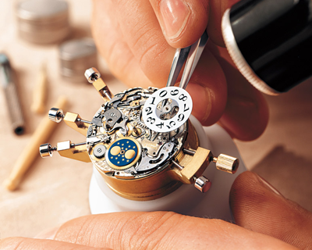
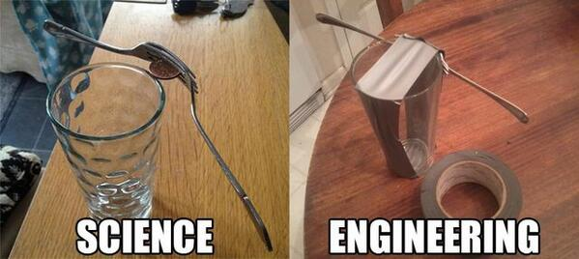
Hardware Design is Hard
Hard to Design
  Programmer LOC productivity is > 10X lower than software design
    Massively parallel program (each always block is a thread!)
  Have to worry about not just functionality
    Low-level performance – within one clock cycle!
    Power
    Area on silicon
    No higher-level abstraction – e.g. synchronization, OO
  Most designers are great craftsmen, not great mathematicians
Hard to Verify

Slide 4
Hard to Verify – Example Schedule
uarch
reqs
RTL
coding
sandbox
verif.
subsystem fixes + minor features
bugs + timing
fixes
ECO
fixes
post-ECO
WARs
post-si
WARs
12-month schedule

Slide 5
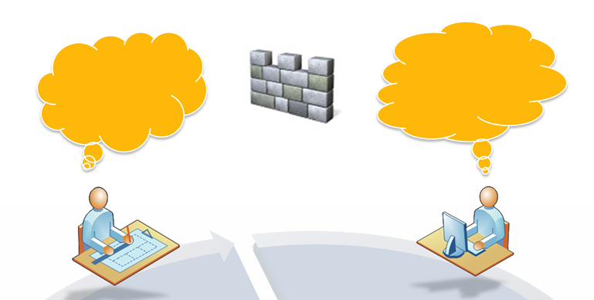
Current Design & Verification Challenges
Implicit wall between design and verification engineers
  Infrequent communication
  Miscommunication
  Delay in communication
Drawback
  Loss of efficiency and productivity
  Lack of design quality
  Prolonged project cycle
    Verification is taking too long
  Missing bugs after tapeout

Slide 6
Ziyad Hanna: “Typical Design & Validation Work Flows - two “disconnected” tasks”
Validation
Arch and uArch exploration
Design
Arch Val.
Spec Dev.
Env/Flow Dev
Black Box
Unit/FC Test Plan
RTL Rev0
Coding Done
Validation
Flows
Simulation,
Coverage,
FPV,
Emulation
Validation
Data Base
RTL Rev 1
Unit Level Val
Parallel Design
Parallel Validation
Full Chip Val
RTL Freeze
>95% Quality
System Val
Emulation
CKT Design
Notes:
Two parallel tracks
Designers focus on RTL implementation to meet timing, power and area targets
Verification engineers focus on black-box verification. They understand the spec but do not understand the implementation
There is are disconnected activities and therefore the huge risk on quality, productivity and schedule

Slide 7

My 2020 Vision

Slide 8
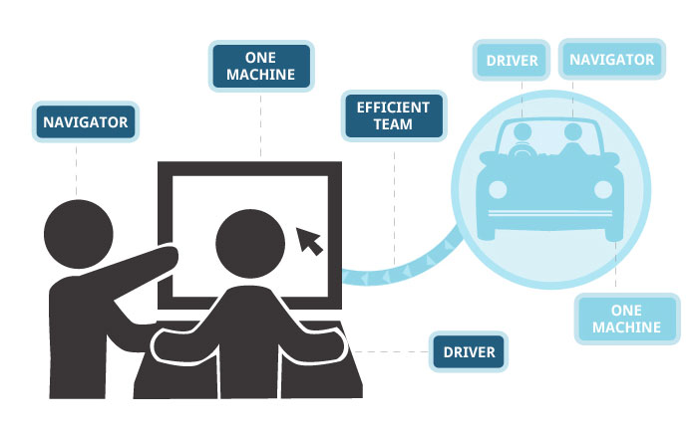
Taking Insight from Pair Programming
Pair programming
  Agile software development technique: two programmers develop software side by side at one computer
  The driver writes code
  The observer reviews each line of code as it is typed in
  The two programmers switch roles
Pair programming benefits
  Improve design quality
  Reduce defects
  Reduce staffing risk
  Enhance technical skills
  Improve team communications
  Considered more enjoyable than traditional practice

Slide 9
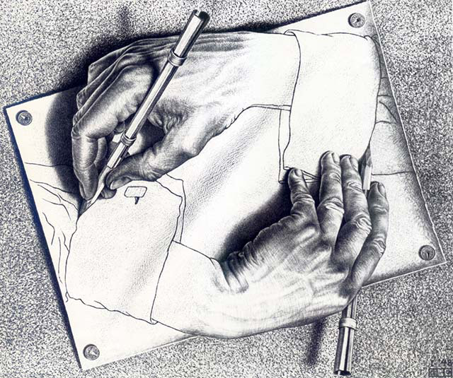
Paired Formal Design
Each designer is paired with a formal verification engineer
  Microarchitecture decisions take formal plan into consideration
  Formal engineer gains intimate knowledge of design
    A must have for formal engineers to apply techniques likes abstraction
  Designer can have another pair of eyes to check implementation
  Designer can bravely try optimizations, timing and power fixes
  Unlike Pair Programming, roles are not inter-changeable
Paired Formal Design benefits:
  Improve design quality
  Reduce project cycle & cost
    Verification is done when design is done
  Late-stage fixes take 10X less time
  Each can fix bugs!
Organizational hierarchy?
Seat assignment?
Hiring?

Slide 10
Improved Schedule and Quality at No Extra Cost
uarch
reqs
RTL
coding
sandbox
verif.
subsystem fixes + minor features
bugs + timing
fixes
ECO
fixes
post-ECO
WARs
post-si
WARs
uarch
reqs
RTL coding +
formal verification
minor
features
timing
fixes
ECO
fixes
2X savings in schedule
no increase in resources
12-month schedule

Slide 11
What Kind of Formal Tools
Outstanding UX
Ability to specify abstractions, symmetry, proof decompositions
Guides when problem is intractable
Links to coverage and completeness
…

