Slide 1

On Concurrency Idioms and their Effect on Program Analysis
Guy Katz and David Harel
Weizmann Institute of Science

Slide 2
Overview
Program analysis: verification, repair, synthesis, etc
Very desirable, but very difficult
State explosion
How can we make analysis more scalable?

Slide 3
Improving Scalability
Traditional focus: more efficient algorithms
Symbolic model checking
Abstraction / refinement
Compositional verification
And many others
Our focus: how to choose the modeling language in a way that improves scalability
A design for analysis approach

Slide 4
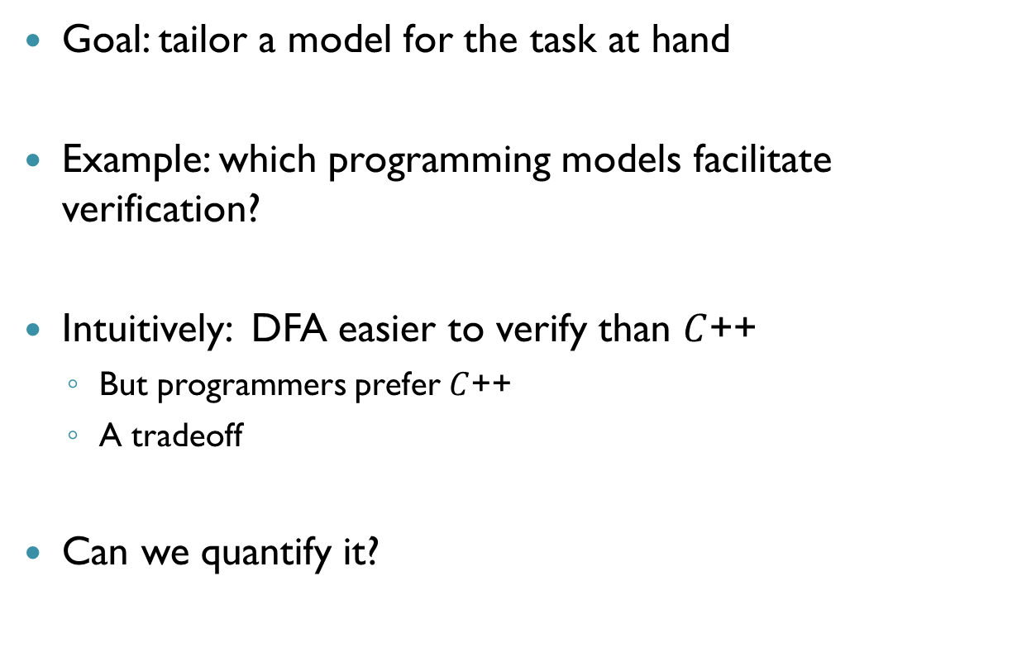
Choosing a Computational Model
Goal: tailor a model for the task at hand
Example: which programming models facilitate verification?
Intuitively: DFA easier to verify than $C$++
But programmers prefer $C$++
A tradeoff
Can we quantify it?

Slide 5

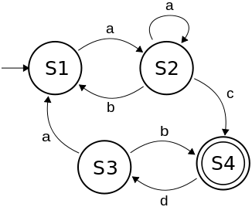

Our Goal
Focus on individual concurrency idioms
Idioms define inter-thread communication
Which idioms are amenable to analysis? When?
Retain just enough concurrency: keep things simple!
Idiom A
Idiom B
Idiom C
Idiom D
Idiom E
Easy to analyze

Slide 6
Example: Program Repair

Slide 7
Program Repair
A bug is found in existing software. Now what?
Manual repair is difficult
Automation is much needed

Slide 8
Repair Using Blocking
Blocking: threads prohibit actions by other threads
Very useful in repair
Safety bugs: something bad happens
Use blocking to prevent erroneous runs
Liveness bugs: good things may never happen
Use blocking to steer the execution towards good states
Patches are non-intrusive
"Non-Intrusive Repair of Safety and Liveness Violations in Reactive Programs", TCCI, 2014

Slide 9









Simple Safety Repair
Some states are marked bad
Finally, add a thread (“patch”) that blocks these edges
$$q_{1}$$
$$q_{2}$$
$$q_{3}$$
$$q_{2}$$
$$q_{4}$$
$$q_{4}$$
$$q_{5}$$
$$q_{5}$$
$$q_{6}$$

Slide 10
Additional Topics
Compositional verification
In some cases, simple idioms facilitate assume/guarantee reasoning
Can even allow for automation (see talk later today)
Succinctness
Simple idioms are enough to write small programs
Just as strong as very liberal models
Automatic optimization of the program
Relax certain synchronization constraints, while maintaining the program’s semantics

Slide 11
Thank You!

