Slide 1

Formal Verification of Hybrid
Control Operator Language
Vadim Zaliva, Franz Franchetti
Carnegie Mellon University
Department of Electrical and Computer Engineering
Funded by the DARPA I2O HACMS Program through award FA8750-12-2-0291
2015-09-16
Notes:
Hybrid Control Operator Language

Slide 2
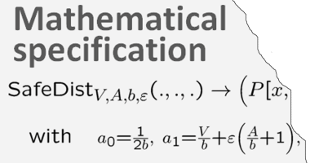
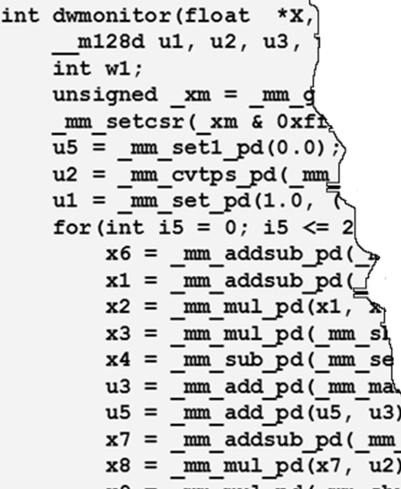
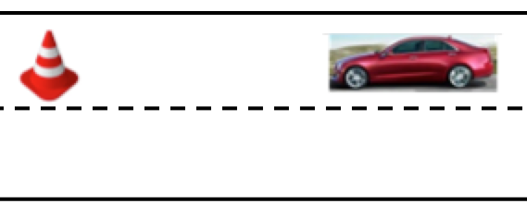

Project’s Goal and High Level Approach
Approach
HCOL specification
Vehicular control system is specified in HCOL language
HCOL specification is transformed to the code via a series of steps
Transformation steps are formally verified in Coq proof assistant
SPIRAL-Synthesized and formally verified code deployed on a robot.
Expansion + backtracking
HCOL (dataflow) expression
Recursive descent
Ʃ-HCOL (loop) expression
Goal
Confluent term rewriting
Optimized Ʃ-HCOL expression
To synthesize executable code for the control system of a robot satisfying certain safety and security properties and to produce machine-checkable proofs assuring that this code implements functional specification.
Recursive descent
Final code
Abstract code
Confluent term rewriting
Optimized abstract code
Recursive descent
C code
Notes:
The goal of the project I am working on is to prove the accuracy of code generated for vehicular control system
System is described in HCOL language
This is an input language of SPIRAL system which through a series of transformations converts it into optimized C code
The goal of transformations is to reshape computations to match properties of target hardware architecture

Slide 3
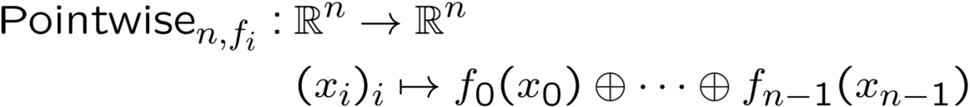
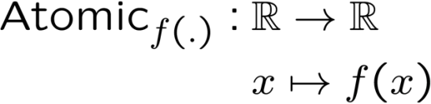
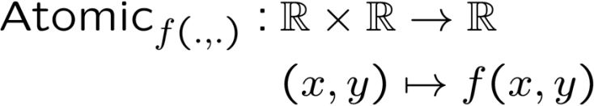
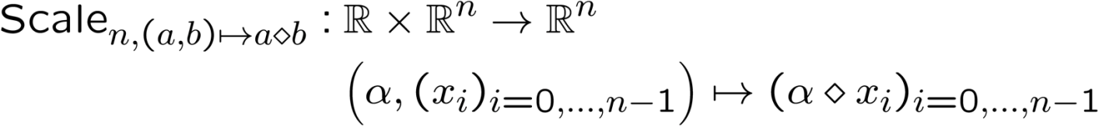
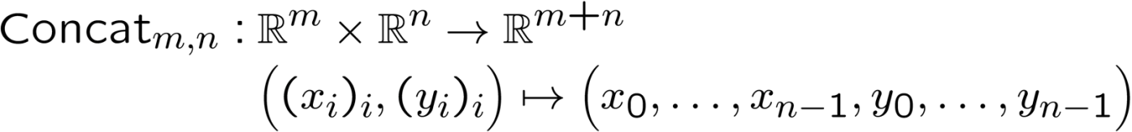
HCOL Basic Operators

Slide 4
HCOL Formalization
Syntax:
Inductive HOperator: nat→ nat → Type :=
│HOReduction : ∀ m (f: A → A →)
‘{pF: !Proper ( (=) ==> (=) ==> (=) ) f } (id:A), HOperator m 1
│HOPointWise : ∀ n (f: A → A →A)
‘{pF: !Proper ( (=) ==> (=) ==> (=) ) f }, HOperator (n+n) n
│HOScalarProd: ∀ {k:nat}, HOperator (k+k) 1
│HOEvalPolynomial: ∀ {n} (a:vector A n), HOperator 1 1
│HOCompose: ∀ m {k} n, HOperator k n → HOperator m k →
→ HOperator m n.
An HCOL expression can be represented by an Abstract Syntax Tree (AST). A subset of the language syntax could be defined in Coq using the following inductive type:
Semantics:
The semantics of is defined via an evaluation function, which takes an HOperator object and an input vector and returns the resulting vector:
evalHCOOL: ∀ {m n}, HOperator m n → vector A m → vector A n.
Operators’ definition:
Fixpoint EvalPolynomial {n} ‘{SemiRing A}
(a: vector A n) (x:A) : A :=
match a with
nil ⇒ 0
│ cons a0 p a’ ⇒ a0 + (x × (EvalPolynomial a x ))
end
Example definitions of
Polynomial operator:

Slide 5
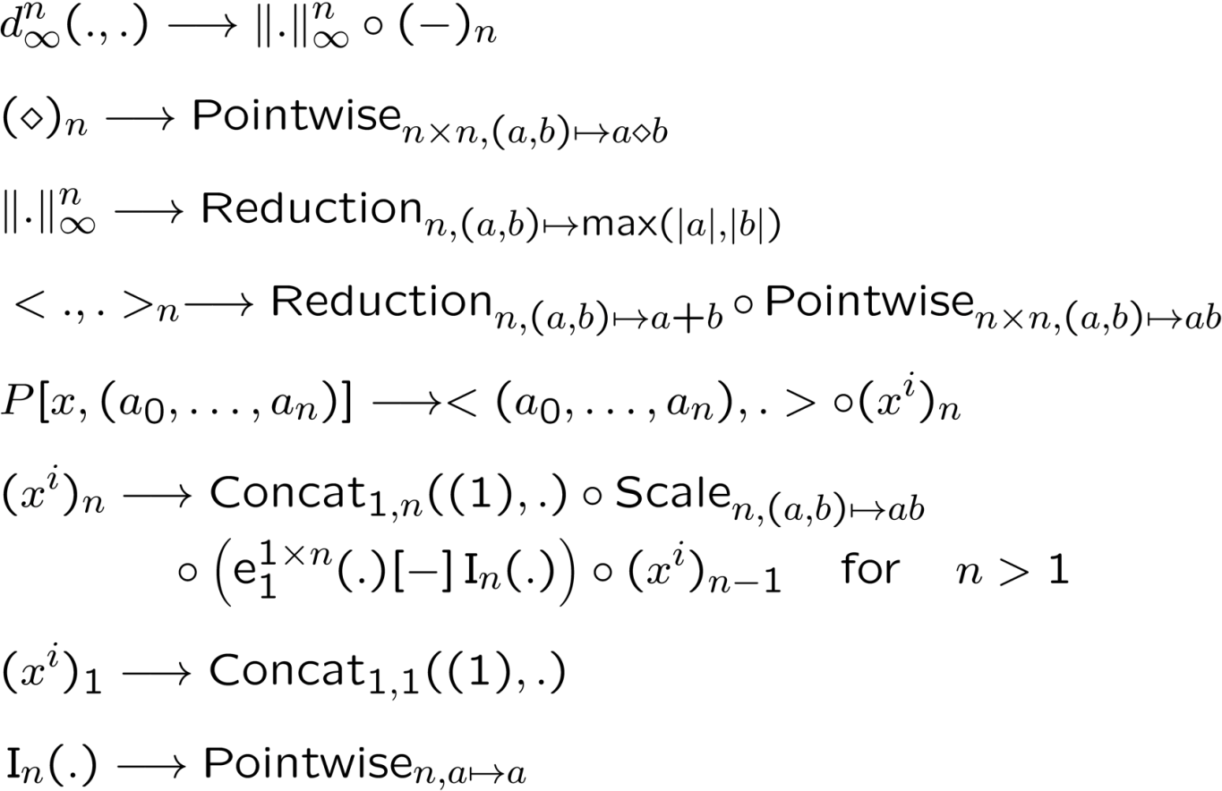
HCOL Rewriting Rules
Notes:
ScalarProduct example

Slide 6

Proving HCOL Rewriting
Using Coq Proof Assistant
Syntax: Inductive type for HCOL expressions
Semantics: evaluation
Equivalence: extensionality
Rewriting rules as lemmas
“Translation validation” – proving sequence of rule applications from SPIRAL trace.
Notes:
“Translation validation” approach.

Slide 7
Rewriting Rules as Lemmas
We express each rule as a lemma stating equality of two operators. For example,
Lemma breakdown_ScalarProd:
∀ {h:nat},
HOScalarProd h =
HOCompose _ _
(HOReduction _ (+) 0)
(HOPointWise _ (.*.) ).
We defined operator extensional equality:
Global Instance HCOL_equiv {i o: nat}: Equiv (HOperator i o) :=
fun a b ⇒ ∀ (x: vector A i), evalHCOL a x = evalHCOL b x.
Informally: two operators “a” and “b” are equal if for any input vector “x” the values of (evalHCOL a x) and (evalHCOL b x) are also equal.

Slide 8
Results and Future Directions
We completed Axiomatic proofs of the HCOL operator language transformations:
  7 breakdown rules
  76 Lemmas
  2,138 lines of Coq code
Next steps to prove:
  HCOL ➣ Ʃ-HCOL
  Ʃ-HCOL transformations
  Ʃ-HCOL ➣ i-Code
  i-Code ➣ “C” code generation
  “C” code ➣ machine code compilation

Slide 9
Thanks!
For more information go to: http://www.spiral.net/
Contact: vzaliva@cmu.edu

