Slide 1
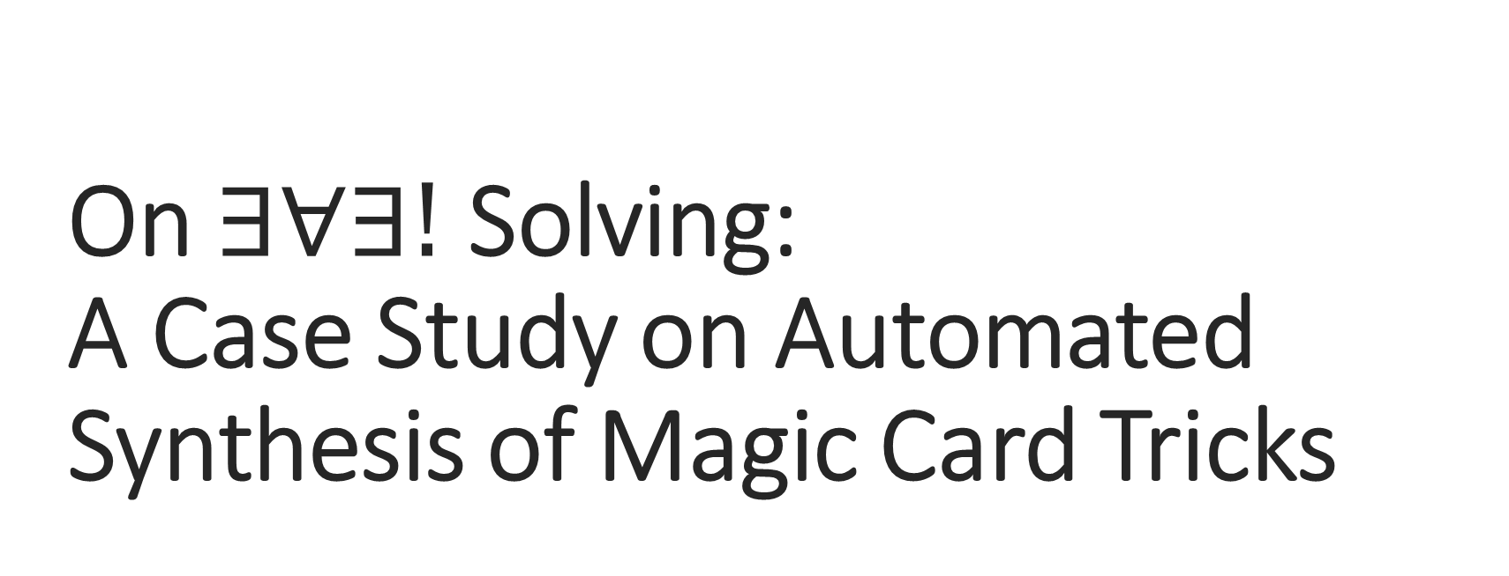
On $∃∀∃!$ Solving:
A Case Study on Automated Synthesis of Magic Card Tricks
Susmit Jha¹, Vasumathi Raman, Sanjit A. Seshia²
¹SRI International
²University of California, Berkeley

Slide 2
Formal Synthesis
Given a high-level specification explicitly in a logical form or implicitly as an oracle, generate a formal artifact (program/controller/plan) that satisfies the specification.
The space of possible artifacts often represented as a parametric space and synthesis reduces to efficiently searching over this space.
  Missing constants/holes in a program: A. Solar-Lezama, L. Tancau, R. Bodik, S. A. Seshia, and V. A. Saraswat, “Combinatorial sketching for finite programs.” in ASPLOS, 2006, pp. 404–415
  Composition of component functions: S. Jha, S. Gulwani, S. A. Seshia, and A. Tiwari, “Oracle-guided component-based program synthesis,” in ICSE, 2010, pp. 215–224
Successful application in synthesizing programs, plans, controllers, invariants…

Slide 3
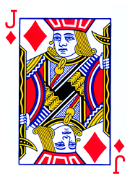
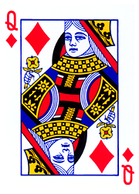
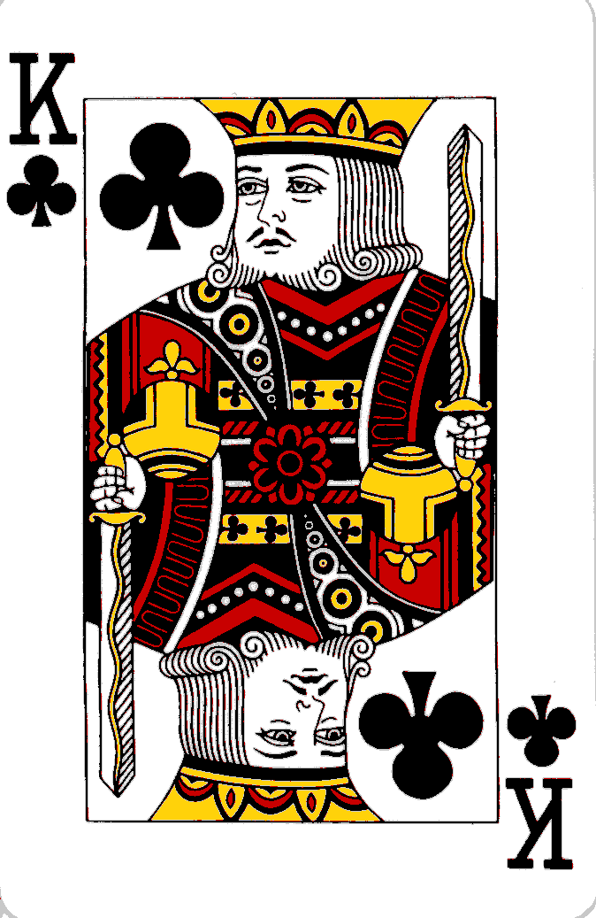
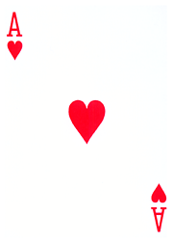
Card Trick: Example with 4 cards

Slide 4
Card Trick: Example with four cards

Slide 5

Card Trick: Example with four cards
J --- Back
Q
K
A --- Front
Trick Summary: Irrespective of the choice from the users, we can ensure that the bottom most card (Jack) will always end up being the odd facing card.

Slide 6
Card Trick: Top Card to Bottom
J --- Back
Q
K
A --- Front
A --- Back
J
Q
K --- Front

Slide 7
Card Trick: Turn over the top card
A --- Back
J
Q
K --- Front
A --- Back
J
Q
K’ --- Front

Slide 8
Card Trick: Straight Cut (Audience Choice)
A --- Back
J
Q
K’ --- Front
K’ --- Back
A
J
Q --- Front
Q --- Back
K’
A
J --- Front
J -- Front
Q
K’
A --- Back
A --- Back
J
Q
K’ --- Front

Slide 9
Card Trick: Turn over top two together
A --- Back
J
K
Q’ --- Front
K’ --- Back
A
Q’
J’ --- Front
Q --- Back
K’
J’
A’ --- Front
J -- Front
Q
A’
K --- Back
A --- Back
J
Q
K’ --- Front
K’ --- Back
A
J
Q --- Front
Q --- Back
K’
A
J --- Front
J -- Front
Q
K’
A --- Back

Slide 10
Card Trick: Loop of Audience Choice
Repeat{ // As many times as audience chooses
Straight Cut // Audience Choice
Turn over top two together
}

Slide 11
Card Trick: After a few iterations
K’ --- Back
A
Q’
J’ --- Front

Slide 12
Card Trick: Turn over the top card
K’ --- Back
A
Q’
J’ --- Front
K’ --- Back
A
Q’
J --- Front

Slide 13
Card Trick: Put it to bottom
K’ --- Back
A
Q’
J --- Front
J --- Back
K’
A
Q’ --- Front

Slide 14
Card Trick: Put top to bottom again
J --- Back
K’
A
Q’ --- Front
Q’ --- Back
J
K’
A --- Front

Slide 15
Card Trick: Turn Over the Top Card
Q’ --- Back
J
K’
A --- Front
Q’ --- Back
J
K’
A’ --- Front

Slide 16
Card Trick: Odd facing card !
Q’ --- Back
J
K’
A’ --- Front
Q’ --- Back
J
K’
A’ --- Front

Slide 17
Card Trick: Example
Take 4 card all facing down
Put top card to bottom
Turn over top card
Turn top card
Repeat { //Audience choice on how many times
Straight Cut (at position of Audience Choice )
Turn over top two together
}
Turn over top card and put it to bottom
Put top card to bottom
Turn over top card
Specification/Property
The card which was at the bottom of the stack in the beginning is always odd-facing card at the end !
Magic Card Trick:
Non-deterministic Program
Inputs at different steps

Slide 18
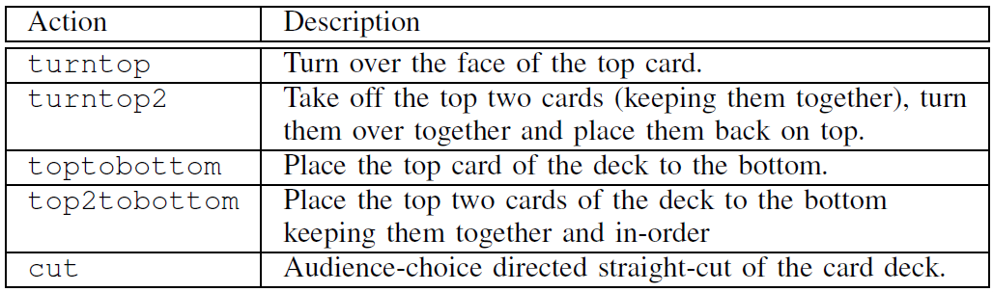
Card Trick: Example
Take 4 card all facing down
Put top card to bottom
Turn over top card
Turn top card
Repeat { //Audience choice on how many times
Straight Cut (at position of Audience Choice )
Turn over top two together
}
Turn over top card and put it to bottom
Put top card to bottom
Turn over top card
SYNTHESIS
Specification/Property
The card which was at the bottom of the stack in the beginning is always odd-facing card at the end !
Take 4 card all facing down
Put top card to bottom
Turn over top card
Turn top card
Repeat { //Audience choice on how many times
Straight Cut (at position of Audience Choice )
Turn over top two together
}
Turn over top card and put it to bottom
Put top card to bottom
Turn over top card
Take 4 card all facing down
Put top card to bottom
Turn over top card
Turn top card
Repeat { //Audience choice on how many times
Straight Cut (at position of Audience Choice )
Turn over top two together
}
Turn over top card and put it to bottom
Put top card to bottom
Turn over top card
Take 4 card all facing down
Put top card to bottom
Turn over top card
Turn top card
Repeat { //Audience choice on how many times
Straight Cut (at position of Audience Choice )
Turn over top two together
}
Turn over top card and put it to bottom
Put top card to bottom
Turn over top card
Components
MAGIC CARD TRICKS

Slide 19
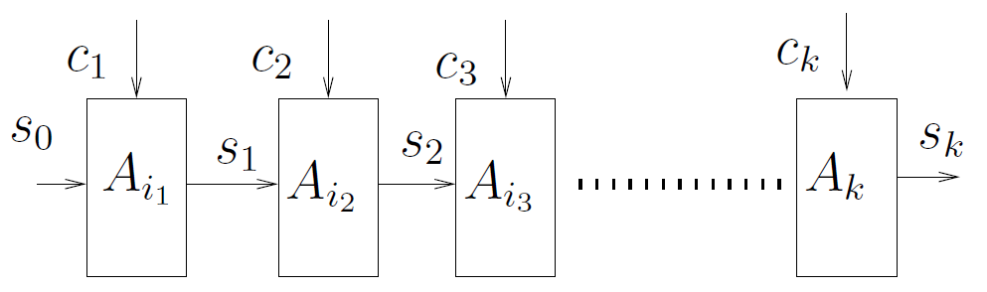
Component Based Synthesis
Straight-line program : Sequence of actions
Non-deterministic input to some actions in form of choice from audience
$∃ A_{i_{1}}$ $A_{i_{2}} …∀ c_{1} c_{2} … ∃! s_{0} s_{1} …{ φ}_{des}\left(A,c, s\right)∧φ\left(s_{0}, s_{k}\right)$

Slide 20
Composing Component Actions
A magic trick is a straight-line program : Sequence of component actions
Non-deterministic input to some actions in form of choice from audience
State is function of previous state and choice of audience.
$∃ A_{i_{1}}$ $A_{i_{2}} …∀ c_{1} c_{2} … ∃! s_{0} s_{1} …{ φ}_{des}\left(A,c, s\right)∧φ\left(s_{0}, s_{k}\right)$

Slide 21
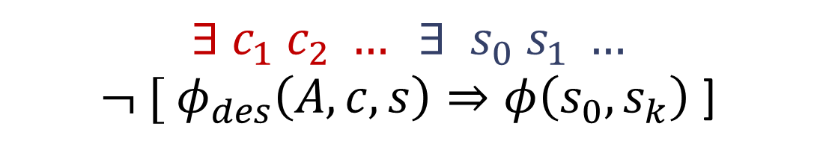
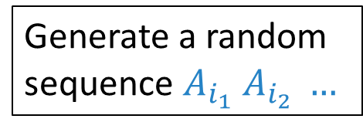
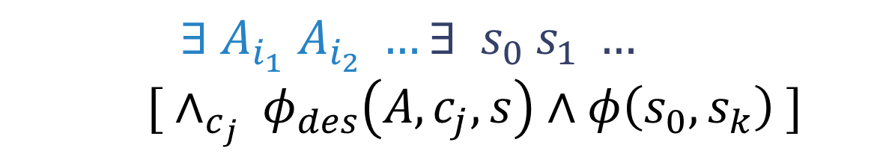
CEGIS: Counterexample guided synthesis
Learn from example choices
Generate a random sequence $A_{i_{1}}$ $A_{i_{2}} …$
$∃ A_{i_{1}}$ $A_{i_{2}} …∃ s_{0} s_{1} …$
${ [ ∧_{c_{j}} φ}_{des}\left(A,c_{j}, s\right)∧φ\left(s_{0}, s_{k}\right) ]$
Obtain counterexample choice
Use verification to obtain counterexample choices
$$∃ c_{1} c_{2} … ∃ s_{0} s_{1} …$$
${ ¬ [ φ}_{des}\left(A,c, s\right)⇒φ\left(s_{0}, s_{k}\right)$ ]
Y
Learn from example choices
Final Magic Sequence
Iterate till no counterexample choice left.

Slide 22
Results
1. Baby Hummer : A magic trick of length 10-15, 6 variants of the original trick.
2. Elmsley Shuffles: Repeating in-shuffles and out-shuffles 6-10 times, placing card from any initial position in deck to any target position through apparently random shuffles.
3. Mind-reading card-trick: Distributed magic trick where three audiences cut card decks randomly and select top cards, we find each audience’s card.

Slide 23
Future Work
1. Application to adversarial planning : Non-reactive Plan in presence of adversaries where plan is guaranteed to reach the goal irrespective of adversary’s choice.
2. Understanding magic tricks using program analysis tools.
3. A medium to introduce and teach formal methods to students.
Take 4 card all facing down
Put top card to bottom
Turn over top card
Turn top card
Repeat { //Audience choice on how many times
Straight Cut (at position of Audience Choice )
Turn over top two together
}
Turn over top card and put it to bottom
Put top card to bottom
Turn over top card
What is the invariant of this loop?

Slide 24
Thanks.
Conclusion: Illustrates the success of formal synthesis approach to automate discover of magic tricks which has been long seen as a creative art.

