Slide 1
Routing under Constraints
Alexander Nadel
Intel, Israel
FMCAD
Mountain View CA, USA
October 4, 2016

Slide 2
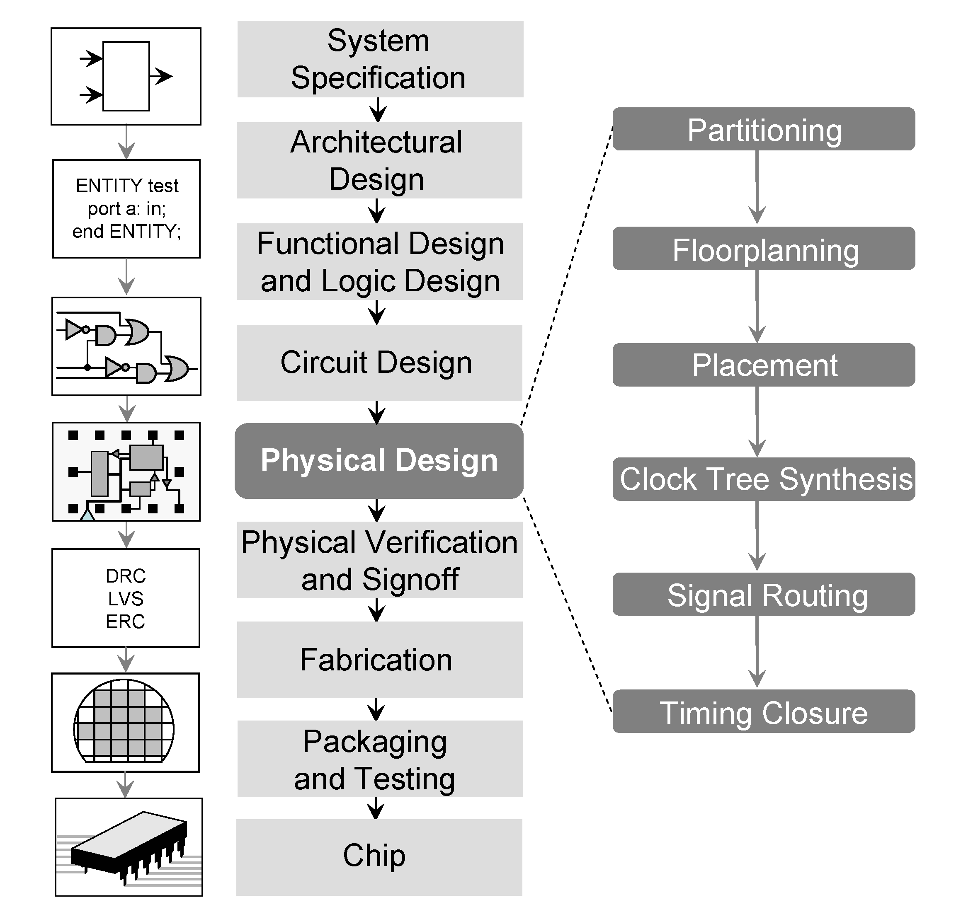
Routing
"PhysicalDesign" by Linear77 - Own work. Licensed under CC BY 3.0 via
Wikimedia Commons - https://commons.wikimedia.org/wiki/File:PhysicalDesign.png#/media/File:PhysicalDesign.png

Slide 3
Outline
Goal: Design a Scalable Design Rule-aware Router
Routing under Constraints (RUC): Problem Formalization
Bit-Vector / SAT Encoding
DRouter through SAT Solver Surgery
Doesn’t scale
A*-based decision strategy (emulates constraints!)
Net restarting &
net swapping
Graph conflict analysis
Unsolved crafted and industrial RUC instances are routed!

Slide 4
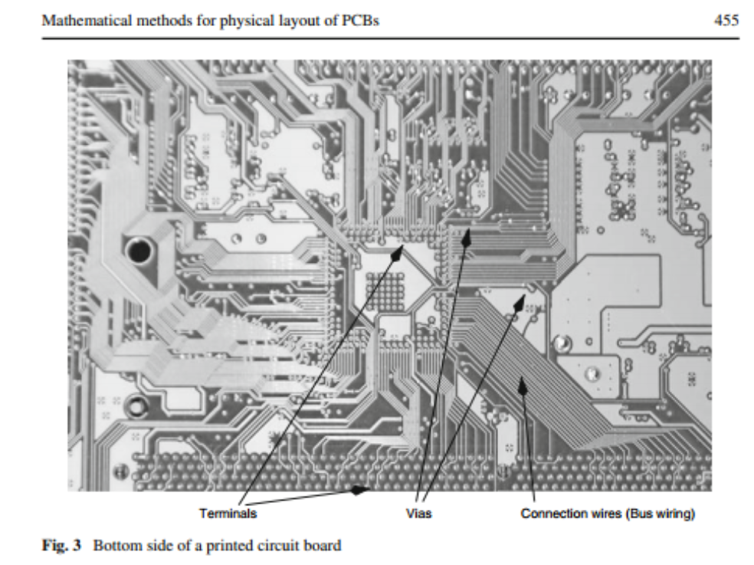
Abboud et al, OR Spectrum’08

Slide 5
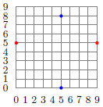
Routing: Input
(AKA Steiner Tree Packing Problem)
Input
A graph G(V,E)
Disjoint Nets N_{i} ⊆ V
Terminals

Slide 6
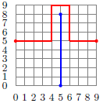
Routing: Output
It is NP-hard to find:
Shortest solution for one multi-terminal net (Steiner tree problem)
Any solution for many multi-terminal nets
Input
Output
Each net is spanned by a tree,
called the net routing
Net routings can’t intersect
Optimization: minimize the total
routing length

Slide 7
Design Rules
Routing is to satisfy design rules
  Originating in the manufacturing requirement
Example “short” rule:
  The 2 vertices of any edge can’t belong to two distinct net routings
Short rule is violated for these edges
When the short rule is on, this example is UNSAT

Slide 8
Industrial Approach:
Rip-Up and Reroute
Nets are routed one-by-one
  Using A*
    s-t shortest-path given costs’ under-approximation
    A*≡Dijkstra if no costs’ under-approximation is provided
  Trying to heuristically obey design rules
Violations are allowed, hence the initial solution might be problematic
  Net routings might intersect
  Design rules might be violated
Clean-up is applied
  Rip-up: problematic net routings are removed
  Reroute: un-routed nets are attempted again

Slide 9


The Problem with the Current Solution
Design rule violations persist
  Manual clean-up is carried out
Some violations still persist
Time-to-market is impacted

Slide 10
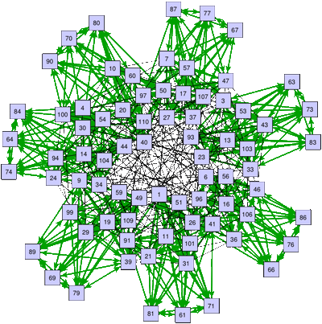
Potential Solution
Constraint Solving
Next: formalizing Routing under Constraints

Slide 11
Routing Induces Assignment
Edge variables
Bool e: edge activity

Slide 13
0
0
0
0
1
1
0
0
0
0
0
0
0
1
0
1
0
0
0
0
0
0
0
0
0
0
0
0
0
0
0
0
1
1
1
0
0
0
0
0
0
0
0
0
0
0
0
0
0
0
0
1
1
1
0
0
0
0
0
0
0
0
0
0
0
0
0
0
0
0
1
1
1
0
0
0
1
1
1
1
0
0
1
1
1
0
0
0
0
0
1
0
0
0
0
0
0
0
0
0
0
0
0
0
0
0
0
0
0
1
0
0
0
0
0
0
0
0
0
0
0
0
0
0
0
0
0
0
1
0
0
0
0
0
0
0
0
0
0
0
0
0
0
0
0
0
0
1
0
0
0
0
0
0
0
0
0
0
0
0
0
0
0
0
0
0
1
0
0
0
0
0
0
0
0
0
0
0
0
0

Slide 14
Routing Induces Assignment
Bool v: activity status
Bit-vector n: net id
(∅ for inactive vertices)
Vertex variables

Slide 16
0,∅
0,∅
0,∅
0,∅
1,0
1,0
1,0
0,∅
0,∅
0,∅
0,∅
0,∅
0,∅
0,∅
1,0
1,1
1,0
0,∅
0,∅
0,∅
0,∅
0,∅
0,∅
0,∅
1,0
1,1
1,0
0,∅
0,∅
0,∅
0,∅
0,∅
0,∅
0,∅
1,0
1,1
1,0
0,∅
0,∅
0,∅
1,0
1,0
1,0
1,0
1,0
1,1
1,0
1,0
1,0
1,0
0,∅
0,∅
0,∅
0,∅
0,∅
1,1
0,∅
0,∅
0,∅
0,∅
0,∅
0,∅
0,∅
0,∅
0,∅
1,1
0,∅
0,∅
0,∅
0,∅
0,∅
0,∅
0,∅
0,∅
0,∅
1,1
0,∅
0,∅
0,∅
0,∅
0,∅
0,∅
0,∅
0,∅
0,∅
1,1
0,∅
0,∅
0,∅
0,∅
0,∅
0,∅
0,∅
0,∅
0,∅
1,1
0,∅
0,∅
0,∅
0,∅

Slide 17
Modeling Routing under Constraints
Design rules can be easily expressed in BV logic
  Variables:
    Edge & vertex activities
    Vertex nids
    Any auxiliary variables
“Short” rule example
  For every edge e=(v,u): ¬v ∨ ¬u ∨ nid(v)=nid(u)
Short rule is violated for these edges

Slide 18
Routing under Constraints (RUC): Problem Formulation
Input
Graph G(V,E)
Disjoint Nets N_{i} ⊆ V
A quantifier-free
bit-vector formula F(V ∪ E ∪ N ∪ A)
  V : vertex activity
  E : edge activity
  N : vertex net id
  A : any auxiliary variables
(represents the design rules)
Output: a model to F, which induces a routing:
e=(v,u) is active →
  v and u are active, and
  nid(v) = nid(u)
For each net i: active vertices with nid i and active edges span the net’s terminals
Optional optimization requirement: the overall weight of active edges is as small as possible

Slide 19

Solving Attempt: Encoding into
Bitvector Logic / SAT
For 2-terminal nets:
  e=(v,u) is active →
    v and u are active, and
    nid(v) = nid(u)
  A terminal has one active neighbor edge
  An active non-terminal has two active neighbor edges
For n-terminal nets:
  Encode directed trees
    Using edge directions

Slide 20
SAT Solver’s Internals
Boolean Constraint
Propagation
Decision Strategy
(Conflict-driven)
Conflict Analysis &
Learning
No conflict
Time-to-restart?
Conflict
Backtracking
Restarts

Slide 21

SAT → DRouter through Surgery

Slide 22
SAT → DRouter
Boolean Constraint
Propagation
Decision Strategy
(Conflict-driven)
A*-based Router
Conflict Analysis &
Learning
No conflict
Graph-based
Learning
Time-to-flip?
Time-to-
restart?
Conflict
Time-to-restart?
Backtracking
Net
Swapping
Net
Restarting
Restarts

Slide 23
DRouter
Encoded constraints:
Edge consistency
  e=(v,u) is active →
    v and u are active
    nid(v) = nid(u)
User-provided constraints modelling design rules
That’s it! What about disconnected terminals???
Routing correctness is guaranteed by the decision strategy!
Boolean Constraint
Propagation
Decision Strategy
(Conflict-driven)
A*-based Router
Conflict Analysis &
Learning
No conflict
Graph-based
Learning
Time-to-flip?
Time-to-
restart?
Conflict
Backtracking
Net
Swapping
Net
Restarting

Slide 24
1-Net Example
Boolean Constraint
Propagation
Decision Strategy
(Conflict-driven)
A*-based Router
Conflict Analysis &
Learning
No conflict
Graph-based
Learning
Time-to-flip?
Time-to-
restart?
Conflict
Backtracking
Net
Swapping
Net
Restarting

Slide 25
1-Net Example
2
s: (0, 0)
t: (3, 0)
¬(1,0) ∨ ¬(2,0)
¬(1,0) ∨ ¬(1,1)
¬(3,2) ∨ ¬(3,1)
σ (sugg.)
Real path
1
x
Design rules
SAT
Decision
Initial path:
A* from s->t
x
0
1
2
3
Path Suggestion
(not an actual SAT decision)
Activate edge in sugg.
σ-violation
  A* search
  for new σ

Slide 26
1-Net Example
BCP
2
s: (0, 0)
t: (3, 0)
¬(1,0) ∨ ¬(2,0)
¬(1,0) ∨ ¬(1,1)
¬(3,2) ∨ ¬(3,1)
σ (sugg.)
Real path
1
x
Initial path:
A* from s->t
Repeat
x
0
1
2
3
Activate edge in sugg.
No σ-violation
Path found
no
  A* search
  for new σ
Target is part of path?

Slide 27
1-Net Example
2
s: (0, 0)
t: (3, 0)
¬(1,0) ∨ ¬(2,0)
¬(1,0) ∨ ¬(1,1)
¬(3,2) ∨ ¬(3,1)
σ (sugg.)
Real path
1
x
x
Initial path:
A* from s->t
Repeat
x
0
1
2
3
Activate edge in sugg.
σ-violation
No σ-violation
no
  A* search
  for new σ
Target is part of path?

Slide 28
1-Net Example
x
s: (0, 0)
t: (3, 0)
¬(1,0) ∨ ¬(2,0)
¬(1,0) ∨ ¬(1,1)
¬(3,2) ∨ ¬(3,1)
σ (sugg.)
2
Real path
1
x
x
(2,0) ∨ ¬(3,2)
Initial path:
A* from s->t
Repeat
x
0
1
2
3
Activate edge in sugg.
1UIP conflict clause: (2,0) ∨ ¬(3,2)
Add conflicting clause: vertex cut (2,0) ∨ (3,1)
σ-violation
No σ-violation
no
  A* search
  for new σ
Target is part of path?
  Learn & Backtrack
Graph conflict (s and t can’t be connected)

Slide 29
1-Net Example
x
s: (0, 0)
t: (3, 0)
¬(1,0) ∨ ¬(2,0)
¬(1,0) ∨ ¬(1,1)
¬(3,2) ∨ ¬(3,1)
σ (sugg.)
2
Real path
1
x
(2,0) ∨ ¬(3,2)
Initial path:
A* from s->t
Repeat
x
0
1
2
3
Result:
Path that follows constraints!
Activate edge in sugg.
σ-violation
No σ-violation
Path found
no
  A* search
  for new σ
Target is part of path?
(yes!)
  Learn & Backtrack
DONE!
Graph conflict

Slide 30

Multiple Nets Handling
Route the nets one-by-one
  Order is critical!
Example Order 1:
  Violet
  Black
  Red
Example Order 2:
  Red
  Black
  Violet

Slide 31
Multiple Nets Handling
Graph conflict
  black is blocked
Early conflict detection
  Check for graph conflicts
  after routing each terminal
Learn a conflict clause &
re-route
Route the nets one-by-one
  Order is critical!
Example Order 1:
  Violet
  Black
  Red
Example Order 2:
  Red
  Black
  Violet
Too slow! Solution: dynamic net reordering!

Slide 32
DRouter
Boolean Constraint
Propagation
Decision Strategy
(Conflict-driven)
A*-based Router
Conflict Analysis &
Learning
No conflict
Graph-based
Learning
Time-to-flip?
Time-to-
restart?
Conflict
Backtracking
Net
Swapping
Net
Restarting

Slide 33
Net Swapping
Example Order 2:
  Red
  Black
  Violet
Flip:
  Black
  Red
  Violet
Swapped
Net Swapping:
  After N conflicts, swap the order between:
    the first blocked net i
    the blocking net j
  {A,j,B,i,C} → {A,i,j,B,C}

Slide 34
Net Restarting
Example Order 2:
  Red
  Black
  Violet
Flip:
  Black
  Red
  Violet
Moved to the top
Net Restarting
  Restart and move the blocked net to the top
    (after M conflicts for that net)

Slide 35
Net Swapping vs. Net Restarting
Swapping is local
Restarting is global
In practice both techniques are crucial
Strategy:
  Swap for some time
  If it doesn’t work, restart

Slide 36
Related Work 1: Clock Routing
Erez & Nadel, CAV’15
Reduction to finding bounded-path in graph
SAT solver surgery: graph-aware decision strategy & graph conflict analysis
The decision strategy:
  Emulates constraints!
  Guides the solver towards the solution
  Considers additional optimization requirements
Clock Routing

Slide 37
Related Work 2: Monosat Solver
Bayless & Bayless & Hoos & Hu, AAAI’15
Can reason about graph predicates & SAT/BV
Graph conflict analysis
Shortest-path decision heuristic can be optionally applied
Path-finding (routing for one 2-terminal net) is conceptually similar in Monosat and DRouter
  Main difference:
    Lazy A* in DRouter vs.
    Eager incremental Ramalingam-Reps in Monosat
RUC can be easily expressed in Monosat language

Slide 38
Monosat vs. DRouter for Routing under Constraints
Monosat’s algorithms are not routing-aware
  No net re-ordering
  Graph conflict analysis for routing is inefficient
Routing in DRouter (net swapping&restarting are off)
Routing in Monosat
Conflict
Conflict

Slide 39
Experimental Results on Crafted Instances
Solvers:
  Drouter (default)
  Drouter – R: no net restarting
  Drouter – S: no net swapping
  Drouter – SR: no net swapping, no net restarting
  Monosat (default)
  Monosat + D: shortest-path decision strategy is on
  BV: reduction to BV
Instances:
  120 solid grid graphs of size M × 20
    M ∈ {3,5,7}
  20 random 2-terminal nets
  Generate C * |V| random binary clauses ¬v ∨ ¬u
    v,u ∈ V
    C ∈ {0,0.1,0.2,0.3}

Slide 40
Full-fledged DRouter only can solves all the instances
  Both net restarting and net swapping are essential!
Monosat and BV can’t solve a single instance

Slide 41
DRouter on Industrial Instances
Run DRouter on difficult clips from Intel designs
  Couldn’t be routed cleanly by 2 industrial routers
Area in μm² | Nets | Vertices | Constraints | Time in sec. | Memory in Gb.
24 | 110 | 42,456 | 484,008 | 25 | 0.7
24 | 230 | 42,456 | 484,008 | 391 | 1.0
32 | 352 | 63,740 | 667,764 | 705 | 2.2
129 | 788 | 127,480 | 2,669,056 | 14,733 | 6.5
129 | 891 | 127,480 | 2,669,056 | 92,950 | 6.5

Slide 42
Conclusion
DRouter: design-rule-aware router
  SAT solver surgery:
    Decision heuristic → A*-based router
    Conflict analysis enhanced with graph reasoning
    Restarts → net swapping & net restarting
Solves instances which can’t be solved by existing tools
  Including clips from real Intel designs

