Slide 1
Testing Composable Specifications
Ken McMillan
Microsoft Research

Slide 2
Case study
TileLink is a protocol for implementing a coherent memory in a system-on-chip (SoC).
Goal: a formal, modular specification of TileLink
Specify the protocol
Prove that it implements correct memory semantics
Rigorously test component implementations
Allow rapid configuration of SoC designs

Slide 3
TileLink system
Hierarchy of memory system components for SoC using a common interface protocol.
CORE
L2$
NET
DIR
MEM
CORE
DIR
MEM
CORE
L2$
DIR
MEM
TL
TL
TL
TL
Hierarchy implements weakly consistent memory model.

Slide 4
Modular verification
General approach:
Write generic formal specifications of components
Verify components locally against specifications
Infer that systems of such components are correct
Composable specifications:
Correctness of components implies correctness of system.
With a composable specification, we can assemble arbitrary configurations of components.
Some composable specifications are better than others, however…

Slide 5





Good composability
Assume/guarantee specifications
A conjunction of temporal properties of interfaces
Assume/guarantee relationships
A
$$p$$
B
A: “$G (Hq⇒p)$”
B: “$G (Hp⇒q)$”
$$q$$
A$∥$B: “$G(p∧q)$”
composable!
This proof is checkable in P-time
We want our specifications to be composable “by construction”.

Slide 6
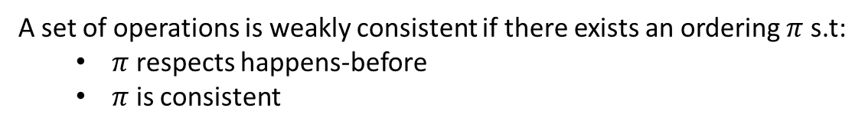
Memory semantics
op(loc,kind,addr,data)
Memory operations:
read
write
atomic
CPU
Happens-before relation on operations:
happens-before($op_{1},op_{2}$) $⇔$ loc($op_{1}$) $=$ loc($op_{2}$) $∧$ time($op_{1}$) < time($op_{2}$)
$∧$ (addr($op_{1}$) $=$addr($op_{2}$) $∨$ atomic($op_{1}$) $∨$ atomic($op_{2}$))
Consistency:
A sequence of ops is consistency if every read sees value of most recent write.
Weak consistency:
A set of operations is weakly consistent if there exists an ordering $π$ s.t:
$π$ respects happens-before
$π$ is consistent

Slide 7

Problem
How do you write a “good” composable specification for a system if its key property refers to all events in the system?
How do we witness the serialization $π$?
How do local operations fit into the global serialization?

Slide 8


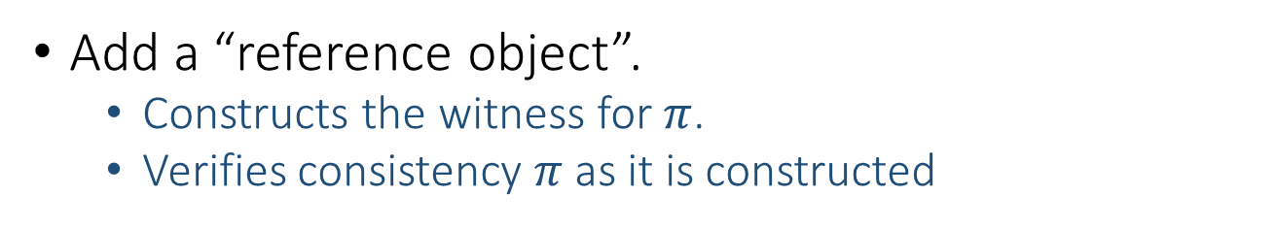


Solution
Add a “reference object”.
Constructs the witness for $π$.
Verifies consistency $π$ as it is constructed
create
ref.
create : op $×$ loc $→$ stamp
commit
commit : stamp $→$ unit
eval
eval : stamp $→$ value
mem
commit(stamp):
assumes happens-before(X,op(stamp)) $⇒$committed(X)
value = eval(stamp):
assumes committed(stamp)
guarantees value = result($π$,op(stamp))
These operations allow us to define the semantics of the system interfaces.

Slide 9
TileLink system
Hierarchy of memory system components for SoC using a common interface protocol.
CORE
L2$
NET
DIR
MEM
CORE
DIR
MEM
CORE
L2$
DIR
MEM
TL
TL
TL
TL

Slide 10
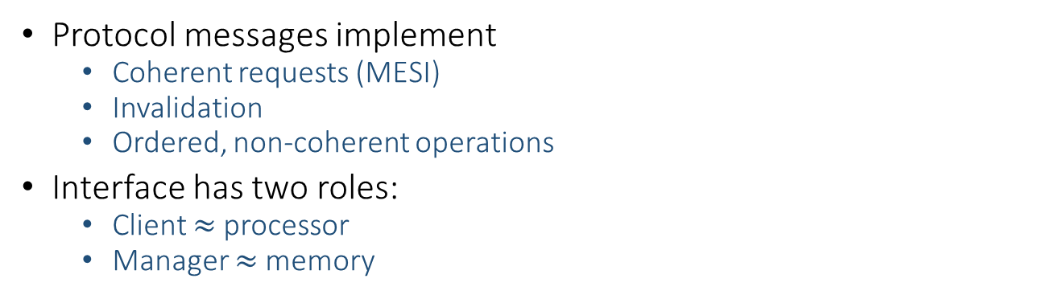
TileLink interface protocol
Protocol messages implement
Coherent requests (MESI)
Invalidation
Ordered, non-coherent operations
Interface has two roles:
Client $≈$ processor
Manager $≈$ memory
Typical transaction flow at interface
client
Acquire
Grants
Finish
Probe
Release
manager

Slide 11
Writing a “good” composable spec
Specification has two parts:
Temporal properties of interface
Assume/guarantee relationships between properties
Interface properties of two types:
Interface protocol properties
Semantic properties, relative to reference object

Slide 12
Semantic interface properties
These properties refer to the reference object to define ordering and data values at the interface.
Manager-side properties
M[1]: Data in cached Grant must match ref.mem.
M[2]: If uncached resp. then committed(stamp)
M[3]: If uncached resp. then data = eval(stamp)
Client-side properties
C[1]: Data in cached Release must match ref.mem.
C[2]: If uncached req. then happens-before(X,stamp) implies requested(X).
C[3]: If uncached resp. then data = eval(stamp)

Slide 13
Commitment properties
The coherence state determines what commitments are allowed on either side of the interface. This is the function of coherence.
Client-side commitments:
SC[1]: Read may be committed on client side only if interface has shared or exclusive permissions.
SC[2]: Write may be committed on client side only if interface has exclusive permissions.
Manager-side properties
SM[1]: Read may be committed on manager side only if interface has shared or invalid permissions.
SM[2]: Write may be committed on manager side only if interface has invalid permissions.
Note: “client side” means any component left of the interface.

Slide 14












Assume/guarantee relationships
An L2 cache has TileLink interfaces on processor side and memory side.
$$C_{m}$$
$$M_{m}$$
$$C_{c}$$
$$M_{c}$$
…
$$comp$$
$$P$$
$$comp$$
…
$${SM}_{m}$$
$${SM}_{c}$$
$${SC}_{m}$$
$${SC}_{c}$$
$$RA_{P}$$
reference object

Slide 15

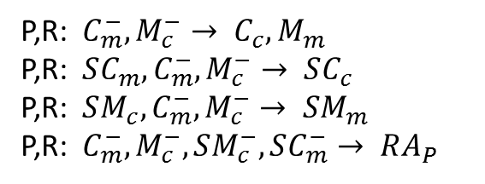
Assume/guarantee relationships
An L2 cache has TileLink interfaces on processor side and memory side.
$$C_{m}$$
$$M_{m}$$
$$C_{c}$$
$$M_{c}$$
…
$$comp$$
$$P$$
$$comp$$
…
$${SM}_{m}$$
$${SM}_{c}$$
$${SC}_{m}$$
$${SC}_{c}$$
$$RA_{P}$$
reference object
P,R: $C_{m}^{−}, M_{c}^{−}→ C_{c}, M_{m}$
P,R: $SC_{m}, C_{m}^{−}, M_{c}^{−}→ SC_{c}$
P,R: $SM_{c}, C_{m}^{−}, M_{c}^{−}→ SM_{m}$
P,R: $C_{m}^{−}, M_{c}^{−}, SM_{c}^{−}, SC_{m}^{−}→ RA_{P}$
Checking this proof is a purely syntactic operation
$$G RA_{p}$$

Slide 16
Formal proofs
We can now formally verify components in isolation against their assume/guarantee specifications:
Reording buffer
Hierarchical cache
Processor, memory, etc.
These are simple abstract component models, intended to show that the specification has the intended implementations.
Show key property that protocol is insensitive to message re-ordering.
In the process, specification was corrected.
Because our assume/guarantee specification is composable, we know that hierarchies built from these components implement a weakly consistent shared memory.

Slide 17







Compositional testing
From an assume/guarantee specification, we can automatically generate a test environment.
$$M_{m}$$
$$M_{c}$$
$$C_{m}$$
$$C_{c}$$
check
$$L2$$
RTL
check
…
$$comp$$
$$comp$$
…
generate
generate
$${SM}_{m}$$
$${SM}_{c}$$
$${SC}_{m}$$
check
$${SC}_{c}$$
$$RA_{P}$$
reference object
Tested two RTL level components with randomized generation using Z3:
L2 cache bank
Snooping hub

Slide 18
Testing results
Compositional testing revealed currency errors in the RTL in under 1s (< 100 cycles)
Unit testing provides much greater flexibility in covering internal corner cases
Randomized specification-based testing reduces bias
Latent bugs
Most bugs could not be stimulated in integration test
Latent bugs affect re-usability
Importance of composability
All system-level errors exposed to unit testing
Gain confidence that components can be assembled into arbitrary configuration.

Slide 19
Conclusion
Good composable specification is such that:
Correct component imply correct system
The proof of this is efficiently checkable
Global properties (such as memory consistency)
Reference object + temporal assume/guarantee
Allows local specification of interface semantics
Composable TileLink interface spec provides:
Documentation of the interface
Ability to reason formally about specification
Efficient and rigorous test to find latent bugs
Composable specifications provide a way to formal verification experts to provide value in an environment where most engineers do not have formal skills.

Slide 20
Specification as a social process
The specification develops over time in collaboration with the system architects.
Ambiguities in informal specs must be resolved.
Initial formal spec almost certainly does not reflect designers intention.
Mismatch with implementation may indicate properties should be strengthened or weakened for efficiency.
Over time the formal spec becomes a valuable document.
Encapsulates design knowledge.
Allows rigorous testing and verification.

