Slide 1
Equivalence Checking By Logic Relaxation
Eugene Goldberg
FMCAD,
Mountain View, CA, USA
October 3-6, 2016

Slide 2
Outline
Introduction
Equivalence checking by logic relaxation
Experimental results and conclusions

Slide 3
Motivation
Equivalence Checking (EC) is an important part of formal verification
Any progress in EC empowers logic synthesis
Short EC proofs for structurally similar circuits
Ideas of EC of combinational circuits can be re-used in EC of sequential circuits and software

Slide 4
Solving EC
z'
z"
Prove
EQ ∧ G_{rlx} ⇒ (z' ≡ z"),
N'
N"
where G_{rlx} = F_{N'} ∧ F_{N"}
This reduces to proving
EQ ∧ G_{rlx} ∧ ~(z'≡ z")
UNSAT
…
…
X'
X"
EQ(X',X" )
EQ(x',x" ) = 1, iff x' = x"

Slide 5
Cut Image
Let Img_{cut} specify the cut image
N'
N"
q'
Cut
q"
Img_{cut}(q',q")=0, iff there is no input (x',x"), x' = x" for which N',N" produce (q',q")
…
…
Let Cut = {z',z"}.
N' and N" are equivalent iff
Img_{cut} ⇒ (z' ≡ z"),
x'
x"
EQ(X',X" )

Slide 6
Problem To Solve: Finding an Inductive Proof Of Equivalence
z'
z"
Given combin. circuits N' and N", find formulas H_{i} such that
Cut_{k}
…
Img_{i} ⇒ H_{i} , 0 ≤ i < k
H_{i} are as simple as possible
H_{i} can be derived from H_{i-1}
H_{k} ≡ Img_{k}(z',z")
Cut_{i}
…
Cut₀
…
…
X'
X"
A simple inductive proof should exist if N' and N" are struct. similar

Slide 7
Some Background
Building inductive proofs of equivalence
Berman, Trevillyan 1988
Brand 1993
Kuehlmann, Krohm 1996
Goldberg, Prasad, Brayton 2001
Mishchenko,Chatterjee,Brayton,Een 2006
Proofs are based on derivation of
pre-defined relations e.g. equivalences

Slide 8
Outline
Introduction
Equivalence checking by logic relaxation
Experimental results and conclusions

Slide 9
Structure Of Cut Image
Assignments excluded from cut image: S_{excl} = S_{rlx} U S_{imp}
z'
z"
S_{rlx} = {(q',q") | only relaxed inputs (x',x") where x' ≠ x" can produce (q',q") }
S_{imp} = {(q',q") | no input (x',x") can produce (q',q") }
q'
Cut
q"
…
…
X'
X"
  (q',q") ∈ S_{imp} iff
  q' cannot be produced in N' and/or
  q" cannot be produced in N"
EQ(X',X" )

Slide 10
Definition Of Boundary Formulas
EC by Logic Relaxation:
“replace” Img_{cut} with boundary formula H_{cut}
Boundary formula H_{cut} :
If (q',q") ∈ S_{rlx} , then H_{cut}(q',q") = 0
If (q',q") ∈ S_{imp} , then H_{cut}(q',q") can take an arbitrary value
Img_{cut} ⇒ H_{cut}

Slide 11
Boundary Formula for
Cut = {z',z" }
z'
z"
Assume that N' and N"
are not constants
Cut
N'
N"
S_{imp}= ∅
S_{excl} = S_{rlx}
…
…
H_{cut} ≡ Img_{cut}
X'
X"
EQ(X',X" )
Testing if N' is a constant:
two easy SAT checks

Slide 12
Boundary Formula And Partial Quantifier Elimination
Complete Quantif. Elimin.
Img_{cut} ≡ ∃W [ EQ ∧F_{M}]
W = Vars(F_{M}) \ Vars(Cut)
N'
N"
Cut
Partial Quantif. Elimin.
M
H_{cut} ∧ ∃W [ F_{M}] ≡ ∃W [ EQ ∧F_{M}]
…
…
x'
x"
EQ ∧ G_{rlx} ∧ ~(z' ≡ z") is equisat. with H_{cut} ∧ G_{rlx} ∧ ~(z' ≡ z")
EQ(X',X" )
where G_{rlx} = F_{N'} ∧ F_{N"}

Slide 13
Contrasting Cut Image And Boundary Formulas
N'
N"
N'
N"
Img_{cut}
Cut
H_{cut}
Cut
M
M
…
…
…
…
EQ(X',X" )
EQ(X',X" )

Slide 14
Boundary Formulas Of Structurally Similar Circuits
Suppose, ∀ v ∈ Cut'
v = g_{v}(L_{v}) where L_{v} ⊆ Cut"
N'
N"
Cut
Cut'
Cut"
Let Max_{cut} be the largest value of |L_{v}| , ∀v ∈ Cut'
…
…
x'
x"
Then H_{cut} can be built from
(Max_{cut} + 1)-literal clauses
EQ(X',X" )

Slide 15
EC By Logic Relaxation
z'
Cut₀ = X' ∪ X",...,Cut_{k}={z',z“ }
z"
Compute H₀,..,H_{k}
Cut_{k}
…
where H₀= EQ(X',X" )
Cut_{i}
H_{i} ∧ ∃W_{i} [ F_{Mi} ] ≡ ∃W_{i} [H_{i-1} ∧ F_{Mi}]
M_{i}
W_{i} = Vars(F_{Mi} ) \ Vars(Cut_{i})
Cut₀
…
…
If H_{k} ⇒ (z' ≡ z"),
N' and N" are equivalent
X'
X"
If, say, H_{k}(z' =0,z"=1)=1 and N', N"
can produce 0 and 1, they are inequivalent

Slide 16
Outline
Introduction
Equivalence checking by logic relaxation
Experimental results and conclusions

Slide 17
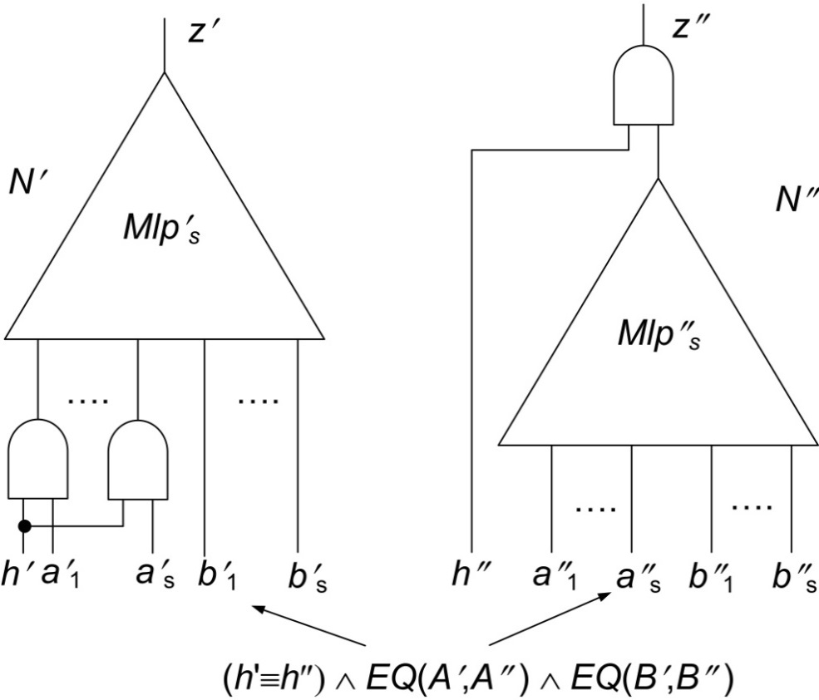
Non-Trivial Example Of EC
Mlp_{s} computes a median bit of an s-bit multiplier
Operands A and B where
A={a₁,..,a_{s}}, B={b₁,...,b_{s}}
h is an additional input variable
If h=1, then N' and N" compute Mlp_{s}
if h=0, then N' and N" evaluate to 0

Slide 18
Comparison With ABC
Partial Quantifier Elimination (a variation of HVC-14 algorithm) is based on machinery of D-sequents (FMCAD-12 , FMCAD-13)
ABC is a high-quality tool developed at UC, Berkeley
val. of s in Mlp_{s} | #cuts | EC by LoR (s.) | ABC (s.)
10 | 37 | 4.5 | 10
11 | 41 | 7.1 | 38
12 | 45 | 11 | 142
13 | 49 | 16 | 757
14 | 53 | 25 | 3,667
15 | 57 | 40 | 11,237
16 | 61 | 70 | > 6 h
Formulas H_{i} were comp-uted approximately
H_{i} ∧ ∃W_{i} [ F_{Mi} ] ≡ ∃W_{i} [H_{i-1} ∧ F_{Mi}]
F_{Mi} specifies logic below i-th cut
Only a subset of clauses of
F_{Mi} was used

Slide 19
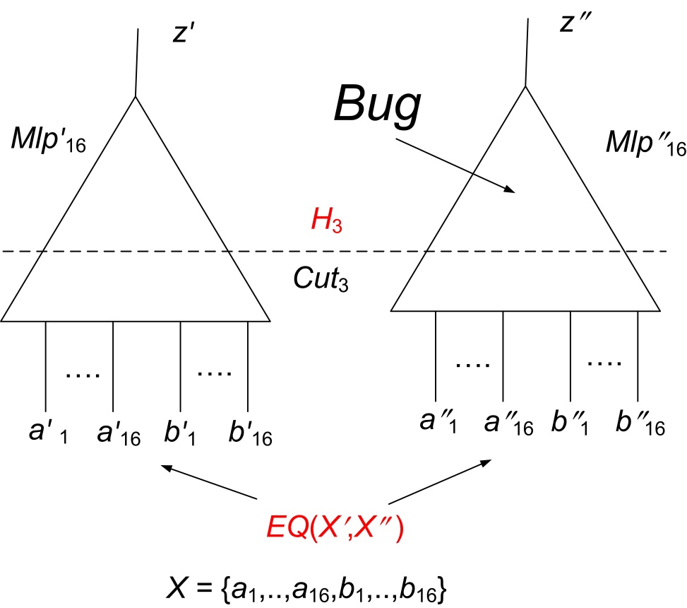
Proving Inequivalence
Formula α
EQ(X',X") ∧ F_{N'} ∧ F_{N"} ∧ ~(z'≡ z")
Formula β
H₃ ∧ F_{N'} ∧ F_{N"} ∧ ~(z'≡ z")
Formula H₃ was computed precisely
Sat-solver : Minisat 2.0, Time limit: 600 s
Form. type | #solved | total time (s) | median time (s)
α | 95 | > 3,490 | 4.2
β | 100 | 1,030 | 1.0

Slide 20
Conclusions
Relative_complexity(N',N") << Absolute_complexity(N',N")
EC by logic relaxation gives a general solution
It can be extended to sequential circuits/programs
Efficient partial quantifier elimination is of great value

