Slide 1
Post-Silicon Fault Localisation using
MAX-SAT & Backbones
(Photo: Intel Press Kit)
Georg Weissenbacher
Charlie Shucheng Zhu, Sharad Malik
Princeton University
Notes:
joint work with Charlie and Sharad

Slide 2
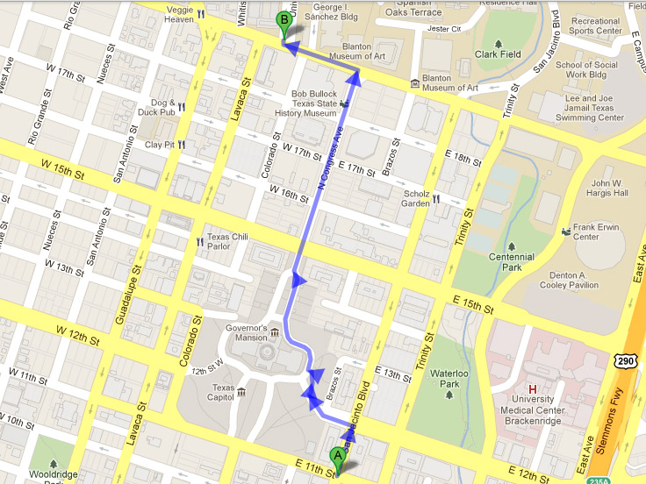
Notes:
Conference venue was booked out, booked hotel in walking distance.

Slide 3
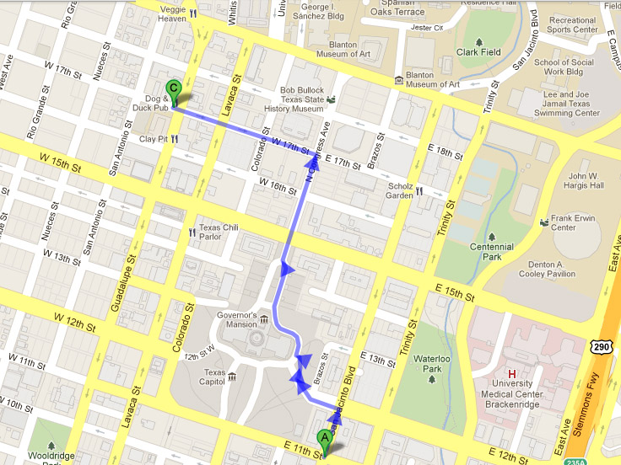
Notes:
not very a focused person, my mind started wandering and I ended up at the Dog and Duck, wondering what went wrong.
Where did I take the wrong turn?

Slide 4
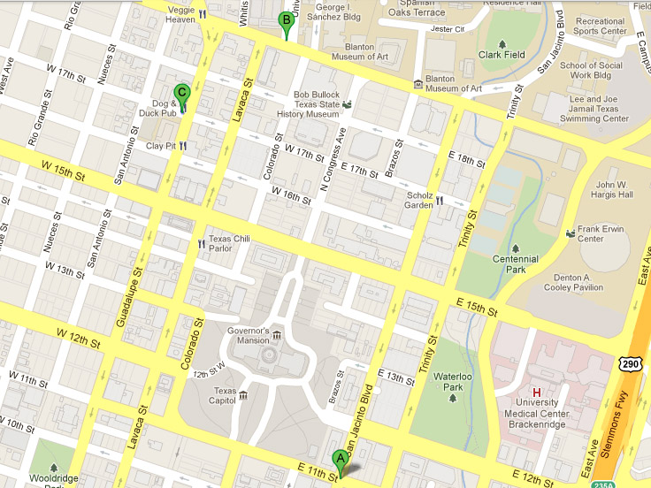
Notes:
But I didn’t pay attention so I don’t remember the route I took.
Can you still tell me where I went wrong?

Slide 5
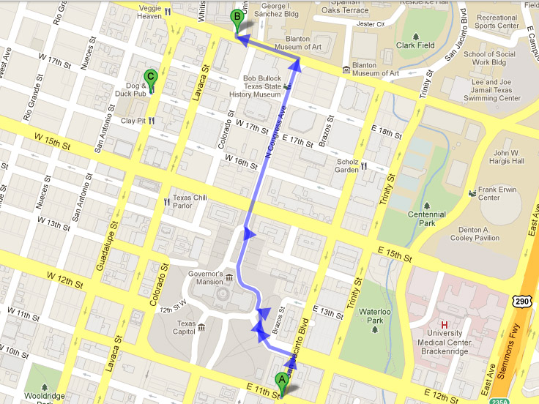
Notes:
hint: We have the information about the route I should have taken

Slide 6

Where did things go wrong?
origin
destination
Intel Pentium FDIV Bug 1994
  incorrect results for division
Understanding bugs is often more time consuming than finding them
  Failed test scenarios may have millions of execution cycles
Notes:
You might wonder: Where is he going with this? How is a metaphor for hardware verification?
Chip performs computation, inputs can be seen as origin, the result is the destination
Intel Pentium took a decisively wrong turn in 1994

Slide 7
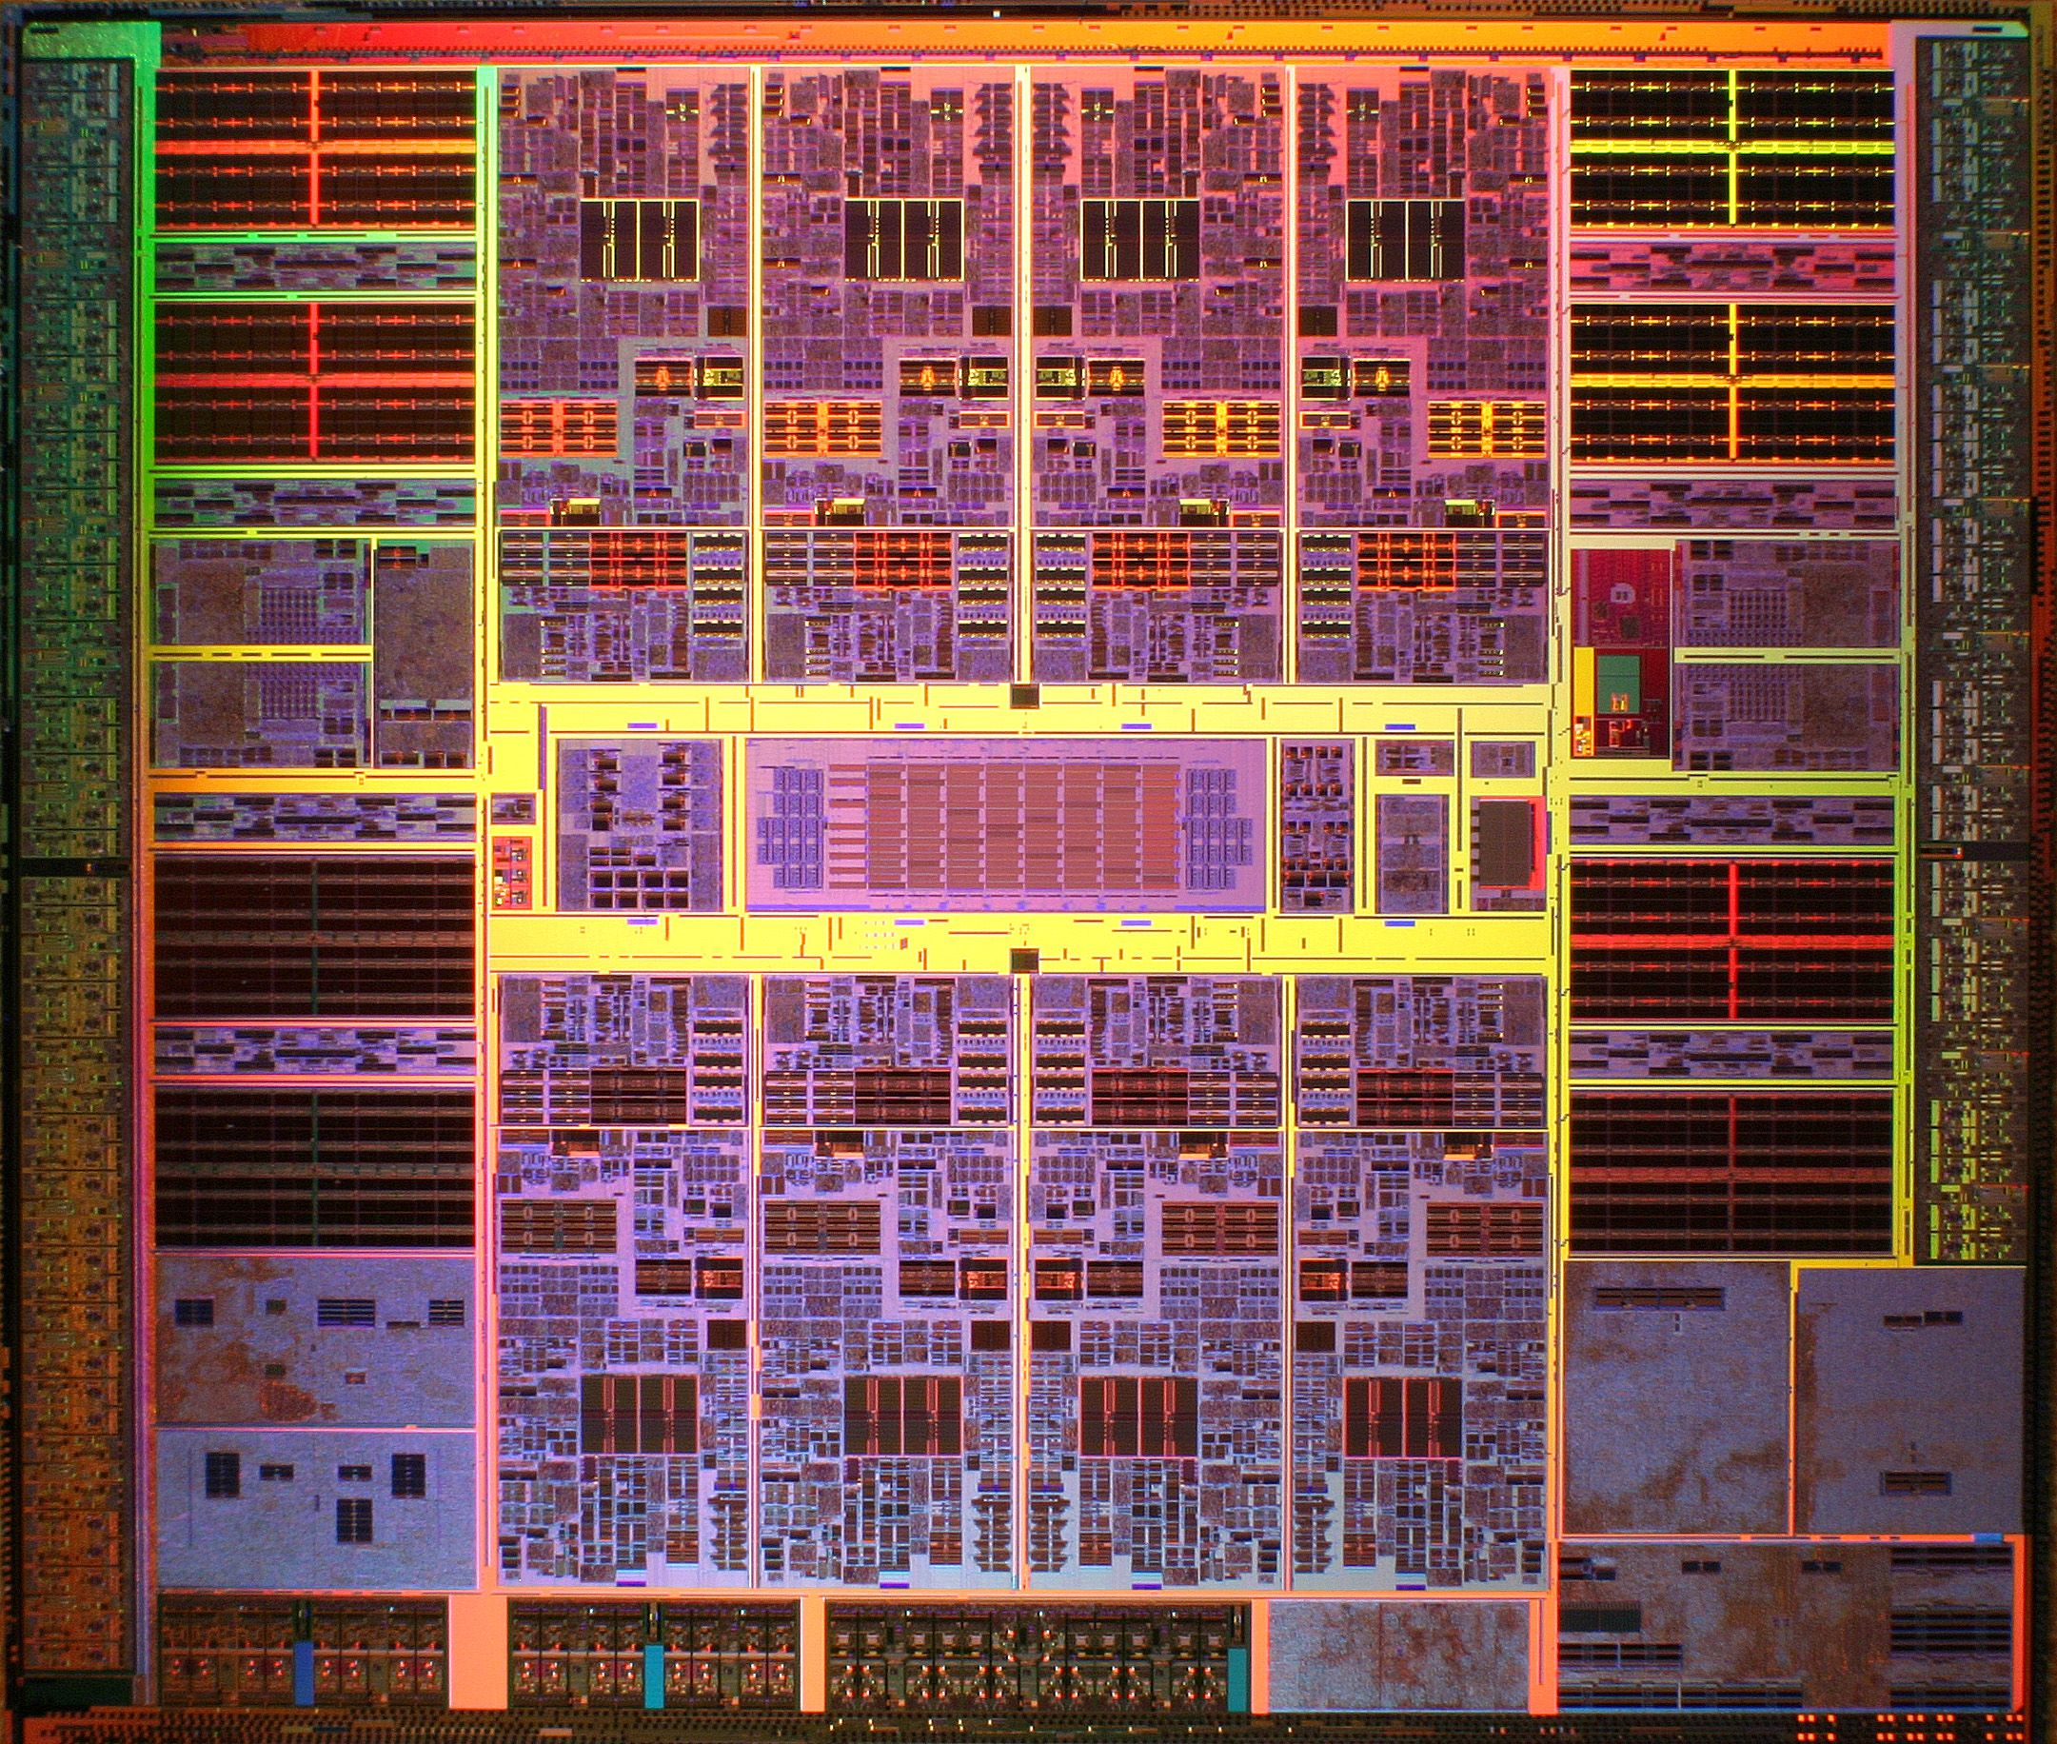
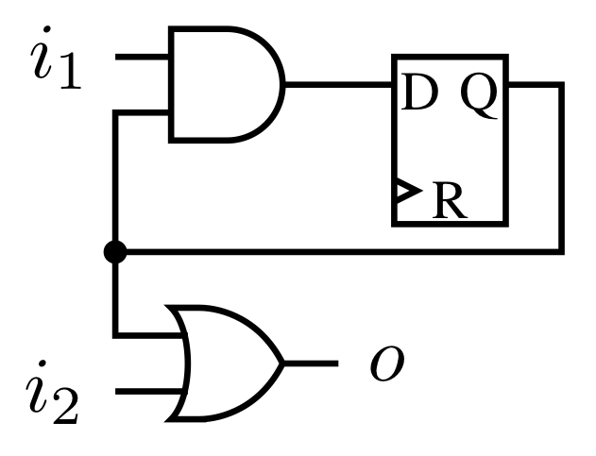
Where did things go wrong?
A
Notes:
We’re not really looking for a location on the surface of the chip
Hidden underneath the surface, deep inside the chip: gates
Have the hardware design of chip: pinpoint the location in the hardware model

Slide 8
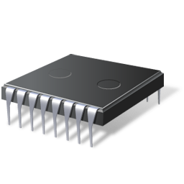
Where did things go wrong?
Design Debugging:
  find fault in chip design
Post-Silicon Validation
  find faulty physical gate
Fault
Fault
0
1
A
1
A
0
0
1
0
1
Difficulty:
some signals are
not observable
Notes:
Things can go wrong at different levels
Bug might already be in the design, or it might be introduced by manufacturing process
In the latter case, internal behaviour of chip is hard to observe

Slide 9
Specification or HDL Design
Design
Error
Diagnosis
RTL Synthesis
pre-silicon
Logic Net-List
Physical Design
Fault
Diagnosis
post-silicon
Chip Prototype
[Smith, Veneris, Ali, Viglas 2004]
Notes:
top: what your customer wants
bottom: what you deliver

Slide 10
HDL Specification
Design
Error
Diagnosis
RTL Synthesis
Logic Net-List
Physical Design
Fault
Diagnosis
post-silicon
Chip Prototype
Notes:
This talk’s focus: post-silicon

Slide 11
Post-Silicon Validation
The net-list is the fault-free golden model
  We assume functional correctness
The test vector represents the erroneous behavior
  Class of faults: Electrical bugs
    Fault model: (small number of) faulty gates
    Not in every time-frame: may be transient or intermittent
Faulty Chip
Golden Model
✗
Undesired
Test Result
✓

Slide 12
Post-Silicon Validation
Problem Definition
Golden Model
Golden Model
Unfolding
Logic Net-List
Propositional Encoding
Consistent?
Testing
Chip Prototype
Test Result

Slide 13
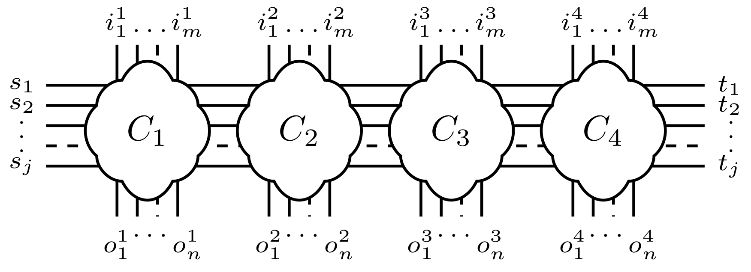
Post-Silicon Validation
Limited observability of signals in manufactured chip
  Trace buffers: Record limited number of signals (less than 10%)
  Scan chains: Read-out after chip execution stopped
0 … 1
1 … 1
1 … 1
0 … 1
1
0
…
1
?
?
…
1
?
?
…
0
?
?
…
1
1
1
…
0
Trace Buffer
Scan chain
1 … 0
1 … 0
0 … 0
1 … 1

Slide 14
Test Results as Circuit Constraints
Test results used as constraint for unwinding
? = information was not recorded
0 … 1
1 … 1
1 … 1
0 … 1
1
0
…
1
?
?
…
1
?
?
…
0
?
?
…
1
1
1
…
0
1 … 0
1 … 0
0 … 0
1 … 1

Slide 15
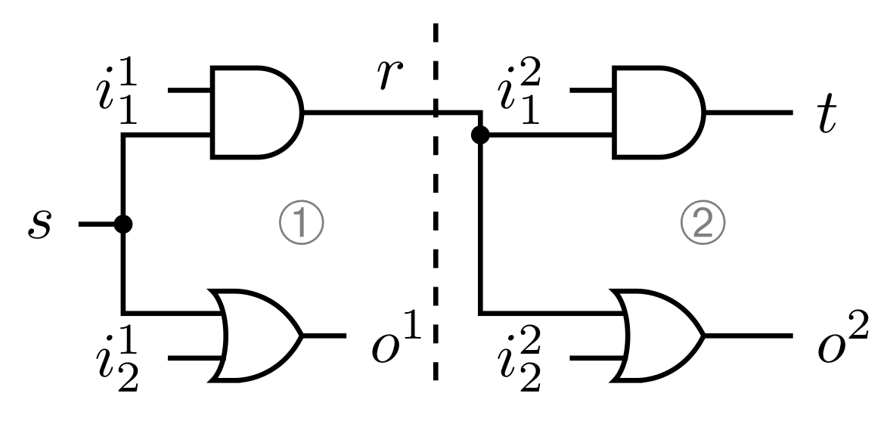
Test Results as Constraints
Example
Test run
time-frame 1
s = 0
i₁ = ?
i₂ = 0
o = 0
r = ?
time-frame 2
r = ?
i₁ = ?
i₂ = 0
o= 1
t = ?
Logic net-list

Slide 16
Test Results as Constraints
Example
Add test results as constraints to circuit
The corresponding CNF formula is inconsistent
Identify gates inconsistent with observed behaviour
0
0
1
0
0

Slide 17
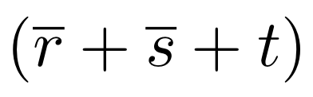
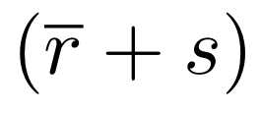

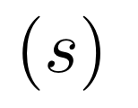

Minimal Correction Set (MCS)
Minimal number of clauses that must be dropped to make instance satisfiable
Given an UNSAT instance
dropping and (s) “corrects” the formula
Remaining clauses are consistent
The complement of a MAX-SAT solution is an MCS
  Algorithm to compute MCSes based on core-guided MAX-SAT
Notes:
Dropping an MCS “corrects” the formula

Slide 18

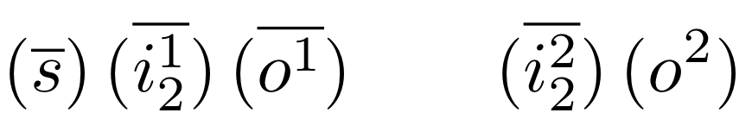
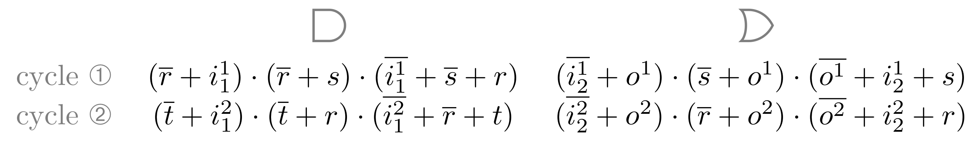
Fault Localisation
Using Minimal Correction Sets
Use MCSes to identify error location
Recorded test results are hard constraints

Slide 19
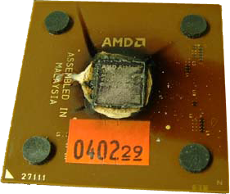
Post-Silicon Faults and MCSes
Limits of Scalability
Test scenarios may be millions of cycles long
Limited observability results in hard decision problems
Analysing millons of time-frames computationally infeasible
?
?
…
1
?
?
…
0
?
?
…
1

Slide 20
Post-Silicon Faults and MCSes
Limits of Scalability
Analysis limited to small (contiguous) sequence of cycles
Scalability of decision procedure determines window size
Slide window backwards in time to cover different cycles
?
?
…
1
?
?
…
0
?
?
…
1

Slide 21
Sliding Windows
Example
0
0
1
0
0
Sliding windows may fail to locate fault
Approach is incomplete due to limited information
  In this particular example: we don’t know the value of r

Slide 22
Sliding Windows
r=?
Example
0
0
1
0
0
Would like to propagate information across windows
  At a reasonable computational cost
Maybe we can infer the value of r in the first window?

Slide 23
Reconstructing Information
r=1
With Inferred Values
1
0
r = 1
0
1
0
0

Slide 24

Backbones
Inferring “Fixed” Signals
Backbone of a formula:
Set of variables that have same value in all assignments
Consider the satisfiable formula
Satisfying assignments:
r | s | t
1 | 0 | 0
1 | 1 | 0

Slide 25
Computing Backbones
Given a Boolean formula F
Obtain initial satisfying assignment A₀
For each literal p such that A₀[p]=0
  variable of p is part of backbone if (F . p) is UNSAT
Optimization (Filtering):
If (F . p) is satisfiable, look at satisfying assignment A₁
Literals differing in value in A₀ and A₁ are not in backbone
[Marques-Silva, Janota, Lynce 2010]

Slide 26
Propagating Backbones
Across Sliding Windows
0 … 1
1 … 1
1 … 1
0 … 1
1
0
…
1
1
?
…
0
1
1
…
1
1
1
…
0
?
?
…
1
?
?
…
0
?
?
…
1
?
1
…
1
1 … 0
1 … 0
0 … 0
1 … 1

Slide 27
Experimental Results
oc8051 (2784 latches) and 68hc05 (127 latches)
  microcontroller/processor from OpenCores
  also used in Alan Hu’s Backspace work
Seeded stuck-at-constant fault in 2000 cycle test scenario
Error surfaces up to 1000 cycles before end of the trace
1.) Measured window size required to localise the fault
  For a trace-buffer recording 5% of latches (chosen at random)
2.) Measured trace-buffer size required to localise the fault
  For a fixed window-size of 3

Slide 28
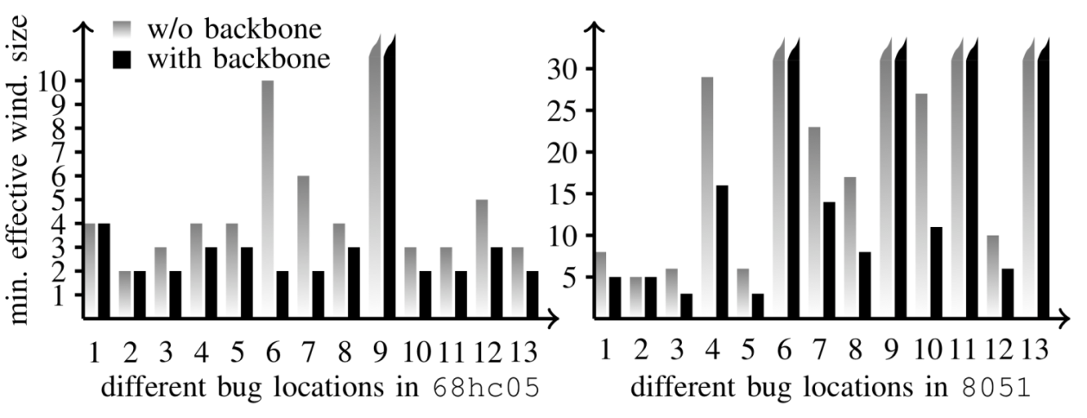
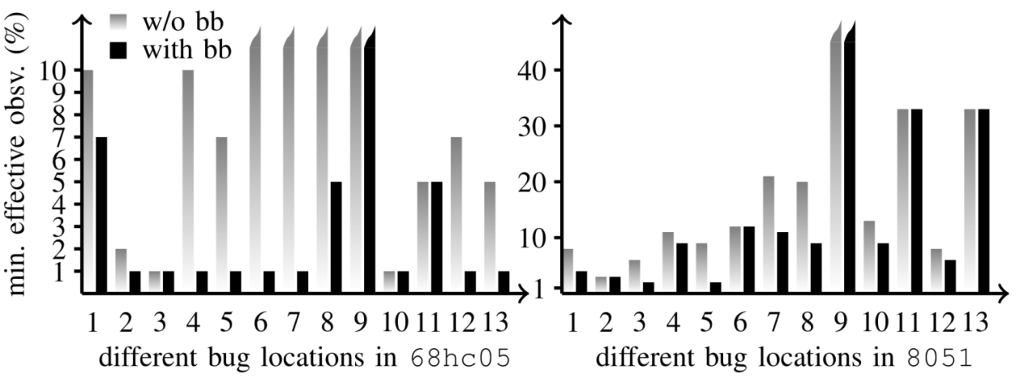
Experimental Results
  Experiment 1: With Backbone, sliding window size can be reduced to detect a bug.
    Trace-buffer recording 5% of latches (chosen at random)
  Experiment 2: With Backbone, trace buffer overhead can be reduced.
    Fixed window-size of 3

Slide 29
More…
Extended version of this talk: http://vimeo.com/user5157725
  Courtesy of Center for Embedded Systems For Critical Applications, Virginia Tech
“SAT-based Techniques for Determining Backbones for
Post-Silicon Fault Localisation”, HLDVT ’11, Charlie Shucheng Zhu et al.
  More on algorithms to compute backbones
“Boolean Satisfiability Solvers: Techniques and Extensions”, Tools for Analysis and Verification of Software Safety and Security, IOS Press 2012
  Tutorial for SAT, minimal correction sets, and fault localisation as application
Future work:
  Automated placement of trace buffers
  Narrow down number of fault candidates

Slide 30
Post-Silicon Validation: Summary
1.)
Generate Iterative Logic Array
Analyze small “sliding windows”
2.)
Infer signals from trace-buffer
Propagate signals to next window
3.)
Detect discrepancies
Localise fault
0
1
1
error
error
t=1
t=2
t=3
t=n
t=1
t=2
t=3
t=n
t=1
t=2

Slide 31
References
[Smith, Veneris, Ali, Viglas 2004]
Fault Diagnosis and Logic Debugging Using Boolean Satisfiability
IEEE Transactions on Computer-Aided Design of Integrated Circuits and Systems
[Liffiton, Sakallah 2009]
Generalizing Core-Guided MAX-SAT
Theory and Applications of Satisfiability Testing
[Chen, Safarpour, Marques-Silva, Veneris 2009]
Automated Design Debugging with Maximum Satisfiability
IEEE Transactions on Computer-Aided Design of Integrated Circuits and Systems
[Marques-Silva, Janota, Lynce 2010]
On Computing Backbones of Propositional Theories
European Conference on Artificial Intelligence

