Slide 1
Scaling Probabilistic Timing Verification of Hardware using Abstractions in Design Source Code
Jayanand Asok Kumar, Lingyi Liu and Shobha Vasudevan
Electrical and Computer Engineering
Coordinated Science Laboratory
University of Illinois at Urbana-Champaign

Slide 2
Stochastic nature of hardware
Sources of timing variations
  Random input data, process variations
  Variable hardware delay can result in incorrect latching of values
Traditional hardware verification (non-probabilistic)
  “Does the hardware always provide correct input/output functionality ?”
  Cannot provide quantitative measures of “correctness”
  We incorporate statistical reasoning into the high-level hardware verification paradigm

Slide 3
Probabilistic verification of hardware
We employ probabilistic model checking (PRISM tool)
“What is the probability that the correct hardware output is available at the correct time?”
Quantitative timing estimates can be obtained
  Eg: “Probability [Delay of a block < Specified time constraint T ]?”
Feasible only for systems with less than 10¹⁰ states
We present an abstraction for scaling probabilistic timing verification of hardware systems

Slide 4
Abstractions for probabilistic timing
Timing property of the form P[Delay < T ]
  Delay = F (hardware variables)
  Delay < T is the predicate Λ
Hardware modeled as Discrete-Time Markov Chain (DTMC)
  Each state = unique assignment of values to hardware inputs
  States (i.e., input values) where Λ = TRUE are relevant
Our abstraction is property-specific and is in the source code, prior to model generation
Input variations is source of randomness in delay
High-level
Source code
Full range of
Values for inputs
DTMC
generation
Concrete
DTMC M
Inputs
constrained to
relevant intervals
DTMC
generation
Abstract
DTMC M^{A}
Use Λ as a constraint
Irrelevant states of M are lumped together

Slide 5
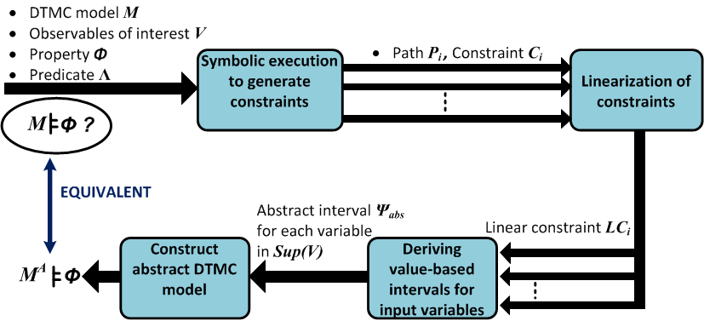
Our approach
Propagate constraints backwards to inputs
Obtain a set of
integer linear constraints
We use a symbolic execution engine and an ILP solver
Using intervals to generate relevant DTMC states
Solving ILP to
obtain value-based intervals

Slide 6
Design source code
We consider Register Transfer Level (RTL) designs
  Data is represented as variables in the “program”
Variables are assigned integer values
  An N-bit variable can be assigned 2^{N} numeric values
input [9:0] I1,I2,I3;
output [9:0] O1;
always @(posedge clk)
if (select)
O1 <= I1 + I2; RTL Path P₁
else
O1 <= 4*I2 + I3; RTL Path P₂
end
In the example
  10-bit variables (2¹⁰ possible numeric values)
Input variables
Output variables
Rising edge of clock = Next time step
Assignment of values in each clock cycle

Slide 7
Statistically distributed data
Assumptions on input variables ( I )
  Statistically independent
  Probability distributions are stationary (do not change over time)
System function for variable v
  A “formula” for evaluation of v as a function of input values
  Sup(v) is the support of v
  f_{i} is the system function for v in path P_{i}
We formally represent the statistical behavior of a design

Slide 8
Statistical model for RTL
We use Discrete Time Markov Chains (DTMCs)
  Use RTL inputs as state variables
DTMC M for an RTL variable v
  State variables S = Sup(v)
if (select)
O1 <= I1 + I2; DTMC for O1
else S = Sup(O1) = { I1, I2, I3 }
O1 <= 4*I2 + I3; DTMC has 2³⁰ states
Define state variables independently in PRISM
  Reduce complexity of PRISM model description
State µ
State µ’
An assignment of values
to Sup(v)
1 clock cycle = 1 transition
New values assigned to
Sup(v)
Joint probability of Sup(v)

Slide 9
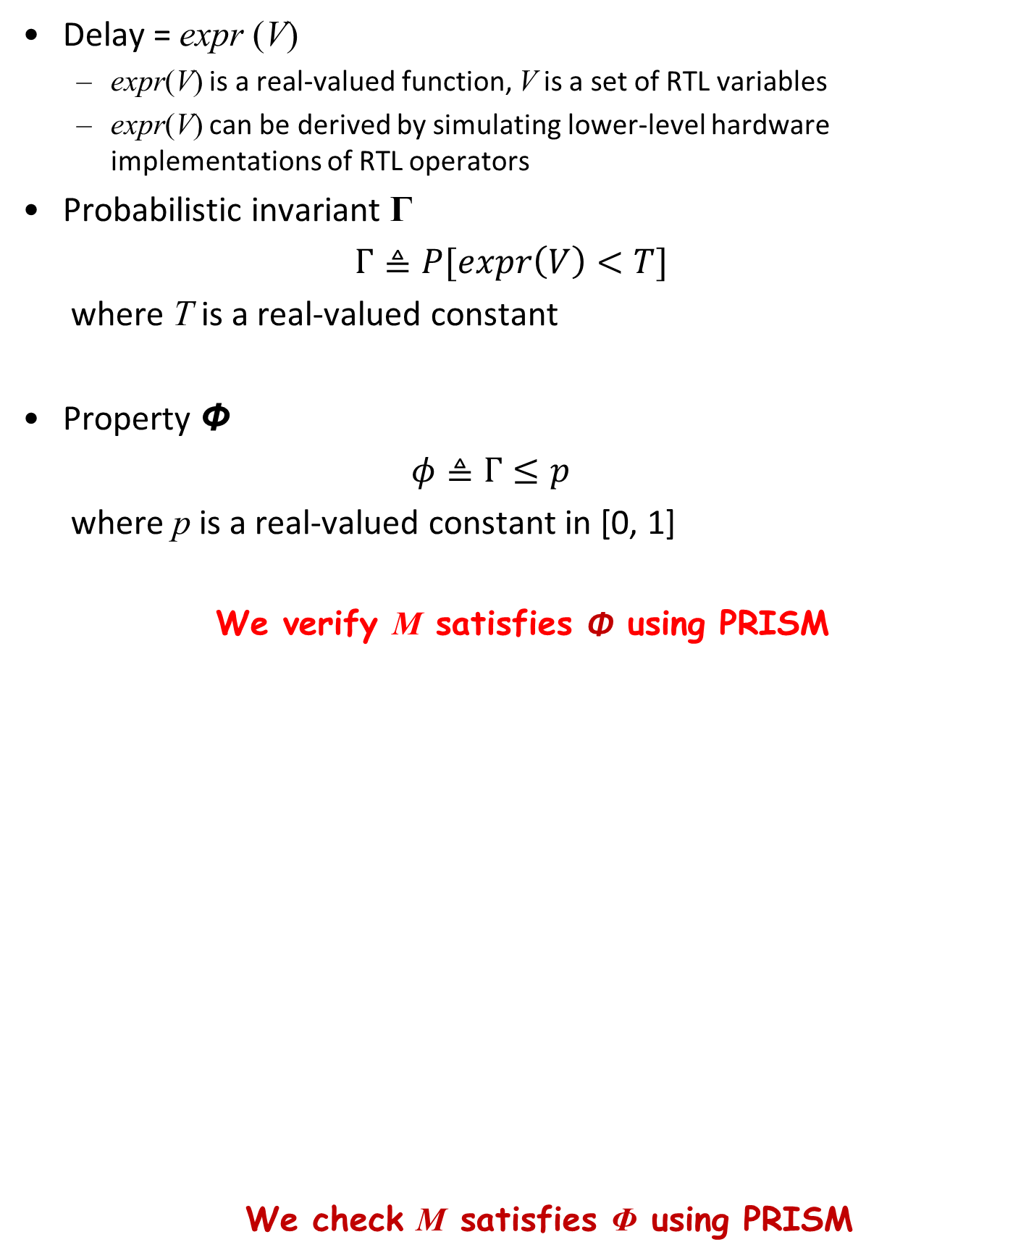
Property specification
Delay = expr (V)
  expr(V) is a real-valued function, V is a set of RTL variables
  expr(V) can be derived by simulating lower-level hardware implementations of RTL operators
Probabilistic invariant Γ
$Γ≜P[\operatorname{expr}\left(V\right)<T]$
where T is a real-valued constant
Property Φ
$φ≜Γ≤p$
where p is a real-valued constant in [0, 1]
We verify M satisfies Φ using PRISM
  We check M satisfies Φ using PRISM
expr (V ) < T is the predicate Λ of our interest

Slide 10
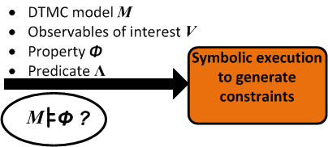
Propagating constraints backwards to inputs

Slide 11
Symbolic execution in RTL
Propagate constraint expr(V) < T backwards to Sup(V)
  We employ symbolic execution in RTL program
RTL example: Consider the constraint O1< 100
if (select)
O1 <= I1 + I2; Constraint C₁ : I1 + I2 < 100
else
O1 <= 4*I2 + I3; Constraint C₂ : 4*I2 + I3 < 100
Sup(V)
expr (f_{i} (Sup(V))) < T
Constraint C_{i} for Sup(v)
Path P_{i}
Substitute V = f_{i} (Sup(V)) in Λ
Consider all paths
V
expr (V) < T
Predicate Λ is a constraint on V

Slide 12
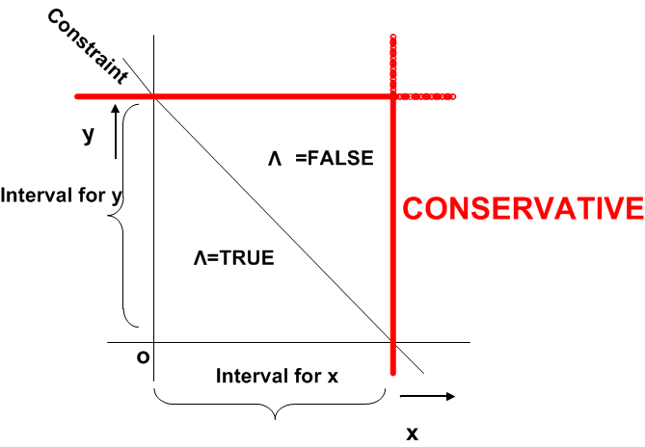
Conservative bounds on inputs
Constraints specify exact bounds on input values
  Expressed jointly over multiple input variables
In PRISM, we define DTMC state variables independently
  We obtain constraints for individual inputs
  We do not discard any state where Λ is TRUE
Allow some
states where
Λ = FALSE

Slide 13
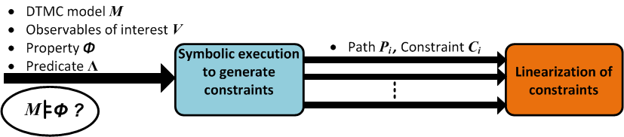
Solving ILP to obtain value-based intervals

Slide 14
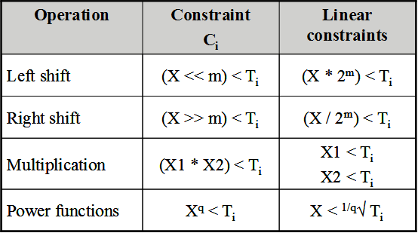
Linearization of constraints
Define rules for ``linearization”
  We consider unsigned arithmetic
Non-linearity in constraints
  expr(V) may have non-linear operators
  RTL operators like multiplication and bitshift (i.e., shift by m bits)
Transform each constraint C_{i} into a set of linear constraints

Slide 15
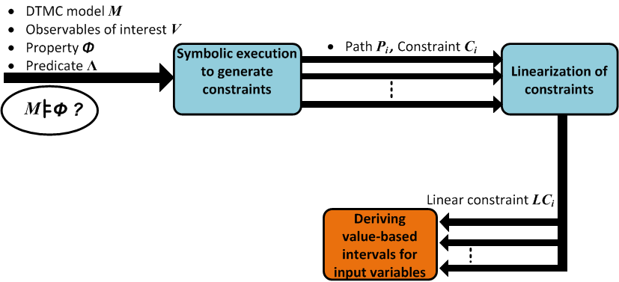
Obtaining a set of integer linear constraints

Slide 16
Formulating and solving ILP instances
In path P_{i} , the restricted interval for v is ψ^{(i)} = [l^{(i)} u^{(i)}]
  l, u denote the lower and upper bounds of v, respectively.
Compute u^{(i)}
Should not discard any value for which Λ = TRUE in any path
  Abstract interval ψ_{abs} of v is the union of all ψ^{(i)}
  Path P₁ I1 + I2 < 100 => Intervals for I1, I2 is [0 99]
  Path P₂ 4*I2 + I3 < 100 => Interval for I2 is [0 24], I3 is [0 99]
  Abstract interval for I1, I2, I3 is [0 99]
  Objective:
  MAX v
  Constraints:
  LC_{i}
  v_{j} ≥ 0
  v_{j} is an integer
  (for all v_{j} that appear in LC_{i} )
Maximize v subject to all integer linear constraints
Similarly, compute l^{(i)} by minimizing v

Slide 17
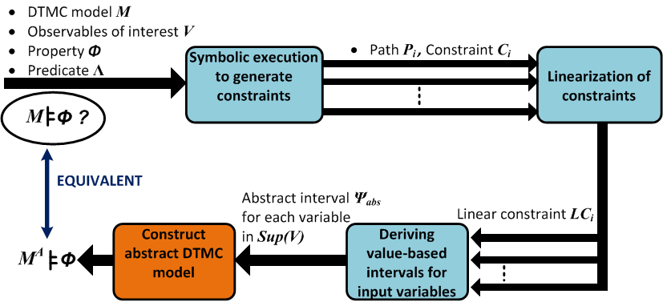
Using intervals to generate relevant DTMC states

Slide 18
Construct the abstract DTMC model
Modify the description of variables in PRISM language
  Constrain each variable to its abstract interval ψ_{abs}
Substitute all values outside the abstract interval ψ_{abs} with a single representative value
  Corresponding states are lumped to a single state
PRISM now constructs the abstract DTMC M^{A} instead of the concrete DTMC M
RTL example
  M^{A} has ≈ 2²⁰ states (reduction from 2³⁰ states in M)
  Our abstraction is at the language level prior to DTMC construction

Slide 19


Sketch of proof for correctness
Let α denote the abstraction with respect to Λ
We interpret α as an equivalence relation on states in M
  Preserves value of Λ
A state of M^{A} = An equivalence class of M
M^{A} is a probabilistic bisimulation of M
  Probabilistic invariant Γ for M^{A} = Γ for M
M $⊨$ Φ
EQUIVALENT
M^{A} $⊨$ Φ

Slide 20
Experiments: Designs and Properties
We consider several RTL designs
  Data-intensive benchmarks fir,elliptic,fft8 (HLS’95 suite)
  Several modules of an open source H.264 decoder
We define predicates as constraints on RTL variables
  Linear expressions expr( ) with `<‘ comparison
Design name | Predicate name | Predicate description
Inter_pred_LPE | p1 | bilinear0_A + bilinear0_B < 8
 | p2 | bilinear0_A + bilinear0_B < 6
 | p3 | bilinear0_A + bilinear0_B < 4
Inter_pred_pipeline | p4 | 8*Inter_blk_mvx + Inter_blk_mvy < 2
 | p5 | Inter_pred_out0 < 200
Inter_pred_sliding_window | p6 | Inter_pix_copy0 < 2
 | p7 | Inter_H_window_0_0 < 3
fir | p8 | y < 30
elliptic | p9 | outp < 30
fft8 | p10 | s3r < 127

Slide 21
Results: Abstraction time
Design name | Predicate name | No. of inputs | No. of paths | No. of constraints
Inter_pred_LPE | p1 | 5 (8-bit) | 180 | 131
 | p2 | 5 (8-bit) | 180 | 131
 | p3 | 5 (8-bit) | 180 | 131
Inter_pred_pipeline | p4 | 32 (8-bit) | 1936 | 1932
 | p5 | 3 (8-bit) | 8 | 5
Inter_pred_sliding_window | p6 | 19 (8-bit) | 29 | 21
 | p7 | 16 (8-bit) | 29 | 21
fir | p8 | 6 (8-bit) | 1 | 1
elliptic | p9 | 12 (8-bit) | 1 | 1
fft8 | p10 | 8 (16-bit) | 4 | 4
Each constraint expressed over a subset of inputs (ILPs are small)
  Total abstraction time < 10 seconds for each design
Control-intensive designs may face an RTL path explosion problem
  Our abstractions are more meaningful in data-intensive designs

Slide 22
Results: Demonstrating reductions
Design name | Predicate name | Concrete DTMC (states) | Abstract DTMC (states)
Inter_pred_LPE | p1 | 2⁴⁰ | ≈ 2^{15.85}
 | p2 | 2⁴⁰ | ≈ 2^{14.04}
 | p3 | 2⁴⁰ | ≈ 2^{11.61}
Inter_pred_pipeline | p4 | 2²⁵⁶ | 2³²
 | p5 | 2²⁴ | ≈ 2^{22.95}
Inter_pred_sliding_window | p6 | 2¹⁵² | ≈ 2^{30.11}
 | p7 | 2¹²⁸ | 2³²
fir | p8 | 2⁵⁶ | 2²⁸
elliptic | p9 | 2⁹⁶ | ≈ 2^{29.73}
fft8 | p10 | 2¹⁶ | 2¹⁶
We demonstrate consistent reductions in state space
  Makes probabilistic model checking feasible
Reduction factors depend on value of T in expr(V) < T
  Smaller the value of T, smaller the abstract DTMC

Slide 23
Results: Empirical proof of correctness
Design name | Predicate | Concrete DTMC |  | Abstract DTMC
 |  | No. of States | PRISM result | No. of States | PRISM result
fir(small) | y < 12 | 2²⁴ | 4.6539 x 10⁻⁴ | ≈ 2^{15.57} | 4.6539 x 10⁻⁴
elliptic(small) | outp < 30 | 2³⁰ | 9.6485 x 10⁻⁷ | ≈ 2^{14.39} | 9.6485 x 10⁻⁷
Consider smaller versions of fir and elliptic
  Choose bitwidths such that concrete DTMC can be constructed
  Eg: Choose 3-bit data for fir
Compute probabilistic invariant Γ (PRISM result)
PRISM result using concrete DTMC
=
PRISM result using abstract DTMC

Slide 24
Thank you!

