Slide 1
Post-silicon Timing Diagnosis Made Simple using Formal Technology
Daher Kaiss, Jonathan Kalechstain
Formal Engines and Technologies Team
Core CAD Technologies
Intel Corp. - Haifa

Slide 2
Agenda
Motivation
Speed path debug at Intel
Introducing our tool: NGSPA
  Next Generation Speed Path Analyzer
Results
Challenges and next steps

Slide 3
Static Timing Analysis
An important pre-silicon design activity
Pros: Aims to compute the expected timing to a digital circuit without requiring simulation
Cons: miscorrelation between the pre. and post silicon behaviors
  usage of simplified delay models:
  limited ability to consider the effects of logical interactions between signals
Result: about 5% of the chip frequency is achieved by post silicon speed path debug

Slide 4
Post-silicon Speed Debug
Time consuming process
  Hundreds of speed paths for some chips
Based on Laser Assisted Device Alternation (LADA)
  Costly machines (>$1 Million per machine)
  Requires skilled operators
  Serial process
  Some units might be burnt/broken
TTM requirements sometimes cause projects to go with low GHz

Slide 5
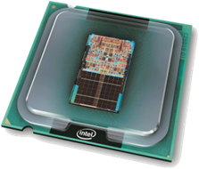
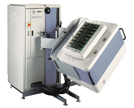
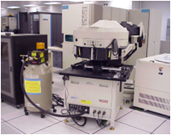
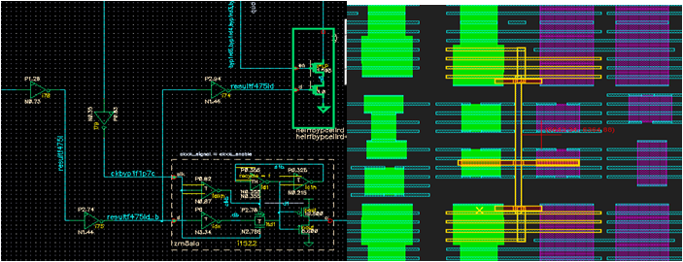
How it was done so far
Validation
Reproduce the Failure
Isolate and Id Speedpath
Probing
Failures to Debug
“ZBB”ed Failures
Debug Each Failure
Si. Debug
Collect All Failures
Bug Fix

Slide 6
Timing Domains
A timing domain is a set of HW devices controlled by a common clock
Combinatorial
Block
Combinatorial
Block
Combinatorial
Block
SRC clock domain
DST clock domain
Optical Probing

Slide 7

What is NGSPA?
Next Generation Speed Path Analyzer
A new CAD tool for preforming speed path isolation
Enables replacing >$1M optical probing (LADA) machines with CAD application running on a $1K x86 server
Optical Probing
NGSPA
Saving machine cost
Saving machine operators resource
From serial LADA execution → Parallelized CAD
From burnt/broken units → Deterministic SW

Slide 8
Inputs to NGSPA
Gate level schematic model (Structural Verilog)
A trace produced by simulating a trace on the RTL
  Either RTL simulation (~overnight)
  Or, Emulation trace (~2 hours)
Failing scan and failing cycle
Path length
  10-20 cycles
Source and Destination timing domains

Slide 9
How it works
Failing Scanout
CORE
CORE
A
B
Block1
SRC
Block2
Block4
DST
Block5
Block6
Block3
SRC Domain
DST Doamin

Slide 10
A speed path
SRC
domain
DST
domain
Scan
Inputs
Not widely inserted

Slide 11
Our approach for isolating speed paths
Reproduce the functional behavior of the speed path
  Instead of silicon debug, we use the logical model of the design
Assumptions:
  The speed path was triggered by a logic transition at one of the sequentials in the source domain

Slide 12
Using SAT for Backward propagation
X
1
0
→
X
1
→
1
X
1
→
1
0
0
X
0
→

Slide 13
Finding Speed paths
Scan
Scan
SRC
Scan
DST
Scan
Scan
SRC
[v0,v1,…, vj, .. vk]
SRC
DST
Inp1
Same inputs with same values
Inp2
Stimuli from Trace
Same free inputs
Scan
Scan
SRC
Scan
DST
Scan
Only one selector is high
Scan
SRC
[?,?,…, NOT vj, .. ?]
SRC
DST
Inp1
Inp2
Flipping Scanat scanout_phase(=j)

Slide 14
First Challenge: Reconverging logic
[F]
[F]
A
Out [F]
[T]

Slide 15
In a more general way
SRC
f
Scan

Slide 16
Handling Reconverging Paths
f
Scan
SRC
SEL-2
f
Scan
SEL-1
SEL-3
Mutex (SEL-2, SEL-3)

Slide 17
Second Challenge: Dealing with complexity
CORE
A
B
Block1
SRC
Block2
Block4
DST
Block5
Block6
Block3

Slide 18
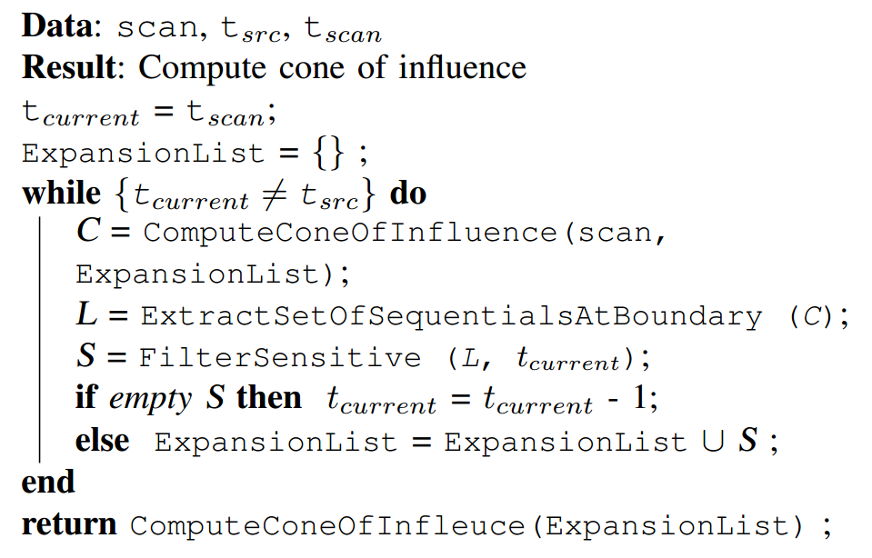
Iterative Cone Expansion

Slide 19
Iterative Cone Expansion
Failing Scan
j
j
j
j
j-1
j-2
j-3
j-4

Slide 20
Results
Test No. | # signals in cone | # of inputs on oundary | # of latches in cone | # of econverg. signals | # of iterations | path length (in phases) | # of paths | Run Time (Sec.)
1 | 296 | 26 | 2 | 4 | 5 | 3 | 1 | 248
2 | 509 | 67 | 14 | 11 | 6 | 4 | 1 | 278
3 | 405 | 54 | 3 | 12 | 11 | 8 | 1 | 214
4 | 305 | 19 | 3 | 0 | 6 | 4 | 1 | 290
5 | 248 | 11 | 1 | 0 | 1 | 1 | 1 | 186
6 | 517 | 50 | 14 | 26 | 55 | 44 | 1 | 227
7 | 497 | 83 | 4 | 3 | 7 | 4 | 1 | 222
8 | 1528 | 212 | 59 | 86 | 14 | 8 | 1 | 745
9 | 27696 | 3009 | 635 | 8569 | 31 | 16 | 1 | 7168
10 | 3025 | 617 | 43 | 650 | 15 | 8 | 2 | 434
11 | 2403 | 345 | 22 | 209 | 12 | 7 | 2 | 318
12 | 1798 | 258 | 58 | 236 | 33 | 20 | 2 | 442
13 | 855 | 164 | 8 | 27 | 8 | 5 | 3 | 222
14 | 25895 | 7279 | 294 | 1070 | 30 | 16 | 3 | 6458
15 | 21864 | 4618 | 165 | 2266 | 33 | 18 | 3 | 3395
16 | 855 | 164 | 8 | 27 | 8 | 5 | 4 | 242
17 | 1545 | 303 | 46 | 5 | 12 | 6 | 5 | 5555
18 | 837 | 90 | 39 | 29 | 23 | 12 | 6 | 619
19 | 4665 | 704 | 106 | 1149 | 31 | 18 | 7 | 579
20 | 8789 | 994 | 125 | 2132 | 26 | 14 | 7 | 1713
21 | 26226 | 4035 | 168 | 2422 | 27 | 14 | 15 | 3285
22 | 4931 | 675 | 167 | 689 | 27 | 14 | 40 | 780

Slide 21
How speed paths looks like
SRC
DST
SRC
SRC
S
DST
SRC
SRC
A
B
DST

Slide 22
Results

Slide 23
Progress so far
>90% of the optical probing activity was saved
One of two LADA machines in the debug lab will be released
Work on progress deployment this technology across Intel
Limitations:
  No failing scan was detected, despite the fact that the test failed

Slide 24
Future work
Can we drop the need for RTL simulation/emulation and use scan dump traces only?
  Pros: faster TAT
  Cons: less observability
Use same technology for yield analysis

Slide 25
Summary
NGSPA is one of the great examples demonstrating the glory of formal verification
  Ability to replace laser based machines with CAD
Same technology can be applied to other adjacent areas like : fault isolation & glitch detection
Formal technologies (SAT and SMT) are being deployed in other interesting areas in Intel
  Tester scheduling, layout routing and filling and others

Slide 26
Thank You

