Slide 1
A Program Transformation For Faster Goal-Directed Search
Akash Lal, Shaz Qadeer
Microsoft Research

Slide 2
Optimizations
In the context of compilers, an optimization is:
A program transformation that preserves semantics
Aimed at improving the execution time of the program
We propose an optimization targeted towards program verification
The optimization is semantics preserving
Aimed at improving the verification time
Targets “Deep Assertions”

Slide 3
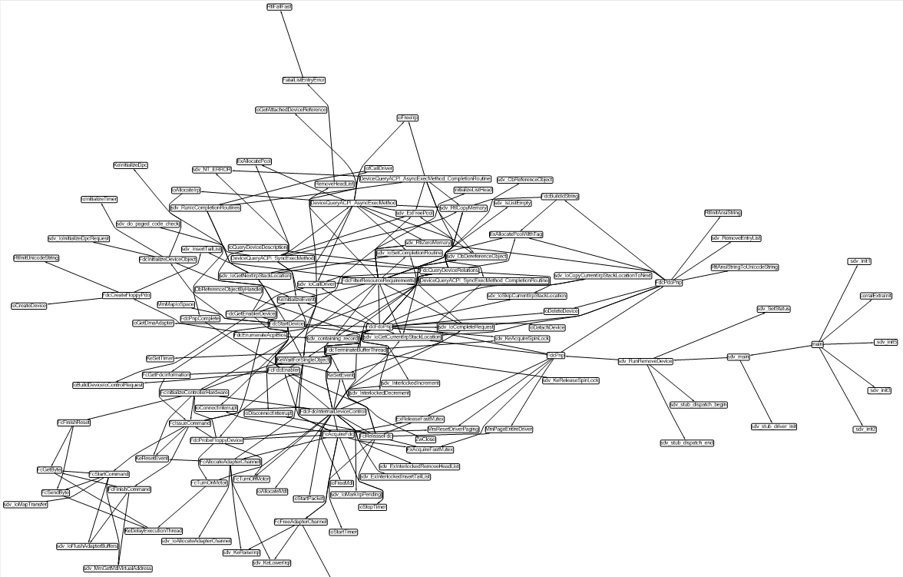
Deep Assertions
Assertion
Search in a large call graph
Main

Slide 4
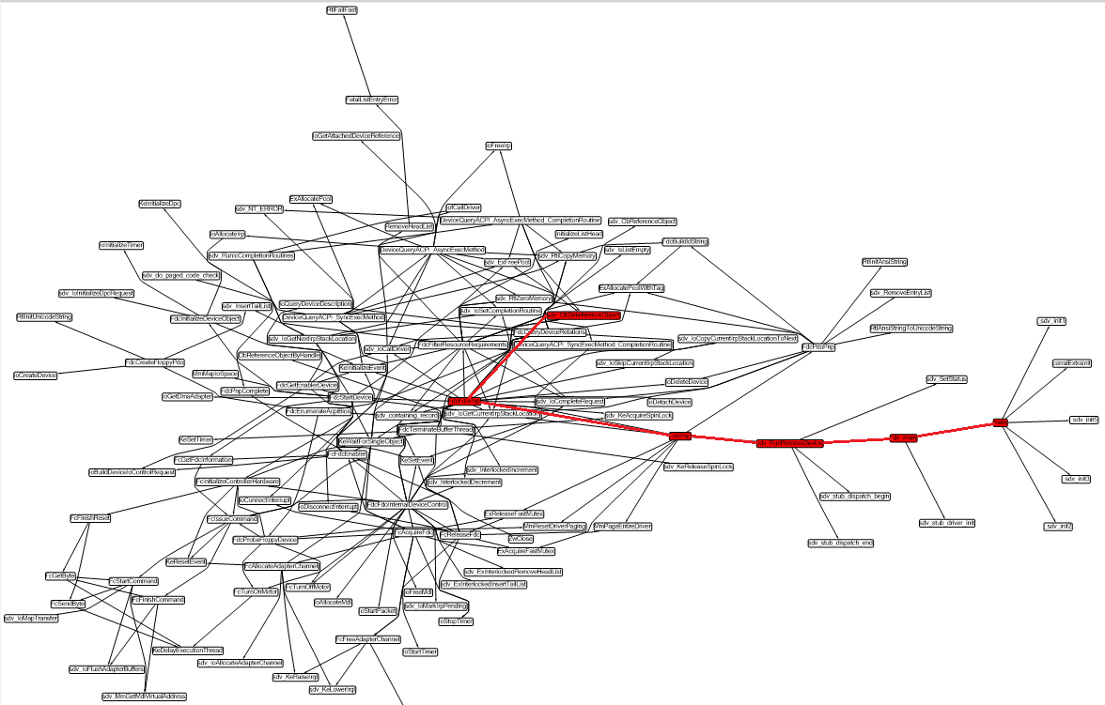
Deep Assertions
Search in a large call graph
Path of length 5

Slide 5
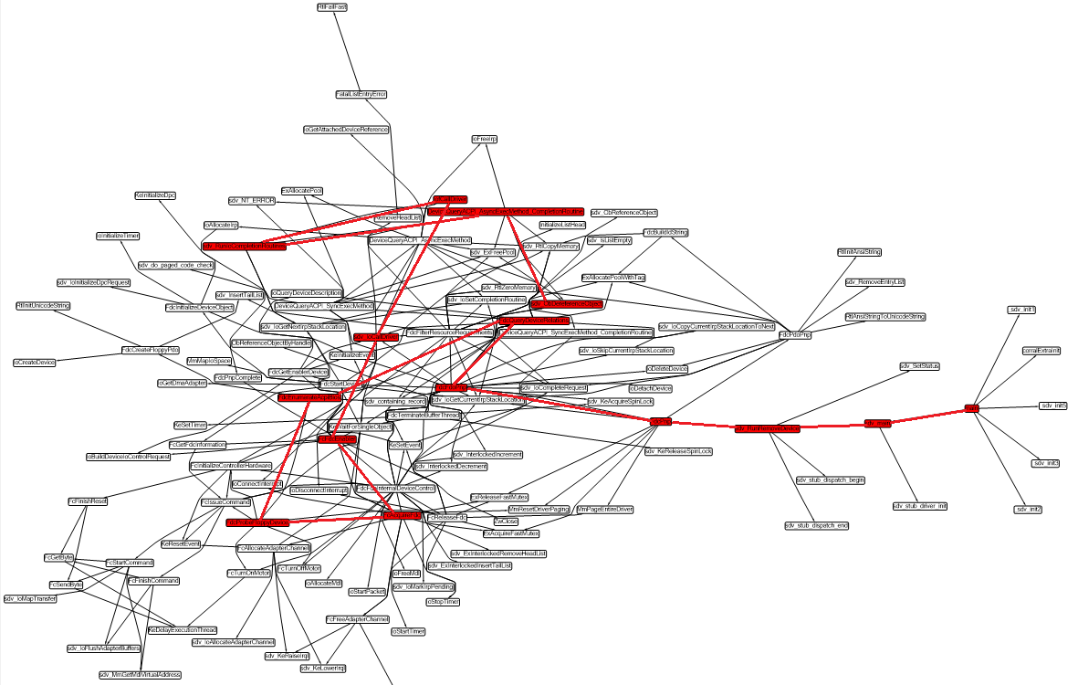
Deep Assertions
Search in a large call graph
Path of length 15

Slide 6
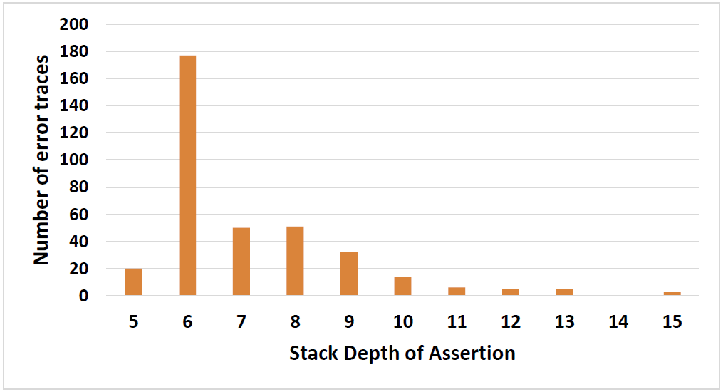
Deep Assertions
Statically, distance from main to the assertion was up to 38!

Slide 7
Deep Assertions
Goal-directed verifiers try to establish relevant information
For instance, SLAM infers only predicates relevant to the property
Contrast this with symbolic-execution based testing or explicit-state model checkers that are not goal-directed
When the target is far away, knowing what is relevant is harder to determine

Slide 8
Example
// global variables
var s, g: int;
procedure main()
{
// Initialization
s := 0; g := 1;
P1();
}
procedure P1()
{
P2();
P2();
}
procedure P2()
{
P3();
P3();
}
procedure Pn()
{
// loop
while(*) {
if(g == 1) Open();
Close();
}
}
procedure Open()
{
s := 1;
}
procedure Close()
{
assert s > 0;
s := 0;
}
Deep call graph!

Slide 9
Inlining-Based Verifiers
Example: CBMC, Corral
Based on exploring the call graph by unfolding it
Inline procedures, unroll loops
Either in forward or backward direction
Use invariants to help prune search

Slide 10
Example
// global variables
var s, g: int;
procedure main()
{
// Initialization
s := 0; g := 1;
P1();
}
procedure P1()
{
P2();
P2();
}
procedure P2()
{
P3();
P3();
}
procedure Pn()
{
// loop
while(*) {
if(g == 1) Open();
Close();
}
}
procedure Open()
{
s := 1;
}
procedure Close()
{
assert s > 0;
s := 0;
}
Corral, forward
Full inlining: O(2^n)*R, Or
Produce the invariant for each Pi:
old(g) == 1 ==> (s == old(s) && !err)
Corral, backward
Full inlining: O(2^n)*R, Or
Produce the precondition for each Pi:
(g == 1)

Slide 11
Example
// global variables
var s, g: int;
procedure main()
{
// Initialization
s := 0; g := 1;
P1();
}
procedure P1()
{
P2();
P2();
}
procedure P2()
{
P3();
P3();
}
procedure Pn()
{
// loop
while(*) {
if(g == 1) Open();
Close();
}
}
procedure Open()
{
s := 1;
}
procedure Close()
{
assert s > 0;
s := 0;
}
After our transformation:
(Corral, forward = Corral, backward) : O(1)
No invariants needed!

Slide 12
Our Transformation
Key Guarantee: Lift all assertions to main, that is for any procedure call, it will be to a procedure that cannot fail
How?
Call-Return semantics: a procedure call stores the return address on the stack, jumps to the procedure, and on exit returns to the address on stack.
When a procedure call doesn’t fail, then we already have our guarantee
When a procedure call will fail then we don’t need the return address!

Slide 13
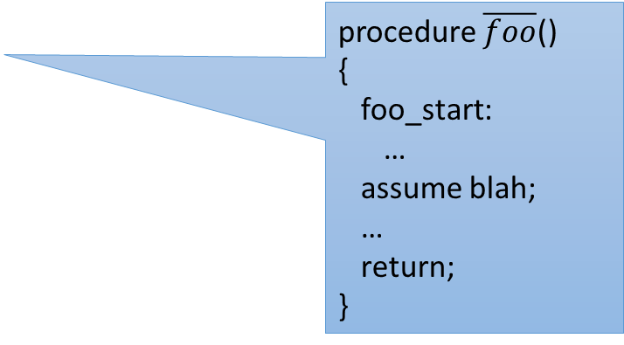
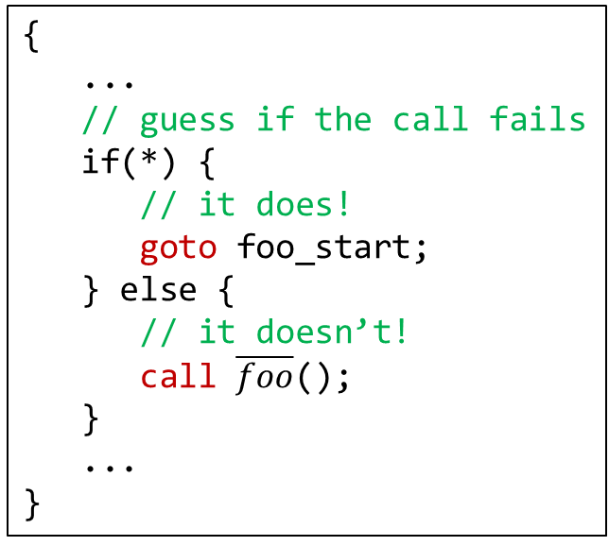
Our Transformation
{
...
// guess if the call fails
if(*) {
// it does!
goto foo_start;
} else {
// it doesn’t!
call $\overline{foo}$();
}
...
}
foo_start:
…
assert blah;
…
assume false;
{
...
call foo();
...
}
procedure $\overline{foo}$()
{
foo_start:
…
assume blah;
…
return;
}
procedure foo()
{
foo_start:
…
assert blah;
…
return;
}

Slide 14

Our Transformation
main()
{
call foo();
assert e1;
}
foo()
{
call bar();
assert e2;
}
bar()
{
assert e3;
}
main() {
if(*) {
goto foo_start;
} else {
call $\overline{foo}$();
}
assert e1;
}
$\overline{foo}$() {
...
call $\overline{bar}$();
assume e2;
}
$\overline{bar}$() {
assume e3;
}
?

Slide 15
Our Transformation
main()
{
call foo();
assert e1;
}
foo()
{
call bar();
assert e2;
}
bar()
{
assert e3;
}
main() {
if(*) {
goto foo_start;
} else {
call $\overline{foo}$();
}
assert e1;
}
$\overline{foo}$() {
...
call $\overline{bar}$();
assume e2;
}
$\overline{bar}$() {
assume e3;
}
foo_start:
call bar();
assert e2;
assume false;
?

Slide 16

Our Transformation
main()
{
call foo();
assert e1;
}
foo()
{
call bar();
assert e2;
}
bar()
{
assert e3;
}
main() {
if(*) {
goto foo_start;
} else {
call $\overline{foo}$();
}
assert e1;
}
$\overline{foo}$() {
...
call $\overline{bar}$();
assume e2;
}
$\overline{bar}$() {
assume e3;
}
foo_start:
if(*) {
goto bar_start;
} else {
call $\overline{bar}$();
}
assert e2;
assume false;

Slide 17


Our Transformation
main()
{
call foo();
assert e1;
}
foo()
{
call bar();
assert e2;
}
bar()
{
assert e3;
}
main() {
if(*) {
goto foo_start;
} else {
call $\overline{foo}$();
}
assert e1;
}
$\overline{foo}$() {
...
call $\overline{bar}$();
assume e2;
}
$\overline{bar}$() {
assume e3;
}
foo_start:
if(*) {
goto bar_start;
} else {
call $\overline{bar}$();
}
assert e2;
assume false;
bar_start:
assert e3;
assume false;
Remarks:
The algorithm terminates
At most one copy of each procedure absorbed into main
All assertions in main!

Slide 18

Our Transformation
Additional Guarantee: Loops don’t have assertions
How?
Only the last iteration can fail
loop(b)
loop(b); if(*) { b }
loop($\overline{b}$); if(*) { b }

Slide 19
Example
// global variables
var s, g: int;
procedure main()
{
// Initialization
s := 0; g := 1;
P1();
}
procedure P1()
{
P2();
P2();
}
procedure P2()
{
P3();
P3();
}
procedure Pn()
{
// loop
while(*) {
if(g == 1) Open();
Close();
}
}
procedure Open()
{
s := 1;
}
procedure Close()
{
assert s > 0;
s := 0;
}
Deep call graph!

Slide 20
Example
Invariant:
g == 1
var s, g: int;
procedure main()
{
s := 0; g := 1;
if(*) goto P1_start;
else P1();
assume false;
P1_start:
if(*) goto P2_start;
else P2();
if(*) goto P2_start;
else P2();
assume false;
...
Pn_start:
while(*) {
if(g == 1) Open();
Close();
}
if(*) {
if(g == 1) Open();
if(*) {
assert s > 0;
s := 0;
} else Close();
}
}
assume false;
Inline: Open
ensures s == 1

Slide 21
Our Transformation
Concurrent Programs: We still retain our guarantee
Key Idea: At most one thread can fail
Main guesses the failing thread upfront and start running it
(But it blocks until the thread is actually spawned)
Rest all of the threads run failure free
Failing thread transformed, as for sequential programs
Details in the paper

Slide 22
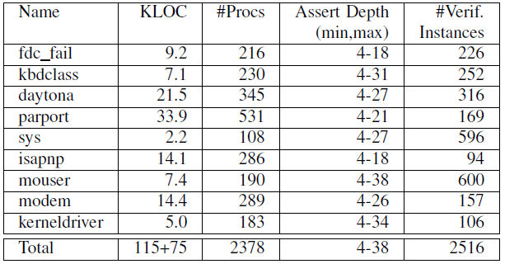
Benchmarks
Windows Device Drivers, source: “The Static Driver Verifier”

Slide 23
Evaluation
Two verifiers
Corral: Based on procedure inlining
Yogi: Based on testing and refinement via lazy predicate abstraction
Implementation
Less than 1000 lines of code!
Evaluation Criteria
Number of instances solved
Running time
Memory consumption
Effect on summary generation (discussed in the paper)

Slide 24
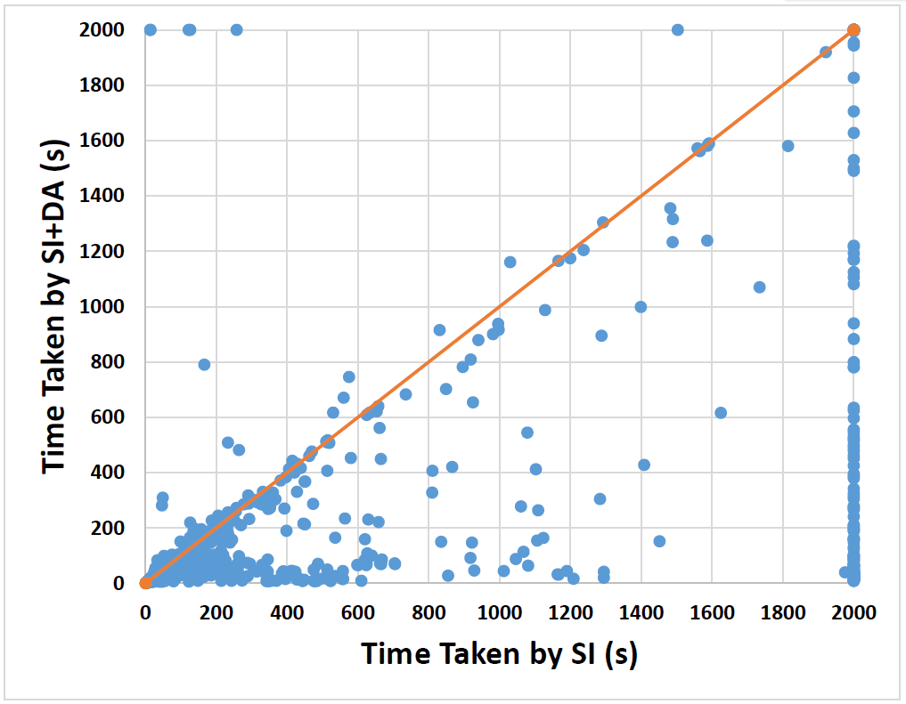
Results: Stratified Inlining
Number of instances: 2516
Reduction in Timeouts: 297
10X speedup: 54
2X speedup: 220
2X slowdown: 5
Program size increase: 1.1X to 1.6X
Memory consumption: reduced!

Slide 25
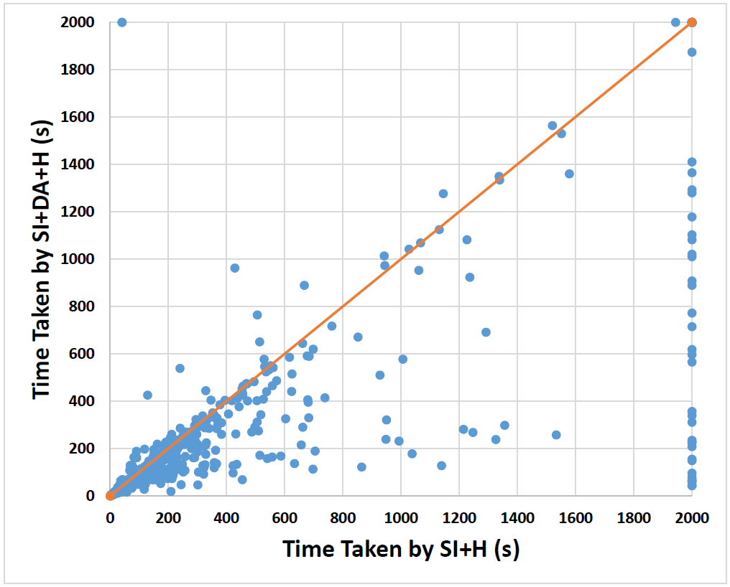
Results: Stratified Inlining + Houdini
Number of instances: 2516
Reduction in Timeouts: 30
2X speedup: 80
2X slowdown: 4

Slide 26
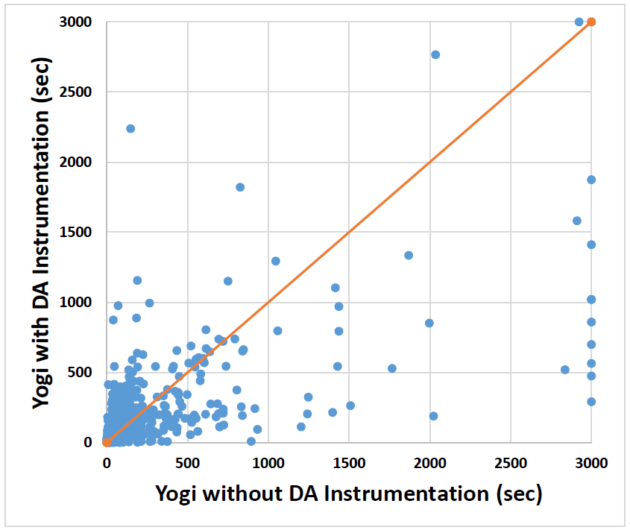
Results: Yogi
Third party tool
Number of instances: 802
Reduction in Timeouts: 7
10X speedup: 36
Slowdown mostly limited to trivial instances

Slide 27
Summary
A program transformation that lifts all assertions to main
Considerable speedups, up to 10X for two different verifiers
Very little implementation effort
Try it out in your verifier today!
Thank You!

