Slide 1

Data Efficient Reinforcement Learning with Off-Policy and Simulated Data
Josiah Hanna
PhD Oral Defense
Notes:
Good afternoon. Thank you all for coming to my final dissertation defense. I’m excited to share with you some of the work I’ve been doing since my thesis proposal in late 2017.

Slide 2

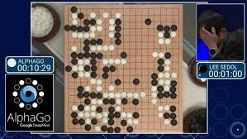
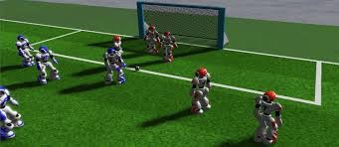



50 millions actions taken
21 days, millions of games
1.5 years of compute
Notes:
The field of reinforcement learning has generated a lot of attention recently with several impressive empirical results.
Since 2015 when I began my PhD, we’ve seen
Super human performance on Atari video games.
Super human performance on the game of GO.
Simulated robots that have learned to run, jump, or play soccer through reinforcement learning
Industry has taken notice of these results and begun applying RL to their problems.
For example, web-marketing, data center control or control of home thermostat systems.
With all of these recent successes, it’s tempting to look at the field of RL and think that it is only a matter of time before RL can be used for real world robotics, healthcare, or any task that involves learning to take actions to achieve a goal.
However, while effective, state-of-the-art RL is not efficient.
For example, super-human performance on Atari -- the agent tried 50 million actions before it could solve the game.
Super-human performance at GO involved 21 days of the computer playing millions of games against itself.
And as one more example, these simulated robots took 1.5 years of compute time to learn the various skills needed to play soccer.
And it should be noted that all of these successes are in settings that can be ran faster than real time and so interaction would take much longer on a physical system

Slide 3
Can reinforcement learning be data efficient enough for real world applications?
Notes:
And so the big question that many people in industry and academia are asking is:
“Can reinforcement learning be data efficient enough for real world applications?”
This is the question that motivates my research as well. And in my dissertation I’ve looked at two ways that RL algorithms are inefficient in how they use data.

Slide 4
Limitations of Reinforcement Learning Algorithms
On-Policy
Only use data generated by the current policy.
On-Environment
Simulated data is useless
Notes:
The first limitation that this dissertation addresses is that many RL algorithms are what is known as on-policy. I’m using this term somewhat loosely. In the strictest sense on-policy means that data can only be used from the current policy. While this is not necessarily true for all state-of-the-art algorithms, it is true that many algorithms only make use of data from a policy similar to their current policy.
The second limitation is that RL algorithms are on-environment meaning that they must learn in the true environment of interest. Applications of RL to robotics are especially limited in this respect as robotics is a domain where we frequently have good simulations of the world. However, if we apply RL in the simulation we should not expect learning to transfer into the real world.
Note: Ciosek and Whiteson [2017] introduce the term off-environment which we adapt here to describe a limitation of RL algorithms.

Slide 5
Can reinforcement learning be data efficient enough for real world applications?
Notes:
In principle, if we can address these two limitations we can answer this big question and make reinforcement learning data efficient enough for real world applications.

Slide 6
Can reinforcement learning be data efficient enough for real world applications?

Slide 7
How can a reinforcement learning agent leverage off-policy and simulated data to evaluate and improve upon the expected performance of a policy?
Can reinforcement learning be data efficient enough for real world applications?
Notes:
This dissertation addresses these limitations by answering the following thesis question:
“How can a reinforcement learning agent leverage off-policy and simulated data to evaluate and improve upon the expected performance of a policy?”

Slide 8


How can a reinforcement learning agent leverage off-policy and simulated data to evaluate and improve upon the expected performance of a policy?
How should an RL agent collect off-policy data?
How should an RL agent weight off-policy data?
How can an RL agent use simulated data?
How can an RL agent combine simulated and off-policy data?
Can reinforcement learning be data efficient enough for real world applications?
Notes:
This dissertation answers its thesis question by answering four smaller questions:
How should an RL agent collect off-policy data?
How should an RL agent weight already collected off-policy data?
How can an RL agent use simulated data?
How can an RL agent combine simulated and off-policy data?
I’m going to discuss

Slide 9
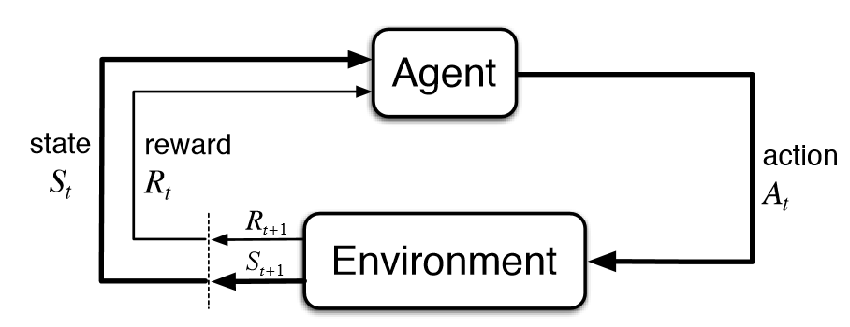


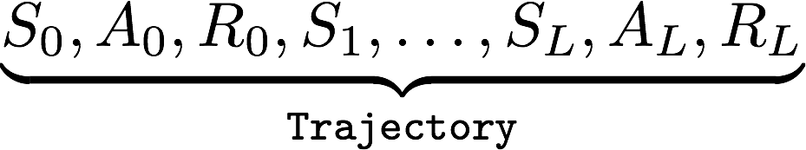




The Reinforcement Learning World
Policy Improvement: Find policy that maximizes expected cumulative reward.
Policy Value Estimation: Given a fixed policy, determine the expected cumulative reward of that policy.

Slide 10
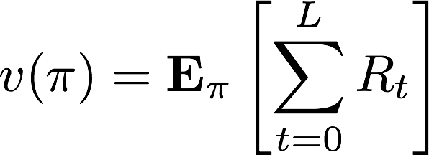

Policy Value Estimation
Evaluation Policy
Expected Total Reward
Notes:
A more formal and general look at policy evaluation, we have a fixed policy that we call pi.
We want to know what is the expected total reward we will see when following this policy.
Introduce what a policy is.
Finally, in the first part of the talk I’m going to assume we are working with stochastic policies -- the policy randomly samples actions.

Slide 11
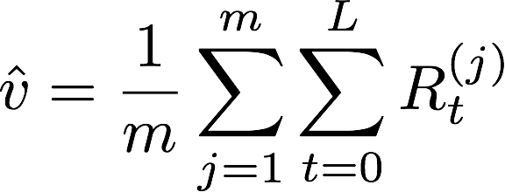
On-Policy Monte Carlo Value Estimation
Repeatedly run the evaluation policy.
Average the total reward seen each trajectory.
Notes:
In reinforcement learning and robotics, this approach is commonly called using Monte Carlo rollouts.
We run the policy for some number of trajectories
Add up all the reward seen along each trajectory
Average these totals
This approach is fairly standard in RL and robotics research.
Note that with Monte Carlo rollouts, we’re being fairly passive in how we evaluate our policy.
We run the fixed policy and we watch and see what happens.

Slide 12
On-Policy Monte Carlo Value Estimation
Notes:
In reinforcement learning and robotics, this approach is commonly called using Monte Carlo rollouts.
We run the policy for some number of trajectories
Add up all the reward seen along each trajectory
Average these totals
This approach is fairly standard in RL and robotics research.
Note that with Monte Carlo rollouts, we’re being fairly passive in how we evaluate our policy.
We run the fixed policy and we watch and see what happens.

Slide 13
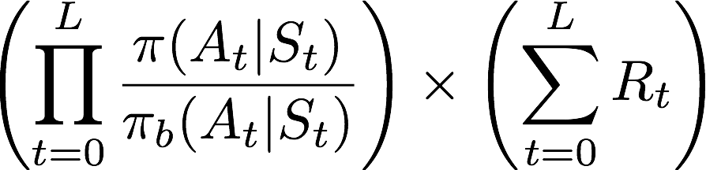
Off-Policy Value Estimation via Importance Sampling
Repeatedly run a different behavior policy.
Add up all of the reward received along each trajectory.
Re-weight the reward total.
Relative Likelihood
Total Reward
Average the re-weighted rewards.
Precup, Sutton, and Singh (ICML 2000)
Notes:
We repeatedly run the behavior policy, add up all the reward along each trajectory, but now we re-weight the reward totals to account for the policy change.
It’s unimportant to understand this expression exactly but what it says is that if a trajectory would have been more likely under the target policy than the behavior policy we want to give it higher weight. Similarly if the trajectory would be less likely then we give it less weight in our average.
This is mathematically very nice. We can use data from any policy as if it were generated by our target policy.

Slide 14
How can a reinforcement learning agent leverage off-policy and simulated data to evaluate and improve upon the expected performance of a policy?
How should an RL agent collect off-policy data?
How should an RL agent weight off-policy data?
How can an RL agent use simulated data?
How can an RL agent combine simulated and off-policy data?
Can reinforcement learning be data efficient enough for real world applications?
Notes:
That concludes the background part of the talk. I’m now going to describe our contribution that answer each of these questions.
I’m going to discuss the first question briefly, then spend most of our time on the second question.
Then I’ll spend a few slides discussing the third question, even less time on the last question, and finally discuss some interesting directions for future research before concluding.

Slide 15
How to collect off-policy data?
How to choose the behavior policy for importance sampling?
Contribution 1: Formulation of behavior policy search problem and behavior policy gradient algorithm for policy value estimation.
Contribution 2: Initial study of the behavior policy gradient algorithm combined with policy gradient policy improvement.

Slide 16
How can a reinforcement learning agent leverage off-policy and simulated data to evaluate and improve upon the expected performance of a policy?
How should an RL agent collect off-policy data?
How should an RL agent weight off-policy data?
How can an RL agent use simulated data?
How can an RL agent combine simulated and off-policy data?
Can reinforcement learning be data efficient enough for real world applications?
Notes:
We’re now going to move to our second question and discuss how an RL agent should weight off-policy data.

Slide 17
How to weight off-policy data?
How to correct for off-policy distribution shift?
Contribution 3: Family of regression importance sampling estimators that improve over ordinary importance sampling.
Contribution 4: Sampling error corrected policy gradient estimator that improves over Monte Carlo policy gradient estimators.
Notes:
The issue with using off-policy data is that we want trajectories from the evaluation policy’s trajectory distribution.
But we only have trajectories from the behavior policy. So we need to weight our data to account for this distribution shift.
Importance sampling is the main way that people provide this correction.
Our 3rd contribution shows that importance sampling is suboptimal for these corrections.
Our new methods improve over ordinary importance sampling by correcting what we call sampling error.
Our 4th contributions applies the same sampling error correction technique to policy gradient RL.

Slide 18

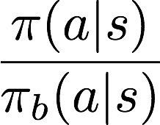
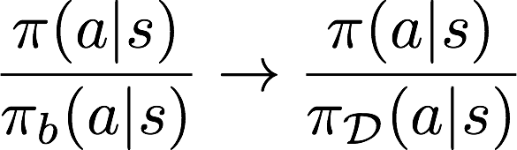
Proposal Time: Importance sampling with an unknown behavior policy
Importance sampling requires the behavior policy probabilities to be known.
Baseline approach: maximum likelihood behavior policy estimation.
Credit: Brenna Argall
Notes:
Before diving into our contributions, I want to revisit my thesis proposal in late 2017.
At that time I proposed to study how to do importance sampling when the behavior policy is unknown.
Importance sampling is completely inapplicable if the behavior policy is unknown. That is because we need the behavior policy action probabilities for the denominator of the importance sampling weight.
This limitation means we can’t use human demonstration data for off-policy evaluation.
I proposed that the baseline approach to this problem be maximum likelihood behavior policy estimation.
Estimate what the behavior policy was that generated the data and then plug this in as the behavior policy.
My expectation was that this approach would perform worse than using the true behavior policy but that we could attempt to bound how much worse it would be and provide practical guidelines for estimating the behavior policy in practice.
\frac{\pi(a|s)}{\pi_b(a|s)} \rightarrow \frac{\pi(a|s)}{\pi_\mathcal{D}(a|s)}

Slide 19
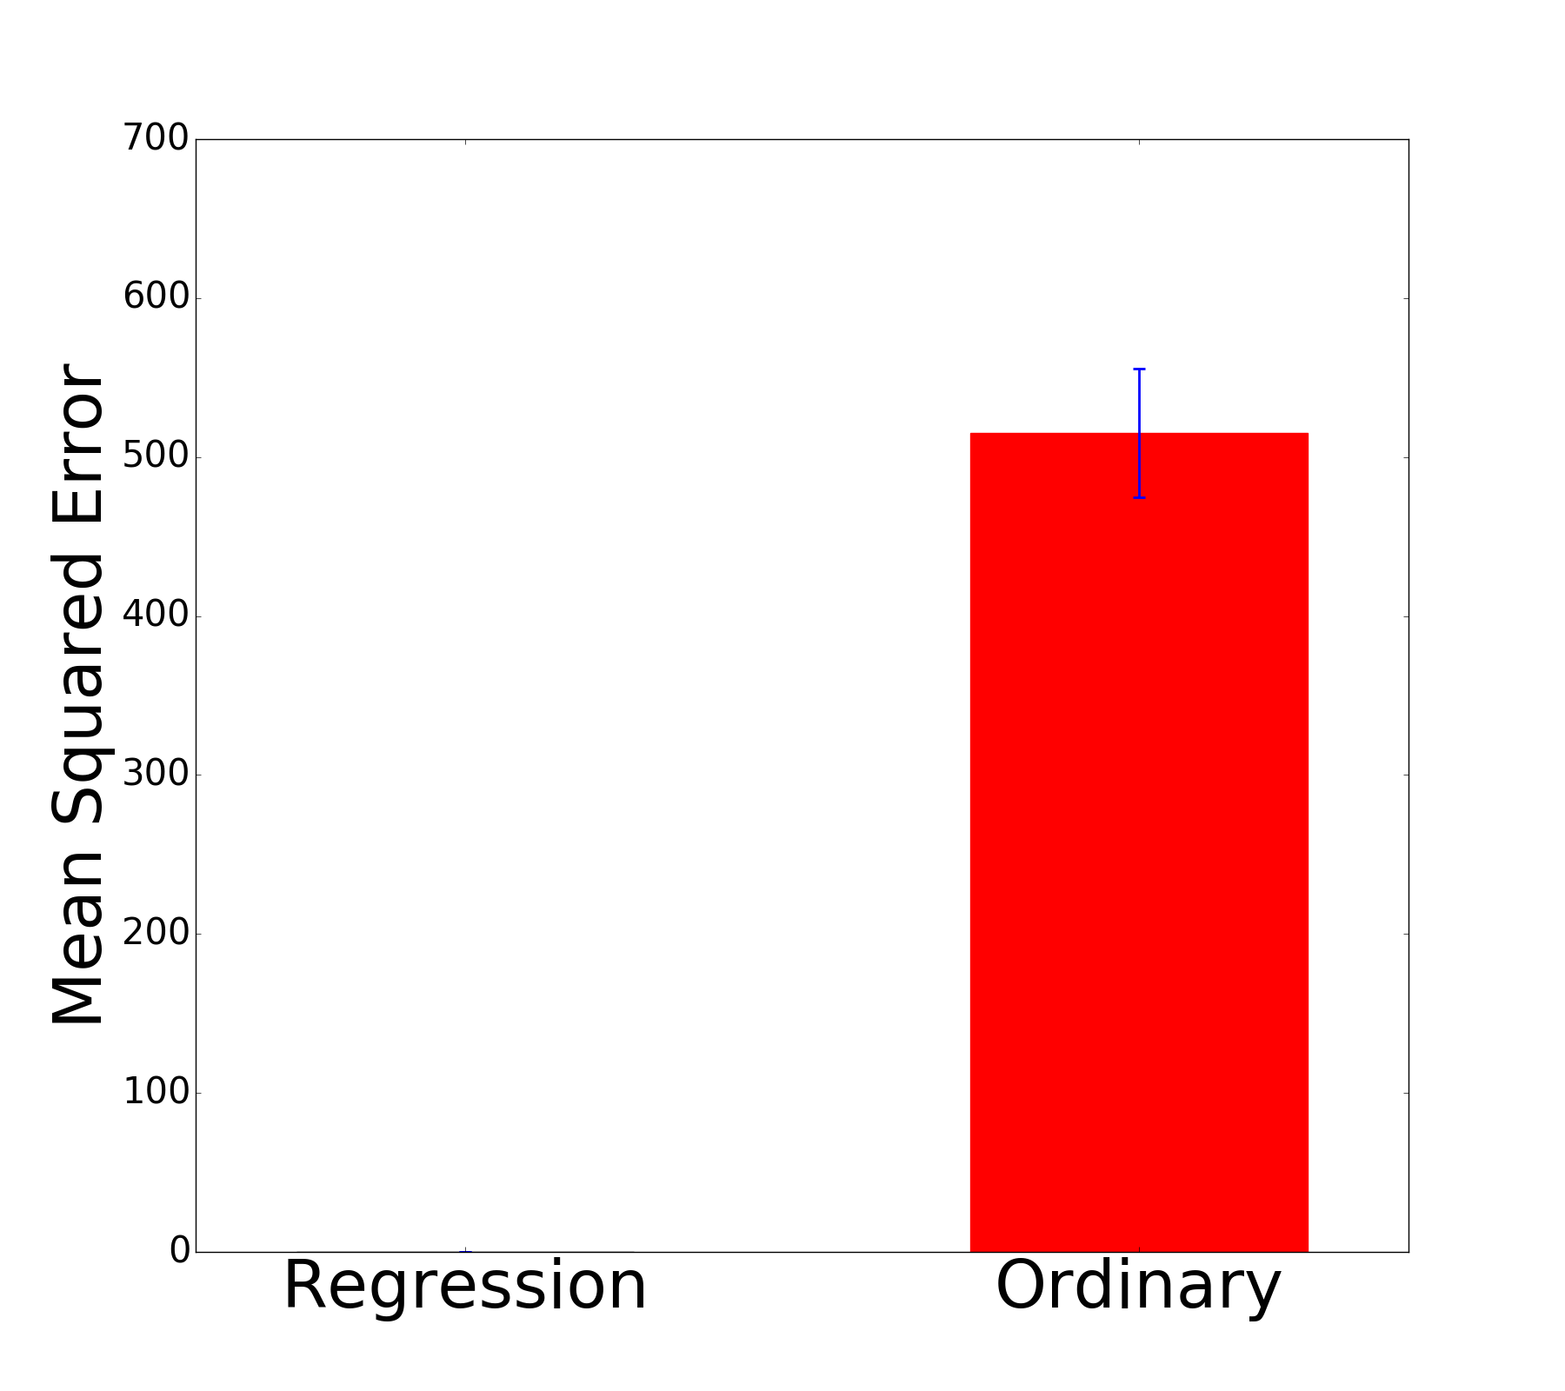
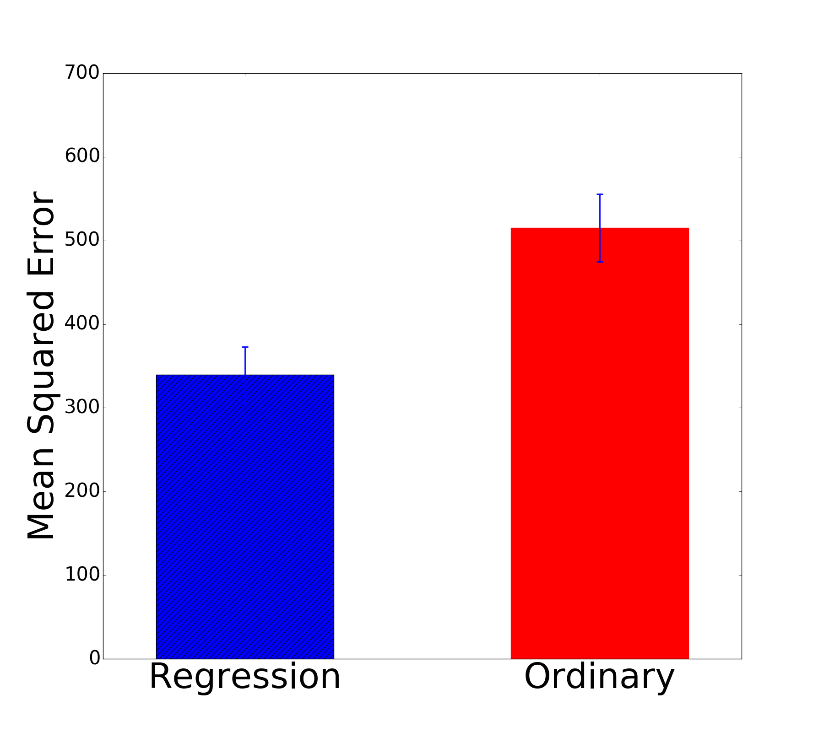
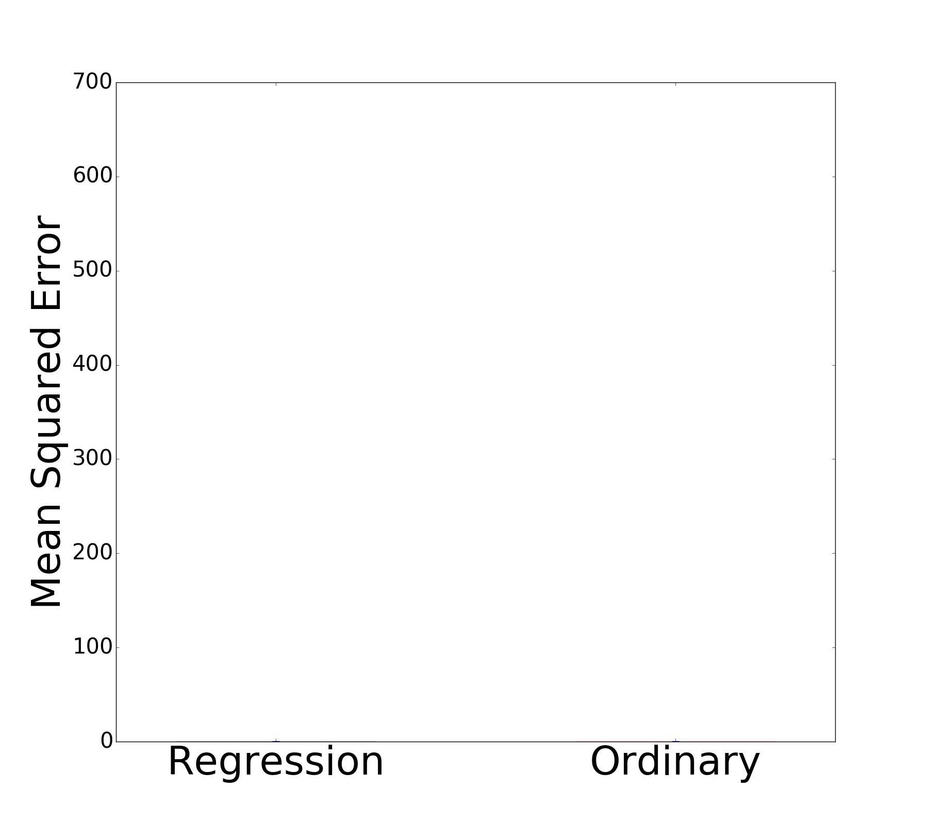
Estimated
True
OpenAI’s RoboschoolHopper-v1
Notes:
As it turns out, the true behavior policy is a worse choice for the denominator in the importance sampling weight.
Here is an RL benchmark task, the y-axis is the MSE (how accurate our estimator is).
We collect 400 trajectories on this task and evaluate the evaluation policy.
Ordinary importance sampling uses the true behavior policy.
The estimated policy does substantially better.

Slide 20
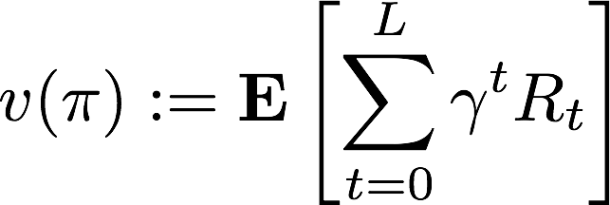
Policy Value Estimation
Given batch of trajectory data:
Given an evaluation policy:
Estimate:
Notes:
In the setting we study, we are given a set of trajectories and an evaluation policy.
We want to use this data to estimate the expected sum of rewards.
We make no assumptions about what policy generated these trajectories.
\mathcal{D} = \{(S_0^i, A_0^i, R_0^i,...,S_L^i,A_L^i,R_L^i)\}_{i=1}^m

Slide 21
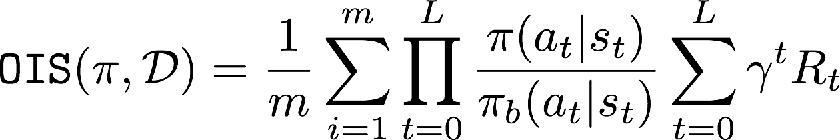
Ordinary Importance Sampling
Correction from behavior policy to evaluation policy
Discounted sum of rewards
Precup, Sutton, and Singh (ICML 2000)
Notes:
Introduce IS: say as sample size grows large we will converge to the right distribution and then IS converts to the proper weighting.
\mathtt{OIS}(\pi, \mathcal{D}) = \frac{1}{m} \sum_{i=1}^m \prod_{t=0}^L \frac{\pi(a_t|s_t)}{\pi_b(a_t|s_t)}\sum_{t=0}^L \gamma^t R_t

Slide 22
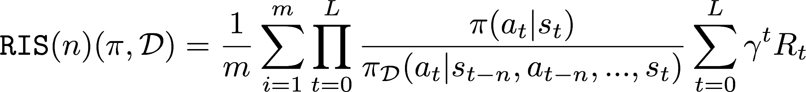
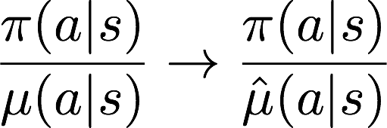
Regression Importance Sampling
Correction from empirical policy to evaluation policy.
Maximum likelihood behavior policy estimate
(empirical policy).
Notes:
\frac{\pi(a|s)}{\mu(a|s)} \rightarrow \frac{\pi(a|s)}{\hat{\mu}(a|s)}

Slide 23
Related Work
Estimated Propensity Scores (Hirano et al. 2003, Li et al. 2015).
Learning in contextual bandits (Xie et al. 2019, Narita et al. 2019)
We are the first to show using an estimated behavior policy improves importance sampling in multi-step environments.

Slide 24
Regression Importance Sampling
Correction from empirical policy to evaluation policy.
Notes:
\frac{\pi(a|s)}{\mu(a|s)} \rightarrow \frac{\pi(a|s)}{\hat{\mu}(a|s)}

Slide 25
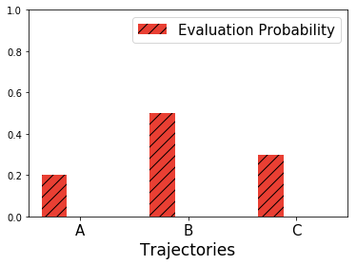
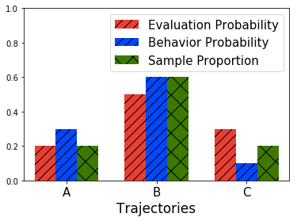
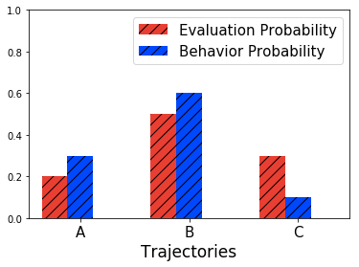
Regression Importance Sampling
Observed data contains 1 of A, 3 of B, and 1 of C

Slide 26
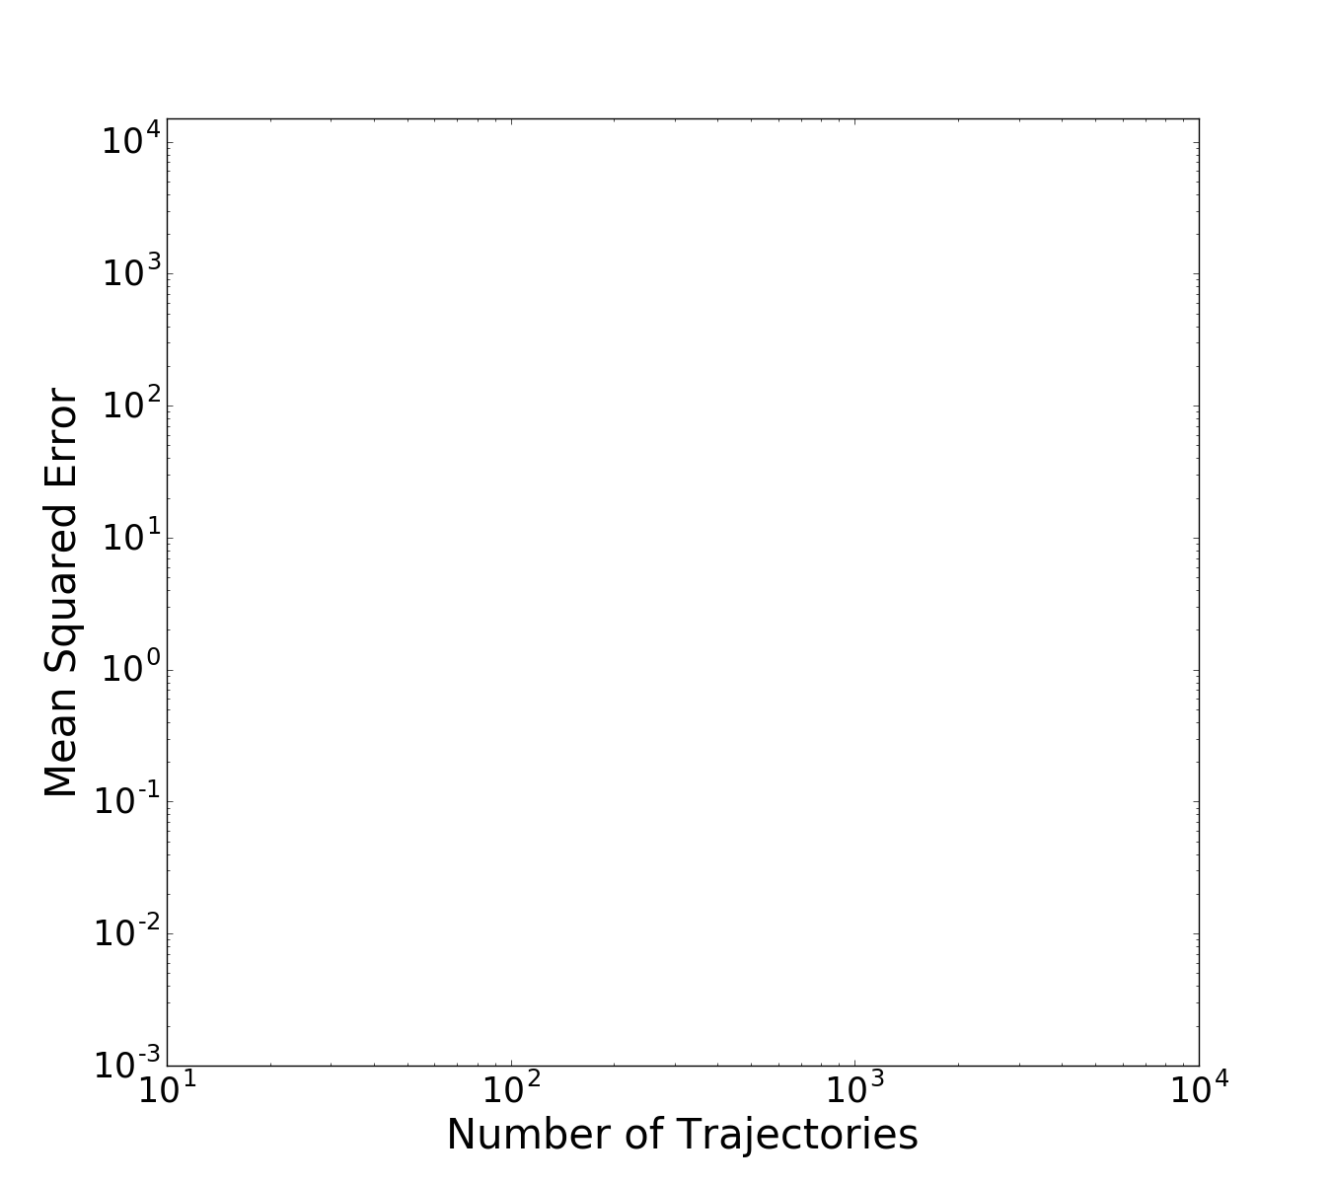
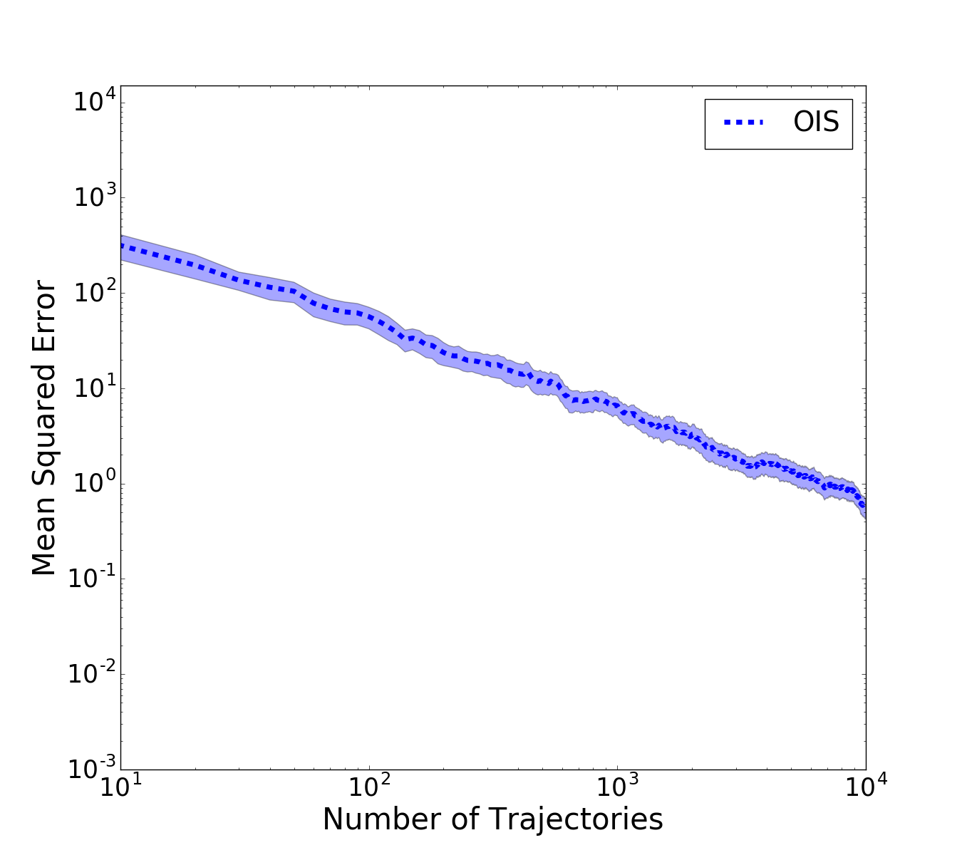
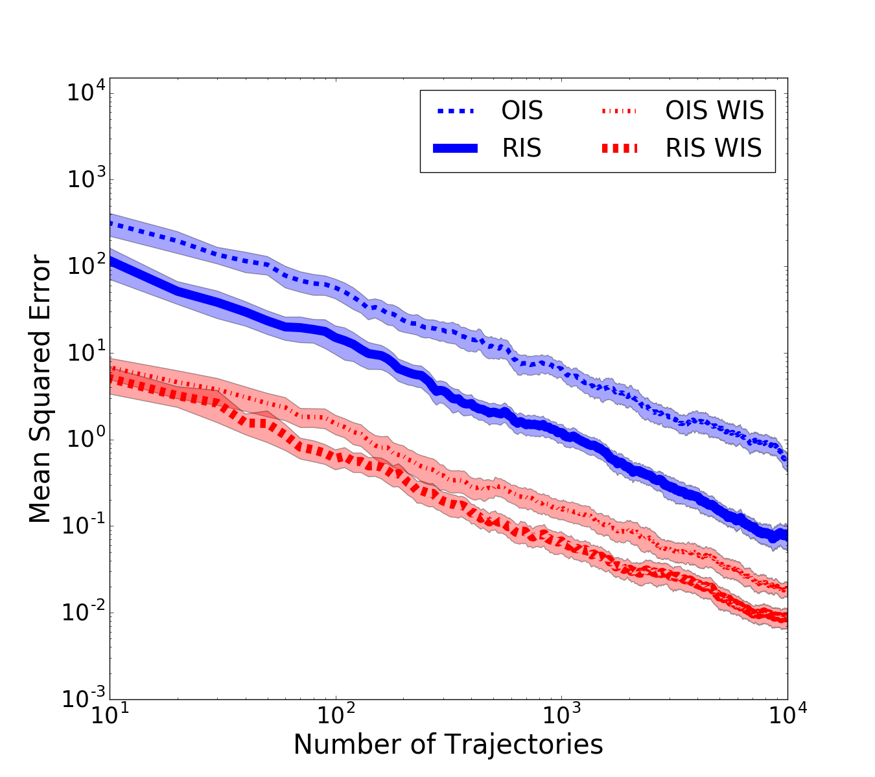
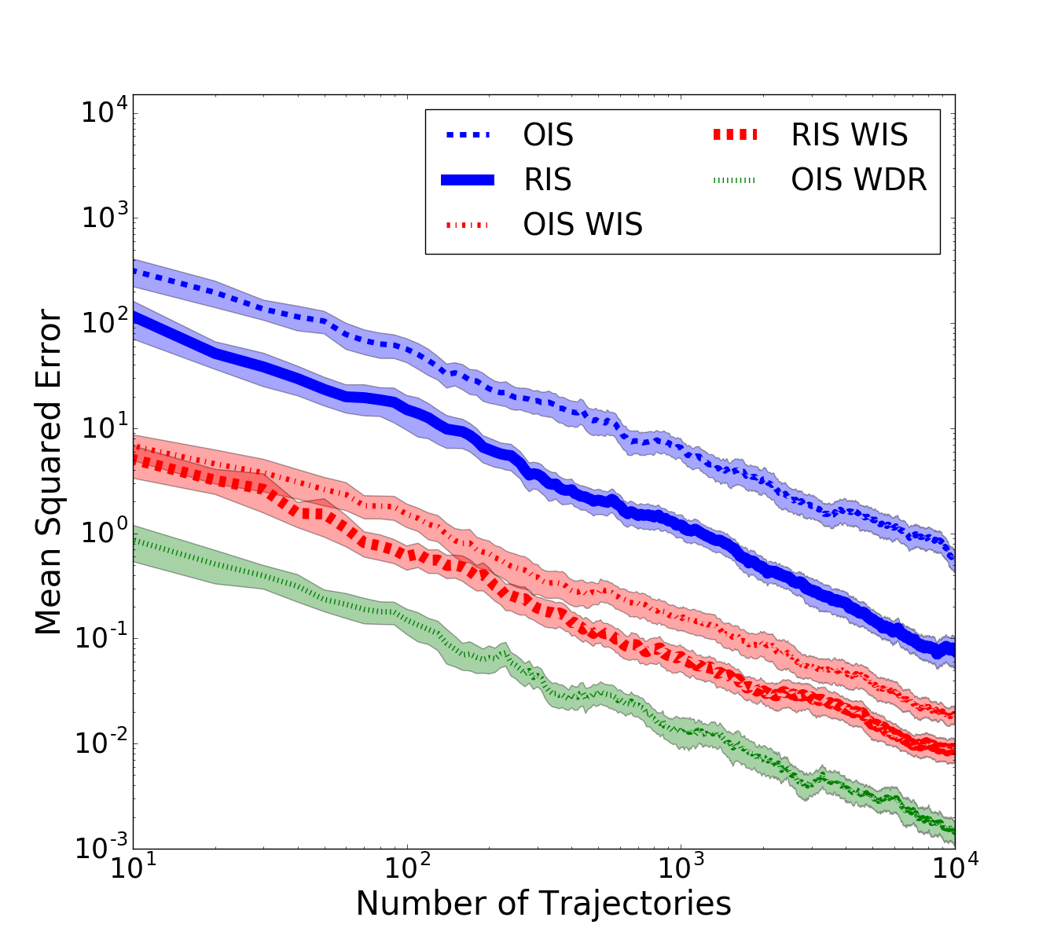
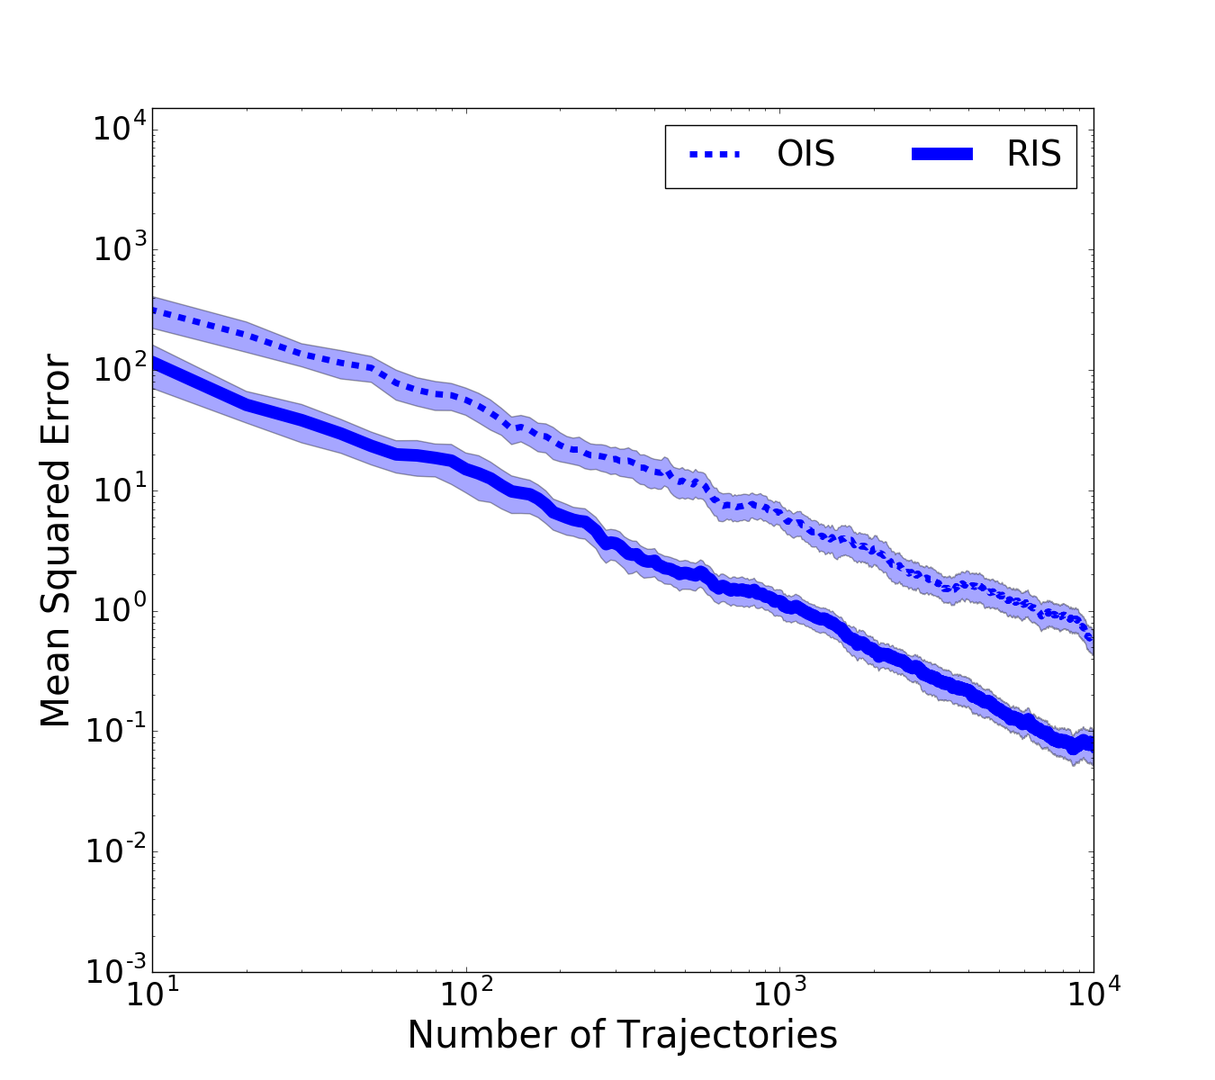
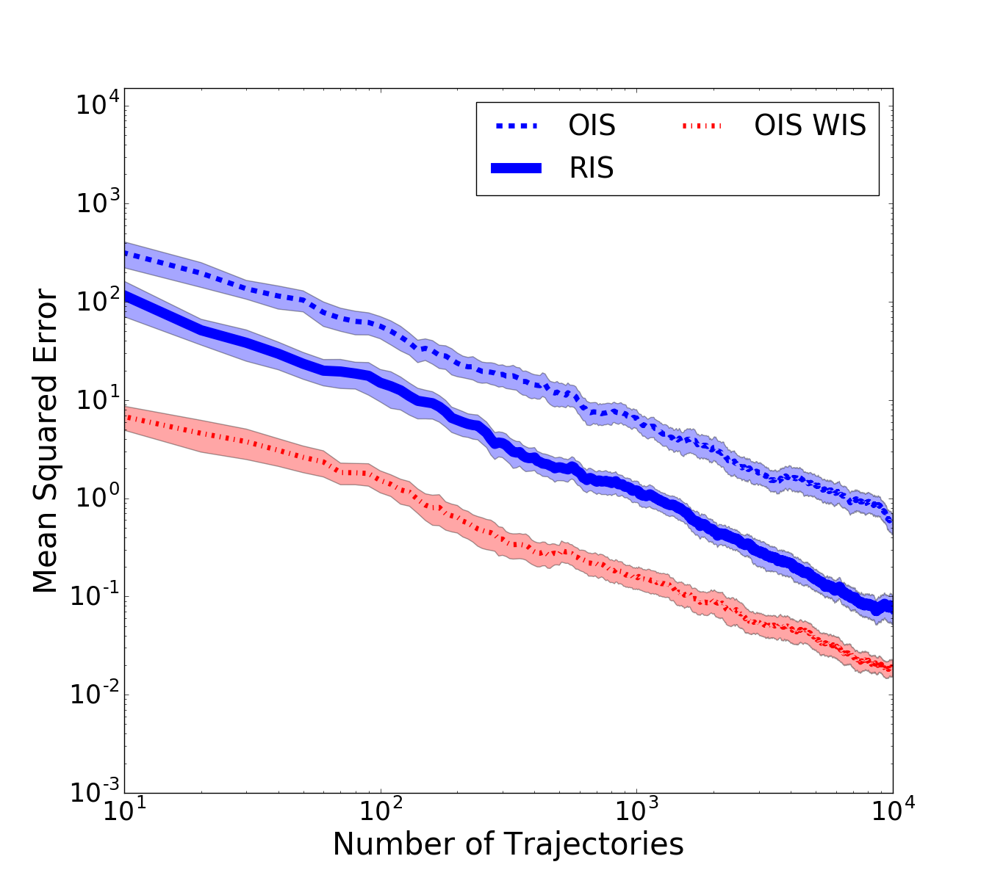
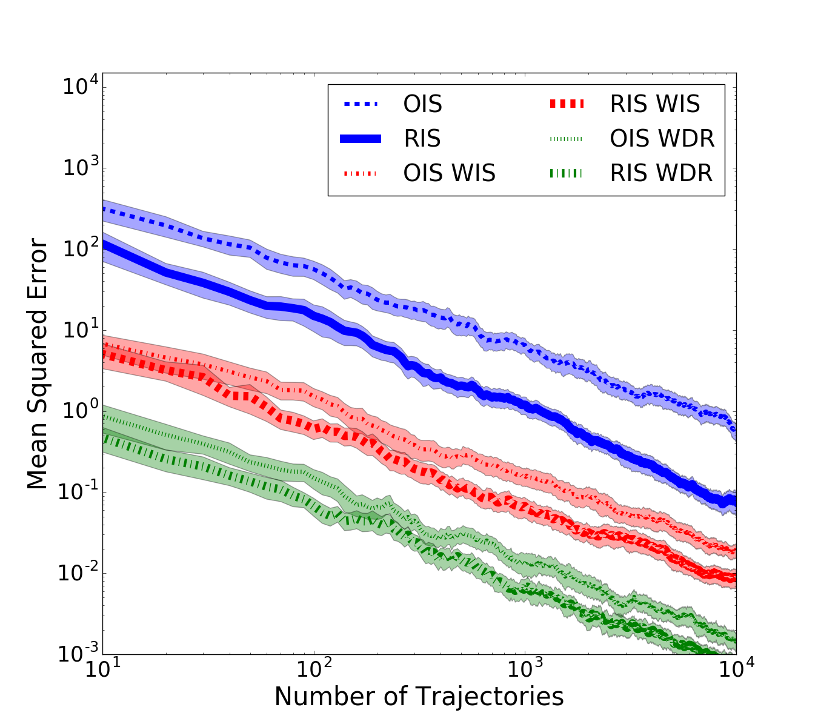
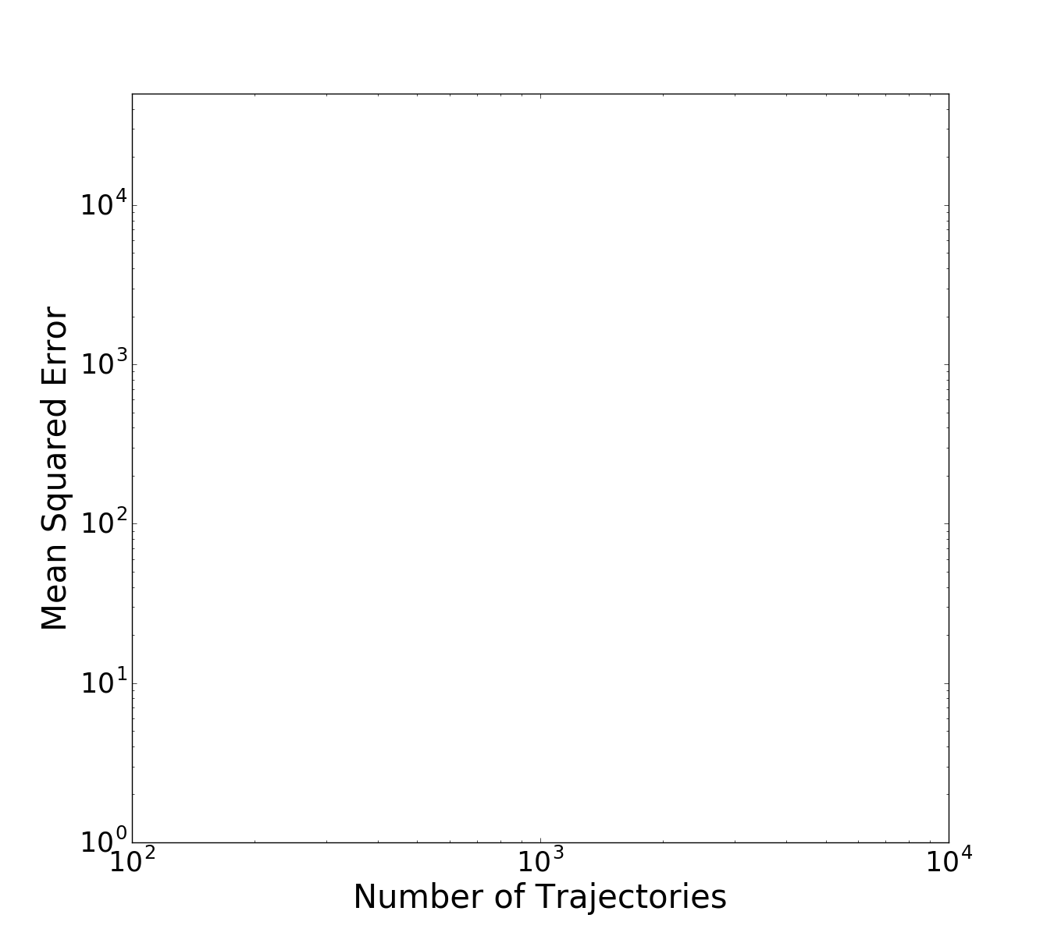
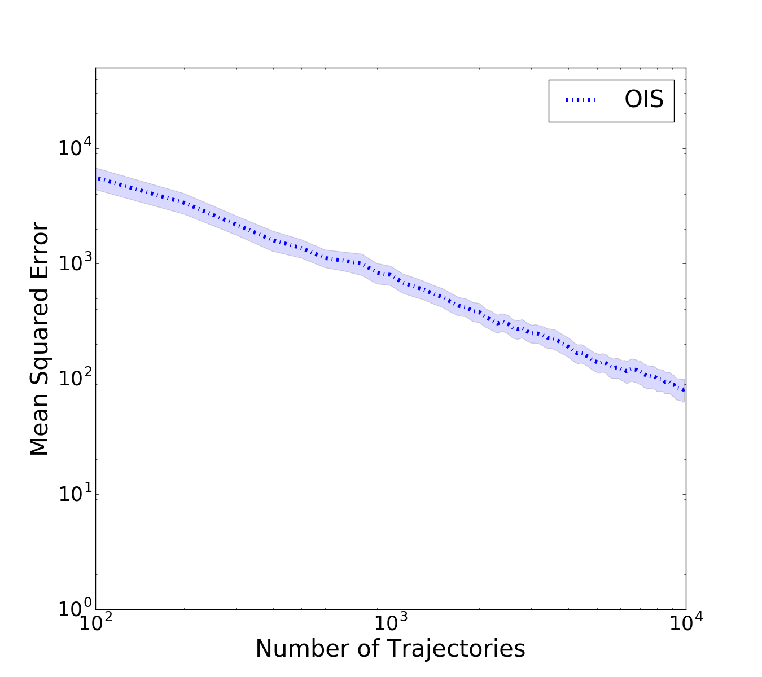
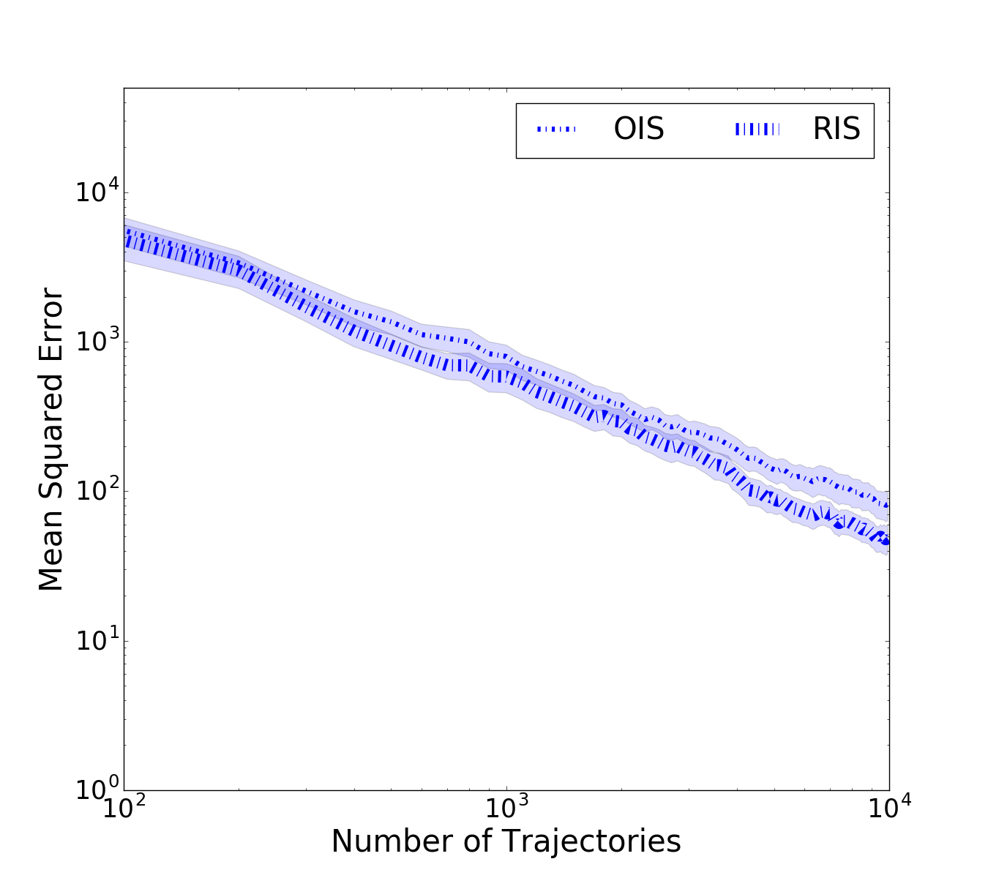
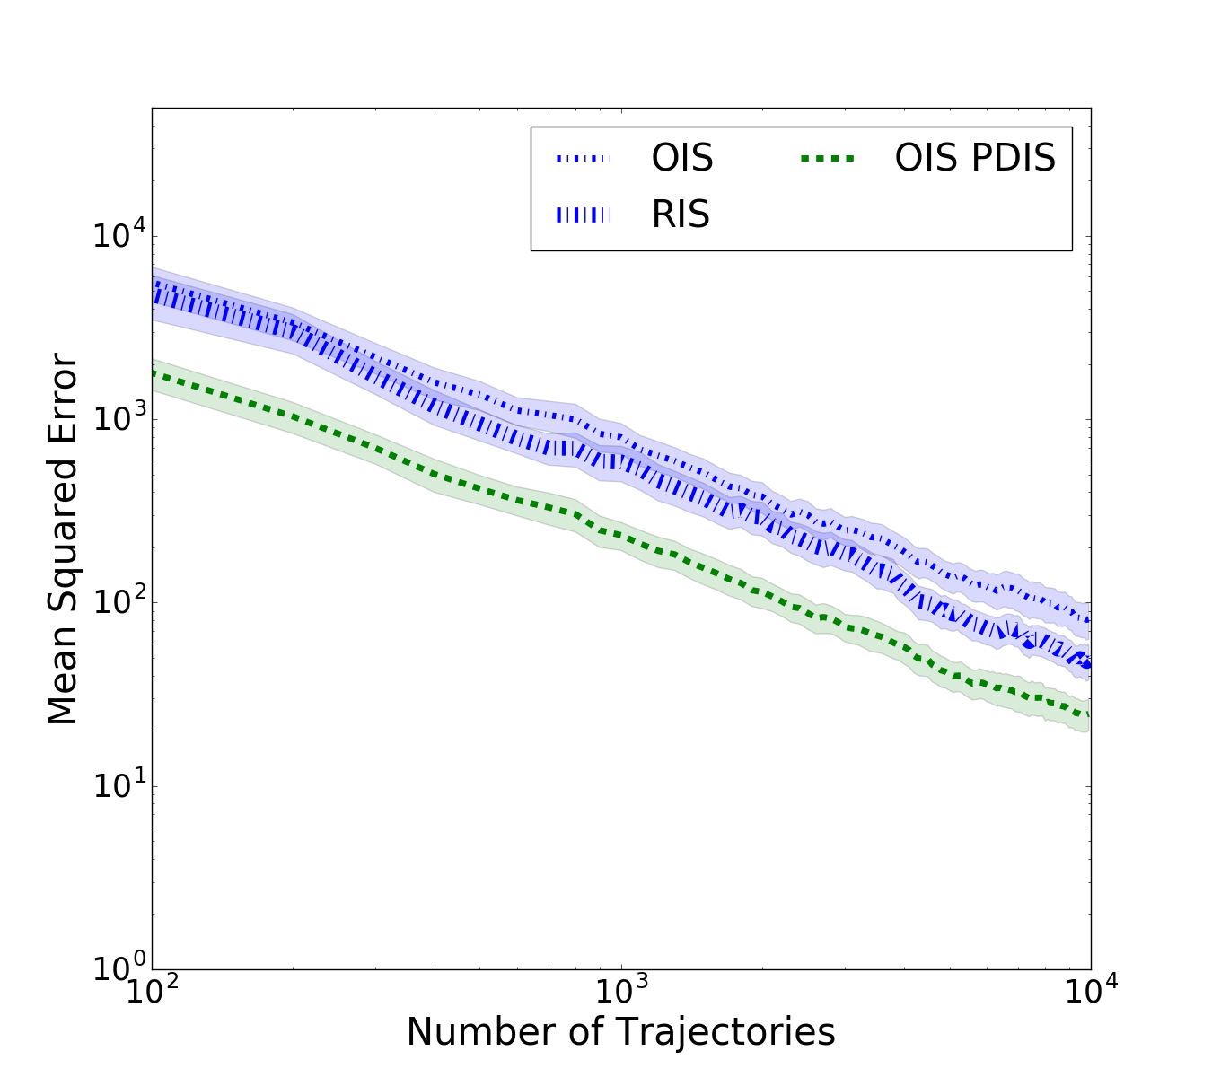
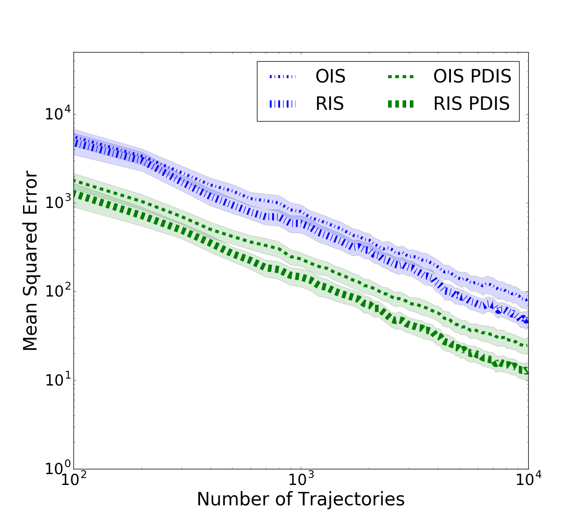
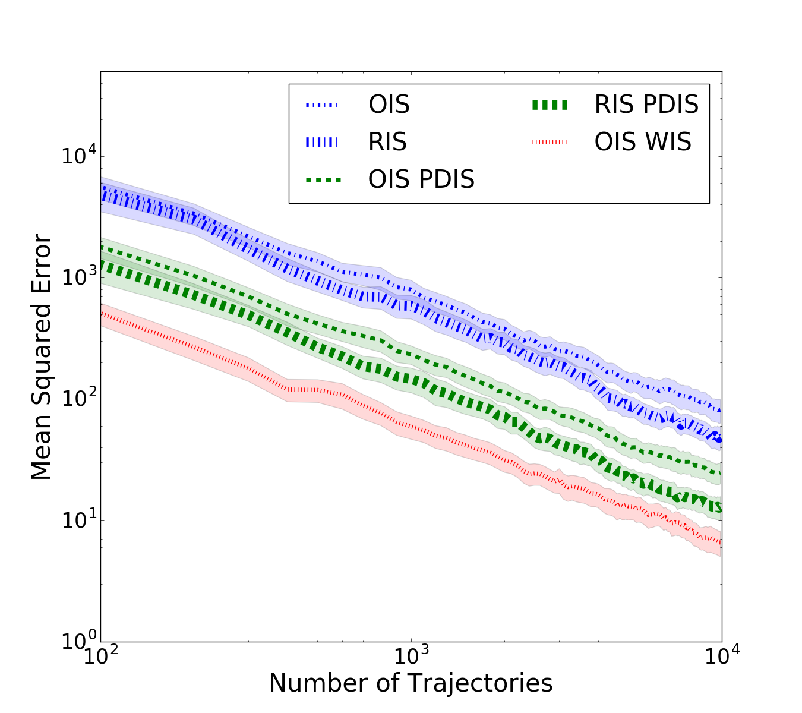
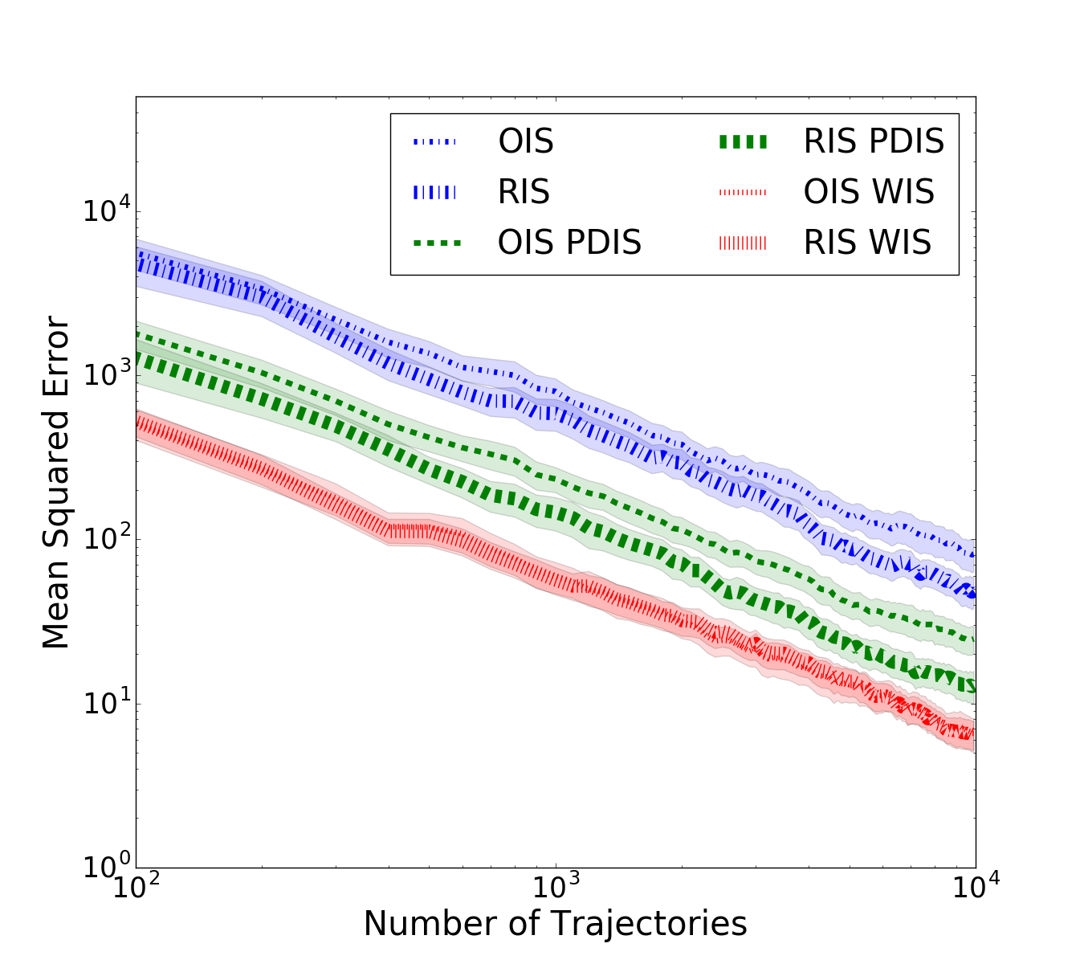
Empirical Results
Gridworld
Linear Dynamical System
Notes:
\frac{\pi(a|s)}{\mu(a|s)} \rightarrow \frac{\pi(a|s)}{\hat{\mu}(a|s)}

Slide 27
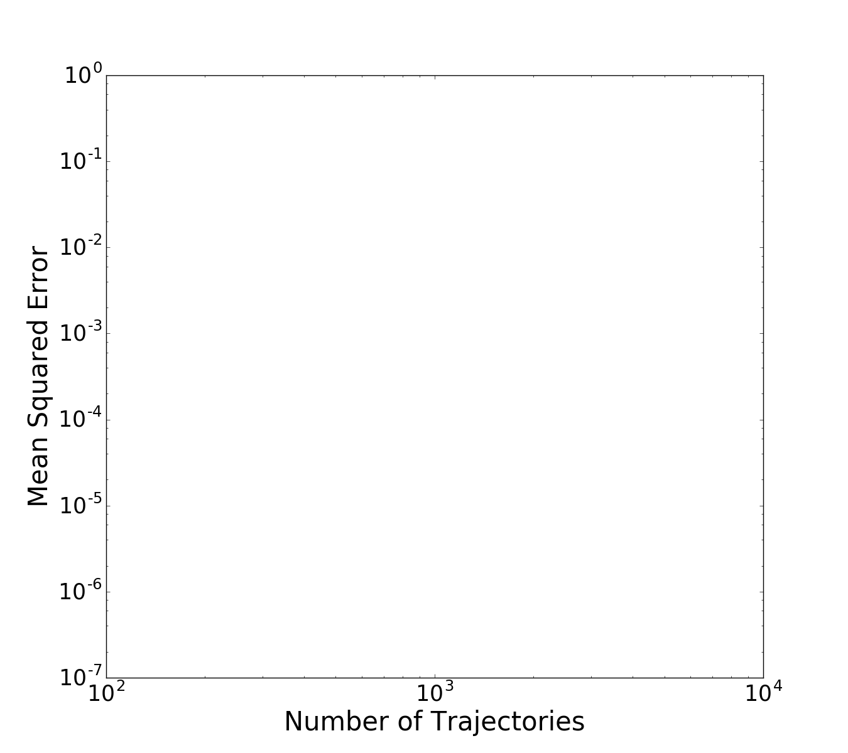
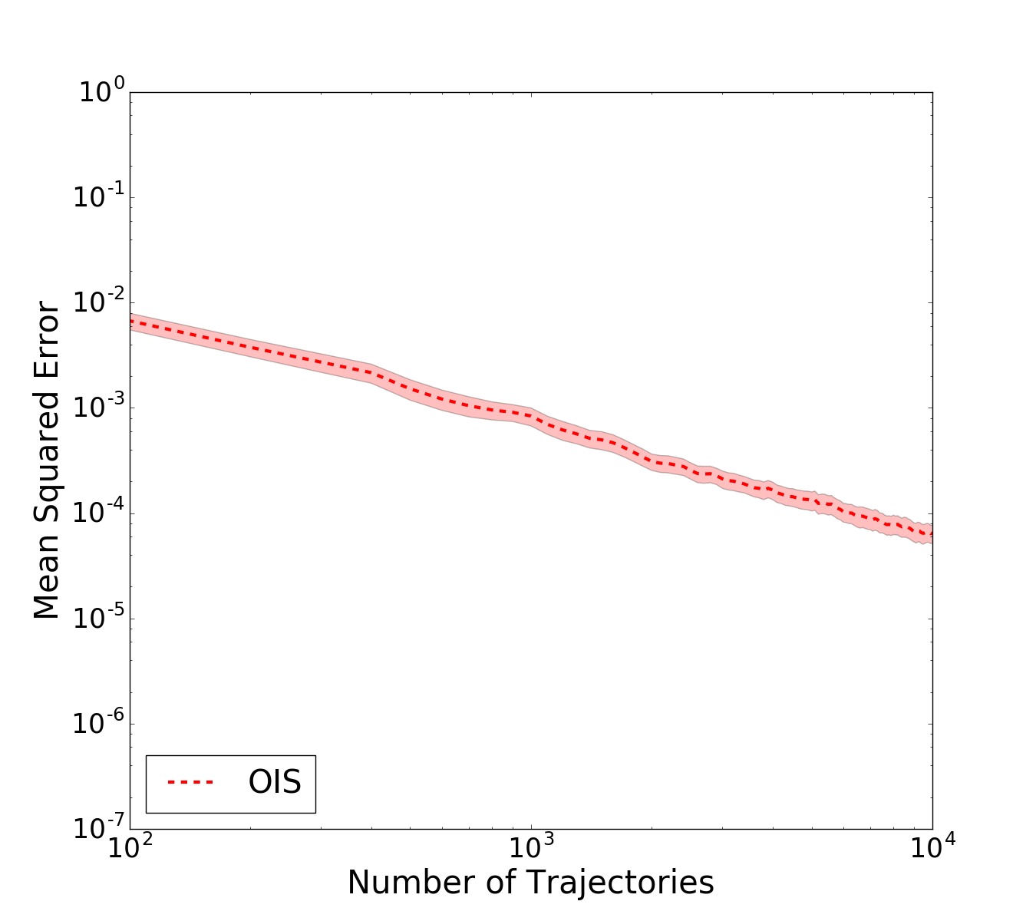
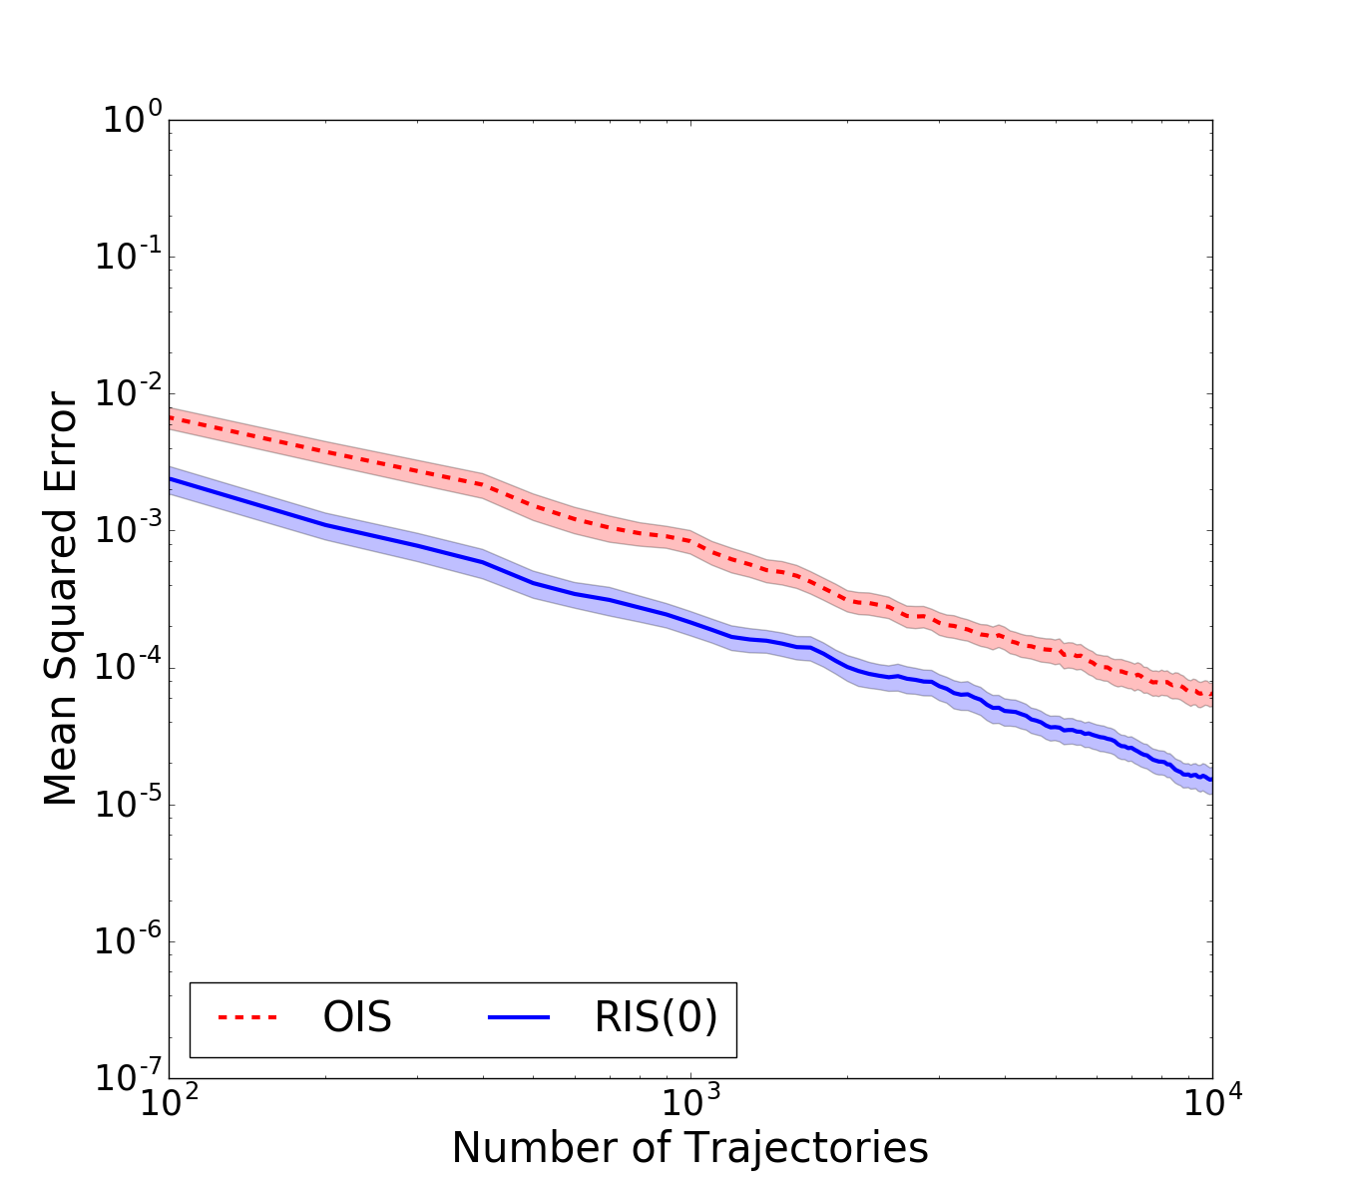
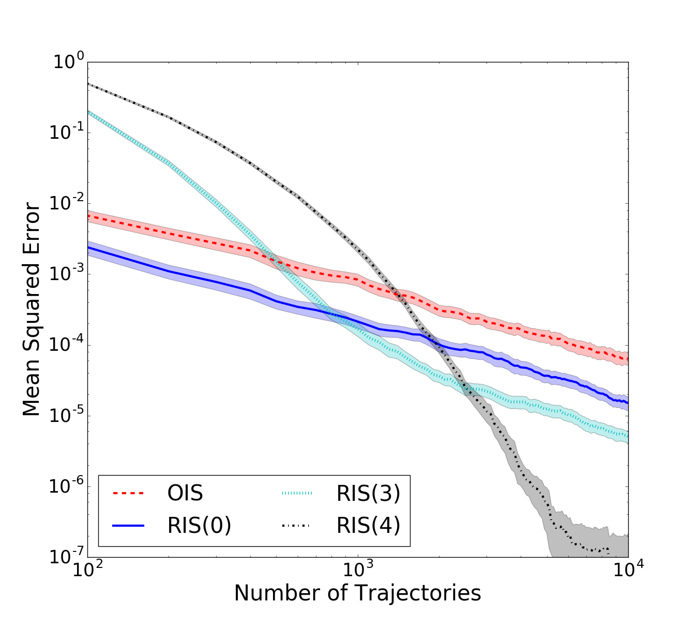
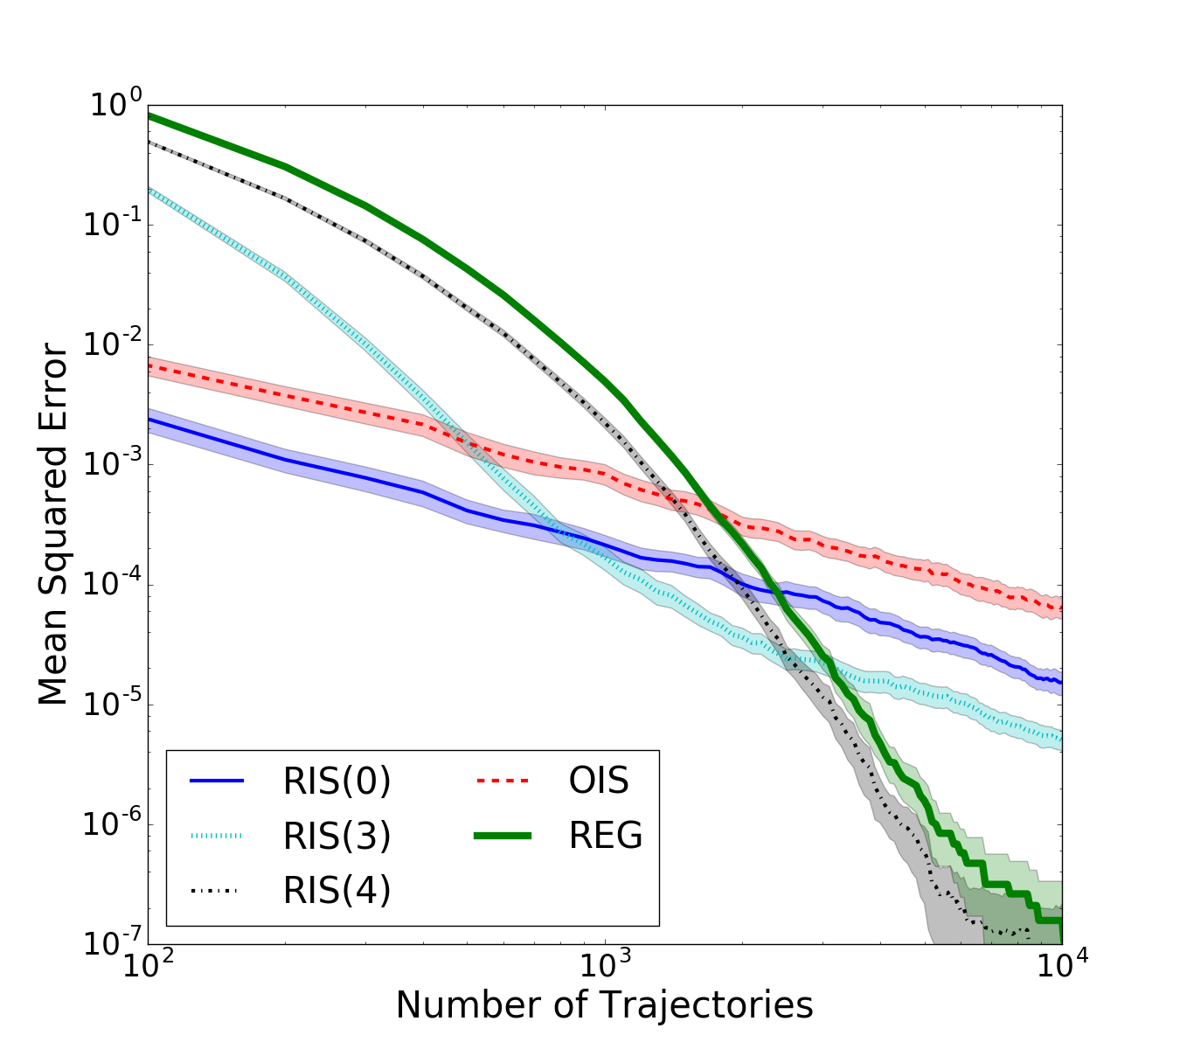
Non-Markovian Empirical Policies
SinglePath MDP (horizon of 5)
Notes:
\frac{\pi(a|s)}{\mu(a|s)} \rightarrow \frac{\pi(a|s)}{\hat{\mu}(a|s)}

Slide 28
Not Only for Off-Policy Data
Same results when behavior policy and evaluation policy are identical.
Any Monte Carlo sampling method may suffer from sampling error.
If we know the desired action probability we can potentially correct this error.
Can correcting sampling error improve other types of reinforcement learning algorithms?
Contribution 4:
Sampling error corrected policy gradient estimator that improves over Monte Carlo policy gradient estimators.
Notes:
\frac{\pi(a|s)}{\mu(a|s)} \rightarrow \frac{\pi(a|s)}{\hat{\mu}(a|s)}

Slide 29
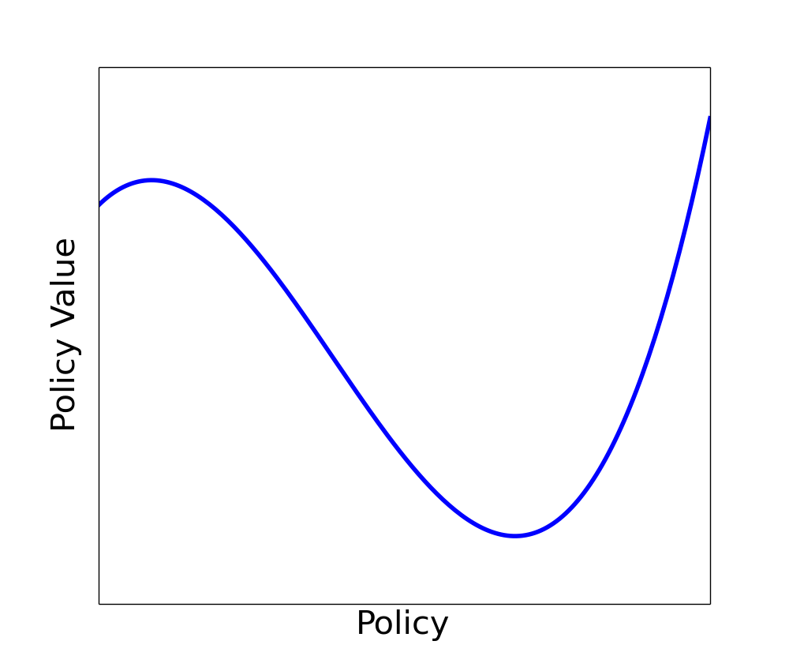


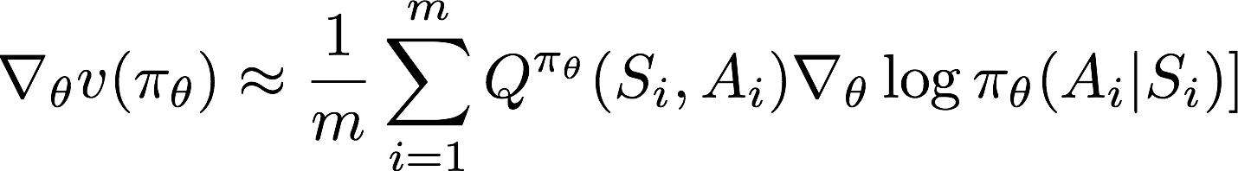
Sampling Error in Policy Gradient RL
Expected reward following S,A
Unknown
State from policy’s state distribution.
Known
Action from policy
Notes:
One of the most straightforward approaches to RL is policy gradient RL.
Visually, imagine the space of all possible policies is given along the x-axis and the y-axis is performance.
This curve tells us how good a particular policy is.
Policy gradient RL uses the gradient of the curve to decide how to change the policy to move towards a better policy.
Now, in reality the gradient cannot be analytically computed and so we must resort to estimating it.
We replace the exact expression with a sample average.
And this is fine…
With enough samples, the law of large numbers tells us our gradient estimate will point us in the right direction.

Slide 30
Monte Carlo Policy Gradient
Execute current policy for m steps.
Update policy with Monte Carlo policy gradient estimate.
Throw away observed data and repeat (on-policy).

Slide 31

Sampling Error
Action
A
Proportion = 0.15
Proportion = 0.1
Probability = 0.15
For a finite amount of data, it may appear that the wrong policy generated the data.
Probability = 0.85
Action
B
Proportion = 0.85
Proportion = 0.9
Notes:
Consider this small example and suppose the current policy samples either action with the shown probabilities.
However, after collecting a *finite* amount of data we observe the actions in a different proportion than what we would in expectation.
What this means is that it may appear that a different policy has generated our data.
We know that in the limit the proportions will converge to the true probabilities, however, in the short term this may not be the case.

Slide 32
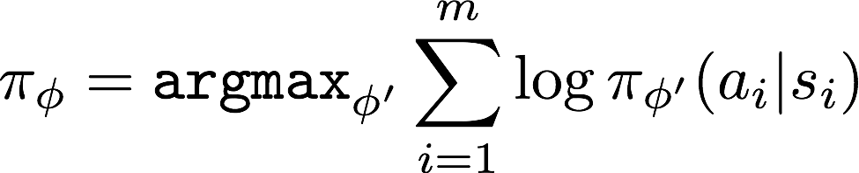
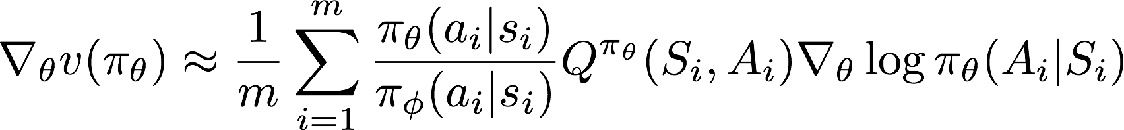
Correcting Sampling Error
Pretend data was generated by policy that most closely matches the observed data.
Correct weight on each state-action pair towards the policy we know actually took actions.
Importance Sampling Correction

Slide 33
Sampling Error Corrected Policy Gradient
Execute current policy for m steps.
Estimate empirical policy with maximum likelihood estimation.
Update policy with Sampling Error Corrected (SEC) policy gradient estimate.
Throw away data and repeat (on-policy).

Slide 34
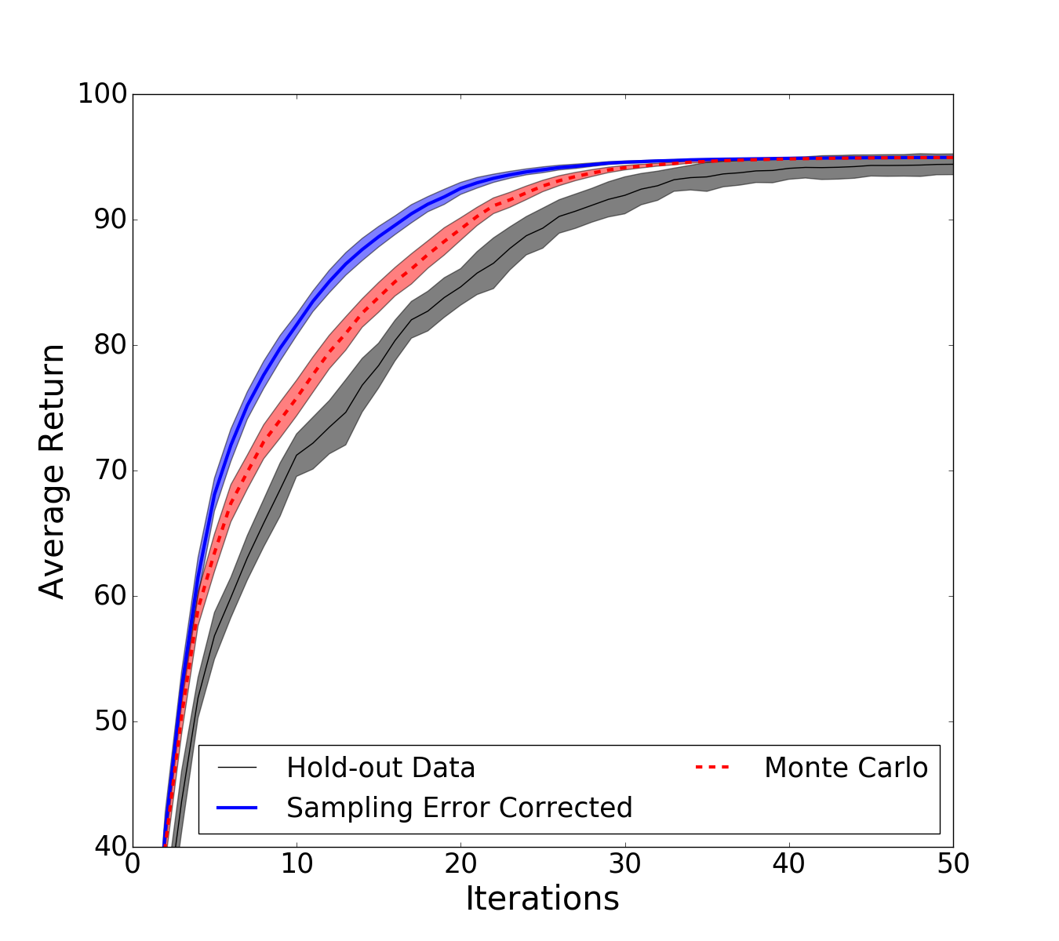
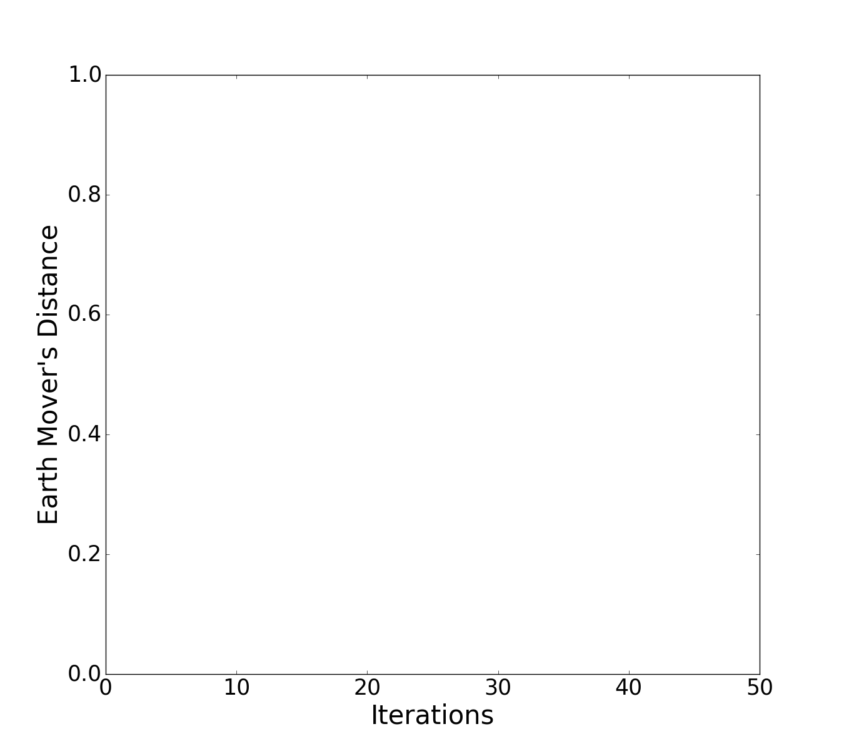
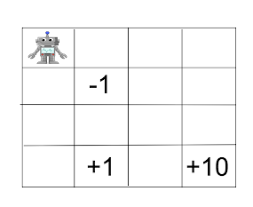
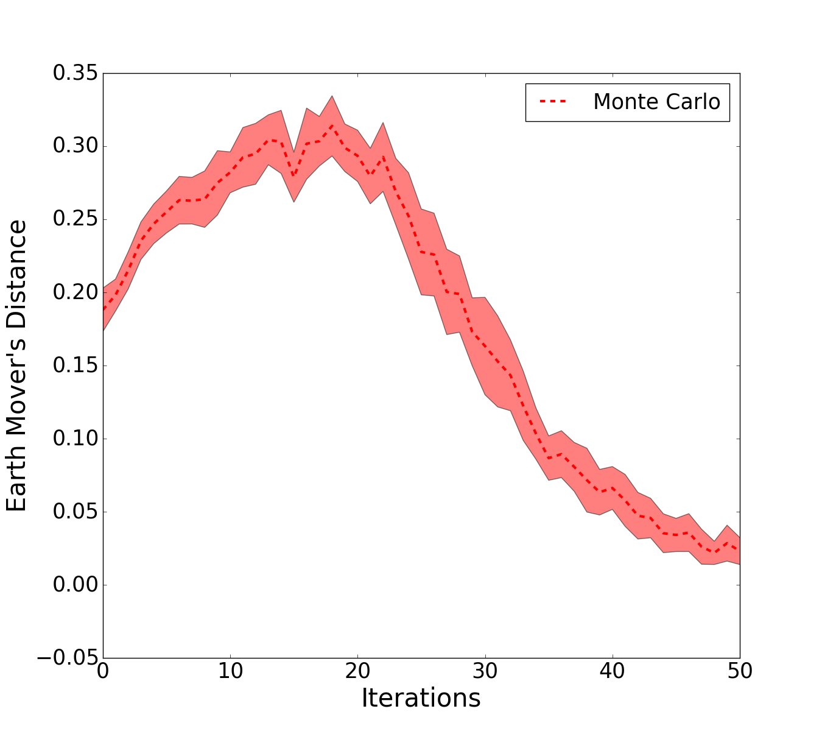
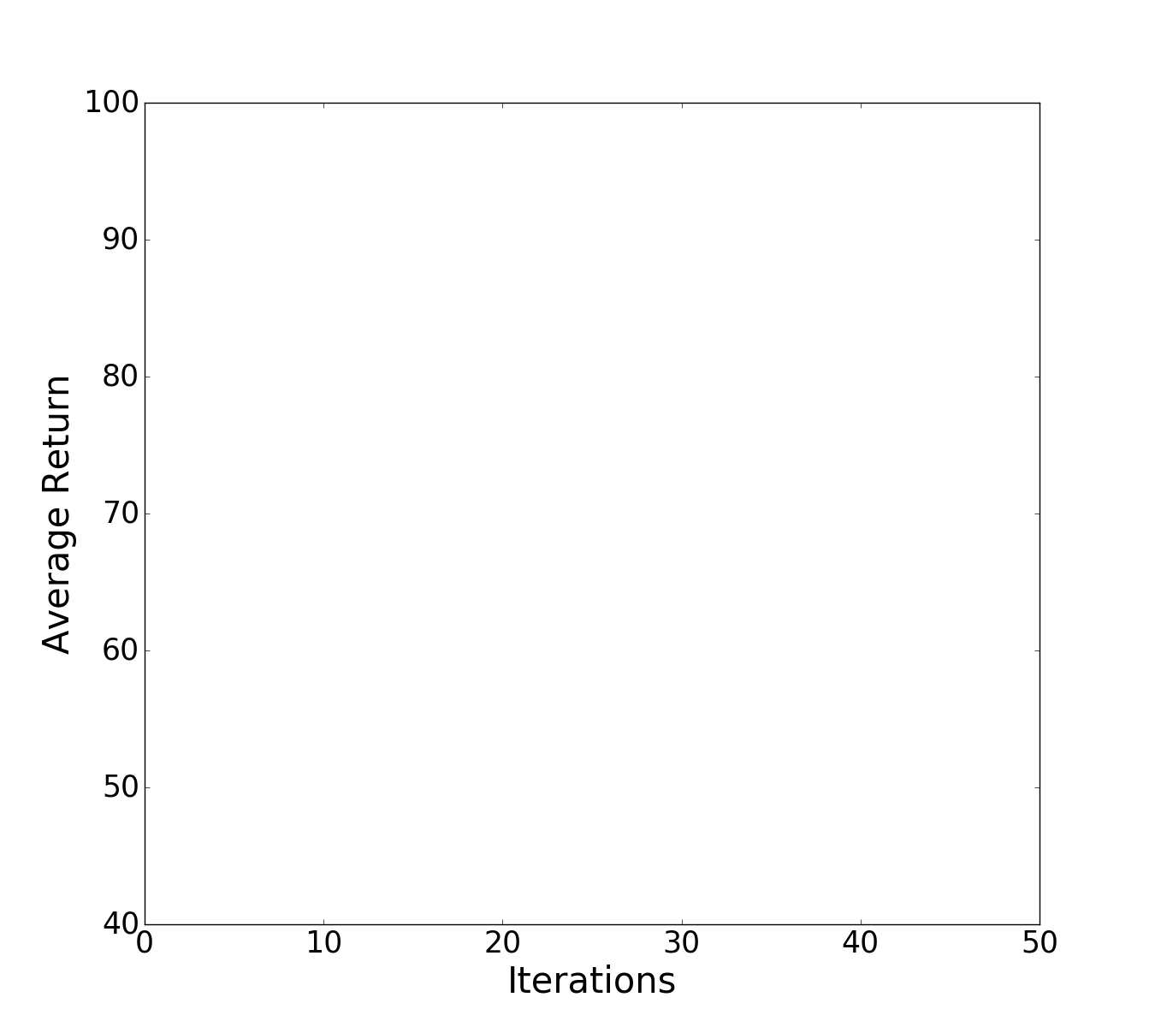
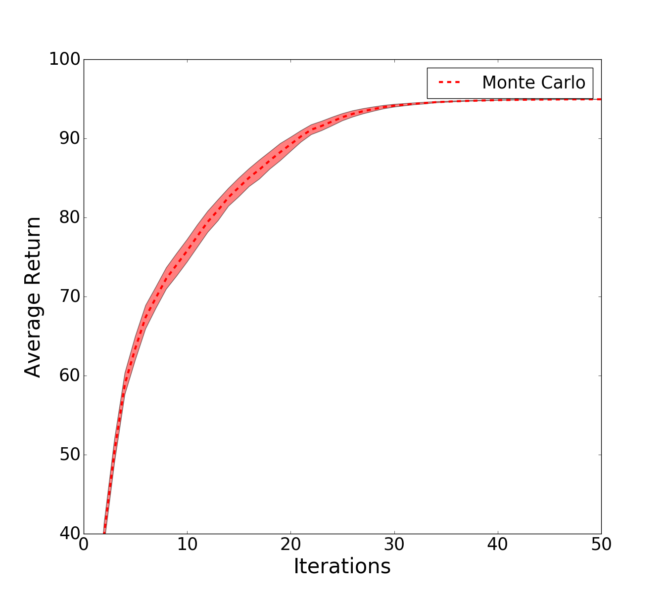
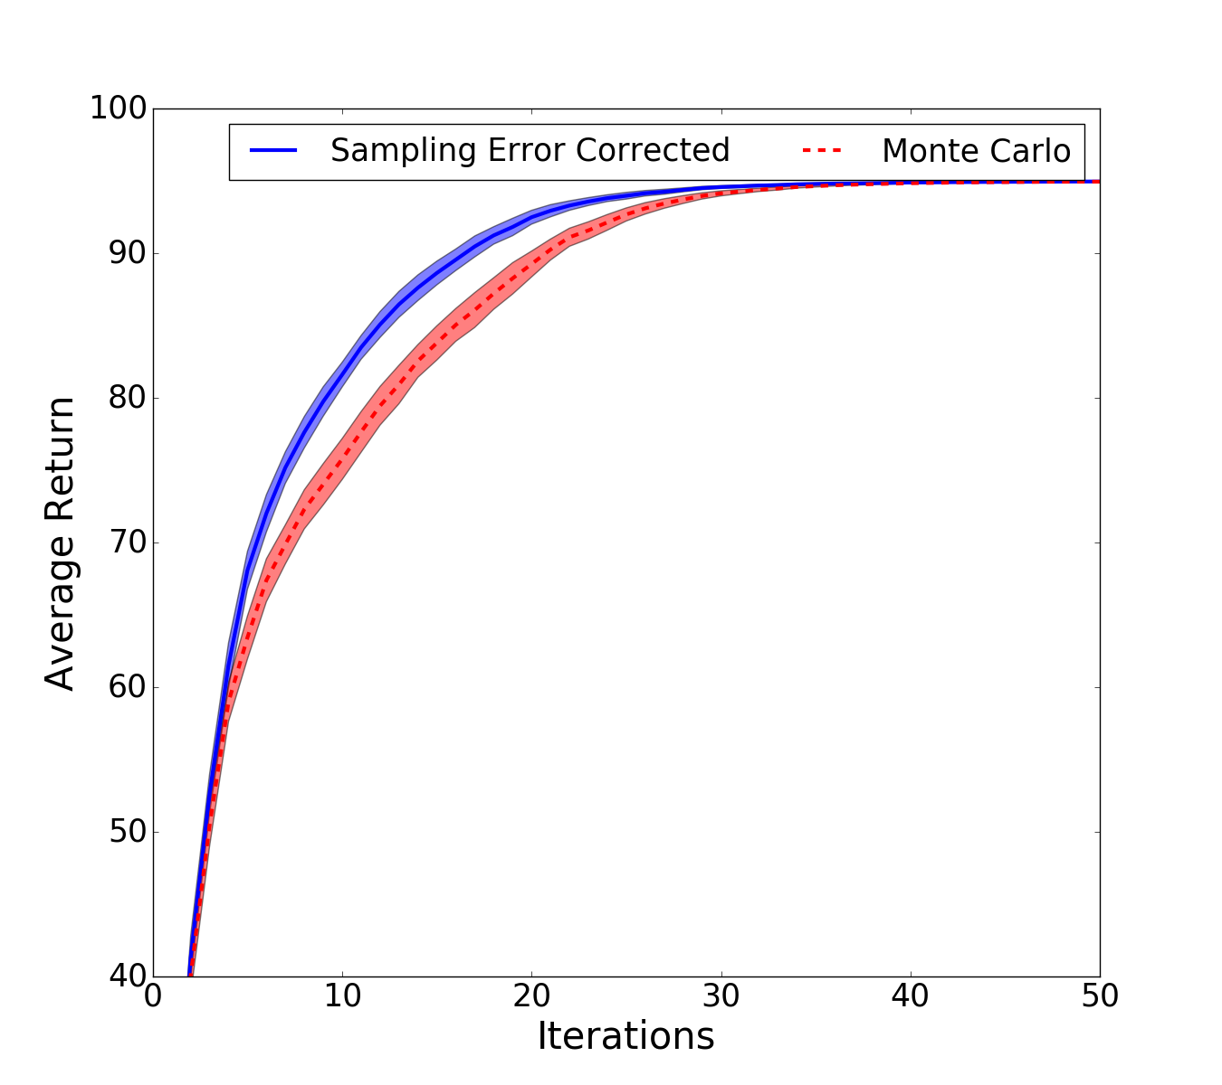
Empirical Results
GridWorld
Discrete State and Actions

Slide 35
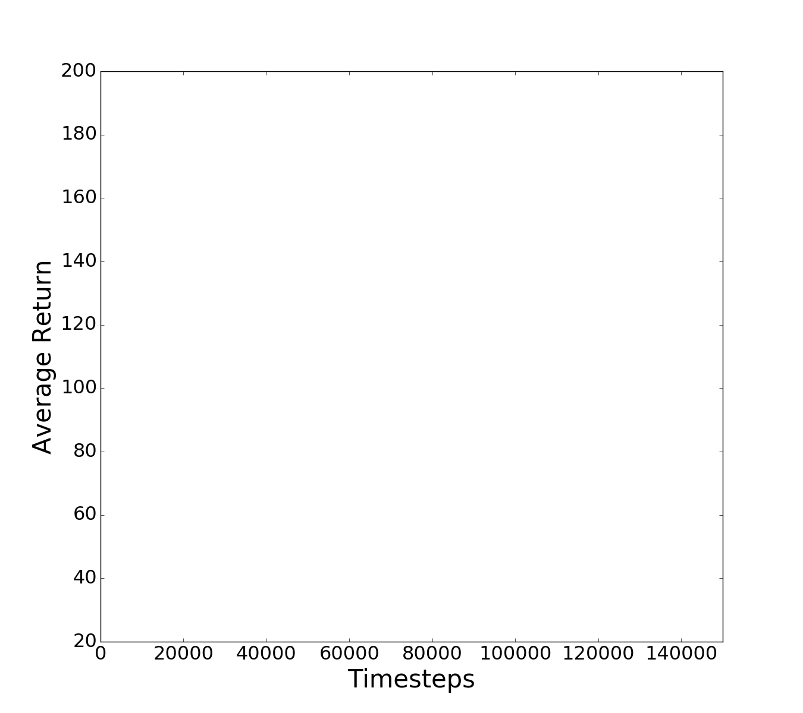




Empirical Results
Cartpole
Continuous state and discrete actions

Slide 36
Related Work
Expected SARSA (van Seijen et al. 2009).
Tree back-up methods (Precup et al. 2000, Asis et al. 2018).
Expected Policy Gradients (Ciosek and Whiteson 2018).
Estimated Propensity Scores (Hirano et al. 2003, Li et al. 2015).
Many people outside of RL + Bandits:
  Blackbox importance sampling (Liu and Lee 2017), Bayesian Monte Carlo (Gharamani and Rasmussen 2003).

Slide 37
Weighting Off-policy Data
Contribution 3: Family of regression importance sampling estimators that improve over ordinary importance sampling.
Contribution 4: Sampling error corrected policy gradient estimator that improves over Monte Carlo policy gradient estimators.
Take-away Message
It is better to estimate the behavior policy than use the true behavior policy.
Doing so corrects sampling error in policy value and policy gradient estimates.
Additional results in dissertation: Asymptotic variance analysis, consistency of RIS, additional experiments.

Slide 38
How can a reinforcement learning agent leverage off-policy and simulated data to evaluate and improve upon the expected performance of a policy?
How should an RL agent collect off-policy data?
How should an RL agent weight off-policy data?
How can an RL agent use simulated data?
How can an RL agent combine simulated and off-policy data?
Can reinforcement learning be data efficient enough for real world applications?

Slide 39

Off-Environment RL
Simulator
Notes:
But before introducing my contribution I want to describe how reinforcement learning problems are typically modelled -- if you’re already familiar with this framework, please bear with me for a few slides. This will provide a short introduction for those less familiar.
We are going to model a learning agent taking decisions in an unknown and dynamic environment.
As an application that many are familiar with, consider an autonomous vehicle:
At any moment in time the vehicle’s world is in some state: this might include where the vehicles is, what speed it is moving at, and where other vehicles and pedestrians are.
The vehicle observes the world through a number of sensors, e.g., cameras or lidar scanners.
And based on these observations, the vehicle chooses actions such as turning the steering wheel or pressing the accelerator or brakes. The actions change the state of the world which in turn changes the observations the agent will see in the future.
As I mentioned earlier, the vehicles policy tells it how to map these sensor readings to actions in order to successfully drive.
Now, “successfully drive” is a fuzzy concept. To make this more concrete for the learning agent, we define a reward that tells the agent how good or bad taking an action is in a particular state.
Interaction with the world happens over time: the vehicle receives an initial observation, chooses an action, and receives a reward. The state of the environment changes and the process repeats until a final time-step.

Slide 40



Learning in Simulation
State
Action
Notes:
The key difference is that when an action is selected the effect will be different in simulation vs. reality.

Slide 41

Grounded Simulation Learning
Simulator Grounding
Simulator Grounding
Real World State-Action Trajectories
Real World State-Action Trajectories
Real World State-Action Trajectories
Grounded Simulator
Grounded Simulator
Grounded Simulator
Real World
Policy Execution
Real World Policy Execution
Reinforcement Learning in Simulation
Reinforcement Learning in Simulation
Improved Policy
Improved Policy
Alon Farchy, Samuel Barrett, Patrick MacAlpine, and Peter Stone (AAMAS 2013)

Slide 42






How do we make simulation more realistic?
St
At
St+1
Joint Positions
Policy
State
Task Environment
Joint Commands
Simulator
Action
Josiah Hanna and Peter Stone (AAAI 2017)

Slide 43
How do we make simulation more realistic?
Joint Positions
St
At
St+1
Policy
Task Environment
Simulator
Grounding Module
Modified Joint Commands
Joint Commands
Josiah Hanna and Peter Stone (AAAI 2017)
Notes:
I’ve shown videos of simulation but I want to be a bit more specific.

Slide 44
How do we make simulation more realistic?
St
At
St+1
Policy
Joint Positions
Task Environment
Simulator
Choose action that causes same effect in simulation.
Predict real world effect.
Modified Joint Commands
Joint Commands
Josiah Hanna and Peter Stone (AAAI 2017)
Notes:
I’ve shown videos of simulation but I want to be a bit more specific.

Slide 45




NAO Walking
Josiah Hanna and Peter Stone (AAAI 2017)

Slide 46


Sim-to-sim transfer: Learning Arm Control
NAO robot learning to move arm joints to target position.
Transfer from Simspark simulator to Gazebo simulator.

Slide 47


Learning to walk with less prior knowledge

Slide 48
Learning with Simulated Data
Take-away Message
Modifying the policy’s actions can correct discrepancy between simulation and reality.
Contribution 5: Grounded action transformation algorithm allowing an RL agent to learn from simulated data.
Additional results in dissertation: Bound on error in model-based policy value estimation, additional empirical results.
Notes:
Sum up past work and say where I’m going (same comments as IS conclusion).
Just summarize what I did and make sure leave them with one thing.

Slide 49
How can a reinforcement learning agent leverage off-policy and simulated data to evaluate and improve upon the expected performance of a policy?
How should an RL agent collect off-policy data?
How should an RL agent weight off-policy data?
How can an RL agent use simulated data?
How can an RL agent combine simulated and off-policy data?
Can reinforcement learning be data efficient enough for real world applications?

Slide 50
Combining Simulated and Off-Policy Data
Contribution 6: Model-based bootstrap algorithm for approximate high confidence off-policy value estimation.
Contribution 7: Weighted doubly robust bootstrap algorithm for approximate high confidence off-policy value estimation.
Notes:
Sum up past work and say where I’m going (same comments as IS conclusion).
Just summarize what I did and make sure leave them with one thing.

Slide 51
How can a reinforcement learning agent leverage off-policy and simulated data to evaluate and improve upon the expected performance of a policy?
How should an RL agent collect off-policy data?
How should an RL agent weight off-policy data?
How can an RL agent use simulated data?
How can an RL agent combine simulated and off-policy data?
Can reinforcement learning be data efficient enough for real world applications?

Slide 52
Future Directions
Hierarchical sim-to-real.
Optimal sampling for regression importance sampling.
From policy value estimation to policy evaluation.

Slide 53


Learning in an abstract simulation
Notes:
Construct abstract model.
Given abstract model, identify what can be learned and what can be transferred.
Causal reasoning
Abstraction as variance reduction

Slide 54






Optimal sampling for regression importance sampling
50-armed bandit with stochastic rewards.
RIS needs to observe every arm!

Slide 55

Value function learning with RIS and BPG
Collecting data:
What is optimal behavior policy with changing value function?
Weighting data:
How to estimate behavior policy during online learning?
Notes:
Learned point estimate
Can we learn value for all states?
%v_{t+1}(S_t) \leftarrow v_t(S_t) + \alpha ( U_t - v_t(S_t))
%
%U_t = \frac{\pi(A_t|S_t)}{\pi_b(A_t | S_t)} (R_t + v_t(S_{t+1}))

Slide 56






Acknowledgments
Scott Niekum
Phil Thomas
Xiang Gu
Peter Stone
Notes:
Before finishing I want to thank my collaborators:
In particular, my adviser Peter Stone who has been involved with all of the work I presented today, Scott Niekum and Phil Thomas collaborated with us on the work presented in the first part of the talk.
And I’ve had the privilege to work with a number of other people on research that I wasn’t able to cover today.

Slide 57




How can a reinforcement learning agent leverage off-policy and simulated data to evaluate and improve upon the expected performance of a policy?
How should an RL agent collect off-policy data?
How should an RL agent weight off-policy data?
Collect off-policy data.
ICML 2017
AAAI SS 2018
AAMAS 2019
ICML 2019
How can an RL agent use simulated data?
How can an RL agent combine simulated and off-policy data?
AAAI 2017
AAMAS 2017

