Slide 1
A formal proof of a necessary and sufficient condition for deadlock-free adaptive networks
Interactive Theorem Proving
11-07-2010
Freek Verbeek & Julien Schmaltz

Slide 2
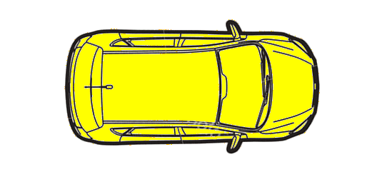
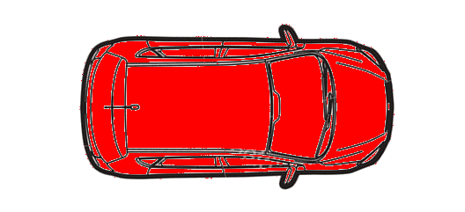
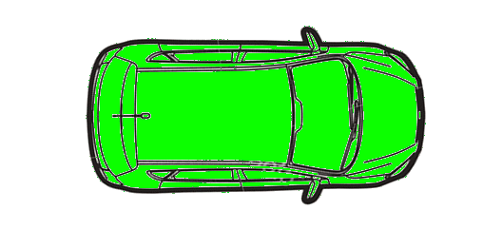
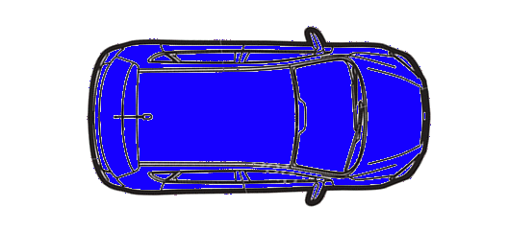
Deadlocks: circular wait

Slide 3
Deadlocks: resources

Slide 4
Deadlocks: dependencies
B
A

Slide 5
Resource dependency graph

Slide 6
Deadlocks: circular wait?
C
B
A

Slide 7
Resource dependency graph

Slide 8
Necessary and sufficient condition
A cyclic dependency graph is only sufficient
Duato was the first to define a necessary and sufficient condition
Duato’s theorem was “complex, counter-intuitive and disruptive”

Slide 9
Necessary and sufficient condition
A cyclic dependency graph is only sufficient
Duato was the first to define a necessary and sufficient condition
Duato’s theorem was “complex, counter-intuitive and disruptive”
A simple, easy to understand and formally proven correct condition for adaptive routing.

Slide 10
Necessary and sufficient condition
A network is deadlock-free if and only if all sets of cycles have an escape.

Slide 11
Escape
C
B
A

Slide 12
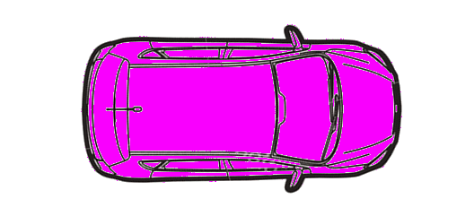
No escape
C
B
A

Slide 13
Necessary and sufficient condition
All sets of cycles must have an escape.
No deadlock
Deadlock
No deadlock
Deadlock

Slide 14
Necessary and sufficient condition
All sets of cycles must have an escape
No deadlock

Slide 15
Necessary and sufficient condition
No deadlock

Slide 16
Interconnection Networks
Interconnection network consists of:
Nodes
n₀
n₁
n₂
n₃
n₄
n₅

Slide 17
Interconnection Networks
Interconnection network consists of:
Nodes
Channels
c₀
c₁
n₀
n₁
n₂
c₂
c₃
c₄
n₃
n₄
n₅
c₅
c₆

Slide 18
Interconnection Networks
Interconnection network consists of:
Nodes
Channels
Routing function
c₀
c₁
n₀
n₁
n₂
R(n₀,n₅)=c₀
R(n₁,n₅)={c_{3,} c₁}
c₂
c₃
c₄
n₃
n₄
n₅
c₅
c₆

Slide 19
Interconnection Networks
Interconnection network consists of:
Nodes
Channels
Routing function
Packet switching
c₀
c₁
n₀
n₁
n₂
c₂
c₃
c₄
n₃
n₄
n₅
c₅
c₆

Slide 20
Formalization of deadlock
A configuration σ is a list of messages and their current channels.
Network:
Configuration:
Message | Destination | Current channel
 | n₅ | c₀
 | n₂ | c₀
 | n₁ | c₆
c₀
c₁
n₀
n₁
n₂
c₂
c₃
c₄
n₃
n₄
n₅
c₅
c₆

Slide 21
Formalization of deadlock
A deadlock is a configuration where all messages are stuck.
c₀
c₁
n₀
n₁
n₂
c₂
c₃
c₄
n₃
n₄
n₅
c₅
c₆

Slide 22
Formalization of deadlock
A deadlock is a configuration where all messages are stuck.
A message is stuck if all its next hops are unavailable.
c₀
c₁
n₀
n₁
n₂
c₂
c₃
c₄
n₃
n₄
n₅
c₅
c₆

Slide 23
Formalization of deadlock
A deadlock is a configuration where all messages are stuck.
A message is stuck if all its next hops are unavailable.
((encapsulate
(((unav * *) => *))
(((dl *) => *))
(defthm deadlock<=>unav-next-hops
(iff (dl σ)
(unav (next-hops (msgs σ)) σ)))
(defthm unav==>free-channel
(implies (unav channels σ)
(free channels σ))))

Slide 24
Formalization of deadlock
A network is deadlock-free iff there exists no deadlock-configuration.
(defun-sk E-deadlock
(exists (σ)
(and (legal-configp σ)
(deadlock-configp σ))))

Slide 25
Formalization of condition
(defun-sk E-escape (cycles)
(exists (channel)
(and (member channel cycles)
(A-dests-E-neighbor-outside channel cycles))
(defun-sk A-cycles-E-escape
(forall (cycles)
(implies (and (consp cycles)
(dep-cyclesp cycles))
(E-escape cycles))))

Slide 26
Formalization of condition
(defthm correctness-of-condition
(iff (not (E-deadlock))
(A-cycles-E-escape)))

Slide 27
Proof of correctness
Condition --> Deadlock:
Define function that creates a legal deadlock from a set of cycles without an escape:
Proof correctness of this function.
Message | Destination | Current channel
m₀ | d₀ | c₀
m₁ | d₁ | c₁
m₂ | d₂ | c₂

Slide 28
Proof of correctness
Deadlock --> Condition:
Define function that creates a set of cycles without an escape from a deadlock:
Proof correctness of this function.
Message | Destination | Current channel
m₀ | d₀ | c₀
m₁ | d₁ | c₁
m₂ | d₂ | c₂

Slide 29
Conclusions
A correct, simple and formal condition for adaptive routing in packet switching networks
Formal proof helped us understanding Duato’s condition
Used defun-sk and defspec to elegantly define theorems
Application: turn model in 2D Meshes

Slide 30
Future work
Do a similar proof for wormhole networks
Create a formally verified algorithm deciding deadlock-freedom

Slide 31
Questions?

Slide 32
Second order existential quantification
A defspec construct does second order universal quantification
Our approach: represent function f in an alist.

Slide 33
Second order existential quantification
Given domain D and predicate p:
(defun-sk A-x-in-D-p (f D)
(forall (x)
(implies (member x D)
(p (cdr (assoc f x))))))
(defun-sk E-f-st-A-x-in-D-p (D)
(exists f
(and (alistp f)
(A-x-in-D-p (f D)))))

