Slide 1
On the Formalization of the Lebesgue
Integration Theory in HOL
T. Mhamdi, O. Hasan and S. Tahar,
HVG, Concordia University
Montreal, Canada
July 2010

Slide 2
Outline
Introduction
Related Work
Measure Theory
Borel Sigma Algebra
Lebesgue Integration
Applications
Conclusion and Future work
2

Slide 3
Introduction
Fundamental concept in many mathematical theories
Real Analysis
Probability theory
Information theory
Model and reason about continuous and unpredictable components of physical systems.
Lebesgue Integral
Probability theory
Expectation
Variance
Density functions
Information theory
Entropy
Relative Entropy
KL divergence
Physical systems
3

Slide 4
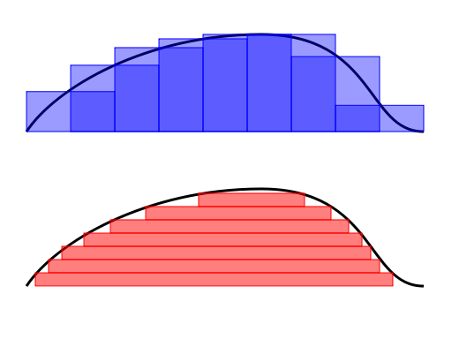
Introduction
Advantages of the Lebesgue integral
Handles a larger class of functions
Better behavior for interchanging limits and integrals
Unified definition for discrete and continuous cases
Defined for arbitrary measures
Reimann Integral: partition the domain
Lebesgue Integral: partition the range
4

Slide 5
Related Work
Hurd (PhD Thesis, Cambridge UK)
Formalization of measure theory in HOL
A measure space is a pair (A,µ)
The space is implicitly the universal set of the appropriate type.
Restriction of the measure spaces that can be constructed.
To apply the formalization for an arbitrary space X, a new HOL type should be defined as well as operations on this type and their properties must be proven.
Considerable effort that needs to be done for every space of interest.
5

Slide 6
Related Work
Richter (TPHOLs'08)
Formalized measure theory in Isabel/HOL based on Hurd’s.
Same limitation as the work of Hurd.
Defined the Borel sigma algebra based on the intervals and used it to formalize the Lebesgue integral.
We provide a formalization that is based on the open sets: Can be used for any topological space: real numbers, complex numbers, n-dimensional Euclidian space,…
6

Slide 7
Related Work
Hasan (Mathematical Methods in the Applied Sciences - 2006)
Builds on top of Hurd’s work
Formalized continuous random variables
Formalized statistical properties for discrete random variables.
Valid for specific distributions.
Case studies (coupon collector's problem, stop-and-wait protocol).
7

Slide 8
Related Work
Coble (PhD Thesis, Cambridge UK)
Generalized the measure theory of Hurd
A measure space is a triplet (X,A,µ)
Formalized the Lebesgue integral
Proved properties of the Lebesgue integral only for positive simple functions.
Formalization does not include the Borel sigma algebra.
No properties of measurable functions.
No properties of the Lebesgue integral for arbitrary functions.
8

Slide 9
Proposed Solution
Formalize of the measure theory based on the work of Coble.
Extend it by formalizing the Borel sigma algebra.
Borel Sigma algebra is generated by the open sets.
We prove that our definition is equivalent to the definition of Richter in the special case where the space is the set of real numbers.
Using the formalization of the Borel sigma algebra, we prove
properties of real-valued measurable functions
properties of the Lebesgue integral
9

Slide 10
Measure Theory
Basic definitions
Sigma Algebra: A collection A of subsets of a space X defines a sigma algebra on X iff its contains the empty set and is closed under countable unions and complementation within the space X
Measurable Space (X,A)
Measure Function
Measure Space (X,A,µ)
Measurable Functions
Generated Sigma Algebra σ(X,G)
10

Slide 11
Borel Sigma Algebra
Definition
The Borel sigma algebra on X is the sigma algebra generated by the open sets of X.
Example: Borel sigma algebra on the real line B(R).
Theories needed to formalize B(R)
Topology: to define the notions of neighborhoods, open sets and prove necessary theorems.
Rational Numbers: to prove the properties of real-valued measurable functions.
11

Slide 12
Borel Sigma Algebra
Topology
A formalization of some concepts of topology is available in HOL
Developed by John Harrison.
It does not use the set theory operations (SUBSET, UNION, INTER, …)
It does not include needed theorems.
A much more complete theory was developed by John Harrison for Hol Light.
We formalized the notions of neighborhoods, open sets and proved some of their properties.
12

Slide 13
Borel Sigma Algebra
Neighborhood:
Open set of R:
The inverse image of an open set by a continuous function is open
Any open set of R can be written as a countable union of open intervals.
The formalization is not complete, we developed only the concepts we needed.
13
Notes:
13

Slide 14
Borel Sigma Algebra
Rational Numbers
The main results that we need are:
The set of rational numbers is countable, infinite
The set of rational numbers is dense is R:
For all x,y in R such that x < y, there exists a rational number r such that x < r < y
The set of open intervals with rational end-points is countable.
Q as a subset of R.
None of this is available in the existing rational theory in HOL.
14
Notes:
14

Slide 15
Borel Sigma Algebra
Rational Numbers
Set of rational numbers:
Properties of rational numbers: -x, x+y, x*y, 1/y, x/y
Q is dense in R:
The formalization is fairly rich.
15
Notes:
15

Slide 16
Borel Sigma Algebra
Theorem: B(R) is generated by the open intervals ]c,d[.
It is also generated by any of the following classes of intervals ]-∞,c[, [c,+∞[, ]c,+∞[, ]-∞,c],
[c,d[, ]c,d], [c,d].
Theorem (real-valued measurable functions):
Let (X,A) be a measurable space, A function f: X→R is measurable with respect to (A,B(R)) iff f-1(]-∞,c[) ϵ A, for all c ϵ R.
16

Slide 17
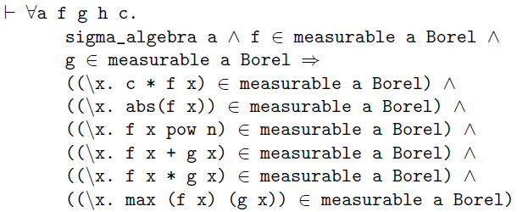
Borel Sigma Algebra
Properties of real-valued measurable functions
If f and g are measurable, then the following functions are also measurable:
cf, |f|, f^{n}, f+g, fg, max(f,g)
- Most challenging property: sum of measurable functions
- Main reason we formalized the rational numbers.
17
Notes:
17

Slide 18
Borel Sigma Algebra
Properties of real-valued measurable functions
Every continuous function g: R → R is (B(R),B(R)) measurable.
If g: R → R is continuous and f is (A,B(R)) measurable then so is g o f.
If (f_{n}) is a monotonically increasing sequence of real-valued measurable functions with respect to (A,B(R)) and point-wise convergent to a function f then f is also (A,B(R)) measurable.
18
Notes:
18

Slide 19
Lebesgue Integral
Positive Simple Functions
Lebesgue Integral of Positive Simple Functions
Lebesgue Integral of non-negative Functions
Lebesgue Integral of Arbitrary Functions
where,
and
19

Slide 20
Lebesgue Integral
Definition: Lebesgue Integrable Functions
Let (X,A,µ) be a measure space, a measurable function f is integrable iff
Equivalently,
Problem:
Not possible to prove some of the Lebesgue integral properties using the definition.
Solution:
Prove the properties for positive simple functions.
If g is a non-negative function, find a sequence of positive simple functions that is pointwise convergent to g.
Extend the properties to non-negative functions.
Extend the properties for the non-negative functions f⁺ and f⁻ to arbitrary functions.
20

Slide 21
Lebesgue Integral
Theorem: Integrability Theorem
For any non-negative integrable function f, there exists a monotonically increasing sequence of positive simple functions (f_{n}) that is pointwise convergent to f.
Besides,
Proof:
Pointwise convergence
Monotonicity
Upper bound
21

Slide 22
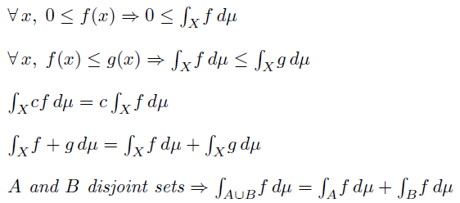
Lebesgue Integral
Lebesgue Integral Properties
Let f and g be integrable functions and c ϵ R, then
Issue: Some properties does not require integrable functions.
22

Slide 23
Lebesgue Integral
Lebesgue Monotone Convergence
Let f be an integrable function and (f_{n}) be a monotonically increasing sequence of non-negative functions, point-wise convergent to f then
Almost Everywhere
Definition: A property is true almost everywhere relative to the measure µ, iff the subset where the property does not hold is a null set.
For example: f = g a.e. when the set is a null set.
Theorems:
A is a null set
f = g a.e.
f ≤ g a.e.
23

Slide 24
Applications
We prove important properties from the theory of probability, namely, the Chebyshev and Markov inequalities and the Weak Law of Large Numbers.
Provide estimates of tail probabilities.
The Chebyshev inequality guarantees that nearly all values are close to the mean.
The Markov inequality provides loose yet useful bounds for the CDF.
The WLLN is used in a multitude of fields. It is used, for instance, to prove the Asymptotic Equipartition Property, a fundamental concept in information theory.
24

Slide 25
Applications
Let X be a random variable with expectation m and finite variance σ². Then for all k > 0,
Chebyshev Inequality
Markov Inequality
Theorem: Let (S,A,µ) be a measure space and f a measurable function defined on S. Then for any non-negative function g, non-decreasing on the range of f, then for all t>0,
25

Slide 26
Applications
Chebyshev Inequality
t = k σ
f = |X-m|
g(t) = t² if t ≥ 0 and 0 otherwise.
Markov Inequality
t = k
f = |X|
g(t) = t if t ≥ 0 and 0 otherwise.
Weak Law of Large Numbers
Let X₁,X₂,… be a sequence of iid random variables with finite expectation m. Let , then for any ,
Proof: Chebyshev inequality, Properties of the Expectation and Variance
26

Slide 27
Conclusion
Measure Theory
Borel Sigma Algebra
Properties of real-valued measurable functions
Lebesgue Integration
Properties of Lebesgue Integral
Classical inequalities
Weak Law of Large Numbers
Formalization required more than 7000 lines of code.
Only 250 lines to verify the properties of the applications section
~400 man hours.
27

Slide 28
Ongoing and Future Work
Radon Nikodym Theorem
Asymptotic Equipartition Property
Source Coding Theorem
28

Slide 29
Thank you!
http://hvg.ece.concordia.ca
29
Notes:
29

