Slide 1
Beltway: Getting Around Garbage Collection Gridlock
Mrinal Deo
CS395T Presentation
March 2, 2011

Slide 2
Introduction
2004 – close to 40 years of research in GC.
Many New GC algorithms proposed.
Cherry-pick the best features and fine tune them. Why??
GC performance is not that intuitive.

Slide 3
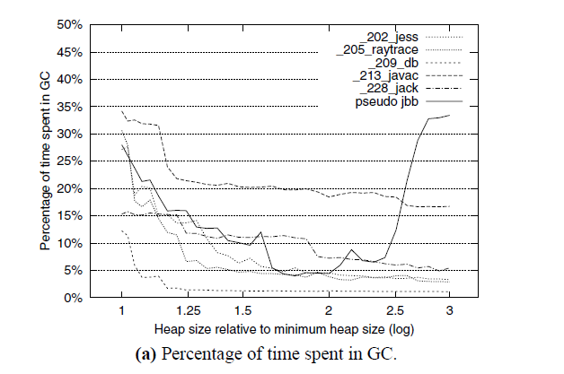
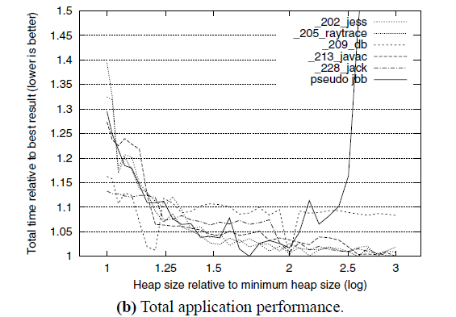

Motivation

Slide 4
5 Key Ideas in Copying GC
Generational hypothesis (Ungar, Lieberman/Hewitt)
  Young objects: most die, so collect frequently
  Old objects: most live, so collect infrequently
Older-first principle (Stefanovic/McKinley/Moss)
  Give objects as much time to die as possible
Incrementality improves responsiveness
Copying GC can improve locality
Can one GC incorporate them all?

Slide 5
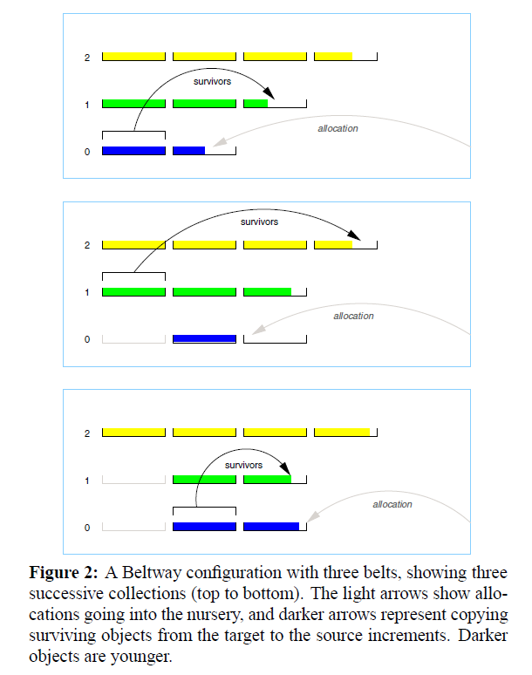
Beltway Collector
* Increments, Belts , FIFO

Slide 6
A Simple Example
Belt
0
1
1
2
3
4
5
6
7
0
2
3
4
5
6
7
8
2
1
2
3
4
5
6
7
3
4
5
6
7
8
9
Increments
Notice:
  Need for copy reserve (rightmost increment)
  Corresponds to “OF-Mix” GC [Stefanovic 99]
  Semi-Space (degenerate form, 2 increments)
Notes:
Incompleteness (w.r.t. cross-increment cycles)

Slide 7
A More Interesting Example
1
2
3
etc. etc. …
2
3
4
4
5
6
7
8
0
5
6
7
8
9
0
1
1
2
2
3
3
4
4
5
5
6
6
7
7
33
0
34
34
1
35
2
36
3
37
4
38
5
39
6
40
35
36
37
38
39
40
7
1
2
3
4
5
6
7
41
8
Notice:
  Generational & older first principles
  Still incomplete
This heap organization is Beltway X.X
  X is the increment size (e.g. Beltway 20.20 or Beltway 14.14)
Beltway 100.100 = Appel-style generational
Rules:
  Only N increments available (N=8 here)
  Must reserve one for copying
  Always collect leftmost, lowest full increment

Slide 8
Completeness
0
1
3
4
5
6
7
8
9
10
33
34
35
36
37
38
39
40
Add a third belt (“Beltway X.X.100”)
  Large increment (100% of available)
  Only collect third belt when it is full
    Reduce incrementality, gain completeness

Slide 9
Efficient Implementation
Crucial issues:
  Write barrier cost (consequence of incrementality)
  Knowing when to collect
  Minimizing ‘copy reserve’ overhead

Slide 10
New Mechanisms
Frames
  Incrementality with cheap write barrier
  One for each <source, target> frame pair
Dynamic, conservative copy reserve
  Only reserve as much as necessary
GC triggers
  Don’t necessarily collect only when full
Remembered sets
  One for each <source, target> frame pair
    2^{n}-aligned contiguous virtual memory space
    Accommodates an increment*
    Allows fast inter-increment w/b
2^{f}
7x2^{f}
8x2^{f}
9x2^{f}
10x2^{f}
increment
frame

Slide 11
Experimental Results!
New garbage collector toolkit
6 SPEC benchmarks, best time of 5 runs, 33 heap sizes!
Try fixed and variable nurseries
Beltway robust against heap sizes
MMU & responsiveness
  Time utilized by mutator, taken by collector

Slide 12
Discussion
Should we use Copying or MS for the nursery.
Would Beltway work concurrently?
Is Beltway parallelizable?
How would this do with cache/paging?
Why was Beltway not ubiquitously adopted?
  Tuning X?

Slide 13
Problems
Could copy very old objects many times
Requires 3rd belt for completeness
  Mature Object Space = completeness w/o whole heap collection
Beltway X.X doesn’t do older-first
Beltway uses fixed nursery, but variable better

