Slide 1
MC²: High Performance GC for Memory-Constrained Environments
N. Sachindran, E. Moss, E. Berger
Ivan Jibaja
CS 395T
*Some of the graphs are from presentation by S. Narayanan

Slide 2
Motivation
Handheld Devices
Cellular phones, PDAs widely used
Diverse applications
Media players, Video Games, Digital cameras, GPS
Ideally:
High throughput
Short response time
Better memory utilization (Constrained memory)

Slide 3
Review: Generational Collection
Divide heap into regions called generations
Generations segregate objects by age
Focus GC effort on younger objects
Nursery
Old Generation

Slide 4
Generational Copying Collection
Root
Root
Nursery
Old Generation
D
A
C
E
E
B
D
Remset
Root

Slide 5
Generational Copying Collection
Root
Nursery
Old Generation
Root
A
C
A
B
E
B
D
D
E
Root
Root

Slide 6
Mark Copy (MC)
Extends Generational Copying Collector
Old generation: A number of equal size subregions called windows
Start MC when we have 1 full window left of space

Slide 7
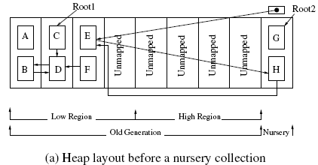
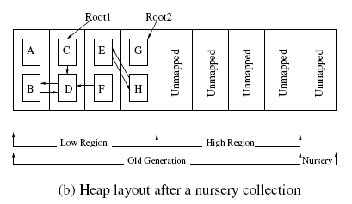
MC – Mark Phase

Slide 8
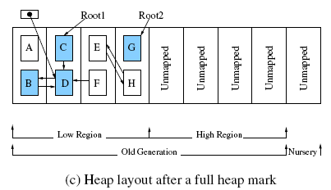
MC – Mark Phase

Slide 9
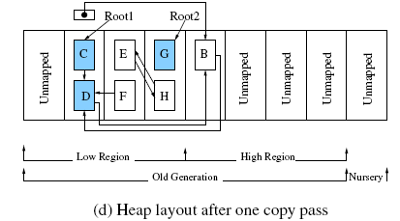
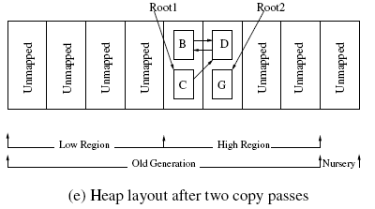
MC-Copy Phase

Slide 10
Why not Mark-Copy?
Maps and unmaps pages in windows during copying phase (virtual memory)
Always copies all live data in the old gen.
Long pauses are possible from marking and copying

Slide 11
MC²
Free list of windows
Does not use object addresses for relative location. Instead, indirect addressing
Decouples address from logical window number
No need to map and unmap evacuated windows
No need to copy data out of every window. A new logical number can be assigned to it
Two phases: Mark and Copy

Slide 12
MC² – Mark Phase
Logically order old gen. windows
Three mark phase tasks:
Mark reachable objects
Calculate live data volume in each window
Build per-window remembered sets
If occupancy exceeds threshold (80%): start
Interleave marking with nursery allocation
Reduces mark phase pauses

Slide 13
MC² Example – Mark Phase
Root
Root
Old Generation
Nursery
L1
L2
L3
L4
Lmax
Lmax
Root
Nursery
Reachable
Copied
Unreachable
Marked
MC² keeps a work queue: objects marked but not yet scanned

Slide 14
MC² Example – Mark Phase
Root
Old Generation
Root
Nursery
L1
L2
L3
L4
Lmax
Lmax
Root
Nursery
Reachable
Copied
Unreachable
Marked

Slide 15
MC² Example – Mark Phase
Root
Old Generation
Root
Nursery
L1
L2
L3
L4
Lmax
Lmax
Root
Root
Nursery
Reachable
Copied
Unreachable
Marked

Slide 16
MC² Example – Mark Phase
Root
Old Generation
Root
Nursery
L1
L2
L3
L4
Lmax
Lmax
Root
Root
Nursery
Reachable
Copied
Unreachable
Marked

Slide 17
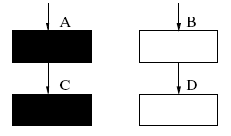
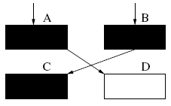
Incremental Marking Error

Slide 18
Handling marking error
Track mutations using write barrier
Record modified old generation objects
Scan these modified objects at GC time
Snapshot at the beginning
Incremental Update
Notes:
Snapshot: Any object that is live at the start, will be live for the duration of this collection.
Incremental: Every black-to-white pointer, the source and target are recorded. Source: rescanned. Target: kept alive

Slide 19
MC² – Copy Phase
Copy and compact reachable data
Performed in small increments
One windowful of live data copied per increment
One increment per nursery collection
High-occupancy windows copied logically

Slide 20
MC² Example – Copy Phase
Root
Old Generation
Root
Nursery
L2
L3
L4
Lmax
Lmax
Lmax
Root
Root
Nursery
Reachable
Copied
Unreachable
Marked
Copy a window worth of data during nursery collection

Slide 21
MC² Example – Copy Phase
Old Generation
Root
Root
Nursery
L2
L3
L4
Lmax
Lmax
Lmax
Root
Root
Nursery
Reachable
Copied
Unreachable
Marked
Copy a window worth of data during nursery collection

Slide 22
MC² Example – Copy Phase
Root
Root
Old Generation
Nursery
L4
Lmax
Lmax
Lmax
L2
L3
Root
Root
Nursery
Reachable
Copied
Unreachable
Marked
Copy a window worth of data during nursery collection

Slide 23
MC² Example – Copy Phase
Root
Root
Old Generation
Nursery
Lmax
Lmax
Lmax
L2
L3
L4
Root
Root
Nursery
Reachable
Copied
Unreachable
Marked
Copy a window worth of data during nursery collection

Slide 24
MC² Example – Copy Phase
Root
Root
Old Generation
Nursery
Lmax
Lmax
Lmax
Lmax
Lmax
Lmax
Root
Root
Nursery
Reachable
Copied
Unreachable
Marked
Copy a window worth of data during nursery collection
Notes:
The large volume windows don’t even have to be scanned later on if they still have large volumes of data

Slide 25
MC² Details
Large remembered sets
Bounding space overhead
Popular objects
Preventing long pauses

Slide 26
Handling large remembered sets
W1
W2
Normal remembered set for W1 stores 5 pointers (20 bytes on a 32 bit machine)

Slide 27
Handling large remembered sets
W1
W2
W0
Card 1
W1
W2
1
1
Card 2
Card table requires only 2 bytes (one per card)

Slide 28
Handling large remembered sets
Set a limit on the total remembered set size (e.g., 5% of total heap space).
Replace large remembered sets with card table when total size approaches limit
Trade offs
Marking bit is more expensive than inserting into sequential buffer
Scanning card table when marking also more expensive

Slide 29
Handling popular objects
When converting SBB -> Card Table
Keep count of pointers to each object
If > 100, move them to especial window
Normal Window
Group
Popular
Window
Normal Window
Group

Slide 30
Handling popular objects
Isolate popular object at high end of heap
Do not need to maintain references to the objects
Copying a popular object can cause a long pause, but does not recur

Slide 31
Experimental Results
Implemented in Jikes RVM (2.2.3)/MMTk
Pentium 4 1.7 GHz, 512MB memory, RedHat Linux 2.4.7-10
Benchmarks: SPECjvm98, pseudojbb
Collectors evaluated
Generational Mark-Sweep (MS)
Generational Mark-(Sweep)-Compact (MSC)
MC2

Slide 32
Results Summary
MC2: suitable for handheld devices with software real time requirements
Low space overhead (50-80%)
Good throughput (3-4% slower than non-incremental compacting collector)
Short pause times (17-41ms, factor of 6 lower than non-incremental compacting collector)
Well distributed pauses

Slide 33
Discussion
Compare to IMMIX: windows vs blocks and lines
CMP:
Incremental Marking
Incremental Copying
We lost objects ordering: Is there a way we could have the benefits of MC² without having to look at the roots and remsets for each window?
What about the effects of paging? Can we hint the VMM to NOT evict certain windows or what/when to bring back certain windows

Slide 34
Execution Time relative to MC² (Heap Size = 1.8x max. live size)

Slide 35
Max. Pause Time relative to MC² (Heap Size = 1.8x max. live size)
MC² max. pause range: 17-41ms

