Slide 1
Comparison of Compacting Algorithms for Garbage Collection
Mrinal Deo
CS395T – Spring 2011

Slide 2
Recap
Mark Sweep
Pros
We use the entire heap
Cons
The heap gets fragmented over time
Copying
Pros
Heap is rearranged by copying into one large chunk.
Better locality
No fragmentation i.e. speedier allocation.
Cons
We use only half of the heap.
Introduce – Mark-Compact . Bring to benefits of Copying to Mark Sweep

Slide 3
Algorithms
Classical
– Lisp 2
• D.E. Knuth, 1973
– Table Compactor
• Modified algorithm based on Waite and Haddon, 1967
Modern (at the time)
– Morris’ algorithm, 1978
– Jonkers’ algorithm, 1979

Slide 4
Layout of a Cell

Slide 5
Lisp 2
Requires additional space in each cell for a pointer
Compaction phase is done in 3 passes:
Start traversing the cells – sorted in terms of their address
Compute new address of each active cell
@start free_ptr = 0; free_ptr += free_ptr + size of live cell
Update pointer fields of each active cell
Sliding Compactor - Relocate active cells to one end of the heap.

Slide 6
Lisp 2

Slide 7
Table Compactor
Uses the same basic idea as the Lisp 2.
Differs in the place where we store the ‘new’ addresses of each cell.
Uses the ‘garbage cells’ to prepare the table of relocated cells with destinations.

Slide 8
Table compactor Algorithm

Slide 9
Table Allocator Contd
0 | 100 | 300 |  |  | 950 | 1200 |  |  | 1600
0 | 100 | 100,100 |  |  | 950 | 1200 |  |  | 1600
0 | 100 |  | 100,100 950, 750 |  | 950 | 1200 |  |  | 1600

Slide 10
Threading
B
C
A
P (data)
A
B
C
data
P

Slide 11
Morris Algorithm
3 passes – 1 forward 2 backward
2 tag bits per field
0 inactive
1 pointer
Swapped pointer
Non pointer

Slide 12
Morris Algorithm

Slide 13
Jonker’s Algorithm
Based on the same principle as Morris i.e threading.
Require only 1 tag bit.
2 passes – both in forward direction
Pointers can ONLY point to the head of a cell.

Slide 14
Jonker’s Algorithm

Slide 15
Time-Formulas
Create optimized versions of each algorithm
Describe each procedure with a formula from the type and number of operations performed
Replace unknowns in the formula with machine specific constants, leaving the following variables:
– α: Marked cell ratio (NMC/NC)
– β: Live pointer ratio (NAP-1)/(NPC*NMC)

Slide 16
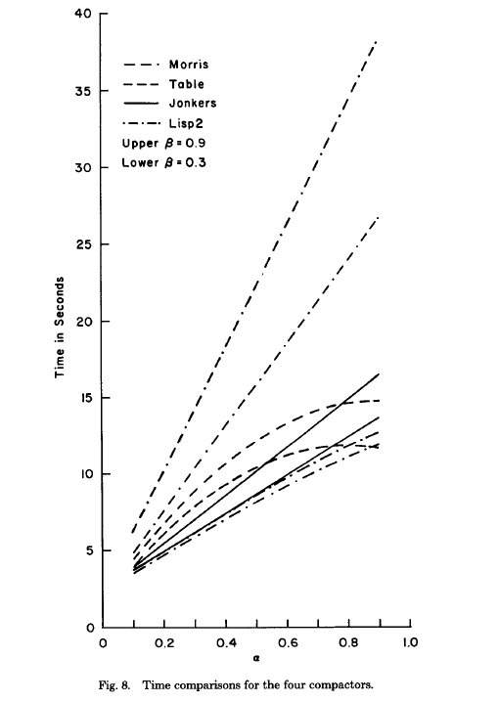
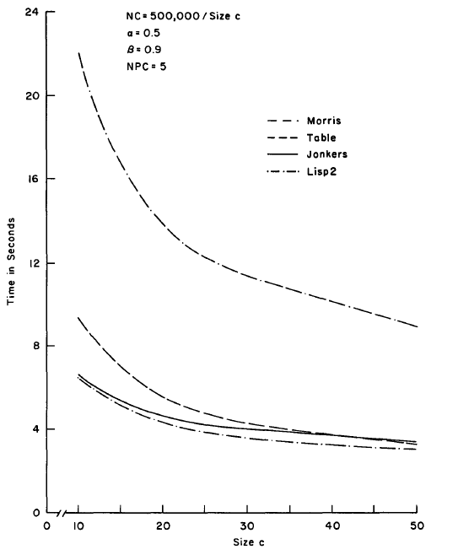
Results

Slide 17
Discussion
Applicability of these algorithms to current Multicore Architectures.
Performance of these Algorithms on modern workloads.
Traversing heap objects in increasing order of their address – lower to higher. Does this put any kind of constraints on PL design?

Slide 18
Backup Slides.

Slide 19
Requirements of each Algorithm

