Slide 1
Leak Pruning
Michael Bond Kathryn McKinley
The University of Texas at Austin
Presented by Na Meng
Most of the slides are from Mike’s original talk. Many thanks go to the authors.
Notes:
The original slides are so perfect and I can imagine the original talk should be quite successful. I can never reproduce the success, but I’ll try my best to do a good job.

Slide 2
Motivation
Memory bugs
  Memory corruption: dangling pointers, double frees, buffer overflows
  Memory leaks
    Lost objects: unreachable but not freed
    Useless objects: reachable but not used
Managed languages
Notes:
As we know, there are two kinds of memory bugs: memory corruption and memory leaks.
Managed languages can eliminate memory corruption errors and memory leaks caused by lost object, but cannot do so for memory leaks caused by useless objects.

Slide 3
Motivation
Memory leaks are a real problem
  Managed languages do not eliminate them
Unreachable
Reachable
Notes:
A garbage collector performs a transitive closure over the object graph from program roots to identify reachable objects and reclaim unreachable ones.

Slide 4
Motivation
Memory leaks are a real problem
  Managed languages do not eliminate them
Dead
Live
Reachable
Notes:
However, within the reachable objects, there are still some dead objects which are not used again.
These dead objects take up more and more memory, and finally slow down or crash the program

Slide 5
Motivation
Memory leaks are a real problem
  Managed languages do not eliminate them
Live
Reachable
Dead

Slide 6
Motivation
Memory leaks are a real problem
  Managed languages do not eliminate them
Reachable
Live
Dead

Slide 7
Motivation
Memory leaks are a real problem
  Managed languages do not eliminate them
  Slow & crash real programs
Live
Dead
Notes:
Memory leaks may slow and crash real programs by consuming unnecessary memory resources, increasing garbage collection frequency and workload. Such errors are unacceptable, especially to deployed long-running applications

Slide 8
Motivation
Memory leaks are a real problem
  Managed languages do not eliminate them
  Slow & crash real programs
Fixing leaks is hard
  Leaks take time to materialize
  Failure far from cause
Leaks exist in production software
Notes:
Fixing such memory leaks is hard because they have no immediate symptoms.
For example, the moment when a leaking Java program exhausts memory depends on the heap size, choice of garbage collector, and nondeterministic factors not directly related to the leak.
Despite in-house testing, leaks exist in production software because they are input and environment sensitive.

Slide 9
Possible Solutions
Precisely determine liveness of objects
  Liveness is in general undecidable
Approximately treat stale objects as dead
Leak Pruning
Notes:
An intuitive solution is to precisely determine liveness of objects to reclaim dead objects. However, liveness is hard to determine and in general undecidable.
A simpler solution is to approximately treat stale objects as dead and reclaim the stalest large objects when the memory is exhausted
Stale objects are not equivalent to dead objects; since stale objects are still live and accessible to the running application, while dead objects will never come back to life. Therefore, a cautious implementation of this approach is to reclaim large stale objects only when necessary

Slide 10
Leak Pruning
Reachable
Live
Dead
Notes:
In the common case, garbage collectors only reclaim unreachable objects. If we use dash lines to represent the boundary of available memory, reachable objects may take up all the memory at some point. Instead of throwing Out-of-memory error, leak pruning reclaims some stale objects.

Slide 11
Leak Pruning
Reachable
Live
Dead

Slide 12
Leak Pruning
Reachable
Live
Dead

Slide 13
Leak Pruning
Reachable
Out of memory!
Live
Throw OOM error
Dead
Notes:
Dash lines represent boundary of the available memory. When the memory is exhausted, an Out-of-memory will be thrown.

Slide 14
Leak Pruning
Reachable
Out of memory!
Live
Throw OOM error
Dead
Reclaim some objects

Slide 15
Leak Pruning
  Reclaim predicted dead objects
Reclaimed
Live

Slide 16
Leak Pruning
  Reclaim predicted dead objects
Reclaimed
Live
b
a
Notes:
Each reference from a live object to a reclaimed object is poisoned.

Slide 17
Leak Pruning
  Reclaim predicted dead objects
  Poison references to reclaimed objects
Live
?
a

Slide 18
Leak Pruning
  Reclaim predicted dead objects
  Poison references to reclaimed objects
Live
a
Notes:
Once the program attempts to access a reclaimed object via a poisoned reference,

Slide 19
Leak Pruning
  Reclaim predicted dead objects
  Poison references to reclaimed objects
Live
Throw InternalError with OOMError attached
X
a
Notes:
the access is intercepted and an InnerError with OOMError attached is thrown.

Slide 20
Leak Pruning
  Reclaim predicted dead objects
  Poison references to reclaimed objects
Worst case: defers fatal errors
Live
Best case: keeps leaky programs running indefinitely
Throw InternalError with OOMError attached
X
a
Preserves semantics
Notes:
In the worst case, leak pruning only defers out-of-memory error. Leak pruning preserves semantics.
In the best case, it enables leaky program with unbounded reachable memory to run indefinitely in bounded memory. Leak pruning provides the illusion that the garbage collector is liveness-based rather than reachability-based.

Slide 21
State Diagram for Leak Pruning
Heap not nearly full
<50% Heap filled
Heap not full
Heap still nearly full
INACTIVE
OBSERVE
SELECT
PRUNE
>50%
>90%
Heap nearly full
Notes:
Initially, leak pruning is INACTIVE and does not observe program behavior. This state avoids the overhead of leak pruning’s analysis when the program is not running out of memory.
When memory usage crosses the threshold 50%, leak pruning enters the OBSERVE state and then analyzes program reference usage pattern. Once leak pruning enters the OBSERVE state, it never returns to INACTIVE because it permanently considers the application to be in an unexpected state.
Leak pruning moves from OBSERVE to SELECT when the program has nearly run out of memory--the memory usage is above 90%. The SELECT state chooses references to prune, based on information collected during the OBSERVE state.
Two options are supported : (1) moving to PRUNE when the heap is 100% full after a collection and the VM is about to throw an out-of-memory error, or (2) moving to the PRUNE state after finishing a collection in the SELECT state. (2) is more appealing since it avoids the VM grinding to a halt before pruning can commence.
The PRUNE state poisons selected references by invalidating them and not traversing the objects that were reachable only from the pruned references. If the collector claims enough memory so that the heap is no longer nearly full, leak pruning returns to the OBSERVE state. Otherwise, it returns to SELECT, identifying more references to prune.

Slide 22
OBSERVE State
Header
001
Tracking staleness
  o.staleCounter increments from k to k + 1 after 2^{k} garbage collections
  Read barrier
o.staleCounter
How does staleCounter’s increment work?
b = a.f; //Application code
if (b & 0x1){ // Read barrier
//out-of-line code path
t = b; // Save ref
b &= ~0x1; // Clear lowest bit
a.f = b;[iff a.f == t] // Atomic
b.staleCounter = 0x0; //Atomic
}
Notes:
By default, the lowest bit is set for each created object. When an object is accessed, its lowest bit and staleCounter are cleared.
If the lowest bit is already cleared, no action is taken. Therefore, this instrumentation is efficient.

Slide 23
OBSERVE State
b₁
1
b₂
2
Maintaining edge table
a
0
src_{class}→ tgt_{class} | maxStaleUse | bytesUsed
2
A → B
0
b = a.f; //Application code
if (b & 0x1){ // Read barrier
//out-of-line code path
t = b; // Save ref
b &= ~0x1; // Clear lowest bit
a.f = b;[iff a.f == t] // Atomic
b.staleCounter = 0x0; //Atomic
}
if (b.staleCounter > 1){//set maxStaleUse
edgeTable[a.class->b.class].maxStaleUse =
max(edgeTable[a.class->b.class].maxStaleUse,
b.staleCounter);}
Notes:
OBSERVE state starts maintaining an edge table. For a stale edge in the heap, src->tgt, the table records the Java class of the both source and target objects, together with maxStaleUse, to identify edge types that are stale for a long time.
Stale objects are used infrequently, so the edge table update occurs infrequently.

Slide 24
SELECT State
Transitive Closure
  Phase I: in-use transitive closure
  Phase II: stale transitive closure
roots
b₁
0
c₁
3
d₁
3
a₁
0
    Enque candidate ref if tgt.staleCounter > 2 + ref.maxStaleUse
d₂
3
b₂
0
c₂
3
b₃
0
c₃
3
e₁
0
    Compute the bytes reachable from each stale candidate
src_{class}→ tgt_{class} | maxStaleUse | bytesUsed
B → C | 0
E → C | 2
80
60
Notes:
A full-heap collection in SELECT chooses one edge type for pruning during the subsequent GC in the PRUNE state.
The regular transitive closure, which marks all reachable objects, is divided into two phases
The edge entry is selected for pruning since it has the greatest value of bytesUsed
Question: when maxStaleUse is small, 2 + maxStaleUse is easy to meet. However, when maxStaleUse is large, 2 + maxStaleUse is hard to meet

Slide 25
PRUNE State
In-use transitive closure
  Collector poisons each reference
roots
b₁
0
?
c₁
3
d₁
3
a₁
0
d₂
3
b₂
0
?
c₂
3
b₃
0
?
c₃
3
e₁
0
src_{class}→ tgt_{class} | maxStaleUse | bytesUsed
B → C | 0 | 80
E → C | 2
Notes:
The PRUNE performs only the in-use closure, during which it prunes all references corresponding to the selected edge type and whose target objects have staleness values that are at least 2 more than the entry’s maxStaleUse.
The collector poisons each reference in the candidate set by setting its lowest 2 bits. Further collections see the poisoned references and do not dereference them.

Slide 26
Intercepting Accesses to Pruned References
Read barrier checks for poisoned references
roots
X
b₁
0
?
Throw InternalError
a₁
0
b₂
0
?
b₃
0
?
c₃
3
e₁
0
b = a.f; //Application code
if (b & 0x1){ // Read barrier
//out-of-line code path
if (b.staleCounter > 1){
edgeTable[a.class->b.class].maxStaleUse =
max(edgeTable[a.class->b.class].maxStaleUse,
b.staleCounter);}
if (b & 0x2){//Check if poisoned
InternalError error = new InternalError();
err.initCause(avertedOutofMemoryError);
throw err;
Notes:
To intercept program accesses to pruned reference, the read barrier checks for poisoned references.

Slide 27
Evaluation
Leaking pruning added to Jikes RVM 2.9.2
  http://www.jikesrvm.org/Research+Archive
Generational Mark-Sweep in MMTk
Performance stress test
  Non-leaking programs: Dacapo & SPEC
  Replay compilation
Leak tolerance test
  Leaking programs
Notes:
Enable read barrier, track staleness and select reference

Slide 28
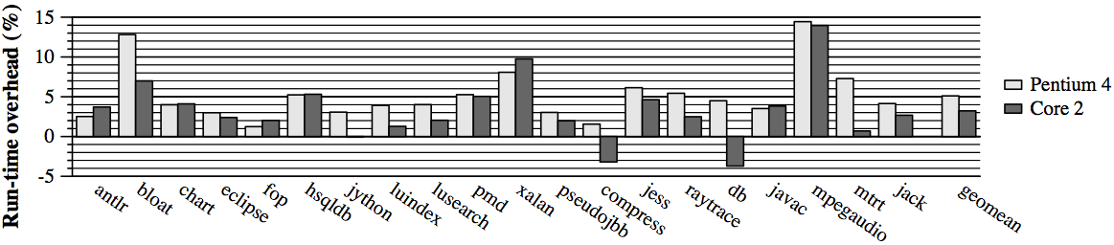
Application + Collection Overhead
SELECT State
  5% overhead on Pentium 4
  3% overhead on Core 2
Why overhead is negative for some benchmarks ?
Notes:
The authors force leak pruning to be in the SELECT state continuously. Therefore, runtime overhead includes application and collection overhead, but does not include compilation overhead. The overhead mainly comes from read barrier’s checking and staleness tracking, collector’s maintenance for object staleness and reference selection.

Slide 29
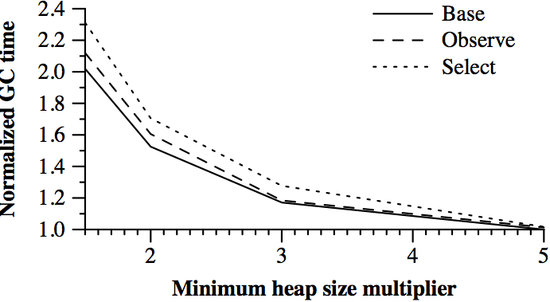
Garbage Collection Overhead
OBSERVE State 5%
SELECT State 14%
Notes:
Observe: involves maintaining each object’s staleness bits during collection.
Select: adds the rest of leak pruning’s functionality without actually pruning references: stale trace and selection of an edge type to prune.
14% in total

Slide 30
Compilation Overhead
Insert read barrier
  17% on average, 34% at most
  Negligible compared with overall execution time

Slide 31
Tolerating Leaks
Leak | Leak pruning’s effect
Eclipse “Diff” | Tolerates until 24-hr limit (>200X longer)
ListLeak | Tolerates until 24-hr limit (>25,000X longer)
SwapLeak | Tolerates until 24-hr limit (>2,200X longer)
Eclipse “Copy-Paste” | Most dead but some live (81X longer)
MySQL | Most dead but some live (35X longer)
JbbMod | All dead but pruning misses some (21X longer)
SPECjbb2000 | Heap growth is mostly live (4.7X longer)
Mckoi Database | Thread leak: extra support needed (1.6X longer)
DualLeak | Heap growth is live (No help)

Slide 32
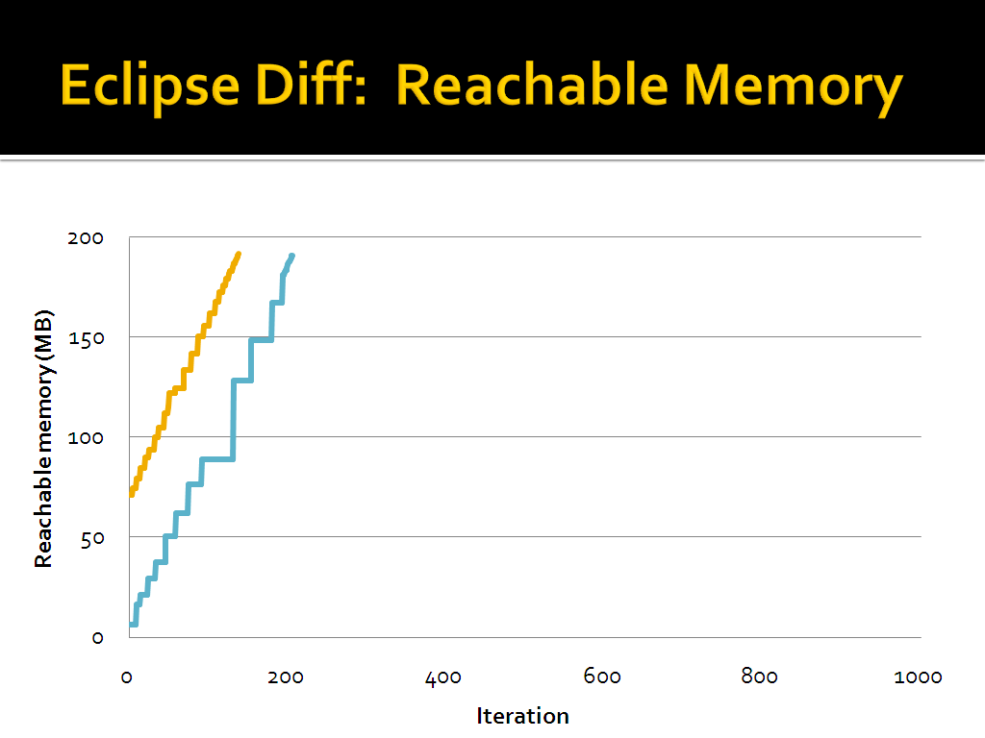

Slide 33
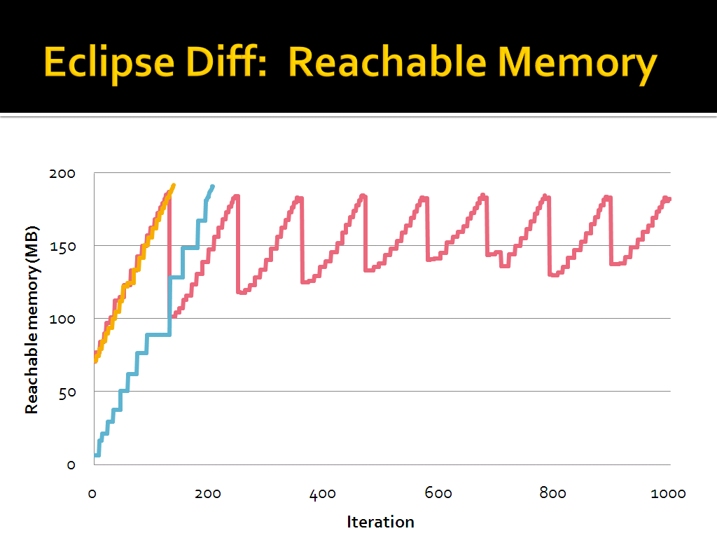

Slide 34
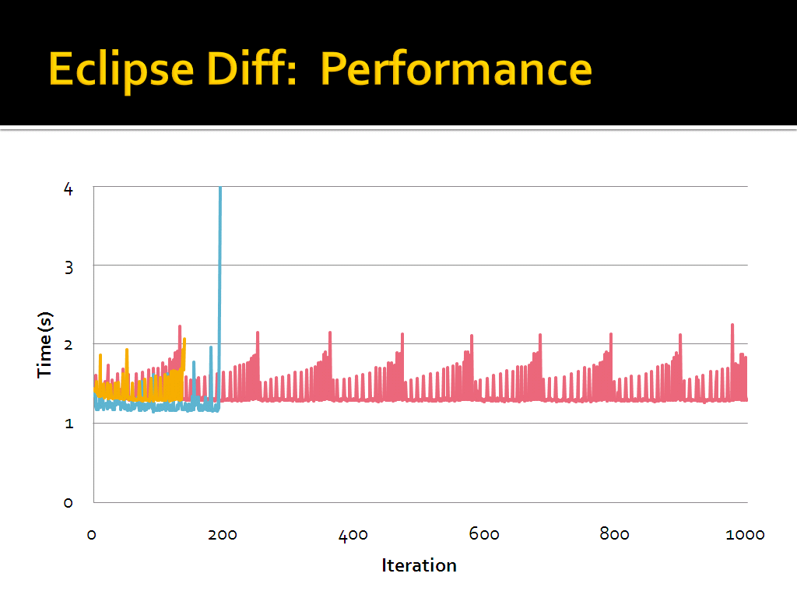

Slide 35
Discussion
What about the leaked memory grows too fast?
What are the character of data structures involved with memory leak?
In addition to staleness, what else can we use to determine objects responsible for memory leak?
Notes:
Large collections with variable lengths are always involved in memory leak.

