Slide 1
Networking
New and Sustaining Professional Relationships
Kathryn S McKinley, Microsoft Research
CRA-W co-chair

Slide 2
What’s Next?
About me
Building and sustaining professional relationships
Questions
Practicum

Slide 3
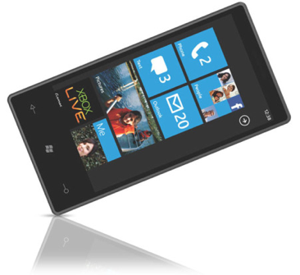

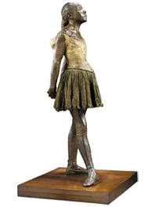
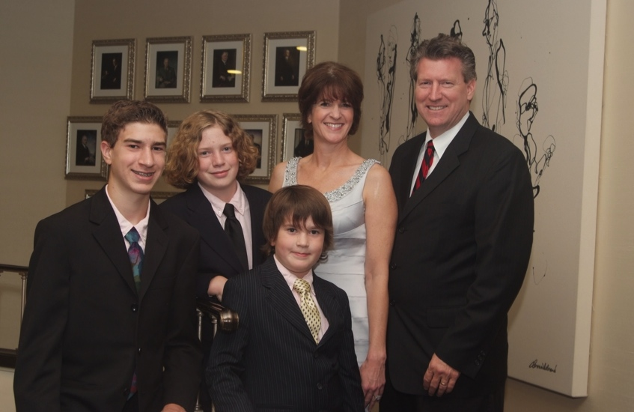
Kathryn McKinley
Principal Research, Microsoft
Software for future hardware
fast, portable, secure, energy efficient
Programming Language Implementation
DaCapo Benchmarking
Cross system boundaries
Software for Heterogeneous Hardware
Energy
+
Professor, UT Austin
ACM Fellow, IEEE Fellow
17 PhD students
Testified to Congress

Slide 4
Networking New People
But I am horrible at small talk!
    Networking is not genetic.
    It is a skill.
    Practice
    Meet people Go places Volunteer!

Slide 5

Networking is …
Making professional connections
and using them wisely
Systematically seeking out new and sustaining relationships with people in the service of professional goals

Slide 6
Networking is not …
A substitute for quality work
Using people
Notes:
Network = your community, you are a good citizen in your community

Slide 7
Networking …
Makes you known
Makes your work known
Source of new research ideas &
different slants on old ideas
Feedback on your research
New collaborations
Letters of recommendation
Professional opportunities
Notes:
Why should you network?

Slide 8
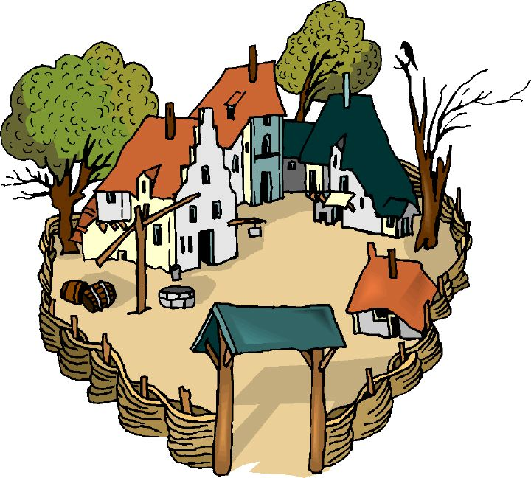
It takes a village …
you get to create your own village
Notes:
Background with what John did at Berkeley

Slide 9
Creating your own village
All villages need elders
All villages need regular Joes
All villages need diversity
  Learn different strokes from different folks
All villages need uniformity
  Similar folks have similar issues
John S. Davis, IBM, 2003
Notes:
Not just serendipity

Slide 10
Networking up & down
Established Researchers
  in your area
  in other areas!
Researchers junior to you
Peers!

Slide 11
Networking at home
Go to talks
Sign up to meet with visitors
Start or join a group: reading, women, etc.
Convey excitement about your research and interest in theirs
Talk to people about life as well as work
Serendipity happens
  Talk to people you meet by chance
Listen!

Slide 12
Networking at conferences
Prepare (write it down, practice)
Research Elevator talk
    1 & 3 minute versions
    Why is it an interesting problem?
    Why is it important?
    Why is your solution unique?
Prepare
  Who will be there? Who do you want to meet? What do you want to ask them? Read the papers.
Notes:
Dave - stuck in elevator
Tom’s work: Model coupling metadata, Geol, Language, systems

Slide 13
Questions?

Slide 14
Speed Dating Musical Chairs
What you need
  pad of paper, pen, your brain & SMILE!
Even rows, sit tight
Odd rows, turn your chair around.
If you are not facing a lovely woman whom you do not already know, move to a seat where you are.
Notes:
Before explaining exercise, get everyone in the right place.
Our room was classroom style, so to get people aligned in pairs, I asked the “even” rows to sit tight and the odd rows to turn around and put their chair in front of another people.
There will be some chaos at the back of the room if there are not an even number of rows. Ask the final row to pair themselves up at one table.

Slide 15
10 Minute Speed Dating
1 minute Quick Intros
  Shake hands (cultural caveat),
  look person in eye, & smile
  “My name is Kathryn…Happy to meet you, Hermione”
  Ask a question
2.5 minutes speak
  Listener listens actively, makes eye contact,
  1.5 Listener mirrors & responds directly
Swap Roles. Lather, Rinse, Repeat!
Odd row shifts left one seat & wrap

Slide 16
What to talk about?
Where are you from?
Where are you in graduate school? undergraduate studies?
Why are you studying CS?
What is your research area? What attracts you to this subject area?
What research problem(s) are you working on right now?
How do you enjoy working (alone, one partner, small or big group)?
What is your greatest (professional or personal) challenge right now?
What is your biggest concern about graduate school?
What kind of career path do you want to pursue?
What do you hope to get out of this weekend?
What do you enjoy doing when you’re not doing CS? What are you passionate about?

Slide 17
Homework
Practice this weekend & beyond
Meet at least 10 people
Introduce yourself with
  handshake (caveat), smile, and your name
Write down their names
Network Forward – network your network
Follow-up with email, Linked-In, or Facebook
Read the slides from previous grad cohorts

Slide 18
Thank you!

Slide 19
Resources
www.cra-w.org
CRA-W Career Mentoring Workshops, Workshop reports and transcripts,
From a summer internship to a permanent position by Keith Farkus, DEC WRL
Finding real world problems by Dirk Grunwald, U Colorado
Networking for your students by Ken Kennedy, Rice
Go outside your department by Jan Cuny, U Oregon
Developing business contacts by Maria Klawe, UBC
Networking at NSF by Caroline Wardle, NSF
Populating a start-up by Dave Ditzel, Transmeta
The ONR program director by Susan Eggers, UW

Slide 20
Conference networking
Prepare (write it down, practice)
  “Elevator talk” (1 & 3 minute versions)
      Why is it an interesting problem?
      Why is it important?
      Why is your solution unique?
  Prepare
    Who will be there? Who do you want to meet? What do you want to ask them? Read the papers.
Notes:
Dave - stuck in elevator
Tom’s work: Model coupling metadata, Geol, Language, systems

Slide 21
Conference networking
Speak
Follow up
    Write down who you met
    Write down the next steps
      read a paper, send a follow up email
    Write down technical tips
    Do it!

Slide 22
At the Conference: Don’ts
Don’t hang around with your friends
Don’t interrupt heavy or private conversations
Don’t be overly negative/critical
Don’t hang on to a conversation too long
Don’t put too much stock in a single, short conversation
Don’t get discouraged

Slide 23
After the conference
  Follow up!
    Send them your related papers, Ask for theirs
    Actually read them! Send them comments
    Share software and workloads
    Do joint work together
    Invite them to give a talk (* put them up at your place)
    Ask to give a talk there (* as appropriate)

Slide 24
Acknowledgements
Thanks for sharing their presentations
    Jan Cuny, NSF
    Susan Eggers, University of Washington
    John Davis, IBM
    Mary Jean Harrold, Georgia Tech
  Who did they thank?
  Susan Owicki, Joan Feigenbaum, Judy Goldsmith, Naomi Nishimura, David Johnson, Peter Shor, David Applegate, Richard Beigel

