Slide 1
Presentation and
Oral Communication Skills
Kathryn S McKinley, Microsoft Research

Slide 2
Why do presentation skills matter?
Communicating well makes you happy
Inspires others to give you capital
attention, pointers, funding, collaboration,
ideas, jobs, financing, etc.
You will explain ideas, techniques, and results your entire life
  Formally and informally in your personal & professional relationships, at conferences, in interviews, in classrooms, with colleagues

Slide 3


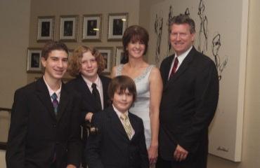
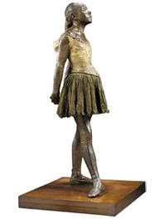
Kathryn S McKinley
Principal Researcher, Microsoft
Energy
Better systems
Programmable, correct, fast, secure, energy efficient
Uncertain<T> programming with estimates
Immix Garbage Collection
DaCapo Benchmarks
Software / hardware cooperation
+ Life
Professional
ACM Fellow, IEEE Fellow, 21 PhD students, Testified to Congress
Family, exercise, house

Slide 4
Why Should you Listen to Me?

Slide 5
What Is Your Hook?

Slide 6



Programming the Internet of
Uncertain <T>hings
James Bornholt
University of Washington
Na Meng
University of Texas at Austin
Todd Mytkowicz
Microsoft Research
Kathryn S. McKinley
Microsoft Research
Notes:
this talk is about a better way to program the world of noisy data.

Slide 7
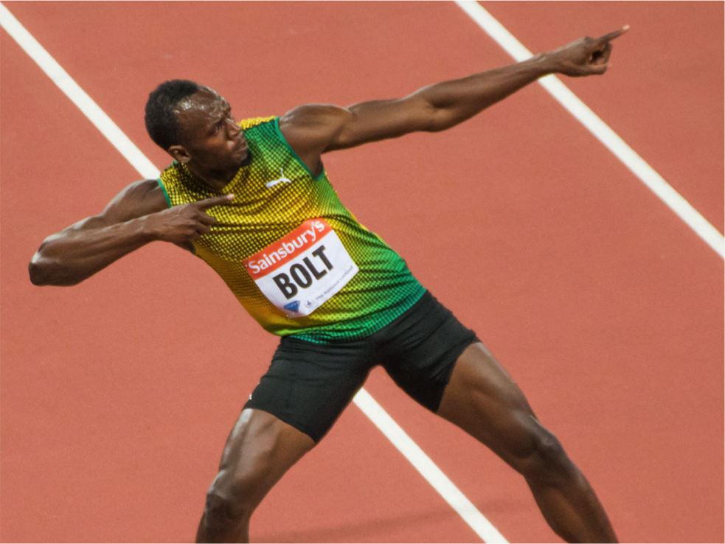
24 mph

Slide 8
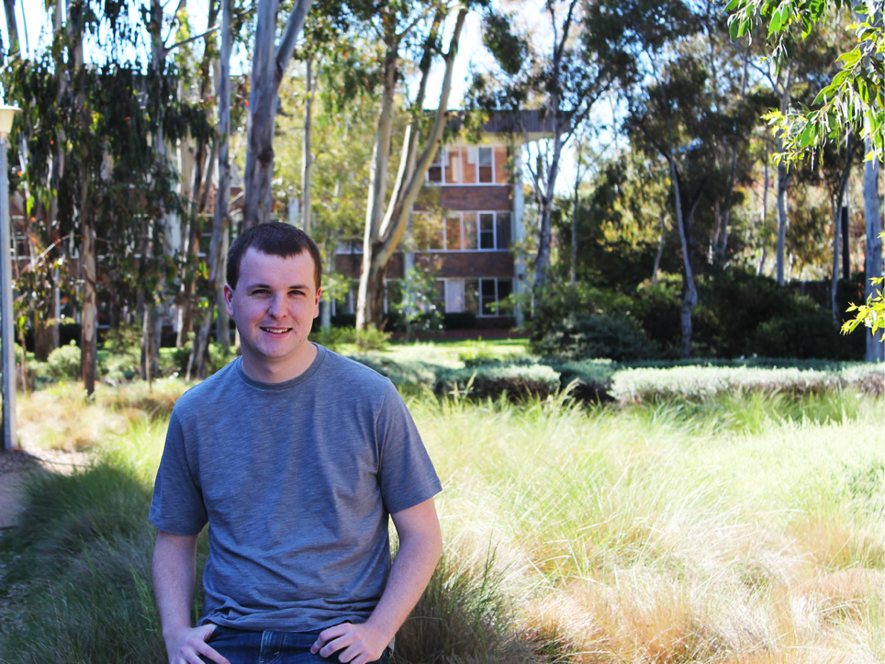
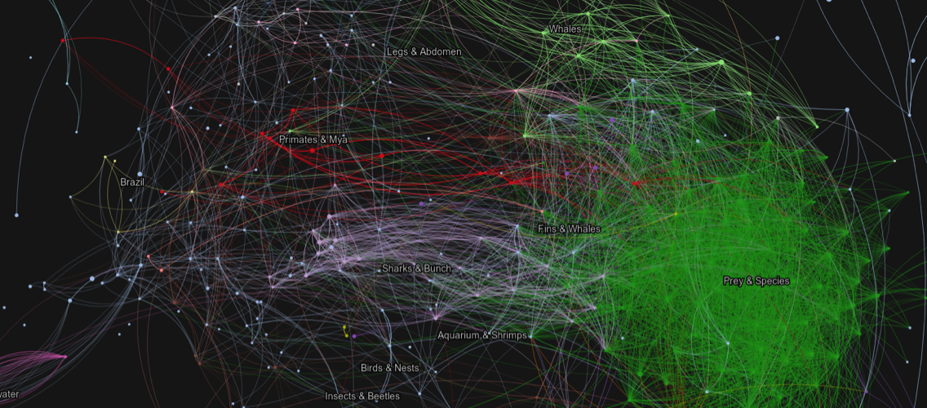
59 mph

Slide 9
GeoCoordinate PrevLocn = Get();
Sleep(5);
GeoCoordinate Location = Get();
double Dist =
Distance(PrevLocn, Location);
double Speed = Dist / 5;
if (Speed > 4)
Alert("Keep it up!");

Slide 10
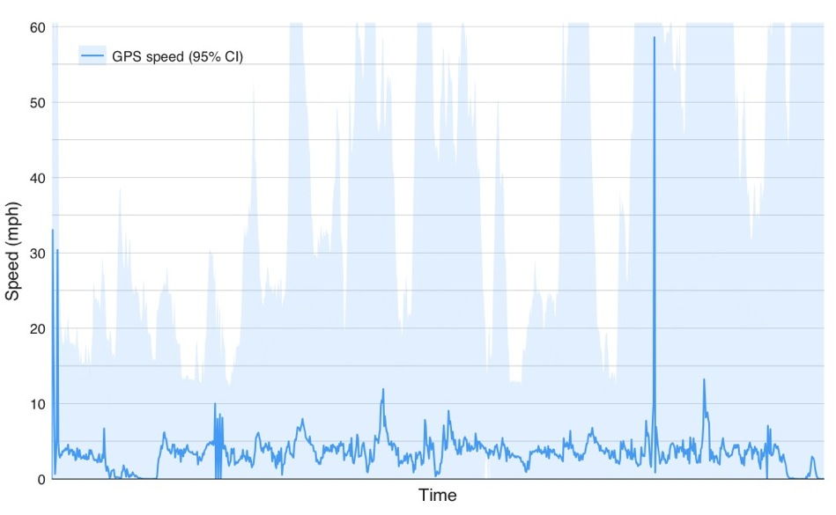
Keep it up!
Keep it up!
Keep it up!
Keep it up!
Keep it up!
Keep it up!
Keep it up!

Slide 11
GeoCoordinate PrevLocn = Get();
Sleep(5);
GeoCoordinate Location = Get();
double Dist =
Distance(PrevLocn, Location);
double Speed = Dist / 5;
if (Speed > 4)
Alert("Keep it up!");

Slide 12
Uncertain<GeoCoordinate> PrevLocn = Get();
Sleep(5);
Uncertain<GeoCoordinate> Location = Get();
Uncertain<double> Dist =
Distance(PrevLocn, Location);
Uncertain<double> Speed = Dist / 5;
if (Speed > 4) // Hypothesis test
Alert("Keep it up!");
Notes:
Rewriting your program this way delivers a concrete benefit. The conditional is a hypothesis test. Is it more likely than not you are going greater than 4 mph? This conditional experiences 86% fewer errors than the previous one.

Slide 13
Keep it up!
Keep it up!
Keep it up!
Notes:
The number of errors and the confidence interval is smaller.

Slide 14
What’s the point of a hook?
Helps your audience pay attention
Peaks audience interest
Learn from great talks and inspiring people
Ted Talks --- Amy Cuddy
“Your body language shapes who you are”

Slide 15
Next
Knowing your constraints
Elements of style
Question & answer
Feel free to ask questions

Slide 16
Analyze your constraints
Audience
What do they know?
Why are they here?
Biases?
Occasion
Time
Size
Purpose
To inform
To teach
To persuade
To inspire

Slide 17
Analyze your constraints
Audience
What do they know?
Why are they here?
Biases?
Occasion
Time
Size
Purpose
To inform
To teach
To persuade
To inspire
Seize your opportunities!

Slide 18
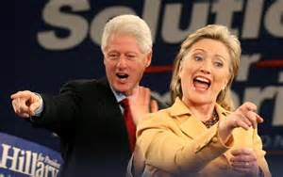
Elements of Style
Structure
Visual aids
Speech vs words on your slides
Delivery

Slide 19
Structure
Hook
Context setting
Talklets
point 1, point 2, … point k
summary
The end

Slide 20

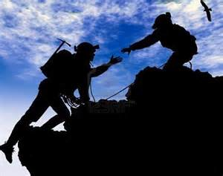

Context setting
Define problem
Background
Significance

Slide 21
Related Work– Version I
“A reasonable approach to page coloring”
  ASPLOS ‘06
“Another page coloring idea”
  OSDI ’08
“Yet another page coloring idea”
  ASPLOS ‘07

Slide 22
Related Work– Version II
Required System Changes
Foundation
ISCA ‘72
Jones et al.
OSDI ‘08
Smith et al.
ASPLOS ‘06
This Paper
Optimal
Runtime Overhead
Spatial design space display
highlights novelty

Slide 23
Middle
Don’t be afraid of technical depth
But… make it understandable
Typically requires new visual materials compared to your reference material

Slide 24
Re-coloring Procedure – Version I
Quick search for K-th hottest page’s hotness
  Bin[ i ][ j ] indicates # of pages in color i with normalized hotness in
  [ j, j+1] range

Slide 25
Re-coloring Procedure – Version II
hot
warm
cold
Cache share decrease
Budget = 2 pages

Slide 26
Middle & End
point 1
point 2
point 3
point 4
point 5
point 6
point 7
point 8
point 1
point 7
Big Picture
Summary
Notes:
That concludes what I wanted to say about the middle of presentations. Now I will discuss a presentation’s ending. In the ending of a presentation, the speakers want to accomplish two things: give a summary of the most important details and provide a big-picture perspective. Many students have a fear of repeating details. Perhaps they confuse repetition for redundancy (a needless repetition such as “bright green in color”). I usually ask them to imagine a technical course in which there was no repetition. In such a course there would be no help sessions or classes in which review was done. For each type of problem, the teacher would work through only one example.
Repetition is important in scientific writing and in scientific speaking. After all, on average, people remember only about 10 percent of what they hear. For that reason, at the end of a scientific presentation, the speaker should repeat the most important points so that the audience is more likely to walk out the door with those points.
In addition to a summary, the speaker should give a big-picture perspective on the work. In some presentations, that perspective might be a discussion of the work that needs to be done. In another presentation that perspective might be a list of recommendations. In another presentation, this perspective is a look at the technical work from the vantage point of the big picture discussed at the beginning of the talk. Each of these perspectives provide closure for the presentation. (CSP, pages 64-65, 88-91)

Slide 27
Speech vs writing

Slide 28
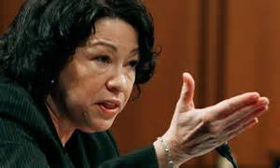
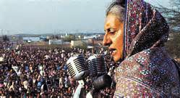
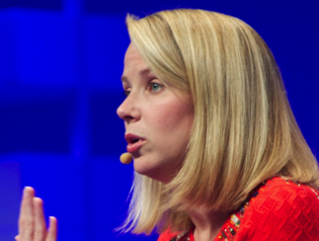
Delivery & Confidence
Practice!

Slide 29
Questions
Anticipate them
Prepares slides
You are the expert
Aggressive questioners
Follow up

Slide 30
Summary
Have a goal
Know your audience
Plan
  Content, Delivery, Design, Practice
  Great visuals are key
Exceed your audience expectations
Accomplish your goal

Slide 31

Acknowledgements
Thanks for sharing their presentations
Michael Alley, Penn State (slides too!)
Mike Dahlin, UT Google
David Patterson, Berkeley
Margaret Martonosi, Princeton
Padma Raghavan, Penn State

Slide 32
Useful Resources
Oral
David Patterson: How to Give a Bad Talk
http://pages.cs.wisc.edu/~markhill/conference-talk.html#badtalk
Mark Hill’s “Oral Presentation Advice”, http://pages.cs.wisc.edu/~markhill/conference-talk.html
CRA-W, http://www.cra-w.org/gradcohort
http://www.randsinrepose.com/archives/2008/02/03/out_loud.html
http://www.slideshare.net/selias22/taking-your-slide-deck-to-the-next-level
http://www.presentationzen.com/
General
Female Science Professor blog!
http://science-professor.blogspot.com/
Writing
Joseph Williams, “The Basics of Clarity & Style”
Gopen & Swan “The Science of Scientific Writing” http://www.americanscientist.org/issues/feature/the-science-of-scientific-writing/9
Many schools provide many writing resources: Use them!
  Writing center or tutor.
It may be worthwhile to *pay* a writing tutor to help teach you to edit your own work

Slide 33
When is it over?

Slide 34
Thank you!
Always thank your audience!

Slide 35
How to Give a Bad Talk

Slide 36
I. Thou Shalt Not Illustrate
Table:
  Precision
  Allow Audience to Draw on Conclusions
Pictures:
  Confucious: “Picture = 10K Words”
  Dijkstra: “Pictures are a crutch for weak minds”
Who are you going to believe?

Slide 37
II. Thou Shalt Not Covet Brevity
Do not omit technical material from your paper
  You did the work; it is important; make sure the audience understands all nuances of approach and also how smart you are
  Many in audience will never read the paper – they *must* leave the room fully understanding your approach, motivation, and contributions!
Include lots of material in each slide
  Avoid sentence fragments because they may make you look illiterate.
    Also, if the slides have full sentences, then you can read the slides verbatim and audience will be able to follow along.
    All points you make orally should also be on the slide, and vice versa.
    Some may say that no item on a slide should span more than one line. Ignore this! Take as much room as you need to make your point.
    Take advantage of technology – small fonts allow you to provide information-rich slides.
      Fonts smaller than 24 point are fine
      And the important people sit in front anyhow!
    Make several points on each slide.
Include lots of slides in each talk
  1 Lampson = 1 slide per second
  Impress audience with intensity and difficulty of material
    They should leave knowing that you did a lot of work and that it was hard, even if they don’t understand all of the details.
  Avoid moving content to “backup slides”
    You probably won’t get a chance to show many of them

Slide 38
II. Thou shatl Not be Neat
Slide layout << ideas!
  “I’m a doctor, Jim, not a graphic designer.”
  spelling checker = waste of time
    don’t worry about consistent capitalization
    Or structure/bullet/etc consistency
  Use color and fonts to emphasize key ideas
Who cares what 50 people think?

Slide 39
IV. Thou Shalt Cover Thy Naked Slides
Keep audience on your point
Surprise them with your train of thought
  If they know the point before you make it
  They may think
  That they could have figured it out
    For themselves
  Will they realize
    How clever you are?
Advanced techniques
Advanced techniques

Slide 40
V. Thou Shalt Remain Humble and Demure
No eye contact
  Bonus: Help avoid questions
Do not distract with motion
  Keep arms at side
  Stay at podium
Avoid rhetorical flourishes
  Keep voice level
    Avoid raising voice on key point
    Avoid pause
  Do not ask rhetorical questions
  Do not use humor
Key tool of the trade
  Laser pointer

Slide 41
VI. Thou Shalt Not Emphasize Key Points
Do not introduce talk/talklet/slide
  Cover more technical material
Do not structure slide
  All points are important
  Graphs should speak for themselves
Do not summarize talk/talklet/slide
  Audience should pay attention

Slide 42
VII. Thou Shalt Not Skip Slides in a Long Talk
You did the work
  The research
    And prepared the slides
  Audience will be interested in seeing them
  Even if briefly
Audience can stay longer
  Your work much more interesting
    Than the next speakers
    Than the break
    Than lunch
If necessary, skip conclusions
  Just repeating points you’ve already made

Slide 43
VIII. Thou Shalt Not Plan for Q&A
Keep answers spontaneous
No such thing as dumb question
  Just dumb questioner
  Whose fault is it they don’t understand?
  Universal answer:
    Dismiss question as irrelevant/naïve
  Everyone remembers a good argument
    Good publicity for paper
Approach
  Don’t repeat question
  Start talking quickly
  Don’t cut discussion short
  When in doubt, bluff

Slide 44
VIII. Thou Shalt Not Prepare Slides Early

Slide 45
IX. Thou Shalt Not Walk In Others’ Shoes
You are the expert
  You’ve been working on project for years
  Anyone could present dumbed down version
  Audiences chance to hear the expert view
Don’t worry if part of talk “drags”
  Present all technical details

Slide 46
X. Thou Shalt Not Practice
Benefits
    Practice wastes Hours
      Out of several years of research
    Ensures spontaneity
If you do practice
    Argue suggestions
    Make talk longer than allotted time
    Audience:
      Experts only (e.g., advisor and group)
    1 Week is plenty
      Converge on content by last practice
        (Night before presentation)
Most Important Commandment!

