Slide 1
Microarchitectural Performance Characterization of Irregular GPU Kernels
Molly A. O’Neil and Martin Burtscher
Department of Computer Science

Slide 2
Introduction
GPUs as general-purpose accelerators
Ubiquitous in high performance computing
Spreading in PCs and mobile devices
Performance and energy efficiency benefits…
…when code is well-suited!
Regular (input independent) vs. irregular (input determines control flow and memory accesses)
Lots of important irregular algorithms
More difficult to parallelize, map less intuitively to GPUs

Slide 3
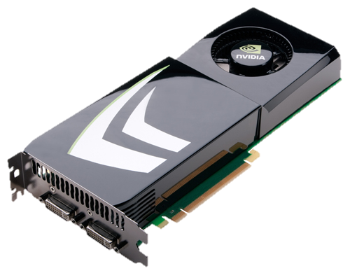
Outline
Impact on GPU performance characteristics of…
Branch divergence
Memory coalescing
Cache and memory latency
Cache and memory bandwidth
Cache size
First, review GPU coding best practices for good performance

Slide 4
Best Practice #1: No Divergence
To execute in parallel, threads in a warp must share identical control flow
If not, execution serialized into smaller groups of threads that do share control flow path → branch divergence

Slide 5
Best Practice #2: Coalescing
Memory accesses within a warp must be coalesced
Within a warp, memory references must fall within the same cache line
If not, accesses to additional lines are serialized

Slide 6
Best Practice #3: Load Balance
Balance work between warps, threads, and thread blocks
All 3 difficult for irregular codes
Data-dependent behavior makes it difficult to assign works to threads to achieve coalescing, identical control flow, load balance
Very different from CPU code considerations

Slide 7
Simulation Study
Want to better understand irregular apps’ specific demands on GPU hardware
To help software developers optimize irregular codes
As a baseline for exploring hardware support for broader classes of codes
GPGPU-Sim v3.2.1 + a few extra perf. counters
GTX 480 (Fermi) configuration
Added configuration variants to scale latency, bandwidth, cache size, etc.

Slide 8
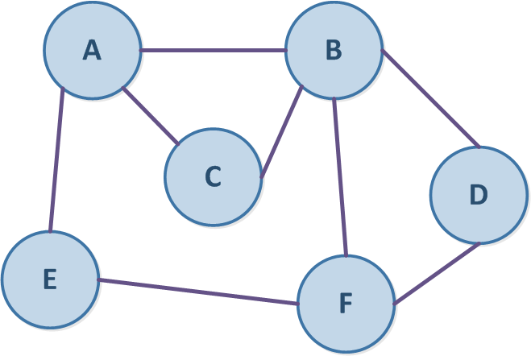
Applications from LonestarGPU Suite
Breadth-First Search (BFS)
Label each node in graph with min level from start node
Barnes-Hut (BH)
N-body algorithm using octree to decompose space around bodies
Mesh Refinement (DMR)
Iteratively transform ‘bad’ triangles by retriangulating surrounding cavity
Minimum Spanning Tree (MST)
Contract minimum edge until single node
Single-Source Shortest Paths (SSSP)
Find shortest path to each node from source

Slide 9
Applications from Other Sources
Semi-Regular
Regular
FP Compression (FPC)
Lossless data compression for DP floating-point values
Irregular control flow
Traveling Salesman (TSP)
Find minimal tour in graph using iterative hill climbing
Irregular memory accesses
N-Body (NB)
N-body algorithm using all-to-all force calculation
Monte Carlo (MC)
Evaluates fair call price for set of options
CUDA SDK version
Inputs result in working set ≥5 times default L2 size

Slide 10
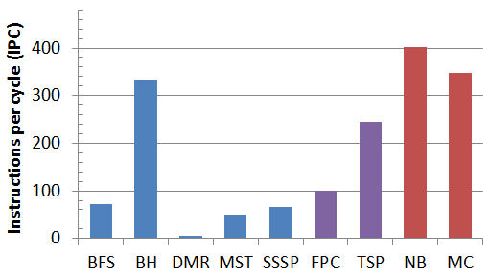
Application Performance
Peak = 480 IPC
As expected, regular mostly means better performing
BH is the exception: primary kernel regularized
Clear tendency for lower IPCs for irregular codes
But no simple rule to delineate regular vs. irregular

Slide 11
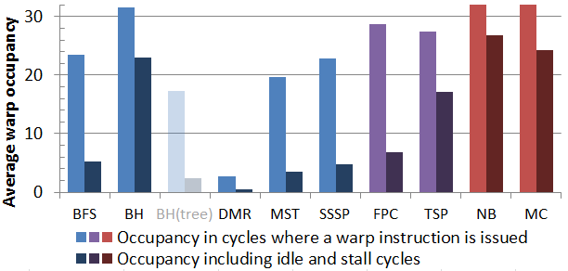
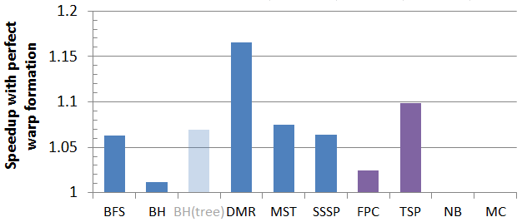
Branch Divergence
Active instructions at warp issue
32 = no divergence
Only one code <50% occupied
Theoretical speedup
Assumes each issue had 32 active insts.

Slide 12
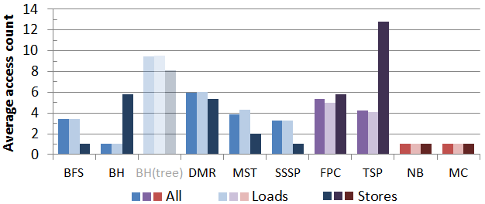
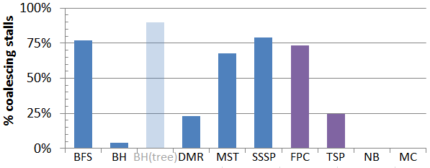
Memory Coalescing
Avg # of memory accesses by each global/local ld/st
>1 = uncoalesced
Percentage of stalls due to uncoalesced accesses
Provides an upper bound on speedup

Slide 13
Memory Coalescing
New configuration to artificially remove pipeline stall penalty from non-coalesced accesses
With no further improvements to memory pipeline, with increased-capacity miss queues and MSHRs
Not intended to model realistic improvement

Slide 14
L2 and DRAM Latency
Scaled L2 hit and DRAM access latencies
Doubled, halved, zeroed
Most benchmarks more sensitive to L2 latency
Even with input sizes several times the L2 capacity

Slide 15
Interconnect and DRAM Bandwidth
Halved/doubled interconnect (L2) bandwidth and DRAM bus width
Benchmark sensitivities similar to latency results
L2 large enough to keep sufficient warps ready

Slide 16
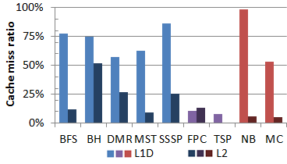
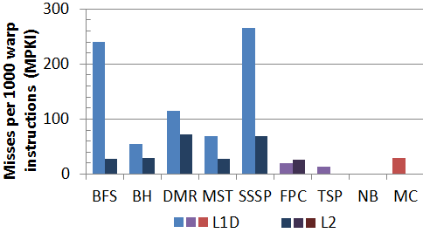
Cache Behavior
Very high miss ratios (generally >50% in L1)
Irregular codes have much greater MPKI
BFS & SSSP: lots of pointer-chasing, little spatial locality

Slide 17
Cache Size Scaling
Halved, doubled both (data) cache sizes
Codes sensitive to interconnect bandwidth are also sensitive to L1D size
BH tree prefixes: L2 better at exploiting locality in traversals
Most codes hurt more by smaller L2 than L1D

Slide 18
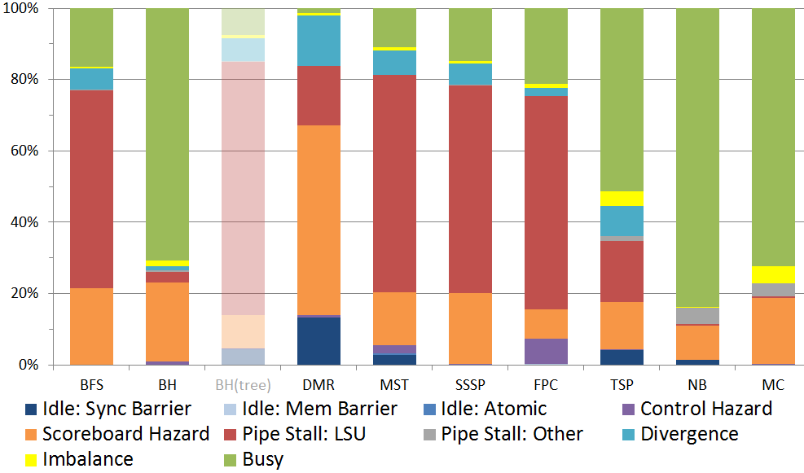
Individual Application Analysis
Divergence penalty less than we expected
Regular codes have mostly fully-occupied cycles
Large memory access penalty in irregular apps
Computation pipeline hazards (rather than LS)
Synchronization penalty also below expectation

Slide 19
Conclusions
Irregular codes
More load imbalance, branch divergence, and uncoalesced memory accesses than regular codes
Less branch divergence, synchronization, and atomics penalty than we expected
Software designers successfully addressing these issues
To support irregular codes, architects should focus on improving memory-related slowdowns
Improving L2 latency/bandwidth more important than improving DRAM latency/bandwidth

Slide 20
Questions?
Acknowledgments
NSF Graduate Research Fellowship grant 1144466
NSF grants 1141022, 1217231, and 1438963
Grants and gifts from NVIDIA Corporation

Slide 22
Related Work
Simulator-based characterization studies
Bakhoda et al. (ISPASS’09), Goswami et al. (IISWC’10), Blem et al. (EAMA’11), Che et al. (IISWC’10), Lee and Wu (ISPASS’14)
CUDA SDK, Rodinia, Parboil (no focus on irregularity)
Meng et al. (ISCA’10) – dynamic warp hardware modification
PTX emulator studies (also SDK, Rodinia, Parboil)
Kerr et al. (IISWC’09) – GPU Ocelot, Wu et al. (CACHES’11)
Hardware performance counters
Burtscher et al. (IISWC’12) – LonestarGPU, Che et al. (IISWC’13)

Slide 23
Input Sizes
Code | Input
BFS | NYC road network (~264K nodes, ~734K edges)
 | (working set = 3898 kB = 5.08x L2 size)
 | RMAT graph (250K nodes, 500K edges)
BH | 494K bodies, 1 time step
 | (working set = 7718 kB = 10.05x L2 size)
DMR | 50.4K nodes, ~100.3K triangles, maxfactor = 10
 | (working set w/ maxfactor 10 = 7840 kB = 10.2x L2 size)
 | 30K nodes, 60K triangles
MST | NYC road network (~264K nodes, ~734K edges)
 | (working set = 3898 kB = 5.08x L2 size)
 | RMAT graph (250K nodes, 500K edges)
SSSP | NYC road network (~264K nodes, ~734K edges)
 | (working set = 3898 kB = 5.08x L2 size)
 | RMAT graph (250K nodes, 500K edges)
FPC | obs_error dataset (60 MB), 30 blocks, 24 warps/block
 | num_plasma dataset (34 MB), 30 blocks, 24 warps/block
TSP | att48 (48 cities, 15K climbers)
 | eil51 (51 cities, 15K climbers)
NB | 23,040 bodies, 1 time step
MC | 256 options

Slide 24
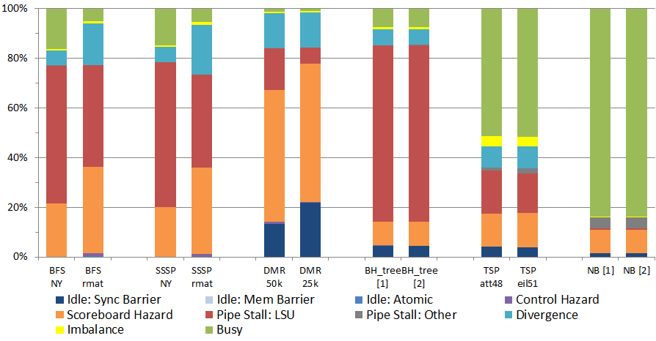
Secondary Inputs

Slide 25
GPGPU-Sim Configurations
 | Latency |  | Bus width |  |  | L1D |  |  |  |  | L2
 | ROP | DRAM | Ict | DRAM | CP | Sz (PS) | Sz (PL) | MQ | MS | MM | Size | MQ | MS | MM
Default | 240 | 200 | 32 | 4 | Y | 16 | 48 | 8 | 32 | 8 | 768 | 4 | 32 | 4
1/2x ROP | 120 | 200 | " | " | " | " | " | " | " | " | " | " | " | "
2x ROP | 480 | 200 | " | " | " | " | " | " | " | " | " | " | " | "
1/2x DRAM | 240 | 100 | " | " | " | " | " | " | " | " | " | " | " | "
2x DRAM | 240 | 400 | " | " | " | " | " | " | " | " | " | " | " | "
No Latency | 0 | 0 | " | " | " | " | " | " | " | " | " | " | " | "
1/2x L1D Cache | 240 | 200 | 32 | 4 | Y | 8 | 24 | 8 | 32 | 8 | 768 | 4 | 32 | 4
2x L1D Cache | " | " | " | " | " | 32 | 96 | " | " | " | " | " | " | "
1/2x L2 Cache | " | " | " | " | " | 16 | 48 | " | " | " | 384 | " | " | "
2x L2 Cache | " | " | " | " | " | " | " | " | " | " | 1536 | " | " | "
1/2x DRAM Bandwidth | 240 | 200 | " | 2 | Y | 16 | 48 | 8 | 32 | 8 | 768 | 4 | 32 | 4
2x DRAM Bandwidth | " | " | " | 8 | " | " | " | " | " | " | " | " | " | "
1/2x Ict + DRAM B/W | " | " | 16 | 2 | " | " | " | " | " | " | " | " | " | "
2x Ict + DRAM B/W | " | " | 64 | 8 | " | " | " | " | " | " | " | " | " | "
No Coalesce Penalty | 240 | 200 | 32 | 4 | N | 16 | 48 | 8 | 32 | 8 | 768 | 4 | 32 | 4
NCP + Impr L1 Miss | " | " | " | " | N | " | " | 16 | 64 | 16 | " | 4 | 32 | 4
NCP +Impr L1+L2 Miss | " | " | " | " | N | " | " | 16 | 64 | 16 | " | 8 | 64 | 8
Latencies represent number of shader core cycles. Cache sizes in kB. ROP=Raster Operations Pipeline (models L2 hit latency). Ict = Interconnect (flit size). CP=Coalesce penalty, PS = Prefer Shared Mem, PL = Prefer L1, MQ=Miss queue entries, MS=Miss status holding register entries, MM=Max MSHR merges

Slide 26
Issue Bin Priority

