Slide 1
Visually Grounded Language:
Past, Present, and Future
Raymond J. Mooney
Dept. of Computer Science
University of Texas at Austin

Slide 2
PAST

Slide 3
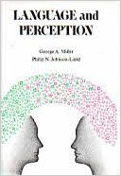
History
Cognitive psychologists have a long history of studying the connection between language and perception.
Miller and Johnson-Laird (1976)

Slide 4
Symbol Grounding
One of the long-standing problems in symbolic AI (Good Old Fashion AI, GOFAI), is how symbols are “grounded” in perception.
Harnad, S. (1990) identified “The Symbol Grounding Problem” as a key issue in AI.

Slide 5
Early Work on Language and Vision
There was a small but diverse set of projects on language and vision in the 90’s and 00’s.

Slide 6
Associating Words and Images
“Matching words and pictures.” Barnard, Duygulu, Forsyth, de Freitas, Blei, and Jordan. JMLR, 2003.
  Uses model adapted from statistical machine translation

Slide 7
Interpreting Captioned Images
“Names and Faces in the News,” Berg, Berg, Edwards, Maire, White, Teh, Learned-Miller, Forsyth, CVPR 2004.
  Connect names in image captions to faces in the image

Slide 8
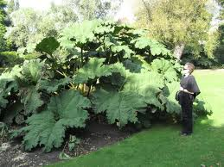
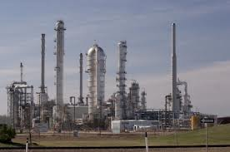
Word Sense Disambiguation with Pictures
Fred Carpenter owns a large plant in Peoria Illinois.
Barnard & Johnson AIJ-2005

Slide 9
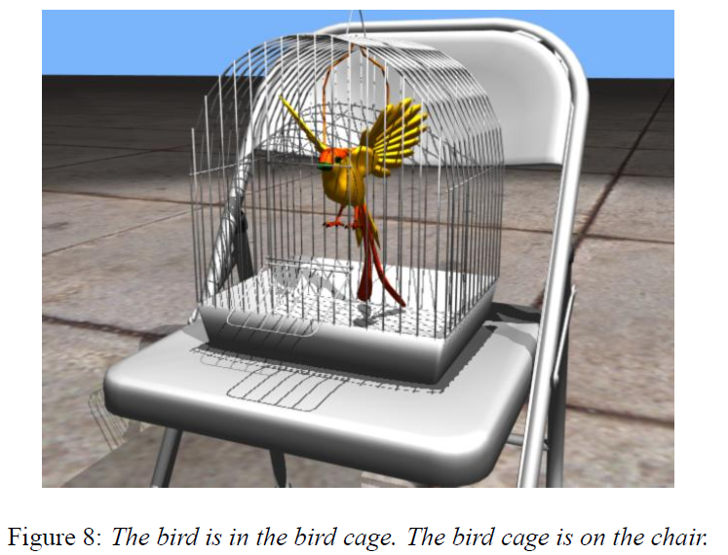
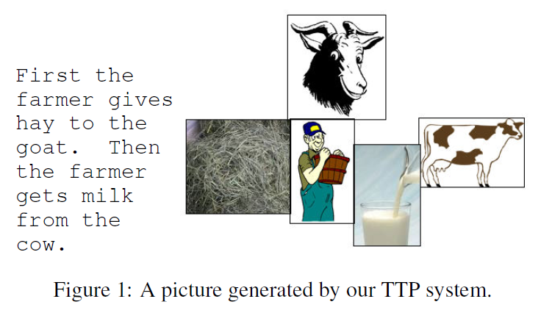
Image Generation from Text
Coyne & Sproat, SIGGRAPH-2001 Zhu et al. AAAI-2007

Slide 10
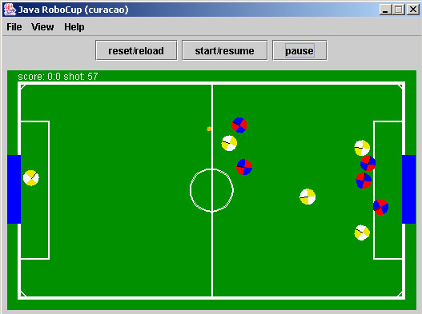
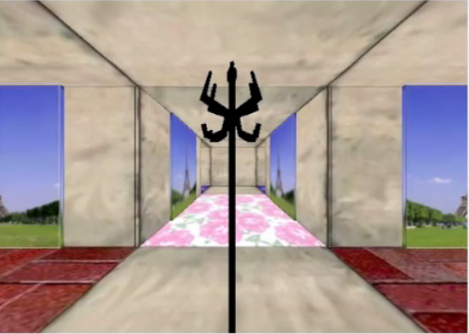
Grounding in Virtual Environments
I started my work on language grounding in virtual environments to avoid difficult perception problems.
  Sportscasting for simulated Robocup (Chen & Mooney, 2008)
    Red 2 passes to Red 4.
  NL direction following in a virtual building (Chen & Mooney, 2011)
    Turn left at the coat rack.

Slide 11
Language and Vision as
Two Views for Co-training
“Watch, Listen & Learn: Co-training on Captioned Images and Videos” Gupta, Kim, Grauman and Mooney, ECML/PKDD 2008.
Semi-supervised classification of captioned images and videos using linguistic and visual “views”

Slide 12
1st Workshop on Language and Vision
NIPS 2011 Workshop on Integrating Language and Vision, Sierra Nevada, Spain, Dec. 16, 2011.
Organized by Trevor Darrell, Kate Saenko, and myself.
Invited Speakers:
Tamara Berg, Stony Brook University
Dieter Fox, University of Washington
Mirella Lapata, University of Edinburgh
Percy Liang, Stanford University
Julia Hockenmaier, UIUC
Louis-Philippe Morency, USC
Stanley Peters, Stanford University
Kate Saenko & Yangqing Jia, UC Berkeley
Jeff Siskind, Purdue University
Josh Tenenbaum, MIT

Slide 13
Following Spate of Workshops on Grounded Language
NAACL-2012 Workshop on Semantic Interpretation in an Actionable Context
AAAI-2012 Workshop on Grounding Language for Physical Systems
NAACL-2013 Workshop on Vision and Language
CVPR-2013 Workshop on Language for Vision
UW-MSR 2013 Summer Institute on Understanding Situated Language

Slide 14
Natural Language Captioning of Images
(Kuznetsova et al., ACL-12)
Trained on 1 million photos from Flickr that were filtered so that they contain useful captions.
Extracts features from images using state-of-the-art object, scene, and “stuff” recognizers from computer vision.
Composes sentences for novel images by using Integer Linear Programming to optimally stitch together phrases from similar training images.

Slide 15
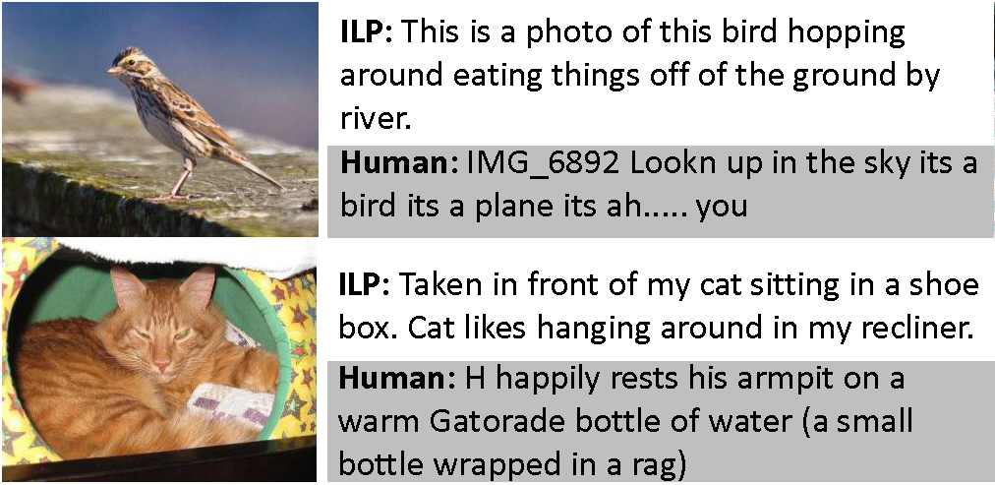
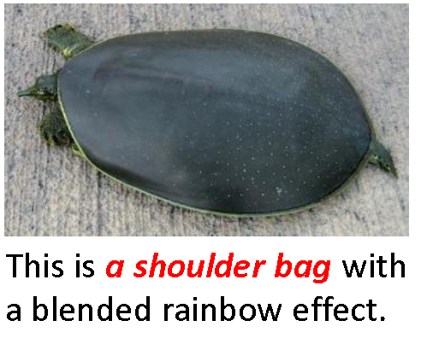
Sample Generated Image Descriptions

Slide 16
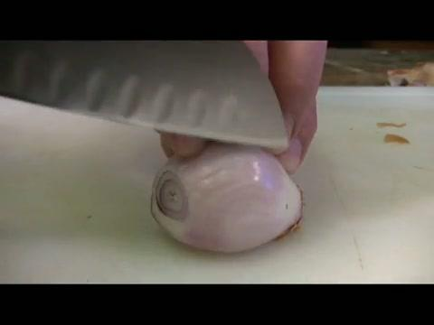
Natural Language Video Description
Generate an NL video description by training a suite of SVM-based visual recognizers and composing their outputs into a coherent sentence using a graphical model (Krishnamoorthy et al., 2013; Thomason et al., 2014)
Video
Content
Selection
SVOP
Surface
Realization
Sentence

Slide 17
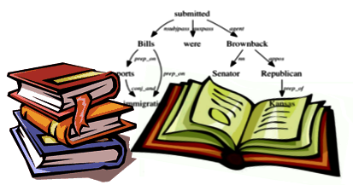
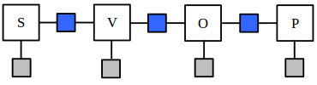
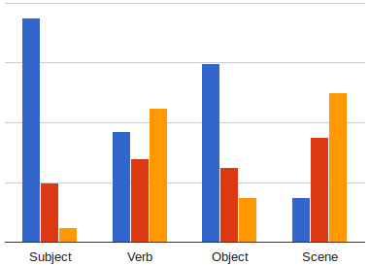
Video Description Architecture
Language Statistics
MAP Inference on Factor Graph
estimates the most likely
SVOP quadruple.
Subject | person
Verb | slice
Object | onion
Place | kitchen
A person is slicing an onion in the kitchen.
Visual Confidences
Notes:
We finally perform inference (MAP) on the factor graph to generate the most likely SVOP quadruple.

Slide 18
PRESENT

Slide 19
Deep Learning Revolution
Deep learning takes over computer vision with deep convolutional neural nets (CNNs).
Deep learning takes over language with recurrent neural nets (RNNs) such as Long Short Term Memory (LSTMs).
CNNs and LSTMs combined to more effectively caption images and videos.

Slide 20


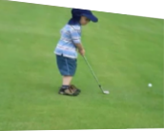
Recurrent Neural Networks (RNNs)
Encoder/Decoder Sequence to Sequence
English
Sentence
RNN encoder
RNN decoder
French
Sentence
[Sutskever et al. NIPS’14]
CNN
Encoder
RNN decoder
Sentence
[Donahue et al. CVPR’15]
[Vinyals et al. CVPR’15]
CNN
Encoder
RNN decoder
Sentence
[Venugopolan et al. NAACL’15]
Encode
CNN
+ RNN encoder
RNN decoder
Sentence
[Venugopalan et al. ICCV’15]
Notes:
We go back to the original machine translation framework. Encode french sentences to vector and decode to english sentence.
Video is a sequence of frames

Slide 21




S2VT: Sequence to Sequence Video to Text
CNN
CNN
CNN
CNN
Now decode it to a sentence!
LSTM
LSTM
LSTM
LSTM
LSTM
LSTM
LSTM
LSTM
...
LSTM
LSTM
LSTM
LSTM
LSTM
LSTM
LSTM
LSTM
Encoding stage
A
man
is
talking
...
Decoding stage
Notes:
Our model uses LSTMs to encode the video clip frame by frame and then decodes it word by word to generate an english description.

Slide 22
Visual Question Answering
(Agrawal, et al., 2016)
Answer natural language questions about an image.

Slide 23
VQA Architectures
Most systems are DNNs using both CNNs and RNNs.

Slide 24
Visual Dialog
Engage in coherent, multi-turn, natural-language dialog about an image, rather than answering a single-shot question.

Slide 25
Visual Dialog
Das et al., CVPR 2017

Slide 26
Learning Cooperative Visual Dialog Agents with Deep Reinforcement Learning.
Das et al., ICCV 2017

Slide 27
Using Vision to Disambiguate Language
Word Sense Disambiguation with visual context.
Machine Translation with visual context.

Slide 28
Multimodal Pivots for Image Caption Translation Hitschler et al., ACL 2016

Slide 29
Using Language to Disambiguate Vision
“A Generalized Model for Multimodal Perception” Shiang et al., AAAIFallSymp-2017

Slide 30
Sample Language Enhanced Vision
Performance of the vision-only (upper) and our multimodal (lower) approaches. The blue boxes are the correctly classified ones; the red boxes, misclassified ones; and the yellow boxes, those boxes that have been corrected after multimodal fusion.

Slide 31
Joint Visual/Linguistic Interpretation
Joint linguistic and visual analysis can simultaneously resolve ambiguity in both.
“Resolving Language and Vision Ambiguities Together: Joint Segmentation & Prepositional Attachment Resolution in Captioned Scenes,” Christie et al., EMNLP 2016.

Slide 32
Joint PP-Attachment
& Image Segmentation

Slide 33
Explainable AI (XAI) for Vision and Language
In order to allow human users to know if and when they should trust an AI system, it should be more transparent and interpretable and be able to explain it’s reasoning.
Deep learning systems used in language and vision are particularly opaque “black boxes.”

Slide 34
Explainable VQA
“Attentive Explanations: Justifying Decisions and Pointing to the Evidence,” Park et al., InterpML, NIPS-2017.
Explanation: “Because he is on a snowy
hill wearing skis”

Slide 35
Multi-Modal Perceptual Grounding
Should ground the meaning of words in multimodal robotic sensory data that goes beyond just vision.
Produce a multi-modal feature vector for each object and train classifiers to recognize descriptive words/phrases such as “empty,” “metallic,” etc.
“Learning Multi-Modal Grounded Linguistic Semantics by Playing ‘I Spy’”, Thomason et al. IJCAI-2016

Slide 36
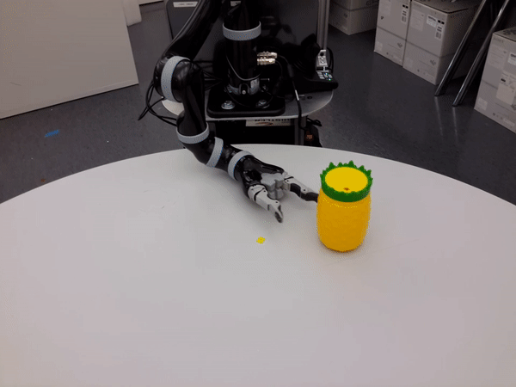
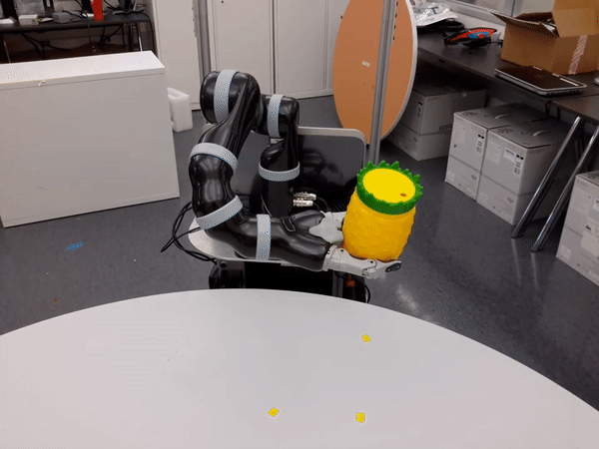
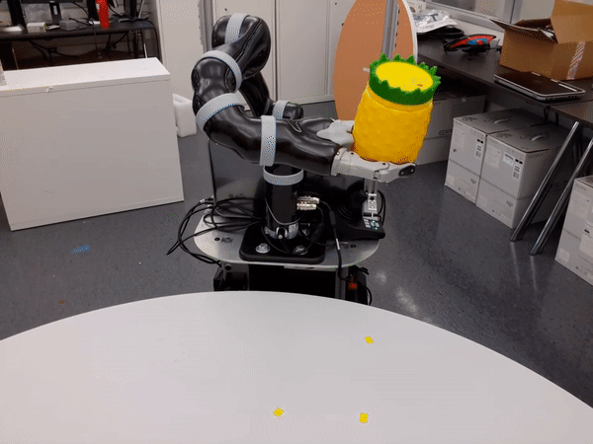
Multimodal Classifiers
The robot used vision, audio and haptic information from manipulating the objects
Grasp
Lift
Lower

Slide 37
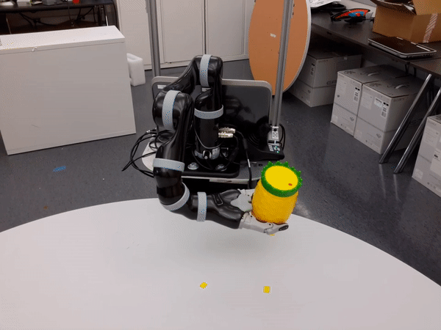
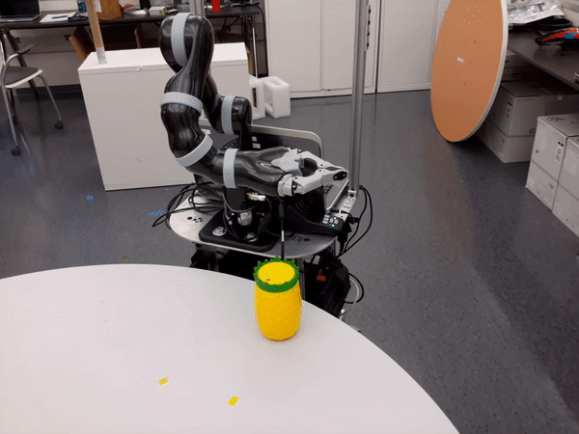
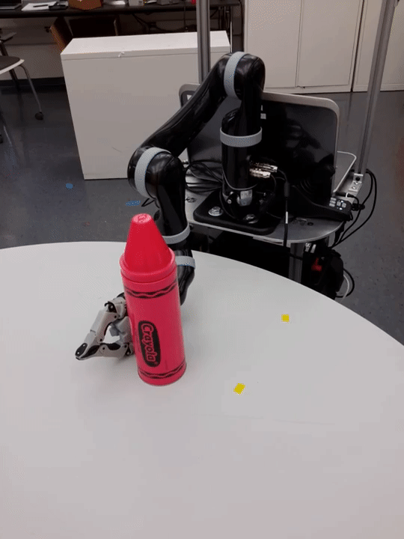
Multimodal Classifiers
The robot used vision, audio and haptic information from manipulating the objects
Drop
Press
Push

Slide 38
Language to 3D Graphics
“Text to 3D Scene Generation with Rich Lexical Grounding,” Chang et al. ACL 2015

Slide 39
FUTURE

Slide 40
Issues with Vector-Space Semantics
How to compose vector-space meanings of larger phrases and sentences from lexical representations? (many recent proposals…)
None of the proposals for compositionality capture the full representational or inferential power of symbolic logic .
“You can’t cram the meaning of a whole
%&!$# sentence into a single $&!#* vector!”

Slide 41
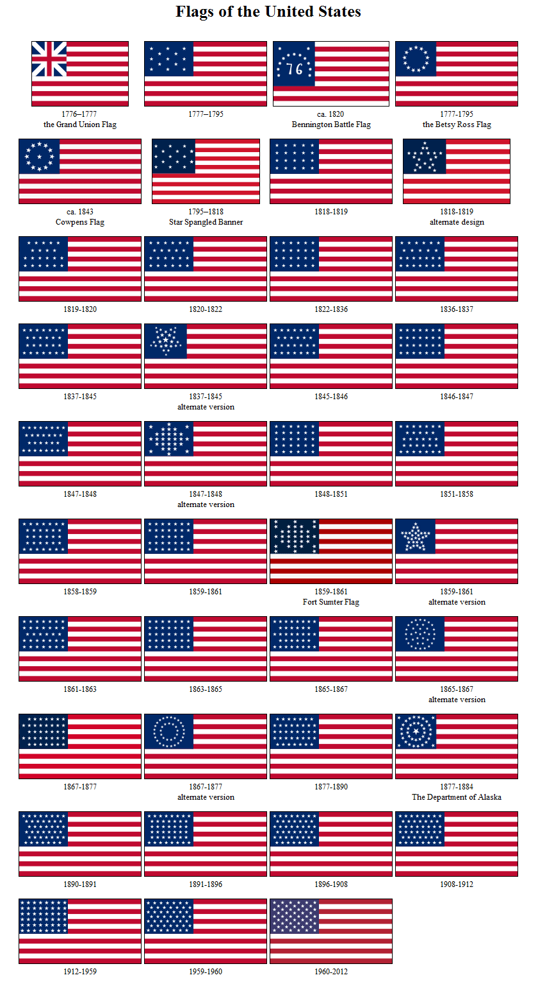
Can you effectively cram this VQA problem into a vector?
What was the number of stars minus the number of stripes on the US flag in 1900?

Slide 42
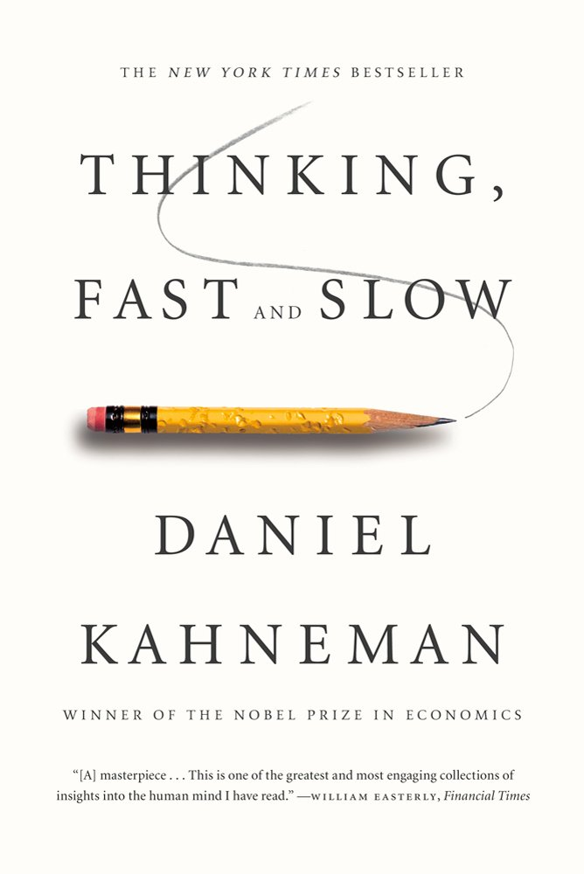
Integrating Pattern Recognition and
Symbolic Reasoning
NNs model thinking fast ̶ pattern recognition.
GOFAI models thinking slow ̶ symbolic reasoning.
Need to integrate both for effective AI.

Slide 43
Modular NN’s
An existing approach to integrating the two is Andreas et al.’s Neural Module Networks (NAACL 2016, ICCV 2017)

Slide 44
NMN’s to N2NMNs
NMNs used a fixed parser to construct the module layout, newer end-to-end version learns to construct the right layout.

Slide 45
Text2Animation
Given a natural language description of an activity, generate a 3-D graphics animation.
Starting with simple human motion using MoCap data captioned with language.

Slide 46
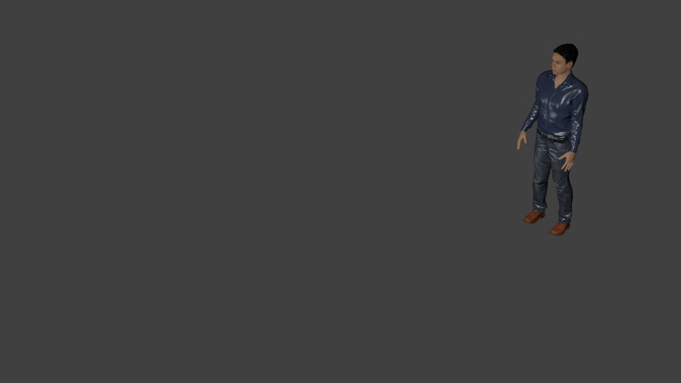
Simple Text2Animation Example
The man jumps forward.

Slide 47


Text2Animation Long-Term Goals
Allow for human interaction with objects and detailed scene descriptions.
  A little boy in a red shirt kicks a soccer ball, it bounces off a pine tree and then hits a glass of red wine sitting on a picnic table and breaks it.
Ultimate vision:
(Thanks to Angel Chang)

Slide 48
Conclusions
Past: Language grounding has a long, rich history.
Present: There is blossoming of recent work using deep learning.
Future: How do we integrate deep learning and symbolic representation and reasoning?

