Slide 1





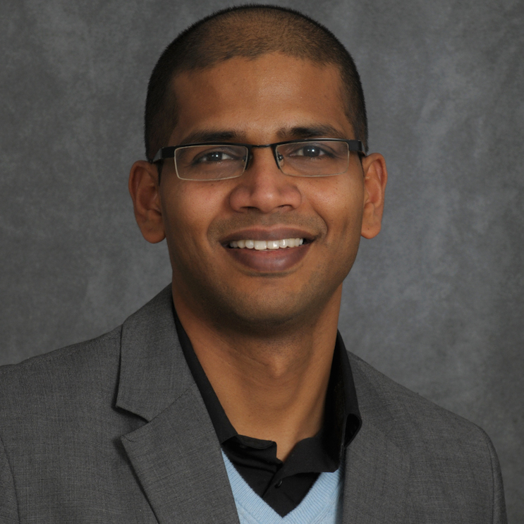

Some Simple Problems that Still Challenge LLMs and VLMs: Plan Step Dependencies and Multimodal Entity Tracking
Raymond J. Mooney
University of Texas at Austin
Niranjan
Balasubramanian
Nate Chambers
Vanya Cohen
Yash Kumar Lal
Notes:
Hi, I’m Yash Kumar Lal presenting this paper

Slide 2
The LLM Revolution
Over the past ~5 years, LLMs and their multimodal extensions (VLMs, VLAs) have made amazing, surprising progress.
However, there has also been excessive hype. AGI / ASI is not around the corner.
Current SOTA models still exhibit fundamental limitations on various problems.
AI shows both great promise and significant threats for the future of human welfare.

Slide 3
AI Timeline (Personalized)
Dartmouth meeting (1956)
Perceptron algo (1957)
Perceptron book (1969)
I wrote HS paper on AI (1979)
Expert systems (my college years) (1980’s)
Backprop NNs (1990’s)
Bayesian AI (2000s)
Deep Learning (2012-present)

Slide 4
AI Timeline (Personalized)
Dartmouth meeting (1956)
Perceptron algo (1957)
Perceptron book (1969)
I wrote HS paper (1979)
Expert systems (my college years) (1980’s)
Backprop NNs (1990’s)
Bayesian AI (2000s)
Deep Learning (2012-present)
Is another AI winter coming?
Popularity of neural networks

Slide 5
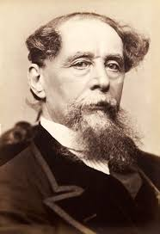
Relevant Quote about the Current State of AI from Charles Dickens
It was the best of times, it was the worst of times, it was the age of wisdom, it was the age of foolishness, it was the epoch of belief, it was the epoch of incredulity, it was the season of Light, it was the season of Darkness, it was the spring of hope, it was the winter of despair.

Slide 6
Recent Papers on LLM Limitations
Limits of LLM Reasoning
Shojaee et al., The Illusion of Thinking: Understanding the Strengths and Limitations of Reasoning Models via the Lens of Problem Complexity, NeurIPS 2025.
Limits of LLM Planning
Kambhampati, Can Large Language Models Reason and Plan?, 2024.
Limits of VLMs
Tong, et al., Eyes Wide Shut? Exploring the Visual Shortcomings of Multimodal LLMs, CVPR 2024
Limits of Video Generation
Bansal, et al., VideoPhy: Evaluating Physical Commonsense for Video Generation, ICLR 2025 (and VideoPhy2)
Limits of Multimodal Reasoning
Hao, et al., EMMA An Enhanced MultiModal ReAsoning Benchmark, ICML 2025

Slide 7
My New Quotable Opinion
Sometimes large language models surprise you how smart they are, and sometimes they surprise you how stupid they are!

Slide 8
My ACL 2014 Semantic Parsing Workshop Comment that Became a “Meme”
You can't cram the meaning of a whole %&!$# sentence into a single $&!#* vector!

Slide 9
My New Quotable Opinion
Sometimes large language models surprise you how smart they are, and sometimes they surprise you how #$&@% stupid they are!
This is called “grawlix” and stands for censored profanity, a convention that started in American comic books.

Slide 10
Understanding Action Ordering in Instructional Text (EMNLP, 2024)
Explored limitations of understanding instructional text.
Specifically, comprehending whether steps can be reordered or not, which tests understanding of the causal connections between actions.
Can LLMs determine whether steps can or cannot be reordered?
Can they explain why they can or cannot be reordered?

Slide 11
Instructional Text Corpus
English Recipe Flow Graph Corpus (Yamakata et al., 2020) which contains 300 English language cooking recipes annotated with named entities and substep procedure dependencies.

Slide 12
Plans contain dependencies
Goal: Bake Almond and Chocolate Cake
…
Step 6: Stir in ground almonds.
Step 7: Add half flour and half milk.
Step 8: Use wooden spoon to stir.
…
Step 12: Whip cream till stiff peaks
…
Notes:
Let’s consider a sequence of steps to bake an almond and chocolate cake. Part of the recipe would be stirring in ground almonds, adding flour and milk and stirring the mixture. Towards the end, we might want to whip some cream as icing and add it on top.

Slide 13
Plans contain dependencies
Goal: Bake Almond and Chocolate Cake
…
Step 6: Stir in ground almonds.
Step 7: Add half flour and half milk.
Step 8: Use wooden spoon to stir.
…
Step 12: Whip cream till stiff peaks
…
Dependent
Steps
Notes:
While plans manifest as a simple sequence of steps, these steps actually encode complex dependencies between them. We can test whether LLMs understand such causal relationships as a way to test their plan understanding capabilities.

Slide 14
Plans contain dependencies
Q: Must Step 6 happen before Step 8?
Preconditions
Goal: Bake Almond and Chocolate Cake
A: Yes, all ingredients have to be in bowl before stirring
…
Step 6: Stir in ground almonds.
Step 7: Add half flour and half milk.
Step 8: Use wooden spoon to stir.
…
Step 12: Whip cream till stiff peaks
…
Questions about dependent steps
Notes:
For instance, if we want to reason about whether Step 6 must happen before Step 8, we can use our knowledge of preconditions to come up with reasoning that all the ingredients must be in the bowl before we stir them together. So, there is a dependency here.

Slide 15
Plans contain dependencies
Q: Must Step 6 happen before Step 8?
Preconditions
Goal: Bake Almond and Chocolate Cake
A: Yes, all ingredients have to be in bowl before stirring
…
Step 6: Stir in ground almonds.
Step 7: Add half flour and half milk.
Step 8: Use wooden spoon to stir.
…
Step 12: Whip cream till stiff peaks
…
Questions about dependent steps
Q: Must Step 7 happen after Step 6?
Parallel Steps
A: No, almonds can be added after flour and milk
Questions about non-dependent steps
Notes:
Similarly, if we want to answer whether Step 7 must happen after Step 6, we understand that adding in ground almonds or flour and milk can be done interchangeably or in parallel. So, there is no dependency here. We use this simple intuition to create CaT-Bench, a benchmarking dataset for plan-based reasoning.

Slide 16
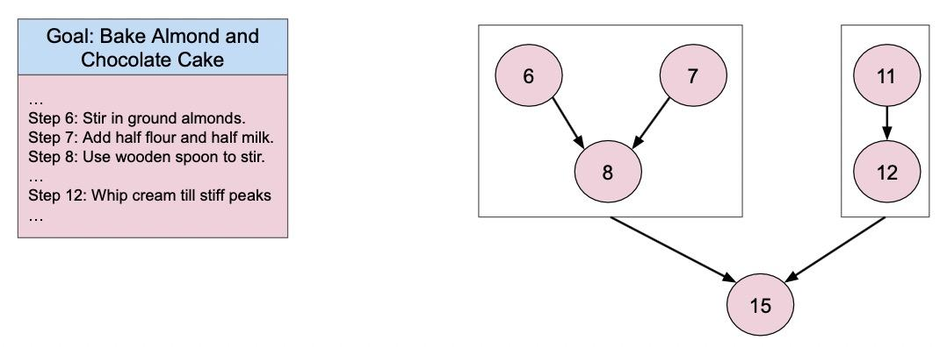
Creating 😺 CaT-Bench
710
Q: Must Step 6 happen before Step 8?
Q: Must Step 12 happen after Step 6?
710
710
Q: Must Step 8 happen after Step 6?
Q: Must Step 6 happen before Step 12?
710
1420
Questions about dependent steps
Questions about non-dependent steps
1420
Notes:
We use these causal dependency graphs to create simple questions related to the temporal order of steps. This leads to questions about two types of pairs of steps - dependent and non-dependent ones. We create a balanced set of 1420 questions of each type, 710 of which test the before relation and 710 of which test the after. Thus, CaT-Bench is created. We use F1 score to measure how well models answer these questions.

Slide 17

Benchmarking Models
GPT-3.5
GPT-4-Turbo
GPT-4o
Notes:
We benchmark a whole host of models on this simple task of predicting whether one step happened before or after another in a plan, starting with the GPT family.

Slide 18

Benchmarking Models
GPT-3.5
GPT-4-Turbo
GPT-4o
Llama-3-8B
Notes:
Including an open-source model in there as well, something smaller that we can run locally

Slide 19

Benchmarking Models
GPT-3.5
GPT-4-Turbo
GPT-4o
Llama-3-8B
Claude-3.5-Sonnet
Notes:
We also add the best Claude model

Slide 20
Benchmarking Models
GPT-3.5
GPT-4-Turbo
GPT-4o
Llama-3-8B
Claude-3.5-Sonnet
Gemini-1.0-Pro
Gemini-1.5-Pro
Gemini-1.5-Flash
Notes:
And a host of models from the Gemini family

Slide 21
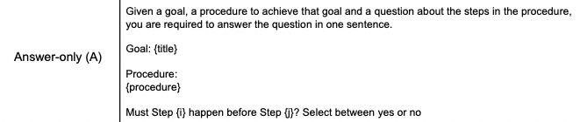
Experiments - Answer Only (A)
Binary Prediction
Notes:
First, we simply ask models to provide binary judgments - a simple yes or no answer. 50% chance of getting it right and 50% chance of getting it wrong

Slide 22
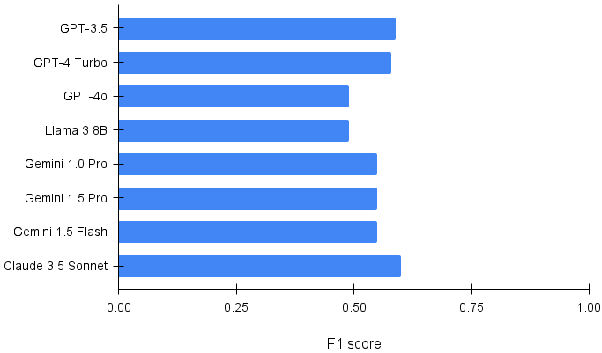
Models Struggle at Predicting Step Order
Notes:
Models struggle at predicting step order, with even the best of them barely performing over random chance.

Slide 23
Models Struggle at Predicting Step Order
Notes:
Surprisingly, GPT-4o actually performs the worst

Slide 24
Additional Reasoning Model Results
Newer models are trained to perform explicit reasoning steps which maybe help on CAT-BENCH.
Definitely improved results, but not yet to 100%.
2024: GPT-O1 preview: 83% F1
2025: GPT-5: 91% F1

Slide 25
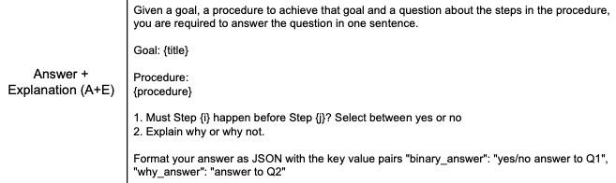
Experiments - Answer + Explanation (A+E)
Binary Prediction and Post-hoc Explanation
Notes:
Next, we also prompt models to add an explanation to their answers. Prior work has shown that this usually helps model reasoning.

Slide 26
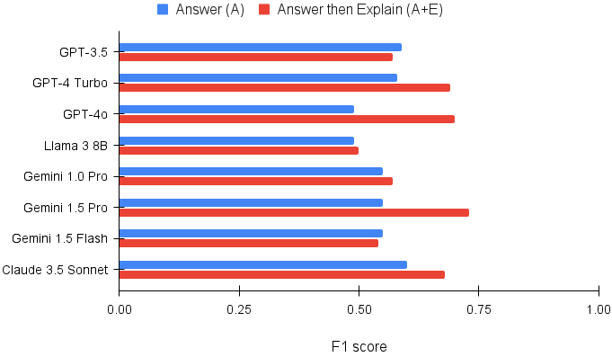
Generating explanations help!
Notes:
And, very obviously, generating explanations always helps.

Slide 27
Generating explanations help!
Notes:
The biggest improvement is seen in GPT-4o, which goes from the worst performing model to the second best one.

Slide 28
Generating explanations help!
Notes:
But, overall, Gemini-1.5-Pro is the best model for this task. Even so, the performance is under 75%. On such a simple task, this is low, showing that models do not necessarily understand causal knowledge encoded in plans.

Slide 29
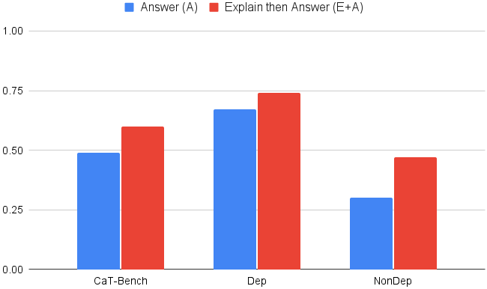
Chain of Thought Improves over Zero-Shot
Notes:
When we prompt GPT-4o to produce intermediate steps as its reasoning before coming up with the answer, we find that there is a significant improvement over zero-shot performance. This is line with all the previous findings.

Slide 30
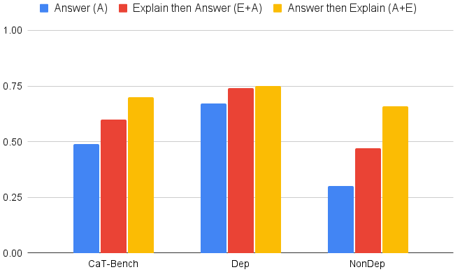
Post-Hoc Explanations are Better than Chain of Thought
Notes:
And this is what happens when we prompt models for post-hoc explanations, i.e., the (A+E) setting. Remember, the red bar is CoT and yellow is A+E. Post-hoc explanations turn out to be much better than chain of thought reasoning overall. We also tried few-shot prompting and self-consistency but they are not better than using post-hoc explanations in a zero-shot setting.

Slide 31
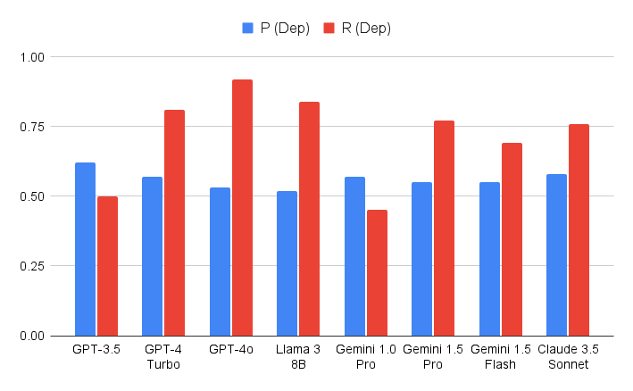
Models are Biased towards Predicting Dependence
Notes:
When we compare model performance on dependent pair of steps to that on nondependent pair of steps, we note there is a huge discrepancy. While these plots only show GPT-4o, the same is true for all the models to different degrees. Models are just more likely to predict that two steps are dependent on each other rather than the opposite. This also forms the basis of their overall performance.

Slide 32
Robustness: Temporal Consistency
Goal: Bake Almond and Chocolate Cake
…
Step 6: Add in ground almonds.
Step 7: Add half flour and half milk.
Step 8: Use wooden spoon to stir.
…
Step 12: Whip cream till stiff peaks
…
Q: Must Step 6 happen before Step 8?
Before
Q: Must Step 8 happen after Step 6?
After
The model answer to the ‘before’ and ‘after’ questions should be the same.
Notes:
Before we can use them as part of any critical systems, we also need to understand how robust these models are. We use the notion of temporal consistency to evaluate the same. Remember, for each pair of steps, CaT-Bench contains two questions, one tests whether Step X must happen before Step Y and the other which tests whether Step Y happens after Step X. The answer to both questions should be the same. So, using temporal consistency, we measure the percentage of times when that is true.

Slide 33
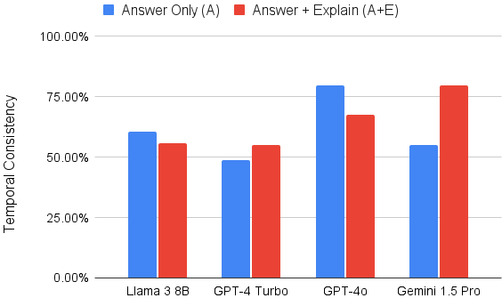
How Robust are Models to Query Rephrasing?
GPT O1 preview:
85% TC
GPT-5:
94% TC
Notes:
I only show some models here but for most of them, prompting for explanations helps. The jump is particularly high for Gemini 1.5 Pro, which incidentally also shows the best overall performance. Answering before and after questions about the same pair of steps requires using slightly different types of causal knowledge but really, it should be simple enough for these large models.

Slide 34

How Good are the Generated Explanations?
Model Explanation: All ingredients must be in the bowl to be mixed well together.
The answer contains the relevant details to address the question.
Likert Scale
Strongly Disagree
(1)
Disagree
(2)
Neutral
(3)
Agree
(4)
Strongly Agree
(5)
Average Likert Score
Notes:
Next, we look at the quality of model explanations. We use human evaluation to judge them. Each explanation is rated on a Likert scale of 1 to 5 by 3 distinct human annotators. We then use the average of their scores to rate a model.

Slide 35
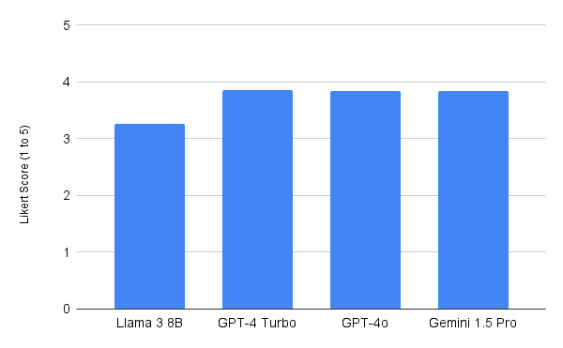
How Good are the Generated Explanations?
neutral
Notes:
From this graph, it looks like model explanations are pretty good, almost reaching a +1 score. The smaller Llama model is clearly worse than its larger closed source counterparts. Due to cost, we only evaluate a subset of explanations from the best models. We measure inter annotator agreement using Weighted Fleiss Kappa, which is 0.76.

Slide 36
Sample Good Yes Answer and Explanation
…
7. Add flour mixture and guava mixture alternately to creamed mixture.
8. Pour batter into prepared tin.
9. Bake at 180 C / Gas 4 for 30-35 minutes.
Must Step 9 happen after Step 8? Explain why or why not.
Yes. Step 9 involves baking the batter, which can only be done after the batter is prepared and poured into the tin in Step 8, following the mixing in Step 7.

Slide 37
Sample Good No Answer and Explanation
…
4. In another bowl, mix together guava pulp and juice.%
5. In another bowl, cream together butter and sugar.
Must Step 5 happen after Step 4? Explain why or why not.
No. Step 5, which involves creaming butter and sugar, can be done independently of mixing the guava pulp and juice in Step 4.

Slide 38
Sample Right Answer with Bad Explanation
Goal: green-tofu-curry Steps:
Place water in a medium saucepan, and stir in the rice.
Bring to the boil.
Cover, reduce heat, and simmer 20 minutes.
Must Step 2 happen after Step 1? Explain why or why not.
Step 2 must happen after Step 1 because the procedure requires bringing the water to a boil before reducing the heat and simmering the rice, which cannot be done if the water has not been brought to a boil first.
(completely misses what Step 1 is about and produces an answer related to Step 3 instead)

Slide 39
Sample Wrong Answer with Good Explanation
Goal: egg-and-bacon-breakfast-parcels
…
Step 14: Remove from oven.
Step 15: Place plate on top on top of loaf and flip over (invert) to remove cooked surprise.
Step 16: This may need a gentle tap with a wooden spoon.
Step 17: Don't worry if it leaks a bit.
Step 18: Just serve it hot and enjoy!
Q: Must Step 14 happen before Step 17? Explain why or why not.
No. You cannot assess whether the parcel leaks during removal (Step 17) before taking it out of the oven (Step 14).

Slide 40
Wrong Answers with Good Explanations
Average across 4 models (llama 3 8b, gemini 1.5 pro, gpt 4 turbo and gpt4o) totaling 1920 data points.
18% of the explanations have incorrect predictions but human Likert ratings of 4 or 5.

Slide 41
Multimodal Entity Tracking (arxiv 2025)
Entity tracking involves reasoning about how actions change the state of entities.
Several previous papers have shown LLMs have trouble tacking entity states over time (Toshniwal et al., AAAI22; Kim & Schuster, ACL23; Fagnou, EMNLP24).
Our results show newer reasoning LLMs are better at entity tracking but that VLMs still have trouble when actions are depicted visually or multimodally.

Slide 42
Multimodal Reasoning
There has been significant recent progress in developing “reasoning” models that are trained to perform multistep reasoning to better solve math and coding problems.
This work has focused primarily on unimodal text inputs.
Integrating reasoning into multimodal models is less well developed.
Hao, et al., EMMA An Enhanced MultiModal ReAsoning Benchmark, ICML 2025
Multimodal Algorithmic Reasoning Workshop at NeurIPS 2024 and 2025

Slide 43
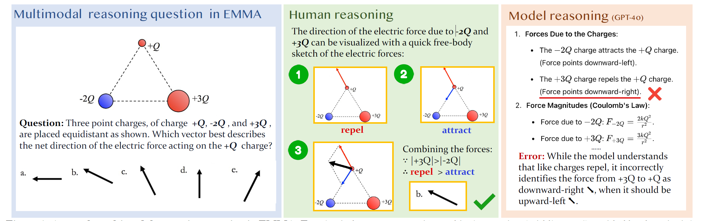
Multimodal Reasoning: Sample Problem from EMMA

Slide 44
Entity State Tracking
Example: Shell Game
Ball placed under one of three cups.
Series of swaps change the hidden ball position.
Predict the final position of the ball.

Slide 45
Example: Text Shell Game
Model receives a text description of the initial state and the actions and asked to predict the final state
Ball Position: 2
Swap 1,2
Swap 1,3
Final State?:

Slide 46
Example: Text Shell Game
Model receives a text description of the initial state and the actions and asked to predict the final state
Ball Position: 2
Swap 1,2
Swap 1,3
Final State?: 3

Slide 47
Example: Multimodal Shell Game
Model receives a text description of the initial state:
Ball Position: 2

Slide 48
Example: Multimodal Shell Game
Model receives an image depiction of the action
1
2
3

Slide 49
Example: Multimodal Shell Game
Model receives an image depiction of the action
1
2
3

Slide 50
Example: Multimodal Shell Game
Asked to predict a text description of the final state:
Final State?

Slide 51
Example: Multimodal Shell Game
Asked to predict a text description of the final state:
Final State?
3

Slide 52
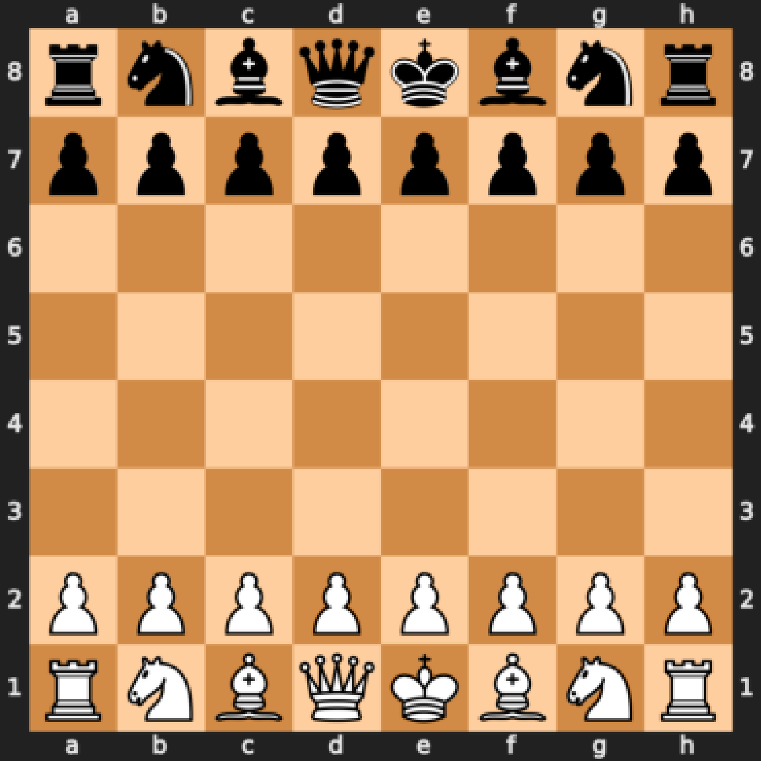
Example: Chess
Text Input:
Forsyth–Edwards Notation (FEN)
"rnbqkbnr/pppppppp/8/8/8/8/
PPPPPPPP/RNBQKBNR w KQkq - 0 1"

Slide 53
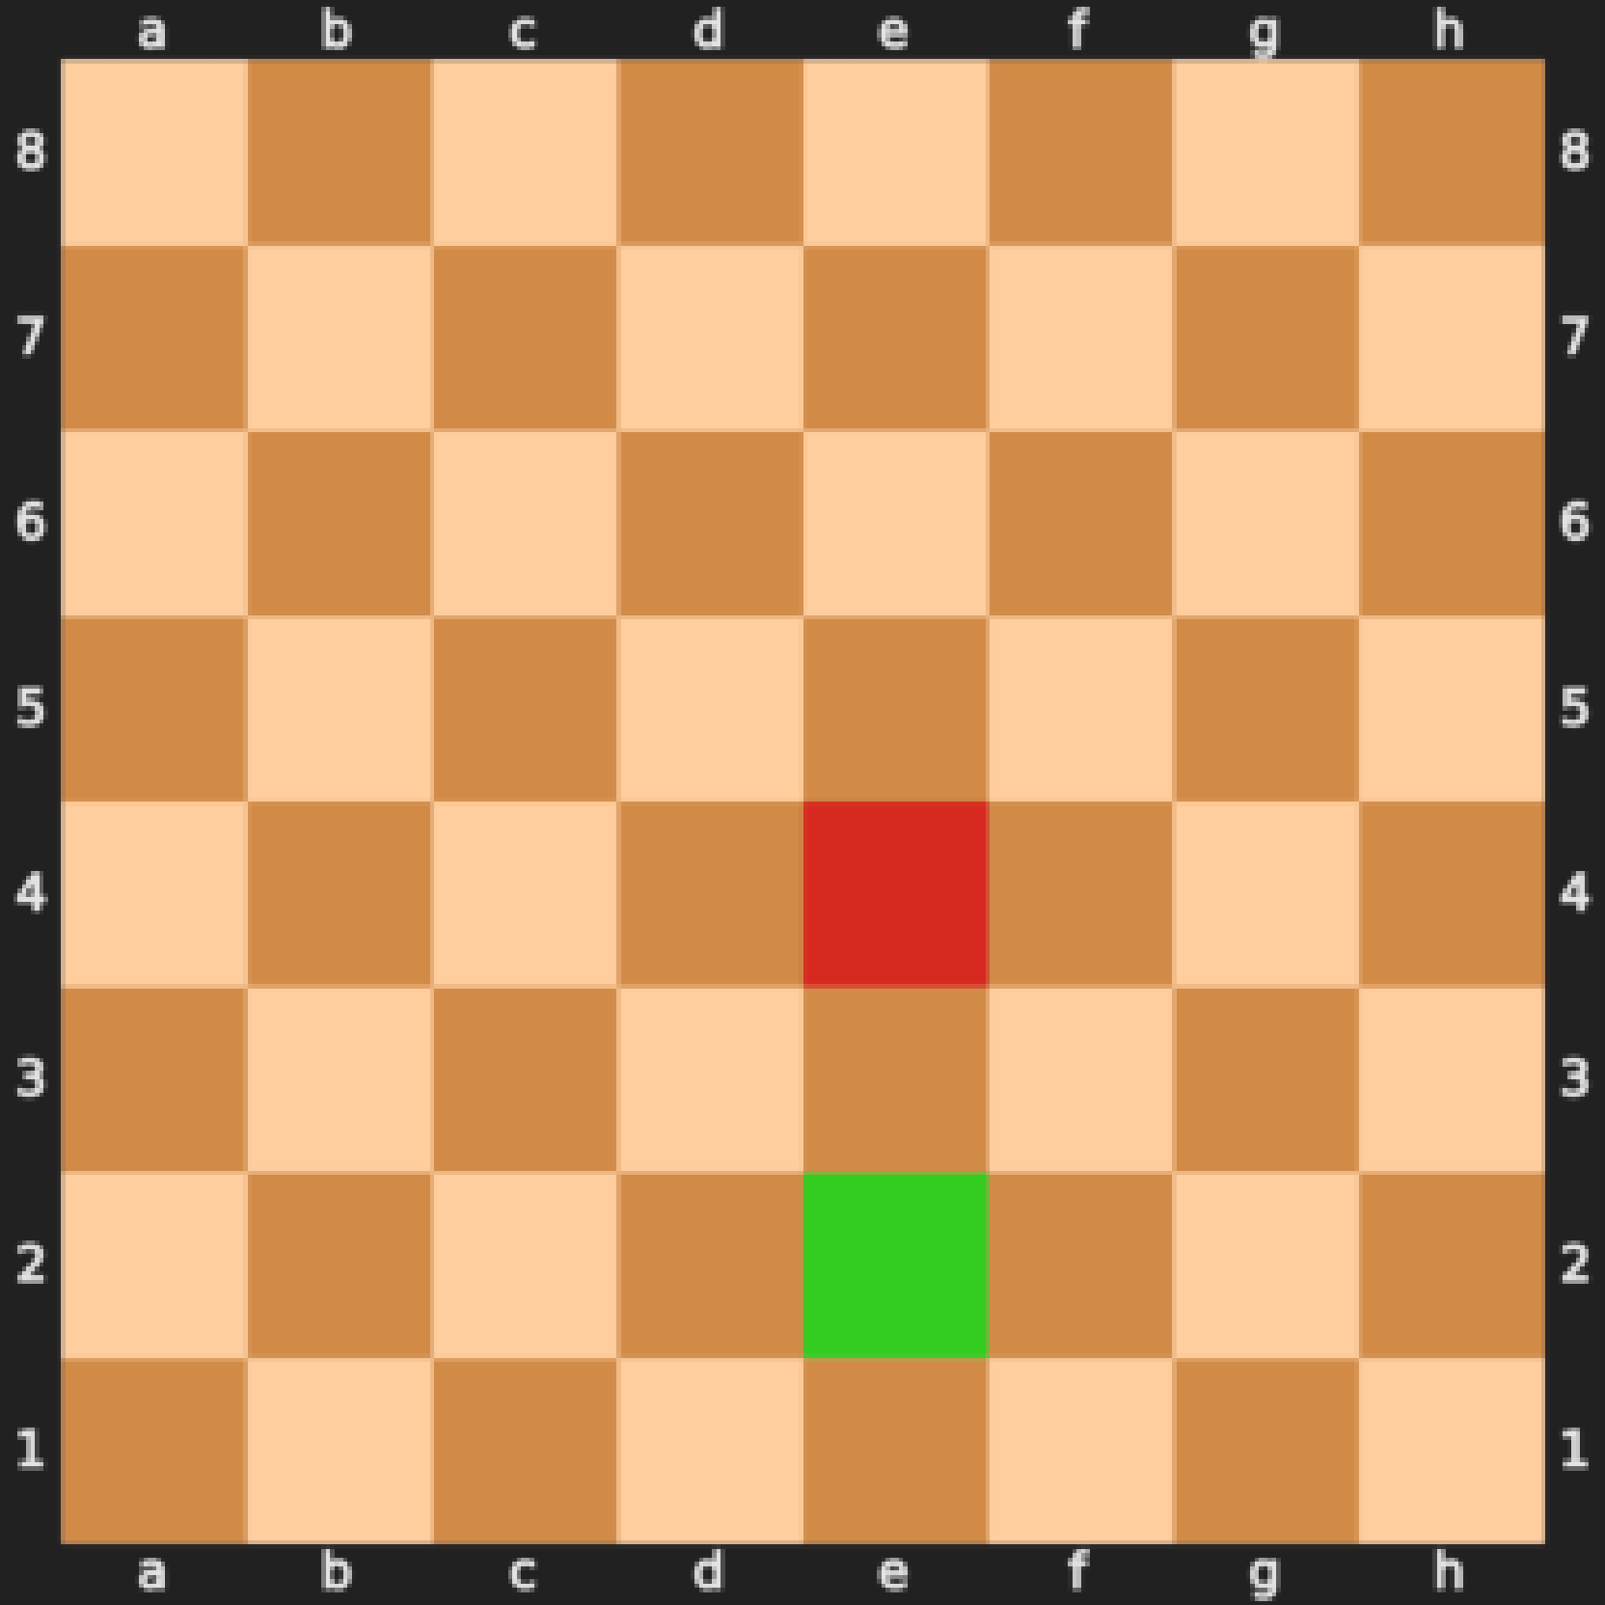
Example: Chess
Universal Chess Interface Notation
e2e4 “The piece at e2 moves to e4.”

Slide 54
Example: Chess
Q: Final State?
A: rnbqkbnr/pppppppp/8/8/4P3/8/PPPP1PPP/RNBQKBNR b KQkq e3 0 1

Slide 55
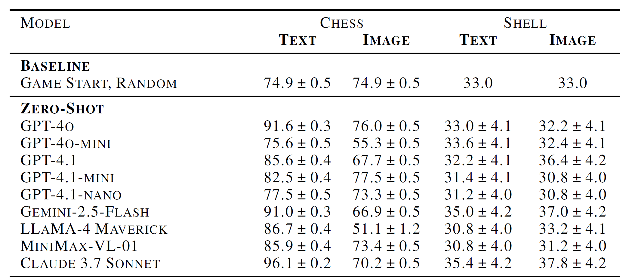
Zero Shot Results for 10 Action Sequence

Slide 56
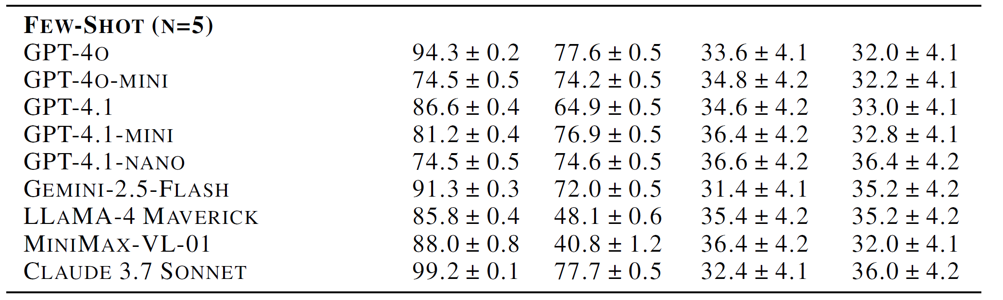
Few Shot Results for 10 Action Sequence

Slide 57
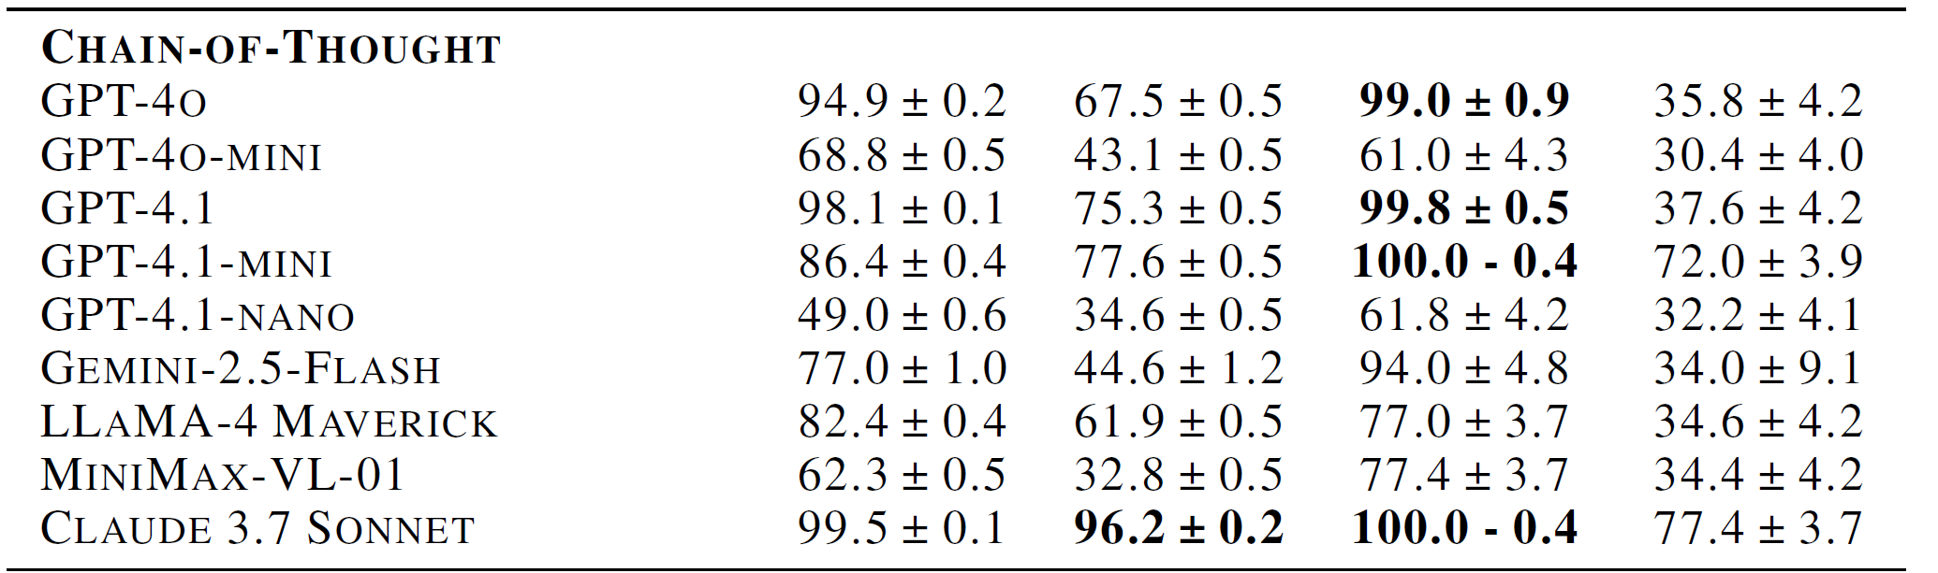
Chain of Thought Results for 10 Action Sequence

Slide 58
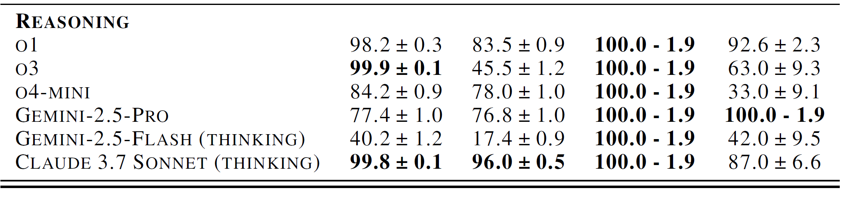
Reasoning Model Results for 10 Action Sequence

Slide 59
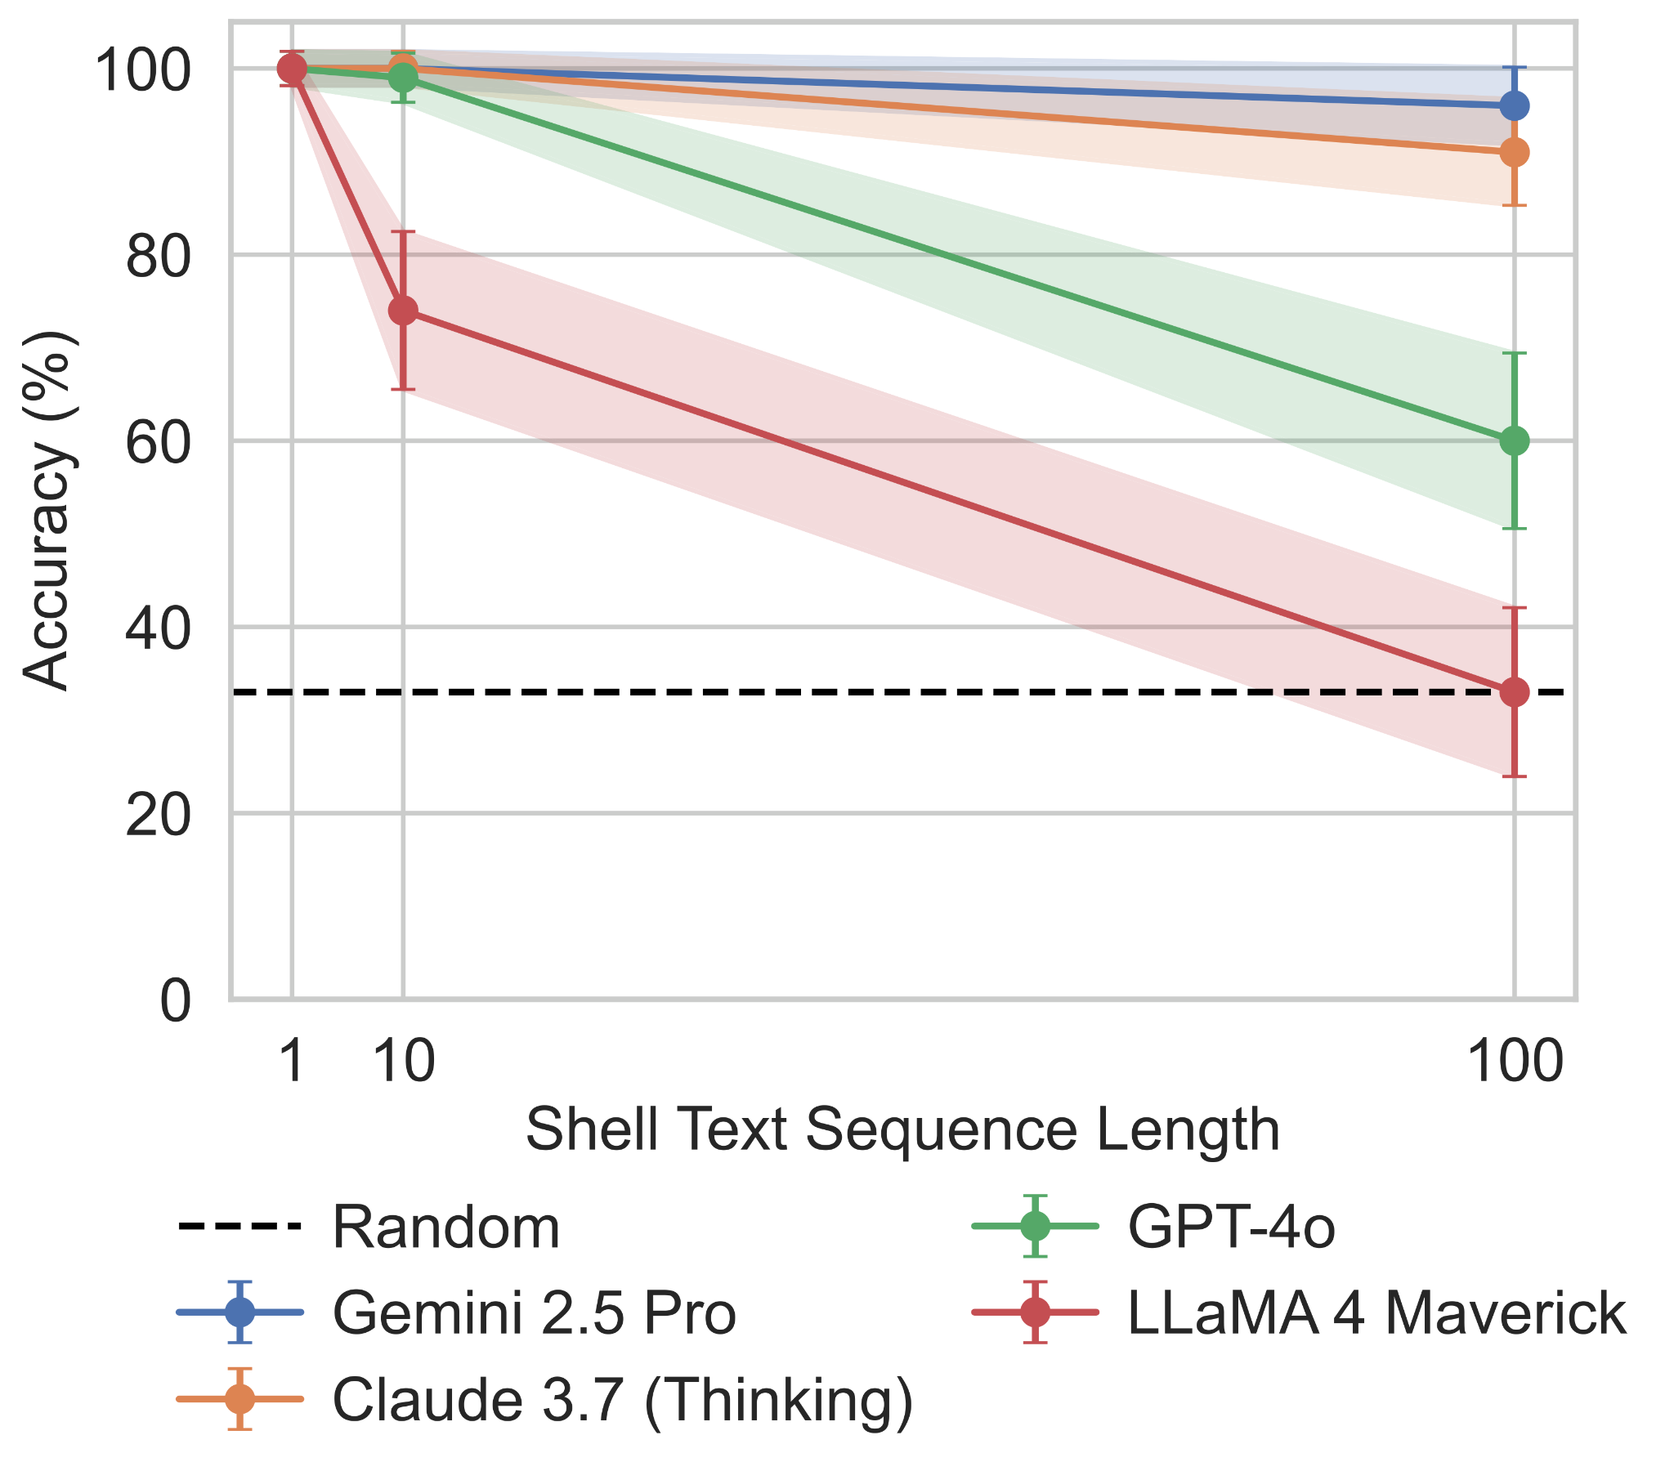
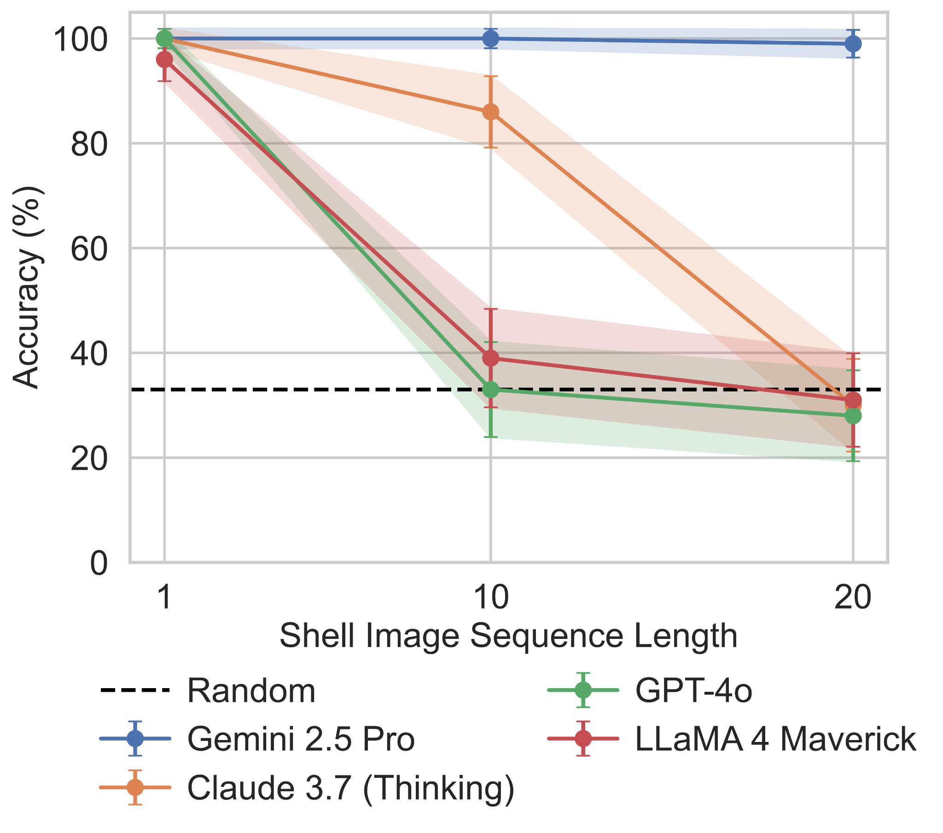
Shell Game With Increase # of Actions

Slide 60
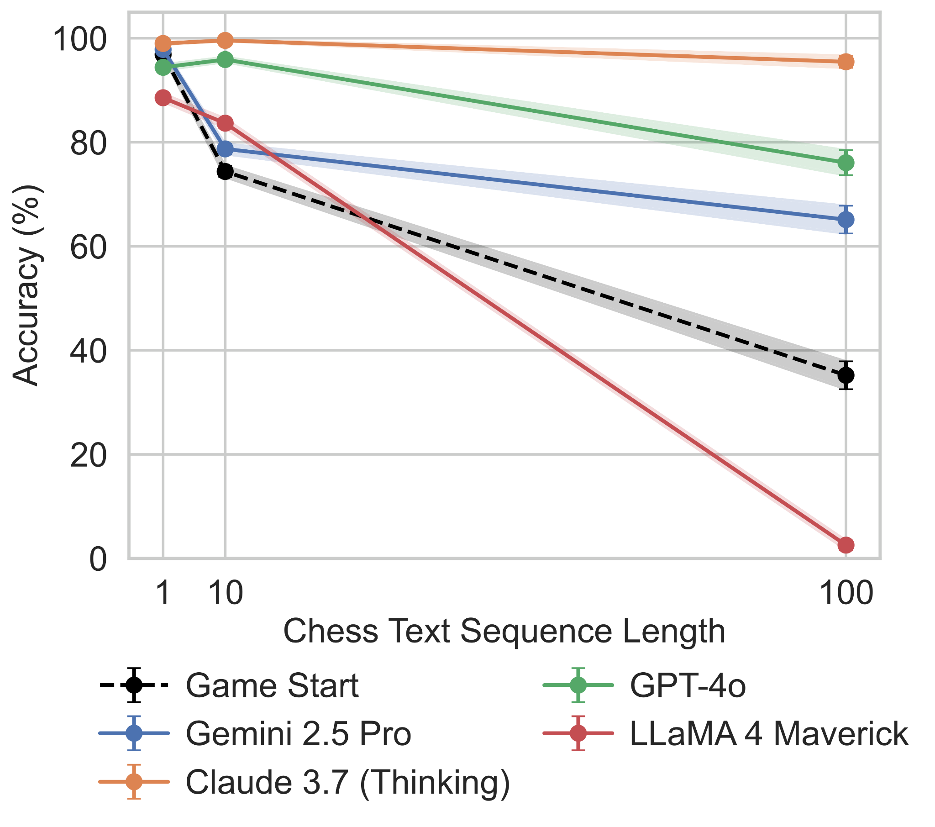
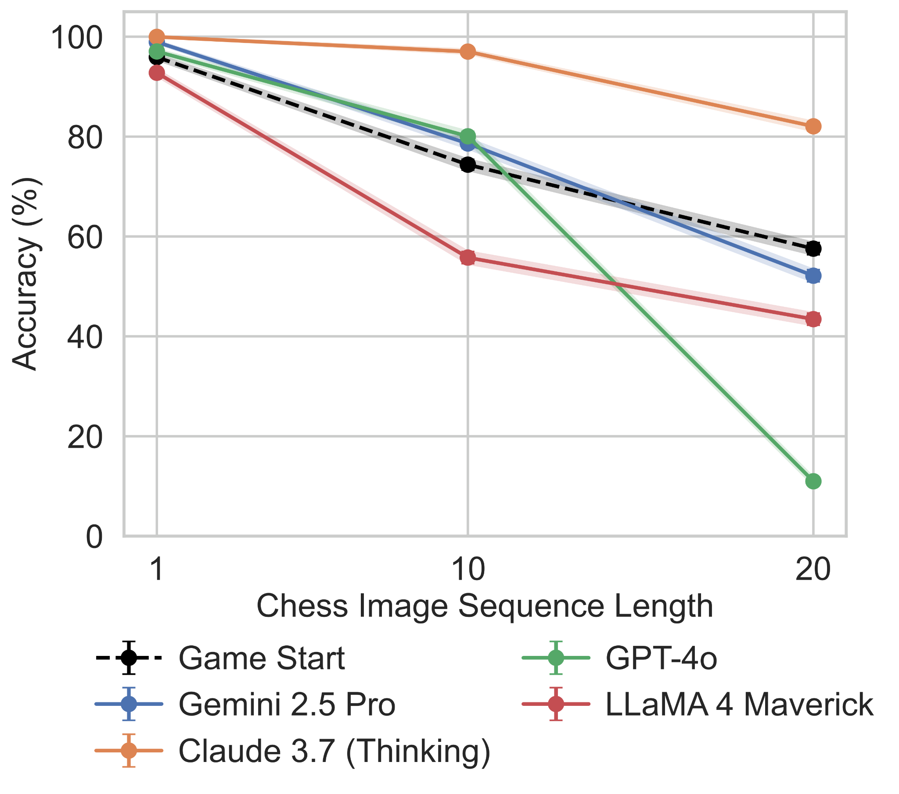
Chess with Increasing # of Actions

Slide 61

Image Action Perception
Q: In UCI notation what move does the chessboard image represent? The move is from the green square to the red square. (e.g., 'g2f3').
Q: Which shells are being swapped in the image? Shells are labeled '1', '2', '3' and the shells being swapped have their numbers highlighted in green. Only output a move in the format 'X swap Y' and nothing else.
1
2
3

Slide 62
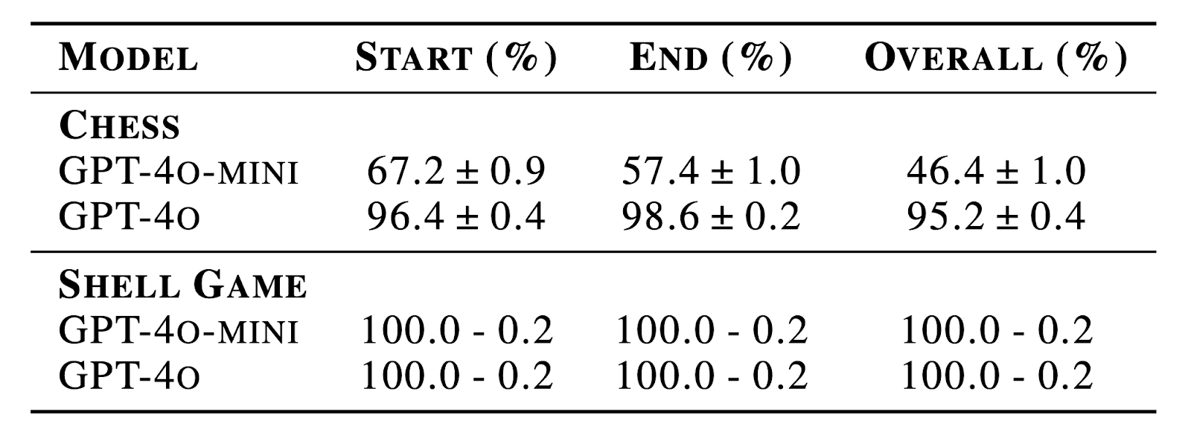
Image Action Perception Results

Slide 63
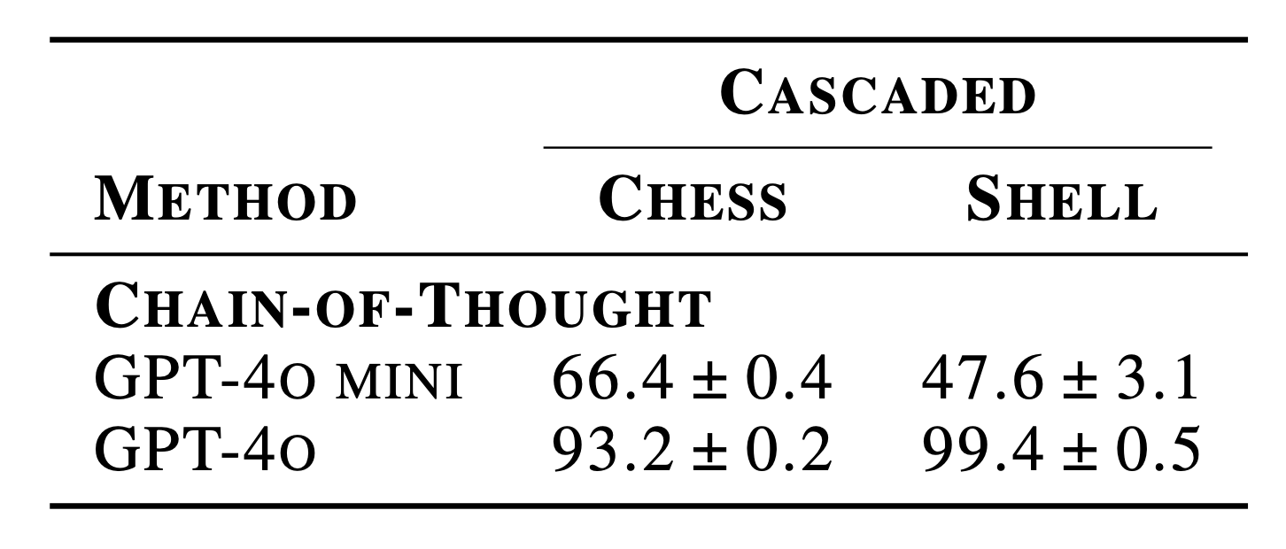
Cascaded Inference
Image Actions → Text Actions → State Prediction

Slide 64
Conclusions on Multimodal Tracking
Base models have trouble tracking how actions change the states of entities.
Tracking is even harder when actions are expressed visually instead of using text.
Recent reasoning models are pretty good at entity tracking for textual inputs.
But multimodal reasoning models still struggle to track entities with visually specified actions.

Slide 65
The “AI Triangle”
AI Boomers
Sam Altman
AI Realist
Emily Bender
Gary Marcus
AI Haters/
Skeptics
AI Doomers
Eliezer Yudkowsky

Slide 66
Conclusions
LLMs and VLMs have made amazing progress in recent years but still have significant limitations.
We have studied two problems that demonstrate such limitations:
Models still have problems determining when two steps specified in instructional text can be reordered, demonstrating an incomplete understanding of causal connections between actions.
Models still have trouble tracking the states of entities when actions are expressed visually or multimodally.
An open question is how to improve the architecture and/or training of models to improve their understanding of actions and their effect on the world.

