Slide 1
Grounded Language Learning
Ray Mooney
Department of Computer Science
University of Texas at Austin

Slide 2
Grounding Language Semantics in Perception and Action
Most work in natural language processing deals only with text.
The meaning of words and sentences is usually represented only in terms of other words or textual symbols.
Truly understanding the meaning of language requires grounding semantics in perception and action in the world.

Slide 3

Sample Circular Definitions from WordNet
sleep (v)
“be asleep”
asleep (adj)
“in a state of sleep”

Slide 4
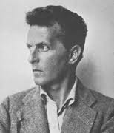

Historical Roots of
Ideas on Language Grounding
  Meaning as Use & Language Games: Wittgenstein (1953)
  Symbol Grounding: Harnad (1990)
4
Notes:
4

Slide 5
Direct Applications of Grounded Language
Linguistic description of images and video
  Content-based retrieval
  Automated captioning for the visually impaired
  Automated surveillance
Human Robot Interaction
  Obeying natural-language commands
  Interactive dialog

Slide 6
Supervised Learning and
Natural Language Processing (NLP)
Manual software development of robust NLP systems was found to be very difficult and inefficient.
Most current state-of-the-art NLP systems are constructed by using machine learning methods trained on large supervised corpora.
  POS-tagged text
  Treebanks
  Propbanks
  Sense-tagged text

Slide 7
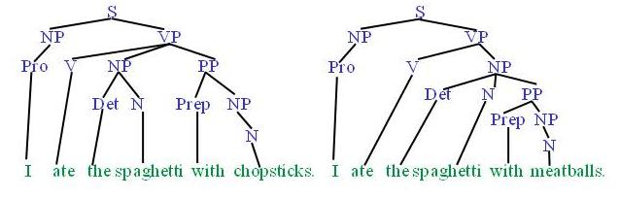
Syntactic Parsing of Natural Language
Produce the correct syntactic parse tree for a sentence.
Train and test on Penn Treebank with tens of thousands of manually parsed sentences.

Slide 8
Word Sense Disambiguation (WSD)
Determine the proper dictionary sense of a word from its sentential context.
  Ellen has a strong interest_{sense1} in computational linguistics.
  Ellen pays a large amount of interest_{sense4} on her credit card.
Train and test on Senseval corpora containing hundreds of disambiguated instances of each target word.

Slide 9
Limitations of Supervised Learning
Constructing supervised training data can be difficult, expensive, and time consuming.
For many problems, machine learning has simply replaced the burden of knowledge and software engineering with the burden of supervised data collection.

Slide 10

Children do not Learn Language from Supervised Data
Penn
Treebank
Propbank
Senseval
Data
Semeval
Data

Slide 11

Children do not Learn Language from Raw Text
  Unsupervised language learning is difficult and not an adequate solution since much of the requisite semantic information is not in the linguistic signal.

Slide 12

Learning Language from Perceptual Context
The natural way to learn language is to perceive language in the context of its use in the physical and social world.
This requires inferring the meaning of utterances from their perceptual context.
That’s a nice
green block you
have there!
12
Notes:
12

Slide 13
Grounded Language Learning in
Virtual Environments
Grounding in the real world requires sufficiently capable computer vision and robotics.
Grounding in virtual environments is easier since perception and action are simulated.
Given the prevalence of virtual environments (e.g. in games & education), linguistic communication with virtual agents also has practical applications.

Slide 14
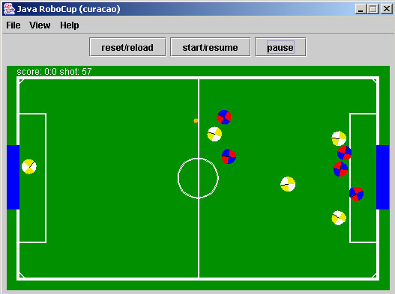
Learning to Sportscast
(Chen, Kim, & Mooney, JAIR 2010)
Learn to sportscast simulated Robocup soccer games by simply observing a person textually commentating them.
Starts with ability to perceive events in the simulator, but no knowledge of the language.
Learns to sportscast effectively in both English and Korean.

Slide 15
Machine Sportscast in English

Slide 16
Learning to Follow Directions in a Virtual Environment
Learn to interpret navigation instructions in a virtual environment by simply observing humans giving and following such directions (Chen & Mooney, AAAI-11).
Eventual goal: Virtual agents in video games and educational software that automatically learn to take and give instructions in natural language.

Slide 17


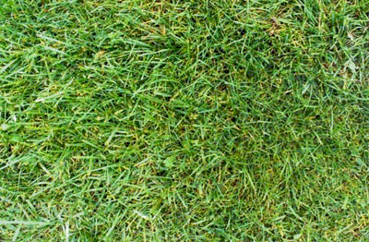


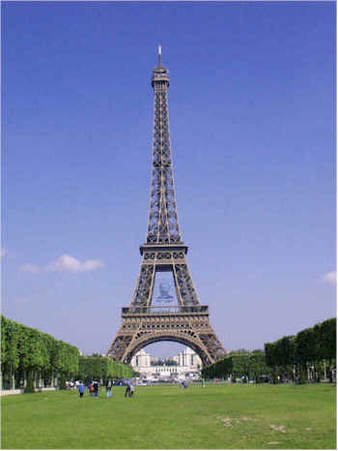





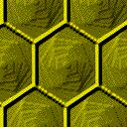
Sample Virtual Environment
(MacMahon, et al. AAAI-06)
H
H – Hat Rack
L – Lamp
E – Easel
S – Sofa
B – Barstool
C - Chair
L
E
E
C
S
S
C
B
H
L

Slide 18


Sample Navigation Instructions
Take your first left. Go all the way down until you hit a dead end.
Start
3
End
H
4

Slide 19
Sample Navigation Instructions
Take your first left. Go all the way down until you hit a dead end.
Start
3
End
H
4
Observed primitive actions:
Forward, Left, Forward, Forward

Slide 20
Sample Navigation Instructions
Take your first left. Go all the way down until you hit a dead end.
Go towards the coat hanger and turn left at it. Go straight down the hallway and the dead end is position 4.
Walk to the hat rack. Turn left. The carpet should have green octagons. Go to the end of this alley. This is p-4.
Walk forward once. Turn left. Walk forward twice.
Start
3
End
H
4
Observed primitive actions:
Forward, Left, Forward, Forward

Slide 21
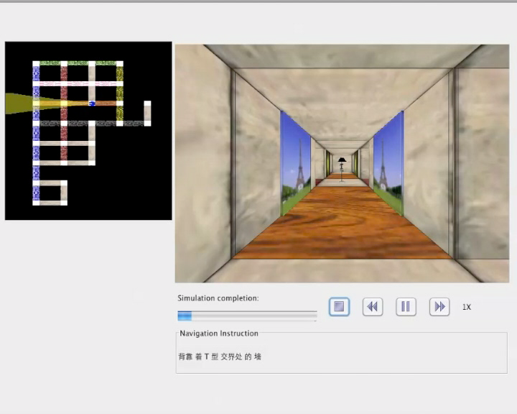
Observed Training Instance in Chinese

Slide 22
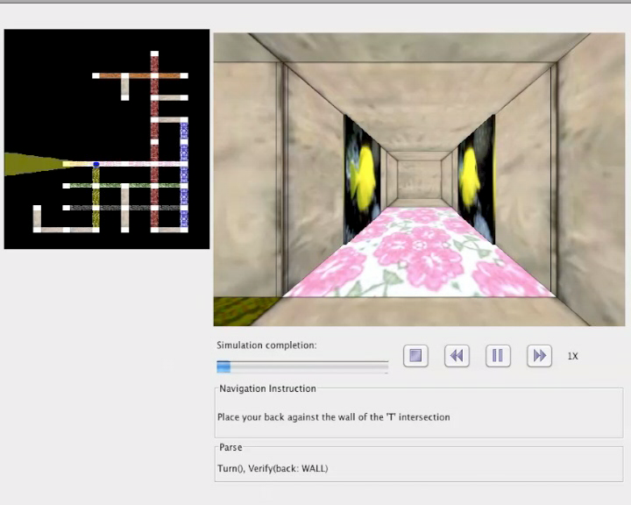
Executing Test Instance in English
(after training in English)

Slide 23
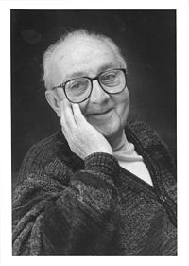
Statistical Learning and Inference for Grounded Language
Use standard statistical methods to train a probabilistic model and make predictions.
Construct a generative model that probabilistically generates language from observed situations.
George Box (1919-2013) :
“All models are wrong,
but some are useful.”

Slide 24
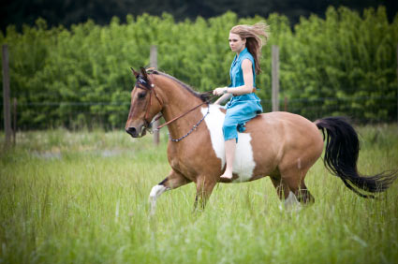
Probabilistic Generative Model for Grounded Language
World
On(woman1,horse1)
Wearing(woman1, dress1)
Color(dress1,blue)
On(horse1,field1)
Perception
World
Representation
Content
Selection
Semantic
Content
On(woman1,horse1)
Language
Generation
Linguistic
Description
A woman is riding a horse

Slide 25
PCFGs for
Grounded Language Generation
Probabilistic Context-Free Grammars (PCFGs) can be used as a generative model for both content selection and language generation.
  CFG with probabilistic choice of productions
Initially demonstrated for Robocup sportscasting (Börschinger, Jones & Johnson, EMNLP-11).
Later extended to navigation-instruction following by using prior semantic-lexicon learning (Kim & Mooney, EMNLP-12).

Slide 26














Generative Process
Context MR
Turn
Verify
Travel
Verify
Turn
Verify
LEFT
front:
BLUE
HALL
front:
EASEL
steps:
2
left:
HATRACK
at:
SOFA
RIGHT
at:
CHAIR
L₁
Turn
L₂
Travel
Verify
Relevant
Components
LEFT
at:
SOFA
$$Phras{e_{L}}_{2}$$
$$Phras{e_{L}}_{1}$$
$$P{{hX}_{L}}_{2}$$
$$Word_{L_{2}}$$
$$P{h_{L}}_{1}$$
$$Word_{∅}$$
$$Ph{X_{L}}_{2}$$
$$Word_{∅}$$
$$Ph{X_{L}}_{1}$$
$$Wor{d_{L}}_{1}$$
$$Ph{X_{L}}_{2}$$
$$Word_{∅}$$
$$Wor{d_{L}}_{1}$$
$$Wor{d_{L}}_{2}$$
NL:
Turn
left
and
go
to
the
sofa

Slide 27
Generative Model Training for Grounded Language
World
On(woman1,horse1)
Wearing(woman1, dress1)
Color(dress1,blue)
On(horse1,field1)
On(woman1,horse1)
Wearing(woman1, dress1)
Color(dress1,blue)
On(horse1,field1)
Perception
World
Representation
Content
Selection
Observed
Training Data
Latent
Variable
Semantic
Content
On(woman1,horse1)
On(woman1,horse1)
Language
Generation
Linguistic
Description
A woman is riding a horse
A woman is riding a horse

Slide 28
Statistical Training with Latent Variables
Expectation Maximization (EM) is the standard method for training probabilistic models with latent variables.
EM for PCFGs is call the Inside-Outside algorithm (Lari & Young, 1990).
Randomly initialize model parameters.
Until convergence do:
E Step: Compute the expected values of the latent
variables given the observed data.
M Step: Re-estimate the model parameters using
these expected values and observed data.

Slide 29
Probabilistic Inference for Grounded Language
World
On(woman1,horse1)
Wearing(woman1, dress1)
Color(dress1,blue)
On(horse1,field1)
On(woman1,horse1)
Wearing(woman1, dress1)
Color(dress1,blue)
On(horse1,field1)
Perception
World
Representation
Content
Selection
Observations
Predicted
Variable
Semantic
Content
On(woman1,horse1)
On(woman1,horse1)
Language
Generation
Linguistic
Description
A woman is riding a horse
A woman is riding a horse

Slide 30
Probabilistic Inference for Grounded Language
Predicted
Variable
Semantic
Content
On(woman1,horse1)
On(woman1,horse1)
Language
Generation
Observations
Linguistic
Description
A woman is riding a horse
A woman is riding a horse

Slide 31
Probabilistic Inference with
Grounded PCFGs
Determining the most probable parse of a sentence also determines its most likely latent semantic representation.
An augmented version of the standard CYK CFG parsing algorithm can find the most probable parse in O(n³) time using dynamic programming.
  Analogous to the Viterbi algorithm for a Hidden Markov Model (HMM)

Slide 32
Sample Successful Parse
Instruction: | “Place your back against the wall of the ‘T’ intersection. Turn left. Go forward along the pink-flowered carpet hall two segments to the intersection with the brick hall. This intersection contains a hatrack. Turn left. Go forward three segments to an intersection with a bare concrete hall, passing a lamp. This is Position 5.”
Parse: | Turn ( ), Verify ( back: WALL ), Turn ( LEFT ), Travel ( ), Verify ( side: BRICK HALLWAY ), Turn ( LEFT ), Travel ( steps: 3 ), Verify ( side: CONCRETE HALLWAY )

Slide 33
Navigation-Instruction Following
Evaluation Data
3 maps, 6 instructors, 1-15 followers/direction
 | Paragraph | Single-Sentence
# Instructions | 706 | 3,236
Avg. # sentences | 5.0 (±2.8) | 1.0 (±0)
Avg. # words | 37.6 (±21.1) | 7.8 (±5.1)
Avg. # actions | 10.4 (±5.7) | 2.1 (±2.4)

Slide 34
End-to-End Execution Evaluation
Test how well the system follows new directions in novel environments.
  Leave-one-map-out cross-validation.
Strict metric: Correct iff the final position exactly matches goal location.
Lower baseline:
  Simple probabilistic generative model of executed plans without language.
Upper bounds:
  Supervised semantic parser trained on gold-standard plans.
  Human followers.
  Correct execution of instructions.

Slide 35
End-to-End Execution Results
English
% Correct Execution

Slide 36
End-to-End Execution Results
English vs. Mandarin Chinese
% Correct Execution

Slide 37
Grammar & Training Complexity
Data | |Grammar| # Productions | Time (hours) | EM Iterations
English | 16,357 | 8.77 | 46
Chinese | 15,459 | 8.05 | 40
Data

Slide 38
Grounding in the Real World
Move beyond grounding in simulated environments.
Integrate NLP with computer vision and robotics to connect language to perception and action in the real world.

Slide 39
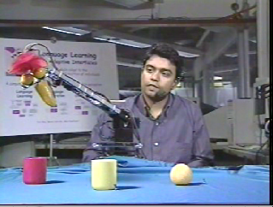
Grounded Language in Robotics
Deb Roy at MIT has worked on grounded language for over a decade.
He has developed a number of robots that learn and use grounded language.
Toco Robot from 2003

Slide 40
Real Robots You Can Instruct in
Natural Language
More recently, a group at MIT has developed a robotic forklift that obeys English commands (Tellex, et al., AAAI-11).
Training data was collected in simulation using crowdsourcing on Amazon Mechanical Turk.
Uses an existing English parser and direct semantic supervision to help learn to map sentences to formal robot commands.

Slide 41
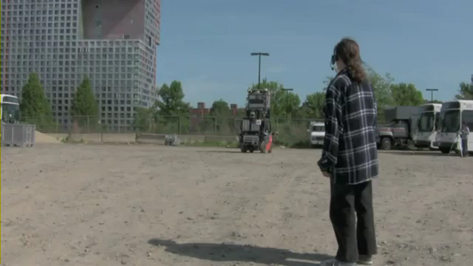
Robotic Forklift NL Instruction Demo
Telex Video

Slide 42
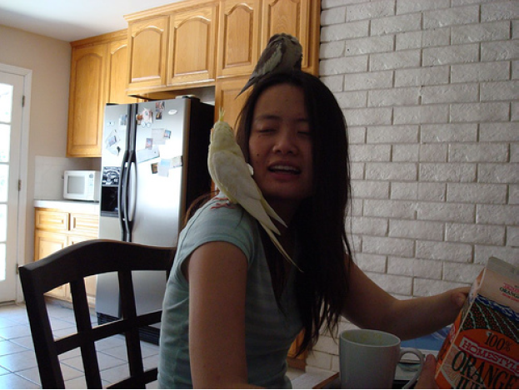
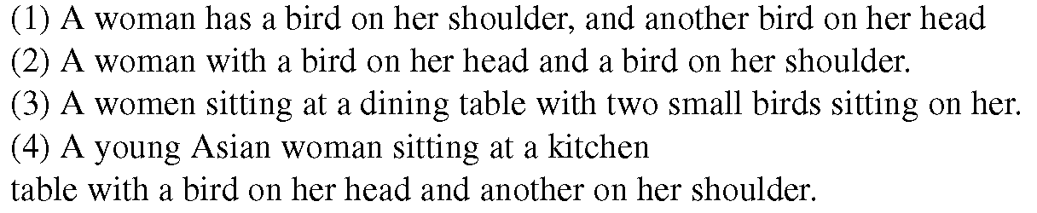
Describing Pictures in Natural Language
Several projects have explored automatically generating sentences that describe images.
Typically trained on captioned/tagged images collected from the web, or crowdsourced human image descriptions.
(Rashtchian et al., 2010)

Slide 43
Natural Language Generation for Images
(Kuznetsova et al., ACL-12)
Trained on 1 million photos from Flickr that were filtered so that they contain useful captions.
Extracts features from images using state-of-the-art object, scene, and “stuff” recognizers from computer vision.
Composes sentences for novel images by using Integer Linear Programming to optimally stitch together phrases from similar training images.

Slide 44
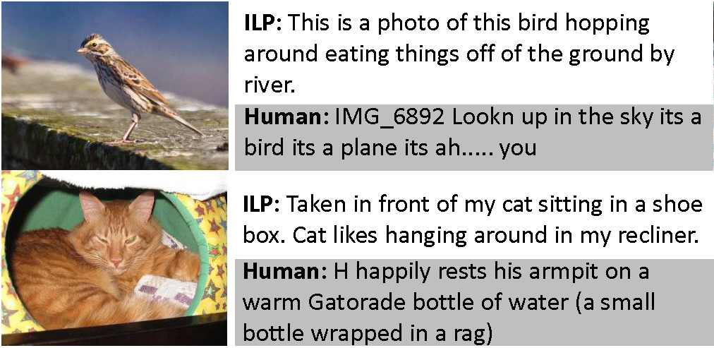
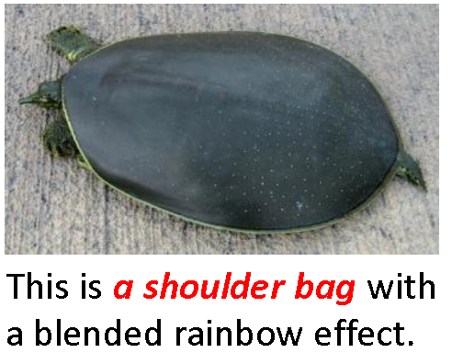
Sample Generated Image Descriptions

Slide 45
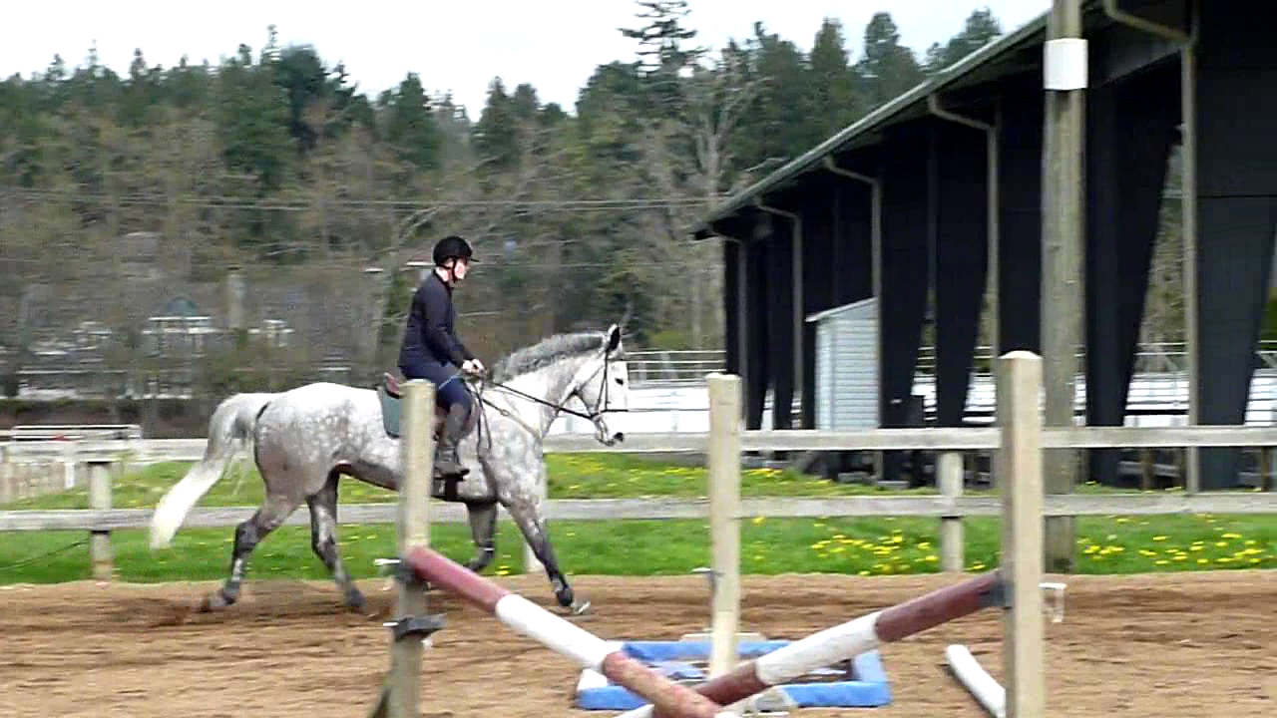
Generating English Descriptions for Videos
A person is riding a horse.

Slide 46
Video Description Research
A few recent projects integrate visual object and activity recognition with NL generation to describe videos (Barbu et al., UAI-12, Khan & Gotoh, 2012).
See our AAAI-13 talk:
  Generating Natural-Language Video Descriptions Using Text-Mined Knowledge
  Niveda Krishnamoorthy
  Session 32A: NLP Generation and Translation
  11:50am, Thursday, July 18th

Slide 47
Connecting Word Meaning to Perception
Word meanings as symbolic perceptual output
Multimodal distributional semantics

Slide 48
Vector-Space (Distributional)
Lexical Semantics
Represent word meanings as points (vectors) in a (high-dimensional) Euclidian space.
Dimensions encode aspects of the context in which the word appears (e.g. how often it co-occurs with another specific word).
  “You will know a word by the company it keeps” (Firth)
Semantic similarity defined as distance between points in this space.
Many specific mathematical models for computing dimensions, dimensionality reduction, and similarity.
  Latent Semantic Analysis (LSA)

Slide 49
Sample Lexical Vector Space
(Reduced to Two Dimensions)
bottle
cup
dog
water
cat
computer
robot
woman
rock
man

Slide 50
Multimodal Distributional Semantics
Recent methods combine both linguistic and visual contextual features (Feng & Lapata, NAACL-10; Bruni et al., 2011; Silberer & Lapata, EMNLP-12) .
Use corpus of captioned images to compute co-occurrence statistics between words and visual features extracted from images (e.g. color, texture, shape, detected objects).
Multimodal models predict human judgments of lexical similarity better.
  “cherry” more similar to “strawberry” than “orange”

Slide 51
Recent Spate of Workshops on Grounded Language
AAAI-2011 Workshop on Language-Action Tools for Cognitive Artificial Agents: Integrating Vision, Action and Language
NIPS-2011 Workshop on Integrating Language and Vision
NAACL-2012 Workshop on Semantic Interpretation in an Actionable Context
AAAI-2012 Workshop on Grounding Language for Physical Systems
NAACL-2013 Workshop on Vision and Language
CVPR-2013 Workshop on Language for Vision
UW-MSR 2013 Summer Institute on Understanding Situated Language

Slide 52
Future Research Challenges
Using linguistic and text-mined knowledge to aid computer vision.
Active/interactive grounded language learning.
Grounded-language dialog.
Applications:
  Language-enabled virtual agents
  Language-enabled vision systems
  Language-enabled robots

Slide 53
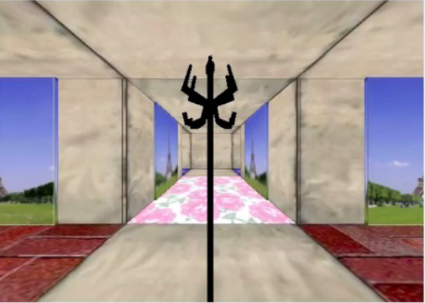
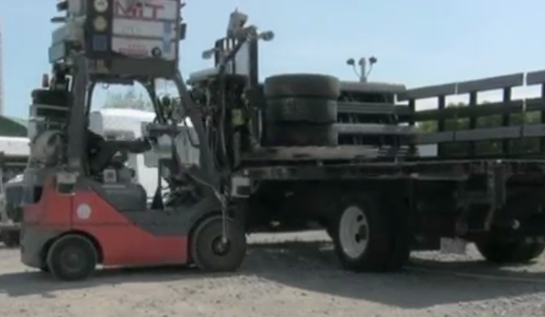
Conclusions
Truly understanding language requires connecting it to perception and action.
Learning from easily obtainable data in which language naturally co-occurs with perception and action improves NLP, vision, and robotics.
The time is ripe to integrate language, vision, and robotics to address the larger AI problem.

Slide 54









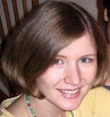


Thanks to
My (Former) Students and Colleagues!
David Chen
Joohyun Kim
Rohit Kate
Sonal Gupta
Tanvi
Motwani
Niveda
Krishnamoorthy
Girish
Malkarnenkar
Subhashini
Venugopalan
Sergio
Guadarrama
Kate Saenko
Kristen
Grauman
Peter Stone

