Slide 1
Using Natural Language Processing to Aid Computer Vision
Ray Mooney
Department of Computer Science
University of Texas at Austin

Slide 2
My Initial Motivation for
Exploring Grounded Language Learning
I became frustrated having to manually annotate sentences with formal meaning representations (MRs) to train semantic parsers.
I hoped to automatically extract MRs from the perceptual context of situated language.
However, computer vision is generally not capable enough yet to provide the MRs needed for semantic parsing.
Therefore, I focused on grounded language learning in virtual worlds to circumvent computer vision.

Slide 3
Computer Vision is Hard
Both language understanding and vision are “AI complete” problems.
However, in many ways, I think vision is the harder problem.

Slide 4
Text Really Helps
Language Learning
Both speech and visual perception begin with a complex analog signal (sound vs. light waves).
However, for language we have orthographic text that intermediates between analog signal and semantic representation.
Training on large, easily available corpora of text dramatically benefits learning for language.
No such pervasive, data rich, intermediate representation exists for vision.

Slide 5
Dimensionality
Language vs. Vision
Language input is fundamentally 1-d, i.e. linear sequences of sounds, phonemes, or words.
Vision is fundamentally a 2-d (arrays of pixels), 2 ½ - d (depth maps) or 3-d (world model) problem.
Therefore, the “curse of dimensionality” makes vision a much harder problem.

Slide 6
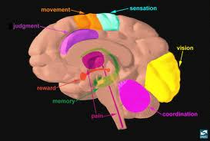
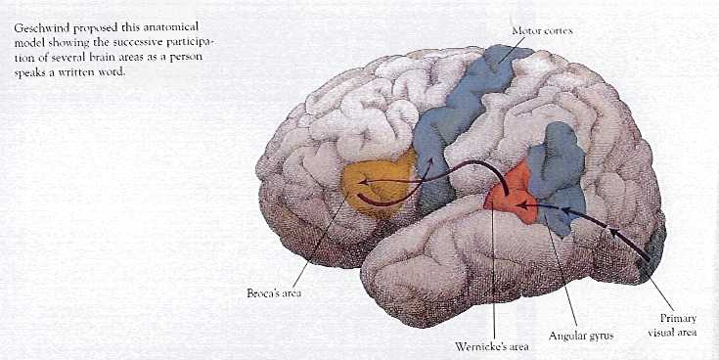
Biological Hardware
Vision vs. Language
Humans arguably have a greater amount of neural hardware dedicated to vision than to language.
Therefore, matching human performance on vision may be computationally more complex.

Slide 7
Biological Evolution
Vision vs. Language
Vision has a much longer “evolutionary history” than language.
  First mammals: 200-250 million years ago (MYA)
  First human language: Homo habilis, 2.3 MYA
Therefore, a much more complex neural system could have evolved for vision compared to language.

Slide 8

Language Helping Vision
Now I feel sorry for my poor computer vision colleagues confronting an even harder problem.
So I’d like to help them, instead of expecting them to help me.
As Jerry Maguire said: Help me, help you!

Slide 9
NL-Acquired Knowledge for Vision
Many types of linguistic knowledge or knowledge “extracted” from text can potentially aid computer vision.

Slide 10
Textual Retrieval of Images
Most existing image search is based on retrieving images with relevant nearby text.
A variety of computer vision projects have used text-based image search to automatically gather (noisy) training sets for object recognition.
Various ways of dealing with the noise in the resulting data:
  Multiple-instance learning
  Cleanup results with crowd-sourcing

Slide 11
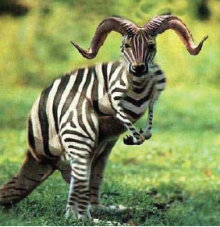
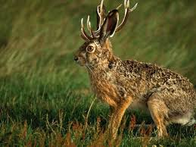
Lexical Ontologies
ImageNet built a large-scale hierarchical database of images by using the WordNet ontology (Deng et al. CVPR-09)
“Hedging Your Bets” method uses ImageNet hierarchy to classify object as specifically as possible while maintaining high accuracy (Deng et al. CVPR-12)

Slide 12
Subject-Verb-Object (SVO) Correlations
We developed methods for using probability estimates of SVO combinations to aid activity recognition (Motwani & Mooney, ECAI-12) and sentential NL description (Krishnamoorthy et al., AAAI-13) for YouTube videos.
SVO probabilities are estimated using a smoothed trigram “language model” trained on several large dependency-parsed corpora.
Similar statistics can also be used to predict verbs for describing images based on the detected objects (Yang et al., EMNLP 2011).

Slide 13
Object-Activity-Scene Correlations
Can use co-occurrence statistics mined from text for objects, verbs, and scenes to improve joint recognition of these from images or videos.
Such statistics have been used to help predict scenes from objects and verbs (Yang et al. EMNLP 2011).

Slide 14
Object-Object Correlations
Could use object-object co-occurrence statistics mined form text to acquire knowledge that could aid joint recognition of multiple objects in a scene.
An “elephant” is more likely to be seen in the same image as a “giraffe” than in the same image as a “penguin”

Slide 15
Scripts
Activity-Activity Correlations and Orderings
Knowledge of stereotypical sequences of actions/events can be mined from text (Chambers & Jurafsky, 2008).
Such knowledge could be used to improve joint recognition of sequences of activities from video.
  Opening a bottle is typically followed by drinking or pouring.

Slide 16
Transferring Algorithmic Techniques from Language to Vision
Text classification suing “bag of words” to image classification using “bag of visual words”
Linear CRFs for sequence labeling (e.g. POS tagging) for text to 2-d mesh CRFs for pixel classification in images.
HMMs for speech recognition to HMMs for activity recognition in videos.

Slide 17
Other Ways Language can Help Vision?
Your
Idea
Here

Slide 18
Conclusions
Its easier to use language processing to help computer vision than the other way around.
For a variety of reasons computer vision is harder than NLP.
Knowledge about or from language can be used to help vision in various ways.
Help me, help you, help me!

Slide 19
Recent Spate of Workshops on Grounded Language
NSF 2011 Workshop on Language and Vision
AAAI-2011 Workshop on Language-Action Tools for Cognitive Artificial Agents: Integrating Vision, Action and Language
NIPS-2011 Workshop on Integrating Language and Vision
NAACL-2012 Workshop on Semantic Interpretation in an Actionable Context
AAAI-2012 Workshop on Grounding Language for Physical Systems
NAACL-2013 Workshop on Vision and Language
CVPR-2013 Workshop on Language for Vision
UW-MSR 2013 Summer Institute on Understanding Situated Language

