Slide 1
Deep Learning and LLMs
Raymond J. Mooney
University of Texas at Austin
1
1
Notes:
1
1

Slide 2
Deep Learning Revolution (2010-)
Recent machine learning methods for training “deep” neural networks (NNs) have demonstrated remarkable progress on many challenging AI problems (e.g. speech recognition, visual object recognition, machine translation, game playing, chat bots)

Slide 3
Very Brief History of Machine Learning
Single-layer neural networks (1957-1969)
Symbolic AI & knowledge engineering (1970-1985)
Multi-layer NNs and symbolic learning (1985-1995)
Statistical (Bayesian) learning and kernel methods (1995-2010)
Deep learning (CNNs,RNNs,Transformers) (2010-?)

Slide 4
Deep Learning Revolution (2010…)
Improved methods developed for training deep neural works.
Particular successes with:
  Convolutional neural nets (CNNs) for vision.
  Recurrent neural nets (RNNs) for machine translation (MT) and speech recognition (ASR).
  Deep reinforcement learning for game playing.
  Transformers for MT, LLMs, ChatBots, etc…

Slide 5
Massive Data and Specialized Hardware
Large collections of supervised (crowdsourced) training data has been critical.
Self-supervision (e.g. LMs) on large internet data.
Efficient processing of this big data using specialized hardware (Graphics Processing Units, GPUs) has been critical.

Slide 6
CNNs
Convolutional layers learn to extract local features from image regions (receptive fields) analogous to human vision (LeCun, et al., 1998).
Deeper layers extract higher-level features.
Pool activity of multiple neurons into one at the next layer using max or mean.
Nonlinear processing with Rectified Linear Units (ReLUs)
Decision made using final fully connected layers.

Slide 7
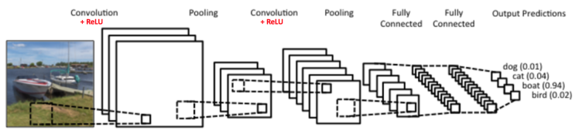
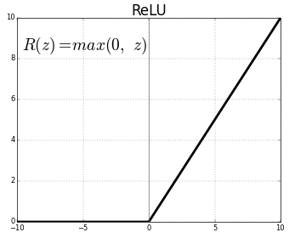
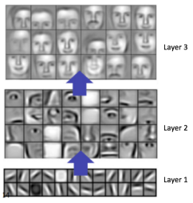
CNNs
Increasingly
broader local
features extracted
from image regions

Slide 8




ImageNet Large Scale
Visual Recognition Challenge (ILSVRC)
Recognize 1,000 categories of objects in 150K test images (given 1.2M training images).
Mongoose
Canoe
Missile
Trombone

Slide 9
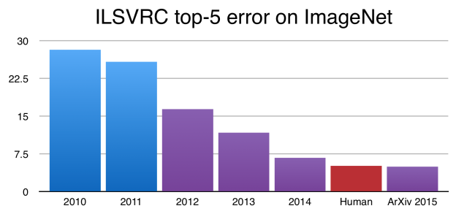
ImageNet Performance Over Time
CNNs
introduced

Slide 10
Word Embeddings
Represent words as dense vectors by building representations that capture the context in which they occur, i.e. by the Firth principle:
  You shall know a word by the company it keeps.
Semantically similar words will have similar embeddings (close in Euclidian space).

Slide 11
Word Association Matrix
Remember its early use for automated query expansion.
Vector for a word is high-dimensional and sparse
w₁ w₂ w₃ …………………..w_{n}
T₁ T₂ …. T_{t}
D₁ w₁₁ w₂₁ … w_{t1}
D₂ w₁₂ w₂₂ … w_{t2}
: : : :
: : : :
D_{n} w_{1n} w_{2n} … w_{tn}
w₁
w₂
w₃
.
.
w_{n}
c₁₁ c₁₂ c₁₃…………………c_{1n}
c₂₁
c₃₁
.
.
c_{n1}

Slide 12
Latent Semantic Analysis (LSA, 1998)
Use dimensionality reduction methods (Singular Value Decomposition, SVD) on the term-document matrix to compute a dense reduced-dimensional vector for each word.
Maintain distance between word vectors while reducing their dimensionality.
T₁ T₂ …. T_{t}
D₁ w₁₁ w₂₁ … w_{t1}
D₂ w₁₂ w₂₂ … w_{t2}
: : : :
: : : :
D_{n} w_{1n} w_{2n} … w_{tn}

Slide 13
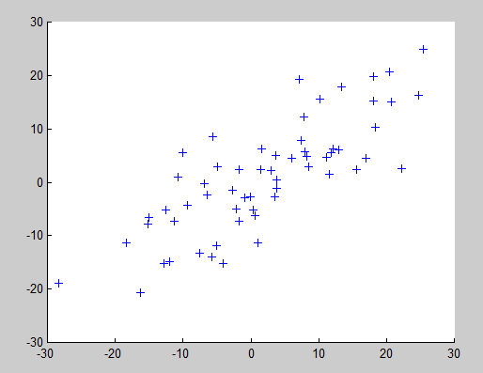
Sample 2 to 1 D Dimensionality Reduction

Slide 14
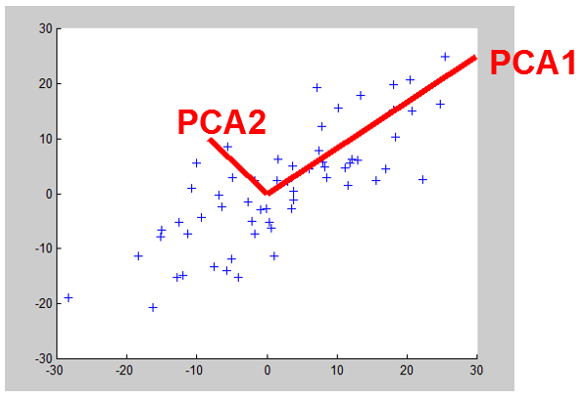
Sample 2 to 1 D Dimensionality Reduction

Slide 15
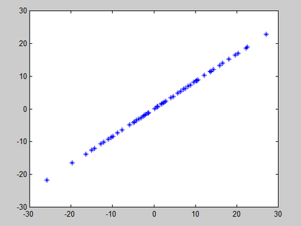
Sample 2 to 1 D Dimensionality Reduction

Slide 16
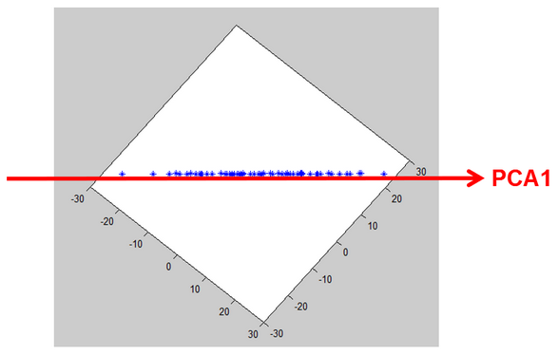
Sample 2 to 1 D Dimensionality Reduction

Slide 17
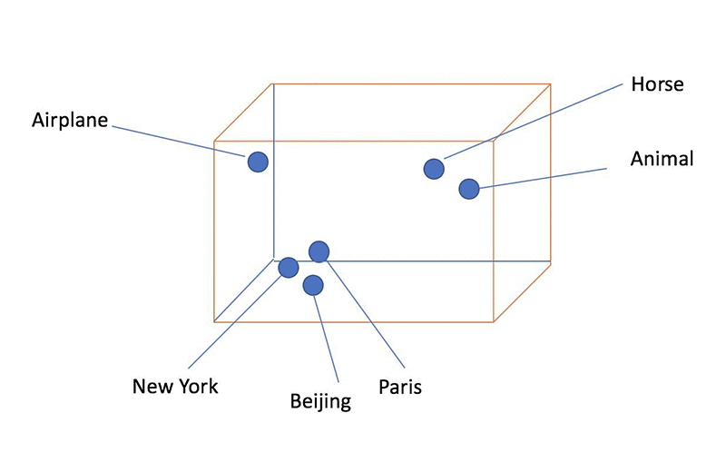
Sample Word Embedding Visualization

Slide 18
Neural Net Word Embeddings
Train a neural network to predict nearby words for a given word.
Use the hidden layer representation in this neural network as the embedding.

Slide 19
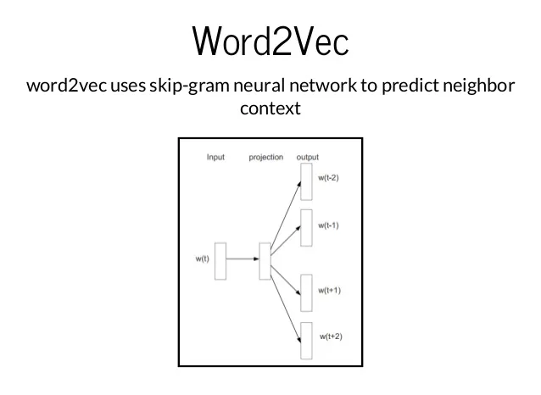
Word2Vec (Mikolov et al., 2013)
Input and output words are represented as sparse “one hot” encodings.
Hidden layer learns a dense encoding of the input word that allows it to predict its neighbors.

Slide 20
Problem with Polysemy and Homonymy
Word meaning depends on context and having a fixed embedding for a word independent of context is problematic.
Semantic similarity of words does not obey the “triangle inequality” and therefore cannot be represented as Euclidian distance between word types.

Slide 21
Triangle Inequality Violation Examples
association is similar to club
association
club is similar to bat
But association is not similar to bat
club
bat
Chiroptera
bat is similar to Chirpotera
But club is not similar to Chiroptera

Slide 22
Recurrent Neural Networks (RNNs)
Add feedback loops where some units’ current outputs determine some future network inputs.
RNNs can model dynamic finite-state machines, beyond the static combinatorial circuits modeled by feed-forward networks.

Slide 23
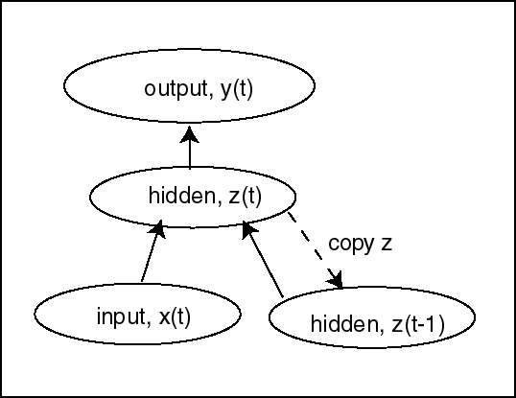
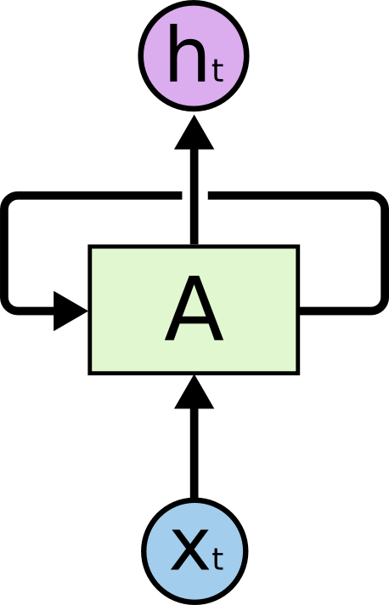
Simple Recurrent Network (SRN)
Initially developed by Jeff Elman (“Finding structure in time,” 1990).
Additional input to hidden layer is the state of the hidden layer in the previous time step.
http://colah.github.io/posts/2015-08-Understanding-LSTMs/

Slide 24
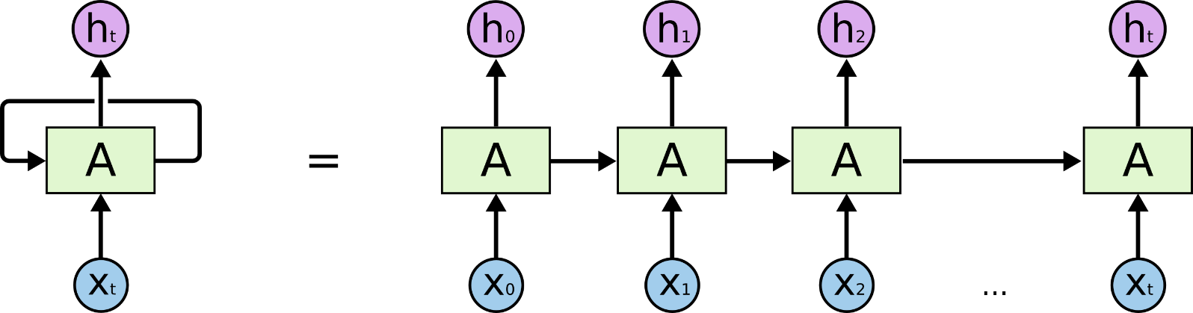
Unrolled RNN
Behavior of RNN is perhaps best viewed by “unrolling” the network over time.
time

Slide 25
Training RNN’s
RNNs can be trained using “backpropagation through time.”
Can viewed as applying normal backprop to the unrolled network.
Training
outputs
y₀
y₁
y₂
y_{t}
B
B
B
B
Training
inputs
backpropagated errors

Slide 26
Vanishing/Exploding Gradient Problem
Backpropagated errors multiply at each layer, resulting in exponential decay (if derivative is small) or growth (if derivative is large).
Makes it very difficult train deep networks, or simple recurrent networks over many time steps.

Slide 27
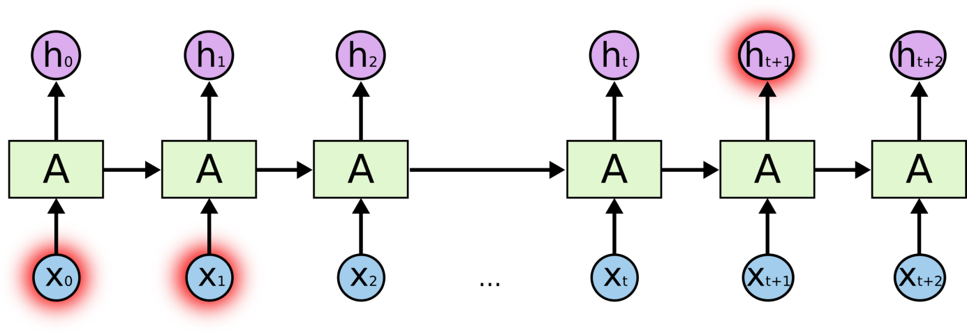
Long Distance Dependencies
It is very difficult to train SRNs to retain information over many time steps.
This make is very difficult to learn SRNs that handle long-distance dependencies, such as subject-verb agreement.

Slide 28
Long Short Term Memory (LSTM)
LSTM networks, add additional gating units in each memory cell (Hochreiter & Schmidhuber, 1997).
  Forget gate
  Input gate
  Output gate
Prevents vanishing/exploding gradient problem and allows network to retain state information over longer periods of time.

Slide 29
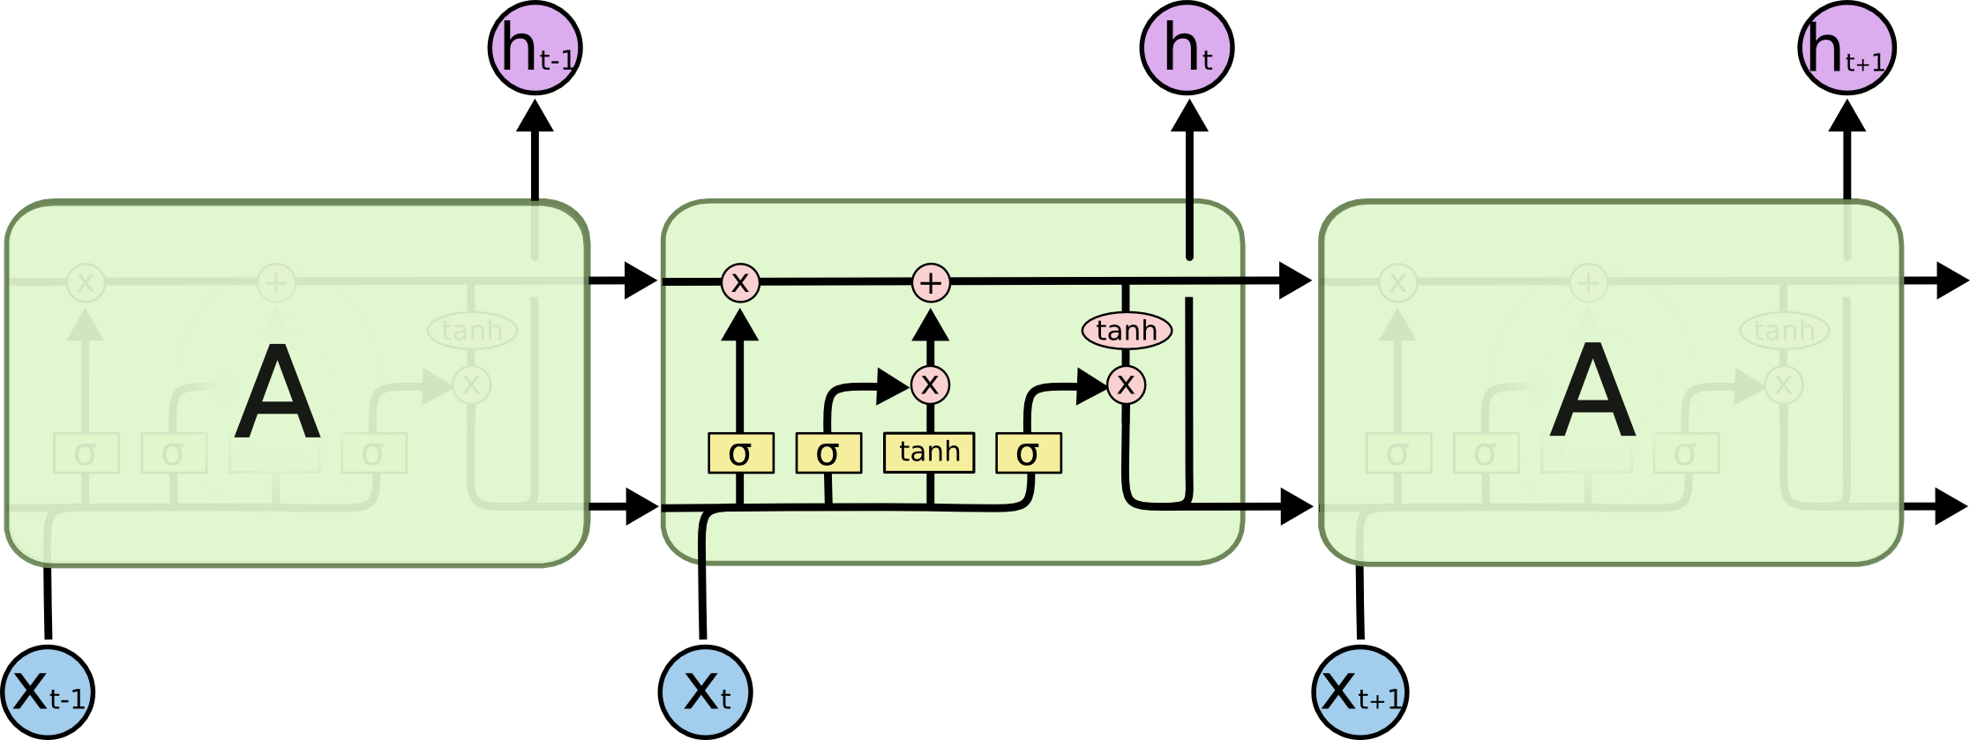
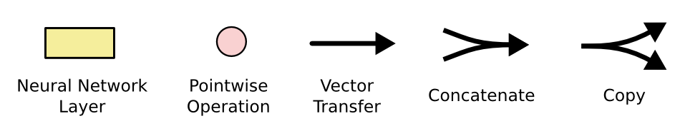
LSTM Network Architecture

Slide 30
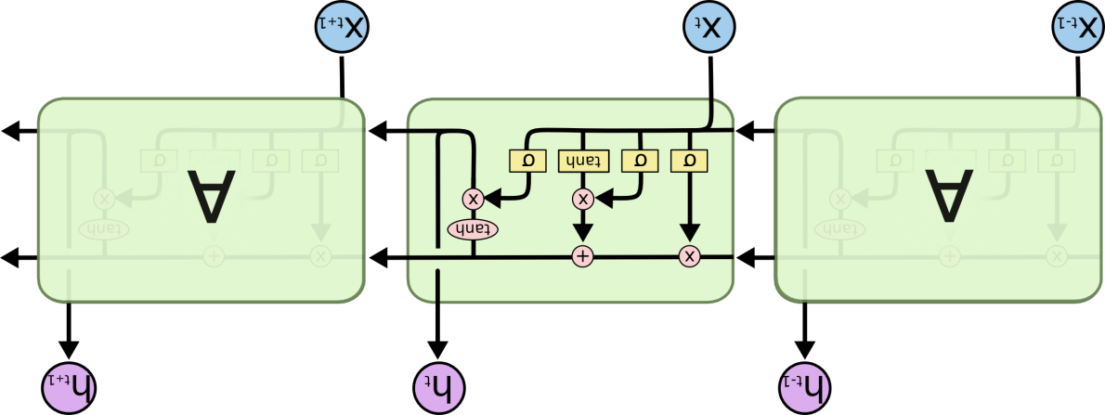

Bi-directional LSTM (Bi-LSTM)
Separate LSTMs process sequence forward and backward and hidden layers at each time step are concatenated to form the cell output.
x_{t-1}
x_{t}
x_{t+1}
h_{t-1}
h_{t}
h_{t+1}

Slide 31
Sequence to Sequence (Seq2Seq) Transduction
Encoder/Decoder framework maps one sequence to a "deep vector" then another LSTM maps this vector to an output sequence (Sutskever et al., 2014).
Encoder
LSTM
Decoder
LSTM
I₁, I₂,…,I_{n}
h_{n}
O₁, O₂,…,O_{m}
Train model "end to end" on I/O pairs of sequences.

Slide 32
Neural Machine Translation (NMT)
LSTM Seq2Seq has led to a new approach to translating human language.
NMT modestly outperforms previous statistical learning approaches to MT (SMT).

Slide 33
NMT Results (Wu et al., 2016)
Experimental results using automated (BLEU) and human evaluation for English→ French translation.
Method | BLEU | Human Rating
SMT | 37.0 | 3.87
NMT | 40.35 | 4.46
Human |  | 4.82

Slide 34
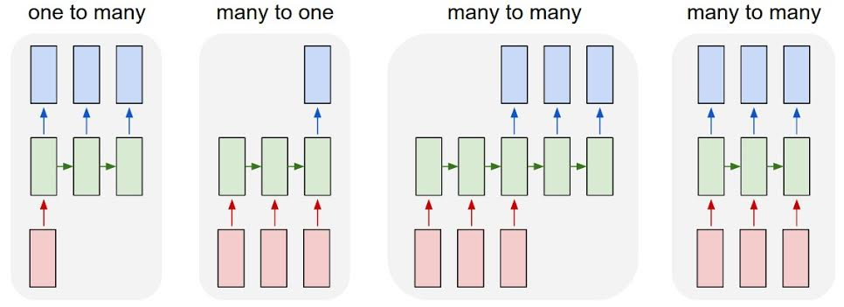
LSTM Application Architectures
Image Captioning
Video Activity Recog
Text Classification
Video Captioning
Machine Translation
POS Tagging, IE,
Language Modeling

Slide 35
Bidirectional Language Model
A standard statistical language model predicts the probability of the next word based on the previous context.
  Your program for Project 4 does not _____
A bidirectional language model (BiLM) predicts the word at each position based on both prior and posterior context encoded using an RNN (e.g. LSTM).

Slide 36
Contextualized Word Embeddings
Produce a vector representation for a specific occurrence of a word, by using textual context to compute its meaning.
ELMo (Embeddings from Language Models, Peters et al., 2018) uses the hidden state of a BiLM to compute contextualized word embeddings.

Slide 37
Transformer Networks
An alternate Seq2Seq neural architecture based on attention rather than recurrence “Attention is all you need”(Vaswani et al., 2017).
See website on “The Ilustrated Transfomer” by J. Alammar for more details.
Attention mechanisms compute the output at each position in the sequence by varying “attention” across different positions in the input sequence.

Slide 38
Self-Attention
Compute a context-sensitive embedding for each word as a weighted sum of initial embeddings of all words in the input.

Slide 39
Transformer Encoder
Context sensitive
Embeddings

Slide 40
Self-attention
Consider: “The animal didn't cross the street because it was too tired”
What meaning should we associate with the word “it”?

Slide 41
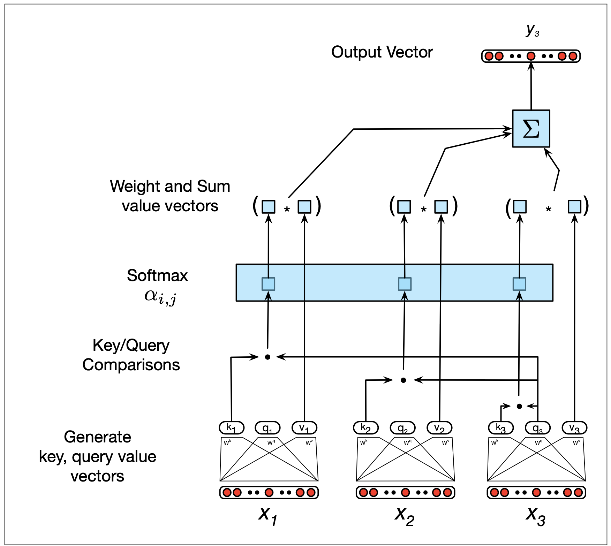
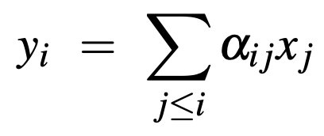
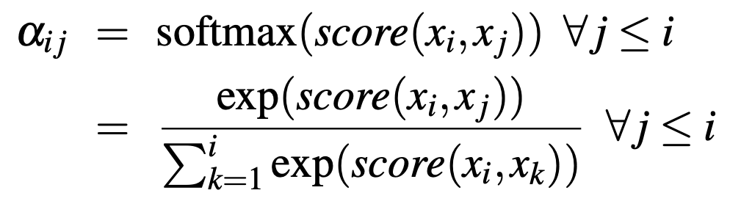

Self-attention
But there is nothing to learn here?

Slide 42
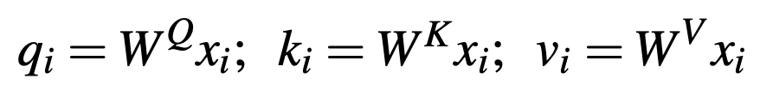
Self-attention
Introducing 3 types of weights, corresponding to 3 roles of each word w:
Query: w is the current word under question
Key: w is the word in context being compared with
Value: learnable weights for the output

Slide 43
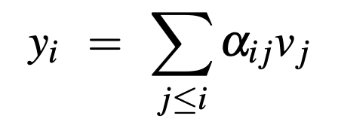

Self-attention
also multiply with v
normalize

Slide 44
Omitted Transformer Details
Multiheaded attending
Positional encoding
Residual connections and layer normalization

Slide 45
Full Seq2Seq Transformer Architecture

Slide 46
BERT Pretrained Language Transformer
Bidirectional Encoder Representations from Transformers (BERT, Devlin et al., 2018)
Trains a transformer network to predict a fraction of “masked” tokens in an input sentence, or predict the next sentence.
Pretrained network can then be “fine tuned” to perform an end task such as text classification using a full document representation for a special “CLS” token added to the input.

Slide 47
BERT Architecture

Slide 48
Neural Information Retrieval
Word embeddings have been used to improve IR by allowing matching words based on semantic similarity.
Can embed entire sentences or documents using an RNN or Transformer and perform vector-based retrieval on these dense vectors rather than sparse BOW vectors.

Slide 49
Nearest Neighbor Retrieval
Find the document embedding that is most similar to the query embedding using Euclidian distance or cosine similarity.
Simplest is linear search of the list of documents to find the most similar item.
Better approach is to use a retrieval index, but an inverted index does not work for dense vectors.

Slide 50
Locality Sensitive Hashing
A hashing technique that hashes “similar” input items into the same “buckets” with high probability.
Attempts to maximize hash collisions rather than minimize them.
Allows for efficient approximate nearest neighbor (ANN) search (see NearPy on gethub).

Slide 51
Conclusions
Progress on training deep neural architectures such as CNNs, RNNs, and Transformers.
These techniques can produce dense vector embeddings of words, sentences, and documents.
Vector-space IR can be based on these deep embeddings rather than sparse BOWs.

