Slide 1
Distributional models
Katrin Erk

Slide 2
You can get an idea of what a word means from observing it in context
He filled the wampimuk, passed it around, and we all drank some
We found a little hairy wampimuk sleeping behind a tree.
  (examples by Marco Baroni)
Distributional modeling:
  Represent the meaning of a word through the contexts in which it is observed
  Similar words appear in similar contexts

Slide 3
What words can appear in these contexts?
Word 1: drown, bathroom, shower, fill, fall, lie, electrocute, toilet, whirlpool, iron, gin
Word 2: eat, fall, pick, slice, peel, tree, throw, fruit, pie, bite, crab, grate
Word 3: advocate, overthrow, establish, citizen, ideal, representative, dictatorship, campaign, bastion, freedom
Word 4: spend, enjoy, remember, last, pass, end, die, happen, brighten, relive

Slide 4
What words can appear in these contexts?
bathtub
apple
Word 1: drown, bathroom, shower, fill, fall, lie, electrocute, toilet, whirlpool, iron, gin
Word 2: eat, fall, pick, slice, peel, tree, throw, fruit, pie, bite, crab, grate
democracy
Word 3: advocate, overthrow, establish, citizen, ideal, representative, dictatorship, campaign, bastion, freedom
day
Word 4: spend, enjoy, remember, last, pass, end, die, happen, brighten, relive

Slide 5
What can you say about word number 5?
bathtub
apple
Word 1: drown, bathroom, shower, fill, fall, lie, electrocute, toilet, whirlpool, iron, gin
Word 2: eat, fall, ripe, slice, peel, tree, throw, fruit, pie, bite, crab, grate
day
Word 4: spend, enjoy, remember, last, pass, end, die, happen, brighten, relive
democracy
Word 3: advocate, overthrow, establish, citizen, ideal, representative, dictatorship, campaign, bastion, freedom
Word 5: eat, paint, peel, apple, fruit, juice, lemon, blue, grow

Slide 6
What can you say about word number 5?
bathtub
apple
Word 1: drown, bathroom, shower, fill, fall, lie, electrocute, toilet, whirlpool, iron, gin
Word 2: eat, fall, ripe, slice, peel, tree, throw, fruit, pie, bite, crab, grate
day
Word 4: spend, enjoy, remember, last, pass, end, die, happen, brighten, relive
democracy
Word 3: advocate, overthrow, establish, citizen, ideal, representative, dictatorship, campaign, bastion, freedom
orange
Word 5: eat, paint, peel, apple, fruit, juice, lemon, blue, grow

Slide 7
Describing meaning through context
Similar words appear in similar contexts
  apple, orange
Measure similarity in meaning as similarity in contexts
Caveat: If a word has multiple meanings, like “orange”, it will appear in a mixture of contexts
How to describe the contexts of a word?
  Count other words nearby

Slide 8
Counting context words for “apple”
They picked up red apples that had fallen to the ground
Eating apples is healthy
Word count, 3-word context window, lemmatized
She ate a red apple
Pick an apple.
a | be | eat | fall | have | healthy | pick | red | that | up
2 | 1 | 2 | 1 | 1 | 1 | 2 | 2 | 1 | 1

Slide 9
How can we compare two context word counts?
Count how often “apple” occurs close to other words
in a large text collection (corpus):
eat | fall | ripe | slice | peel | tree | throw | fruit | pie | bite | crab
794 | 244 | 47 | 221 | 208 | 160 | 145 | 156 | 109 | 104 | 88
Interpret counts as coordinates:
Every context word
becomes a dimension.
fall
apple
eat

Slide 10
How can we compare two context word counts?
Count how often “apple” occurs close to other words
in a large text collection (corpus):
eat | fall | ripe | slice | peel | tree | throw | fruit | pie | bite | crab
794 | 244 | 47 | 221 | 208 | 160 | 145 | 156 | 109 | 104 | 88
Do the same for “orange”:
eat | fall | ripe | slice | peel | tree | throw | fruit | pie | bite | crab
265 | 22 | 25 | 62 | 220 | 64 | 74 | 111 | 4 | 4 | 8

Slide 11
How can we compare two context word counts?
Then visualize both count tables as vectors in the same space:
eat | fall | ripe | slice | peel | tree | throw | fruit | pie | bite | crab
794 | 244 | 47 | 221 | 208 | 160 | 145 | 156 | 109 | 104 | 88
eat | fall | ripe | slice | peel | tree | throw | fruit | pie | bite | crab
265 | 22 | 25 | 62 | 220 | 64 | 74 | 111 | 4 | 4 | 8
fall
apple
Similarity between
two words as
proximity in space
orange
eat

Slide 12
How can we compare two context word counts?
Then visualize both count tables as vectors in the same space:
eat | fall | ripe | slice | peel | tree | throw | fruit | pie | bite | crab
794 | 244 | 47 | 221 | 208 | 160 | 145 | 156 | 109 | 104 | 88
eat | fall | ripe | slice | peel | tree | throw | fruit | pie | bite | crab
265 | 22 | 25 | 62 | 220 | 64 | 74 | 111 | 4 | 4 | 8
fall
apple
Similarity between
two words as
proximity in space
orange
eat

Slide 13
Where do we go from here?
Making the model useful: Lots of parameters
  Corpus
  Measure of similarity
  Measure of association
  Window size effects
  …
Modern instantiations of this idea:
  neural word representations
  For example, word2vec / the SkipGram model

Slide 14
Corpus
How much data do we need?
  At least British National Corpus,
  100 million words
  Better: add
    UKWaC (2 billion words)
    Wikipedia (2 billion words)
Mostly, more data gives better models
Watch out for genre effects

Slide 15
Where do we go from here?
Making the model useful: Lots of parameters
  Corpus
  Measure of similarity
  Measure of association
  Window size effects
  …
Modern instantiations of this idea:
  neural word representations
  For example, word2vec / the SkipGram model

Slide 16
What do we mean by
“similarity” of vectors?
Euclidean distance (a dissimilarity measure!):
apple
orange

Slide 17
Problem with Euclidean distance: very sensitive to word frequency!
apple
Braeburn

Slide 18
What do we mean by
“similarity” of vectors?
Cosine similarity:
apple
Use angle between vectors
instead of point distance
to get around word
frequency issues
orange

Slide 19
Where do we go from here?
Making the model useful: Lots of parameters
  Corpus
  Measure of similarity
  Measure of association
  Window size effects
  …
Modern instantiations of this idea:
  neural word representations
  For example, word2vec / the SkipGram model

Slide 20
Some counts for “letter” in “Pride and Prejudice”. What do you notice?
the | to | of | and | a | her | she | his | is | was | in | that
102 | 75 | 72 | 56 | 52 | 50 | 41 | 36 | 35 | 34 | 34 | 33
had | i | from | you | as | this | mr | for | not | on | be | he
32 | 28 | 28 | 25 | 23 | 23 | 22 | 21 | 21 | 20 | 18 | 17
but | elizabeth | with | him | which | by | when | jane
17 | 17 | 16 | 16 | 16 | 15 | 14 | 12

Slide 21
Some counts for “letter” in “Pride and Prejudice”. What do you notice?
the | to | of | and | a | her | she | his | is | was | in | that
102 | 75 | 72 | 56 | 52 | 50 | 41 | 36 | 35 | 34 | 34 | 33
had | i | from | you | as | this | mr | for | not | on | be | he
32 | 28 | 28 | 25 | 23 | 23 | 22 | 21 | 21 | 20 | 18 | 17
but | elizabeth | with | him | which | by | when | jane
17 | 17 | 16 | 16 | 16 | 15 | 14 | 12
All the most frequent co-occurring words are function words.

Slide 22
Some words are more informative than others
Function words co-occur frequently with all words
  That makes them less informative
They have much higher co-occurrence counts than content words
  They can “drown out” more informative contexts

Slide 23
Using association rather than co-occurrence counts
Degree of association between target and context:
  High association: high co-occurrence with “letter”, lower with everything else
  Low association: lots of co-occurrence with all words
Many ways of implementing this
For example Pointwise Mutual Information between target a and context b:

Slide 24
Where do we go from here?
Making the model useful: Lots of parameters
  Corpus
  Measure of similarity
  Measure of association
  Window size effects
  …
Modern instantiations of this idea:
  neural word representations
  For example, word2vec / the SkipGram model

Slide 25
How large is the context around a target occurrence?
Bag-of-words context:
  Wide context or document: topical similarity
  Narrow context: Mostly cat-dog and dog-animal,
  not so much dog-leash

Slide 26
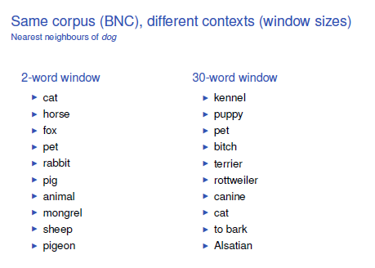

Slide 27
How large is the context around a target occurrence?
Bag-of-words context:
  Wide context or document: topical similarity
  Narrow context: Mostly cat-dog and dog-animal,
  not so much dog-leash
Syntactic parse relations
    Same as narrow context, only more so
    Mostly cat-dog and dog-animal, not so much dog-leash
    Sparser than bag-of-words

Slide 28
Snippets of syntactic structure as context items
TypeDM:
  shot-n aboard-1 train-n 7.3669
  shot-n about argue-v 8.1278
  shot-n about ask-v 28.3219
  shot-n about bias-v 5.6922
  shot-n about brag-v 15.7061
  shot-n coord-1 objective-n 0.4486
  shot-n coord-1 obstacle-n 1.8468
  shot-n coord-1 odd-n 2.0591
  shot-n iobj aim-v 5.2203
  shot-n iobj ask-v 4.1064

Slide 29
Where do we go from here?
Making the model useful: Lots of parameters
  Corpus
  Measure of similarity
  Measure of association
  Window size effects
  …
Modern instantiations of this idea:
  neural word representations
  For example, word2vec / the SkipGram model

Slide 30
Again: a word and its context
How to characterize the contexts in which a word appears?
We can count context
We can also predict contexts
Machine learning: Given a word, what could be its context?

Slide 31
Neural models for predicting context
weight “raisin”
Weights of other
context words
Seen: “apple”.
Which other words
could be nearby?
“raisin”?
apple
Skipgram, Mikolov et al 2013

Slide 32
Neural models for predicting context
weight “raisin”
Weights of other context words
Weights: “raisin”
as context
Weights: “apple”
as target
apple
Skipgram, Mikolov et al 2013

Slide 33
Neural models for predicting context
Weight “raisin”
Weights of other context words
Vector for “apple”
Apple
Skipgram, Mikolov et al 2013

Slide 34
Context prediction models as distributional models
Vector of real numbers:
  counted contexts
  internal representation of a machine learning model that predicts contexts
Cosine similarity as before

Slide 35
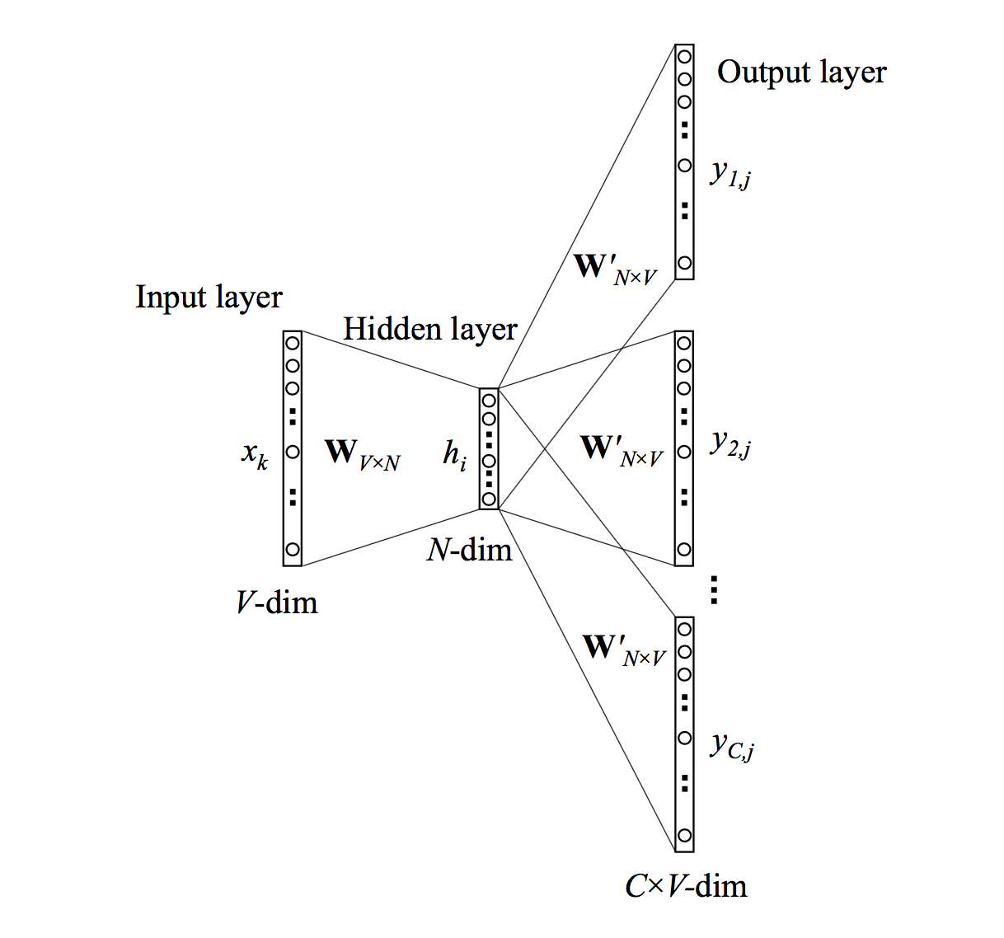
A closer look at SkipGram
xk: input word is
k-th in dictionary
hi: vector for xk
y1j: probability that
context word #1 is
word j in the dictionary
from: Xin Rong,
word2vec parameter
learning explained

Slide 36
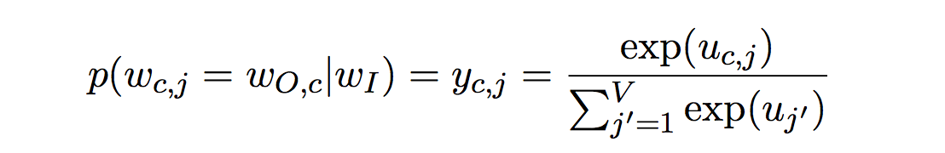
A closer look at SkipGram
Probability that output word number c, w_{Oc},
is really word number j in the dictionary:
Softmax of output value u for word j from the dictionary
Softmax:
  turns sequence of output weights into a probability distribution over output values
  emphasizes large values

Slide 37
A closer look at SkipGram
An issue with the Softmax: normalize by sum of all exp-ed output weights
This is expensive!
Solutions:
  Hierarchical softmax
  Negative sampling

Slide 38
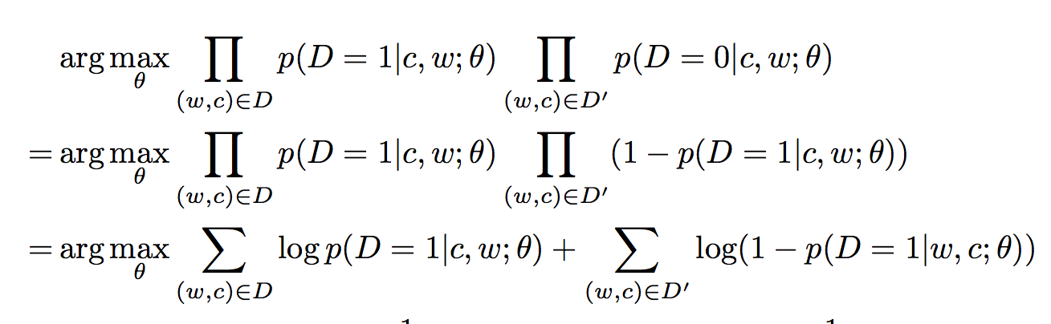
Negative sampling
Too many words
So sample some:
  Keep observed context words as positive samples
  Sample some unobserved words. From what distribution? That is an empirical question
D: set of positive pairs. D’: set of negative pairs. theta: parameters

Slide 39
Variants
Distributional models for words versus distributional models for documents:
  Term-document-matrix: targets are words, dimensions are documents, values count how often the target appears in each document
  Document-term-matrix: term-document-matrix transposed
  Earlier use than distributional models with word targets

Slide 40
Variants
Count-based models (so far)
Bayesian topic models: Latent Dirichlet Allocation
Prediction-based models

Slide 41
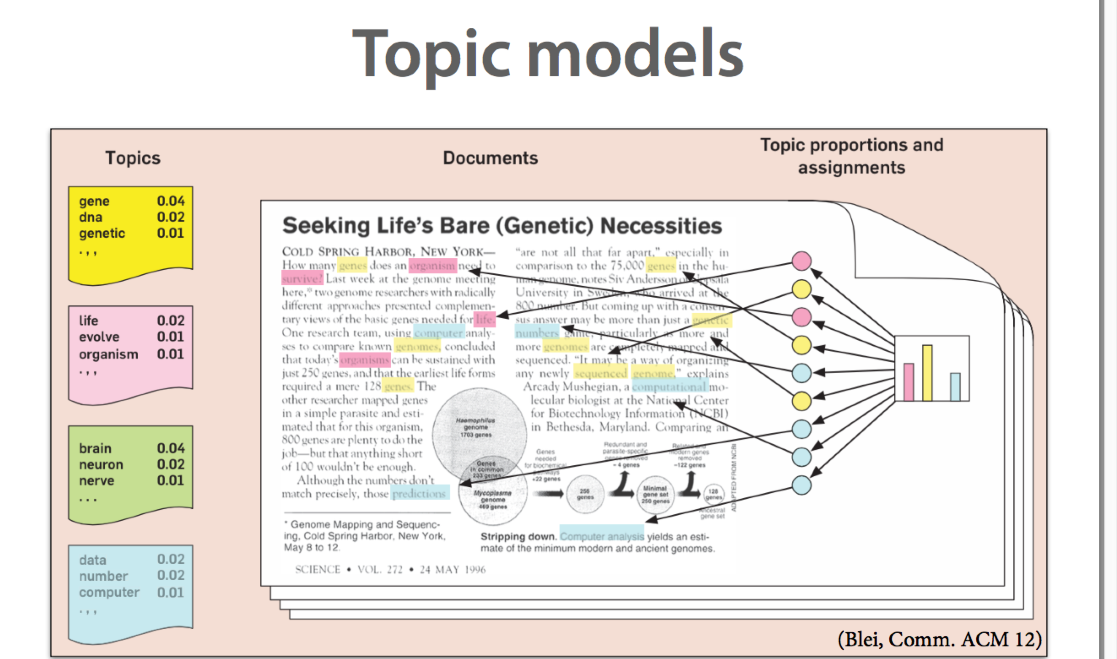
Bayesian topic models

Slide 42
Applications of word similarity: Building a thesaurus
Building a thesaurus automatically (Dekang Lin):
  Syntactically parsed text as a basis,
  context consists snippets of dependency structure
    count(cell, obj-of, contain) = 4
    count(cell, obj-of decorate) = 2
  Use top-10 or 20 similar words as thesaurus entries
    brief(noun): affidavit 0.13, petition 0.05, memorandum 0.05, motion 0.05, lawsuit 0.05, deposition 0.05, slight 0.05, prospectus 0.04, document 0.04 paper 0.04....
    Available with NLTK

Slide 43
Application of word similarity: Learning word senses from data
Schütze 1998: one vector per occurrence of “letter”
  She wrote an angry letter to her niece.
  He sprayed the word in big letters.
  The newspaper gets 100 letters from readers every day.
Make occurrence vector by adding up the vectors of all other (content) words in the sentence:
Cluster occurrence vectors
Clusters = word senses

Slide 44
Applications of word similarity: Learning phrase similarity
Lin/Pantel 2001: Similarity not between words but between phrases:
  X solves Y
  X finds a solution to Y
Similarity of X of “X solves Y”, X of “X finds a solution to Y”: similarity in fillers seen in the two X slots (idiosyncratic similarity measure)
Similarity of the two phrases: average of their
X-slot-similarity and Y-slot-similarity

Slide 45
Applications of word similarity: Learning phrase similarity
Huge collection of more-or-less paraphrases
X manufactures Y: X produces Y; X markets Y; X develops Y; X is supplier of Y; X ships Y; X supplies Y; Y is manufactured by X; X is maker of Y; X introduces Y; X exports Y; X makes Y; X builds Y; X’s production of Y; X unveils Y; Y is bought from X; X’s line of Y; X assembles Y; X is Y maker; X’s Y factory; X’s Y production; X is manufacturer of Y; X’s Y division; X meets demand for Y; ...

Slide 46
Application of word similarity: Learning selectional preferences
Selectional preferences:
  Direct objects of “eat” tend to be foods
  Subjects of “ponder” tend to be animate
  Direct objects of “devein” pretty much have to be shrimp

Slide 47
Application of word similarity: Learning selectional preferences
Learning selectional preference for direct objects of “grate”:
  Make vectors for all words that appear as arguments
  In a text, collect direct objects of “grate”:
    zest, rind, cheese, carrot, onion, parmesan, nutmeg, …
  Selectional preference vector: average of “zest”, “rind”, “cheese”, “carrot”, …
Is “car” a good direct object for “grate”?
  sim(car, direct-obj-preference-of-grate)

Slide 48
Application of word similarity: Learning selectional preferences
Most typical direct objects of…
  rebut: presumption, allegation, charge, criticism, claim
  enunciate: principle, word, theory, philosophy, policy
  break with: tradition, past, precedent, convention, Rome

Slide 49
Combining word vectors into phrase vectors
Simple approaches:
  adding vectors
  dimension-wise multiplication of vectors
More complex:
  Adjective as function
  Maps noun meaning to adjective/noun meaning

Slide 50
Combining word vectors into phrase vectors
Adjective as function that maps noun meaning to adjective/noun meaning
Noun as vector
Adjective as a matrix
Adjective maps noun vector to adjective/noun vector

Slide 51
Applications: Web search
Very first distributional model (Vector Space Model): SMART information retrieval system, 1971,
Gerald Salton and colleagues
  Each document as point in space
  Search query as pseudo-document, point in same space
  Present documents in order of similarity to query

Slide 52
Applications: web search
Query expansion:
  We want to find documents that contain the query keywords
  We also want to find documents with similar keywords
  So automatically expand the query
  Space:
    Query co-occurrences in same user session
    Session contexts
    Click contexts

Slide 53
Applications of document similarity
Essay grading (Landauer and others):
  Compare to one or more high-quality reference essays
  Essay that is highly similar to the reference essays gets a high grade

Slide 54
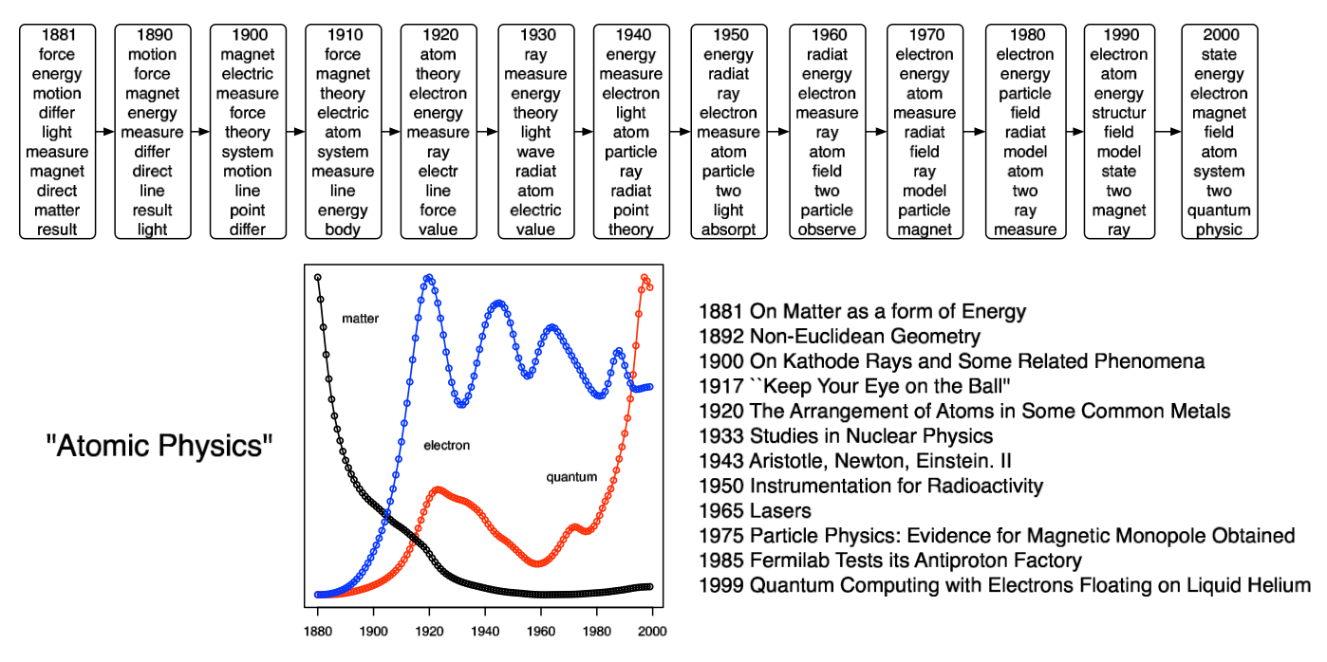
Applications of topic modeling: Topics changing over time (Blei/Lafferty 2006)

