Slide 1
Class Diagram Equivalence
Judy Altoyan
Don Batory

Slide 2
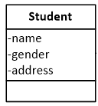
Background
A class diagram (CD) is a standard graphical notation to depict object oriented designs in terms of classes and their relationships
A class defines a “type” which has instances
cone
of
instances
S3
S1
S4
S2
Notes:
http://www.cs.sjsu.edu/~pearce/modules/lectures/ooa/domain/domainModels.htm

Slide 3
Background
An object oriented design usually has many classes
Classes has relationships called associations that have
role names and cardinalities
Notes:
http://www.cs.sjsu.edu/~pearce/modules/lectures/ooa/domain/domainModels.htm

Slide 4
Background
A class diagram has instances – here is one of a colossal number of instances
C1
S1
C2
S2
C3
S3
S4
i1
i2
Notes:
http://www.cs.sjsu.edu/~pearce/modules/lectures/ooa/domain/domainModels.htm

Slide 5
Basic Question: Equivalence
Do two class diagrams encode the same information?
If so, we say they refactorings of each other – show by applying a series of
equality rewrites
Scholar
-
name
-
gender
-
address
Course
?
1
-
-
name
enrolledIn
Enroll
10
..*
1
-
uniqueNumber
-
building
-
1
..
room
6
-
hasStudents
-
time
1
..
2
-
1
-
teaches
taughtBy
Professor
-
name
-
rank
-
serial
#
Notes:
http://www.cs.sjsu.edu/~pearce/modules/lectures/ooa/domain/domainModels.htm

Slide 6



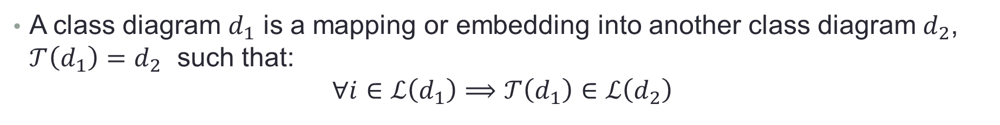



Foundation for Proving Equivalence uses
CD Transformations / Rewrites
A class diagram $d_{1}$ is a mapping or embedding into another class diagram $d_{2}$, $𝒯\left(d_{1}\right)=d_{2}$ such that:
$$∀i∈ℒ\left(d_{1}\right)⟹𝒯\left(d_{1}\right)∈ℒ\left(d_{2}\right)$$
$$d_{1}$$
$$d_{2}$$
$$ℒ\left(d_{1}\right)$$
$$i_{1}$$
$$i_{2}$$
$$ℒ\left(d_{2}\right)$$

Slide 7
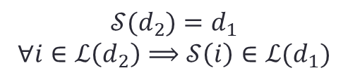

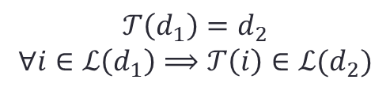




To Prove a CD Refactoring
Of a class diagram $d_{1}$ to class diagram $d_{2}$ requires transformation $𝒯$ to be invertible:
$𝒯^{−1}⋅𝒯\left(x\right)=x$ and $𝒯⋅𝒯^{−1}\left(y\right)=y$
Where $𝒮= 𝒯^{−1}$
$$d_{1}$$
$$𝒯\left(d_{1}\right)=d_{2}$$
$$∀i∈ℒ\left(d_{1}\right)⟹𝒯\left(i\right)∈ℒ(d_{2})$$
$$d_{2}$$
$$𝒮(d_{2})=d_{1}$$
$$∀i∈ℒ\left(d_{2}\right)⟹𝒮\left(i\right)∈ℒ(d_{1})$$
$$i_{1}$$
$$i_{2}$$

Slide 8
In General the Information in a Class Diagram is
Classes – with their scalar-valued fields, domains of objects
Associations among pairs of classes + role names (turn in to set-valued fields)
Cardinalities – how many objects of class T are connect to objects of class R
Can be additional constraints
all courses have unique course numbers
no two students have the same name and postal address
…

Slide 9
Our Immediate Goal
Given two class diagrams (CDs), how do we prove they are equivalent?
This much we know & need:
    We need a formal representation of a CD
    And a mapping/correspondence between CDs must be defined
    Should be able to prove disprove equivalence
Mechanize what we are doing by hand now…

Slide 10
So What? (Always a Good Question To Ask)
Not possible to verify refactorings in commercial languages – Java
    no formal model of Java exists, only tiny versions (Featherweight Java)
Class diagrams are as close as likely anyone can get now
    is still a fundamental open problem in MDE ~15+ years old, UML > 20 years
Fundamental problem:
    CD transformations (that’s what MDE is all about)
    database to database transformations (that’s what database migration is all about)
It is high time to make progress

Slide 11
Formal Notations That Have Been Used
First-order-logic: predicate logic with quantifiers over variables.
Description logic (DL): decidable fragments of first-order logic
  define sets, subset relationships, cross-products, cardinality constraints
Relational Algebra: includes projection, join, etc. on database tables
  CDs represent database schemas
  Mappings represent database translations
Formal specification languages: Alloy, Z notation, Object-Z, Coq
Notes:
DL: the choice of the DL language needs to be considered carefully – different notations vary in analysis complexity.
Object-Z was developed to improve Z in in structuring and object-oriented representations

Slide 12
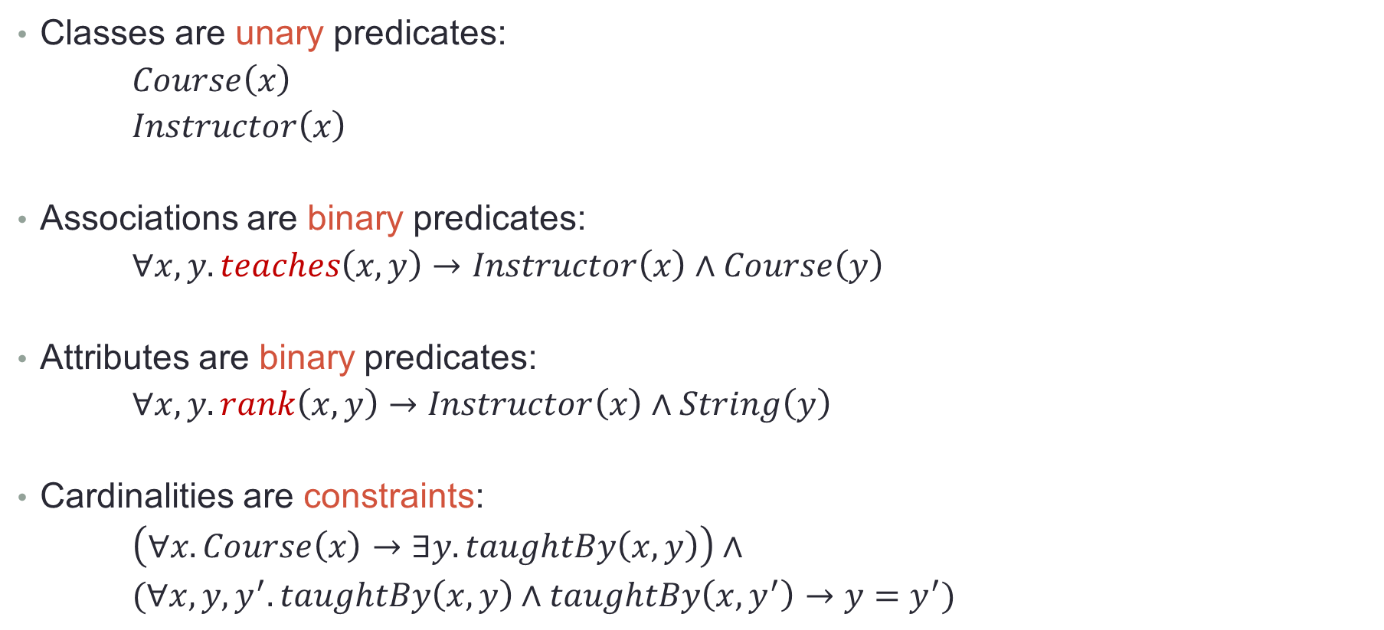
Example in FOL notation
Classes are unary predicates:
$Course\left(x\right)$
$Instructor\left(x\right)$
Associations are binary predicates:
$∀x,y.teaches\left(x,y\right)→Instructor\left(x\right)∧Course\left(y\right)$
Attributes are binary predicates:
$∀x,y.rank\left(x,y\right)→Instructor\left(x\right)∧String\left(y\right)$
Cardinalities are constraints:
$\left(∀x.Course\left(x\right)→∃y.taughtBy\left(x,y\right)\right)∧$
$(∀x,y,y^{′}.taughtBy\left(x,y\right)∧taughtBy\left(x,y^{′}\right)→y=y^{′})$
need set cardinality
primitives

Slide 13
Proof Tools
Problem: maturity and dependability of tools. Most student-produced tools aren’t very good.
DL reasoners: different reasoner for each DL notation. Seem flakey….
  E.g. FaCT++, Pellet, Racer, etc.
Proof assistants: require user interaction.
  E.g. PVS, Isabell, Coq, etc.
Theorem provers: fully automated.
  E.g. ACL2, Prover9, Vampire, SPASS, etc.
SAT solvers
  E.g. Alloy

Slide 14
Prior Work
Most work on class diagram analysis is to prove that it is satisfiable – it has at least one instance
  Description logic reasoners were used to detect unsatisfiable concepts
  (i.e. classes that cannot be instantiated).
Alloy was used to formally represent CDs and analyze them for inconsistences. However, since Alloy only permits bounded analysis scope,
it cannot be used as a theorem prover.
One work on Alloy Model equivalence used PVS where an equivalence notion was defined. CD equivalence can then be derived by translating to corresponding Alloy models.
Notes:
http://theo.cs.ovgu.de/lehre/lehre16s/modelling/slides6.pdf

Slide 15
We Need Advice…
What tool is most suited for proving CD equivalence?
    ideally it directly supports the concepts that we need to express class diagrams
What is the ramp time to learn a tool?
Anyone here (or that you know of) have interest in this problem?
شكرا
Thank Ewe!

