Slide 1
An Introduction to Agda
Curtis Dunham
February 1, 2019

Slide 2
Agenda
History
Agda
  What it is
  Why it’s interesting
  Some basic definitions and proofs
Demo
  Emacs interaction
  Typed holes
  Short proofs

Slide 3
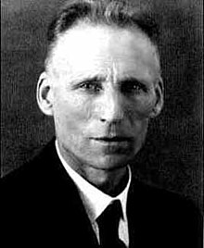
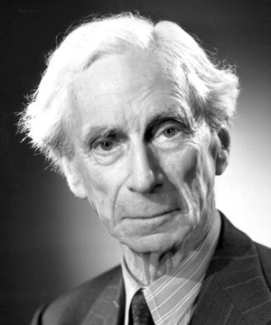
Intuitionistic Type Theory:
The Forefathers
Brouwer
Russell
Intuitionism
Types

Slide 4
Intuitionism
Briefly: mathematics without
The Law of the Excluded Middle (LEM)
LEM: All propositions are either true or false;
∀ P, P ∨ ¬P.
Demands construction of witnesses:
∃x : P(x) can only be proven by constructing an
object x such that P(x).

Slide 5
Russell’s Types
Russell’s Paradox:
“the set of all sets that do not contain themselves”
Self-reference is problematic
Types enforce a hierarchy in which self-reference is impossible

Slide 6
BHK Interpretation₁
The Brouwer-Heyting-Kolmogorov Interpretation:
interpretation of the logical operators in intuitionistic logic
A ∧ B requires a proof of A and a proof of B
A ∨ B requires a proof of A or a proof of B
…

Slide 7
BHK Interpretation₂
A → B requires a construction that transforms any proof of A into a proof of B
  i.e. evidence a : A transformed by function f
  such that f(a) : B
⊥ (absurdity) has no proof
¬A means A → ⊥

Slide 8
Curry-Howard Correspondence
and ⟺ pairing
or ⟺ tagged union
implication⟺ function application
false/absurdity ⟺ type with no members

Slide 9
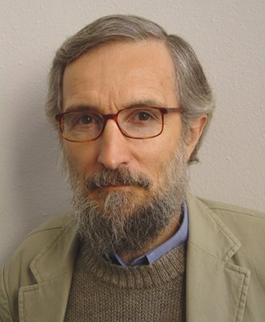
Intuitionistic Type Theory
Per Martin-Löf:
Martin-Löf Type Theory (MLTT) (1972)
Some key contributions towards Agda:
Calculus of Constructions, Coquand
Calculus of Inductive Constructions, Paulin-Mohring
UTT, Luo
Agda 2, Ulf Norell
Notes:
1986, 1993, 1993, 2007

Slide 10
What is Agda?
From the website ^{[1]} :
A dependently-typed functional programming language
A proof assistant
A product of Sweden – Chalmers, Gothenburg University
[1] http://wiki.portal.chalmers.se/agda/

Slide 11
Similar Systems
Coq (CIC), Ocaml
Matita (CIC), Ocaml
Lean (CIC), C++
Idris, Haskell

Slide 12
Agda and Haskell
Agda is…
Written in Haskell
Compiles to Haskell
Liberally borrows Haskell syntax
Haskell influence brings:
Fancy lambda calculus with pattern matching
Significant indentation

Slide 13
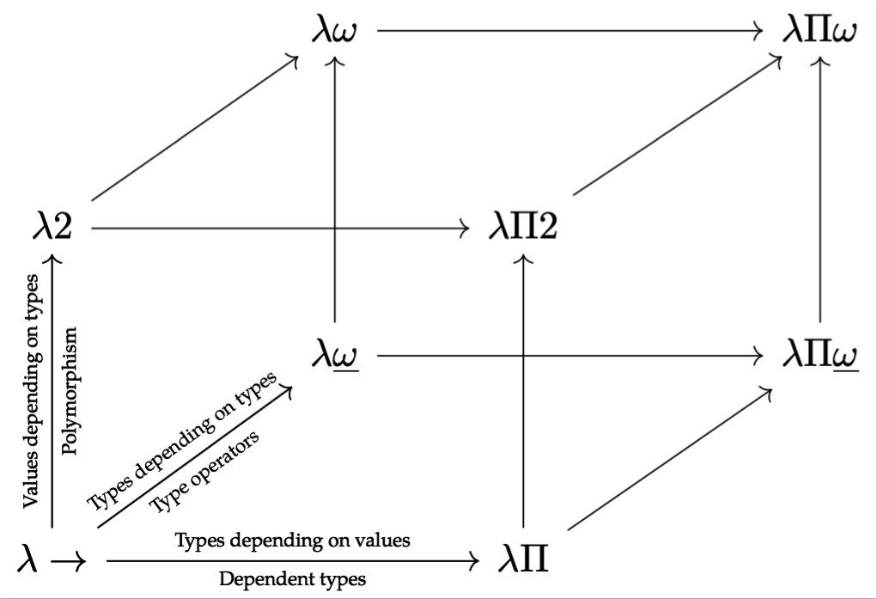
Normal dependently typed features
Types and terms share hierarchy of universes
  Terms in types, types in terms – “full lambda cube”
  Type functions
  “Propositions as Types”, “Proofs are Programs”
    A theorem is the type of its proofs
    A proof “proves” the theorem by inhabiting/having the type
Dependent product (Π), dependent sum (Σ)
  Constructive “for all” and “there exists” quantifiers
Type inference: arguments can often be inferred

Slide 14
Programming Language or Prover?
How?
Recall: Agda is both
A dependently-typed functional programming language
A proof assistant
In this logical system, type checking = proof checking
When using Agda as a prover, programs are not “compiled”; type checking is sufficient.

Slide 15
Distinct features
Interactive editing of typed holes in Emacs
Unicode
Proof terms – deBruijn criterion ✓
  Unlike tactic-oriented provers (e.g. Coq, HOL),
  in Agda the proof terms are written directly
  A brief aside for the next few slides:
  This attribute receives undeserved negative prejudice

Slide 16

Proof Terms
Back in 2010, Ben Delaware gave a Coq introduction to this audience
He suggested that writing proof terms (as in Agda) is unpleasant
e.g. proof of associativity of list append:
Definition app_assoc :=
list_ind
(fun a0 : list A => forall b c : list A, a0 ++ b ++ c = (a0 ++ b) ++ c)
(fun b c : list A => refl_equal (b ++ c))
(fun (a0 : A) (a1 : list A)
(IHa : forall b c : list A, a1 ++ b ++ c = (a1 ++ b) ++ c)
(b c : list A) =>
let H :=
eq_ind_r (fun l : list A => a0 :: (a1 ++ b) ++ c = a0 :: l)
(refl_equal (a0 :: (a1 ++ b) ++ c)) (IHa b c) in
eq_ind_r (fun l : list A => a0 :: a1 ++ b ++ c = l)
(eq_ind_r (fun l : list A => a0 :: l = a0 :: l)
(refl_equal (a0 :: (a1 ++ b) ++ c)) (IHa b c)) H) a

Slide 17
Proof Tactics
But that proofs by tactics was more pleasant
e.g. proof script for associativity of list append:
Lemma app_assoc : forall A (a b c : list A), a ++ (b ++ c) = (a ++ b) ++ c.
induction a; simpl; intros.
reflexivity.
cut (a :: (a0 ++ b) ++ c = a :: (a0 ++ b ++ c)).
intros; rewrite H; rewrite IHa; reflexivity.
rewrite IHa; reflexivity.
Qed.

Slide 18
Counterpoint
This distinction is true of Coq
  Avoid writing Gallina proof terms directly
  Ltac (tactic language) is dirty, but expedient
But in Agda …
  Writing proofs as Agda functions isn’t so bad…
  Typed holes provide equivalent interactivity!
Why?

Slide 19
Associativity of append in Agda
From the Agda standard library (agda-stdlib):
module _ {a} {A : Set a} where
++-assoc : Associative {A = List A} _≡_ _++_
++-assoc [] ys zs = refl
++-assoc (x ∷ xs) ys zs = cong (x ∷_) (++-assoc xs ys zs)
Notes:
Notice how the proof is shorter (more succinct) than even the Coq tactic script.
The use of induction is clear by the recursive call, and the case splitting on the first argument (just as in the Coq proof) is also obvious.

Slide 20
Some Definitional Backchaining…
-- Algebra/FunctionProperties.agda
module Algebra.FunctionProperties
{a ℓ} {A : Set a} (_≈_ : Rel A ℓ) where
Associative : Op₂ A → Set _
Associative _∙_ = ∀ x y z → ((x ∙ y) ∙ z) ≈ (x ∙ (y ∙ z))
-- Algebra/FunctionProperties/Core.agda
Op₂ : ∀ {ℓ} → Set ℓ → Set ℓ
Op₂ A = A → A → A

Slide 21
Definition of ++ (list concatenation)
-- Data/List/Base.agda
infixr 5 _++_
_++_ : ∀ {a} {A : Set a} → List A → List A → List A
[] ++ ys = ys
(x ∷ xs) ++ ys = x ∷ (xs ++ ys)

Slide 22
Definition of ≡ (equality)
-- Agda/Builtin/Equality.agda
infix 4 _≡_
data _≡_ {a} {A : Set a} (x : A) : A → Set a where
instance refl : x ≡ x

Slide 23
Associativity of append, again₁
++-assoc : Associative {A = List A} _≡_ _++_
++-assoc [] ys zs = refl
++-assoc (x ∷ xs) ys zs = cong (x ∷_) (++-assoc xs ys zs)
After applying Associative, the type signature is roughly
λ (x y z : List _) → (x ++ y) ++ z ≡ x ++ (y ++ z)

Slide 24
Associativity of append, again₂
++-assoc : Associative {A = List A} _≡_ _++_
++-assoc [] ys zs = refl
++-assoc (x ∷ xs) ys zs = cong (x ∷_) (++-assoc xs ys zs)
Proof proceeds by case analysis on the first argument.

Slide 25
Associativity of append, again₃
++-assoc : Associative {A = List A} _≡_ _++_
++-assoc [] ys zs = refl
++-assoc (x ∷ xs) ys zs = cong (x ∷_) (++-assoc xs ys zs)
Base case is trivial (‘refl’ means proof by reflexivity):
Recall that (by definition of ++), [] ++ ys ≡ ys. So
([] ++ y) ++ z ≡ [] ++ (y ++ z)
y ++ z ≡ y ++ z
refl (y ++ z)

Slide 26
Associativity of append, again₄
++-assoc : Associative {A = List A} _≡_ _++_
++-assoc [] ys zs = refl
++-assoc (x ∷ xs) ys zs = cong (x ∷_) (++-assoc xs ys zs)
When using proof by induction, the proof is recursive!
(xs ++ ys) ++ zs ≡ xs ++ (ys ++ zs)
x ∷ ((xs ++ ys) ++ zs) ≡ x ∷ (xs ++ (ys ++ zs))
∎

Slide 27
Agenda
Agda
  What it is
  Why it’s interesting
  Some basic definitions and proofs
Demo
  Emacs interaction
  Typed holes
  Short proofs

Slide 28
Agda Strengths
Interactivity
Brevity: Unicode, mixfix
Proof terms
  Powerful formalism, direct Curry-Howard
Active community and developers

Slide 29
Agda Weaknesses
Large body of background knowledge
Poor error messages
Proof automation functionality is minimal
  Counterpoint: mature Reflection API allows self service
Incomplete documentation
Slow

Slide 30
“Agda-Curious”?
Programming Language Foundations in Agda
  https://plfa.github.io/
  Port of Software Foundations (Coq) by Pierce, et al.

Slide 31

An Introduction to Agda
Thank you!
What questions
do you have?
Curtis Dunham
University of Texas at Austin
and
Arm Research

Slide 32
Backup / Slide Graveyard

