Slide 1
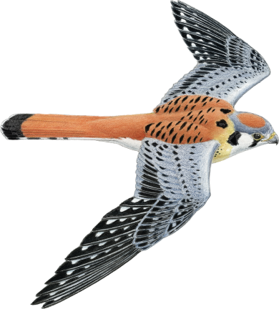


Syntheto:
A Surface Language
for APT and ACL2
Alessandro Coglio
Eric McCarthy
Stephen Westfold
Daniel Balasubramanian
Abhishek Dubey
Gabor Karsai
Kestrel
Institute
WORKSHOP 2022

Slide 2


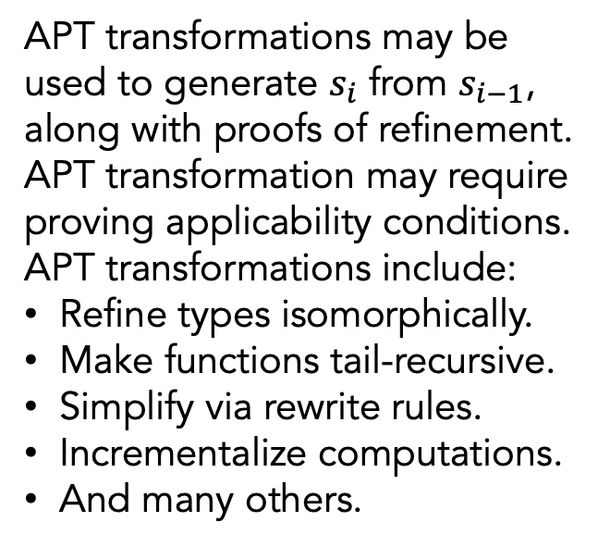


Background
APT (Automated Program Transformations) is a toolkit, built on ACL2,
for formally verified program synthesis via transformational refinement.
program synthesis by refinement
APT transformations may be
used to generate $s_{i}$ from $s_{i−1}$,
along with proofs of refinement.
APT transformation may require
proving applicability conditions.
APT transformations include:
Refine types isomorphically.
Make functions tail-recursive.
Simplify via rewrite rules.
Incrementalize computations.
And many others.
$$s_{0}$$
requirements specification
$$s_{1}$$
stepwise refinements
. . .
intermediate specifications
$$s_{n}$$
code generation
(optional in ACL2)
$$p$$
implementation
Users must have expertise in APT and ACL2.

Slide 3

Architecture
Syntheto uses ACL2 and APT, “hiding” them behind
(1) a strongly statically typed functional language and
(2) a notebook-style IDE based on VS Code.
Syntheto language & IDE
Syntheto front end
ACL2
Syntheto back end
Xtext
APT
ACL2
VS Code
Bridge
The purpose is to provide more familiarity and automation,
making formal program synthesis more widely accessible.

Slide 4







Syntheto Usage
Syntheto
front end
APT & ACL2
back end
The user carries out
derivations in Syntheto,
in the notebook IDE.
The derivations are
realized in APT/ACL2
behind the scenes.
There is a bidirectional
translation between
APT/ACL2 and Syntheto.
$$s_{0}$$
$$s_{0}$$
$$s_{1}$$
$$s_{1}$$
Syntheto
derivation
. . .
. . .
APT
derivation
$$s_{n}$$
$$s_{n}$$
$$p$$
$$p$$

Slide 5
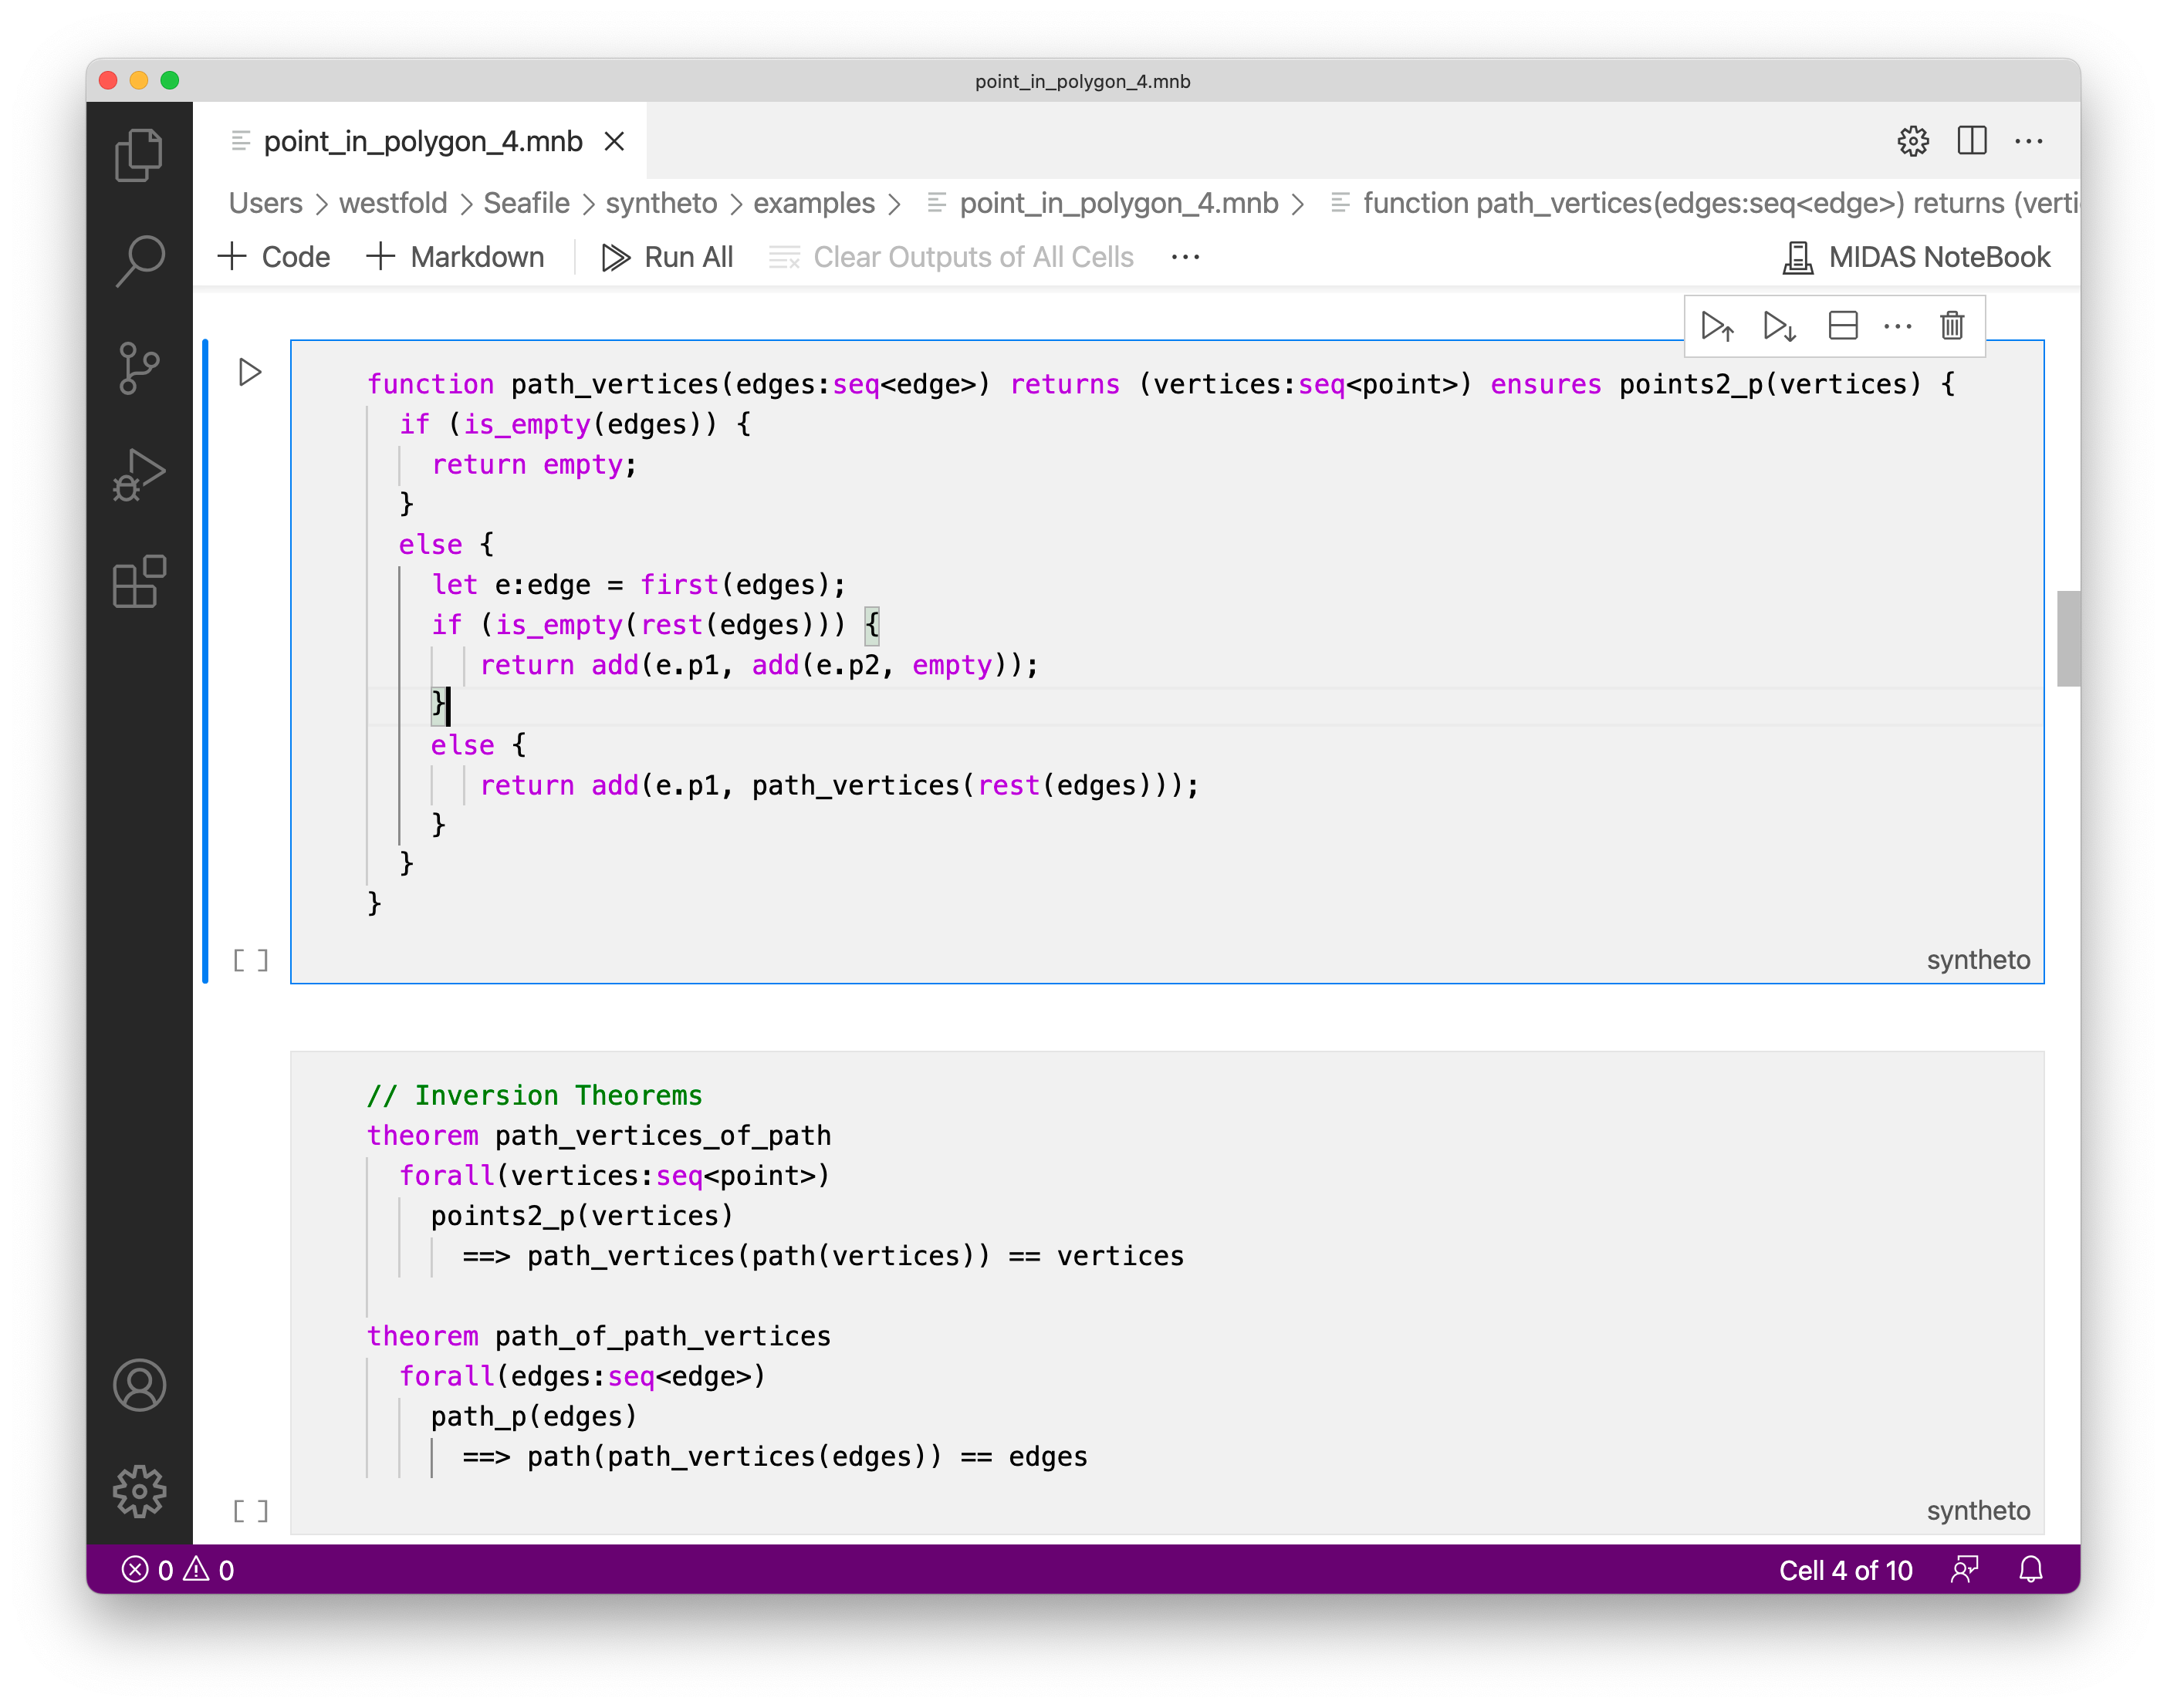

Slide 6
Syntheto Language Features
Strongly Statically Typed
  Parameterized sequence, set, map and option types
  Product and Sum types
  Predicate Subtypes
  Mutual Recursion
  Primitive Types: integer, bool, char, string
Functional but imperative-looking
Functions: Executable and Non-executable (specifications)
Theorems
Transformations

Slide 7
Current Transformations
simplify: Simplifies a function definition using enabled rewrite rules
finite_difference: Adds a parameter to a function along with an invariant that the parameter is equal to a function of the existing parameters
tail_recursion: Puts a function into tail-recursive form
isomorphism: Replaces a parameter of one type by a parameter of an isomorphic type
rename_param: Renames a parameter
drop_irrelevant_parameter: Removes a parameter that is not needed
wrap_output: Wraps a function call around the body of a function
restrict: Adds a precondition on a function

Slide 8
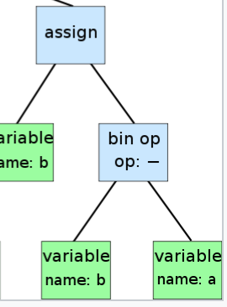
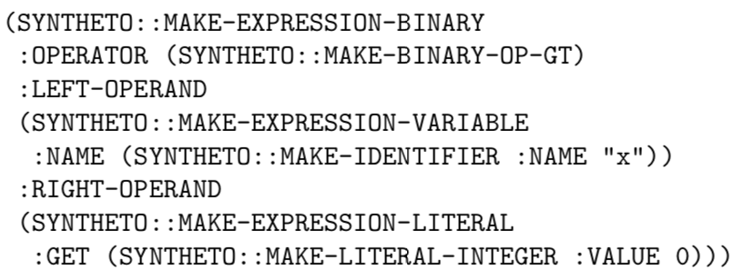
Transfer Language
We want to send definitions and commands to ACL2 and to receive responses. How should we serialize the definitions?
On the ACL2 side, the Syntheto abstract syntax is defined primarily with FTY product types, sum types, list types, and some primitive types. The product types and sum types have handy “make-” macros that make values. We use these S-expressions as the transfer language to transfer definitions in both directions.
Syntheto AST in Java
Syntheto AST in ACL2
Serialize
methods
on AST classes
(read ..)
and
(make-event ..)

Slide 9
Transfer Language, return direction
Results of APT transformations are sent back to the front end.
To facilitate generating the transfer language from ACL2, for each AST node type we set up a make-myself macro such that (make-myself x) returns an S-expression that, when evaluated, makes x.
Syntheto AST in Java
Syntheto AST in ACL2
Parse S-expression
and use reflection
to let each class
build its instance
(make-myself ..)
and
(fmt ..)

Slide 10

ACL2 Server
We want to send definitions and commands to ACL2 over a network connection, and to receive responses.
The ACL2 Bridge did a lot of the work for us.
Some lessons:
* The ACL2 Bridge only works on Clozure Common Lisp (CCL).
* Protocol is simple and easy.
* JSON interface for returned S-expressions loses information, so we found it better to use S-expressions directly.
* When you send an S-expression, the ACL2 Bridge will read it in the listener thread in the ACL2 package, not in the package your main listener is in.
We found the ACL2 Bridge to be super-reliable code!
ACL2
Bridge

Slide 11
ACL2 Server
ACL2
Bridge
Once the definitions get across the bridge, what happens to them? There’s no human looking at an ACL2 prompt.
Some of the issues:
Events must be serialized to the main thread, because memoization is not thread-safe.
Solution: The ACL Bridge has TRY-IN-MAIN-THREAD that shuttles forms from socket listeners to the main listener.
No defined API for submitting events and receiving machine-readable responses.
Solution: Matt Kaufmann came up with NLD, ”Noninteractive LD”, which doesn’t expect to be executing in a REPL and which returns certain output messages as structured data rather than sending them to stdout.

Slide 12
Translation of Syntheto to ACL2
Types → primitive and fty types
Expressions → s-expressions
  Use functions created by fty macros
  Add typing and guard predicates
Function definitions
  Regular → defun and typing defthms
  Quantified → defun-sk
Specifications → defstub and defun-sk
Theorems → defthm
Transformations → one or more APT transformations

Slide 13
Example Translations
struct point
{ x: int,
y: int }
(fty::defprod point
((x int) (y int))
:tag :point)
function connected(e1:edge, e2:edge) returns (b:bool) {
return e1.p2 == e2.p1;
}
(define connected (e1 e2)
:returns (b booleanp)
(and (edge-p e1) (edge-p e2)
(equal (edge->p2 e1) (edge->p1 e2))))
// Given a list of points, return the list of edges
// that connect the points in sequence
function path(vertices:seq<point>) returns (p:seq<edge>)
ensures path_p(p) {
if (is_empty(vertices) || is_empty(rest(vertices))) {
return empty;
}
else {
let e: edge = edge(p1=first(vertices), p2=first(rest(vertices)));
return add(e, path(rest(vertices)));
}
}
(define path ((vertices sequence[point]-p))
:measure (len vertices)
:guard (sequence[point]-p vertices)
:prepwork ((local (include-book "kestrel/lists-light/len" :dir :system)))
:returns (p sequence[edge]-p :hyp :guard)
(if (or (not (mbt (and (sequence[point]-p vertices))))
(endp vertices) (endp (cdr vertices))
nil
(let ((e (MAKE-edge :p1 (car vertices)
:p2 (car (cdr vertices)))))
(cons e (path (cdr vertices)))))
///
(defret path-ENSURES :hyp :guard
(path_p p)
:hints (("Goal" :in-theory (enable path_p)))))
theorem path_p_rest
forall(edges:seq<edge>)
!is_empty(edges) && path_p(edges)
==> path_p(rest(edges))
(defthm path_p_rest
(implies (path_p edges) ; remove-hyps removed 2 hyps
(path_p (cdr edges)))
:hints (("Goal" :in-theory (enable path_p))))

Slide 14
Back Translation of Transformed Functions
Infer types of variables
  Directly from guards
  Simple inference on body
Strip typing and guard predicates from function body
  Can result in significantly simplified expression
Exploit invertible naming scheme
Currently supported APT transformations do not introduce functions that cannot be back-translated

Slide 15
Example Problem: Point in Polygon
A point is in a polygon if there are an odd number of edge crossings to a point outside the polygon.
Points
outside
polygon
Point 1
3 crossings so point 1 is inside
Point 2
4 crossings so point 2 is outside

Slide 16
Main Function
/* number of times edge0 crosses edges */
function crossings_count_aux
(edge0: edge, edges: seq<edge>)
assumes path_p(edges)
returns (n: int) ensures n >= 0 {
if (is_empty(edges)) {
return 0;
}
else {if (edges_intersect(edge0, first(edges))) {
return 1 + crossings_count_aux(edge0, rest(edges));
}
else {
return crossings_count_aux(edge0, rest(edges));
}}
}

Slide 17
Transformation Sequence
function crossings_count_aux_1 =
transform crossings_count_aux
by tail_recursion {new_parameter_name = count}
function crossings_count_aux_2 =
transform crossings_count_aux_1
by restrict {predicate = natp(count)}
function crossings_count_aux_3 =
transform crossings_count_aux_2
by isomorphism {parameter = edges,
new_parameter_name = vertices,
old_type = path_p,
new_type = points2_p,
old_to_new = path_vertices,
new_to_old = path,
simplify = true}
function crossings_count_aux_4 =
transform crossings_count_aux_3
by wrap_output {wrap_function = odd}
function crossings_count_aux_5 =
transform crossings_count_aux_4
by finite_difference {expression = odd(count),
new_parameter_name = count_odd,
simplify = true}
function crossings_count_aux_6 =
transform crossings_count_aux_5
by drop_irrelevant_param {parameter = count}

Slide 18
Main Function Transformation
/* number of times edge0 crosses edges */
function crossings_count_aux
(edge0: edge, edges: seq<edge>)
assumes path_p(edges)
returns (n: int) ensures n >= 0 {
if (is_empty(edges)) {
return 0;
}
else {if (edges_intersect(edge0, first(edges))) {
return 1 + crossings_count_aux(edge0, rest(edges));
}
else {
return crossings_count_aux(edge0, rest(edges));
}}
}
function crossings_count_aux_5
(edge0:edge,vertices:seq<point>,count_odd:bool)
assumes (points2_p(vertices) && path_p(path(vertices)))
returns (b:bool) {
if (is_empty(vertices) || is_empty(rest(vertices))) {
return count_odd;
}
else {
return crossings_count_aux_2
(edge0,rest(vertices),
(edge_points_intersect
(edge0.p1,edge0.p2,first(vertices),first(rest(vertices)))
? !count_odd : count_odd));
}
}

Slide 19
Final ACL2 Function
(defun crossings_count_aux_6 (edge0 vertices count_odd)
(declare (xargs :ruler-extenders :all
:guard (and (points2_p vertices)
(edge-P edge0))
:measure (len (path vertices))))
(and (mbt (points2_p vertices))
(if (or (not (mbt (edge-P edge0)))
(not (consp vertices))
(not (consp (cdr vertices))))
count_odd
(crossings_count_aux_6
edge0
(rest1 vertices)
(if (edge_points_intersect (edge->p1$INLINE edge0)
(edge->p2$INLINE edge0)
(car vertices)
(car (cdr vertices)))
(not count_odd)
count_odd)))))
function crossings_count_aux_5
(edge0:edge,vertices:seq<point>,count_odd:bool)
assumes (points2_p(vertices) && path_p(path(vertices)))
returns (b:bool) {
if (is_empty(vertices) || is_empty(rest(vertices))) {
return count_odd;
}
else {
return crossings_count_aux_2
(edge0,rest(vertices),
(edge_points_intersect
(edge0.p1,edge0.p2,first(vertices),first(rest(vertices)))
? !count_odd : count_odd));
}
}

Slide 20
Future Work
Language Enhancement
  User type parameterization
  Imperative-looking constructs such as loops
  Support for more APT transformations
Prover Interaction
  Hints for prover
  Feedback for failed proofs in Syntheto terms
Improved IDE capabilities
Syntheto Execution
  Ability to interactively run ACL2 code with results in Syntheto syntax
  Generation of Java with ATJ or C code with ATC

