Slide 1
Verifying Quantum Fourier Transform Using Bit-Vector Abstractions
Sudarshan Srinivasan
Department of Electrical and Computer Engineering
North Dakota State University

Slide 2
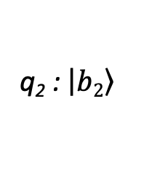
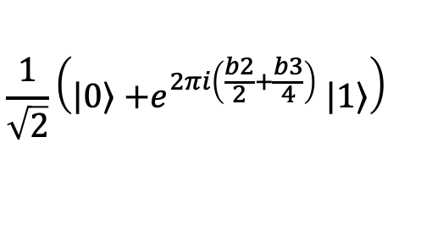
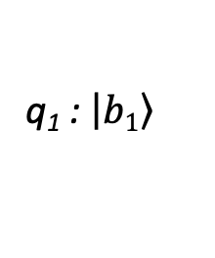
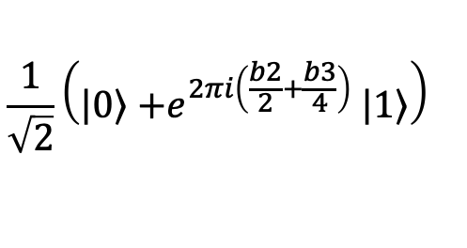
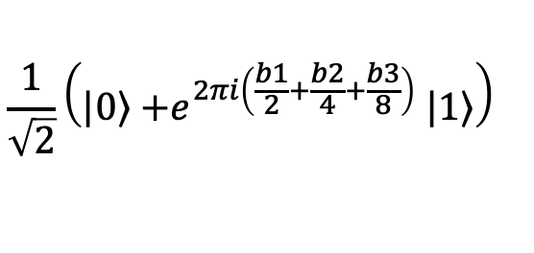
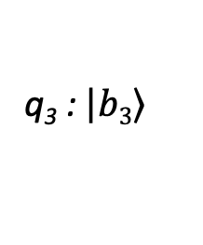
3-Qubit Quantum Fourier Transform (QFT)
q₁ : $\left.\left|b1\right.\right\rangle$
H
R₂
R₃
$$\frac{1}{\sqrt{2}}\left(\left.\left|0\right.\right\rangle {+e}^{2πi\left(\frac{b1}{2}+\frac{b2}{4}+\frac{b3}{8}\right)}\left.\left|1\right.\right\rangle \right)$$
q₂ : $\left.\left|b2\right.\right\rangle$
H
R₂
$$\frac{1}{\sqrt{2}}\left(\left.\left|0\right.\right\rangle {+e}^{2πi\left(\frac{b2}{2}+\frac{b3}{4}\right)}\left.\left|1\right.\right\rangle \right)$$
q₃ : $\left.\left|b3\right.\right\rangle$
H
$$\frac{1}{\sqrt{2}}\left(\left.\left|0\right.\right\rangle {+e}^{2πi\left(\frac{b2}{2}+\frac{b3}{4}\right)}\left.\left|1\right.\right\rangle \right)$$

Slide 3


Rotational Abstraction: Hadamard Gate
1
b
H
$$\frac{1}{\sqrt{2}}$$
$${ 1 e}^{2πi/2}$$
Abs: 0.b

Slide 4

Rotational Abstraction: Control Rotation Gate
0
R₂
$${ 0 e}^{2πi/4}$$
b
Abs: 0.0b

Slide 5

Rotational Abstraction: Control Rotation Gate
0
R₃
$${ 0 e}^{2πi/8}$$
b
Abs: 0.00b

Slide 6

Rotational Abstraction: Control Rotation Gate
0
R_{n}
$${ 0 e}^{2πi/2n}$$
b
Abs: 0.0…0b

Slide 7
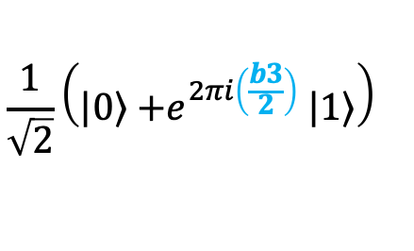
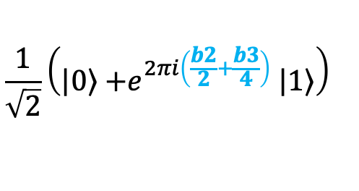
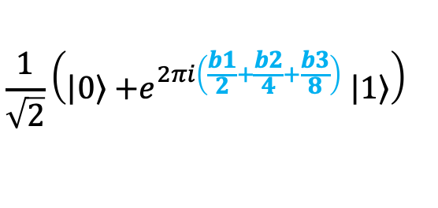
Rotational Abstraction: QFT
q₁ : $\left.\left|b1\right.\right\rangle$
H
R₂
R₃
$$\frac{1}{\sqrt{2}}\left(\left.\left|0\right.\right\rangle {+e}^{2πi\left(\frac{b1}{2}+\frac{b2}{4}+\frac{b3}{8}\right)}\left.\left|1\right.\right\rangle \right)$$
q₂ : $\left.\left|b2\right.\right\rangle$
H
R₂
$$\frac{1}{\sqrt{2}}\left(\left.\left|0\right.\right\rangle {+e}^{2πi\left(\frac{b2}{2}+\frac{b3}{4}\right)}\left.\left|1\right.\right\rangle \right)$$
q₃ : $\left.\left|b3\right.\right\rangle$
H
$$\frac{1}{\sqrt{2}}\left(\left.\left|0\right.\right\rangle {+e}^{2πi\left(\frac{b3}{2}\right)}\left.\left|1\right.\right\rangle \right)$$

Slide 8
Rotational Abstraction: QFT
q₁ : $\left.\left|b1\right.\right\rangle$
H
R₂
R₃
0.b₁ b₂ b₃
H
R₂
0.b₂ b₃
q₂ : $\left.\left|b2\right.\right\rangle$
q₃ : $\left.\left|b3\right.\right\rangle$
H
0.b₃

Slide 9
QFT Verification Results
 | Verification Time [seconds]
#Qubits | Correct Circuit | Control Gate Error | Incorrect Gate Error
128 | 0.04s | 0.02s | 0.04s
256 | 0.19s | 0.08s | 0.06s
512 | 0.26s | 0.2s | 0.2s
1,024 | 1.37s | 1.29s | 0.92s
2,048 | 9.85s | 9.47s | 5.87s
4,096 | 95.75s | 79.68s | 53.57s
8,192 | 1109.0s | 639.57s | 643.9s
10,000 | 2379.88s | 1524.65s | 1568.79s

Slide 10
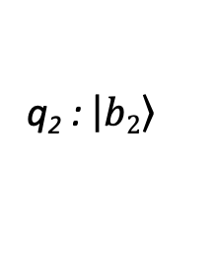


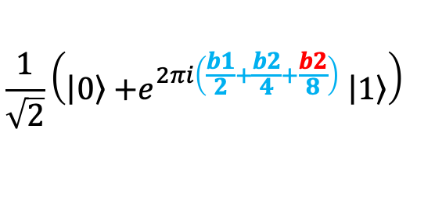
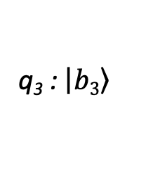
Gate Control Error
q₁ : $\left.\left|b1\right.\right\rangle$
H
R₂
R₃
$$\frac{1}{\sqrt{2}}\left(\left.\left|0\right.\right\rangle {+e}^{2πi\left(\frac{b1}{2}+\frac{b2}{4}+\frac{b2}{8}\right)}\left.\left|1\right.\right\rangle \right)$$
q₂ : $\left.\left|b2\right.\right\rangle$
H
R₂
$$\frac{1}{\sqrt{2}}\left(\left.\left|0\right.\right\rangle {+e}^{2πi\left(\frac{b2}{2}+\frac{b3}{4}\right)}\left.\left|1\right.\right\rangle \right)$$
q₃ : $\left.\left|b3\right.\right\rangle$
H
$$\frac{1}{\sqrt{2}}\left(\left.\left|0\right.\right\rangle {+e}^{2πi\left(\frac{b3}{2}\right)}\left.\left|1\right.\right\rangle \right)$$

Slide 11
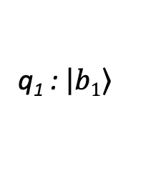

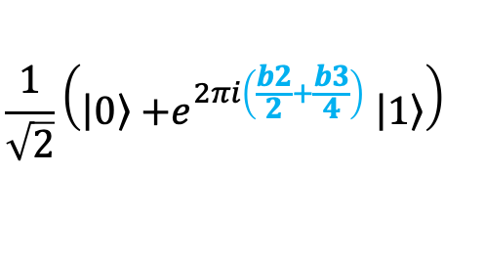

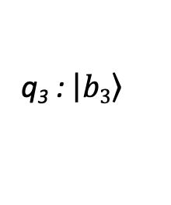
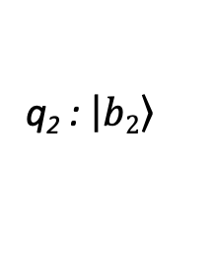
q₁ : $\left.\left|b1\right.\right\rangle$
H
R₂
R₃
$$\frac{1}{\sqrt{2}}\left(\left.\left|0\right.\right\rangle {+e}^{2πi\left(\frac{b1}{2}+\frac{b2}{4}+\frac{b3}{8}\right)}\left.\left|1\right.\right\rangle \right)$$
q₂ : $\left.\left|b2\right.\right\rangle$
H
R₂
$$\frac{1}{\sqrt{2}}\left(\left.\left|0\right.\right\rangle {+e}^{2πi\left(\frac{b2}{2}+\frac{b3}{4}\right)}\left.\left|1\right.\right\rangle \right)$$
q₃ : $\left.\left|b3\right.\right\rangle$
H
$$\frac{1}{\sqrt{2}}\left(\left.\left|0\right.\right\rangle {+e}^{2πi\left(\frac{b3}{2}\right)}\left.\left|1\right.\right\rangle \right)$$
q₁ : $\left.\left|b1\right.\right\rangle$
H
R₂
R₃
$$\frac{1}{\sqrt{2}}\left(\left.\left|0\right.\right\rangle {+e}^{2πi\left(\frac{b1}{2}+\frac{b2}{4}+\frac{b2}{8}\right)}\left.\left|1\right.\right\rangle \right)$$
q₂ : $\left.\left|b2\right.\right\rangle$
H
R₂
$$\frac{1}{\sqrt{2}}\left(\left.\left|0\right.\right\rangle {+e}^{2πi\left(\frac{b2}{2}+\frac{b3}{4}\right)}\left.\left|1\right.\right\rangle \right)$$
q₃ : $\left.\left|b3\right.\right\rangle$
H
$$\frac{1}{\sqrt{2}}\left(\left.\left|0\right.\right\rangle {+e}^{2πi\left(\frac{b3}{2}\right)}\left.\left|1\right.\right\rangle \right)$$

Slide 12
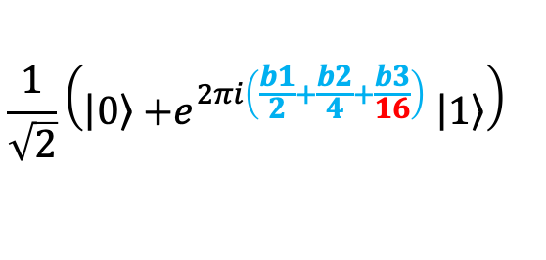
Incorrect Gate Error
q₁ : $\left.\left|b1\right.\right\rangle$
H
R₂
R₄
$$\frac{1}{\sqrt{2}}\left(\left.\left|0\right.\right\rangle {+e}^{2πi\left(\frac{b1}{2}+\frac{b2}{4}+\frac{b3}{16}\right)}\left.\left|1\right.\right\rangle \right)$$
q₂ : $\left.\left|b2\right.\right\rangle$
H
R₂
$$\frac{1}{\sqrt{2}}\left(\left.\left|0\right.\right\rangle {+e}^{2πi\left(\frac{b2}{2}+\frac{b3}{4}\right)}\left.\left|1\right.\right\rangle \right)$$
q₃ : $\left.\left|b3\right.\right\rangle$
H
$$\frac{1}{\sqrt{2}}\left(\left.\left|0\right.\right\rangle {+e}^{2πi\left(\frac{b3}{2}\right)}\left.\left|1\right.\right\rangle \right)$$

Slide 13
q₁ : $\left.\left|b1\right.\right\rangle$
H
R₂
R₃
$$\frac{1}{\sqrt{2}}\left(\left.\left|0\right.\right\rangle {+e}^{2πi\left(\frac{b1}{2}+\frac{b2}{4}+\frac{b3}{8}\right)}\left.\left|1\right.\right\rangle \right)$$
q₂ : $\left.\left|b2\right.\right\rangle$
H
R₂
$$\frac{1}{\sqrt{2}}\left(\left.\left|0\right.\right\rangle {+e}^{2πi\left(\frac{b2}{2}+\frac{b3}{4}\right)}\left.\left|1\right.\right\rangle \right)$$
q₃ : $\left.\left|b3\right.\right\rangle$
H
$$\frac{1}{\sqrt{2}}\left(\left.\left|0\right.\right\rangle {+e}^{2πi\left(\frac{b3}{2}\right)}\left.\left|1\right.\right\rangle \right)$$
q₁ : $\left.\left|b1\right.\right\rangle$
H
R₂
R₄
$$\frac{1}{\sqrt{2}}\left(\left.\left|0\right.\right\rangle {+e}^{2πi\left(\frac{b1}{2}+\frac{b2}{4}+\frac{b3}{16}\right)}\left.\left|1\right.\right\rangle \right)$$
q₂ : $\left.\left|b2\right.\right\rangle$
H
R₂
$$\frac{1}{\sqrt{2}}\left(\left.\left|0\right.\right\rangle {+e}^{2πi\left(\frac{b2}{2}+\frac{b3}{4}\right)}\left.\left|1\right.\right\rangle \right)$$
q₃ : $\left.\left|b3\right.\right\rangle$
H
$$\frac{1}{\sqrt{2}}\left(\left.\left|0\right.\right\rangle {+e}^{2πi\left(\frac{b3}{2}\right)}\left.\left|1\right.\right\rangle \right)$$

Slide 14
QFT Verification Results
 | Verification Time [seconds]
#Qubits | Correct Circuit | Control Gate Error | Incorrect Gate Error
128 | 0.04s | 0.02s | 0.04s
256 | 0.19s | 0.08s | 0.06s
512 | 0.26s | 0.2s | 0.2s
1,024 | 1.37s | 1.29s | 0.92s
2,048 | 9.85s | 9.47s | 5.87s
4,096 | 95.75s | 79.68s | 53.57s
8,192 | 1109.0s | 639.57s | 643.9s
10,000 | 2379.88s | 1524.65s | 1568.79s

Slide 15
Quantum Walks

Slide 16
Superposition Abstraction
Increment
Decrement
H

Slide 17
Quantum Walk Verification Results
 | Verification Time [seconds]
#Qubits | Correct Circuit | Control Gate Error | Incorrect Gate Error
128 | 0.41s | 0.25s | 0.19s
256 | 1.48s | 0.86s | 0.56s
512 | 4.26s | 2.97s | 2.10s
1,024 | 38.49s | 10.18 | 36.84s
2,048 | 1,186.69s | 40.81s | 213.31s
4,096 | 10,486.36s | 180.04s | 320.45s
5,000 | 17,184.68s | 286.20s | 2,099.02s

Slide 18

What We Propose To Do

Slide 19
Verified Generators Using ACL2
1. Unify Rotational Abstraction and Superposition Abstraction
2. Analyze commonly used circuits for other abstractions.
3. Develop Verified Generators in ACL2

