Slide 1
Advanced MPI
Wesley Bland - Senior Software Development Engineer

Slide 2
Last Time…
We covered:
What is MPI (and the implementations of it)?
Startup & Finalize
Basic Send & Receive
Communicators
Collectives
Datatypes

Slide 3
Basic Send/Recv
[...snip...] int rank, size, numbers[100]; MPI_Init(&argc, &argv); MPI_Comm_rank(MPI_COMM_WORLD, &rank); MPI_Comm_size(MPI_COMM_WORLD, &size); if (rank == 0) { for (i = 1; i < size; i++) MPI_Send(&numbers[(100/size)*i], (100/size), …, i, …); else MPI_Recv(&numbers[0], (100/size), …); sort_numbers(numbers, (100/size)); if (rank == 0) { for (i = 1; i < size; i++) MPI_Recv(&numbers[(100/size)*i], (100/size), …, i, …); else MPI_Send(&numbers[0], (100/size), …); combine_arrays(&numbers[0], &numbers[(100/size)], (100/size)); MPI_Finalize(); [...snip...]
Process1
Process2
Process3
Process4
8
23
19
67
45
35
1
24
13
30
3
5
Process1
Process2
Process3
Process4
8
19
23
35
45
67
1
3
5
13
24
30
1
3
5
8
13
19
23
24
30
35
45
67
Process1

Slide 4
What is an MPI Communicator?
Groups of MPI processes that can talk to each other
Start with MPI_COMM_WORLD that includes everyone that started with your job
Can divide MPI_COMM_WORLD to be smaller communicators like comm1, comm2, comm3.
Each process has a rank in each communicator
Each communicator has its own size
Communicator could even be a copy of a previous communicator
0
0
1
1
2
2
0
3
1
4
2
5
0
6
1
7
2
8

Slide 5
What Are Collectives?
A group of processes works together to accomplish something.
E.g. Calculate a value, distribute some data, gather a result, synchronize operations, etc.
Instead of sending a value to each process in a for loop, use one collective call and let MPI optimize doing that for you.

Slide 6
MPI Datatypes
MPI_Type_vector(int count, int blocklen, int stride,
MPI_Datatype oldtype, MPI_Datatype *newtype)
Specify strided blocks of data of oldtype
Very useful for Cartesian arrays
0
1
2
3
4
5
6
7
8
9
10
11
12
13
14
15
16
17
18
19
20
MPI_Type_vector(6, 1, 6, MPI_DOUBLE, &column)

Slide 7
This Time
Non-blocking communication
Brief look at advanced topics (RMA, threads)
Analyzing the performance of MPI
How does MPI get used in the real world?

Slide 8
Blocking vs. Non-blocking Communication
MPI_SEND/MPI_RECV are blocking communication calls
Return of the routine implies completion
When these calls return the memory locations used in the message transfer can be safely accessed for reuse
For “send” completion implies variable sent can be reused/modified
Modifications will not affect data intended for the receiver
For “receive” variable received can be read
MPI_ISEND/MPI_IRECV are nonblocking variants
Routine returns immediately – completion has to be separately tested for
These are primarily used to overlap computation and communication to improve performance

Slide 9
What’s the Cost of Doing Computation?
Computation
Want to spend time here
Cache Reads/Writes
More Expensive
Memory Reads/Writes
Not Here
Network Reads/Writes
Notes:
Accomplish this by aggregating and overlapping

Slide 10
Blocking Communication
In blocking communication:
MPI_SEND does not return until buffer is empty (available for reuse)
MPI_RECV does not return until buffer is full (available for use)
Exact completion semantics of communication generally depends on the message size and the system buffer size
Blocking communication is simple to use but can be prone to deadlocks
if (rank == 0) {
MPI_SEND(..to rank 1..) MPI_RECV(..from rank 1..)
} else if (rank == 1) {
MPI_SEND(..to rank 0..) MPI_RECV(..from rank 0..)
}
This will usually deadlock!

Slide 11
Non-Blocking Communication
Non-blocking (asynchronous) operations return requests that can be queried
MPI_Isend(buf, count, datatype, dest, tag, comm, request)
MPI_Irecv(buf, count, datatype, src, tag, comm, request)
MPI_Wait(request, status)
MPI_Test(request, flag, status)
Non-blocking operations allow overlapping computation and communication
Anywhere you use MPI_SEND or MPI_RECV, you can use the pair of MPI_ISEND and MPI_WAIT or MPI_IRECV and MPI_WAIT

Slide 12
Multiple Completions
It is sometimes desirable to wait on multiple requests:
MPI_Waitall(count, array_of_requests, array_of_statuses)
MPI_Waitany(count, array_of_requests, &index, &status)
MPI_Waitsome(incount, array_of_requests, outcount, array_of_indices, array_of_statuses)
There are corresponding versions of MPI_TEST for each of these

Slide 13
Message Completion and Buffering
For a communication to succeed:
Sender must specify a valid destination rank
Receiver must specify a valid source rank (including MPI_ANY_SOURCE)
The communicator must be the same
Tags must match
Receiver’s buffer must be large enough
A send has completed when the user supplied buffer can be reused
Just because the send completes does not mean that the receive has completed
Message may be buffered by the system
Message may still be in transit
*buf = 3;
MPI_Send(buf, 1, MPI_INT …)
*buf = 4; /* OK, receiver will always
receive 3 */
*buf = 3;
MPI_Isend(buf, 1, MPI_INT …)
*buf = 4; /* Receiver may get 3, 4, or
anything else */
MPI_Wait(…);

Slide 14
A Non-Blocking communication example
[...snip...]
/* Compute each data element and send it out */ if (rank == 0) {
for (i=0; i< 100; i++) { data[i] = compute(i); MPI_Isend(&data[i], 1, MPI_INT, 1, 0, MPI_COMM_WORLD, &request[i]); } MPI_Waitall(100, request, MPI_STATUSES_IGNORE)
} else if (rank == 1) {
for (i = 0; i < 100; i++) MPI_Recv(&data[i], 1, MPI_INT, 0, 0, MPI_COMM_WORLD, MPI_STATUS_IGNORE);
}
[...snip...]

Slide 15
A Non-Blocking communication example
P0
Blocking Communication
P1
P0
Non-blocking Communication
P1
Notes:
Async

Slide 16
Mesh Exchange
9
10
11
Let’s imagine communicating with a mesh of processes.
Very common type of application communication pattern.
Also known as a stencil (can be multiple dimensions)
6
7
8
3
4
5
0
1
2
Notes:
No periodic exchange

Slide 17
Sample Code
What is wrong with this code?
for (i = 0; i < n_neighbors; i++) { MPI_Send(edge, len, MPI_DOUBLE, nbr[i], tag, comm); }
for (i = 0; i < n_neighbors; i++) { MPI_Recv(edge, len, MPI_DOUBLE, nbr[i], tag, comm, status); }

Slide 18
Sample Code
What is wrong with this code?
for (i = 0; i < n_neighbors; i++) { MPI_Send(edge, len, MPI_DOUBLE, nbr[i], tag, comm); }
for (i = 0; i < n_neighbors; i++) { MPI_Recv(edge, len, MPI_DOUBLE, nbr[i], tag, comm, status); }
Deadlocks!
All of the sends may block, waiting for a matching receive (will if large enough messages)

Slide 19
Fix 1: Swap Send and Recv
This variation solves the problem.
But it introduces a performance problem.
Can anyone say what it is?
if (has up neighbor)
MPI_Recv(…up…)
else
MPI_Send(…down…)

Slide 20
Sequentializes Communication
7
8
9
10
11
4
3
6
7
8
5
2
3
4
5
6
1
0
1
2
9
10
Notes:
No periodic exchange

Slide 21
Fix 2: Use Isend and Irecv
for (i = 0; i < n_neighbors; i++) { MPI_Irecv(edge, len, MPI_DOUBLE, nbr[i], tag,
comm, requests[i]); }
for (i = 0; i < n_neighbors; i++) { MPI_Isend(edge, len, MPI_DOUBLE, nbr[i], tag, comm,
requests[n_neighbors + i]); }
MPI_Waitall(2 * n_neighbors, requests, statuses);

Slide 22
Parallelizes Communication
1
1
9
10
11
1
1
6
7
8
1
1
3
4
5
1
1
0
1
2
We Ran the Numbers
1 < 10
1
1
Notes:
No periodic exchange

Slide 23
Lesson: Defer Synchronization
Send-receive accomplishes two things:
Data transfer
Synchronization
In many cases, there is more synchronization than required
Use non-blocking operations and MPI_Waitall to defer synchronization
Tools can help out with identifying performance issues
Intel® Trace Analyzer and Collector (ITAC), Tau, HPCToolkit, and Scalasca are popular profiling tools

Slide 24
All of This Works for Collectives Too!
Recently (MPI 3.0), non-blocking collectives were added to the MPI Standard.
Now you can use MPI_IREDUCE, MPI_IBCAST, and even MPI_IBARRIER.

Slide 25
Advanced Topics: One-sided Communication

Slide 26
One-sided Communication
The basic idea of one-sided communication models is to decouple data movement with process synchronization
Should be able to move data without requiring synchronization
Each process exposes a part of its memory to other processes
Other processes can directly read from or write to this memory
Process 0
Process 1
Process 2
Process 3
Remotely
Accessible
Memory
Private
Memory
Remotely
Accessible
Memory
Private
Memory
Remotely
Accessible Memory
Private
Memory
Remotely
Accessible Memory
Global Address Space
Private
Memory
Private
Memory
Private
Memory
Private
Memory
Private
Memory

Slide 27
Two-sided Communication Example
Memory
Processor
Processor
Memory
Memory
Segment
Memory
Segment
Memory
Segment
Memory
Segment
Memory
Segment
Send
Recv
Send
Recv
MPI implementation
MPI implementation

Slide 28
One-sided Communication Example
Memory
Processor
Processor
Memory
Memory
Segment
Memory
Segment
Memory
Segment
Memory
Segment
Send
Recv
Send
Recv
MPI implementation
MPI implementation

Slide 29
Comparing One-sided and Two-sided Programming
Process 0
Process 1
SEND(data)
DELAY
Even the sending process is delayed
RECV(data)
Process 0
Process 1
PUT(data)
DELAY
Delay in process 1 does not affect process 0
GET(data)

Slide 30
Creating Public Memory
Any memory used by a process is, by default, only locally accessible.
X = malloc(100);
Once the memory is allocated, the user has to make an explicit MPI call to declare a memory region as remotely accessible.
MPI terminology for remotely accessible memory is a “window”
A group of processes collectively create a “window”
Once a memory region is declared as remotely accessible, all processes in the window can read/write data to this memory without explicitly synchronizing with the target process.
Process 0
Process 1
Process 2
Process 3
window
window
window
window
Private
Memory
Private
Memory
Private
Memory
Private
Memory
Private
Memory
Private
Memory
Private
Memory
Private
Memory

Slide 31
MPI_WIN_CREATE
MPI_Win_create(void *base, MPI_Aint size, int disp_unit, MPI_Info info, MPI_Comm comm, MPI_Win *win)
Expose a region of memory in an RMA window
Only data exposed in a window can be accessed with RMA ops.
Arguments:
base - pointer to local data to expose
size - size of local data in bytes (nonnegative integer)
disp_unit - local unit size for displacements, in bytes (positive integer)
info - info argument (handle)
comm - communicator (handle)
win - window (handle)

Slide 32
Data movement
MPI provides ability to read, write and atomically modify data in remotely accessible memory regions
MPI_PUT
MPI_GET
MPI_ACCUMULATE (atomic)
MPI_GET_ACCUMULATE (atomic)
MPI_COMPARE_AND_SWAP (atomic)
MPI_FETCH_AND_OP (atomic)

Slide 33
Data movement: Put
MPI_Put(const void *origin_addr, int origin_count,
MPI_Datatype origin_dtype, int target_rank,
MPI_Aint target_disp, int target_count,
MPI_Datatype target_dtype, MPI_Win win)
Move data from origin, to target
Separate data description triples for origin and target
Remotely Accessible Memory
Private Memory
Origin
Target

Slide 34
Data movement: Get
MPI_Get(void *origin_addr, int origin_count,
MPI_Datatype origin_dtype, int target_rank,
MPI_Aint target_disp, int target_count,
MPI_Datatype target_dtype, MPI_Win win)
Move data to origin, from target
Separate data description triples for origin and target
Remotely Accessible Memory
Private Memory
Origin
Target

Slide 35
RMA Synchronization Models
RMA data access model
When is a process allowed to read/write remotely accessible memory?
When is data written by process X is available for process Y to read?
RMA synchronization models define these semantics
Three synchronization models:
Fence (active target)
Post-start-complete-wait (generalized active target)
Lock/Unlock (passive target)
Data accesses occur within “epochs”
Access epochs: contain a set of operations issued by an origin process
Exposure epochs: enable remote processes to update a target’s window
Epochs define ordering and completion semantics
Synchronization models provide mechanisms for establishing epochs
E.g., starting, ending, and synchronizing epochs

Slide 36
MPI + X: Threads

Slide 37
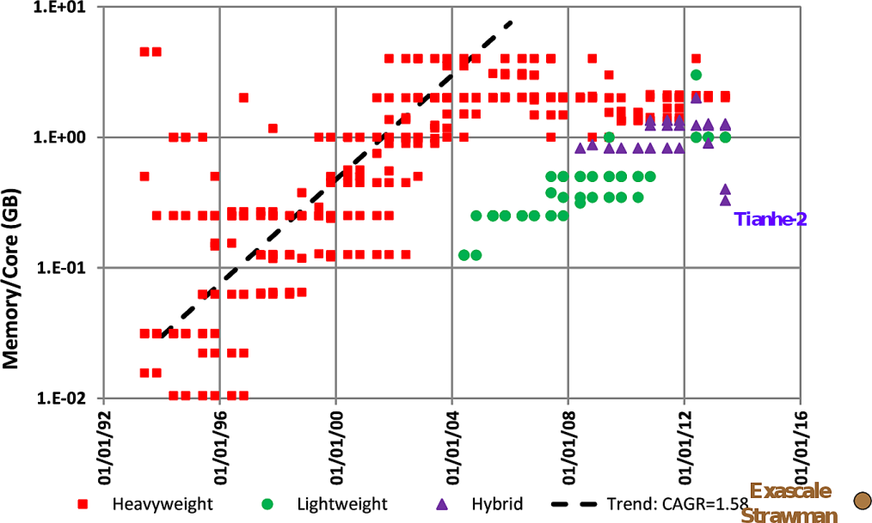
Why Hybrid MPI+X?
Strong scaling applications are increasing in importance
Hardware limitations: not all resources scale at the same rate as cores (e.g., memory capacity, network resources)
Desire to solve the same problem faster on a bigger machine
Strong scaling pure MPI applications is getting harder
On-node communication is costly compared to load/stores
O(P^{x}) communication patterns (e.g., All-to-all) costly
MPI+X benefits (X= {threads,MPI shared-memory, etc.})
Less memory hungry (MPI runtime consumption, O(P) data structures, etc.)
Load/stores to access memory instead of message passing
P is reduced by constant C (#cores/process) for O(P^{x}) communication patterns
Sunway TaihuLight
Evolution of the memory capacity per core in the Top500 list (Peter Kogge. Pim & memory: The need for a revolution in architecture.)
Strong scaling = fixed problem size
Weak scaling = variable problem size

Slide 38
MPI + Threads: How To?
Core
Core
Core
Core
Core
Core
Core
Core
Multi- or Many-core Nodes
Core
Core
Core
Core
Core
Core
Core
Core
MPI Process
MPI Process
Threads
MPI only
MPI + Threads
Notes:
Memory capacity limits problem sizes per core
Memory capacity limits buffer sizes
Fine-grained domain decomposition limits coarse-grained communication
Breaking bulk-synchronous
Asynchronous tasking models require fine-grained communication
IDEAL: Extremely fast small message transfers

Slide 39
MPI + Threads: How To?
Interoperation or thread levels:
Restriction
Low Thread-Safety Costs
MPI_THREAD_SINGLE
No additional threads
MPI_THREAD_FUNNELED
Master thread communication only
MPI_THREAD_SERIALIZED
Threaded communication serialized
MPI_THREAD_MULTIPLE
No restrictions
Flexibility
High Thread-Safety Costs

Slide 40
MPI_THREAD_SINGLE
There are no additional user threads in the system
E.g., there are no OpenMP parallel regions
int buf[100];
int main(int argc, char ** argv)
{
MPI_Init(&argc, &argv);
MPI_Comm_rank(MPI_COMM_WORLD, &rank);
for (i = 0; i < 100; i++)
compute(buf[i]);
/* Do MPI stuff */
MPI_Finalize();
return 0;
}
MPI Process
COMP.
MPI COMM.
COMP.

Slide 41
MPI_THREAD_SERIALIZED
int buf[100];
int main(int argc, char ** argv)
{
int provided;
MPI_Init_thread(&argc, &argv, MPI_THREAD_FUNNELED,
&provided);
if (provided < MPI_THREAD_FUNNELED) MPI_Abort(MPI_COMM_WORLD,1);
#pragma omp parallel
{
/* Do non-MPI stuff */
#pragma omp single
{
/* Do MPI stuff */
}
/* Do non-MPI stuff */
}
MPI_Finalize();
return 0;
}
Only one thread can make MPI calls at a time
Protected by OpenMP critical regions
Essentially the same as MPI_THREAD_FUNNELED
MPI Process
COMP.
MPI COMM.
COMP.

Slide 42
MPI_THREAD_MULTIPLE
int buf[100];
int main(int argc, char ** argv)
{
int provided;
MPI_Init_thread(&argc, &argv, MPI_THREAD_FUNNELED,
&provided);
if (provided < MPI_THREAD_FUNNELED) MPI_Abort(MPI_COMM_WORLD,1);
#pragma omp parallel
{
/* Do non-MPI stuff */
/* Do MPI stuff */
/* Do non-MPI stuff */
}
MPI_Finalize();
return 0;
}
Any thread can make MPI calls any time (restrictions apply)
MPI Process
COMP.
MPI COMM.
COMP.

Slide 43
Intel Cluster Tools
Tuning MPI Application Performance

Slide 44
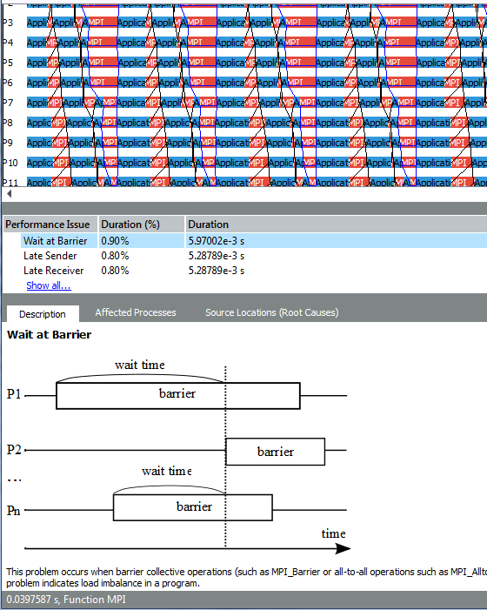
Intel® Trace Analyzer and Collector (ITAC)
Automatic Performance Assistant
Detect common MPI performance issues
Automated tips on potential solutions
Automatically detect performance issues and their impact on runtime

Slide 45
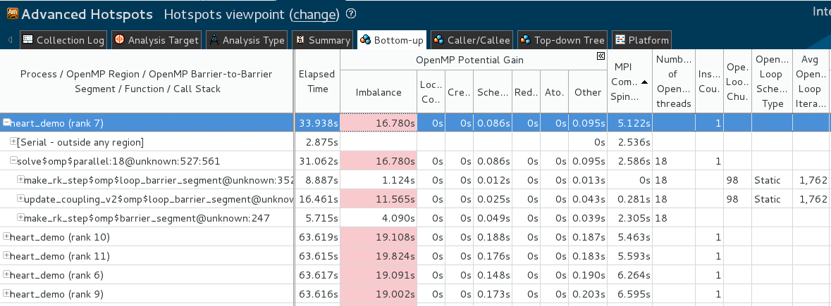
Intel® VTune™ Amplifier XE Tune hybrid parallelism using ITAC + VTune Amplifier
Tune OpenMP performance of high impact ranks in VTune Amplifier
Ranks sorted by MPI Communication Spins – ranks on the critical path are on the top
Per-rank OpenMP Potential Gain and Serial Time metrics
Process names link to OpenMP metrics
Detailed OpenMP metrics per MPI ranks
Notes:
ITAC generates the VTune Amplifier command line for selective rank profiling of multiple ranks.
Per-rank Intel MPI communication busy wait time detection and showing the metric in summary, grid and timeline view
For hybrid MPI and OpenMP applications, it is important to explore OpenMP inefficiency along with MPI communication between ranks. VTune Amplifier recognizes samples in Intel MPI communication busy wait functions and shows metrics based on that information. For multi-rank OpenMP results, VTune Amplifier’s Summary view is enriched with a table of Top MPI ranks with OpenMP metrics sorted by MPI Communication Spin time from low to high values. The lower the Communication time the more the rank was executing (vs. spinning) and the more impact OpenMP tuning will have on the application elapsed time.
Process names are hyperlinked to the Bottom-up view with ‘/Process /OpenMP Region/ …’ groupings to get details of the OpenMP metrics aggregated per-process, with the ability to expand the results by Regions and Barrier-to-Barrier Segments.
MPI Communication Spin time is highlighted on the timeline.

Slide 46
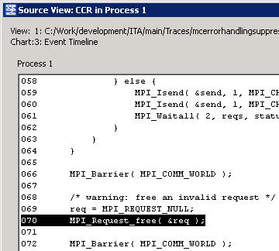
Checking MPI Application Correctness
Warnings indicate potential problems that could cause unexpected behavior (e.g., incomplete message requests, overwriting a send/receive buffer, potential deadlock, etc.).
Errors indicate problems that violate the MPI standard or definitely cause behavior not intended by the programmer (e.g., incomplete collectives, API errors, corrupting a send/receive buffer, deadlock, etc.).
Notes:
Levels of severity:
Warnings: application can continue
Error: application can continue but almost certainly not as intended
Fatal error: application must be aborted
Some checks may find both warnings and errors
Example: CALL_FAILED check due to invalid parameter
Invalid parameter in MPI_Send() => msg cannot be sent => error
Invalid parameter in MPI_Request_free() => resource leak => warning

Slide 47
Real World Uses

Slide 48
Who Uses MPI?
Scientific computing
Universities and national laboratories
Commercial Users
Oil & Gas companies are a big user
Other programming models (as the runtime for communication)
Parallel Global Address Space, Machine/Deep Learning Frameworks
Single-Node Systems
Matlab

Slide 49
Wrapping Up

Slide 50
What did we learn?
What is MPI (and the implementations of it)?
Startup & Finalize
Basic Send & Receive
Communicators
Collectives
Datatypes
Non-blocking communication
Brief look at advanced topics (RMA, threads)
Analyzing the performance of MPI
How does MPI get used in the real world?

Slide 51
What is Next for MPI?
Fault Tolerance
Always under research, coming in incremental changes
Persistent Collective Communication
Avoid setting up collective communication channels multiple times
“Sessions”
Improve interaction between applications, libraries, and tools
Allow better scalability for sparse applications
Improved Tool Support
Allow multiple tools to attach at once
Get event-driven callbacks

Slide 52
Where Can I Learn More?
Standard Documentation: http://mpi-forum.org/docs
Stack Overflow (tags: mpi, mpich, open-mpi)
Websites: http://mpitutorial.com

Slide 53
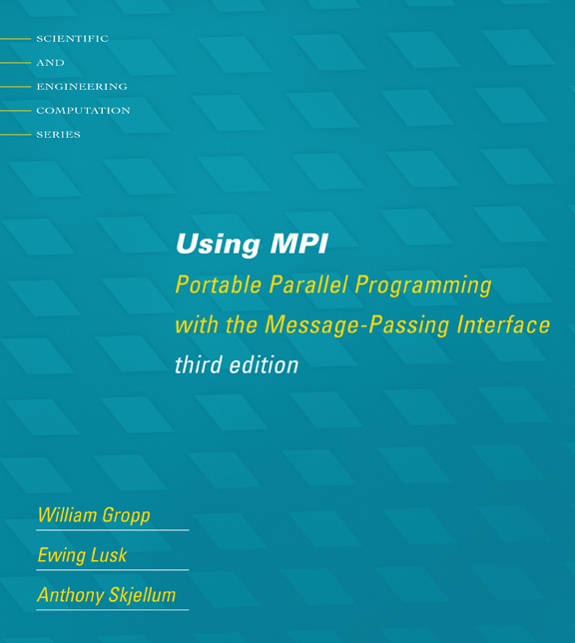
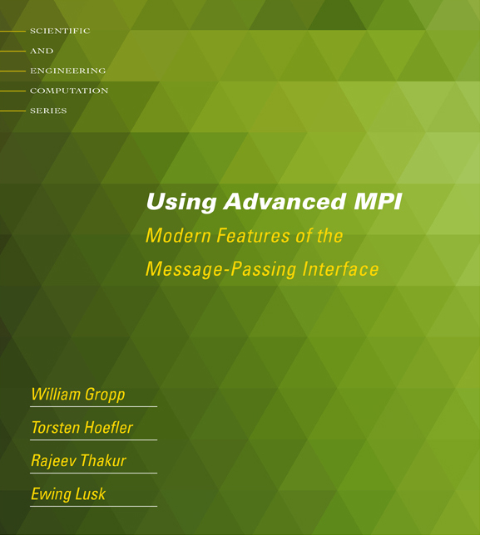
Tutorial Books on MPI
Basic MPI
Advanced MPI, including MPI-3

