Slide 1

GPU Hardware and CUDA Programming
Martin Burtscher
Department of Computer Science

Slide 2
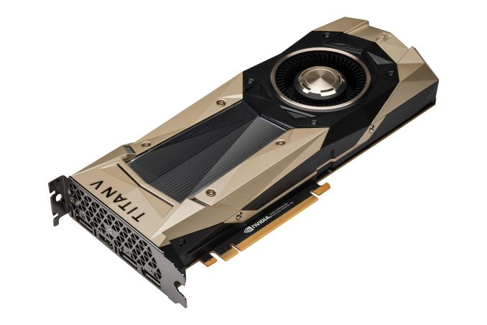
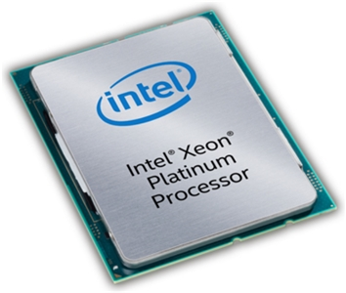
High-end CPU-GPU Comparison
  Xeon 8180M Titan V
  Cores 28 5120 (+ 640)
  Active threads 2 per core 32 per core
  Frequency 2.5 (3.8) GHz 1.2 (1.45) GHz
  Peak performance (SP) 4.1? TFlop/s 13.8 TFlop/s
  Peak mem. bandwidth 119 GB/s 653 GB/s
  Maximum power 205 W 250 W*
  Launch price $13,000 $3000*
  Release dates
    Xeon: Q3’17
    Titan V: Q4’17

Slide 3
GPU Advantages
Performance
  3.4x as many operations executed per second
Main memory bandwidth
  5.5x as many bytes transferred per second
Cost- and energy-efficiency
  15x as much performance per dollar*
  2.8x as much performance per watt
(based on peak values)

Slide 4
GPU Disadvantages
Clearly, we should be using GPUs all the time
  So why aren’t we?
GPUs can only execute some types of code fast
  Need lots of data parallelism, data reuse, & regularity
GPUs are harder to program and tune than CPUs
  Mostly because of their architecture
  Fewer tools and libraries exist

Slide 5
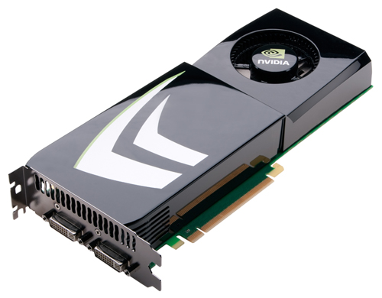
Outline
Introduction
CUDA basics
Programming model and architecture
Implementation challenges

Slide 6
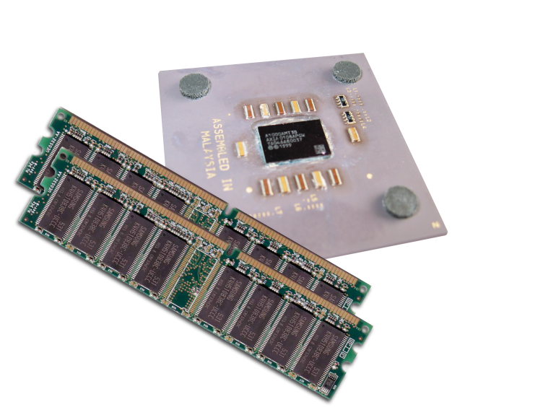
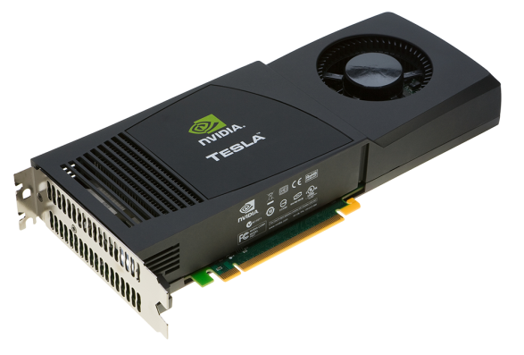
Heterogeneous Computing
Terminology:
  Host The CPU and its memory (host memory)
  Device The GPU and its memory (device memory)
Host
Device

Slide 7
Heterogeneous Computing
#include <iostream>
#include <algorithm>
using namespace std;
#define N 1024
#define RADIUS 3
#define BLOCK_SIZE 16
__global__ void stencil_1d(int *in, int *out) {
__shared__ int temp[BLOCK_SIZE + 2 * RADIUS];
int gindex = threadIdx.x + blockIdx.x * blockDim.x;
int lindex = threadIdx.x + RADIUS;
// Read input elements into shared memory
temp[lindex] = in[gindex];
if (threadIdx.x < RADIUS) {
temp[lindex - RADIUS] = in[gindex - RADIUS];
temp[lindex + BLOCK_SIZE] = in[gindex + BLOCK_SIZE];
}
// Synchronize (ensure all the data is available)
__syncthreads();
// Apply the stencil
int result = 0;
for (int offset = -RADIUS ; offset <= RADIUS ; offset++)
result += temp[lindex + offset];
// Store the result
out[gindex] = result;
}
void fill_ints(int *x, int n) {
fill_n(x, n, 1);
}
int main(void) {
int *in, *out; // host copies of a, b, c
int *d_in, *d_out; // device copies of a, b, c
int size = (N + 2*RADIUS) * sizeof(int);
// Alloc space for host copies and setup values
in = (int *)malloc(size); fill_ints(in, N + 2*RADIUS);
out = (int *)malloc(size); fill_ints(out, N + 2*RADIUS);
// Alloc space for device copies
cudaMalloc((void **)&d_in, size);
cudaMalloc((void **)&d_out, size);
// Copy to device
cudaMemcpy(d_in, in, size, cudaMemcpyHostToDevice);
cudaMemcpy(d_out, out, size, cudaMemcpyHostToDevice);
// Launch stencil_1d() kernel on GPU
stencil_1d<<<N/BLOCK_SIZE,BLOCK_SIZE>>>(d_in + RADIUS, d_out + RADIUS);
// Copy result back to host
cudaMemcpy(out, d_out, size, cudaMemcpyDeviceToHost);
// Cleanup
free(in); free(out);
cudaFree(d_in); cudaFree(d_out);
return 0;
}
parallel fn
serial code
parallel code
serial code

Slide 8
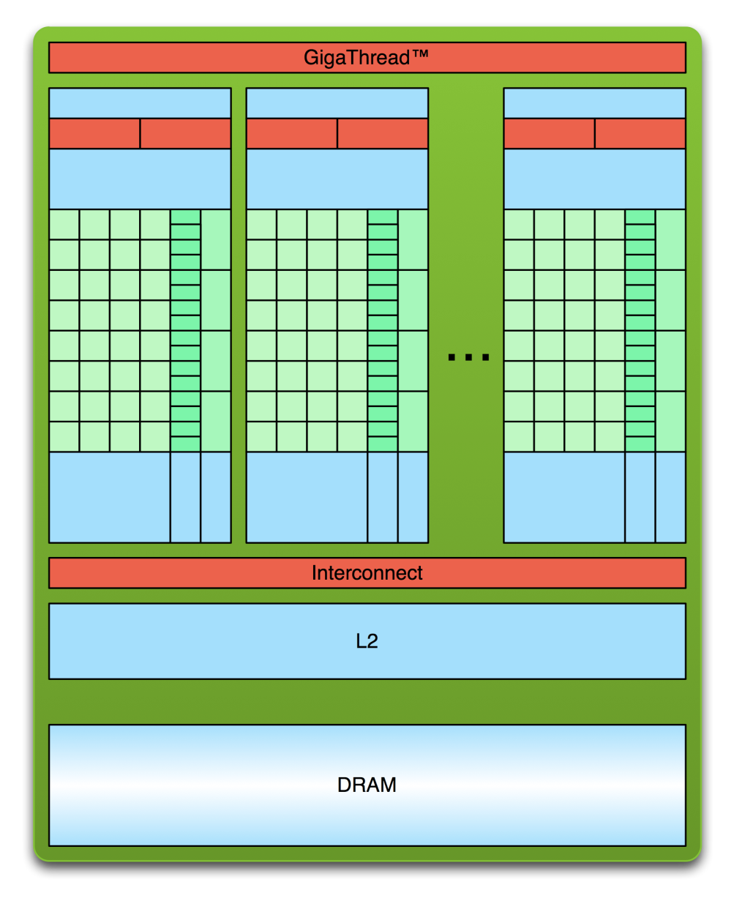
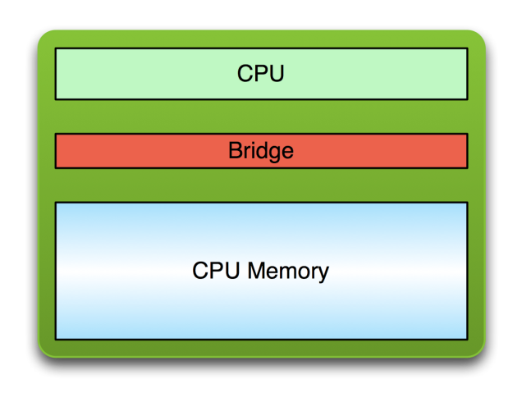
Simple Processing Flow
PCI Bus
Copy input data from CPU memory to GPU memory

Slide 9
Simple Processing Flow
PCI Bus
Copy input data from CPU memory to GPU memory
Load GPU program and execute,
caching data on chip for performance

Slide 10
Simple Processing Flow
PCI Bus
Copy input data from CPU memory to GPU memory
Load GPU program and execute,
caching data on chip for performance
Copy results from GPU memory to CPU memory

Slide 11
Vector Addition with Blocks and Threads
#define N (2048*2048)
#define THREADS_PER_BLOCK 512
int main(void) {
int *a, *b, *c; // host copies of a, b, c
int *d_a, *d_b, *d_c; // device copies of a, b, c
int size = N * sizeof(int);
// Alloc space for device copies of a, b, c
cudaMalloc((void **)&d_a, size);
cudaMalloc((void **)&d_b, size);
cudaMalloc((void **)&d_c, size);
// Alloc space for host copies of a, b, c and setup input values
a = (int *)malloc(size); random_ints(a, N);
b = (int *)malloc(size); random_ints(b, N);
c = (int *)malloc(size);

Slide 12
Vector Addition with Blocks and Threads
// Copy inputs to device
cudaMemcpy(d_a, a, size, cudaMemcpyHostToDevice);
cudaMemcpy(d_b, b, size, cudaMemcpyHostToDevice);
// Launch add() kernel on GPU
add<<<(N + TPB – 1) / TPB, TPB>>>(d_a, d_b, d_c, N);
// Copy result back to host
cudaMemcpy(c, d_c, size, cudaMemcpyDeviceToHost);
// Cleanup
free(a); free(b); free(c);
cudaFree(d_a); cudaFree(d_b); cudaFree(d_c);
return 0;
}

Slide 13
Handling Arbitrary Vector Sizes
Typical problems are not friendly multiples of TPB
Avoid accessing beyond the end of the arrays:
__global__ void add(int *a, int *b, int *c, int n)
{
int index = threadIdx.x + blockIdx.x * TPB;
if (index < n) {
c[index] = a[index] + b[index];
}
}

Slide 14
Outline
Introduction
CUDA basics
Programming model and architecture
Implementation challenges

Slide 15
CUDA Programming Model
Non-graphics programming
  Uses GPU as massively parallel co-processor
SIMT (single-instruction multiple-threads) model
  10,000s of threads needed for full efficiency
C++ with extensions
  Function launch
    Calling functions on GPU
  Memory management
    GPU memory allocation, copying data to/from GPU
  Declaration qualifiers
    Device, shared, local, etc.
  Special instructions
    Barriers, fences, etc.
  Keywords
    threadIdx.x, blockIdx.x
CPU
PCI-Express
bus
GPU

Slide 16
Calling GPU Kernels
Kernels are functions that run on the GPU
  Callable by CPU code
  CPU can continue processing while GPU runs kernel
  KernelName<<<m, n>>>(arg1, arg2, ...);
Launch configuration (programmer selectable)
  GPU spawns m blocks with n threads (i.e., m*n threads total) that run a copy of the same function
  Normal function parameters: passed conventionally
    Different address space, should never pass CPU pointers

Slide 17
GPU Architecture
GPUs consist of Streaming Multiprocessors (SMs)
  Up to 80 SMs per chip (run blocks)
SMs contain Processing Elements (PEs)
  Up to 64 PEs per SM (run threads)
Shared
Memory
Shared
Memory
Shared
Memory
Shared
Memory
Shared
Memory
Shared
Memory
Shared
Memory
Shared
Memory
Global Memory
Adapted from NVIDIA

Slide 18
Block Scalability
Hardware can assign blocks to SMs in any order
  A kernel with enough blocks scales across GPUs
  Not all blocks may be resident at the same time
GPU with 2 SMs
Kernel
Block 0
Block 1
GPU with 4 SMs
Block 2
Block 3
Block 0
Block 1
Block 4
Block 5
Block 6
Block 7
Block 0
Block 1
Block 2
Block 3
Block 2
Block 3
time
Block 4
Block 5
Block 6
Block 7
Block 4
Block 5
Adapted from NVIDIA
Block 6
Block 7

Slide 19
GPU Memories
GPU
Separate from CPU memory
  CPU can access GPU’s global & constant mem. via PCIe bus
  Requires slow explicit transfer
Visible GPU memory types
  Registers (per thread)
  Local mem. (per thread)
  Shared mem. (per block)
    Software-controlled cache
  Global mem. (per kernel)
  Constant mem. (read only)
  Slow communic. between blocks
Block (0, 0)
Block (1, 0)
Shared Memory (SRAM)
Shared Memory (SRAM)
Registers
Registers
Registers
Registers
Thread (0, 0)
Thread (1, 0)
Thread (0, 0)
Thread (1, 0)
CPU
Global + Local Memory (DRAM)
Constant Memory (DRAM, cached)
Adapted from NVIDIA

Slide 20
SM Internals
Caches
  Software-controlled shared memory
  Hardware-controlled incoherent L1 data cache
Synchronization support
  Fast hardware barrier within block (__syncthreads())
  Fence instructions: enforce ordering on mem. ops.
Special operations
  Thread voting (warp-based reduction operations)

Slide 21
Block and Thread Allocation Limits
Blocks assigned to SMs
  Until first limit reached
Threads assigned to PEs
Hardware limits
  32 resident blocks/SM
  2048 active threads/SM
  1024 threads/block
  64k 32-bit registers/SM
  48kB shared mem/SM
  2³¹-1 blocks/kernel
SM 0
SM 1
t0 t1 t2 … tm
MT IU
MT IU
t0 t1 t2 … tm
PE
PE
Blocks
Blocks
Shared
Memory
Shared
Memory
Adapted from NVIDIA

Slide 22
Warp-based Execution
32 contiguous threads form a warp
  Execute same instruction in same cycle (or disabled)
  Warps are scheduled out-of-order with respect to each other to hide latencies
Thread divergence
  Some threads in warp jump to different PC than others
  Hardware runs subsets of warp until they re-converge
  Results in reduction of parallelism (performance loss)

Slide 23
Thread Divergence
Non-divergent code
  if (threadID >= 32) {
  some_code;
  } else {
  other_code;
  }
Divergent code
  if (threadID >= 13) {
  some_code;
  } else {
  other_code;
  }
Thread ID:
0 1 2 3 … 31
Thread ID:
0 1 2 3 … 31
disabled
disabled
Adapted from NVIDIA
Adapted from NVIDIA

Slide 24
Parallel Memory Accesses
Coalesced main memory access
  HW tries to combine multiple memory accesses of same warp into a single coalesced access
    All accesses to the same 128-byte aligned 128-byte cache block are combined into a single transaction
  Up to 32x faster
Bank-conflict-free shared memory access
  32 independent banks
  No superword alignment or contiguity requirements
    32 different banks + one-word broadcast each

Slide 25
Coalesced Main Memory Accesses
single coalesced access one and two coalesced accesses*
NVIDIA NVIDIA

Slide 26
Outline
Introduction
CUDA basics
Programming model and architecture
Implementation challenges

Slide 27
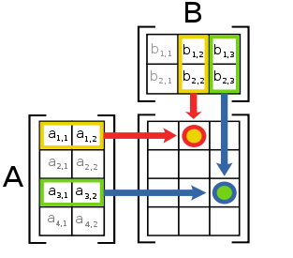
Regular Programs
Typically operate on arrays and matrices
  Data is processed in fixed-iteration FOR loops
Have statically predictable behavior
  Exhibit mostly strided memory access patterns
  Control flow is mainly determined by input size
  Data dependencies are static and not loop carried
Example
  for (i = 0; i < size; i++) {
  c[i] = a[i] + b[i];
  }
wikipedia

Slide 28
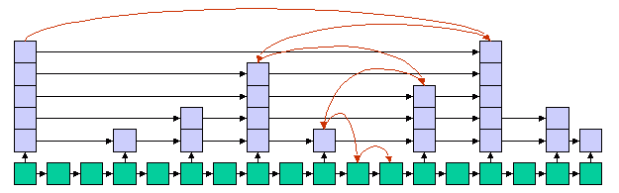
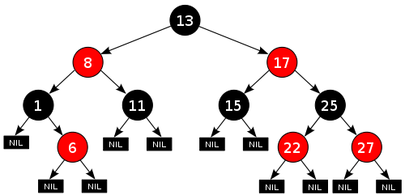
Irregular Programs
Are important and widely used
  Social network analysis, data clustering/partitioning, discrete-event simulation, operations research, meshing, SAT solving, n-body simulation, etc.
Typically operate on dynamic data structures
  Graphs, trees, linked lists, priority queues, etc.
  Data is processed in variable-iteration WHILE loops
tripod
wikipedia

Slide 29
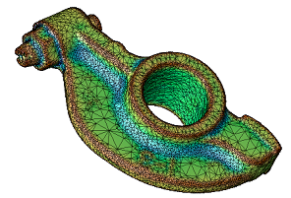
Irregular Programs (cont.)
Have statically unpredictable behavior
  Exhibit pointer-chasing memory access patterns
  Control flow depends on input values and may change
  Data dependences have to be detected dynamically
Example
  while (pos != end) {
  v = worklist[pos++];
  for (i = 0; i < count[v]; i++){
  n = neighbor[index[v] + i];
  if (process(v,n)) worklist[end++] = n;
  } }
LANL

Slide 30
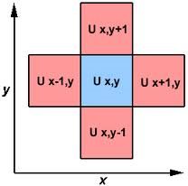

Mapping (Ir-)Regular Code to GPUs
Many regular codes are easy to port to GPUs
  E.g., matrix codes executing many ops/word
    Dense matrix operations (level 2 and 3 BLAS)
    Stencil codes (PDE solvers)
Many irregular codes are difficult to port to GPUs
  E.g., data-dependent graph codes
    Sparse graph operations (DMR, DES)
    Tree operations (BST)
LLNL
FSU

Slide 31
GPU Implementation Challenges
Indirect and irregular memory accesses
  Little or no coalescing [low bandwidth]
Memory-bound pointer chasing
  Little locality and computation [exposed latency]
Dynamically changing irregular control flow
  Thread divergence [loss of parallelism]
Input dependent and changing data parallelism
  Load imbalance [loss of parallelism]

